Slide 1
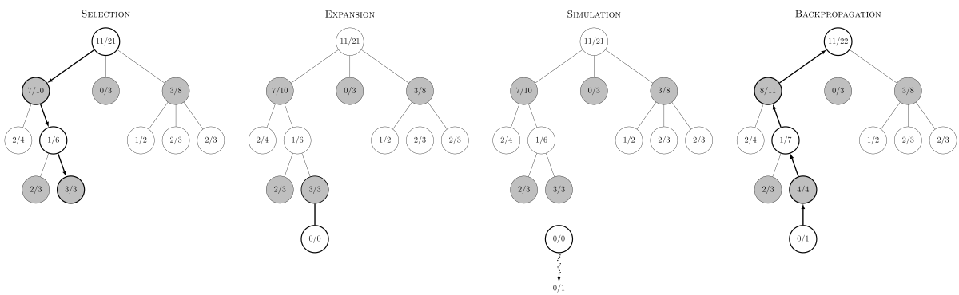
Monte Carlo tree search
Random/heuristic/net-policy/etc..
By some model of the environment

Slide 2
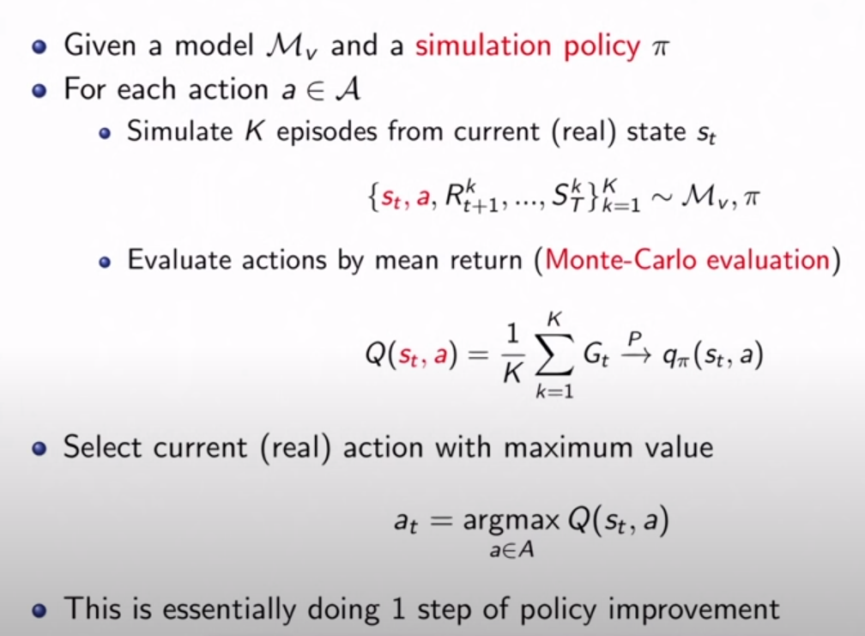

Problems in our unique case
The agents doesn’t have a model of the environment $M_{v}$.
Can be learned online
An agent doesn’t know the action space of the other agents.
We can’t grow a minimax tree
We can: treat the other-agent node as hidden node somehow?

Slide 3
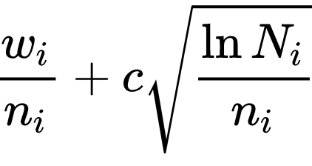
Implementing MCTS - Summary
The basic MCTS agent is planning with the following policies:
Tree policy: UCT
Roll-out policy: Random moves
Main parameters in the algorithm are:
Number of simulations
Simulations depth
Exploration constant
After implementing the algorithm, I’ve evaluated the results over the following parameter-sets:
Board size (N*N) – 5,10,15
Exploration constant: 0.5, 0.75, 1, 1.25, 1.5, 1.75, 2
*** The convergence achieved only when evaluating the MCTS agent as the zombie agent.

Slide 4
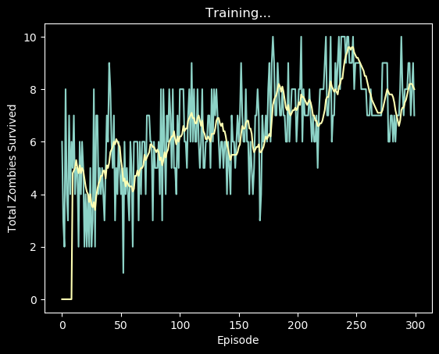
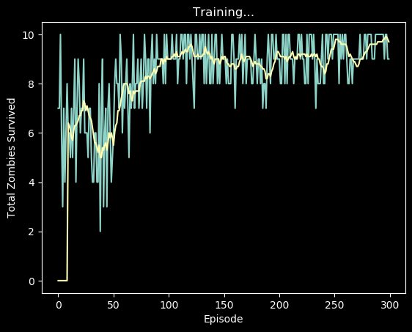
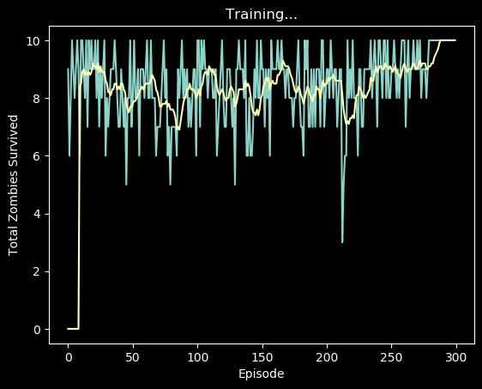
Best results over the param-sets
Board size: 5*5
Exploration rate: 1.5
Board size: 10*10
Exploration rate: 1.5
Board size: 15.*15
Exploration rate: 0.75
Shared parameters:
Light size: 3
Zombies per episode (maximum reward): 10
Number of simulations: 25
Simulation depth: 5 nir@afeka.ac.il

