Slide 1
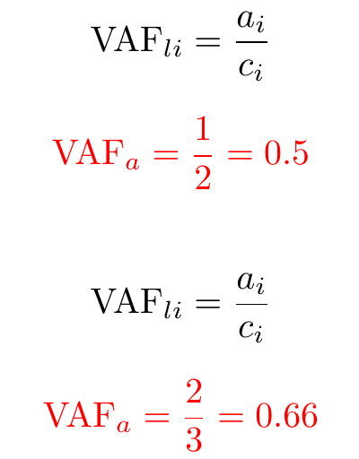
Variant Allele Frequency computation
Homogenous sample
For each locus: #copies with alterations and #total copies
a_{i}
c_{i}
l_{i} {
a
Ch₁
Ch₂
100% of tumour cells
1 clonal population
Notes:
Allele specific copy number ⇒ quantifies the number of copies of each allele at each variant loci rather than the total number of chromosome copies
Allele spécifique copi number = Nombre de copie spécifique à l’allelle
Allele specifique copy numer ⇒ quantifies the number of copies of each allele at each variant loci rather than the total number of chromosome copies

Slide 2
Copy Number impact on VAF
Homogenous sample
For each locus: #copies with alterations and #total copies
a_{i}
c_{i}
l_{i} {
a
Ch₁
Ch₂
100% of tumour cells
1 clonal population
Notes:
Duplication
Allele specific copy number ⇒ quantifies the number of copies of each allele at each variant loci rather than the total number of chromosome copies
Allele spécifique copi number = Nombre de copie spécifique à l’allelle
Allele specifique copy numer ⇒ quantifies the number of copies of each allele at each variant loci rather than the total number of chromosome copies

Slide 3
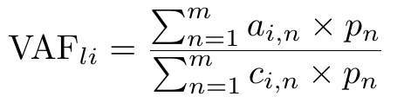
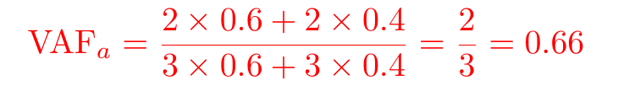
Tumoral heterogeneity impact on VAF
Heterogeneous sample
a
a
} l_{i}
b
} l_{j}
Ch₁
Ch₂
Ch₁
Ch₂
Clone1 cell proportion
p₁ = 0.60
Clone2 cell proportion
p₂ = 0.40
100% of tumour cells
2 clonal populations
Notes:
Allele specific copy number ⇒ quantifies the number of copies of each allele at each variant loci rather than the total number of chromosome copies

Slide 4
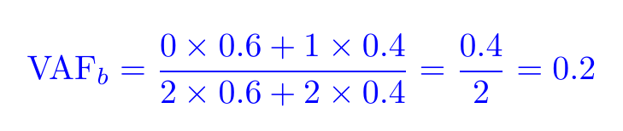
Tumoral heterogeneity impact on VAF
Heterogeneous sample
a
a
} l_{i}
b
} l_{j}
Ch₁
Ch₂
Ch₁
Ch₂
Clone1 cell proportion
p₁ = 0.60
Clone2 cell proportion
p₂ = 0.40
100% of tumour cells
2 clonal populations
Notes:
Allele specific copy number ⇒ quantifies the number of copies of each allele at each variant loci rather than the total number of chromosome copies

Slide 5
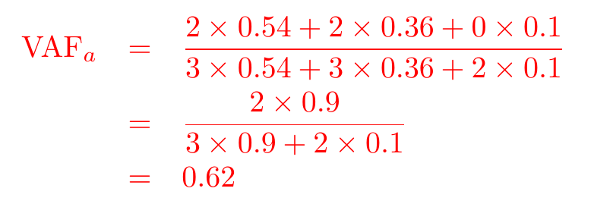
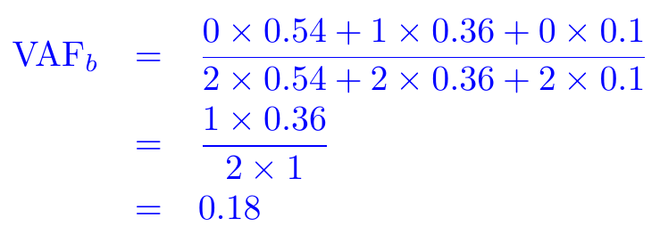
Normal cell contamination impact on VAF
Heterogeneous sample
a
a
} l_{i}
b
} l_{j}
Ch₁
Ch₂
Ch₁
Ch₂
Ch₁
Ch₂
Clone1 cell proportion
p₁ = 0.54
Clone2 cell proportion
p₂ = 0.36
Normal cell proportion
p₃ = 0.1
90% of tumour cells
2 clonal populations
Notes:
On va considerer seulement les altérations somatiques donc seul le nombre de copies total va augmenté ce qui va faire diminué la VAF
Mettre formule + couleur des 3 populations
Allele specific copy number ⇒ quantifies the number of copies of each allele at each variant loci rather than the total number of chromosome copies

