Slide 1

What economic and political policies can Syria implement to achieve post-war economic stability and long-term growth in the Middle East?

Slide 2
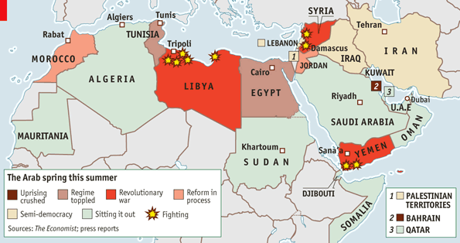
Using Data from Post-Arab Spring Economies (2010-Present) to Identify Economic Strategies for Syria’s Reconstruction and Growth Over the Next Decade.

Slide 3

References and sources

Slide 4
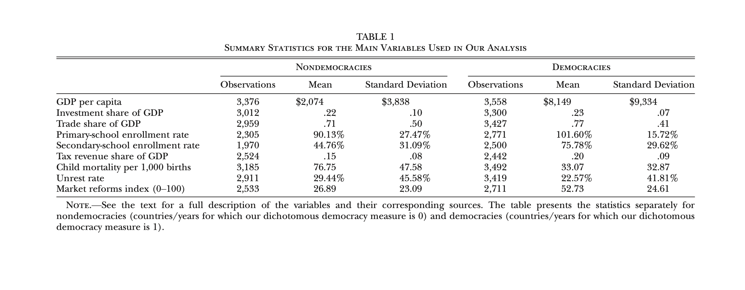
1) Democracy Does Cause Growth
Citation: Daron Acemoglu, Suresh Naidu, Pascual Restrepo, and James A. Robinson,
"Democracy Does Cause Growth,
" Journal of Political Economy 127, 1 (February 2019): 47-100.

Slide 5
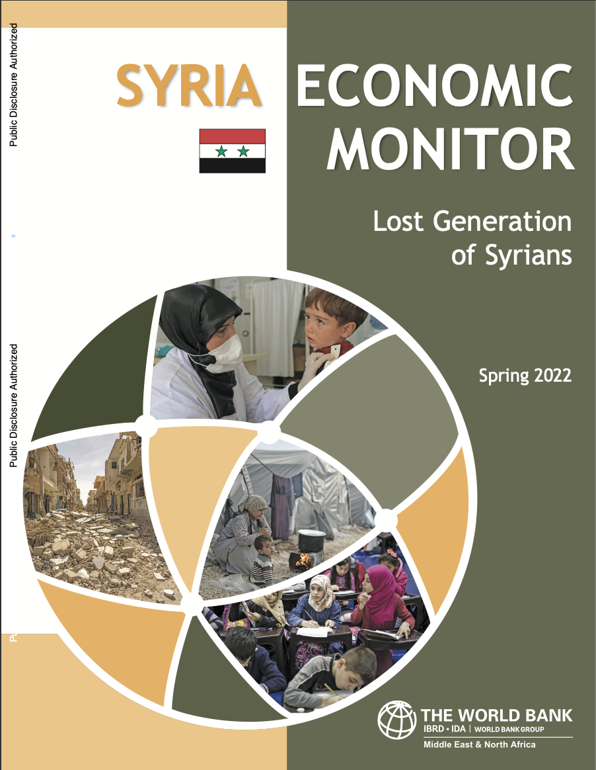
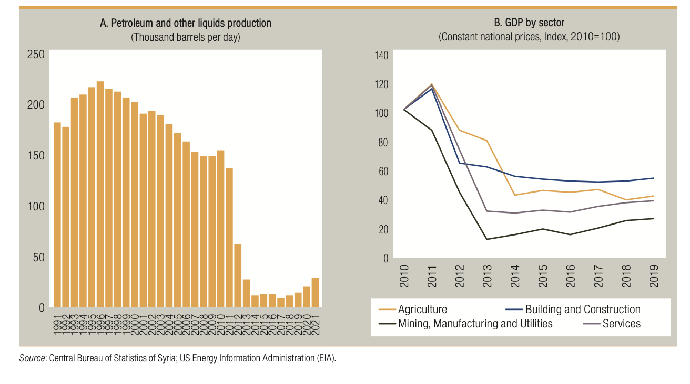
2) SYRIA ECONOMIC MONITOR Lost Generation of Syrians ( world bank 2022)

Slide 6
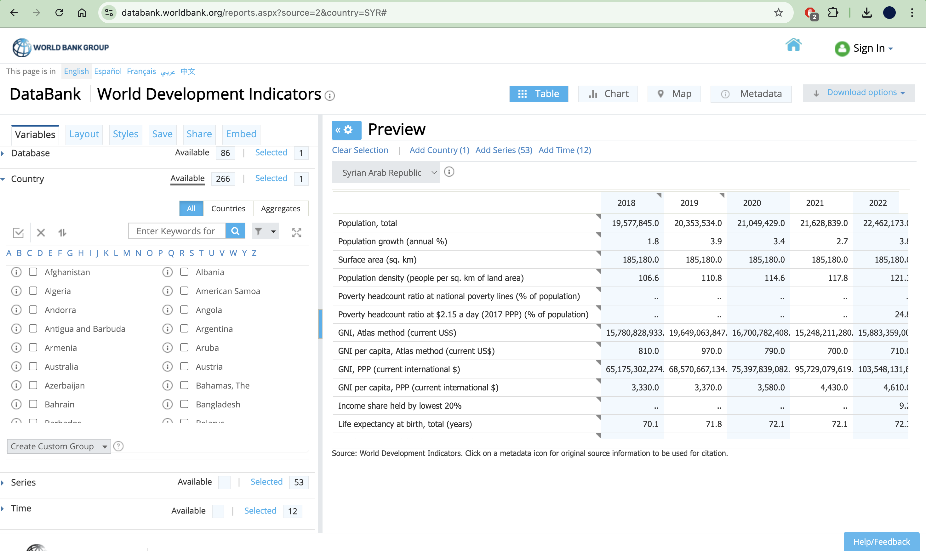
3)
Databank WorldBank

Slide 7
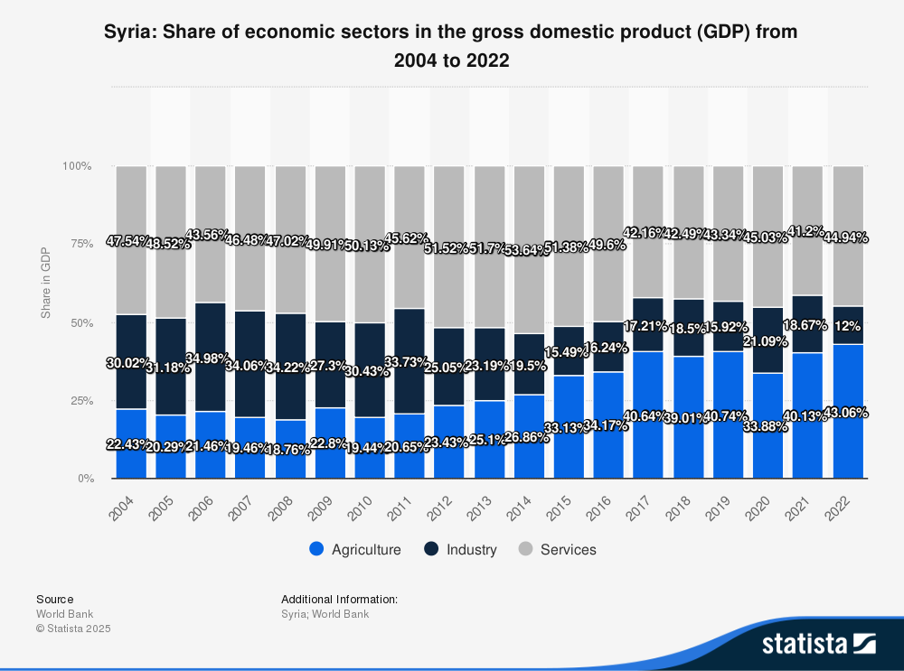

Slide 8
Problems
Lack of recent and fiable data about Syria
Not getting to much historical or political and keep focusing with data modelling

