Slide 1
Diabetes 130-us hospitals for years 1999-2008
PAYET Tom and OBADIA Elie

Slide 2
Ins and outs
Our problem was a classification and clustering type of data analysis.
Our target was to analyse the readmission of patients with diabetes and other factors like the age, race or other molecule in the body of the patient.
By looking at the different variables we try to understand what they mean and if they could influence our model.
Given this situation we decided to first make a logistic regression and then a random forest.

Slide 3
Visualisation and analyse
STARTING
FIRST CLEAN
The first step was to apprehend the data set and it’s data so we load it, print it and also print a resume of it.
After taking a look at the data we decided to make a first clean by removing the useless and missing data.
VISUALISATION
CONCLUSION
To visualise the data we have looking for some command to have a great vision on what we are dealing with and the relation between the variables. We have found the « ProfileReport(dataset) » from the pandas_profiling library
Thanks to all these previous step we could have a better vision on our problem and put aside the variables that will not influence our target prediction.

Slide 4
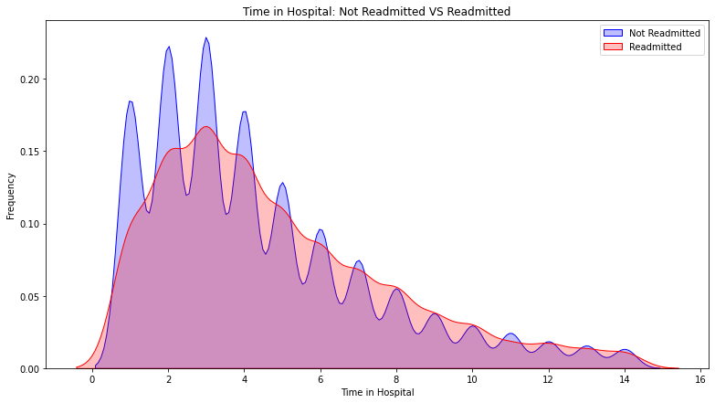
Some graphics to have a better understanding

Slide 5
Modifying the data to apply models
Medications and their features
For these types of data we have chosen to make these modifications : No = 0 , Yes = 1 , Down = 2 , Steady = 3
Race, gender and age
Race : Caucasian = 1 , African American = 2 , Other = 3 , Asian = 4 , Hispanic = 5
Gender : Male = 0 , Female = 1
Age : we have decided to limit the categories by their minimum value for example [0-10) become 0 and same for the others
Glucose serum test result
We have chosen : None = -1 , >300 = 300 , Norm = 1 , >200 = 200
A1C haemoglobin test
Our choice on this one was : None = 0 , >8 = 8 , Norm = 1 , >7 = 7

Slide 6
Grid Search attempt
We used the GridSearchCV packages from the sklearn.model_selection library
The first step was to split the dataset into a training and a testing one.
Then we define the model and hyperparameters linked to it for our situation.
After that we fit the grid search and print the most precise hyperparameters for our modelisation.
We have encountered an issue the execution time was really big and even after trying to modify the parameters to make it faster it still raise some errors so we decided to take the default hyperparameters for our following models.

Slide 7
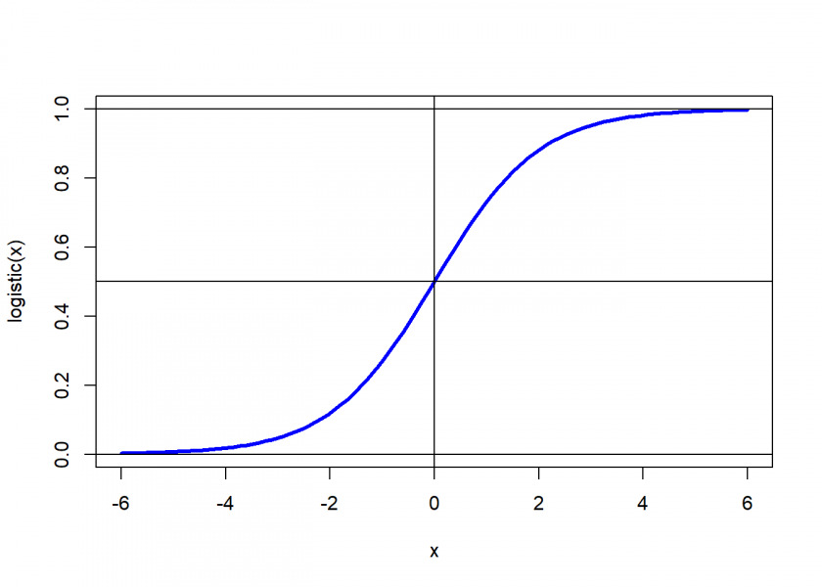
Our first model to make predictions
We used these libraries and functions to conceive our model :
accuracy_score from sklearn.metrics
sklearn.model_selection
LogisticRegression from sklearn.linear_model
The first step was to split the dataset into a training and a testing one.
Then we instantiate the model and apply it on our situation.
To conclude we try the model that we have obtained and calculate it’s accuracy.
In this case our model has an accuracy of 0.89
Logistic regression

Slide 8
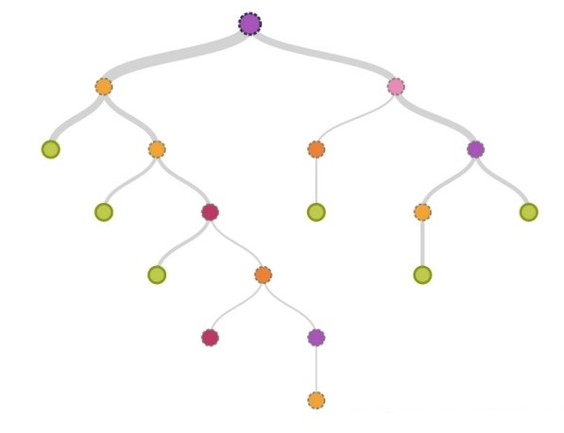
Our second model to make predictions
We used these libraries and functions to conceive our model :
accuracy_score from sklearn.metrics
sklearn.model_selection
DecisionTreeClassifier from sklearn.tree
The first step was to split the dataset into a training and a testing one.
Then we instantiate the model and apply it on our situation.
To conclude we try the model that we have obtained and calculate it’s accuracy.
In this case our model has an accuracy of 0.79
Decision tree

Slide 9
Let’s try to code a Django api
Our objectives were to make an API to have a better look at our code.
The API was wanted on Django so we installed it to start creating it.
The first part was to define what we want to show and how to show it.
We have chosen to select the graphics, the dataset and the accuracy of our models on different html pages.
We succeed to show the accuracy but not the graphics and the dataset due to some ununderstood raised error even when searching on internet.

Slide 10
Thanks
PAYET Tom
tom.payet@edu.devinci.fr
OBADIA Elie
elie.obadia@edu.devinci.fr

