Slide 1
3D Oil and Gas Data in
ArcGIS Pro
7/11/17
ESRI UC 2017

Slide 2
Agenda
University Lands
Our Challenge
3D Data
ArcGIS Pro
Questions

Slide 3
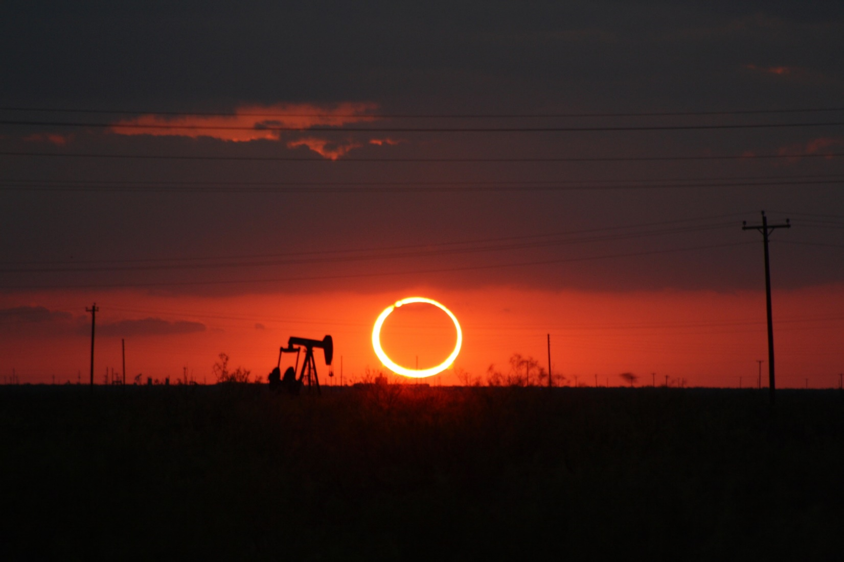
University Lands

Slide 4
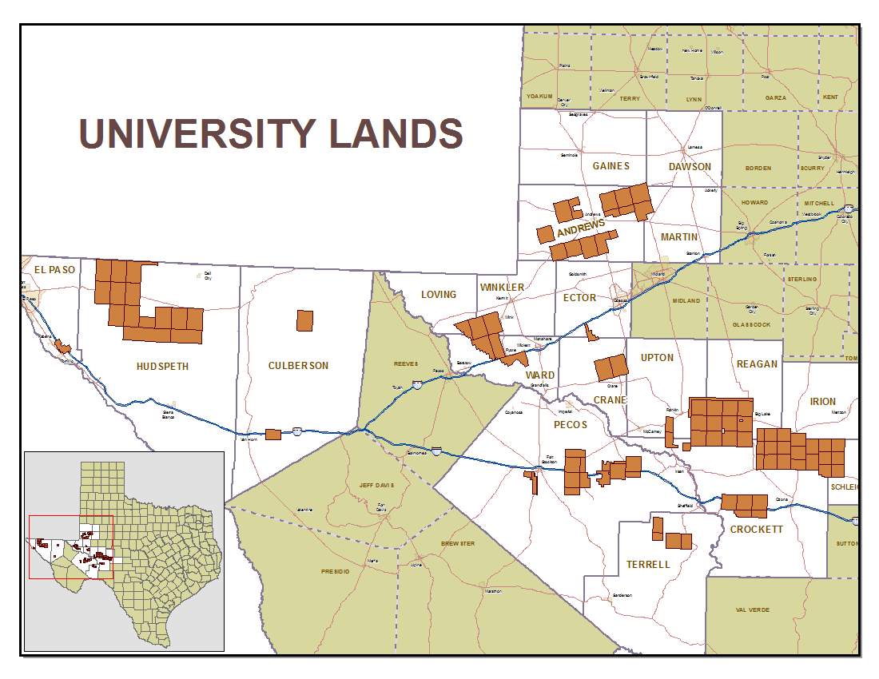
University Lands
Land set aside beginning in 1838
Appropriated Lands for University System in 1876
2.1 million acres primarily in West Texas
Revenue Supports UT & A&M Systems
Permanent University Fund (PUF) Value = $17.4 Billion
$9.4 Billion Deposited by UL

Slide 5
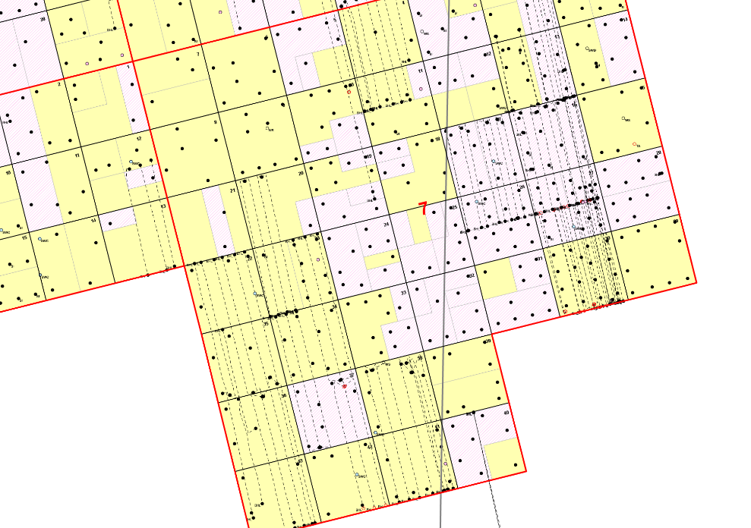
Our Challenge
Horizontal drilling introduced a new issues
Laterals overlap in different horizons
Need to quickly identify production sources
Land and Regulatory need to see info in 3D
ArcReader
Can’t view 3D

Slide 6
Our Challenge - 3D Oil & Gas Data
No GIS data was in 3D
This meant that we needed to create or acquire the 3D datasets
Leases
Laterals
Perforations (first and last take points)
This data needed to be integrated with the current enterprise GIS system

Slide 7
3D Oil & Gas Data - Leases
Problem
Leases are stored as 2D Polygons
Leases are depth severed
Solution
Leases could be extruded based on the top and bottom depths
Multipatch feature class of leases

Slide 8
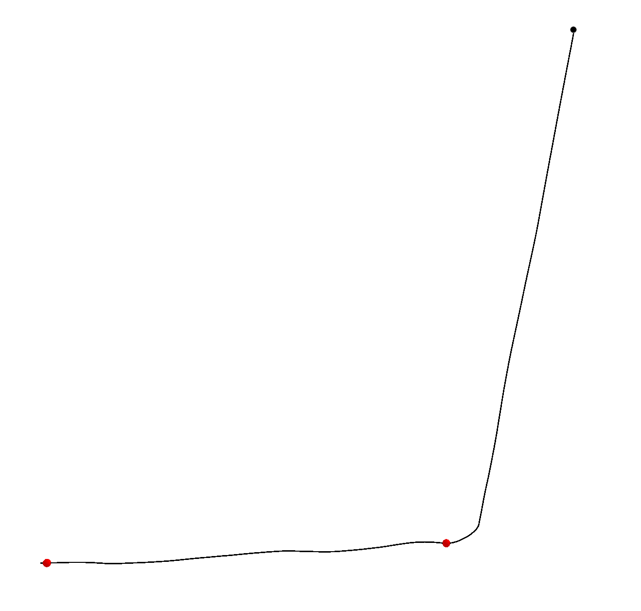
3D Oil & Gas Data - Laterals
Problem
Lateral information currently stored in 2D feature class
There are close to 2000 laterals on University Lands
Directional surveys are stored in Excel and PDF format
Solution
Downloaded Lateral information from third party (1200 laterals)
Converted to GIS using ArcPy site package
Data Conversion
corrected with UL well spots
Added z and m value
m value stored the measure distance
This allowed for the creation of perfs
Tool in ArcMap but would require manual entry of each point (no batch)
Used python script to create point along line based on measure value

Slide 9
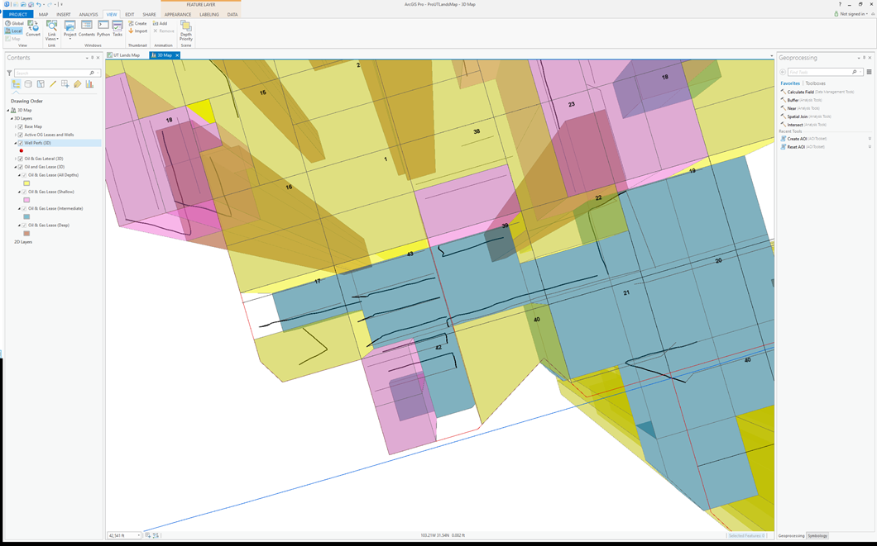
ArcGIS Pro - 3D Integration
Chose ArcGIS Pro
Easy to switch between 2D and 3D maps
Easy to integrate with current GIS architecture
Allowed for the building of tools

Slide 10
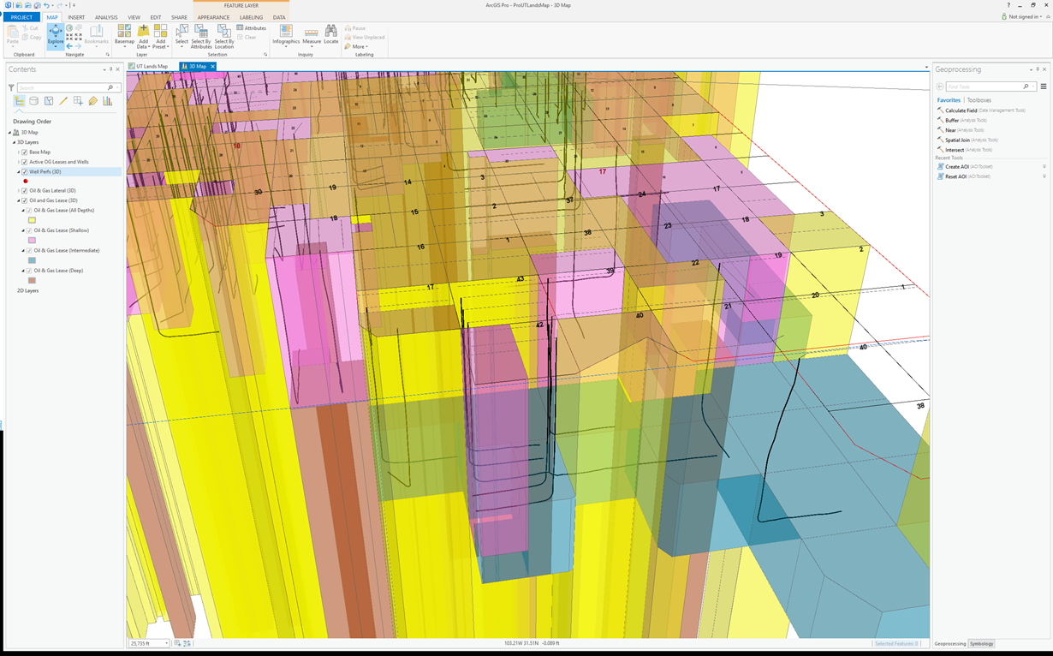
ArcGIS Pro - 3D Integration
Visual Nightmare
Not useful in this form

Slide 11
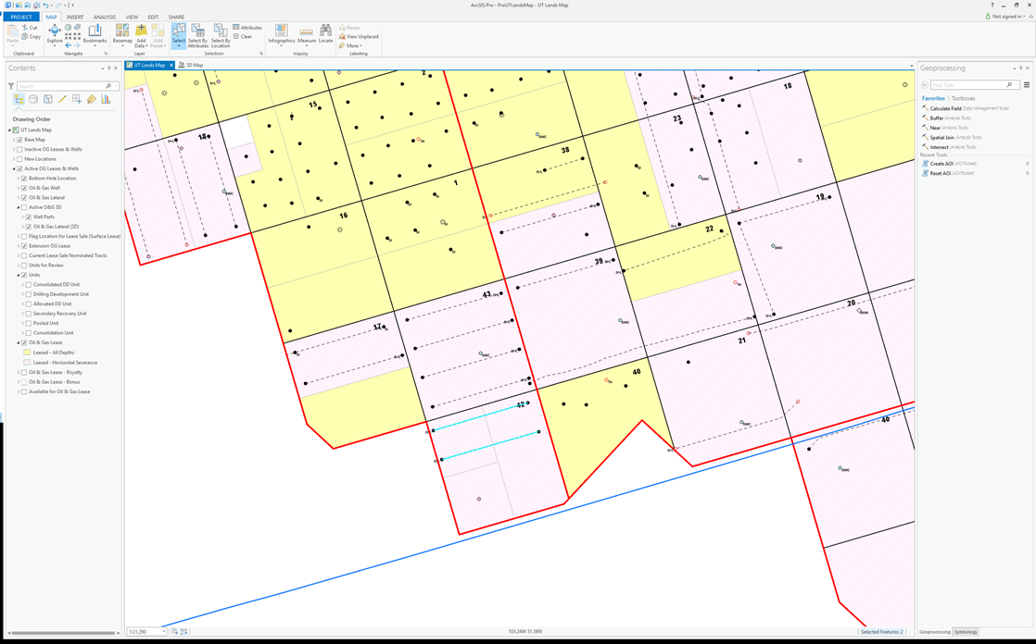
ArcGIS Pro - AOI
Area Of Interest (AOI) Tool
Created so that a specific area could be explored
Developed using python – What its doing

Slide 12
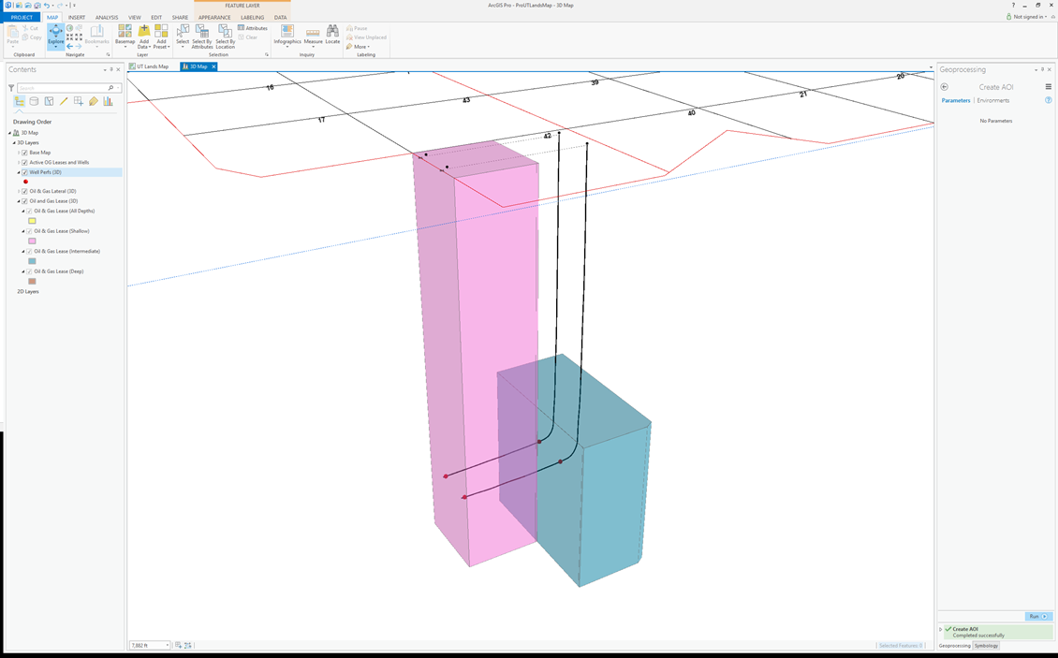
ArcGIS Pro – AOI
Result after running the AOI tool
Only Leases that intersect laterals are shown

Slide 13
Future Plans
Recreate AOI as add-in
Include formation tops and bottoms

Slide 14
Questions?
Scripts can be downloaded from:
https://github.com/ULGIS/ESRIUC2017

