Slide 1
Less is More: Robust and Novel Features for Malicious Domain Detection
Authors: Chen Hajaj , Nitay Hason , Nissim Harel, and Amit Dvir.
Extended by: Michael Perry, Daniel Korotin, Zohar Zrihen.

Slide 2
The Problem
Malicious URLs are a links created with the purpose of promoting scams, attacks, and frauds
Naturally, we want to have systems that can recognise whether a URL is malicious or benign
What if the attacker knows by which parameters the URL is classified?

Slide 3
Methodology
Data Collection
Feature Engineering
Robust Feature Selection
Novel Features

Slide 4
Data Collection
Benign - Malicious ratio 75:25.
Benign URLs from ALEXA TOP 1 MILLION
Malicious URLs from Phishtank, Scumware, URLhaus
Data about URLs: WHOIS, Urlscan, VirusTotal*, RiskIQ*, BuiltWith**
*VirusTotal API used only in original paper, replaced with RiskIQ API for the same purpose
**BuiltWith API was used to extract our new features

Slide 5
Base Features
Length of the domain - non robust
Number of consecutive characters - robust
Entropy of the domain - non robust
Number of IP addresses - non robust
Distinct Geo-Location of IP addresses - non robust
Mean TTL value - robust
STD of the TTL value - non robust
Life time of the domain - semi robust
Active time of the domain - semi robust

Slide 6
Novel Features
Communication Country Rank
Communication ASNs Rank
Number of passive DNS changes
Remaining time of SSL certification

Slide 7
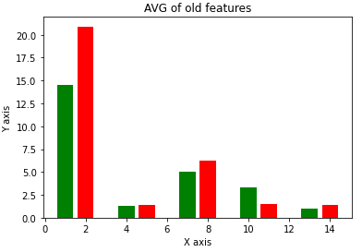
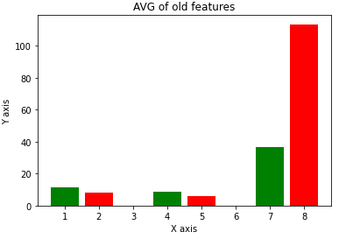
Old Features Statistics

Slide 8
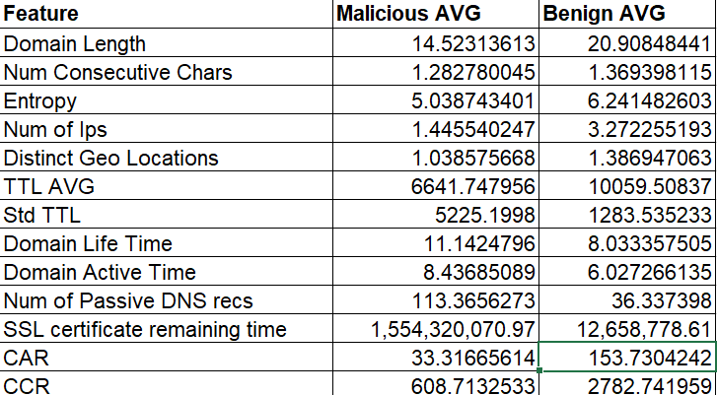
Old Features Statistics

Slide 9
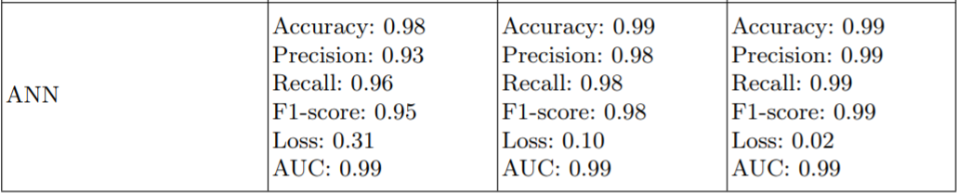
Model
ANN achieved the best results in the original paper

Slide 10
Our Work
Our Goal:
To create new features that will reduce the dependency on non robust features such as domain length, entropy, etc.
Our Features:
Use Builtwith site to check each domain and explore it content such as length, number of analytics tools. Can be extended to much more characteristics.

Slide 11
Problems we dealt with
A large percentage of malicious URLs were not available anymore
Obtained a new malicious URL Dataset from Phishtank
VirusTotal API used to be free at the time of writing of the original paper
RiskIQ’s API has the same functionality

Slide 12

Data Exploration
Web content length
Builtwith platform
Web Analytics

Slide 13
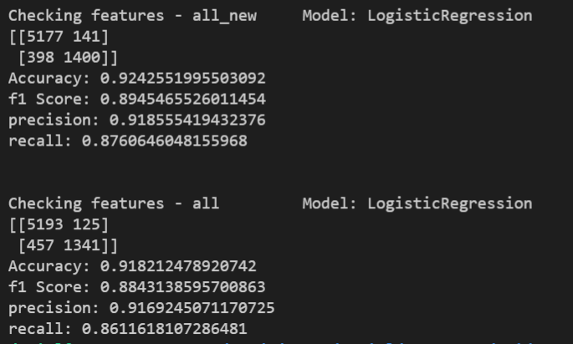
Results - Logistic Regression
Regression:

Slide 14
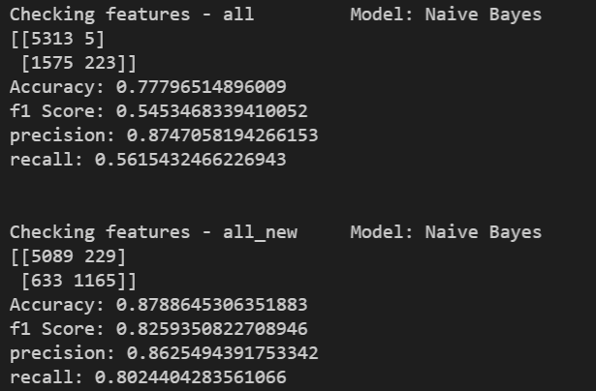
Results - Naive Bayes

Slide 15
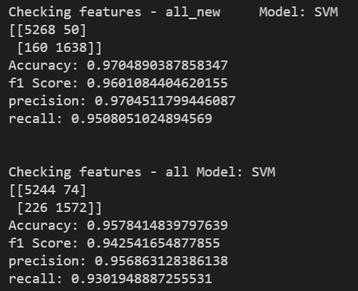
Results - SVM

Slide 16
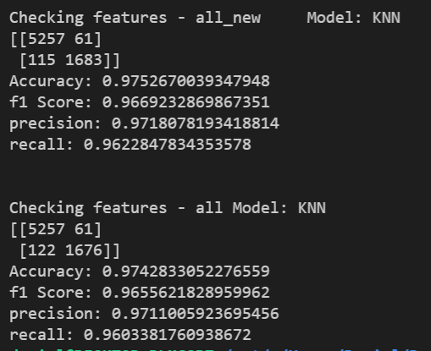
Results - KNN

Slide 17
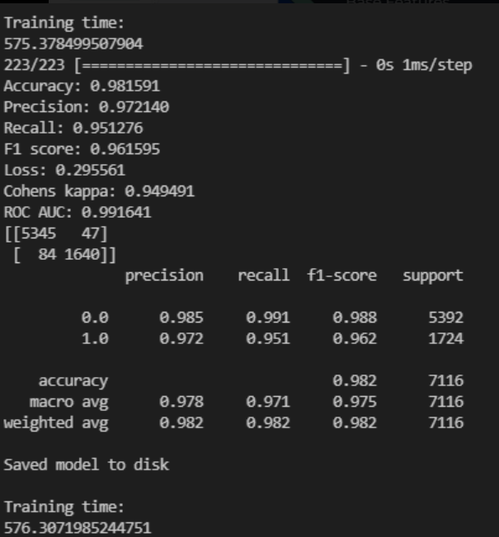
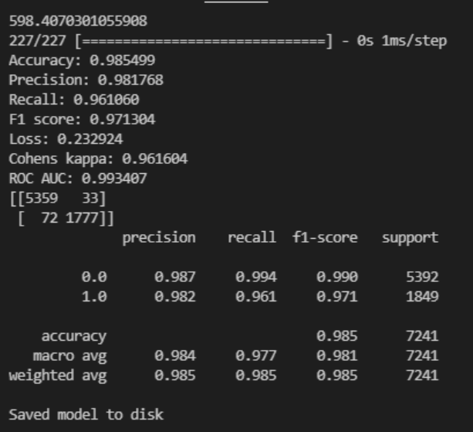
Results - ANN
BR+Robust w\o new features
BR + Robust with our new features

Slide 18
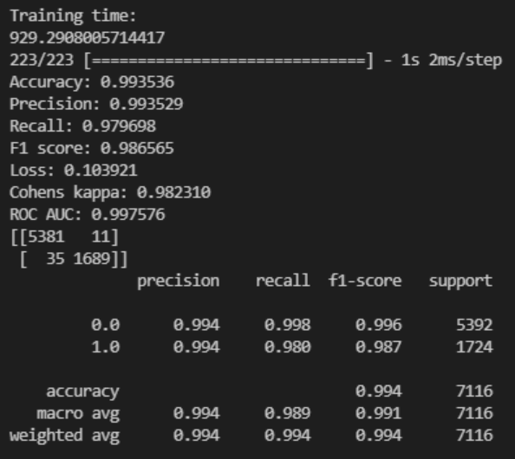
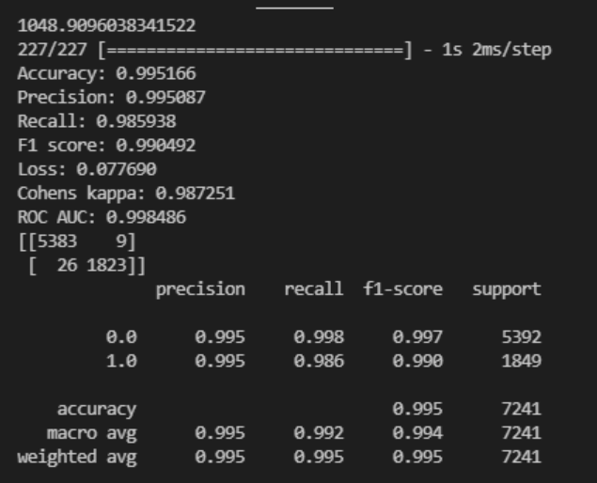
Results- ANN
All old features
All old features + Our new features

Slide 19
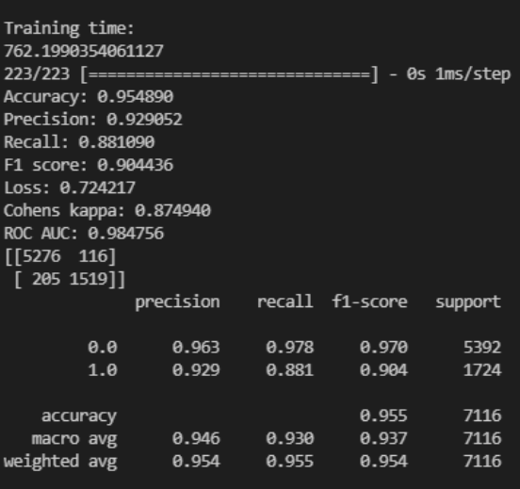
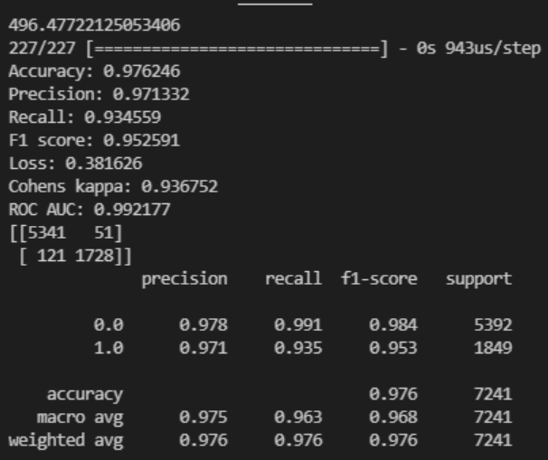
Results- ANN
Their 4 robust features
with our new features
Only their 4 robust features

Slide 20
Future Work
Extract more similar features that analyze the structure of the URLs, such as number of commercial tools, java scripts and more.
We used BuildWith’s free API. The paid version reveals much more information about the website.
Classify into malicious URL classes, eg. Phishing,Command & Control, …

