Slide 1


PRODUCTIVITY
ANALYSIS
IN MANUAL LABOR SECTOR

Slide 2

WHAT IS PRODUCTIVITY
Productivity: Tells you how efficiently and effectively your workforce is delivering results over a set period.
Total Output / Total Input = Productivity

Slide 3


CONTENT
01
GOALS AND OBJECTIVES
02
ABOUT THE DATA
03
MISSION N.1
04
PEARSON X SPEARMAN
05
VALUES
06
PERFORMANCE
07
NEXT TIME

Slide 4



GOALS AND OBJECTIVES
Objective n° 1
Objective n° 2
Objective n° 3
Create a Algorithmic Model that is based on easy acessbility business features.
Incentives
Standard Min. Value
Idle Workers
Build an in depth Analysis with Interactable Graphs to futher the investigation of what drives Productivity.
Format a Data Base where data can be stored, organized, related, secured and distributed.

Slide 5

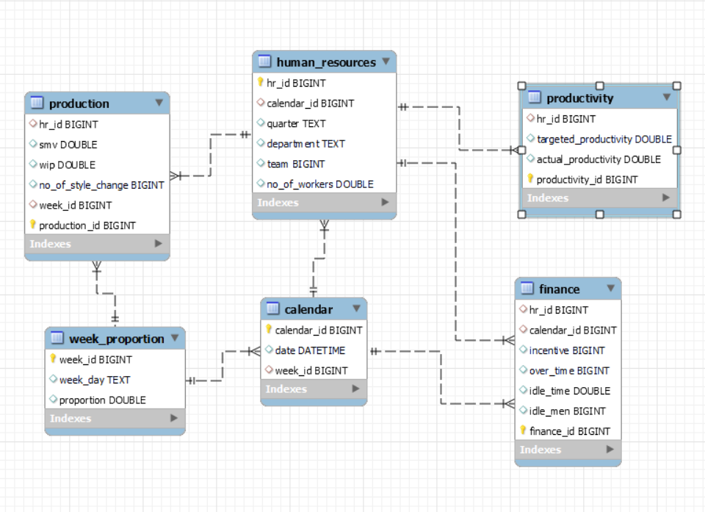



ABOUT THE DATA
This data was a obtained in the UC Irvine Machine Learning Repository, and there is a article published in the subject.
It nice to mention it had some issues, related to the formatting, data types and formating.
With the cleaning and wrangling done, I divide the set to fit sectors of a manufacturing company, to perform a “proto-server”.

Slide 6
MISSION NUMBER 1
It is good to mention the goals of the whole project and each role related to the whole. Moreover there is a clear priority here.
So I’ll leave mission number 2 for the website part.
.

Slide 7

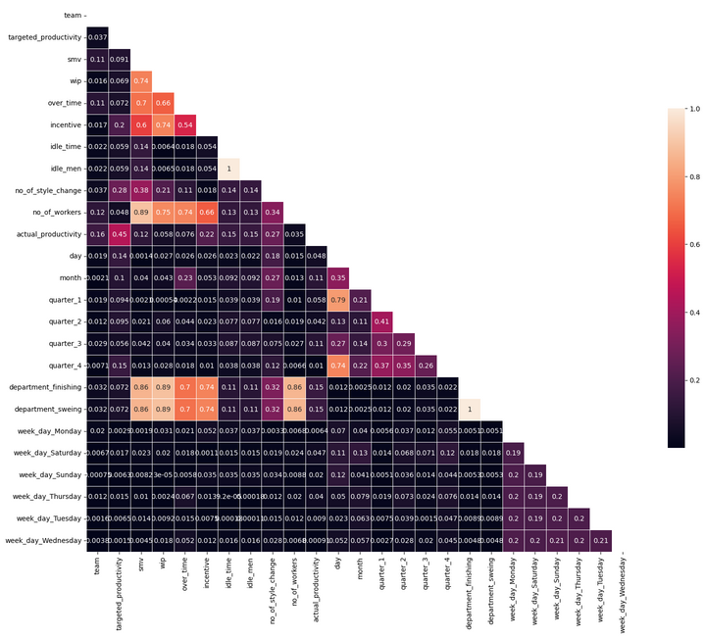

PEARSON X SPEARMAN
Low correlation with the Target.
Spearman with 0.1%-2.0% edge.
Non-Linear.
Target Productivity = 45%.
Amount of Style Chg. = 27%.
Incentive = 22%.

Slide 8
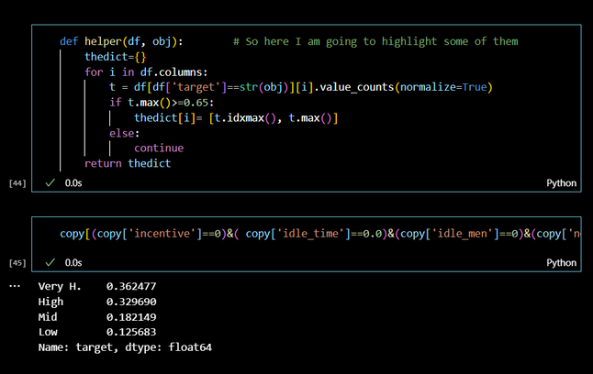
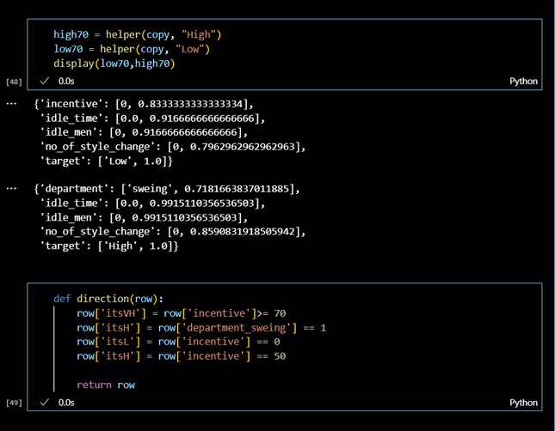
VALUES
Seek
Regression to Classification.
Function to Flag High Frequency Values.
Confirm that HFV had behavioral Patterns.
Act
Then it is green light create boolean feature based on the pattern.
The model reacted positivilly with the new features, despite the function logic not being inputed to the model.

Slide 9



PERFORMANCE
BEST PURE REGRESSION
RMSE: 0.10820
RMSE on Train: 0.08542
R2 score: 0.63508
R2 score on Train: 0.75713
Difference: 0.12205
BEST FLAGED CLASSIFIER
R2 score: 0.63333
R2 score on Train: 0.64566
Difference: 0.012331
High: P:0.67 R:0.76
Mid: P:0.42 R:0.38
REGRESSING THE CLASSIFIER
RMSE: 0.03269
RMSE train: 0.03107
R2 score: 0.96536
R2 score on Train: 0.96816
Difference: 0.00280
STRATEGY N°1
STRATEGY N°2
STRATEGY N°3

Slide 10


THANK'S FOR WATCHING
And a Productive weekend, grateful for the attention of all.
Ja Acabou!
Eliel Almeida

