Slide 1
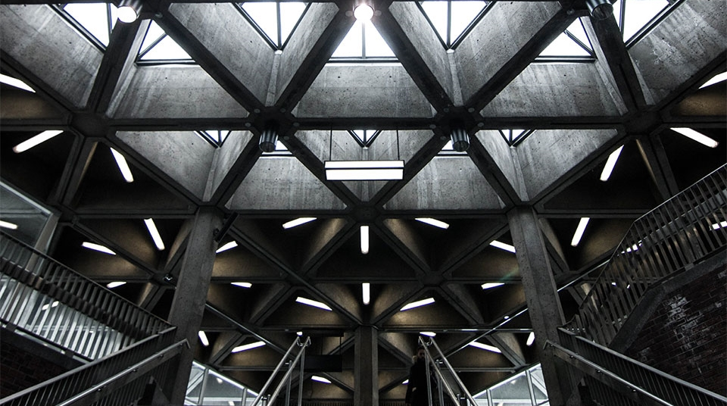
Elite Systems inc.
2
+
2
+

Slide 2

Introduction
We are a reputable company with highly skilled experienced systems developers.
Our mission is to develop high quality, user friendly and economic systems that meet all the needs of our clients in a timely fashion

Slide 3

Executive summary
2
+
We are the best company for the job because we understand your business and we will improve it by offering the following :
Growth: The primary purpose is to attract new customers. This results in more business i.e. growth
Cost: We can develop the system using a minimal budget.
Scheduling: We can develop the system in a timely fashion.
Interactive catalogue: Allows clients to view the business’s various services and products at their own pace.
Online Ad: Allows the business to showcase their various products in a clear and understandable manner.

Slide 4
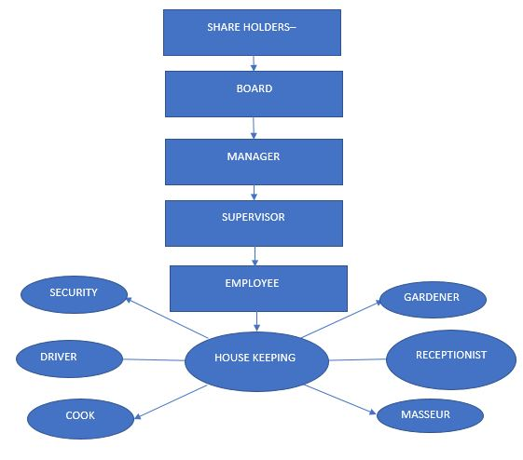
ORGANOGRAM
2
+

Slide 5
context LEVEL DFD
2
+

Slide 6
LEVEL 1 DFD
2
+

Slide 7
Body
2
+
Our intention is to develop a system that full satisfies all the customer requirements and as such it will have the following features :
a)Offline/ online booking - 24/7
b) Intelligent system to infer future conditions such as demand, cash flow and income statements.
c) Interactive catalogue
d) Reviews
e) Interactive directions to the physical location of the Spa
f) User support

Slide 8
conclusion
2
+
We look forward to developing this wonderful and highly profitable system.
It will be in the best interest of the business to consider our proposal and contact us as soon as possible because time is money.

Slide 9
THANK YOU
2
+
2
+
Elite systems inc.

