Slide 1
Epidemic Control with Temporal Immunization and Limited Vaccine Budget
By Jiaming Cui and Elie Diaz

Slide 2

Introduction
With the ongoing effort to create an effective way to distribute vaccines, there is an important factor to account for: the idea that a vaccine may only allow for temporary immunization.
Several vaccines do need to be re-administered over time, and this can range from long to short-time re-vaccination

Slide 3
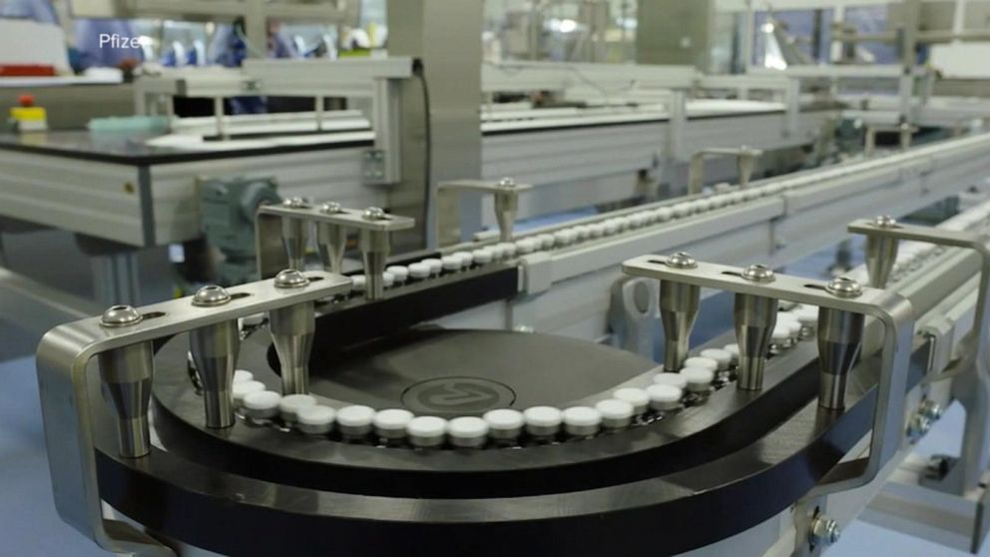
Introduction
For an ongoing global pandemic, such as the current one with COVID-19, there may also be a very limited budget for vaccinations.
This can be due to distribution or manufacturing delays

Slide 4

Introduction
In addition, a vaccine may be more necessary for specific populations, such as those with pre-existing health conditions or that are in an especially at-risk age.

Slide 5
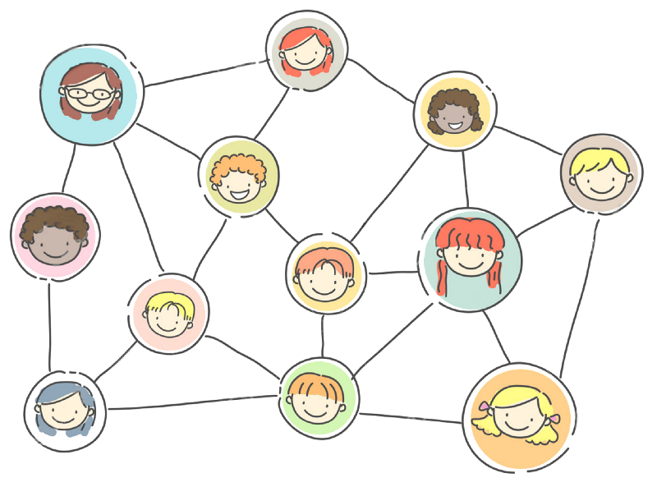
Problem Definitions
We aim to create an algorithm that takes in a temporal graph, a limited budget for vaccines, a temporal immunization pattern, and a risk factor to continuously update the method by which the vaccine should be administered.

Slide 6
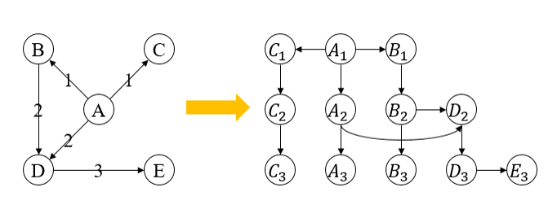
Problem Definitions
A Temporal Graph can be difficult to perform the analysis and distribute vaccines with limited budget.
Therefore we convert the temporal graphs to stable graphs.

Slide 7

Problem Definitions
Given:
a temporal network G(V,E)
a decay of immunization function R(t), showing rate of decay for time t
a risk function D(v), showing the risk of a node v
a budget of Vaccines at each timestamp, shown by C(t)
Find the best nodes to give vaccine injections V(t), which satisfy:
$arg\min_{V(t)}{E_{Risk}\left[V\left(I\left(t_{N}\right)\right)\right]−E_{Risk}\left[V\left(I\left(t_{0}\right)\right)\right]}$
Where:
$E_{Risk}\left[V\left(I\left(t+1\right)\right)\right]=E_{Risk}\left[V\left(I\left(t\right)\right)\right]+ \sum_{V}{D(v) {(1−(\left(1−R\left(v,t\right)\right)p)}^{|\left|V\left(E\left(,v\right)\right)\right||}}$
V(t) < C(t) for any t

Slide 8

The Algorithm
We ant to design our algorithm in a greedy method, such that for each time t, we find the nodes V(t) at each time t that minimize:
$E_{Risk}\left[V\left(I\left(t+1\right)\right)\right]−E_{Risk}\left[V\left(I\left(t\right)\right)\right]$
Specifically, we update the GreedyValue
$D(v) {(1−(\left(1−R\left(v,t\right)\right)p)}^{|\left|V\left(E\left(,v\right)\right)\right||}$
At each timestamp, then pick the priority nodes at each timestamp, then “vaccinate” them.

Slide 9
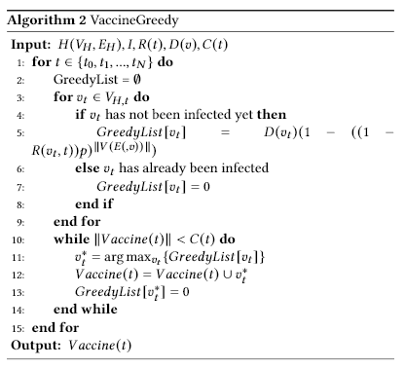
The Algorithm
We want to show that at each timestamp, by picking the priority nodes as the ones with the highest GreedyValue and “vaccinate them”, we will achieve a 1 – 1/e guarantee over the optimal performance.

Slide 10
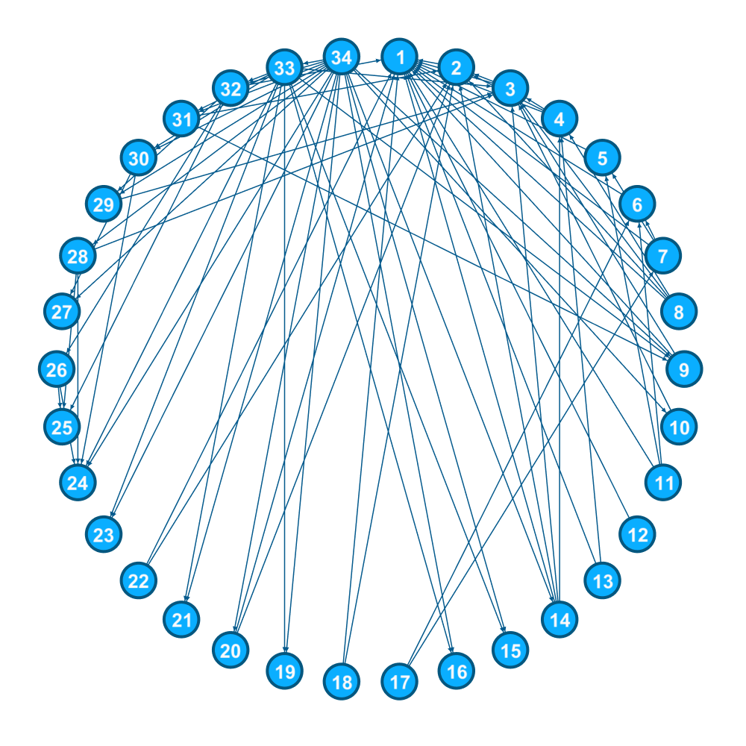
The Experiments: Data
We used two datasets: “Zachary’s Karate Club” and “Oregon-1”.
Zachary’s Karate Club, illustrated on the right, is a small network of 34 nodes and 156 edges, was generated automatically from the networkx library.
Oregon-1 is a large network created from 10670 nodes and 22002 links. This is from Stanford’s SNAP datasets (linked at the bottom of the slide)
As our algorithm takes in temporal graphs, we converted the data into temporal graphs by selecting edges in the original graph with p = 0.2 at each timestamp.
https://snap.stanford.edu/data/Oregon-1.html

Slide 11
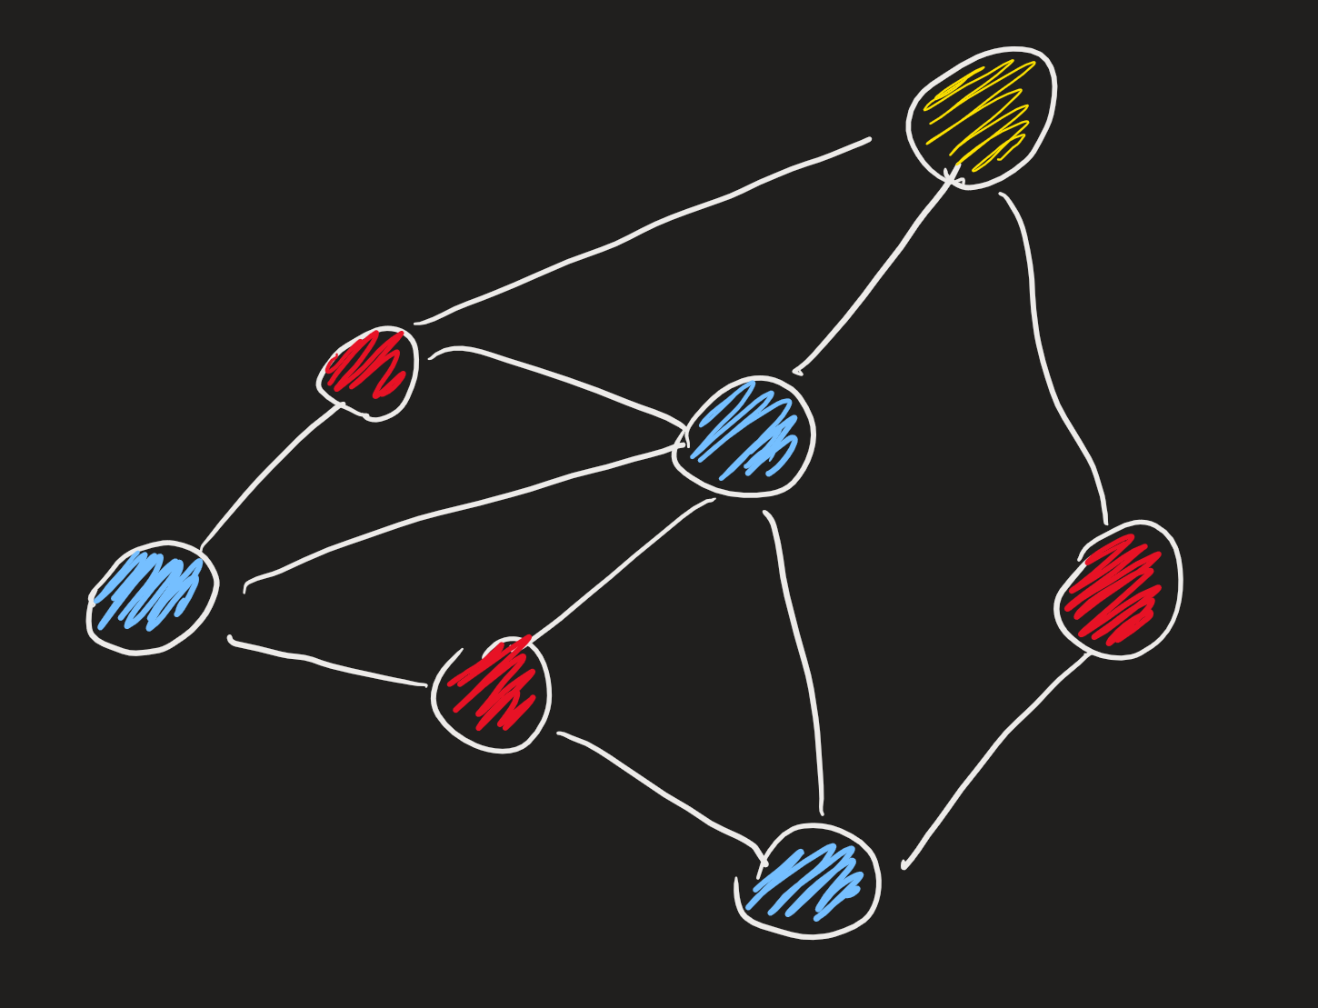
The Experiments: Setup
We compare our algorithm to three baselines:
No vaccinations, just a standard SI model
Vaccinations distributed randomly
Vaccinations distributed to the nodes with the highest degree in the graph
We then also run the greedy algorithm in the graph and compare results

Slide 12
The Experiments: Setup
Run the experiment for 10 time steps
Set the decay to be linear
R(t) = { 1.0, 0.8, 0.6, 0.4, 0.2, 0 }
Distribute the risk values across the nodes in the graph randomly
Set the budget to 5 vaccinations, one every other time step

Slide 13
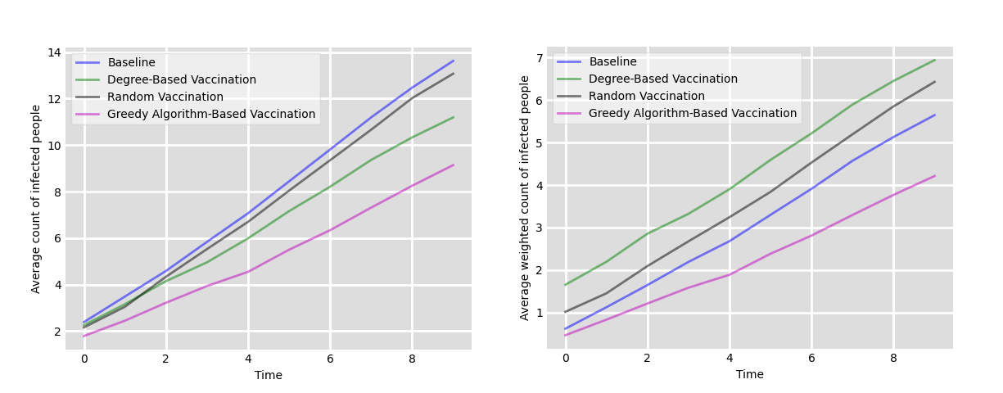
Results
The Karate graph (in pink) shows a very good performance of the greedy algorithm over the three baselines. Even when accounting for risk factors, the greedy algorithm continues to outperform the others.

Slide 14
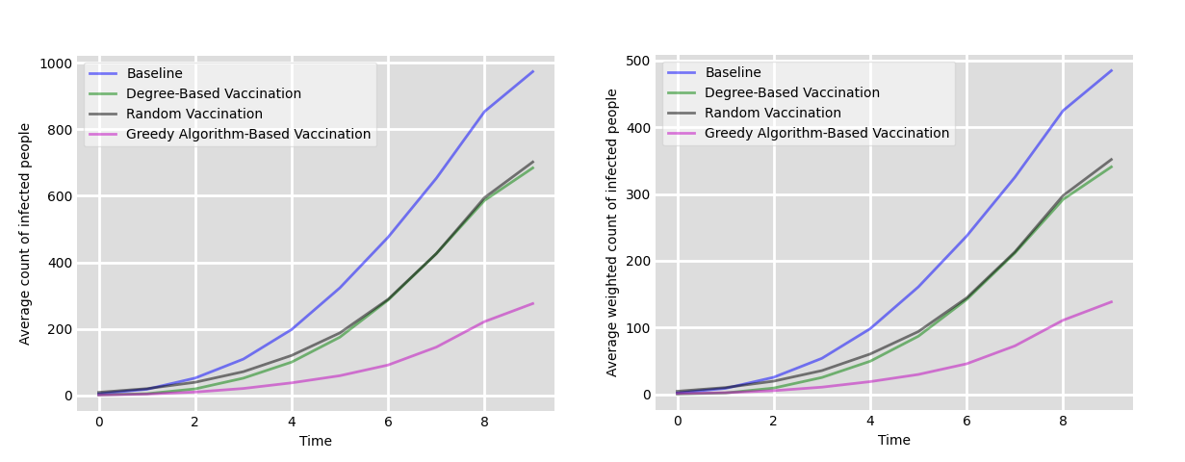
Results
The Oregon Graph shows a more intense growth, but also shows the greedy algorithm outperforming the rest of the baselines, this time by a wider margin.

Slide 15
Conclusions
After observing the different graphs, we can see that the greedy algorithm improves on all three baselines.
This is especially seen on the larger graphs, as the greedy algorithm continually updates at each time step to control the flow of the epidemic and slow it down.

Slide 16
Further Work
Account for a relationship between risk and mortality:
When a high-risk node becomes infected, they do not necessarily continue infecting other nodes at the same rate as a lower-risk node
Account for unknowns in graphs:
As epidemics spread, plans may change and connections may be severed, changing what a temporal graph would otherwise be

Slide 17
Questions?

