Slide 1





CineVisor Consulting Presents
A Guide to
Box Office Success
Elif Surucu & Ricky Bocek

Slide 2



Overview
Understanding the factors that drive financial success is crucial for any production studio.
1
Budget generously, within reason
2
Don't chase ratings.
3
Stick to profitable genres.
4
Dynamic duos hold broad appeal.
5
Work with known quality directors.

Slide 3



OUTLINE
1
Business Understanding
2
Data and Methods
3
Analysis and Results
4
Conclusions

Slide 4




Business Understanding
Competitive and volatile industry
Focus on maximizing profits and minimizing risks
Predicting movie success is challenging
Box office performance has high variance and few clear drivers

Slide 5







Data & Methods
Data Sources
IMDB: Features & Ratings
The Numbers: Budget & Revenue
Kaggle (Ultimate Film Statistics Dataset): Budget, Revenue, Approval Score
Federal Bureau of Labor Statistics: Consumer Price Index Tables
Methods
Adjust for inflation
Linear regression: estimate trends and feature impacts
ANOVA: identify key drivers
Post-Hoc Tukey HSD: quantify and describe drivers

Slide 6
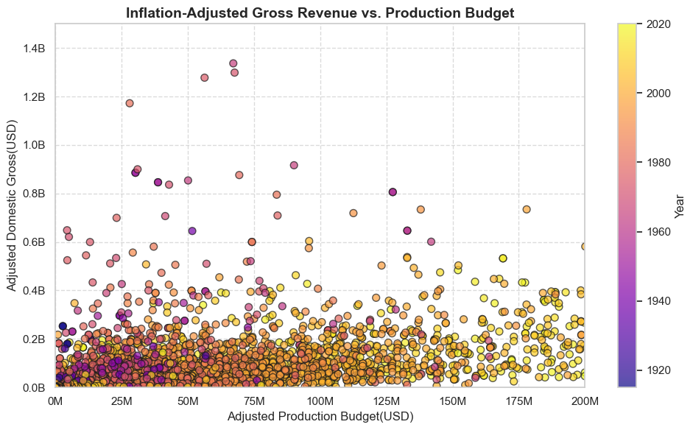

Analysis & Results
Outliers and Variance
Budget outliers and revenue outliers have very little overlap.
Extremely high variance in gross revenue regardless of budget.

Slide 7

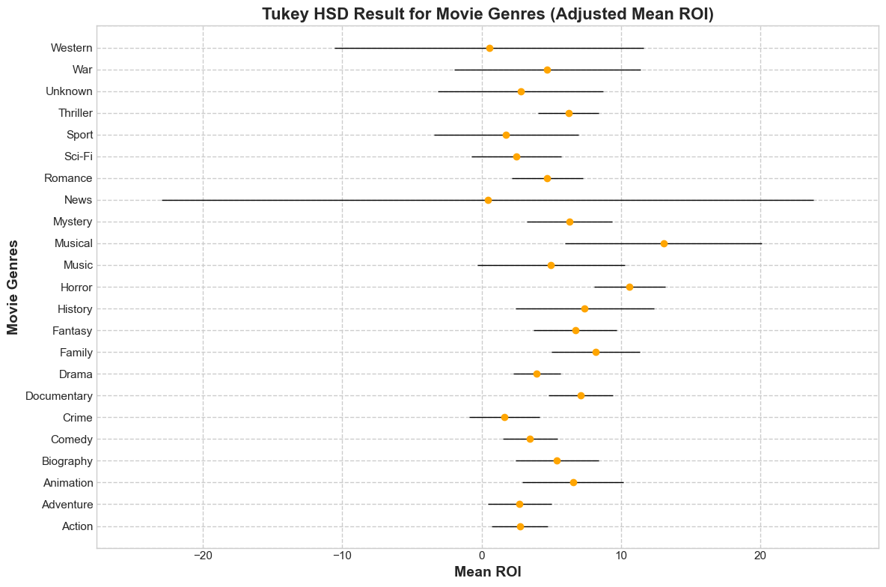

Genre
Most Profitable Genres
Horror: 2nd highest ROI, high confidence
Musicals: highest ROI, low confidence
Drama: 3rd highest ROI, high confidence

Slide 8
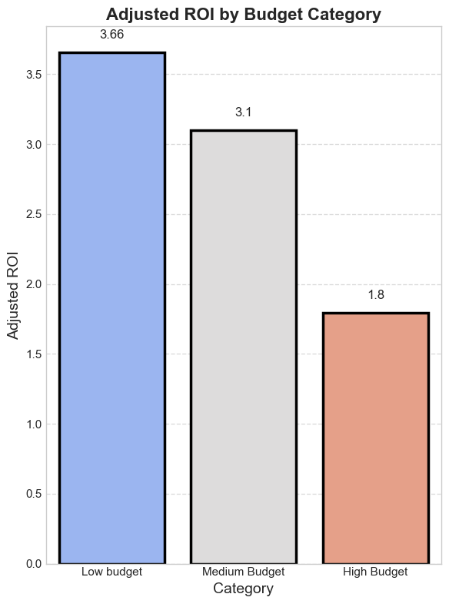
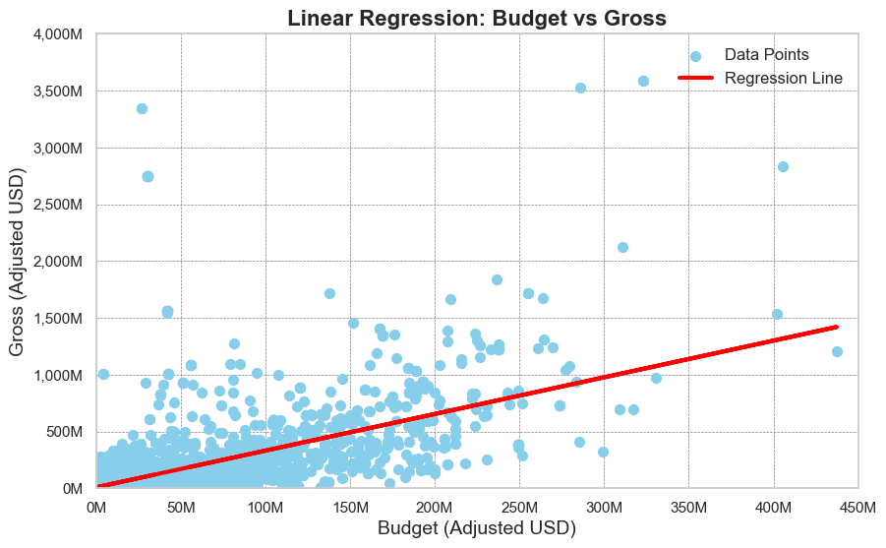
Budget
Low-budget films yield the highest ROI, while high-budget films generate the lowest

Slide 9
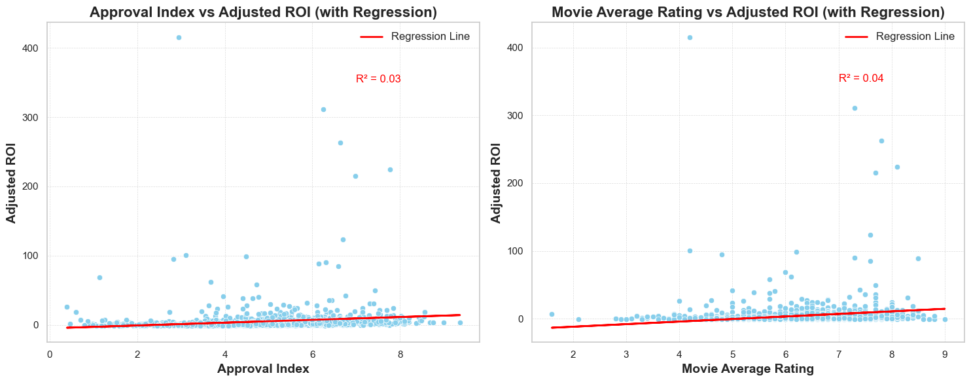
Ratings
Approval Index and Average Ratings show minimal impact on Adjusted ROI.

Slide 10
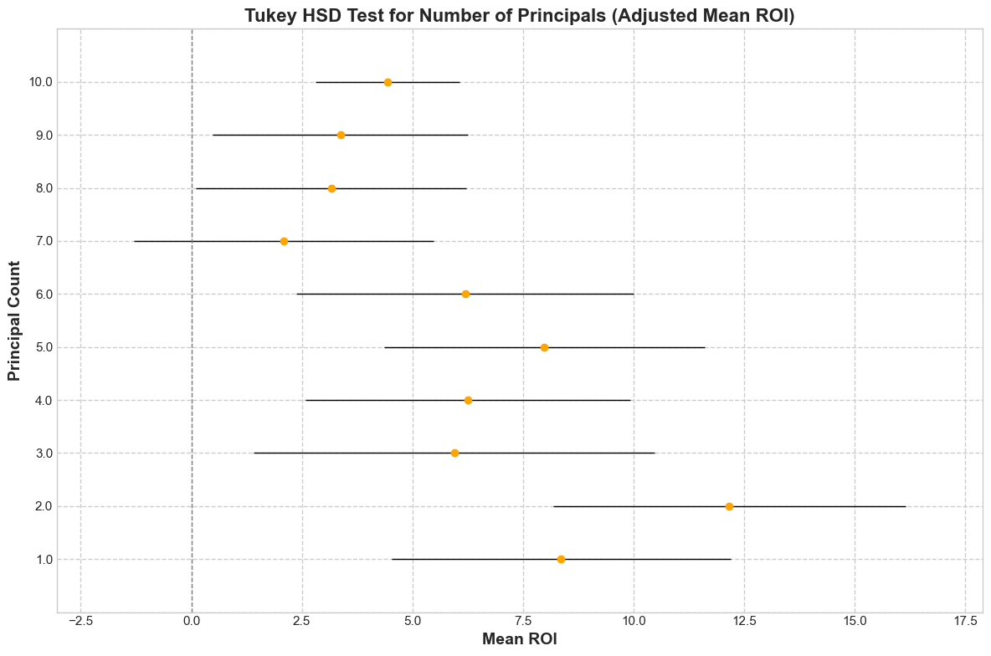
Dynamic Duo Effect
Focus on dynamic duos: 2 principals yield the highest mean ROI, while casts with 7-10 principals show significantly lower returns. Avoid large casts.

Slide 11

Directors
Constraints
Director availability for new projects
Genre experience
Overall experience
Recommendations Top choices; Jordan Peele, Jeff Wadlow, Michael Madsen

Slide 12

Conclusion
&
Next Steps
Untapped Features
Several IMDB dataset features remain to be analyzed.
Machine Learning
Combining features into a comprehensive model could enhance analysis.
Further Data
Including deeper production elements and additional economic or cultural context could lead to new insights.

Slide 13












THANK YOU!
Elif Surucu | elif.src.34@gmail.com
Ricky Bocek | ericabocek@gmail.com

