Slide 1
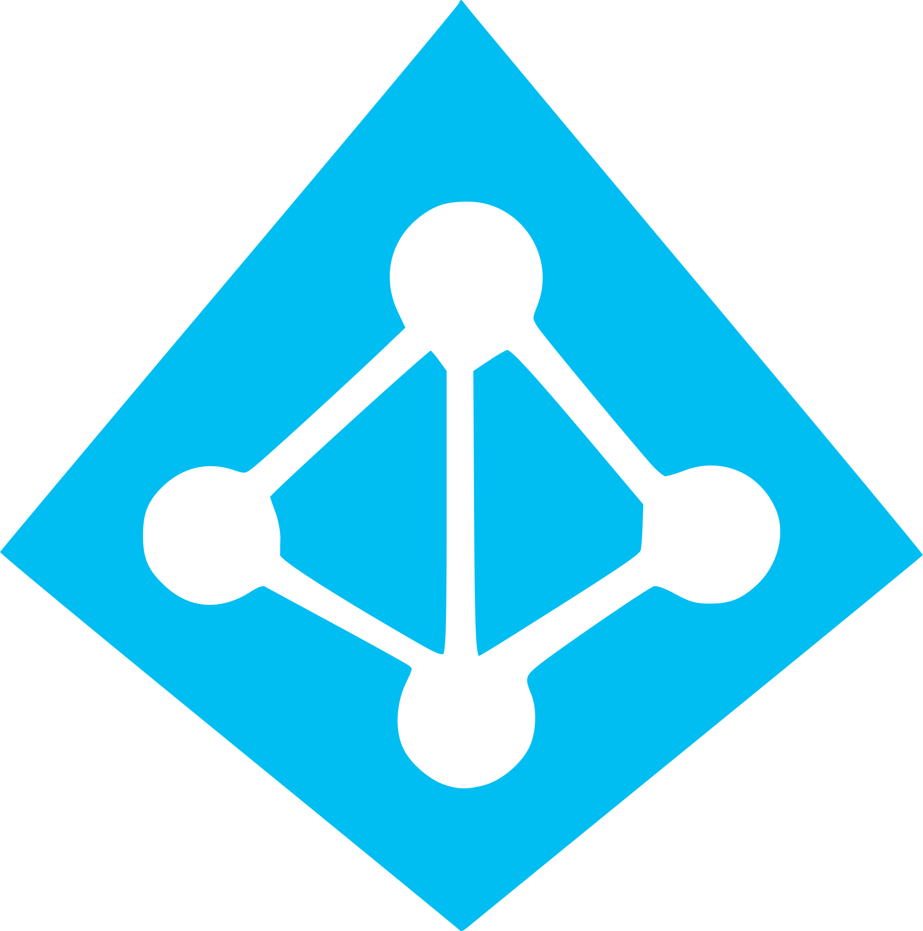

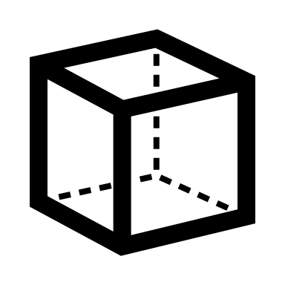

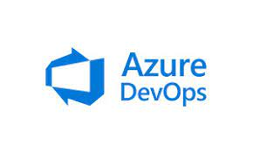







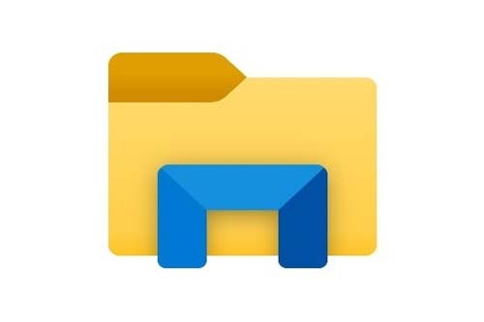

SmartForce Architecture - BotCommander
Bot Commander
VM
Transaction Logs*
Azure Active Directory
Authentication: Personal Access Token & Certified Automation Code Executable
Deloitte Practitioner Using Automations
Direct Access - VPN
Client Applications (examples)
Two-Factor Authentication
Azure Key Vault
Digital Heartbeat

Slide 2
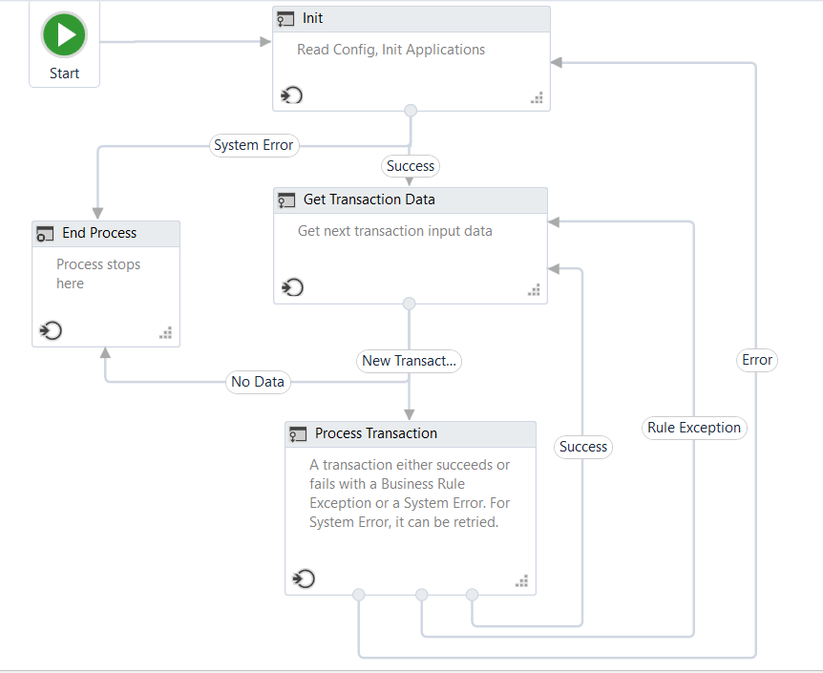
SmartForce Architecture – UiPath Bot

Slide 3
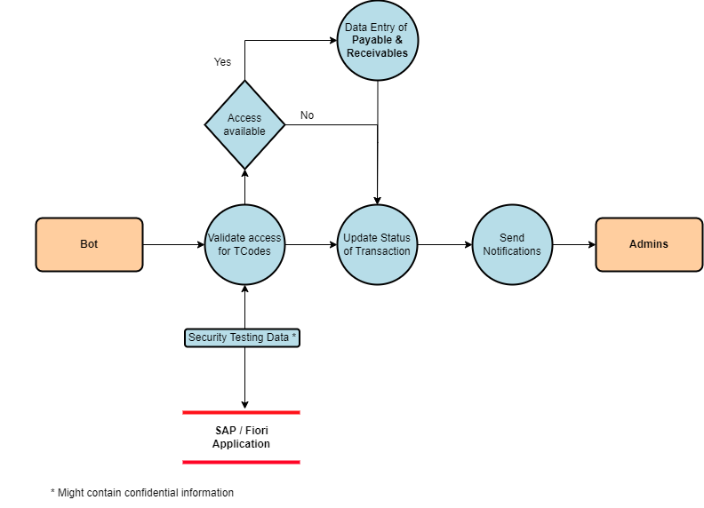
SmartForce Architecture – Data Flow

