Slide 1

RabbitMQ
Eligijus Stugys
Senior Software Engineer
NFQ Technologies
eligijus.stugys@gmail.com
http://stugys.lt

Slide 2
Planas
1. Jaunojo kario kursas.
2. Pluginai
3. Grėbliai

Slide 3
Examples
git clone git@github.com:Eligijus1/vagrant_test_RabbitMQ.git

Slide 4

1. Jauno kario kursas

Slide 5
WTF is RabbitMQ ?
Software that implementing “Advanced Message Queuing Protocol (AMQP)” and has extra plugins, to support other protocols.

Slide 6

Hello World
Producer - program that sends messages.
Queue - post box which lives inside RabbitMQ. Messages stored.
Consumer - program that mostly waits to receive messages.
--------------------------------------------------------------------------------------------
NOTE: Note that the producer, consumer, and broker do not have to reside on the same host.

Slide 7
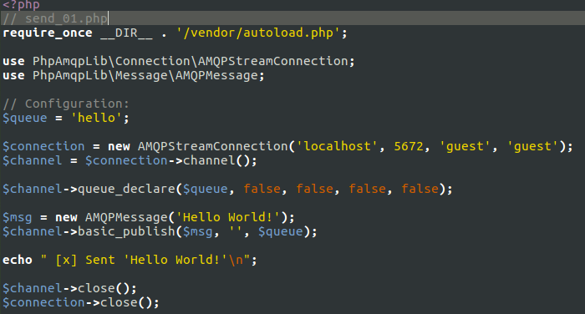
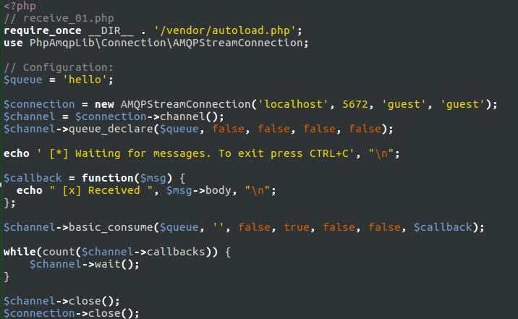


Hello World

Slide 8
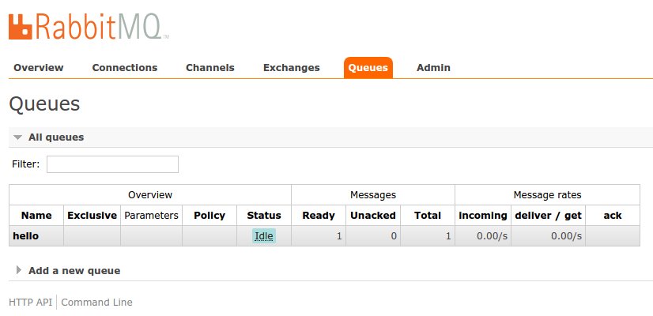
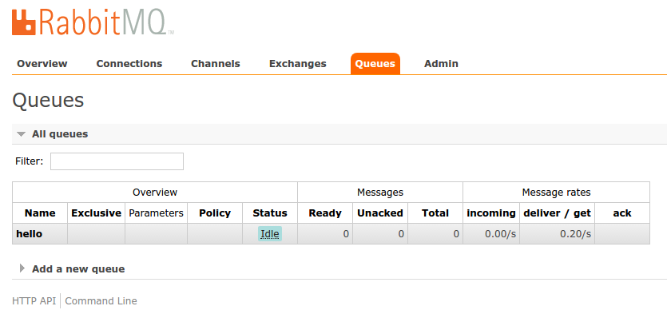
Hello World

Slide 9
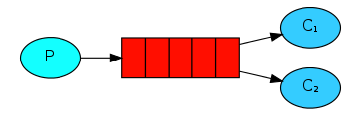
Multiple Consumers
Durable - queue RabbitMQ quits or crashes it will forget the queues and messages unless you tell it not to.
Persistent message delivery mode - tells RabbitMQ to save the message to disk.
Ack - message acknowledgment. Tell RabbitMQ that a particular message has been received, processed and that RabbitMQ is free to delete it.

Slide 10
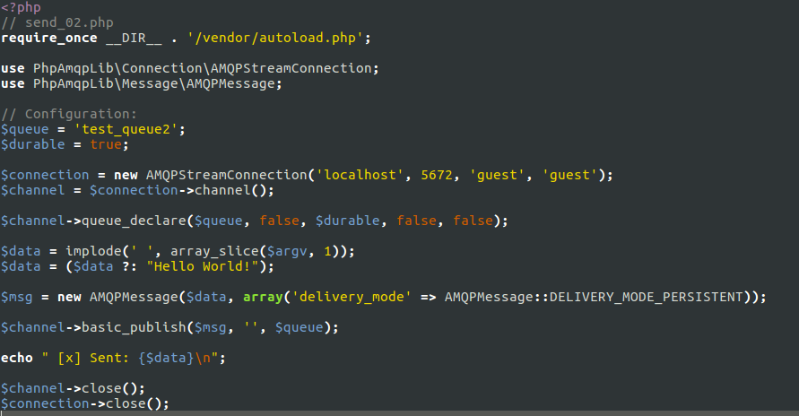
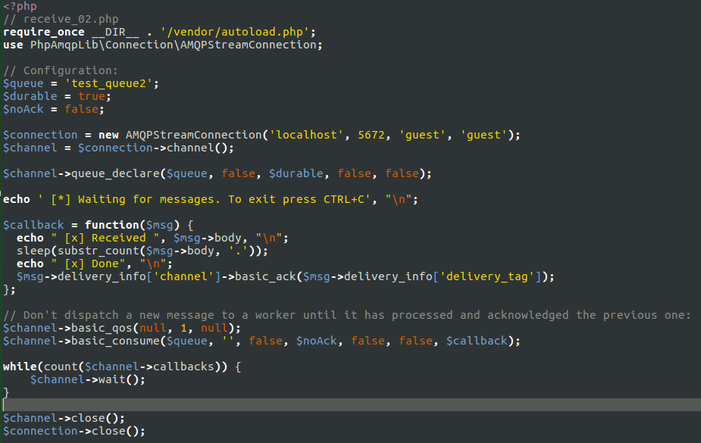
Multiple Consumers
basic_nack
basic_reject

Slide 11
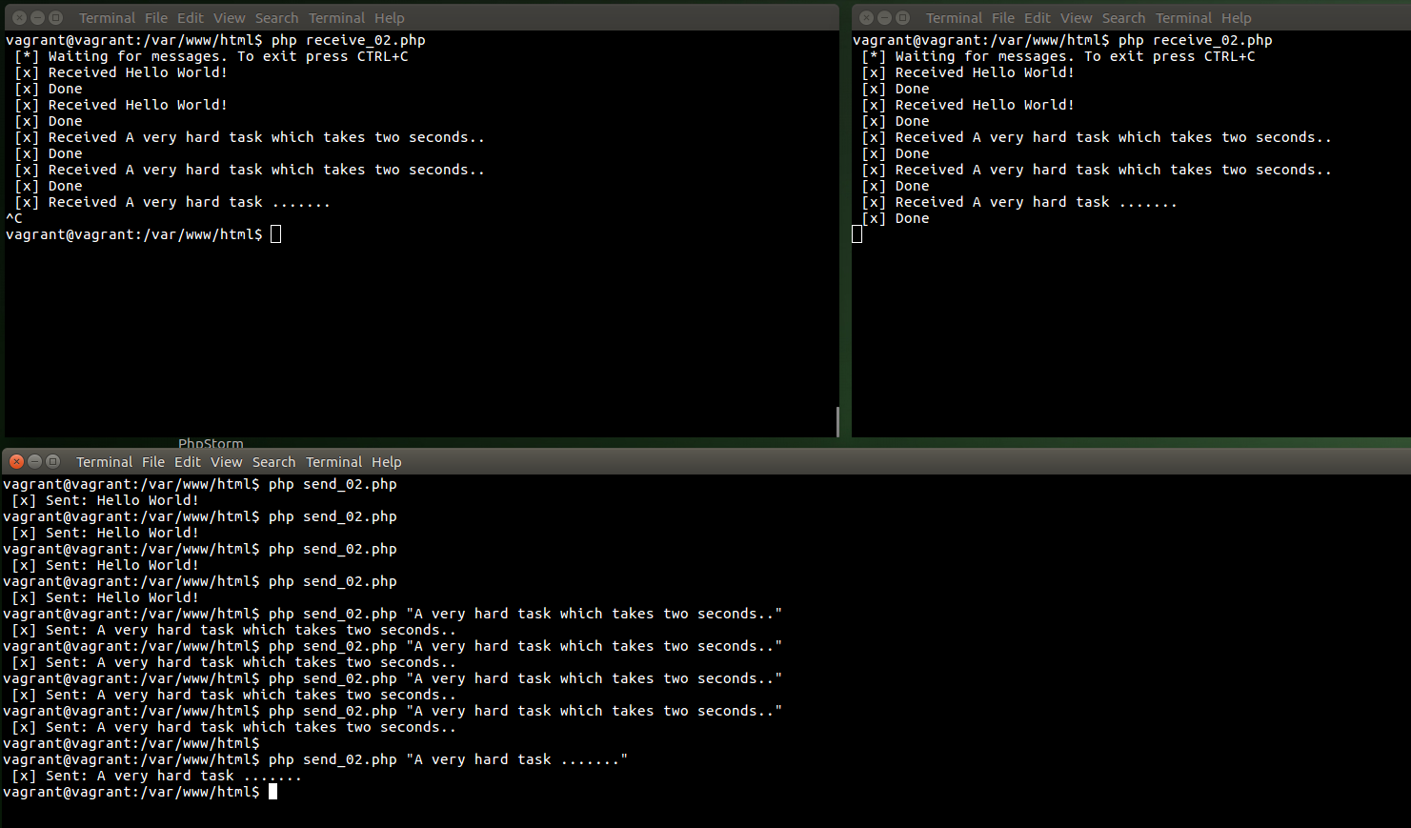
Multiple Consumers

Slide 12
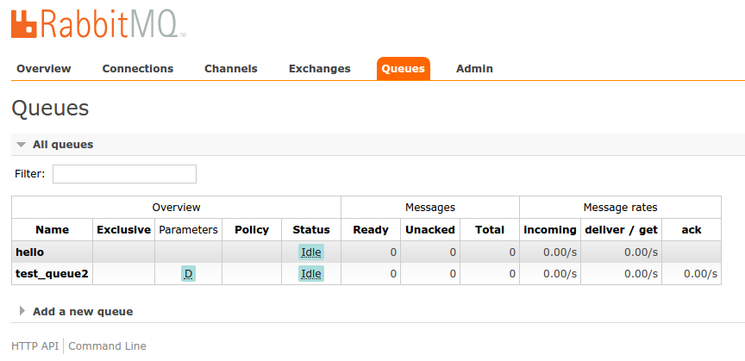
Multiple Consumers

Slide 13

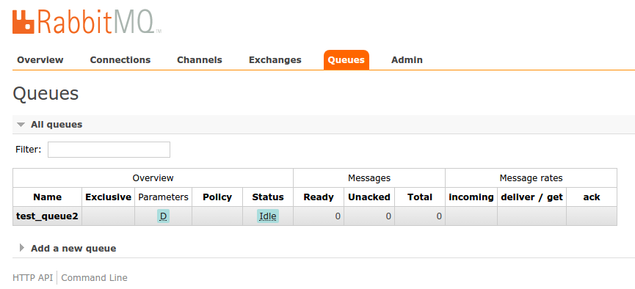
Multiple Consumers

Slide 14
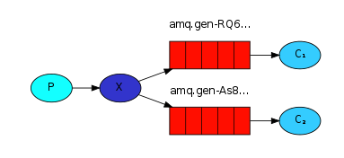
Publish/Subscribe
publish/subscribe - deliver a message to multiple consumers.
exchange - receives messages from producers and the other side it pushes them to queues.
exchange type - received messages managing rules: direct, topic, headers and fanout.
fanout - broadcasts all the messages it receives to all the queues it knows.

Slide 15
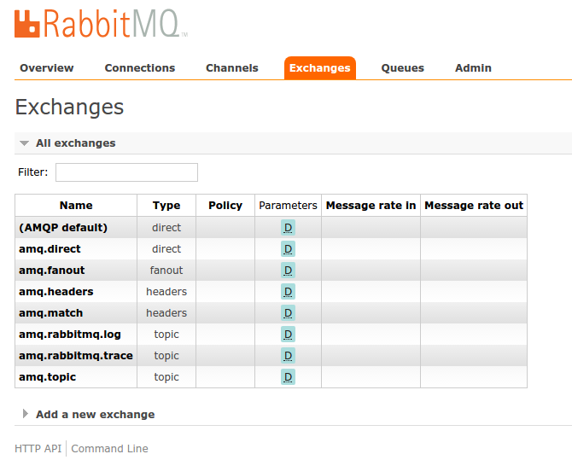
Publish/Subscribe

Slide 16
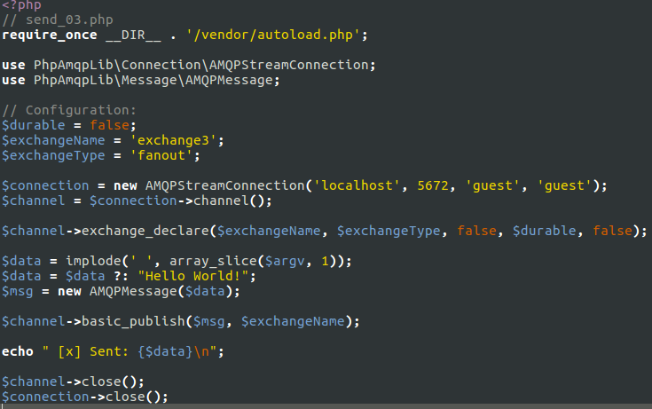
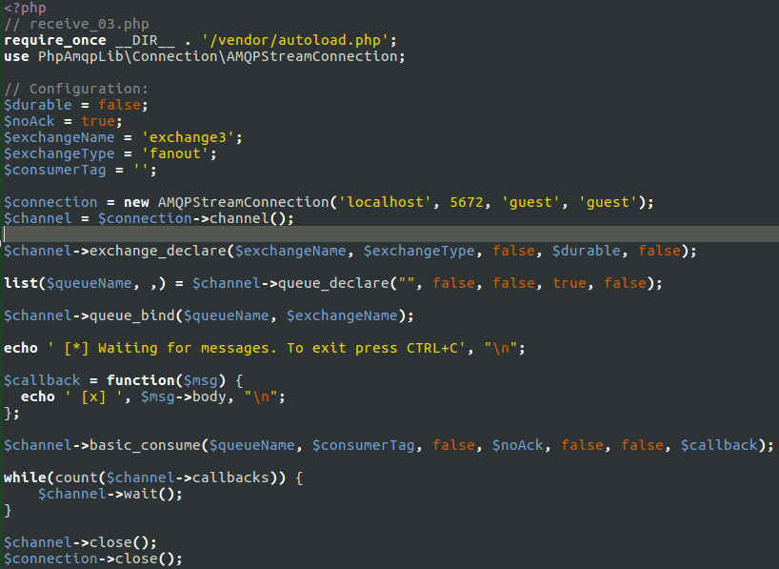
Publish/Subscribe

Slide 17
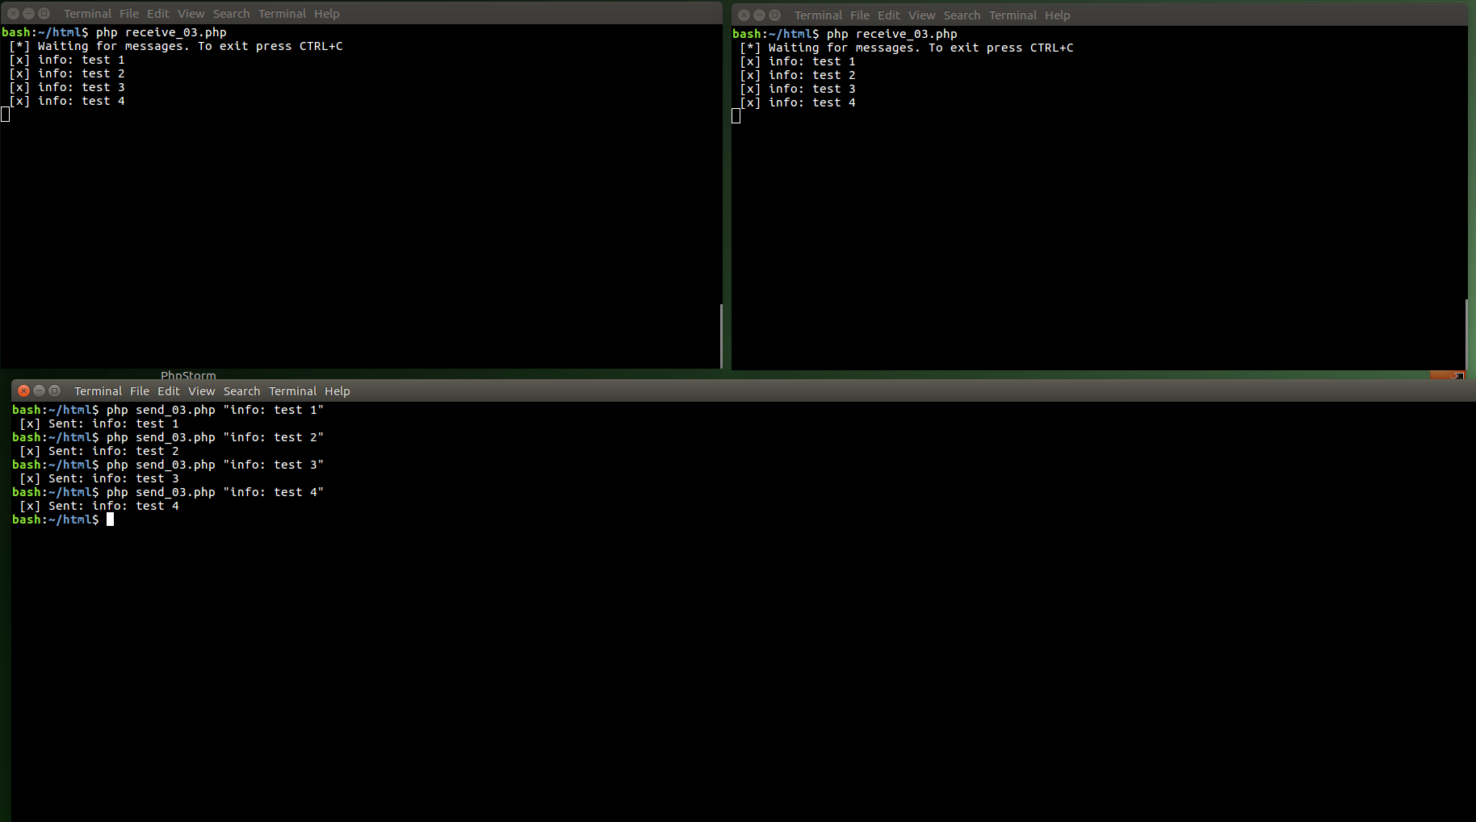
Publish/Subscribe

Slide 18
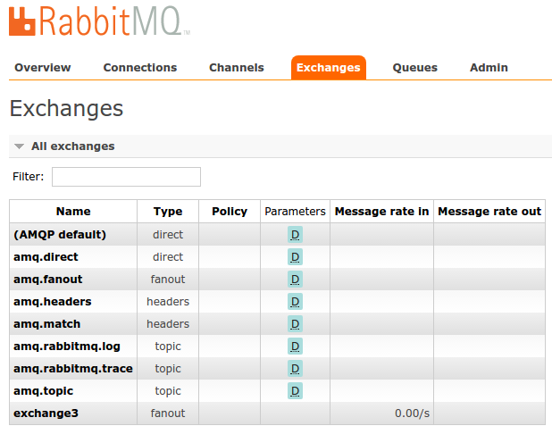
Publish/Subscribe

Slide 19
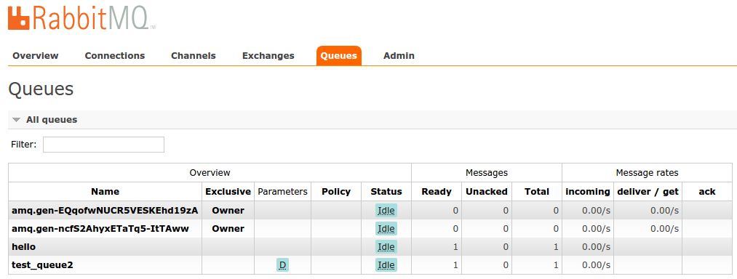
Publish/Subscribe

Slide 20
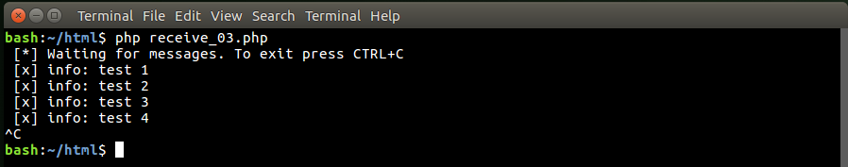
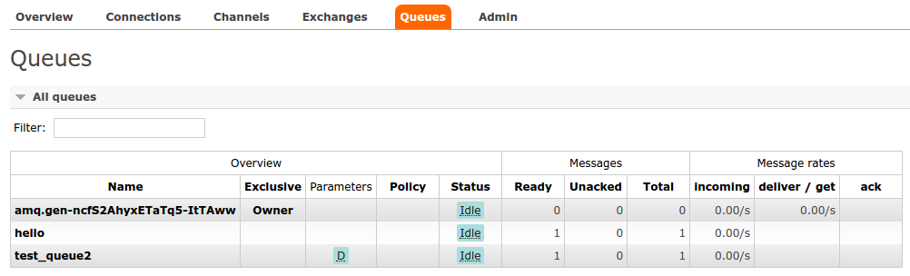
Publish/Subscribe

Slide 21
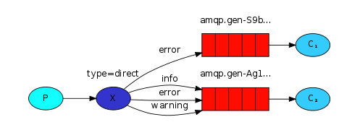
Routing
binding - relationship between an exchange and a queue.
direct exchange - message goes to the queues whose binding key exactly matches the routing key of the message.
routing key - define, to what channel route message.

Slide 22
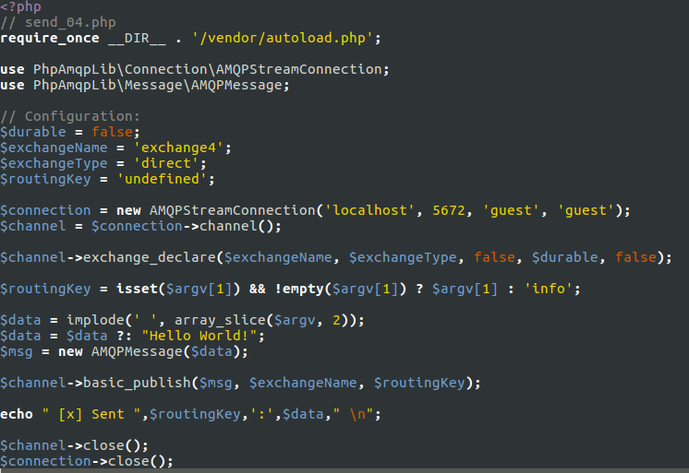
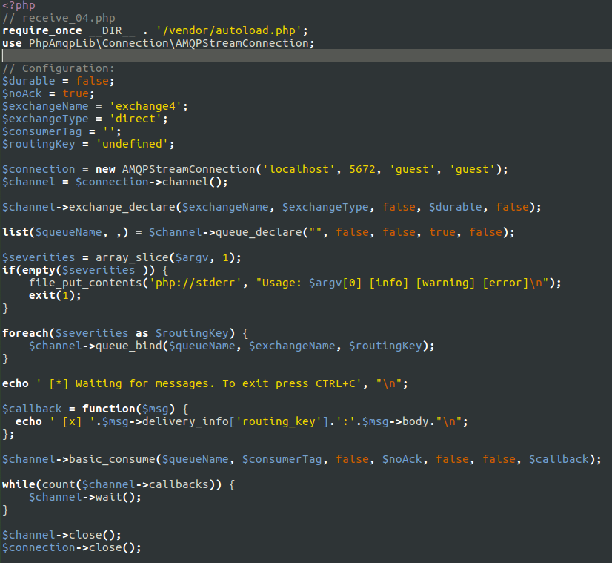
Routing

Slide 23
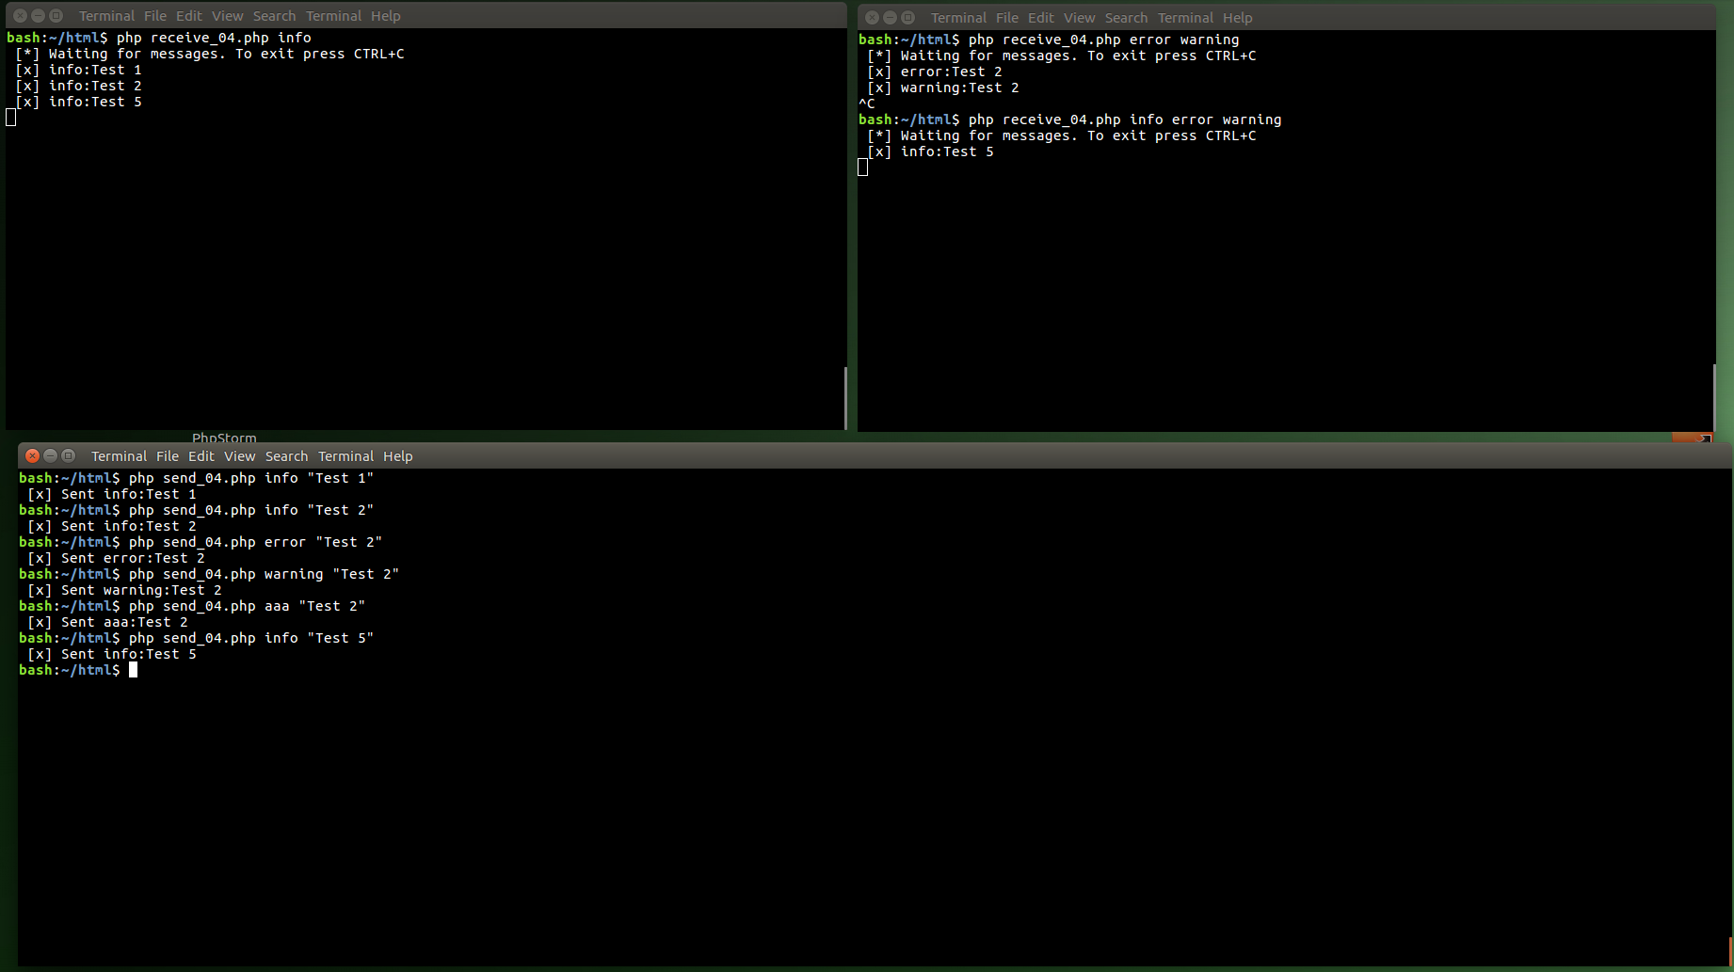
Routing

Slide 24
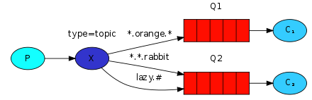
Topics
topic exchange - routing key must be a list of words, delimited by dots. A message sent with a particular routing key will be delivered to all the queues that are bound with a matching binding key.
extra topic case:
* (star) can substitute for exactly one word. # (hash) can substitute for zero or more words.

Slide 25
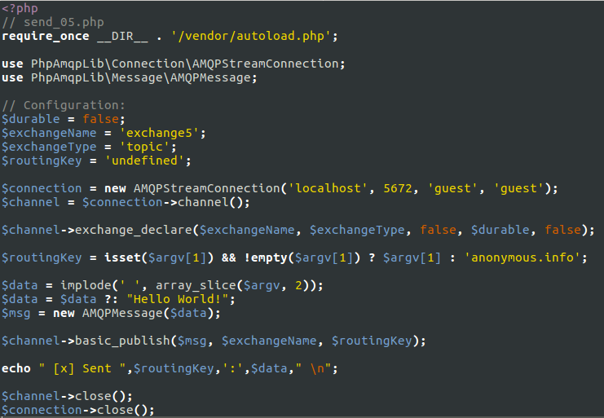
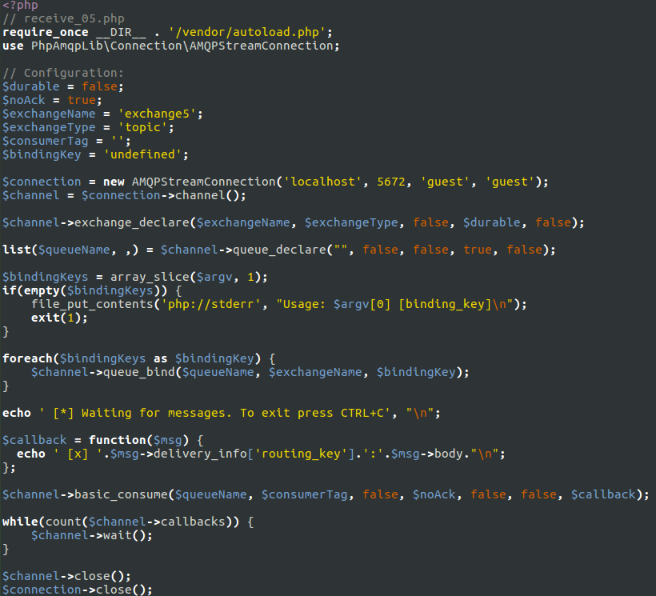
Topics

Slide 26
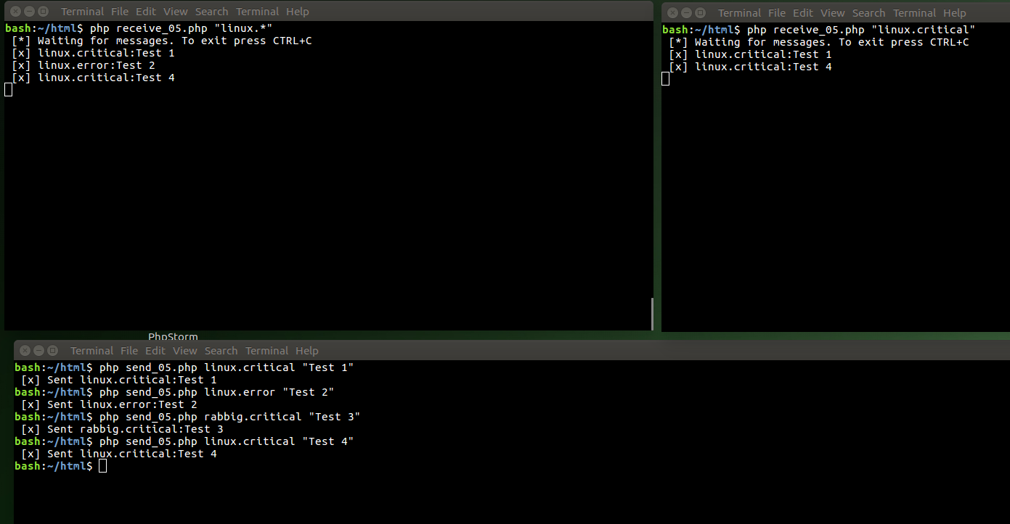
Topics

Slide 27
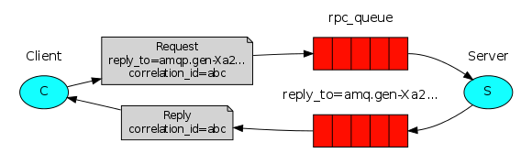
RPC
Remote Procedure Call - run a function on a remote computer and wait for the result.

Slide 28
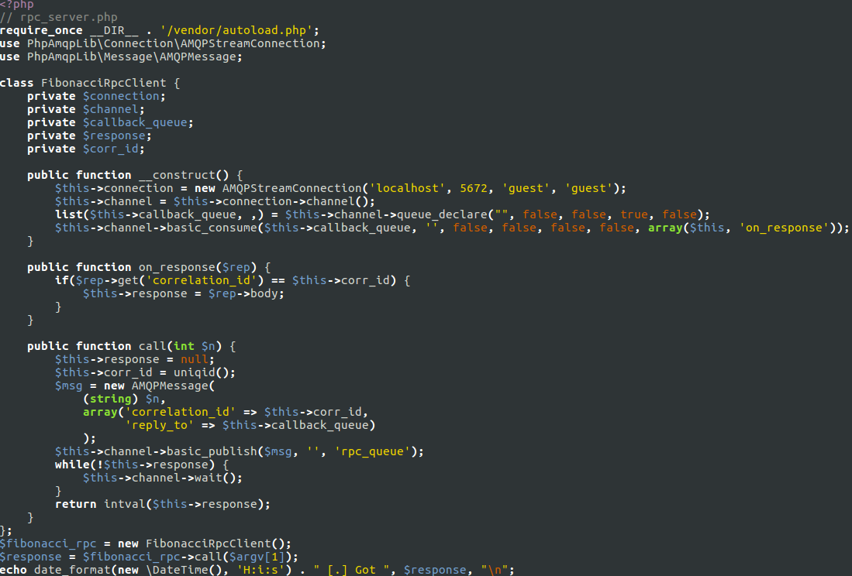
RPC

Slide 29
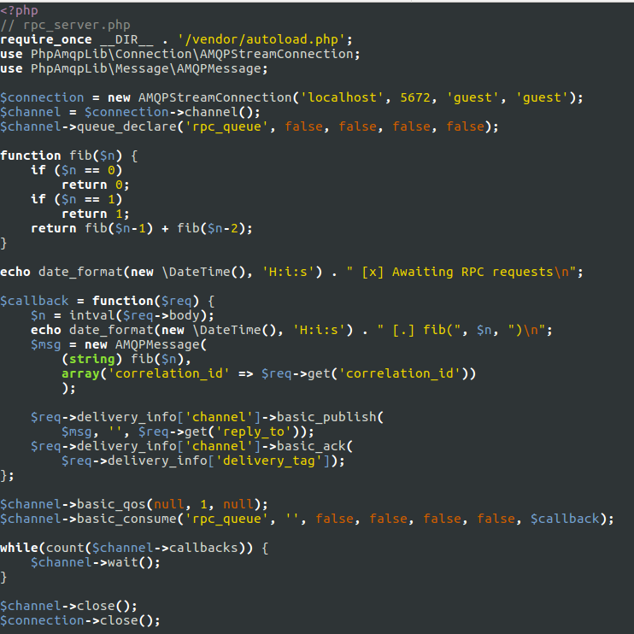
RPC

Slide 30
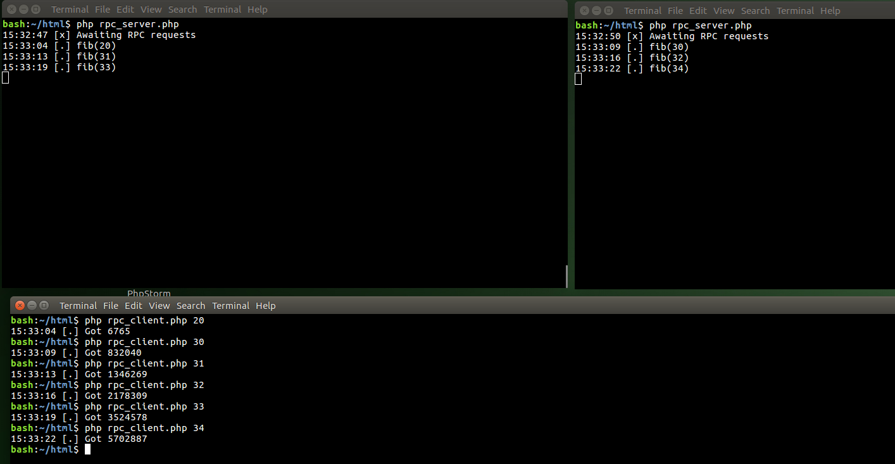
RPC

Slide 31

2. Plugins

Slide 32
List Plugins
~$ rabbitmq-plugins list
…
[ ] rabbitmq_jsonrpc_channel 3.2.4
[ ] rabbitmq_jsonrpc_channel_examples 3.2.4
[E] rabbitmq_management 3.2.4
[e] rabbitmq_management_agent 3.2.4
[ ] rabbitmq_management_visualiser 3.2.4
[ ] rabbitmq_mqtt 3.2.4
...

Slide 33
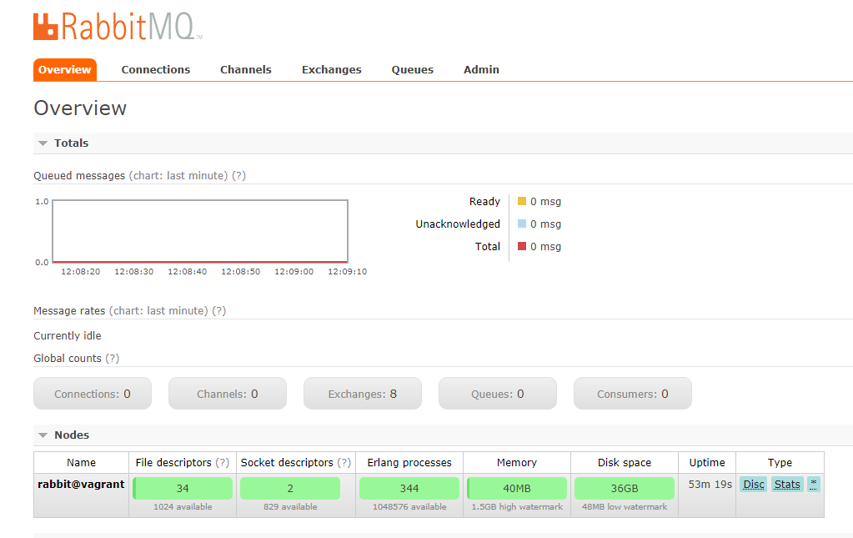
Management Plugin
~$ sudo rabbitmq-plugins enable rabbitmq_management
http://172.28.128.11:15672
guest / guest

Slide 34
Web STOMP Plugin
Simple bridge exposing the STOMP protocol over direct or emulated HTML5 WebSockets.
~$ sudo rabbitmq-plugins enable rabbitmq_web_stomp
http://172.28.128.11:15670/ http://172.28.128.11:15674/stomp
NOTE: JavaScript STOMP library is required. Pvz.: STOMP.js

Slide 35
Web MQTT Plugin
Simple bridge exposing the MQTT protocol over HTML5 WebSockets.
~$ sudo rabbitmq-plugins enable rabbitmq_web_mqtt
~$ sudo rabbitmq-plugins enable rabbitmq_web_mqtt_examples
http://172.28.128.11:15670/
http://172.28.128.11:15675/ws

Slide 36

3. Grėbliai

Slide 37
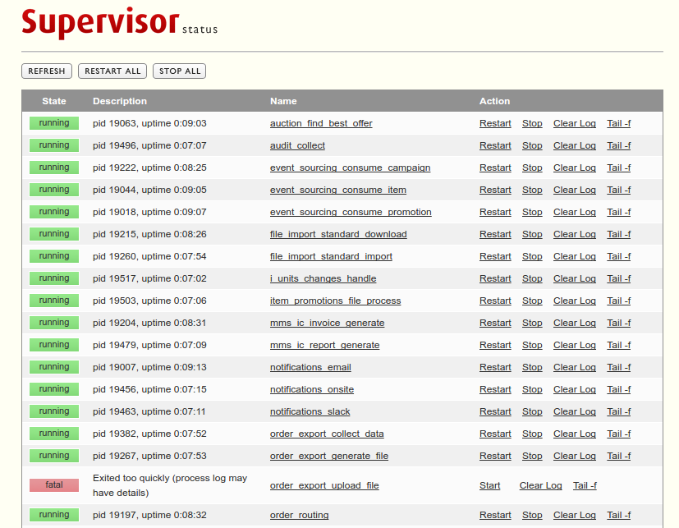
1. Use Supervisor

Slide 38

2. Race conditions

Slide 39

3. Out of memory

Slide 40
4. Symfony bundle
$ composer require php-amqplib/php-amqplib
$ composer require php-amqplib/rabbitmq-bundle

Slide 41
5. ‎Delay messages
$ sudo rabbitmq-plugins enable rabbitmq_delayed_message_exchange

Slide 42
6. ‎Use version no
Timestamp in message
Version no in Queue name

Slide 43
7. ‎YAGNI
You Ain't Gonna Need It
Maybe “beanstalkd”?

Slide 44
Dėkoju už dėmesį :)
Eligijus Stugys
Senior Software Engineer
NFQ Technologies
eligijus.stugys@gmail.com
http://stugys.lt

