Slide 1
This report empirically investigates whether smartphone pricing is primarily determined by technical specifications or by brand premium.
My hypothesis: Brand premium plays the dominant role in pricing decisions.
—So I set out to test: Is smartphone pricing really about performance... or just branding?

Slide 2
🧭 Research Flow
Hypothesis: Brand premium dominates smartphone pricing
Data: Amazon phones (2005–2025)
Step 1: Visual trend – Binning analysis of specs vs price
Step 2: Causal effect – Regression (with/without brand)
Step 3: Consumer bias – Value score & top 20 ranking
Conclusion: Specs matter, but brand matters more
Limitation + Next Steps
📌 This slide helps the audience mentally “zoom out” and grasp your overall roadmap.

Slide 3
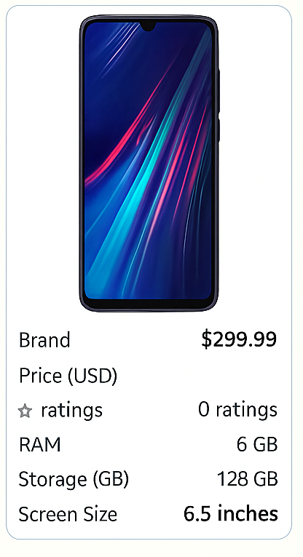
📦 Data Overview & Research Objectives
Dataset: Amazon Cell Phones Dataset from Kaggle
Sample Size: 1,000+ smartphone listings
Time Range: November 2005 – May 2025
Key Variables:
brand: The smartphone’s manufacturer or brand name
price_USD: The listed price in US dollars
ram_GB: RAM size in gigabytes
memory_storage_capacity_GB: Storage size in gigabytes
rating_out_of_5_stars: Average customer rating (1–5 scale)
number_of_reviews_count: Number of customer reviews
standing_screen_display_size_inches: Screen size in inches
📌Goal: Investigate whether technical specifications or brand dominate smartphone pricing.

Slide 4



🔬 Analytical Methods -Here's how I approached the question—step by step, like a detective.
📌 Each method answers a different part of the main research question—from visual insight to causal inference to consumer preference.
Binning & Averaging
Grouped RAM, storage, and screen size into logical bins
Compared average price per bin to observe correlation
✅ Used for intuitive trend exploration; helpful for visualizing nonlinear patterns, but limited in precision.
2. Multivariate Regression
Dependent variable: price_US
Independent variables: RAM, Storage, Rating, Brand (dummy)
Measured each variable’s contribution to price
✅ Quantifies the isolated effect of each variable; statistically rigorous but assumes linear relationships and no omitted variables.
3. Value Score Construction
Metric: (rating / price) * log(review_count + 1)
Identified top “value for money” smartphones
✅ Designed to detect “hidden gems” in the market; however, score may favor unpopular, ultra- cheap devices with distorted relevance.

Slide 5
📊 Spec vs Price – Visual Trend
Binning Result:
Higher RAM, storage, and screen size correlate weakly with price
Specs alone do not explain large price differences
🔍 Conclusion : Specs weakly influence price

Slide 6
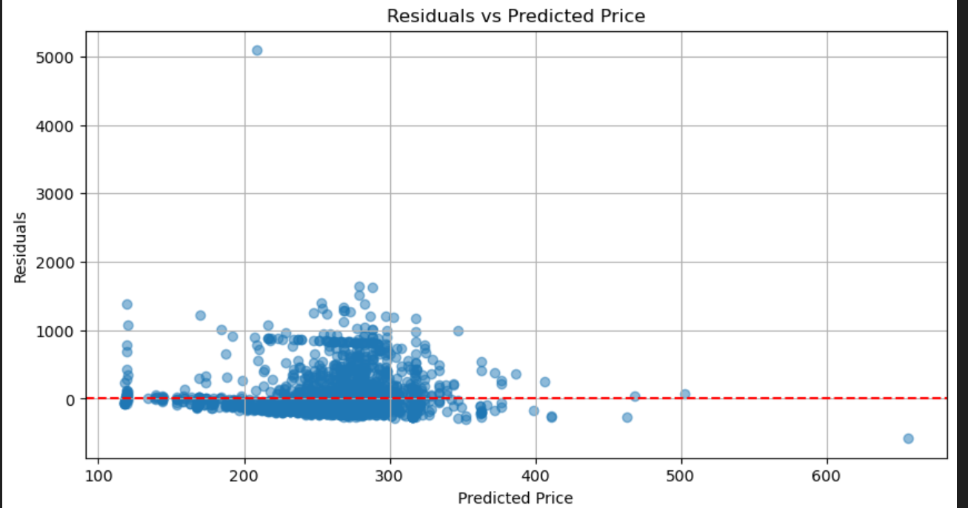
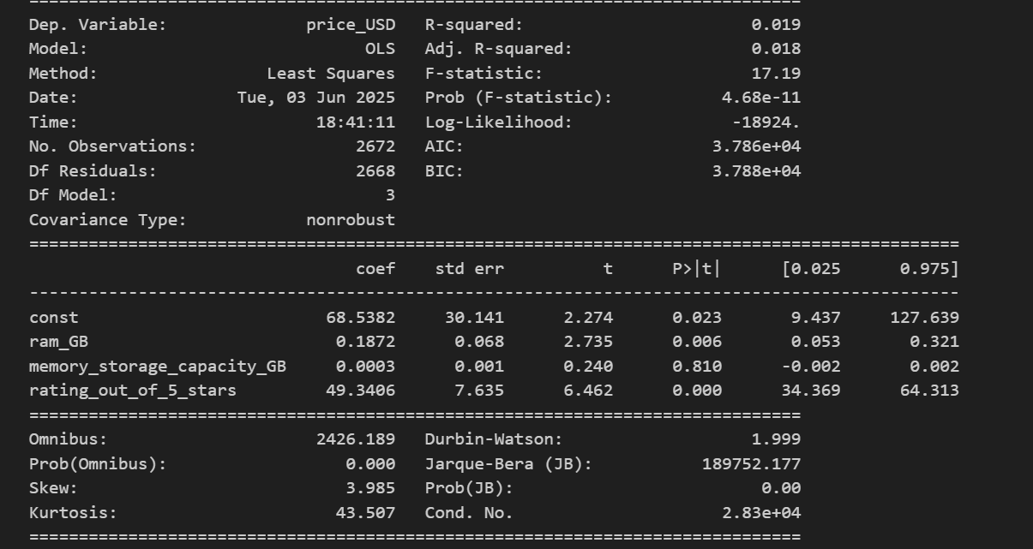
📉 Spec vs Price – Regression (without brand)
Regression Result (without brand):
RAM & Rating: Small positive impact on price
Storage: Negligible effect
R² = 0.019 → Low explanatory power
🔍 Conclusion : Brand explains far more than specs.

Slide 7
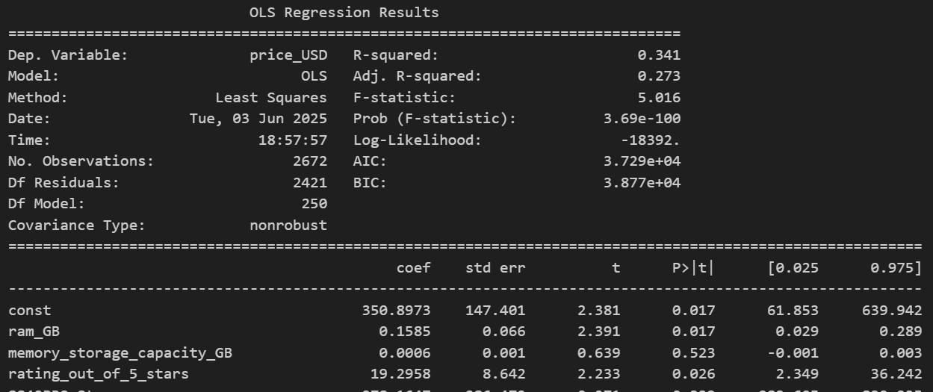
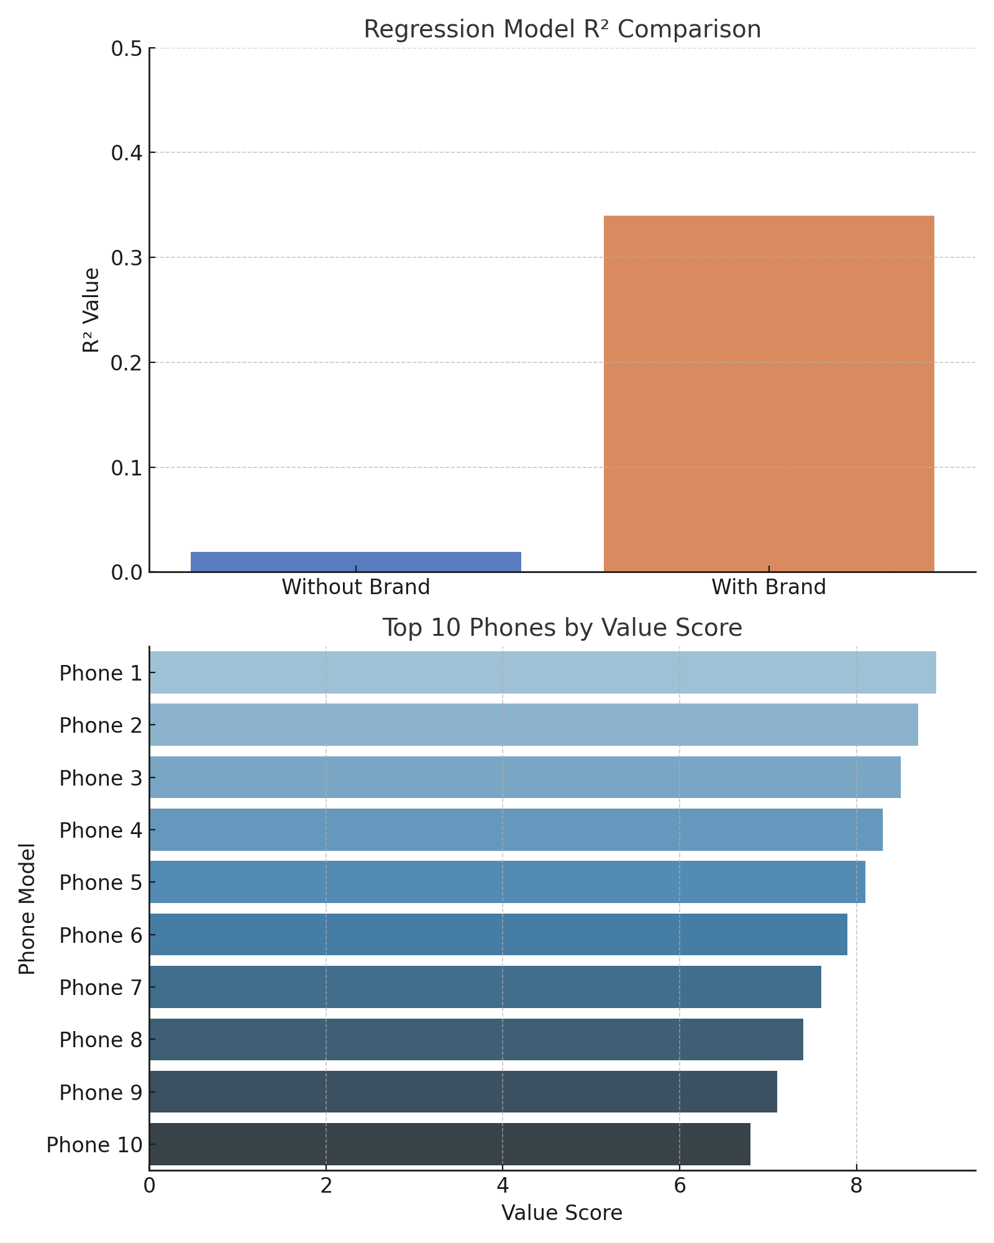
Spec vs Price – Regression(with brand)
Regression Result (with brand):
R² improves to 0.34
Brand becomes the dominant variable
RAM remains significant; Storage still weak
Conclusion :🔍 Brand explains far more than specs.

Slide 8
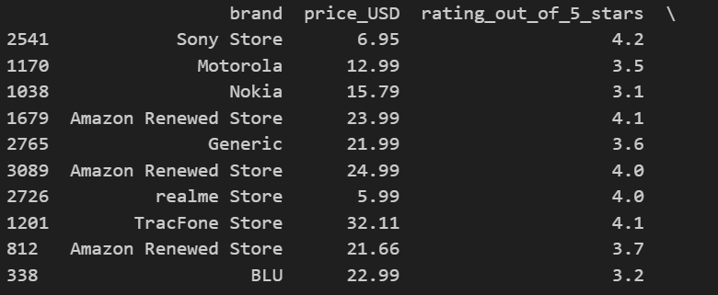
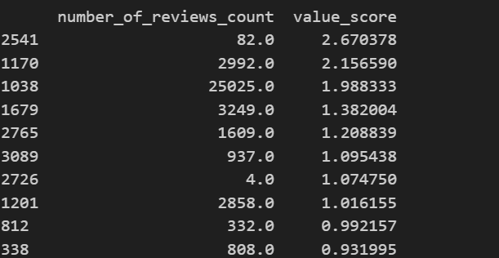
💡 Do High Ratings + Low Price = “Best Value”?
Top 20 phones by value score were:
Mostly ultra-low-cost, unknown Brands
Examples: TracFone, Amazon Renewed, budget Samsung models
Insight:
Rating × Price metrics do not reflect actual consumer favorites
→ Value ≠ Popularity
Some had low ratings (3.0–4.2), not true “top picks”
Conclusion :🧠Value ≠ Popularity

Slide 9
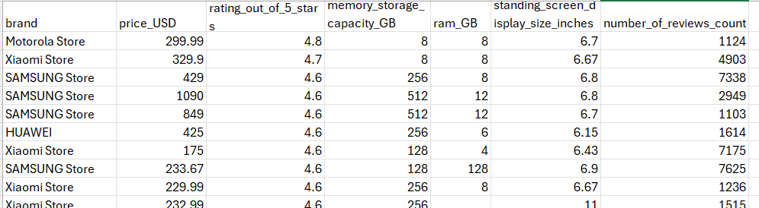
🎯 High Ratings Belong to Brands
🧪 Analysis Goal : High rating (≥4.6) + High review count (≥1000)
📊 Result :
✅ All mainstream brands
✅ Strong specs
✅ Mixed prices
🧠 Conclusion : Brand = Trust

Slide 10
🧩 Key Takeaways (Slide before limitations)
Finding | Insight
📉 Specs have weak correlation with price | Binning & regression confirm weak impact
🧠 Brand explains most price variance | R² jumped from 0.019 → 0.34
💡 “Value” phones are often unpopular | Value score can be misleading
🎯 High-rated phones = Familiar brands | Ratings reflect trust more than specs

Slide 11

Limitations & Future Directions
🔍 Future Directions：
Focus on Mainstream Brands
Narrow the scope to popular manufacturers like Samsung, Huawei, and Xiaomi to better isolate brand premium and spec-based pricing patterns.
Segment by Product Tier & Time
Analyze flagship and budget lines separately, and apply 5-year time windows to capture changes in value perception over time.
Add Nonlinear Models
Explore tree-based or interaction-aware models to capture diminishing returns (e.g. 2→4GB RAM ≠ 12→14GB).
❗ Limitations：
Platform Bias
The dataset is based solely on Amazon, which may not reflect the global smartphone market.
Notably, Apple devices are underrepresented, weakening the generalizability of conclusions.
Time Span Distortion
The data spans 2005–2025, during which smartphone technology and consumer behavior evolved dramatically.
This long window may dilute the real impact of specs on price.
Missing Variables
Key factors like release year, product tier (e.g. flagship vs budget), and contract type were not included.
Their absence may bias the estimation of spec and brand effects.

Slide 12
🎯 Final Takeaway
Pricing isn't always logical—it's psychological. Specs speak, but brand convinces.
This project taught me not just how to analyze data, but how to challenge assumptions with evidence.
🙌 Thank you.

