Slide 1
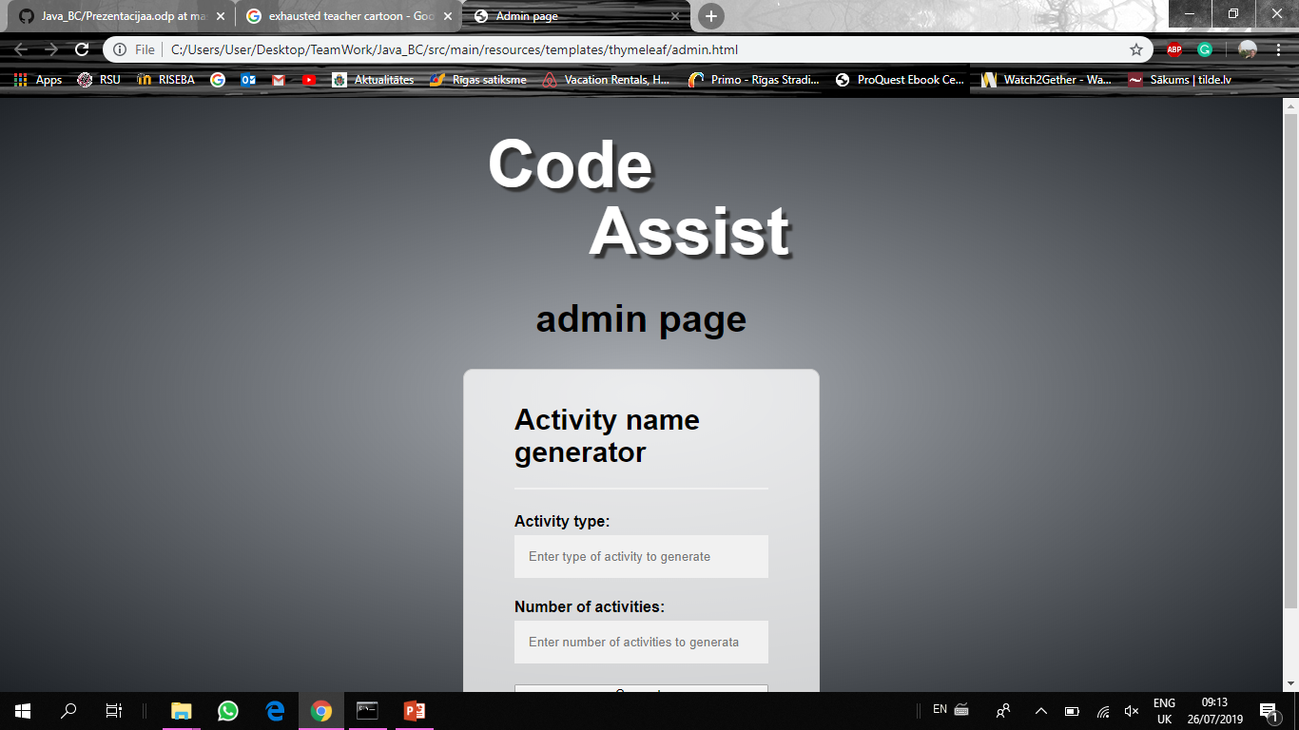
Team No5
Raivo Lapins
Elina Rostoka
Emils Kristians Verins
Janis Vigulis

Slide 2


Business case
Problem:
  Same student issues
  No silent platform for communication
Requirements:
  Easy to use
  Flexible
Extra gains:
  Ability to evaluate
  engagement

Slide 3
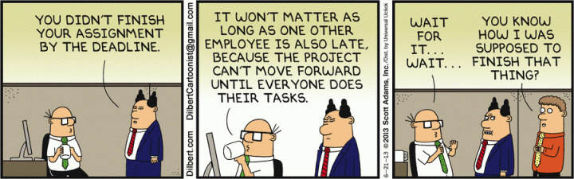
Project management
Task division:
  Task assignment and commit check: 0,25
  Frontend: 1,5
  Backend: 2,25
Tools:
  GitHub
  Automatic Kanban

Slide 4
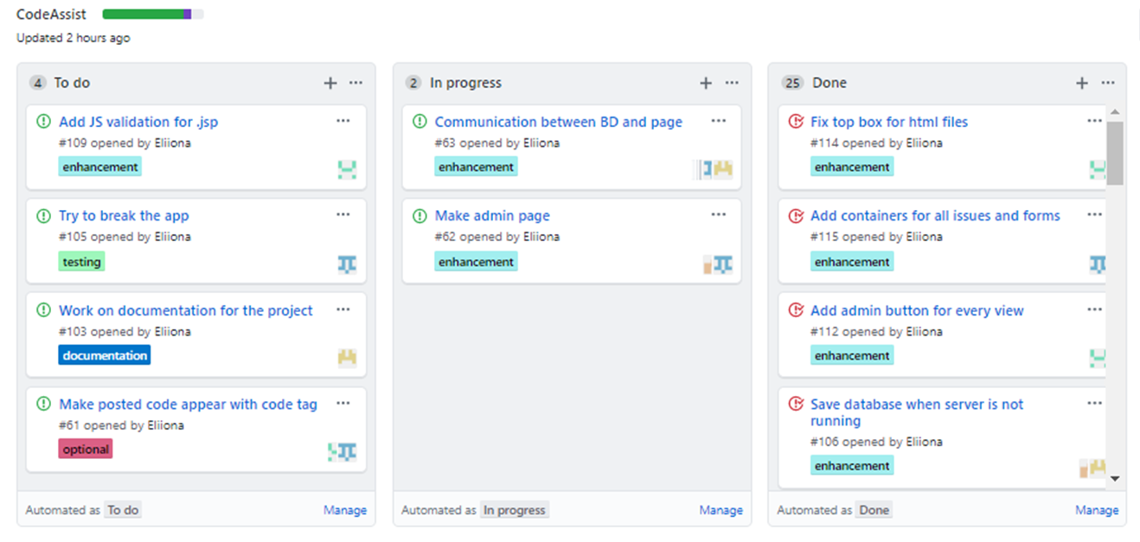
Task management with automatic Kanban

Slide 5
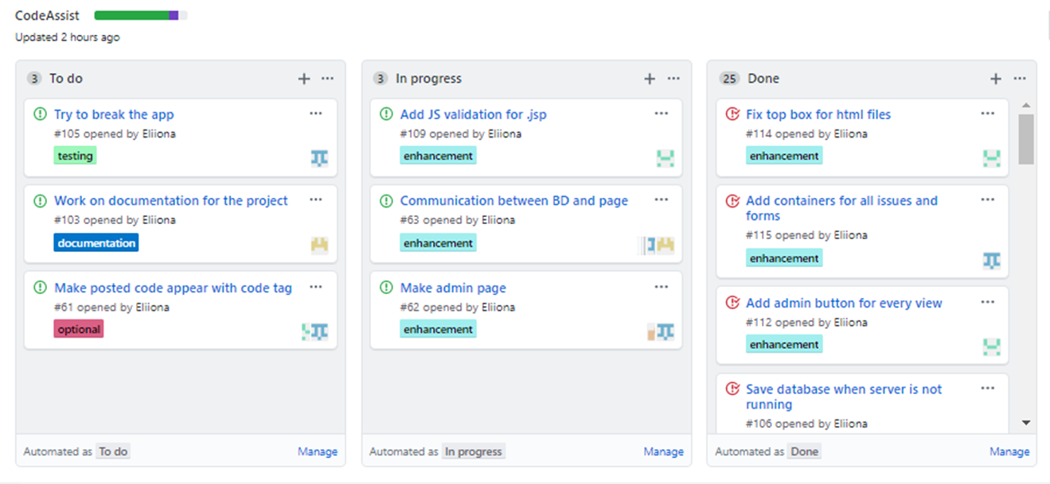
Task management with automatic Kanban

Slide 6
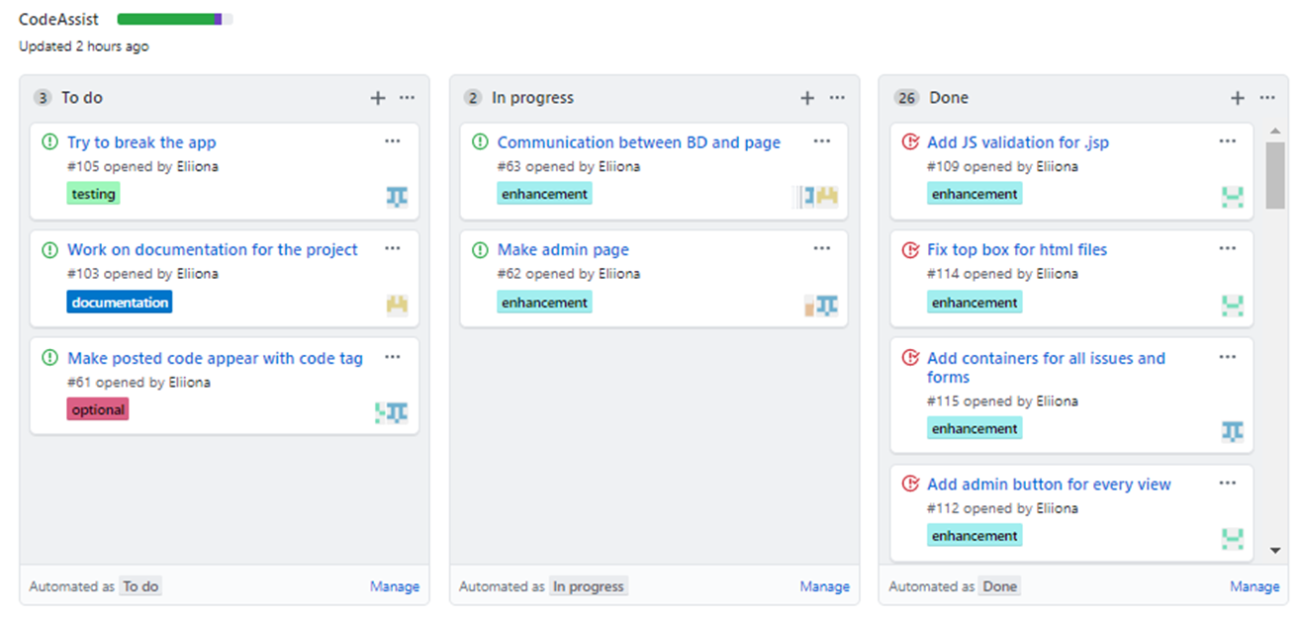
Task management with automatic Kanban

Slide 7
System design
Spring boot
Bootstrap
JAVA, JavaScript, HTML, CSS
Maven
Thymeleaf, Spring Security, JPA

Slide 8
System data model
H2 database
User, Issue, Reply and their relationship
Persistent database

Slide 9
Manual testing

Slide 10
System building and deployment
DevTools
Maven build
Runnable war file
Runs on JRE

Slide 11
Documentation
Web application setup instructions
Client side instructions
Administrative documentation

Slide 12
System demonstration
192.168.8.xx:8080

Slide 13
Main features of the project
Secure login and browsing
H2 long-term database
Admin page
Relationship between objects
Frontend, backend input validation

Slide 14
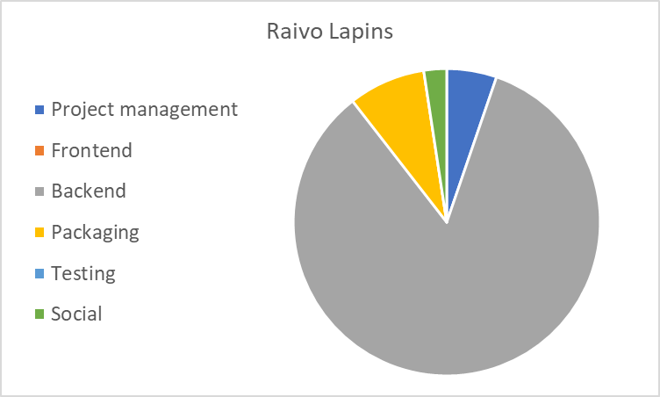
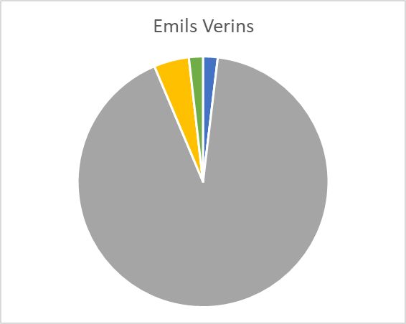
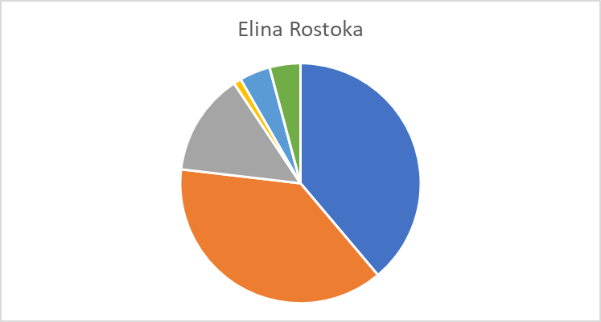
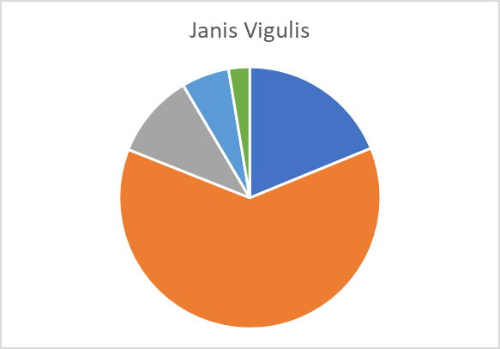
Member contribution

Slide 15
Member contribution
 | Raivo Lapins | Emils Verins | Janis Vigulis | Elina Rostoka
Github setup
Kanban
Thymeleaf
Busines logic design
UI backbone
UI style
UI functionality

Slide 16
Member contribution
 | Raivo Lapins | Emils Verins | Janis Vigulis | Elina Rostoka
Project setup
Database
Business data model implementation
Project deployment
Project configuration
Documentation

Slide 17
Member contribution
 |  | Emils Verins | Janis Vigulis | Elina Rostoka
Security
Controllers
Manual testing
Made fun of frontend
Made fun of backend

Slide 18
Mid-term commitments
Database on server
User registration functionality and authorised browsing security, Issue closing and commenting functionality
Admin page for updating activity list and clearing database of previous users and their issues
Manual testing functionality and database testing using one laptop as server
Project ready for next bootcamp

Slide 19
Biggest challenges
Properly using GitHub
Understanding Spring Boot modules
Workflow management
Steep learning curve
Database configuration
Relation between frontend and backend technologies

Slide 20
Future work
Statistics for admin
Upvote system
Nested reply system
One click deployment
Automatic testing
Chat function
Dynamic and improved UI

