Slide 1

Association Rules mining
Princess of Data Mining
Notes:
This is an alternative title page with space for images.

Slide 2
Reading
Jiawei Han, Micheline Kamber and Jian Pei. (2012) Data Mining: Concepts and Techniques, third edition, Morgan Kaufmann. ISBN: 978-0123814791. (or later edition) Chapter 6
Notes:
Slide for body text

Slide 3
Outline
ARM Background
Apriori
FP-Tree
Various ARM
Constraint ARM
Notes:
Slide for body text

Slide 4
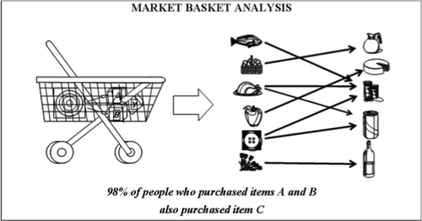
Association Rules Mining
Source: https://au.mathworks.com/
Notes:
Slide for body text

Slide 5
Association Rules Mining
 | I1 | I2 | I3 | I4 | I5 | I6 | I7 | I8 | I9
ID1
ID2
ID3
ID4
ID5
I199999 | I200000
Notes:
Slide for body text

Slide 6
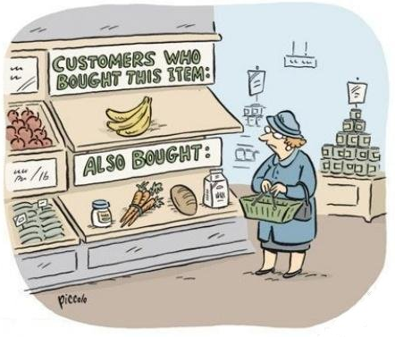
ARM - Cartoon
Source: http://gerardnico.com/wiki/data_mining/association/
Notes:
Slide for body text

Slide 7
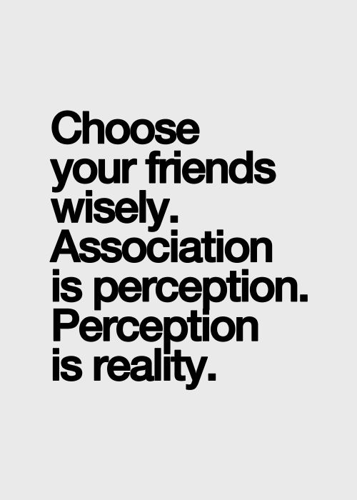
ARM - Quote
Source: https://au.pinterest.com/pin/150378075037497787/
Notes:
Slide for body text

Slide 8
ARM – Important Terms
Frequent patterns
Support
Closed patterns
Lift
Confidence
Strong rules
Max patterns
Notes:
Slide for body text

Slide 9
Association Rules Mining
Concerned with the discovery of significant associations among data items.
Called as “affinity analysis”, “market basket analysis” or “frequent pattern analysis”
Finding inherent regularities (associations) from frequent itemsets (= association rules)
  What products were often purchased together?
Study of “what goes with what”
  Customers who bought X also bought Y
Applications
  Floor/shelf planning, cross-marketing, catalogue design, targeted marketing etc
Notes:
Slide for body text

Slide 10
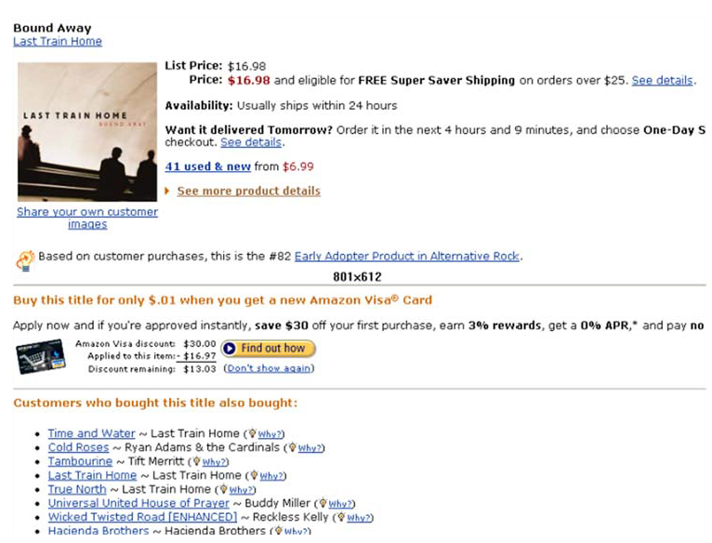
Used in many recommender systems
Notes:
Slide for body text

Slide 11
Transaction Database
TID | Item
100 | Apple
100 | Coke
100 | DVD
200 | Bread
200 | Coke
200 | Egg
300 | Apple
300 | Bread
300 | Coke
300 | Egg
400 | Bread
400 | Egg
TID (Transaction ID) | Items
100 | Apple, Coke, DVD
200 | Bread, Coke, Egg
300 | Apple, Bread, Coke, Egg
400 | Bread, Egg
TID | Apple | Bread | Coke | DVD | EGG
100 | 1 | 0 | 1 | 1 | 0
200 | 0 | 1 | 1 | 0 | 1
300 | 1 | 1 | 1 | 0 | 1
400 | 0 | 1 | 0 | 0 | 1
Notes:
Slide for body text

Slide 12
Transaction Database
ID | Income | City | Married | Age | Own House
000 | 20500 | Cairns | Y | 21 | Y
001 | 100000 | Brisbane | Y | 33 | N
002 | 54490 | Cairns | N | 42 | N
… | … | … | … | … | …
TID | Income <50000 | Income >50000 | Brisbane | Married | Age <40 | Age >40 | Own House
000 | 1 | 0 | 0 | 1 | 1 | 0 | 1
001 | 0 | 1 | 1 | 1 | 1 | 0 | 0
002 | 0 | 1 | 0 | 0 | 0 | 1 | 0
… | … | … | … | … | … | … | …
Notes:
Slide for body text

Slide 13
Itemsets and Association Rules
An itemset is a set of items
  - E.g., {Apple, Coke, Bread} is an itemset
A k-itemset is an itemset with k items.
Given a dataset D, an itemset X has a (frequency) count in D
An association rule is about relationships between two disjoint itemsets X and Y.
  X ⇒ Y (no overlap between X and Y)
  X is the antecedent, the initial assumption.
  Y is the consequent, something else that may happen too.
  {Apple}→{Coke, Bread} is an association rule
It presents the pattern when X occurs, Y also occurs
Notes:
Slide for body text

Slide 14
Use of Association Rules
Association rules do not represent any sort of causality or correlation between the two itemsets.
  X ⇒ Y does not mean X causes Y, so no Causality
  X ⇒ Y can be different from Y ⇒ X, unlike correlation
Association rule types
  Actionable Rules – contain high-quality, actionable information
  Trivial Rules – information already well known by those familiar with the business
  Inexplicable Rules – no explanation and do not suggest action
  (Trivial and Inexplicable Rules occur most often)
Notes:
Slide for body text

Slide 15
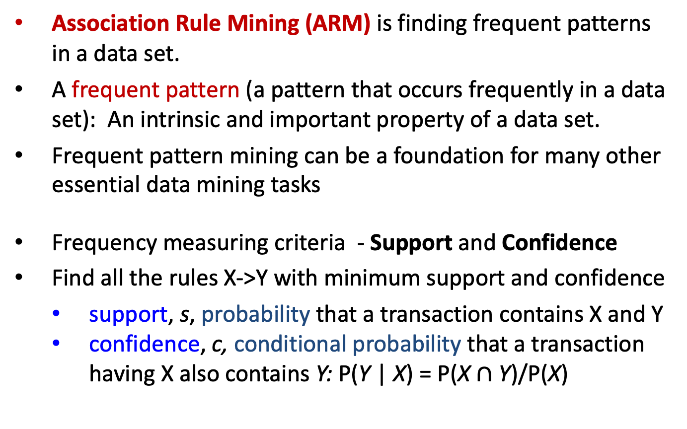
Measuring the strength of a rule
Association Rule Mining (ARM) is finding frequent patterns in a data set.
A frequent pattern (a pattern that occurs frequently in a data set): An intrinsic and important property of a data set.
Frequent pattern mining can be a foundation for many other essential data mining tasks
Frequency measuring criteria - Support and Confidence
Find all the rules X->Y with minimum support and confidence
  support, s, probability that a transaction contains X and Y
  confidence, c, conditional probability that a transaction having X also contains Y: P(Y | X) = P(X $∩$ Y)/P(X)
Notes:
Slide for body text

Slide 16
Support and Confidence
Person
banana
coffee
milk
chicken
a
1
0
0
0
b
1
1
0
0
c
0
0
0
1
d
1
1
1
1
e
0
1
1
0
f
1
1
1
0
Association between Banana and Chicken ?
Association Rule: banana → chicken
  - Support =
  - Confidence =
Notes:
Slide for body text

Slide 17
Support and Confidence
Person
banana
coffee
milk
chicken
a
1
0
0
0
b
1
1
0
0
c
0
0
0
1
d
1
1
1
1
e
0
1
1
0
f
1
1
1
0
Association between Banana and Chicken ?
Association Rule: banana → chicken
  - Support = 1/6 (Only 1 person got both)
  - Confidence = 25% (Of the 4 banana buyers, 1 also got chicken)
Notes:
Slide for body text

Slide 18
Support and Confidence
Person
banana
coffee
milk
chicken
a
1
0
0
0
b
1
1
0
0
c
0
0
0
1
d
1
1
1
1
e
0
1
1
0
f
1
1
1
0
Association between Coffee and Milk ?
Association Rule: Coffee → Milk
  - Support =
  - Confidence =
Notes:
Slide for body text

Slide 19
Support and Confidence
Person
banana
coffee
milk
chicken
a
1
0
0
0
b
1
1
0
0
c
0
0
0
1
d
1
1
1
1
e
0
1
1
0
f
1
1
1
0
Association between Coffee and Milk ?
Association Rule: Coffee → Milk
  - Support = 50% (Half of all people got both)
  - Confidence = 75% (Of the 4 coffee buyers, 3 also got milk)
Notes:
Slide for body text

Slide 20
Support and Confidence
People want strong associations.
  Big support → the rule includes many people who do both X and Y.
  High confidence → if someone does X, there is a good chance they will also do Y.
Set limits on what is a “strong” rule.
  Minimum support, minimum confidence.
  We report all rules that satisfy these limits.
Notes:
Slide for body text

Slide 21

Think/Pair/Share
What happens with large minimum support?
What happens with low minimum confidence?
What are strong rules?
The question is how to efficiently find all strong rules from a massive transactional DB?
Notes:
Slide for body text

Slide 22
Outline
ARM Background
Apriori
FP-Tree
Various ARM
Constraint ARM
Notes:
Slide for body text

Slide 23
How to Mine?
Downward closure property
  Any subset of a frequent itemset must be frequent
  If {coffee, sugar, banana} is frequent, so is {coffee, sugar}
    i.e., every transaction having {milk, coffee, sugar} also contains {milk, coffee}
    E.g., if {coffee, sugar, banana} occurs 20 times, it would be impossible for {coffee, sugar} to occur < 20 times
Scalable ARM methods: Two major approaches
  Apriori
  Frequent pattern growth (FP-growth)
Notes:
Slide for body text

Slide 24
Apriori
Apriori pruning principle:
If there is any itemset which is infrequent, its superset should not be generated or tested!
Method:
  Initially, scan DB once to get frequent 1-itemset
  Generate length (k+1) candidate itemsets from length k frequent itemsets
  Test the candidates against DB
  Terminate when no frequent or candidate set can be generated
Notes:
Slide for body text

Slide 25
Apriori Algorithm – An Example
Sup_{min} = 2
Itemset | sup
{A} | 2
{B} | 3
{C} | 3
{D} | 1
{E} | 3
Database TDB
Itemset | sup
{A} | 2
{B} | 3
{C} | 3
{E} | 3
L₁
Tid | Items
10 | A, C, D
20 | B, C, E
30 | A, B, C, E
40 | B, E
C₁
1st scan
C₂
Itemset | sup
{A, B} | 1
{A, C} | 2
{A, E} | 1
{B, C} | 2
{B, E} | 3
{C, E} | 2
C₂
Itemset
{A, B}
{A, C}
{A, E}
{B, C}
{B, E}
{C, E}
L₂
Itemset | sup
{A, C} | 2
{B, C} | 2
{B, E} | 3
{C, E} | 2
2nd scan
C₃
Itemset
{B, C, E}
3rd scan
L₃
Itemset | sup
{B, C, E} | 2
Notes:
Slide for body text

Slide 26
Details of Apriori
Generate candidates
  Step 1: self-joining L_{k}
  Step 2: pruning
Count supports of candidates
Example of Candidate-generation
  L₃={abc, abd, acd, ace, bcd}
  Self-joining: L₃⨝ L₃
    abcd from abc and abd
    acde from acd and ace
  Pruning:
    acde is removed because ade is not in L₃
  C₄={abcd}
Notes:
Slide for body text

Slide 27
Apriori Rule Generation - Example
Transaction Database Initial Candidates
TID | Items
100 | Apple, Coke, DVD
200 | Bread, Coke, Egg
300 | Apple, Bread, Coke, Egg
400 | Bread, Egg
Itemset | Support
{Apple} | 2
{Bread} | 3
{Coke} | 3
{DVD} | 1
{Egg} | 3
Notes:
Slide for body text

Slide 28
Apriori Rule Generation - Example
MinSupp:50%
Transaction Database
C1
F1
MinConf:90%
TID | Items
100 | Apple, Coke, DVD
200 | Bread, Coke, Egg
300 | Apple, Bread, Coke, Egg
400 | Bread, Egg
Itemset | Support
{Apple} | 2
{Bread} | 3
{Coke} | 3
{DVD} | 1
{Egg} | 3
Itemset | Support
{Apple} | 2
{Bread} | 3
{Coke} | 3
{Egg} | 3
C3
C2
F2
Itemset | Support
{Apple,Bread} | 1
{Apple,Coke} | 2
{Apple,Egg} | 1
{Bread,Coke} | 2
{Bread,Egg} | 3
{Coke,Egg} | 2
Itemset | Support
{Bread,Coke,Egg} | 2
Itemset | Support
{Apple,Coke} | 2
{Bread,Coke} | 2
{Bread,Egg} | 3
{Coke,Egg} | 2
F3
Itemset | Support
{Bread,Coke,Egg} | 2
Notes:
Slide for body text

Slide 29
Apriori Rule Generation - Example
MinSupp:50%
Transaction Database
C1
F1
MinConf:90%
TID | Items
100 | Apple, Coke, DVD
200 | Bread, Coke, Egg
300 | Apple, Bread, Coke, Egg
400 | Bread, Egg
Itemset | Support
{Apple} | 2
{Bread} | 3
{Coke} | 3
{DVD} | 1
{Egg} | 3
Itemset | Support
{Apple} | 2
{Bread} | 3
{Coke} | 3
{Egg} | 3
C3
C2
F2
Itemset | Support
{Apple,Bread} | 1
{Apple,Coke} | 2
{Apple,Egg} | 1
{Bread,Coke} | 2
{Bread,Egg} | 3
{Coke,Egg} | 2
Itemset | Support
{Bread,Coke,Egg} | 2
Itemset | Support
{Apple,Coke} | 2
{Bread,Coke} | 2
{Bread,Egg} | 3
{Coke,Egg} | 2
F3
Itemset | Support
{Bread,Coke,Egg} | 2
Frequent Itemsets
Notes:
Slide for body text

Slide 30
Apriori Rule Generation - Example
MinSupp:50%
Transaction Database
Frequent Itemsets
MinConf:90%
TID | Items
100 | Apple, Coke, DVD
200 | Bread, Coke, Egg
300 | Apple, Bread, Coke, Egg
400 | Bread, Egg
1-Itemset
{Apple}
{Bread}
{Coke}
{Egg}
2-Itemset
{Apple,Coke}
{Bread,Coke}
{Bread,Egg}
{Coke,Egg}
3-Itemset
{Bread,Coke,Egg}
All possible Association Rules are:
Apple->Coke
Coke->Apple
Bread->Coke
Coke->Bread
Bread->Egg
Egg->Bread
Coke->Egg
Egg->Coke
Bread->{Coke,Egg}
Coke->{Bread,Egg}
Egg->{Bread,Coke}
{Coke,Egg}->Bread
{Bread,Egg}->Coke
{Bread,Coke}->Egg
Final Association Rules found
(Rules having more than minimum confidence)
Notes:
Slide for body text

Slide 31
Bottleneck of Apriori
Challenges
  Multiple scans of transaction database
  Huge number of candidates
  Tedious workload of support counting for candidates
Improving Apriori: general ideas
  Reduce passes of transaction database scans
  Shrink number of candidates
  Facilitate support counting of candidates
Notes:
Slide for body text

Slide 32
Think/Pair/Share
Imagine, you are a manger of COLES. You do have a lot of potato chips in stock in your warehouse, but you do not have banana in stock.
You are planning to boost the sales of potato chips and also would like to figure out what products would be affected if the store discontinues selling banana.
How ARM could be used for you to answer these business questions?
Notes:
Slide for body text

Slide 33
Outline
ARM Background
Apriori
FP-Tree
Various ARM
Constraint ARM
Notes:
Slide for body text

Slide 34
FP-Tree
Idea: Frequent pattern growth
  Recursively grow frequent patterns by pattern and database partition
Method
  For each frequent item, construct its conditional pattern-base, and then its conditional FP-tree
  Repeat the process on each newly created conditional FP-tree
  Until the resulting FP-tree is empty, or it contains only one path—single path will generate all the combinations of its sub-paths, each of which is a frequent pattern

Slide 35
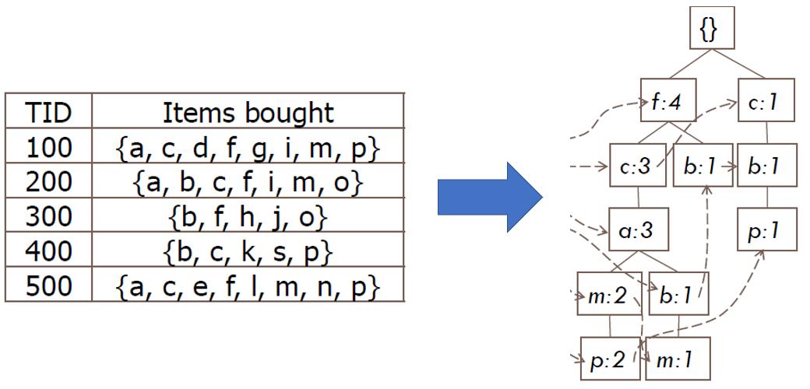
Example for FP-Tree

Slide 36
FP-Tree
Starting at the frequent item header table in the FP-tree
Traverse the FP-tree by following the link of each frequent item p
Accumulate all of transformed prefix paths of item p to form p’s conditional pattern base
{}
Header Table
Item frequency head
f 4
c 4
a 3
b 3
m 3
p 3
f:4
c:1
Conditional pattern bases
item cond. pattern base
c f:3
a fc:3
b fca:1, f:1, c:1
m fca:2, fcab:1
p fcam:2, cb:1
c:3
b:1
b:1
a:3
p:1
m:2
b:1
p:2
m:1

Slide 37
FP-Tree
For each pattern-base
  Accumulate the count for each item in the base
  Construct the FP-tree for the frequent items of the pattern base
m-conditional pattern base:
  fca:2, fcab:1
{}
Header Table
Item frequency head
f 4
c 4
a 3
b 3
m 3
p 3
f:4
c:1
All frequent patterns relate to m
m,
fm, cm, am,
fcm, fam, cam,
fcam
{}
c:3
b:1
b:1

f:3

a:3
p:1
m:2
b:1
c:3
p:2
m:1
a:3
m-conditional FP-tree

Slide 38
Aprior vs. FP-tree
Data set T25I20D10K

Slide 39
Problem: Too Many Patterns
Any sub-patterns of a frequent pattern is also a frequent pattern.
  - If {A, B, C} is a frequent set, {A}, {B}, {C}, {A,B}, {A,C},{B,C}, {A,B,C} are also frequent sets
A long pattern contains a combinatorially large number of sub-patterns.
For example, the set {a₁, …, a₁₀₀} contains this many possible sub-sets:
Solution: Mine only closed patterns or max patterns instead.
→ This reduces the number of possibilities.
Notes:
Slide for body text

Slide 40
Closed Patterns
An itemset X is closed if:
X is frequent (has enough support) and
There exists no super-pattern Y ⊃ X, with the same support as X
Example of 2 itemsets:
  X: 50% of people buy milk and coffee.
  Y: 50% of people buy milk, coffee, sugar.
  Here, Y contains X, written Y ⊃ X (similar to Y > X) as Y has more items. Y has the same support as X.
  Thus X is not a closed pattern
Closed pattern is a lossless compression of frequent patterns (reducing the number of patterns and rules)
Notes:
Slide for body text

Slide 41
Mining Closed Patterns
Flist: list of all frequent items in support ascending order
  Flist: d-a-f-e-c
Divide search space
  Patterns having d
  Patterns having d but no a, etc.
Find frequent closed pattern recursively
  Every transaction having d also has cfa → cfad is a frequent closed pattern
Min_sup=2
TID | Items
10 | a, c, d, e, f
20 | a, b, e
30 | c, e, f
40 | a, c, d, f
50 | c, e, f

Slide 42
Max Patterns
An itemset X is a max pattern if X is frequent and there exists no frequent super-pattern Y כ X.
Mining max-patterns
  1st scan: find frequent items
    A,B,C,D,E
  2nd scan: find support for
    AB, AC, AD, AE: ABCDE
    BC,BD,BE: BCDE
    CD,CE: CDE
    DE:
Since BCDE is a max-pattern, no need to check BCD, BDE, CDE in later scan
Tid | Items
10 | A,B,C,D,E
20 | B,C,D,E,
30 | A,C,D,F
Potential max-patterns
Notes:
Slide for body textTid
Items
10
A,B,C,D,E
20
B,C,D,E,
30
A,C,D,F
Tid
Items
10
A,B,C,D,E
20
B,C,D,E,
30
A,C,D,F

Slide 43
Think/Pair/Share
Exercise. DB = {<a₁, …, a₁₀₀>, < a₁, …, a₅₀>}
  Min_sup = 1.
What is the set of closed itemset?
  <a₁, …, a₁₀₀>: 1
  < a₁, …, a₅₀>: 2
What is the set of max-pattern?
  <a₁, …, a₁₀₀>: 1
What is the set of all patterns?
  !!
Notes:
Slide for body text

Slide 44
Outline
ARM Background
Apriori
FP-Tree
Various ARM
Constraint ARM
Notes:
Slide for body text

Slide 45
ARM Issues in Practice
Possible ways of improving performance of the algorithms
Implementation techniques
  Use of good data structures
  Fast implementation of basic operations
Algorithm improvement
  Finding algorithms that are more efficient
Use of parallel processing
Sampling the transaction databases
Notes:
Slide for body text

Slide 46
ARM Issues in Practice
Interactive Discovery
In ARM, the user plays an important role in the process
The user is responsible for setting the initial minimum support and confidence thresholds
During the discovery, the user may decide to further fine-tune the thresholds
The user can specify what items are to appear on either or both sides of the resulting rules. (for different purposes)
  (e.g.) {X} -> {nappies} or {nappies} -> {X} or {Bear} -> {nappies}
The user can exploit a category hierarchy of some kind among items.
  (e.g.) Instead of “Bread → Coke”, “Bakery products” -> “Soft drinks”
Notes:
Slide for body text

Slide 47
Various Association Rules
Mining multilevel association
Mining quantitative association
Mining interesting correlation patterns

Slide 48
Multi-level ARM
Items often form hierarchies
Flexible support settings
  Items at the lower level are expected to have lower support
uniform support
reduced support
Level 1
min_sup = 5%
Milk
[support = 10%]
Level 1
min_sup = 5%
Level 2
min_sup = 5%
2% Milk
[support = 6%]
Skim Milk
[support = 4%]
Level 2
min_sup = 3%

Slide 49
MARM: Redundancy
Some rules may be redundant due to “ancestor” relationships between items.
Example
  milk ⇒ wheat bread [support = 8%, confidence = 70%]
  2% milk ⇒ wheat bread [support = 2%, confidence = 72%]
We say the first rule is an ancestor of the second rule.
A rule is redundant if its support is close to the “expected” value, based on the rule’s ancestor.

Slide 50
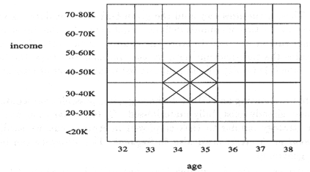
Quantitative ARM
Numeric attributes are discretized
2-D quantitative association rules: A_{quan1} ∧ A_{quan2} ⇒ A_{cat}
Example
age(X,”34-35”) ∧ income(X,”30-50K”)
⇒ buys(X,”high resolution TV”)

Slide 51
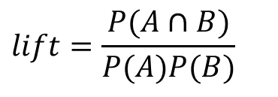
Interesting Measure: Lift
play basketball ⇒ eat cereal [40%, 66.7%] is misleading
  The overall % of students eating cereal is 75% > 66.7%.
play basketball ⇒ not eat cereal [20%, 33.3%] is more accurate, although with lower support and confidence
Measure of dependent/correlated events: lift
 | Basketball | Not basketball | Sum (row)
Cereal | 2000 | 1750 | 3750
Not cereal | 1000 | 250 | 1250
Sum(col.) | 3000 | 2000 | 5000
$$lift=\frac{P(A∩B)}{P(A)P(B)}$$

Slide 52
Lift
If lift is close to 1, this indicates that X and Y are independent of each other, so such rules are not interesting
If lift < 1, X and Y are negatively correlated, the presence of X makes Y less likely, even if they occur together frequently
If lift > 1, X and Y are positively correlated, the presence of X makes Y more likely

Slide 53
Review
Given the rule {X}→{Y}, how do we calculate
  Support?
  Confidence?
  Lift?
Does the rule {Y}→{X} have the same confidence as {X}→{Y}?

Slide 54
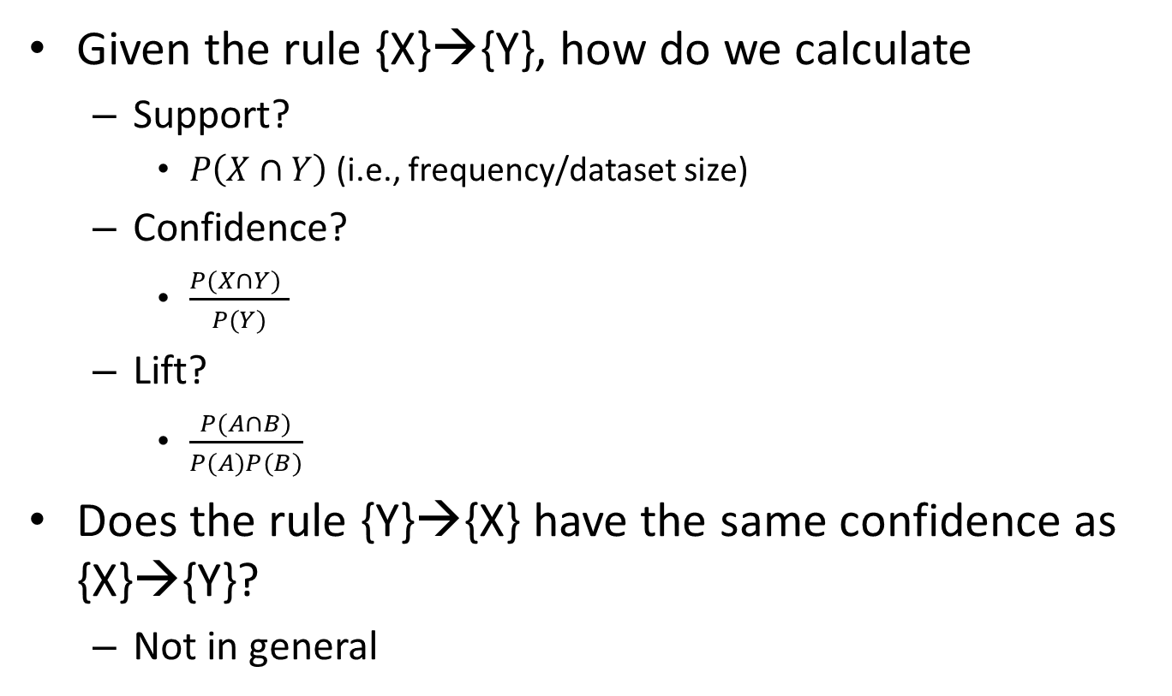
Review
Given the rule {X}→{Y}, how do we calculate
  Support?
    $P\left(X∩Y\right)$(i.e., frequency/dataset size)
  Confidence?
    $\frac{P(X∩Y) }{P(Y)}$
  Lift?
    $\frac{P(A∩B)}{P(A)P(B)}$
Does the rule {Y}→{X} have the same confidence as {X}→{Y}?
  Not in general

Slide 55
Question
A dataset contains 10,000 transactions
Frequencies:
  {CPU}: 6,000
  {GPU}: 1,500
  {CPU, GPU}: 1,200
For the rule {CPU}→{GPU} determine
  Support
  Confidence
  Lift

Slide 56
Question
A dataset contains 10,000 transactions
Frequencies:
  {CPU}: 6,000
  {GPU}: 1,500
  {CPU, GPU}: 1,200
For the rule {CPU}→{GPU} determine
  Support
    P(CPU and GPU) = 1200/10000 = 12%
  Confidence
    P(CPU and GPU)/P(CPU) = 1200/6000 = 20%
  Lift
    P(CPU and CPU)/P(CPU)P(GPU) = 0.12/(0.6×0.15) = 1.33

Slide 57
Think/Pair/Share
Tid | Items
10 | A,B,C
20 | B,C,D
30 | A,C
Give minimum support = 2 and minimum confidence = 90%
Find all frequent patterns
Find all closed patterns
Find all max patterns
Find all strong rules
Notes:
Slide for body text

Slide 58
ARM Quiz
Tid | Items
10 | A,B,C
20 | B,C,D
30 | A,C
Give minimum support = 2 and minimum confidence = 90%
Find all frequent patterns
Find all closed patterns
Find all max patterns
Find all strong rules
A | 2
B | 2
C | 3
D | 1
Frequent 1-itemset
Notes:
Slide for body text

Slide 59
ARM Quiz
Tid | Items
10 | A,B,C
20 | B,C,D
30 | A,C
Give minimum support = 2 and minimum confidence = 90%
Find all frequent patterns
Find all closed patterns
Find all max patterns
Find all strong rules
A | 2
B | 2
C | 3
D | 1
AB | 1
AC | 2
BC | 2
Frequent 1-itemset
Frequent 2-itemsets
Notes:
Slide for body text

Slide 60
ARM Quiz
Tid | Items
10 | A,B,C
20 | B,C,D
30 | A,C
Give minimum support = 2 and minimum confidence = 90%
Find all frequent patterns
Find all closed patterns
Find all max patterns
Find all strong rules
A | 2
B | 2
C | 3
D | 1
AB | 1
AC | 2
BC | 2
Can ABC be is a possible frequent 3-itemsets?
Frequent 1-itemset
Frequent 2-itemsets
Notes:
Slide for body text

Slide 61
ARM Quiz
Tid | Items
10 | A,B,C
20 | B,C,D
30 | A,C
Give minimum support = 2 and minimum confidence = 90%
Find all frequent patterns
  A, B, C, AC, BC
Find all closed patterns
  C, AC, BC
Find all max patterns
  AC, BC
Find all strong rules
  A=> C (100%), C=>A (67%)
  B=> C (100%), C=> B (67%)
A | 2
B | 2
C | 3
D | 1
AB | 1
AC | 2
BC | 2
Frequent 1-itemset
Frequent 2-itemsets
Notes:
Slide for body text

Slide 62
Outline
ARM Background
Apriori
FP-Tree
Various ARM
Constraint ARM
Notes:
Slide for body text

Slide 63
Constraint ARM
Finding all the patterns in a database autonomously? — unrealistic!
  The patterns could be too many but not focused!
Data mining should be an interactive process
  User directs what to be mined using a data mining query language (or a graphical user interface)
Constraint-based mining
  User flexibility: provides constraints on what to be mined
  System optimization: explores such constraints for efficient mining—constraint-based mining

Slide 64
Constraints in Mining
Rule constraints can be categorized as
  antimonotonic
  monotonic
  succinct
  convertible
  inconvertible
64

Slide 65
Anti-monotonicity
TDB (min_sup=2)
Anti-monotonicity
  When an intemset S violates the constraint, so does any of its superset
  sum(S.Price) ≤ v is anti-monotone
  sum(S.Price) ≥ v is not anti-monotone
Example. C: range(S.profit) ≤ 15 is anti-monotone
  Itemset ab violates C
  So does every superset of ab
TID | Transaction
10 | a, b, c, d, f
20 | b, c, d, f, g, h
30 | a, c, d, e, f
40 | c, e, f, g
Item | Profit
a | 40
b | 0
c | 20
d | 10
e | 30
f | 30
g | 20
h | 10

Slide 66
Monotonicity
TDB (min_sup=2)
Monotonicity
  When an intemset S satisfies the constraint, so does any of its superset
  sum(S.Price) ≥ v is monotone
  min(S.Price) ≤ v is monotone
Example. C: range(S.profit) ≥ 15
  Itemset ab satisfies C
  So does every superset of ab
TID | Transaction
10 | a, b, c, d, f
20 | b, c, d, f, g, h
30 | a, c, d, e, f
40 | c, e, f, g
Item | Profit
a | 40
b | 0
c | 20
d | 10
e | 30
f | 30
g | 20
h | 10

Slide 67
Succinctness
succinct
  “All and only those set guaranteed to satisfy the rule can be enumerated”
  Itemsets can be generated that satisfy the rule even before the support count starts
  Once such subset is generated, iterative testing for the constraint can be effectively avoided
  Example : min(Item.price) > 500 max(S) < 120
  average(S) > v , average(S) <v are not succinct

Slide 68
Convertibility
convertible constraints
  Constraints not satisfying to any of antimonotonic, monotonic, succinct can be made to satisfy antimonotonic, monotonic constraints by changing order of elements in the set
  Ex : Average(price) < 100
Inconvertible
  Constraints which are not convertible
  Ex : Sum(S) < v , Sum (S) > v ,
  element of set S could be any real value

Slide 69
The Apriori Algorithm — Example
Database D
L₁
C₁
Scan D
C₂
C₂
L₂
Scan D
C₃
Scan D
L₃

Slide 70
Naïve Algorithm: Apriori + Constraint
Database D
L₁
C₁
Scan D
C₂
C₂
L₂
Scan D
C₃
Scan D
L₃
Constraint:
Sum{S.price} < 5

Slide 71
The Constrained Apriori Algorithm: Push an Anti-monotone Constraint Deep
Database D
L₁
C₁
Scan D
C₂
C₂
L₂
Scan D
C₃
Scan D
L₃
Constraint:
Sum{S.price} < 5

Slide 72
The Constrained Apriori Algorithm: Push a Succinct Constraint Deep
Database D
L₁
C₁
Scan D
C₂
C₂
L₂
Scan D
not immediately
to be used
C₃
Scan D
L₃
Constraint:
min{S.price } <= 1

Slide 73
General Practice
Constraint | Antimonotone | Monotone | Succinct
v ∈ S | no | yes | yes
S ⊇ V | no | yes | yes
S ⊆ V | yes | no | yes
min(S) ≤ v | no | yes | yes
min(S) ≥ v | yes | no | yes
max(S) ≤ v | yes | no | yes
max(S) ≥ v | no | yes | yes
count(S) ≤ v | yes | no | weakly
count(S) ≥ v | no | yes | weakly
sum(S) ≤ v ( a ∈ S, a ≥ 0 ) | yes | no | no
sum(S) ≥ v ( a ∈ S, a ≥ 0 ) | no | yes | no
range(S) ≤ v | yes | no | no
range(S) ≥ v | no | yes | no
avg(S) θ v, θ ∈ { =, ≤, ≥ } | convertible | convertible | no
support(S) ≥ ξ | yes | no | no
support(S) ≤ ξ | no | yes | no

Slide 74
Classification of Constraints
Monotone
Antimonotone
Strongly
convertible
Succinct
Convertible
anti-monotone
Convertible
monotone
Inconvertible

