Slide 1
Elijah Whiting
Xcimer Pulsed Power Manufacturing Engineer Interview

Slide 2
Overview
Chemical Engineer from Widener University
Professional Background: Process engineering for Carpenter Company
  Polyurethane foam manufacturer
  Worked on a team of 3 engineers and 8 operators to produce tens of millions of dollars worth of polyurethane foam per year at one facility
  Over 60 facilities worldwide
  Developed a python based scheduling algorithm
  Project taken over by corporate for further development
  Projected ~$200K savings per year based on throughput volume and conservative reduction targets
Projects (Github.com/Elijah-w15)
  Automatch
  Catalyst
  Enzyme project
  Senior capstone project
  Hardware passion project

Slide 3
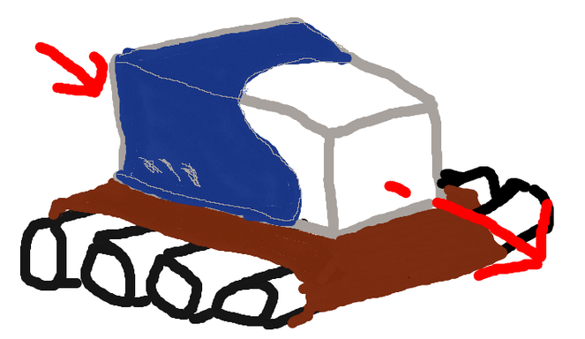
Presentation options
Carpenter scheduling algorithm
  Making foam is a continuous process
  There are 2 main reactions
  Most of the job was monitoring the quality of the foam coming out, root causing any issues, adjusting the 2 reactions to fix the issues, and working with operators to keep the operation running
  Time to reach steady state directly impacts how much waste is created
  Properties like density, height, width and color also affect waste
  Biggest driver of waste was schedule sequencing inefficiencies
  Set a conservative target based on what other plants had already proven was possible
  Traveling salesman problem
  Took tribal knowledge and systemized it
  Hand coded in a locked down environment with no library access
  Handed off to corporate for further development using libraries I did not have access to
  IP free version available on my github as Weighted-Sorting-Greedy-Algorithm

Slide 4
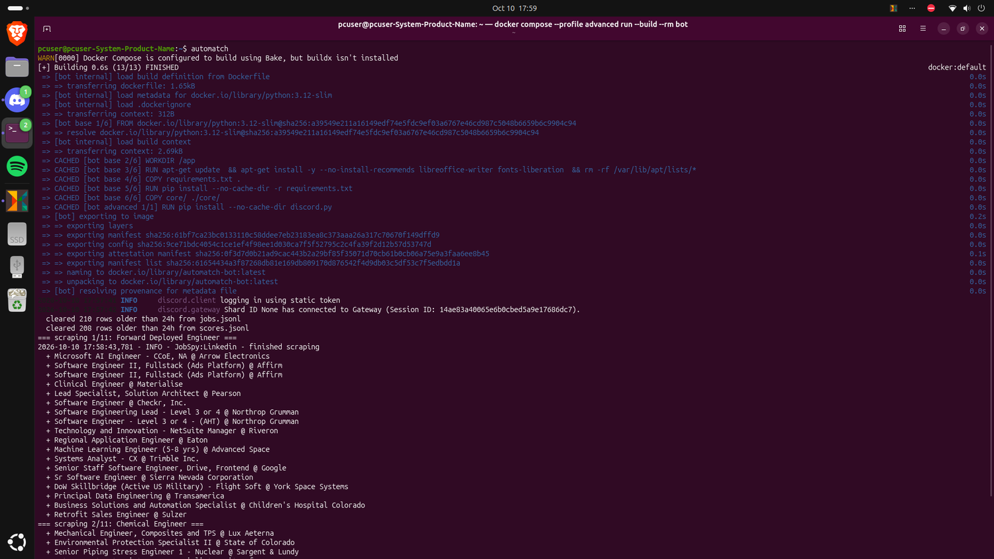
Presentation options
Automatch
  How I found this opportunity
  Custom job scraper
  Define the metrics you care about
  Scrapes and grades using a local AI via Ollama
  Outputs top 10 matches (plus wild card) based on rubric
  Custom setup wizard and uses docker to check and download dependencies
  Open source on my GitHub

Slide 5
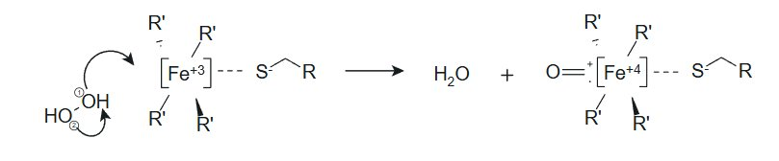
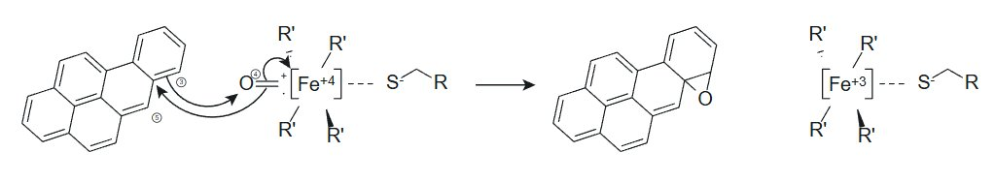
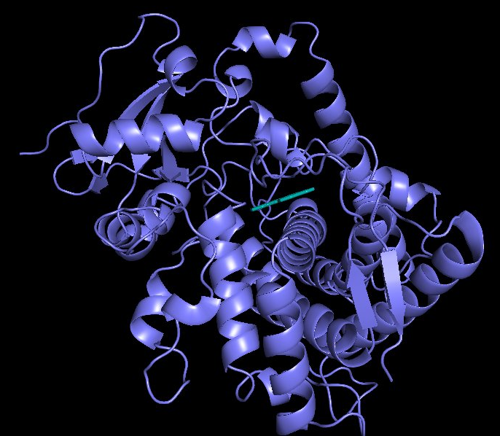
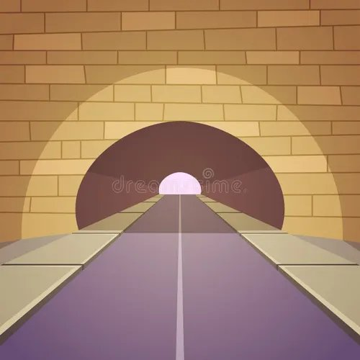
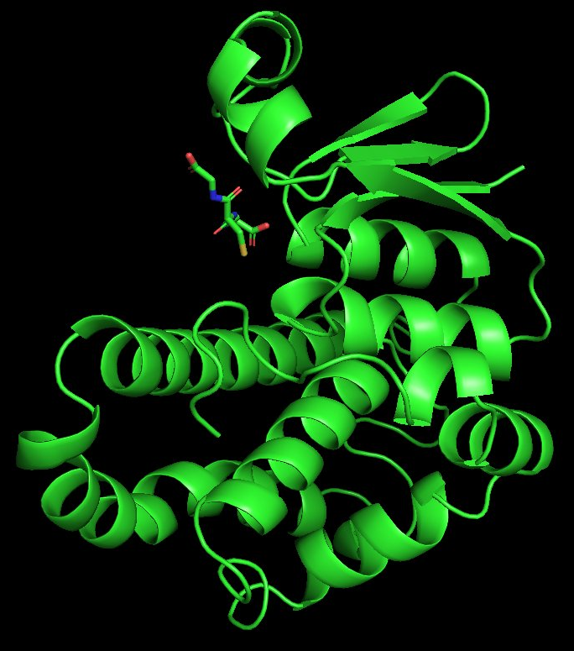
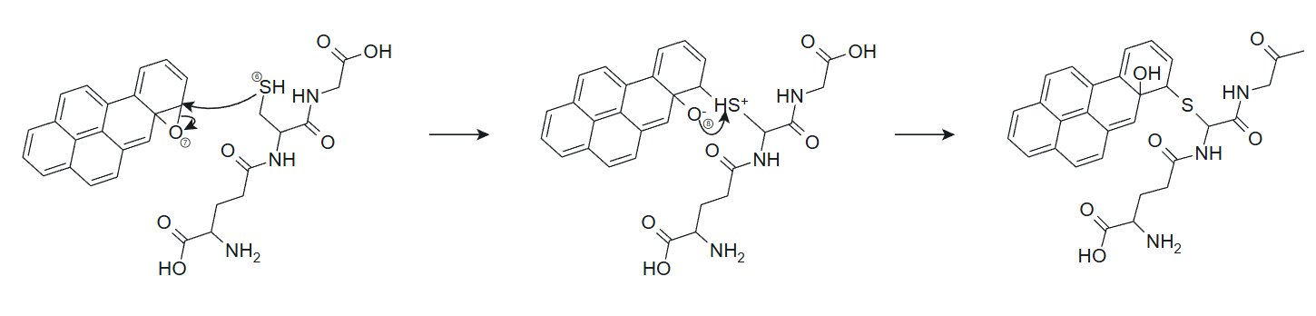
Presentation options
Enzyme project
  Burning organic matter can form PAHs that can aggregate in the lungs if inhaled
  PAHs are tarry, non polar compounds
  Problem is essentially how can I convert these PAHs to something that is soluble
  By combining the P450 and GST enzymes, you are theoretically able to convert non-polar compounds trapped in the lungs into something the body can naturally excrete
  Used pymol and autodock vina to model binding energy
  Next steps were building the water free tunnel using CAVER and Rosetta to connect the 2 enzymes
  Tryptophan synthase does this naturally
  H2O2 is needed to replace the P450’s Oxygen
  Further development required wet lab validation
  SSD corrupted so development stopped

Slide 6
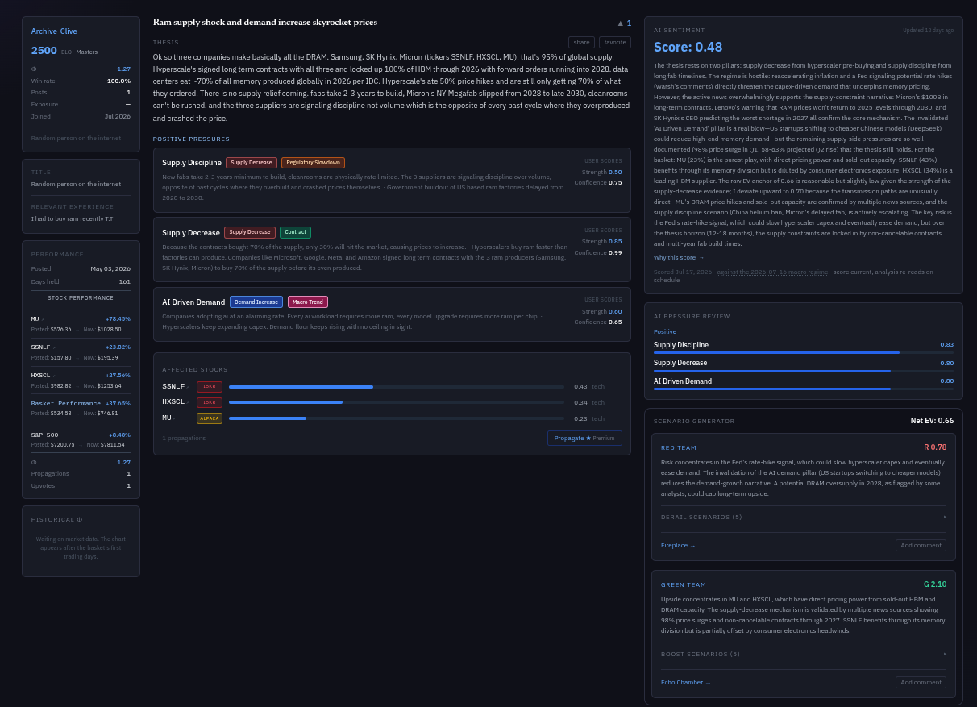
Presentation options
Catalyst (Catalystranked.com)
  Stock pick social media
  Helps investors realize opportunity cost of their picks
  Phi is a metric similar to alpha but expressed as a multiple
  Has a leaderboard based on picked stock performance vs the S&P 500
  Forces investors to cite reasons (pressures) they picked stocks not just say this stock will go up and to the right
  Has an AI news processing pipeline
  Tracks interest rate, CPI data and US bond market
  AI reasons through the user’s ideas with the context of the news pipeline to give a soundness rating for each cited pressure and what could go wrong to derail the idea and monitors news for that thing to adjust the score accordingly (does not affect rank)
  Has Alpaca and IBKR brokerage connections (paper accounts)

Slide 7
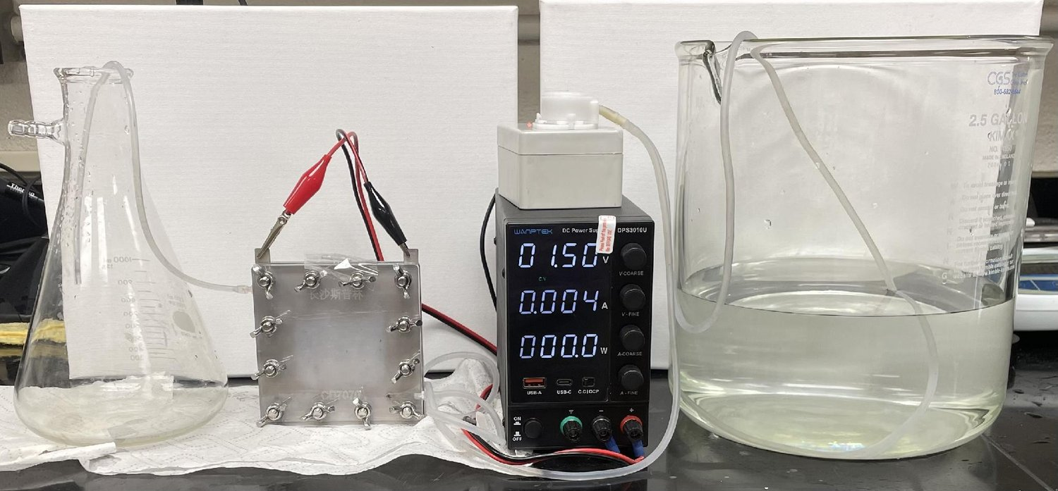
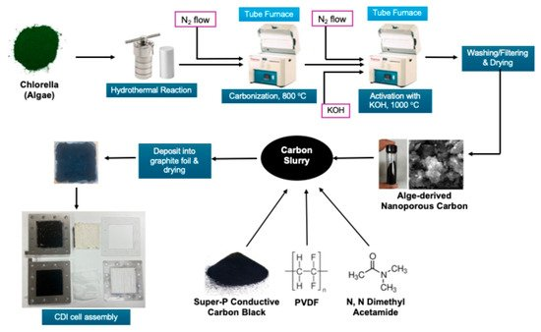
Presentation options
Senior Capstone Project
  Published peer reviewed work in the scientific journal “Molecules”
  Using CDI to desalinate water using only electricity and a renewable carbon source
Steps
  Start with algae: We used algae as a renewable carbon source.
  Heat with water: The algae was heated to 250 C with water in a sealed hydrothermal reactor, carbonizing the algae while the water pulled out polar impurities.
  Heat again under nitrogen to carbonize: The resulting tar was then heated to 800 C under nitrogen, ensuring the carbon didn't combust.
  Activate with KOH: The carbon was mixed with potassium hydroxide and heated again to 1000 C under nitrogen. This produced a huge network of tiny pores that gave the carbon high surface area in order to better hold the ions. (1,747 m^2/g of carbon ~⅓ of a football field)
  Coat it onto electrodes: The activated carbon was made into an organic slurry, coated onto graphite sheets, and then allowed to evaporate in order to form the coated electrodes.
  Run the cell: The electrodes were assembled with ion-exchange membranes, and water with salts was run through the middle channel. A low voltage was applied, and the electricity pulled the ions across the membrane, and into the pockets of the activated carbon electrodes. By flipping the voltage, the electrodes could be cleaned for reuse.

Slide 8
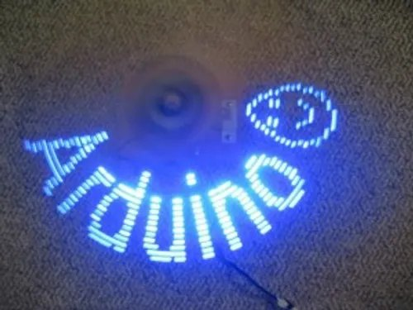
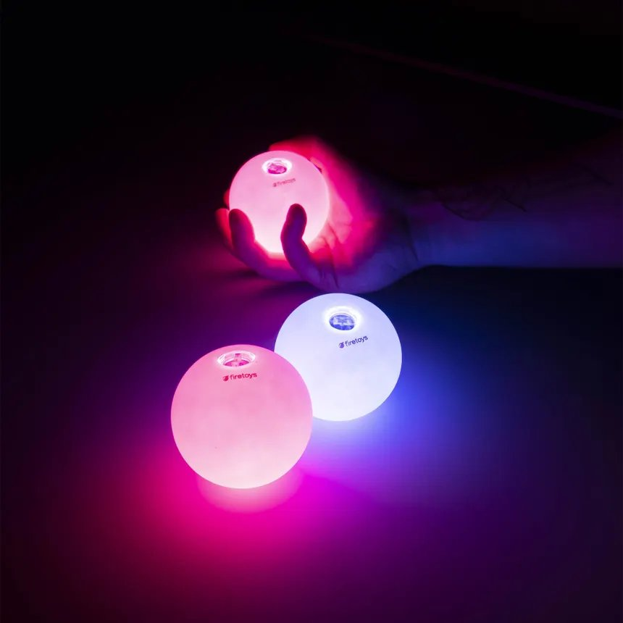

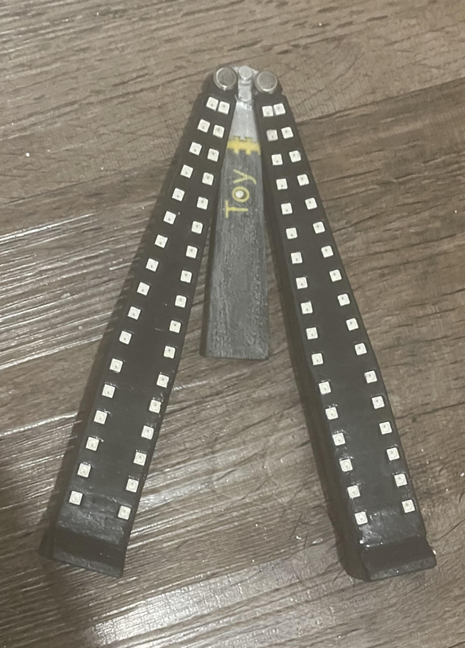
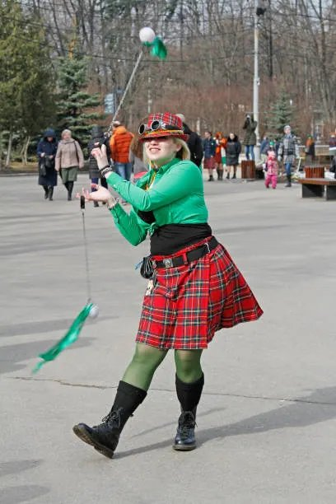
Hardware project
Performance prop similar to juggling, fire staffs or poi
Has pov display functionality so it paints an image in the air
Something that didn’t previously exist that I wanted to exist

Slide 9
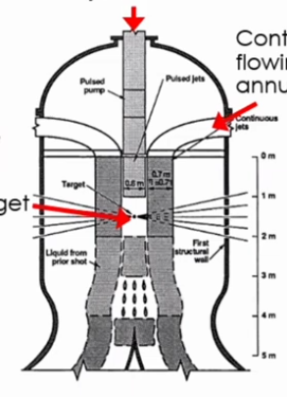
Why Xcimer
Livermore’s NIF proved a fusion shot can release more energy than its laser delivers
If scaled up with a bigger, more efficient laser, the same approach could produce net positive power
Xcimer is doing something that I believe is necessary to advance civilization
I have always been interested in cutting edge science
My background is in process engineering and I could provide root cause analysis to diagnose issues with parts from manufacturers, find out what failed, why and how to prevent it in the future
I’m interested in a fast paced environment with a tight loop between when something gets built and when it gets tested
I enjoy learning new things and I believe I could grow and develop here
I believe having this technology in the world would be a better future than one without it and would love to be a part of this ambitious project to make that vision a reality.
(HYLIFE reactor)

Slide 10
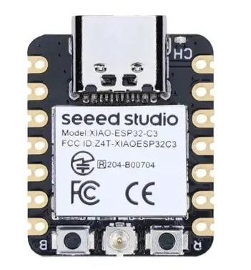
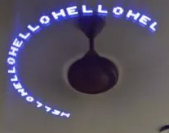
Passion project- what is it?
Hardware passion project
  Uses 34 LEDs per handle driven by an ESP32s and an IMU to display POV effects
  Development in progress this project is 100% mine
  Iterative design process

Slide 11
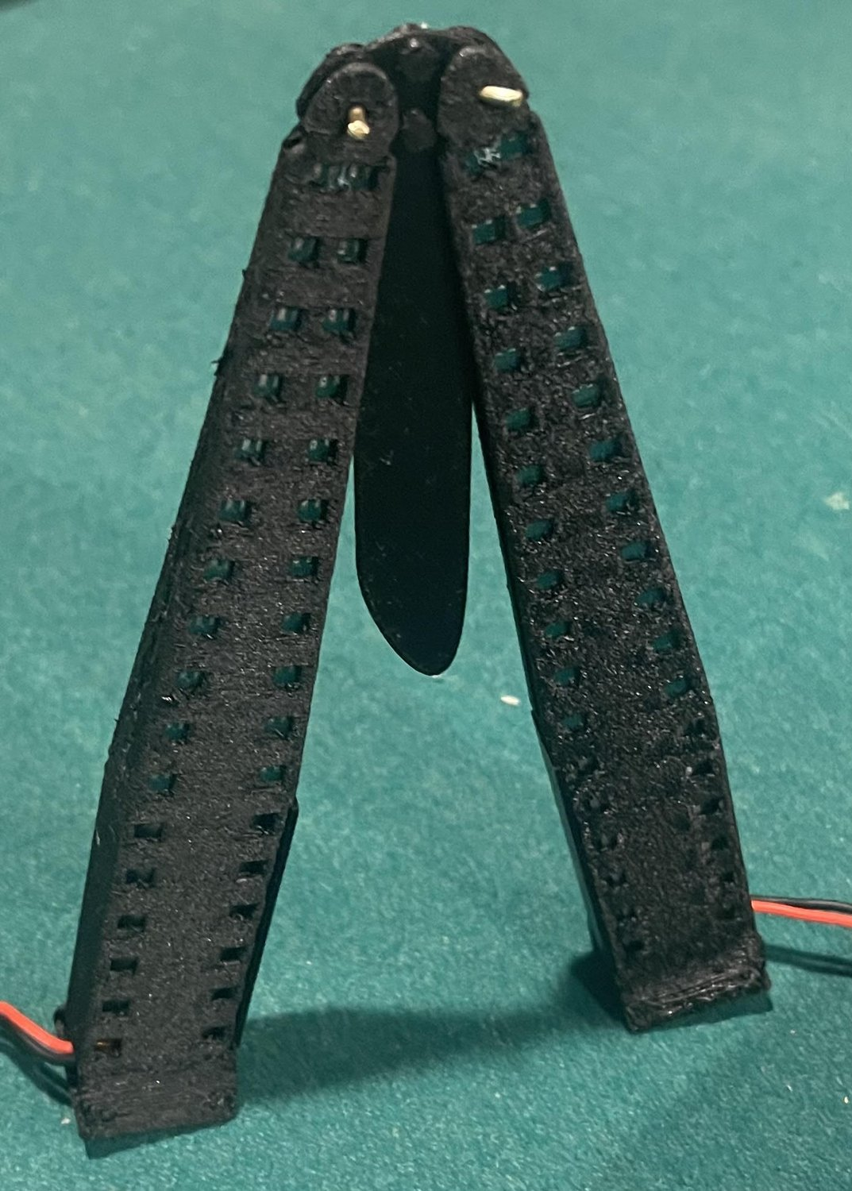
Passion project: material choice
For this project, I wanted to 3d print the prototypes to get fast development
I needed a strong material that could survive repeated impact and maintain its shape
I was between carbon fiber nylon and PET CF
Went with fiber nylon for impact resistance
Issue:
  Carbon fiber nylon when handled can leave small fibers, irritating the skin
  Carbon fiber absorbs water and swells if not sealed
Solution:
  Coat the fibers in ca glue freshly after printing, wicking into the layer lines, then sand down for a smooth finish and seal with wipe on polyurethane and a carnauba wax coating for additional scratch resistance. This allows me to use carbon fiber nylon for its strength while engineering around its weaknesses

Slide 12
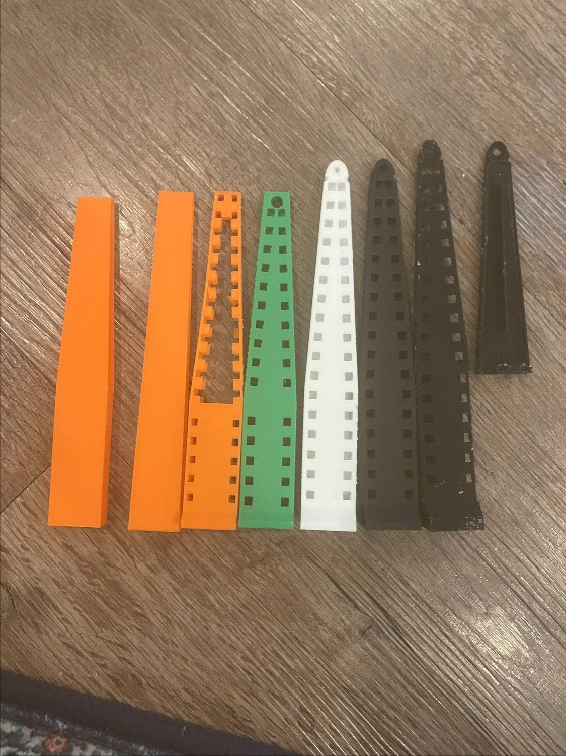
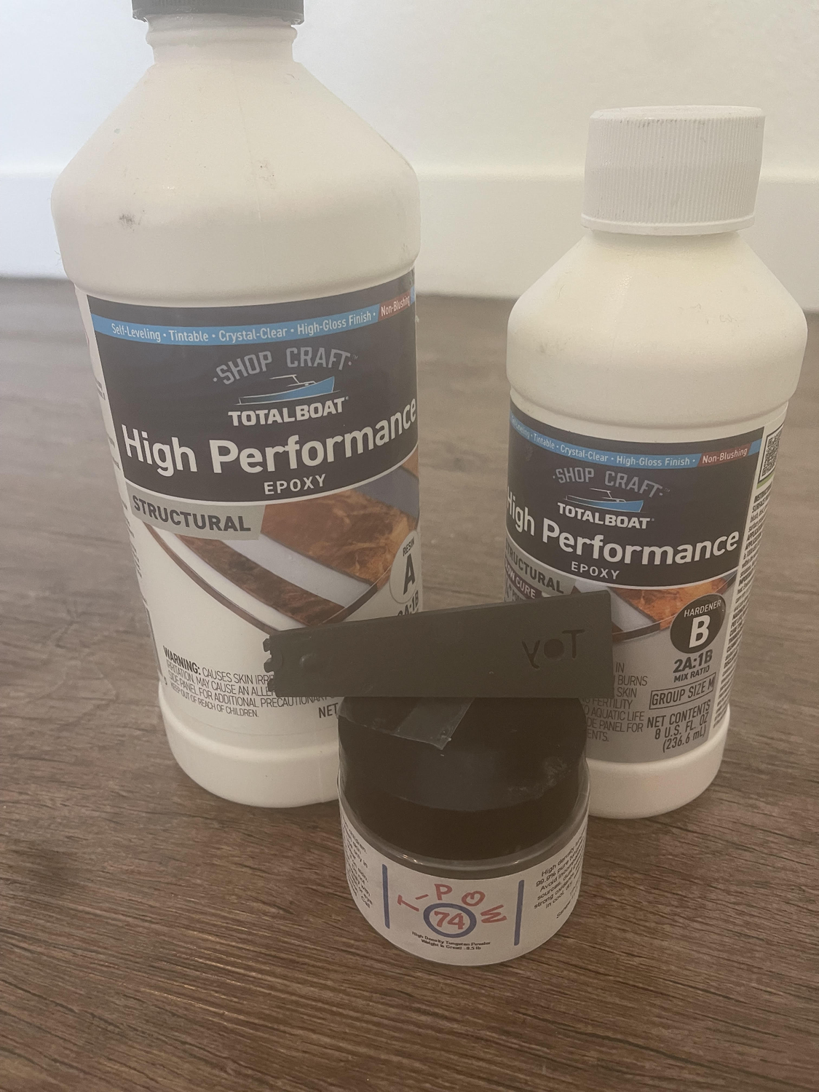
Passion project- Early development
I knew the general shape and feel I wanted but there's an issue
Traditional balisongs have the blade portion run the entire spine
I have to allow room for electronic components
This throws the weight distribution off
Solution?
  Tungsten loaded epoxy as the blade portion
  This counterbalances the batteries that are in the handle and the added weight is necessary to bring the center of mass towards the pivot more evenly to allow for smoother flipping

Slide 13
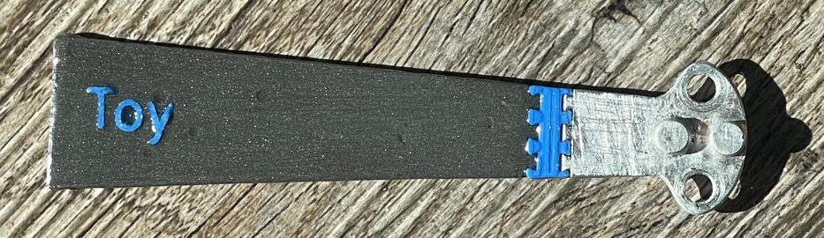
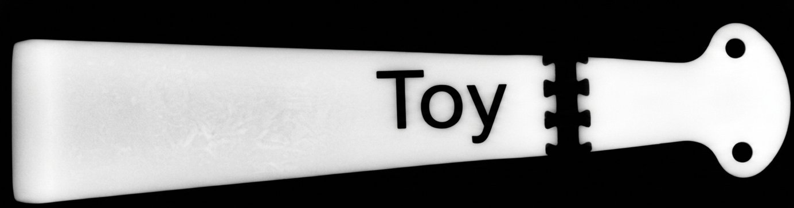
Passion project- issues with from factor
I was planning on using the full blade as loaded tungsten epoxy
Issue:
  Anyone who picks up the trainer should recognize it as a blunt trainer not a weapon
Solution:
  Segmented blade using PLA to break up the outline between the tang and the body
  Plastic “Toy” lettering embedded in the blade and a PLA dovetail connector between the tungsten and aluminum in order to further reinforce that it’s a trainer not a weapon

Slide 14
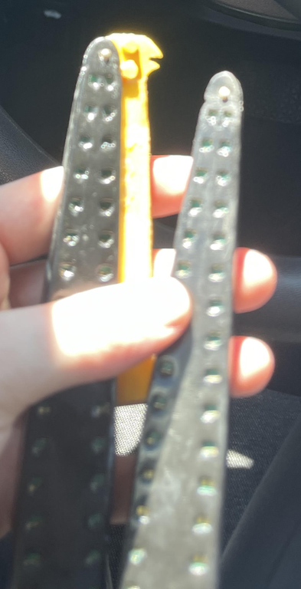
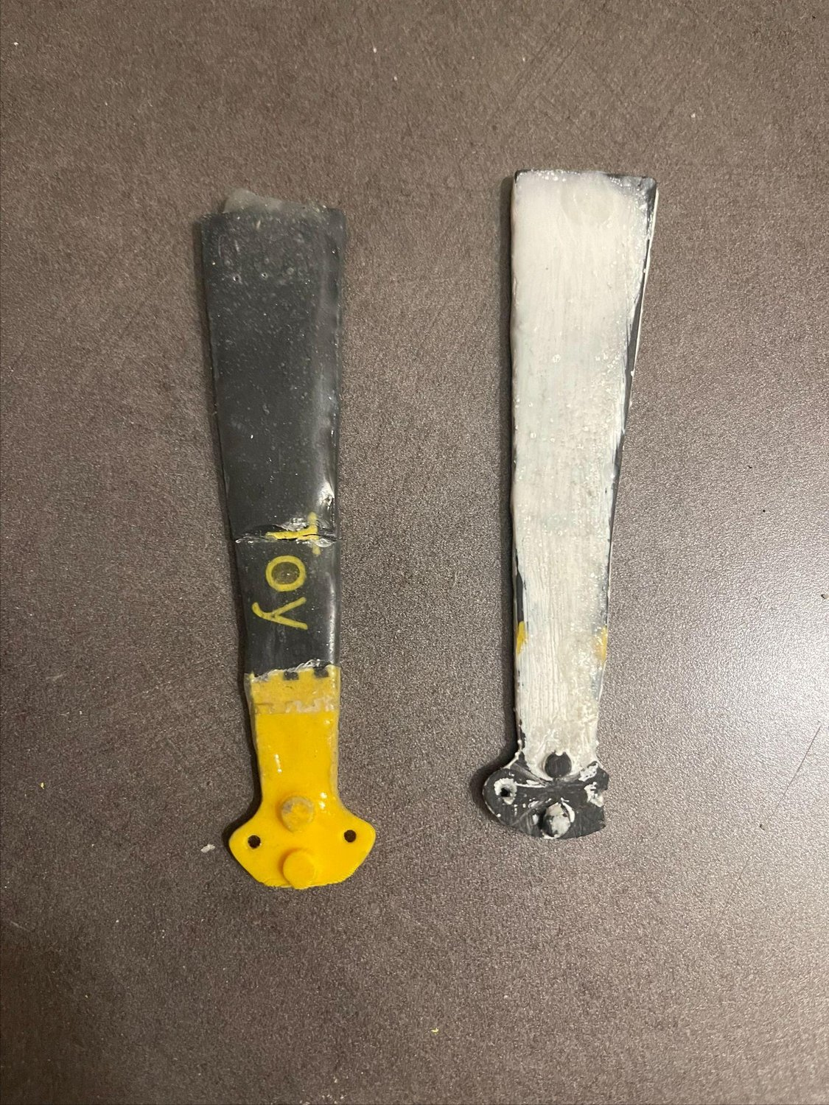
Passion project- pin force stress failure
Tungsten epoxy or PLA as the tang caused failure at the pivot holes
Issue:
  The pinholes were too small causing the forces of the rotation to break the rivets out
Solution:
  Upgrade the pivot hardware from 1.5mm OD brass rivets to 4mm Chicago screws
  Get the tang CNC’d in aluminum

Slide 15
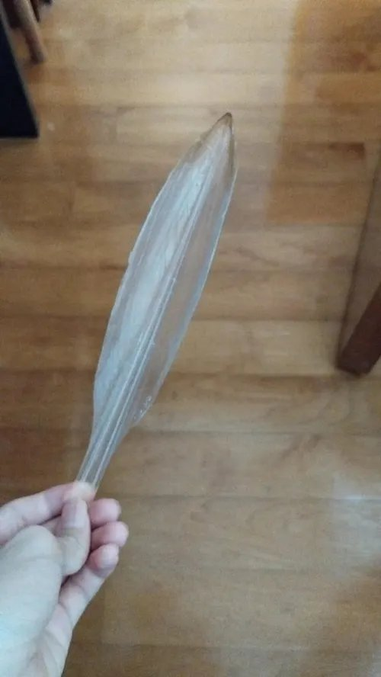
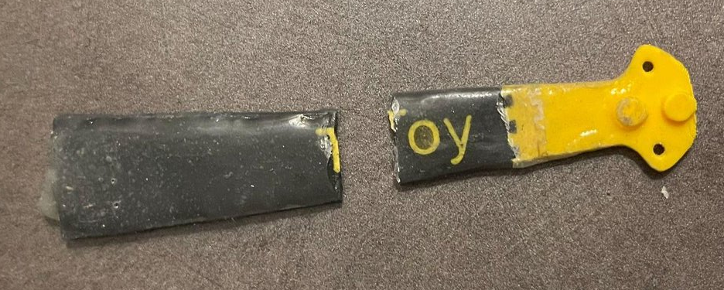
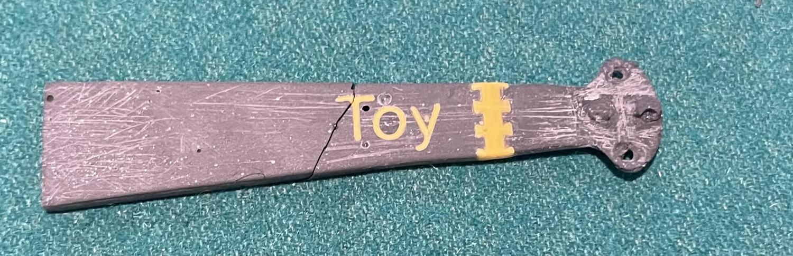
Passion project- body force stress failure
Tungsten epoxy is brittle
Press Fitting the “Toy” lettering caused internal stress in the epoxy
Issue:
  Introducing this dovetail connector and “Toy” PLA pressfit lettering introduces weakness in the blade causing repeated failure in the blade
Solution:
  Anneal the blade at 60 C after press fit to reduce internal stress caused by press fit
  Coat the assembled blade portion in a thin coating of performance epoxy
  Moved the “Toy” lettering up the blade and shrunk the letters so there's more base material
  Future design changes:
    Add a plastic squid pen type portion inside the blade or a steel wire for increased impact resistance
    Embed the toy lettering in the blade during casting instead of press fit after

Slide 16
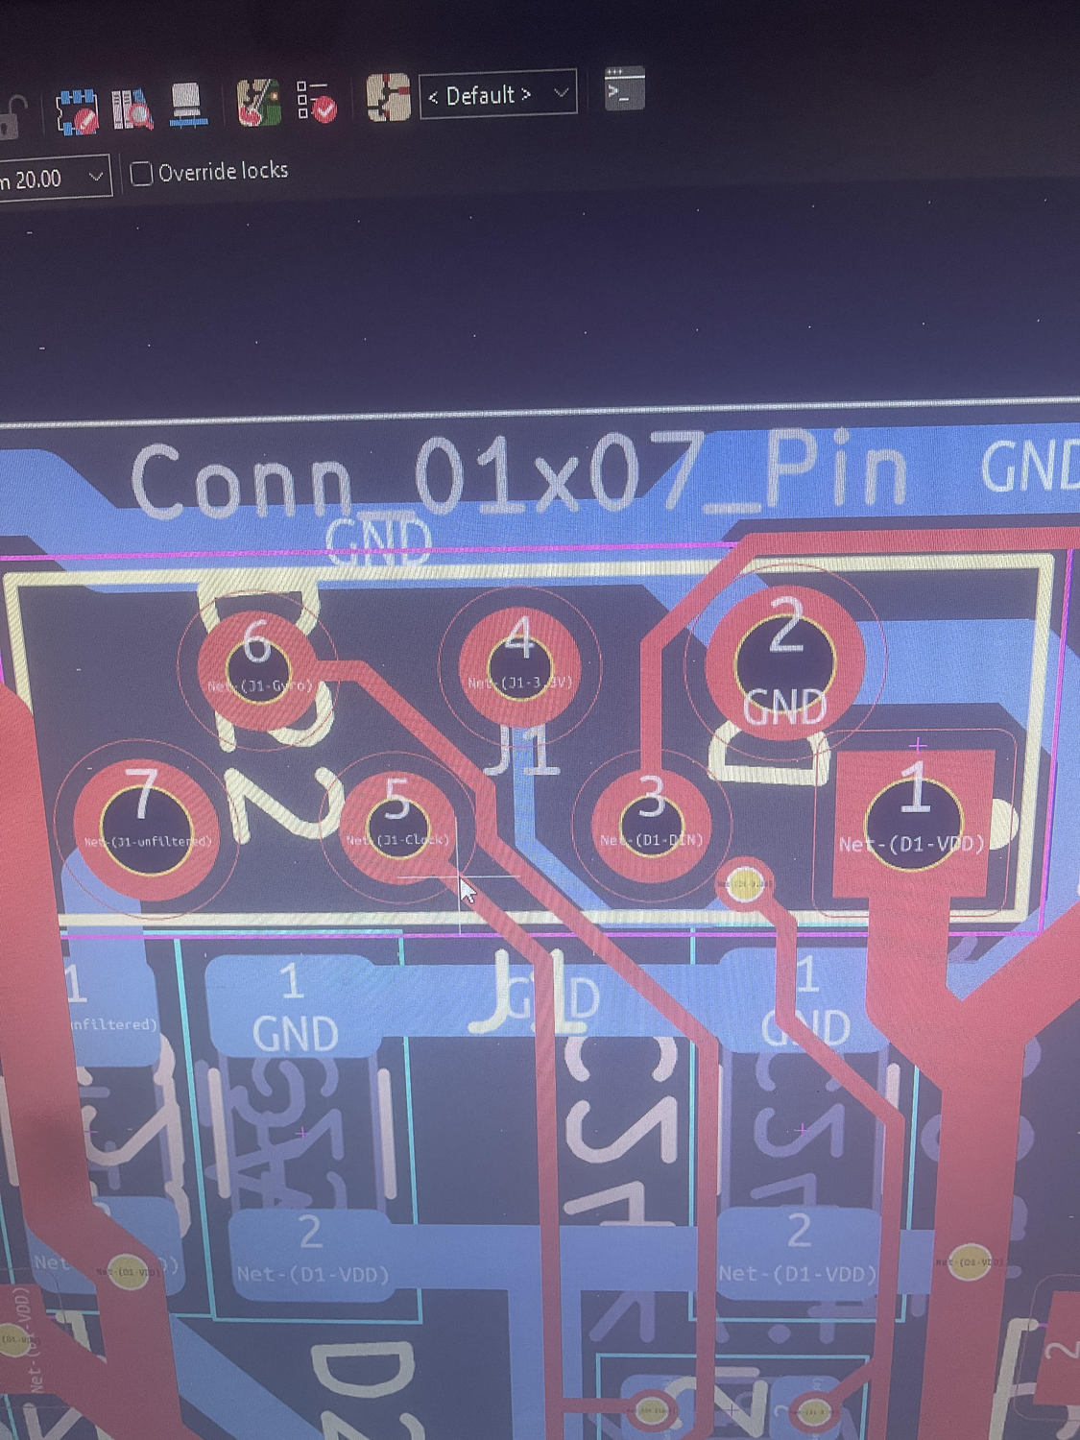
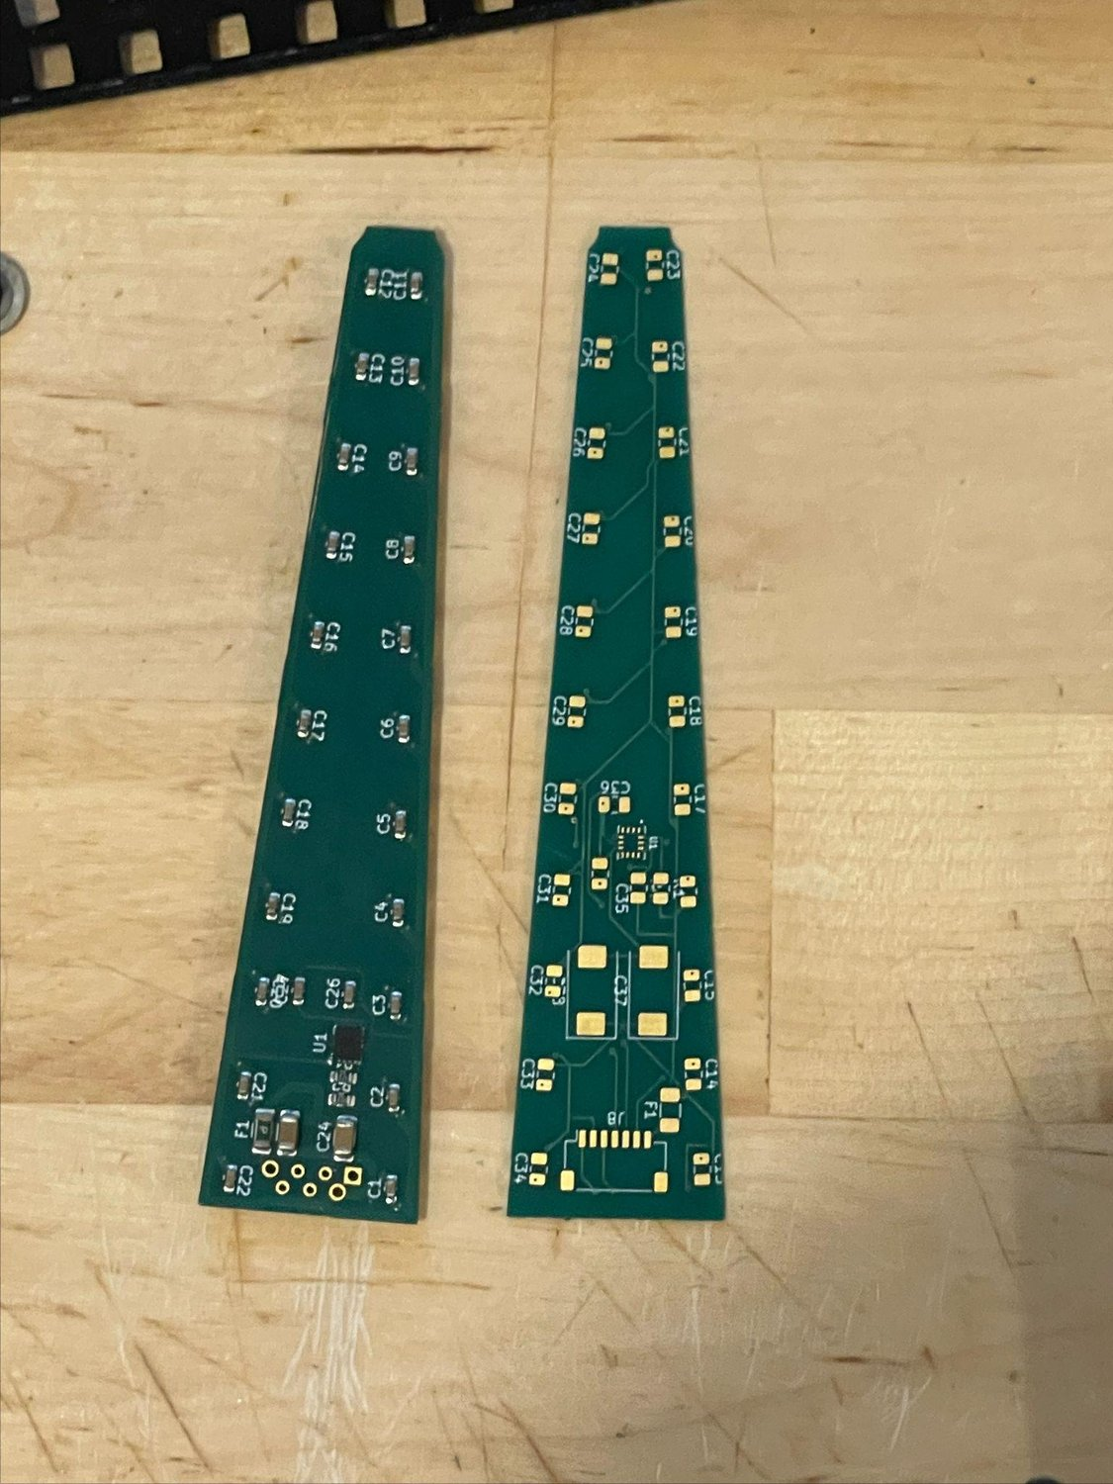
PCB design iteration
I have had fairly limited exposure to circuits: some high school engineering class, plus physics in college, but never designed anything beyond what was needed to pass
I researched the components I needed to build a functional POV circuit
Landed on the SK6812MINI-HS (3.7v) to avoid using a boost converter and 5v LEDs, which boosted run time by an estimated 1/3
One major issue I am currently changing is during assembly there was a short between the 3.3v line and the ground line because the pins were right next to each other, next iteration will move the pin further away to make assembly more consistent or use 2 jst connectors.
Another change was swapping the JST connector with a 7 pinhole connector to reduce height to better fit in the body, couldn't use a 7 pin 1mm pitch JST because the current would exceed the rating in the power and ground line. Low and high current JST split planned.

Slide 17

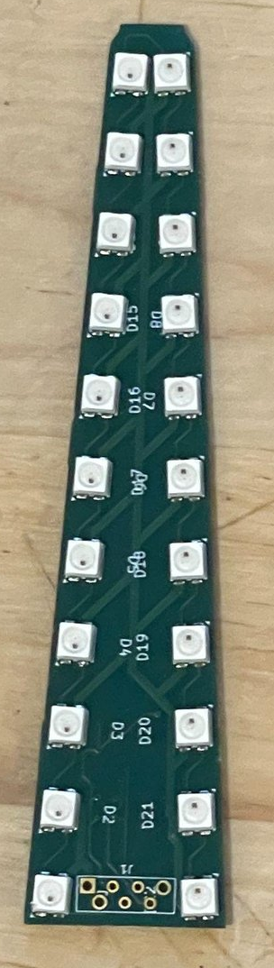
Passion Project- software
You upload an image to a software and it splits the image into 17 concentric rings and splits them into 256 slices at about 1.4 degrees per slice
The code detects movement in the blade via the IMU
The ESP32 reads the IMU data and calculates where the center line is for the handle it controls inside the polar array that stores the image.
It then uses the individual LEDs offset from centerline and trig to calculate what each led color should be as it sweeps through the polar array that stores the image
LEDs are not in a straight line so each led has its own offset value
Future iterations include some app interface that allows you to upload any image and it should be able to map to the LEDs and display the image when spinning without having to reformat the ESP32

Slide 18
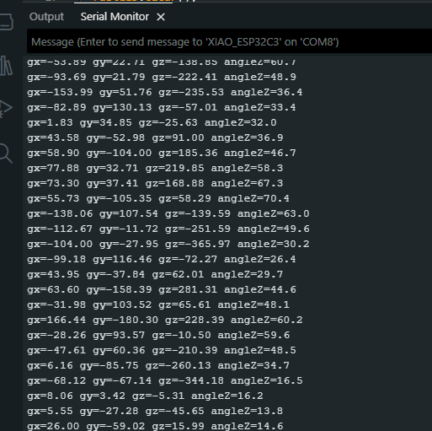
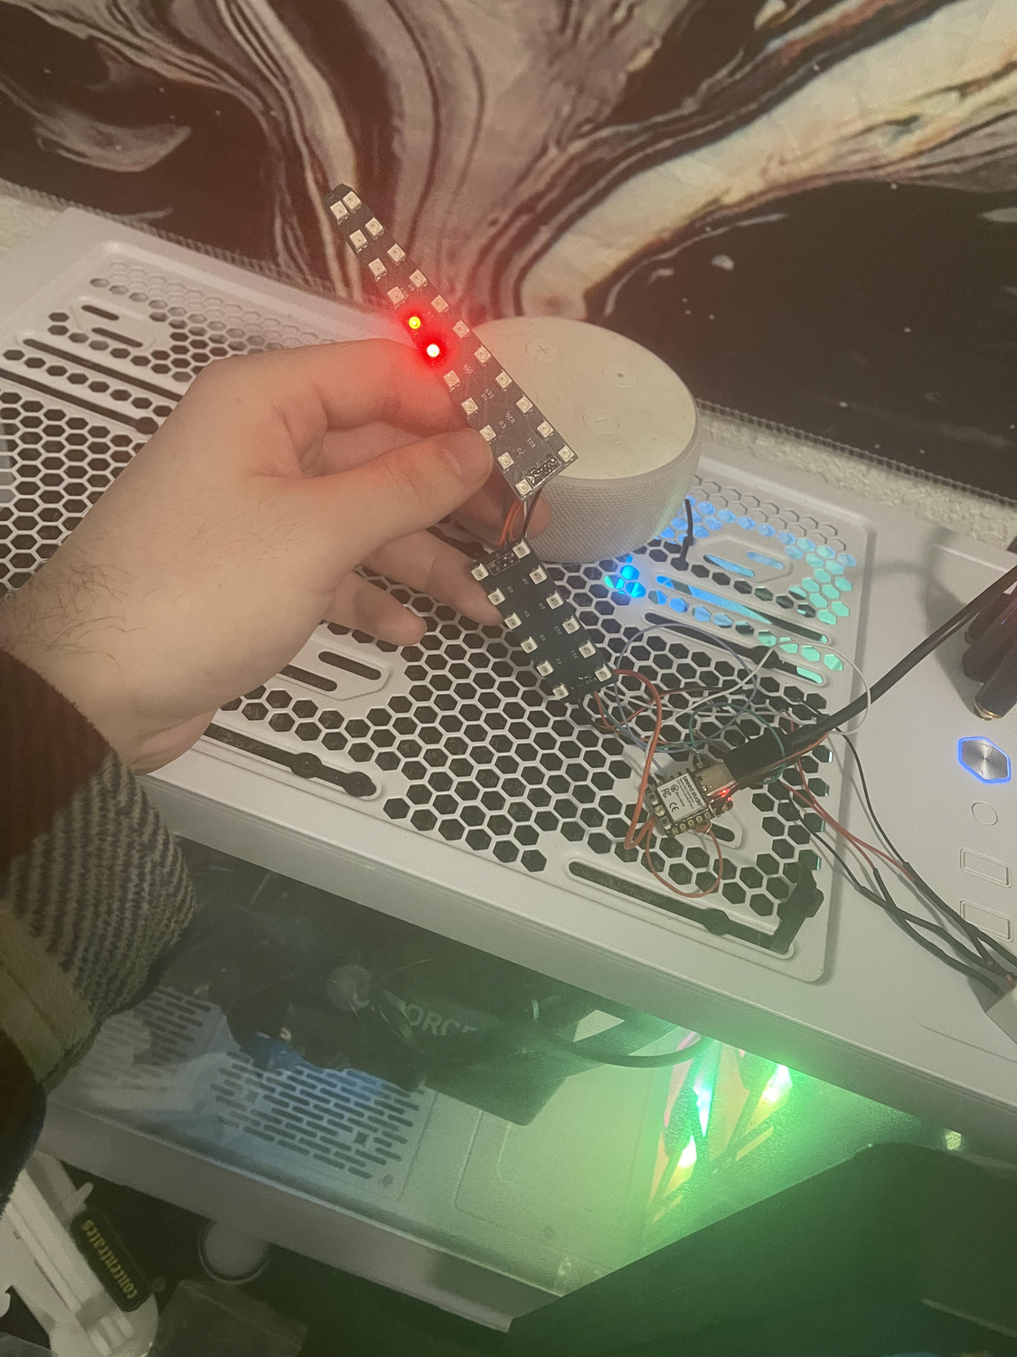
Passion Project- testing and assembly
Made an assembly doc to make assembly more consistent
Continuity test the bridge after solder
Once soldered, test using software outside the housing
Verify the IMU is outputting values
Verify the LED chain is unbroken
If both tests pass seal up the shell and test again before heat welding the shell

Slide 19
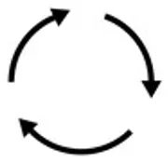
Future design plans
Make software to upload image from your phone directly to the ESP32 without reformatting
Potting compound in the pommel and battery section for further impact protection
Move 3.3v connector pin away from ground to avoid bridging
Reinforce the blade portion with steel wire or a squid pen
Use 2 JST connectors for faster assembly (+ and - vs low current split)
Injection mold tooling for faster build time

Slide 20
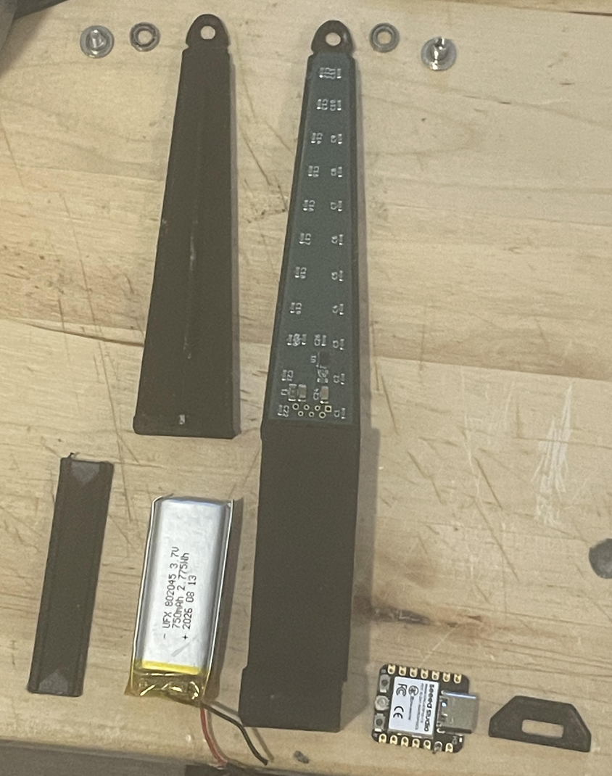
Final remarks / future plans
This project was something that I took from an idea stage into a physical hardware prototype that functions as I imagined it to
Demonstrates my ability to learn new domains, iterative design, problem solving and self directed learning
I had to learn KiCad and soldering from scratch, relearn autodesk fusion, blender, and arduino IDE, I also had to learn how to work with manufacturers and test the parts they gave me.
I’m proud of all my projects, most are showcased on my github at: Elijah-w15
This presentation was reformatted for simplicity by Claude, if you would like to see the original and the prompts used it’s available on my github as “Presentation-Original”
In the interview portion I would be happy to answer any questions you have about this project or about any of my other projects

Slide 21
Thank you for your time. Any Questions?

