Slide 1
Elijah Whiting
Content written by me, design reformatted for simplicity by Claude:
Original PowerPoint + prompts available on my GitHub as “Presentation-Original”
Xcimer Pulsed Power Manufacturing Engineer Interview

Slide 2
Overview
Chemical Engineer, Widener University
Process engineering, Carpenter Company
Polyurethane foam manufacturer
Team of 3 engineers + 8 operators: tens of millions $/yr at one facility
60+ facilities worldwide
Developed Python-based scheduling algorithm
Taken over by corporate for further development
Projected ~$200K/yr savings: throughput volume, conservative reduction targets
Projects
(Github.com/Elijah-w15)
Automatch
Catalyst
Enzyme project
Senior capstone project
Hardware passion project

Slide 3
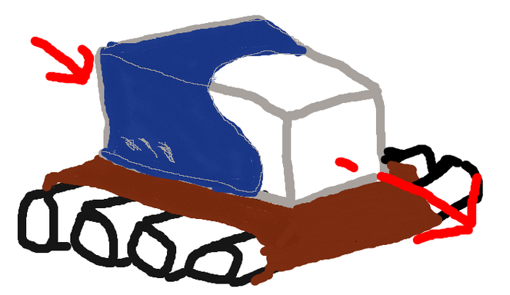
PRESENTATION OPTIONS
Carpenter scheduling algorithm
Making foam: continuous process
2 main reactions
Job: monitor quality, root cause issues, adjust reactions, work with operators
Time to reach steady state drives waste
Density, height, width, color also affect waste
Biggest waste driver: schedule sequencing inefficiencies
Conservative target, already proven at other plants (trim %)
Traveling salesman problem (cost per transition)
Systemized tribal knowledge
Hand coded: locked down environment, no library access
Handed to corporate for further development (libraries I couldn’t access)
IP free version on my GitHub: Weighted-Sorting-Greedy-Algorithm

Slide 4
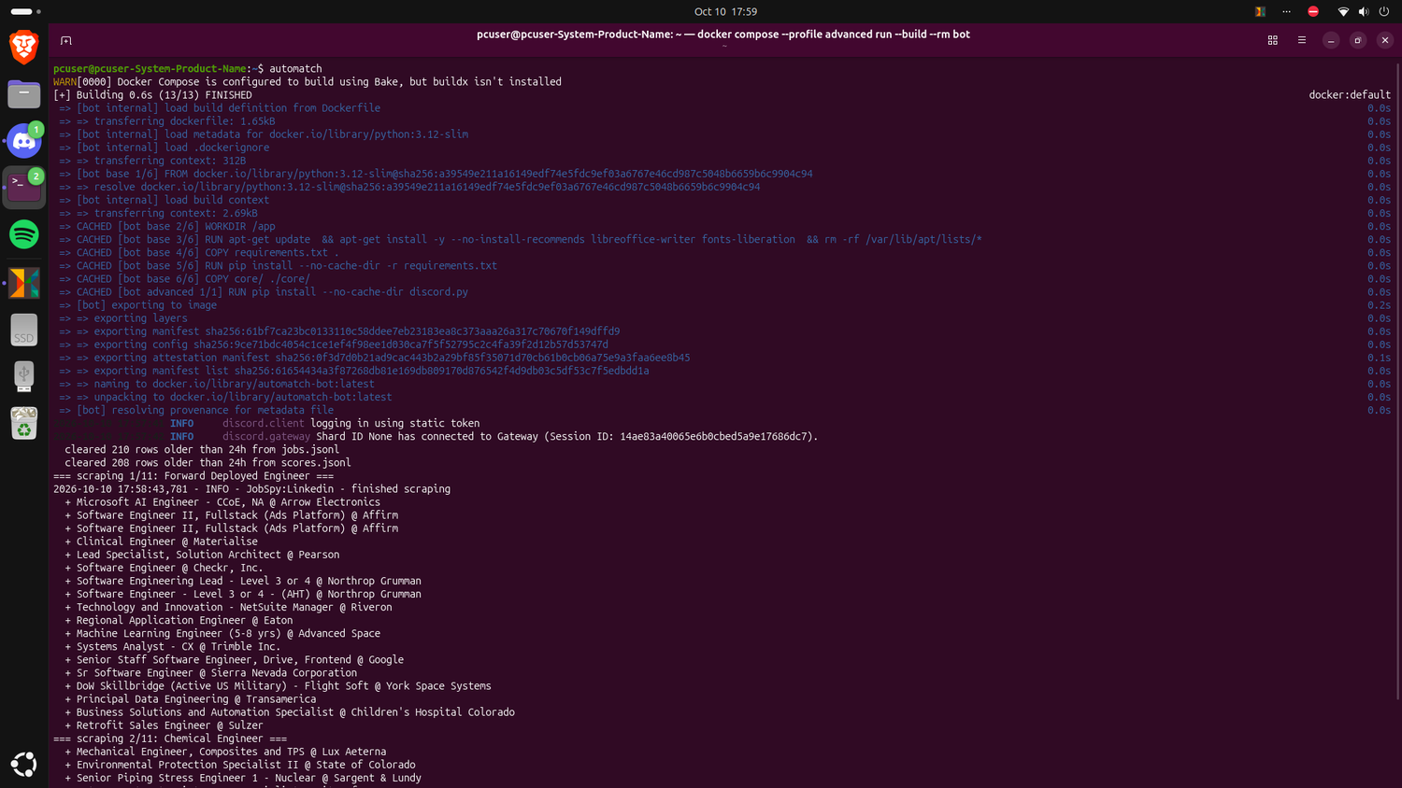
PRESENTATION OPTIONS
Automatch
How I found this opportunity
Custom job scraper
Define the metrics you care about
Scrapes + grades with a local AI via Ollama
Top 10 matches (+ wild card) by rubric
Custom setup wizard; Docker checks + downloads dependencies
Open source on my GitHub

Slide 5
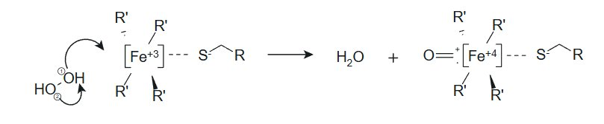
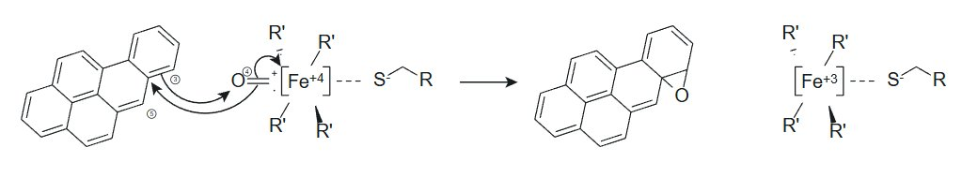
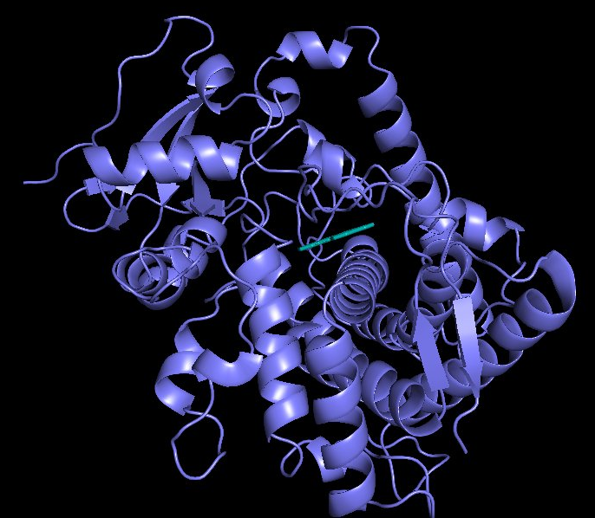
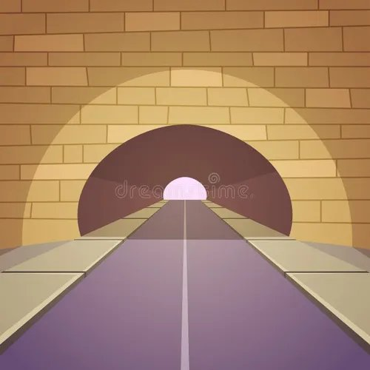
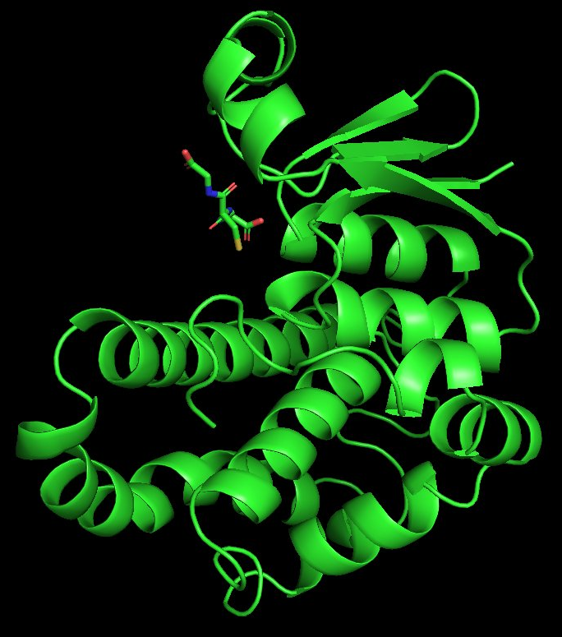
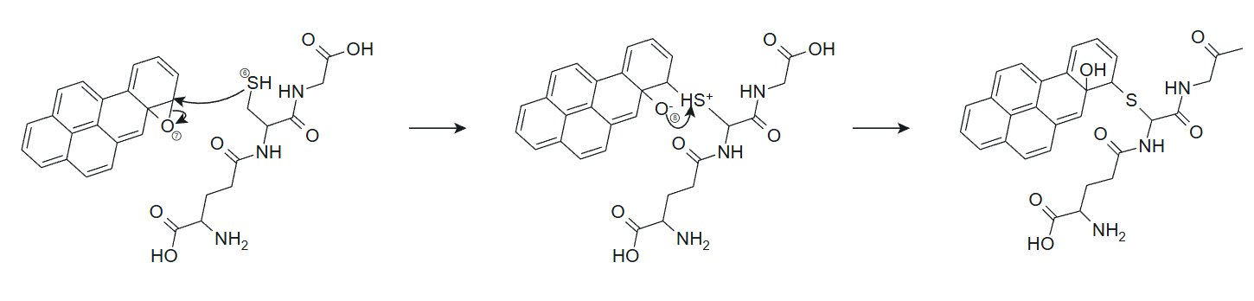
PRESENTATION OPTIONS
Enzyme project
Burning organic matter can form PAHs; if inhaled, they can aggregate in the lungs
PAHs: tarry, non-polar compounds
Problem: convert PAHs into something soluble
P450 + GST enzymes combined: theoretically, something the body can naturally excrete
Modeled binding energy: PyMOL + AutoDock Vina
Next: water free tunnel (CAVER + Rosetta) to connect the 2 enzymes
Tryptophan synthase does this naturally
H2O2 needed to replace the P450’s oxygen
Further development: wet lab validation required
SSD corrupted, development stopped

Slide 6
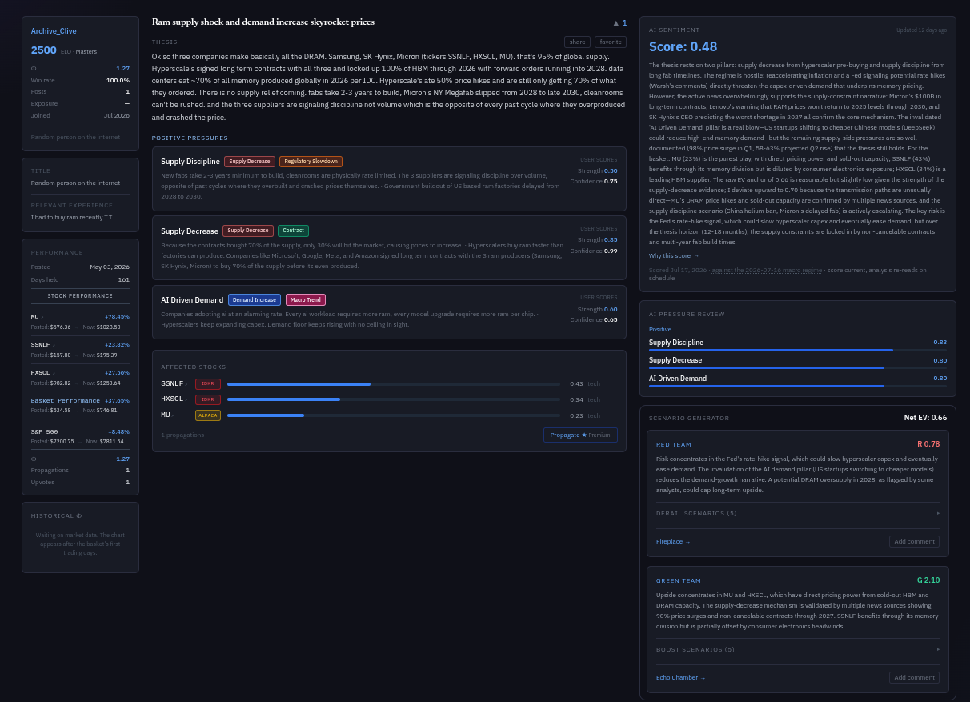
PRESENTATION OPTIONS
Catalyst (Catalystranked.com)
Stock pick social media
Helps investors realize the opportunity cost of their picks
Phi: like alpha, but expressed as a multiple
Leaderboard: picked stock performance vs the S&P 500
Must cite reasons (pressures), not just “up and to the right”
AI news processing pipeline
Tracks interest rate, CPI data, US bond market
AI soundness rating for each cited pressure + what could derail it; monitors news to adjust the score (does not affect rank)
Alpaca + IBKR brokerage connections (paper accounts)

Slide 7
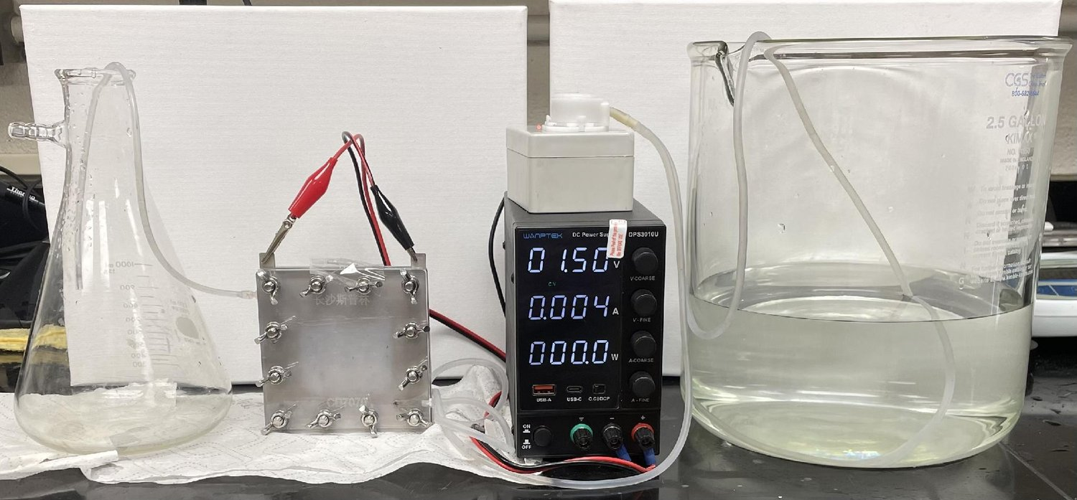
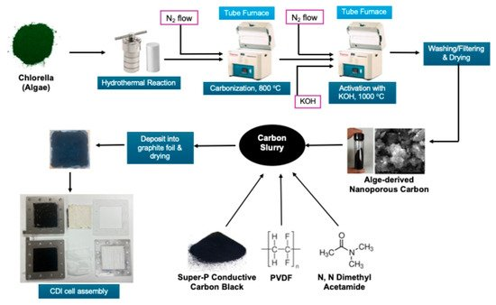
PRESENTATION OPTIONS
Senior Capstone Project
Published peer reviewed work: scientific journal “Molecules”
CDI desalinates water using only electricity + a renewable carbon source
Steps
Start with algae
Renewable carbon source
Heat with water
250 °C in a sealed hydrothermal reactor: carbonizes the algae, water pulls out polar impurities
Heat again under nitrogen to carbonize
Tar to 800 °C under nitrogen, so the carbon doesn’t combust
Activate with KOH
Potassium hydroxide, 1000 °C under nitrogen: network of tiny pores, high surface area to hold ions (1,747 m²/g of carbon ~⅓ of a football field)
Coat it onto electrodes
Organic slurry coated onto graphite sheets, evaporated to form the electrodes
Run the cell
Ion-exchange membranes; salt water through the middle channel; low voltage pulls ions into the activated carbon electrodes; flip voltage to clean for reuse

Slide 8
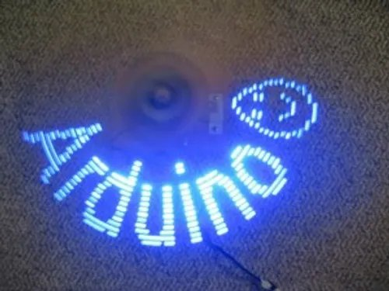
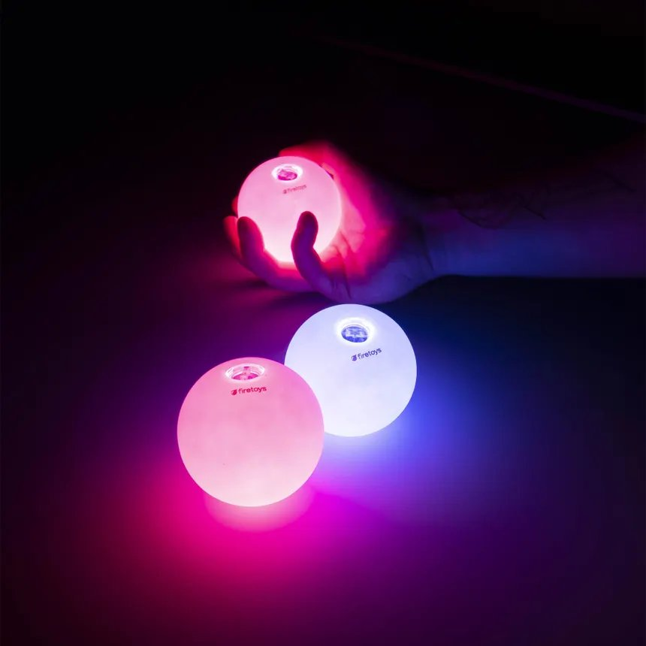
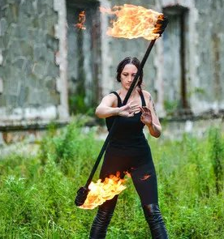
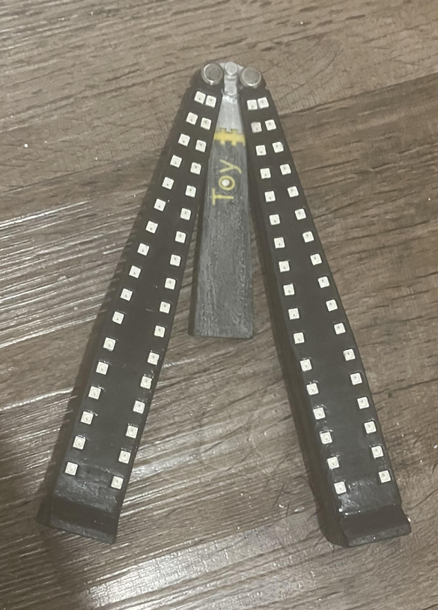
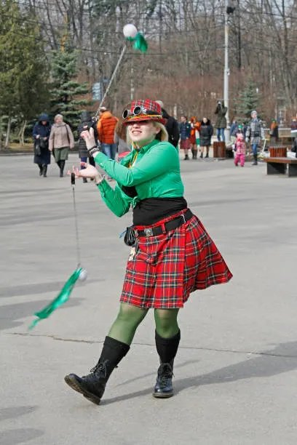
PRESENTATION OPTIONS
Hardware Project
Performance prop similar to juggling, fire staffs or poi
POV display functionality: paints an image in the air
Something I wanted to exist that didn’t

Slide 9
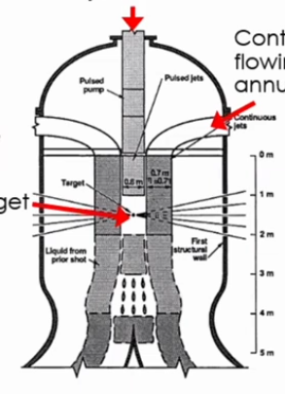
Why Xcimer
Livermore’s NIF proved a fusion shot can release more energy than its laser delivers
Bigger, more efficient laser: same approach could produce net positive power
I believe Xcimer’s work is necessary to advance civilization
Always interested in cutting edge science
Process engineering: root cause analysis on parts from manufacturers (what failed, why, how to prevent it)
Fast paced, tight loop between build and test
Enjoy learning; could grow and develop here
A better future with this technology than without; I’d love to be part of this ambitious project
(HYLIFE reactor)

Slide 10
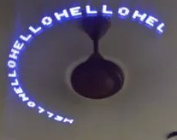
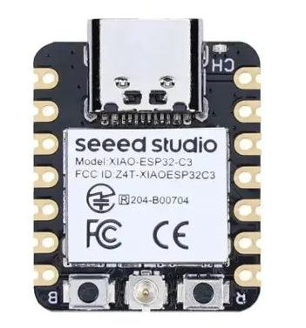
PASSION PROJECT
What is it?
Hardware passion project
34 LEDs per handle, driven by ESP32s + an IMU, for POV effects
Development in progress; 100% mine
Iterative design process

Slide 11
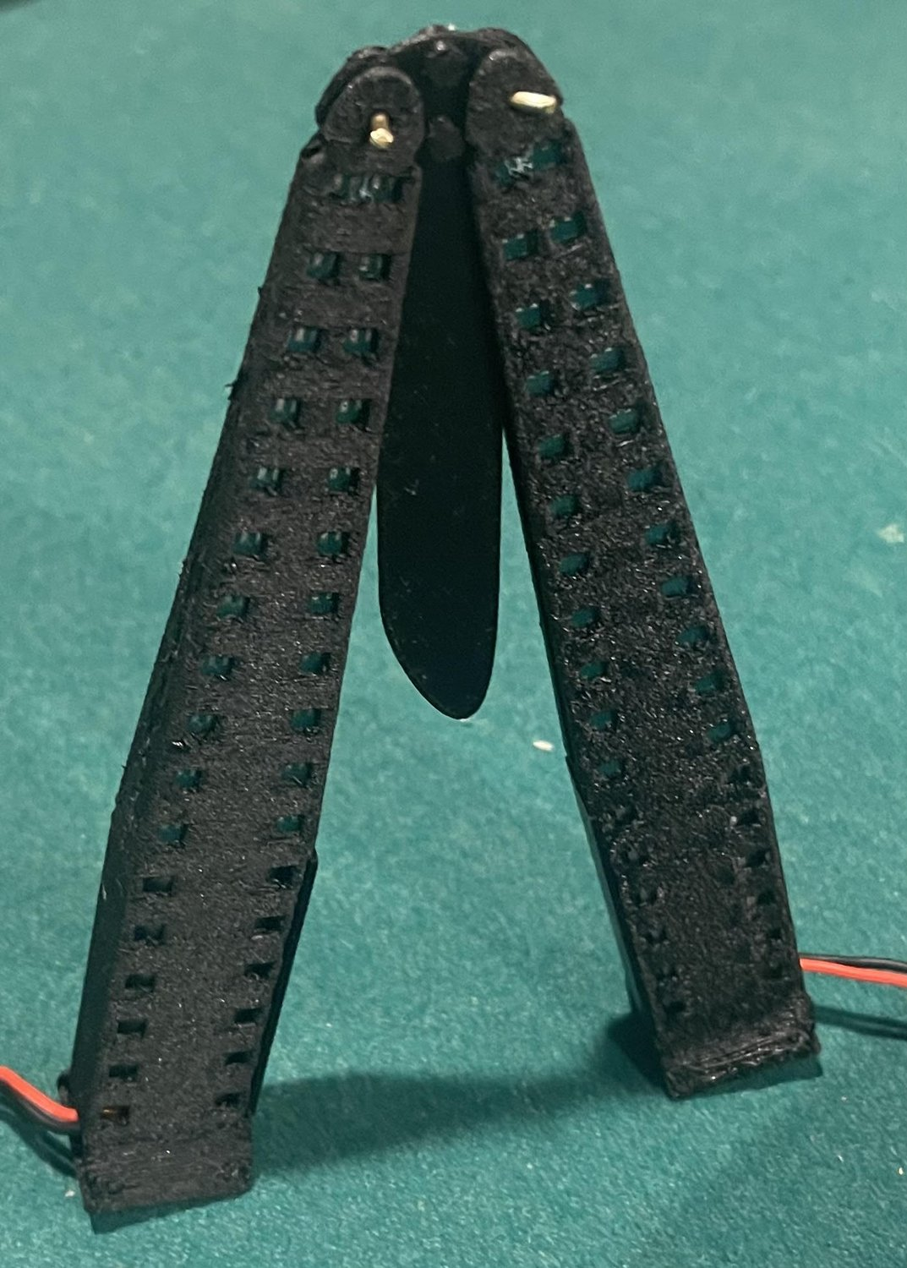
PASSION PROJECT
Material choice
Wanted to 3D print prototypes for fast development
Needed a strong material: survive repeated impact, maintain shape
Carbon fiber nylon vs PET CF
Went with carbon fiber nylon for impact resistance
Issue:
Handling can leave small fibers that irritate skin
Carbon fiber absorbs water, swells if not sealed
Solution:
CA glue fresh after printing (wicks into layer lines) → sand smooth → wipe on polyurethane → carnauba wax coating for scratch resistance
Use carbon fiber nylon for its strength, engineer around its weaknesses

Slide 12
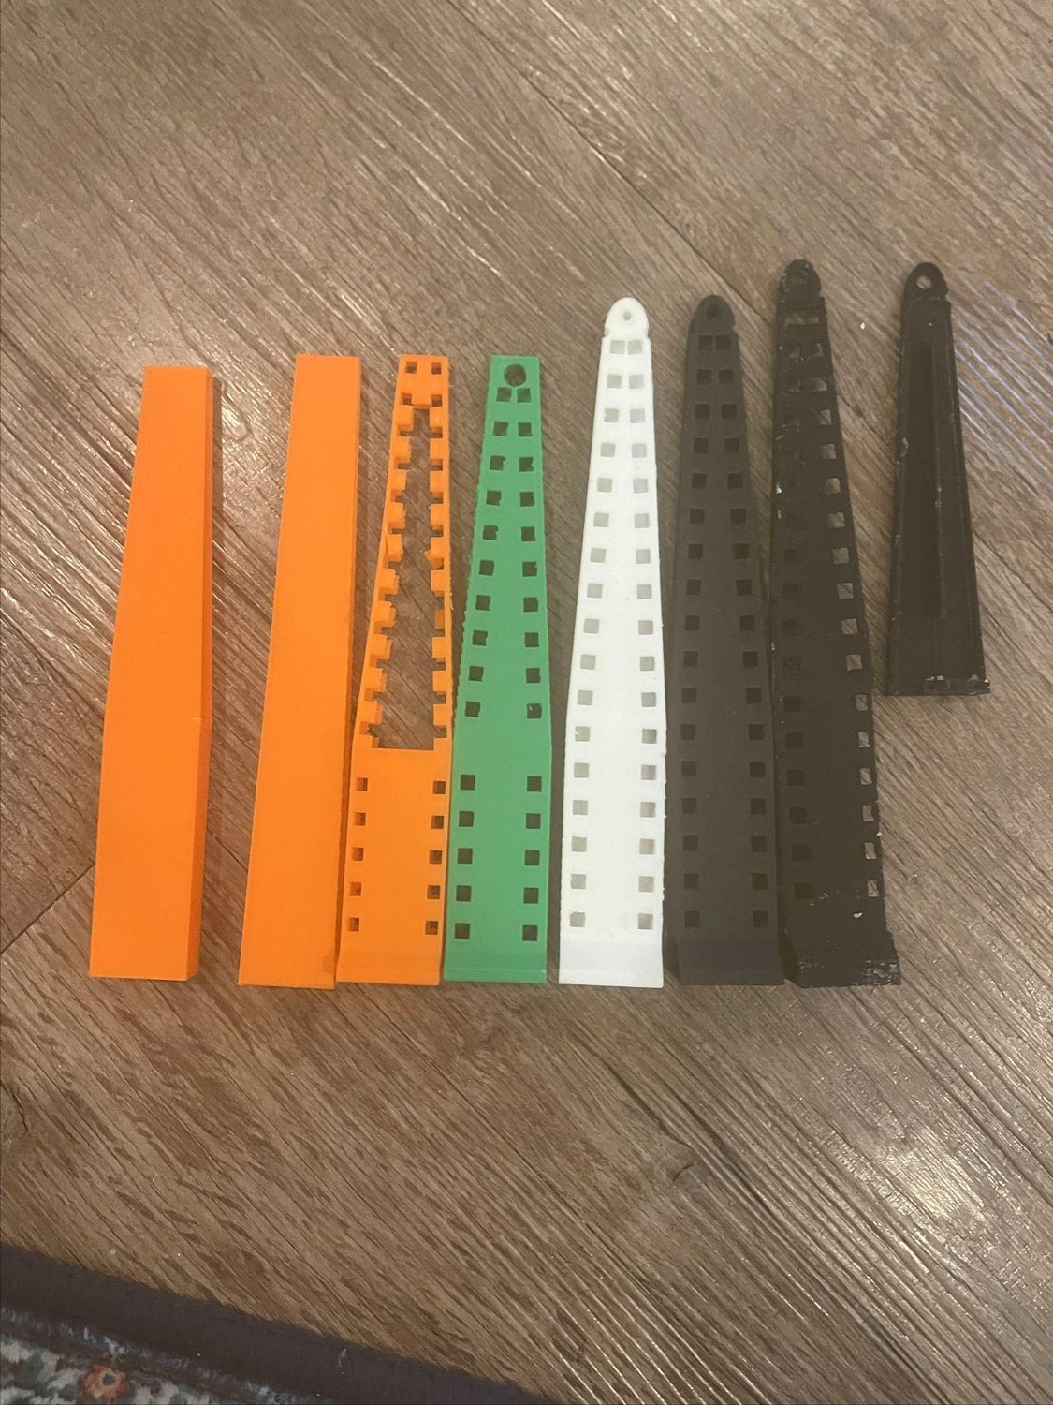
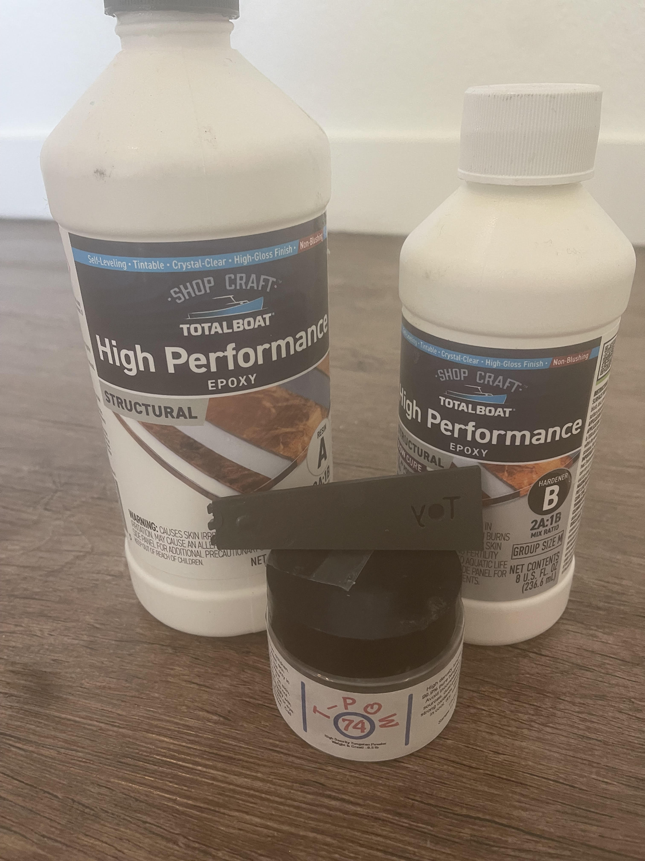
PASSION PROJECT
Early development
Knew the general shape and feel I wanted, but there’s an issue
Traditional balisongs: blade portion runs the entire spine
Need room for electronic components
Throws off the weight distribution
Solution?
Tungsten loaded epoxy as the blade portion
Counterbalances the handle batteries; center of mass toward the pivot for smoother flipping

Slide 13
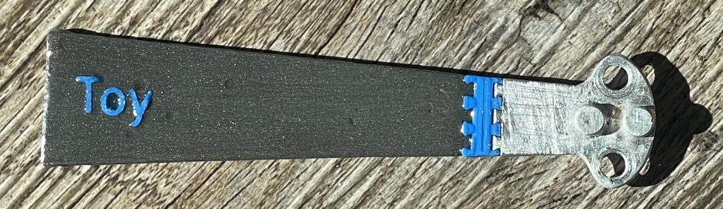
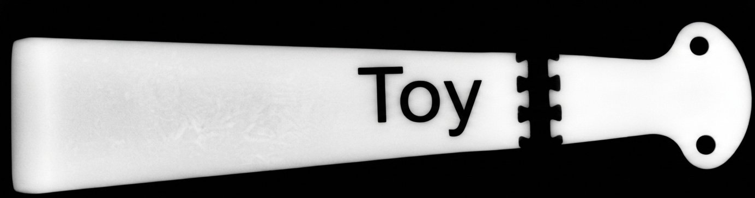
PASSION PROJECT
Issues with form factor
Planned the full blade as loaded tungsten epoxy
Issue:
Anyone who picks it up should recognize a blunt trainer, not a weapon
Solution:
Segmented blade: PLA breaks up the outline between tang and body
Plastic “Toy” lettering in the blade + PLA dovetail connector between tungsten and aluminum: trainer, not weapon

Slide 14
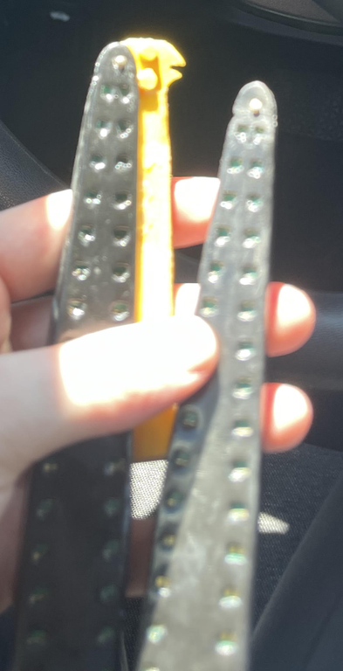
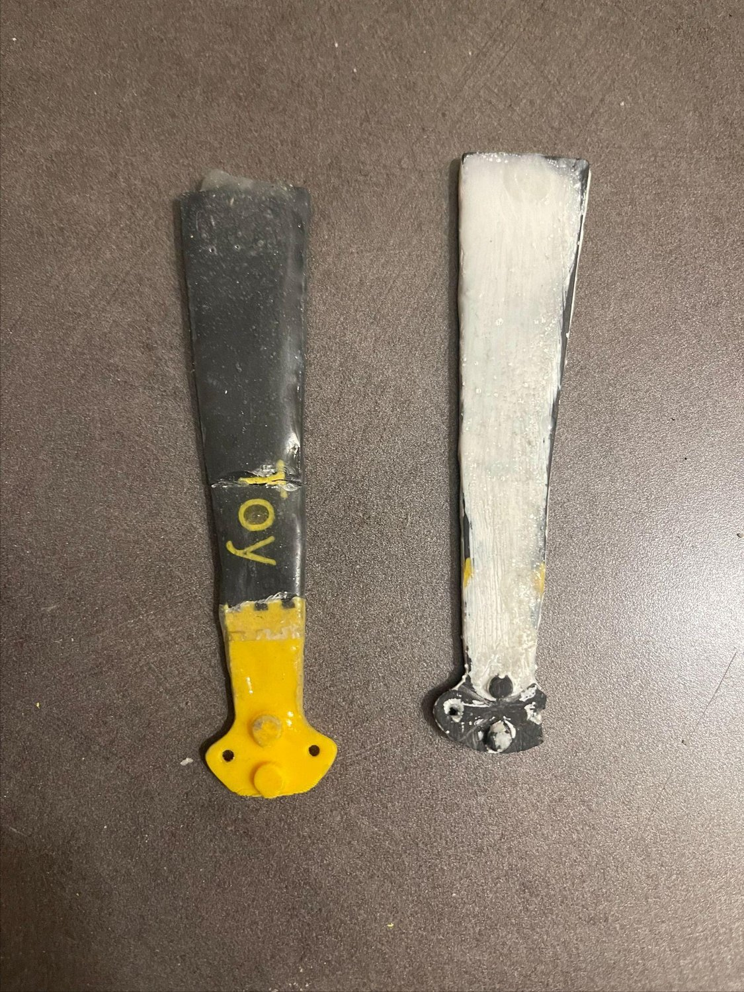
PASSION PROJECT
Pin force stress failure
Tungsten epoxy or PLA as the tang failed at the pivot holes
Issue:
Pinholes too small: rotation forces broke the rivets out
Solution:
Pivot hardware: 1.5 mm OD brass rivets → 4 mm Chicago screws
Tang CNC’d in aluminum

Slide 15
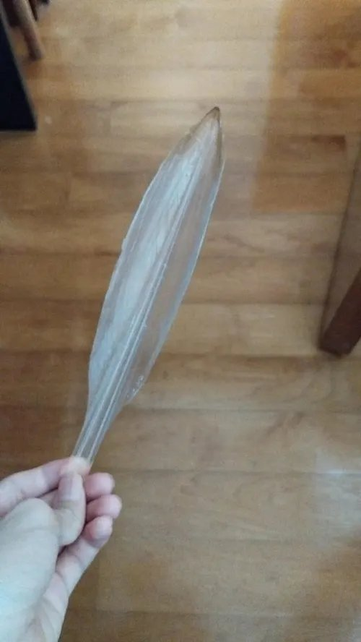
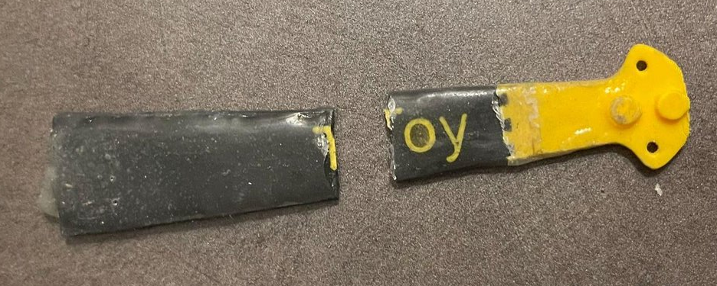
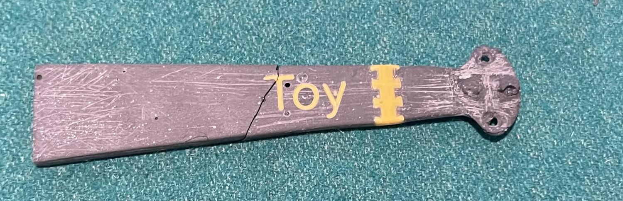
PASSION PROJECT
Body force stress failure
Tungsten epoxy is brittle
Press fitting “Toy” lettering caused internal stress in the epoxy
Issue:
Dovetail connector + “Toy” PLA press fit lettering weaken the blade: repeated failure
Solution:
Anneal the blade at 60 °C after press fit to reduce internal stress
Thin coating of performance epoxy on assembled blade
Moved “Toy” lettering up, shrunk letters: more base material
Future design changes:
Plastic squid pen type portion or steel wire inside the blade for increased impact resistance
Embed “Toy” lettering during casting, not press fit after

Slide 16
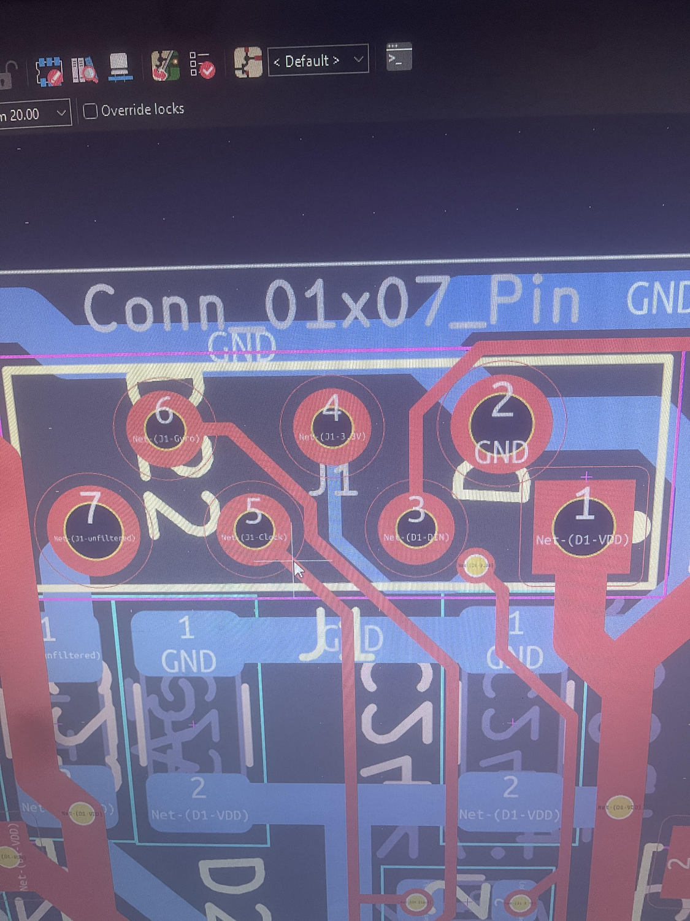
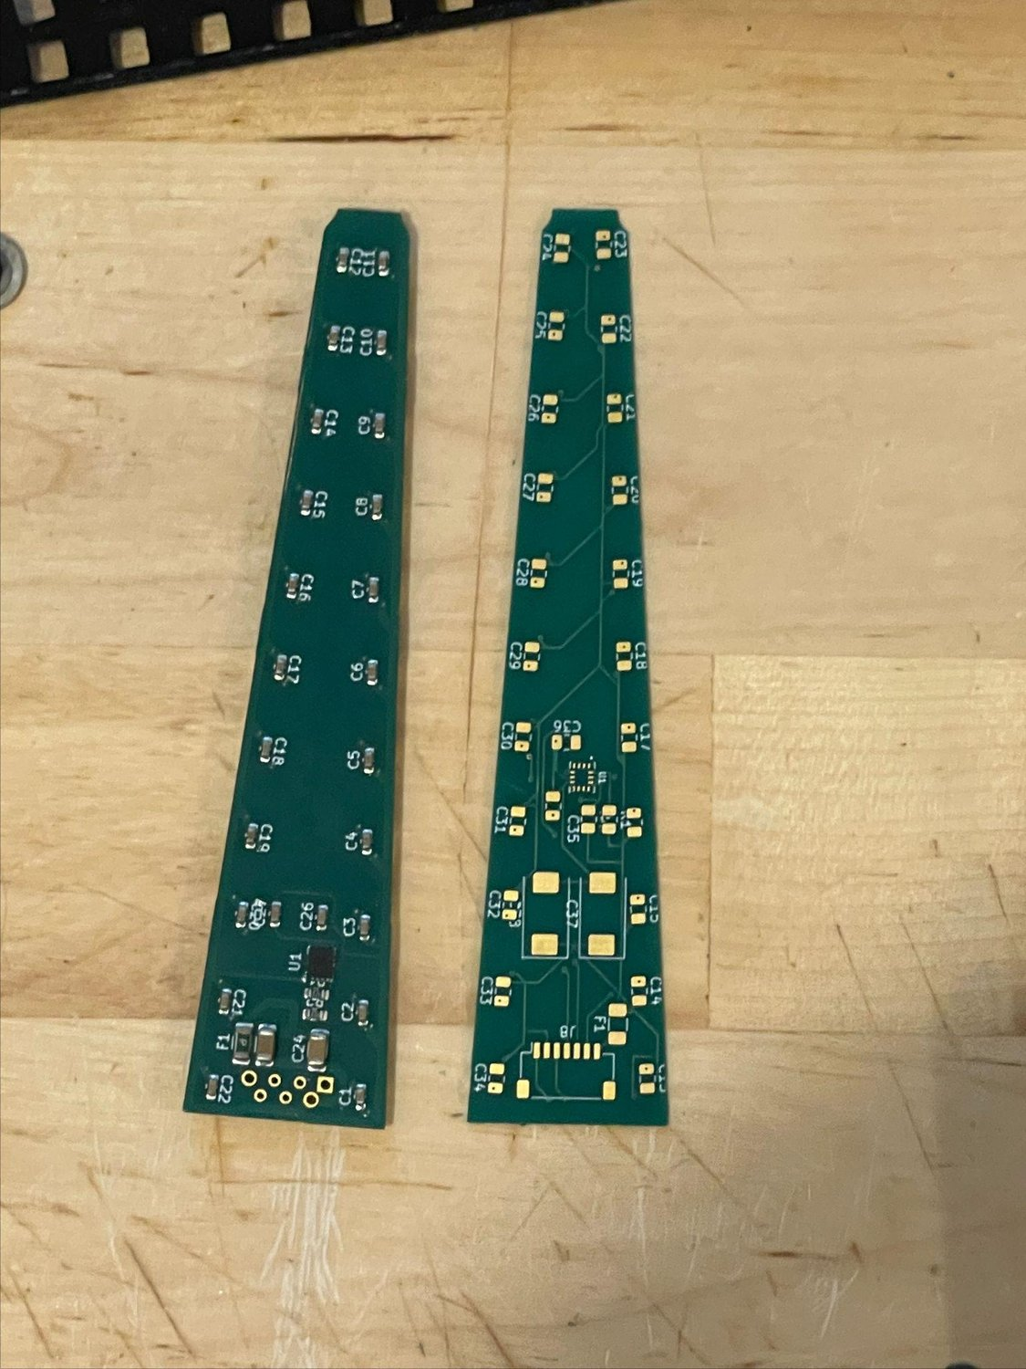
PCB design iteration
Fairly limited exposure to circuits: high school engineering class, college physics; never designed beyond what was needed to pass
Researched components for a functional POV circuit
SK6812MINI-HS (3.7 V nominal): no boost converter or 5 V LEDs, run time boosted by an estimated 1/3
Major issue: assembly short, 3.3 V line right next to ground line → next iteration moves the pin further away or uses 2 JST connectors
Swapped JST for a 7 pinhole connector: lower height, better fit in the body
7 pin 1 mm pitch JST: current would exceed the power and ground line rating
Low and high current JST split planned

Slide 17

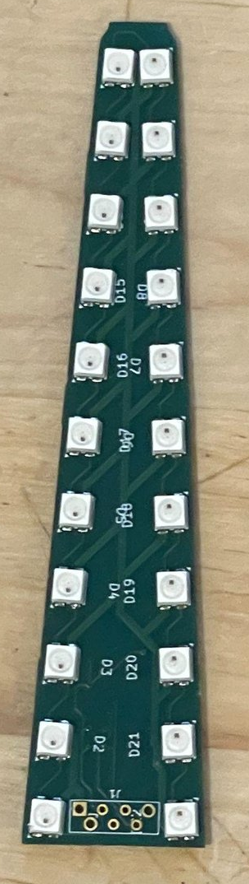
PASSION PROJECT
Software
Uploaded image split into 17 concentric rings × 256 slices (about 1.4° per slice)
Code detects blade movement via the IMU
ESP32 reads IMU data, finds its handle’s center line in the polar array that stores the image
Each LED’s offset from centerline + trig → its color as it sweeps the polar array
LEDs aren’t in a straight line, so each has its own offset value
Future: app interface to upload any image, mapped to the LEDs, without reformatting the ESP32

Slide 18
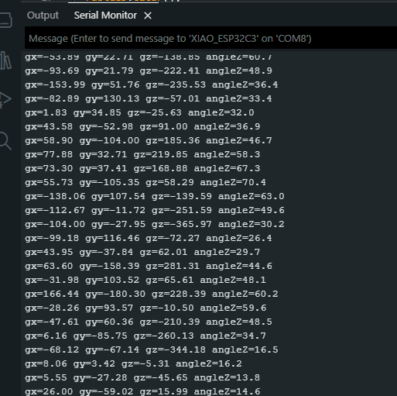
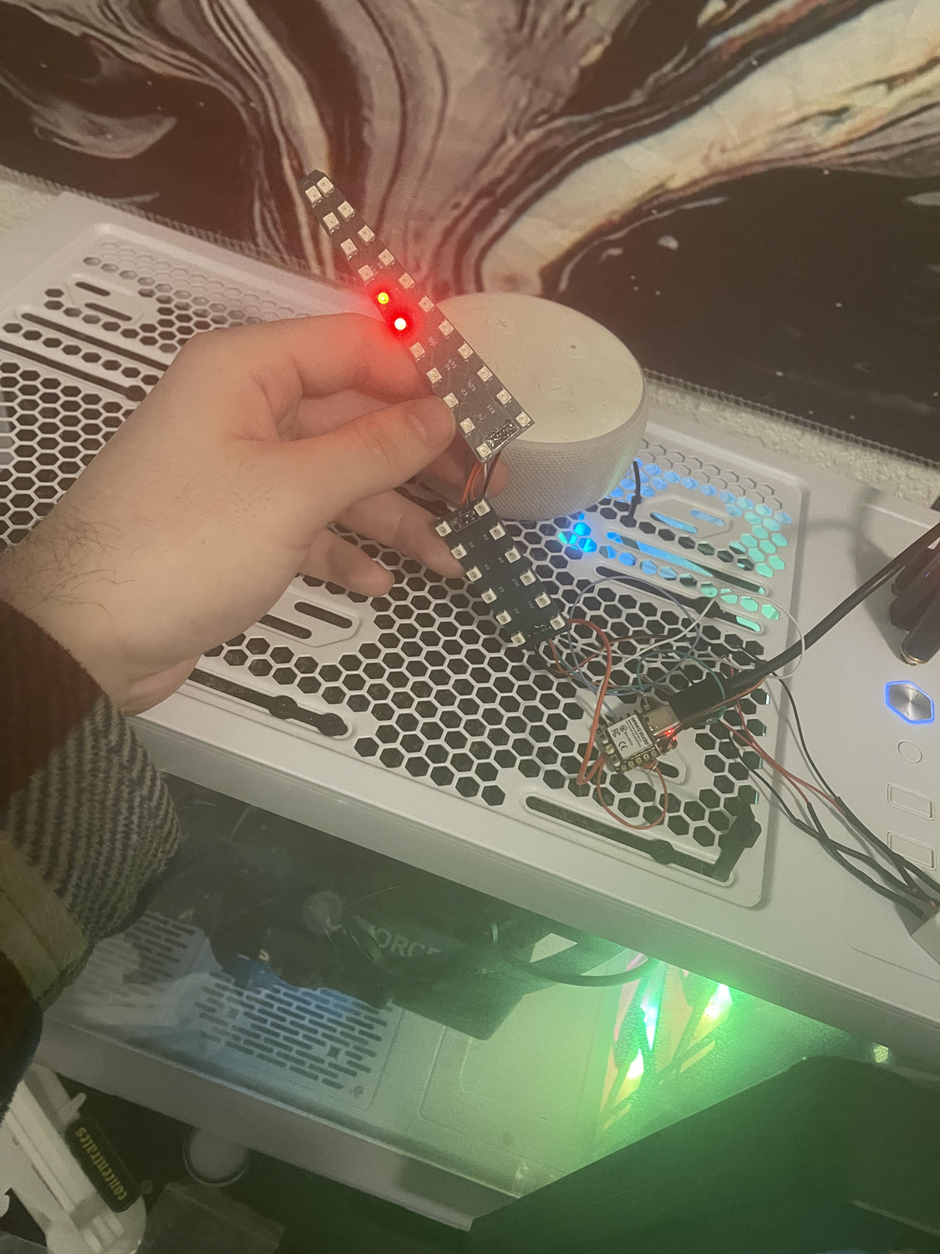
PASSION PROJECT
Testing and assembly
Assembly doc for consistent assembly
Continuity test the bridge after solder
Once soldered, software test outside the housing
Verify the IMU is outputting values
Verify the LED chain is unbroken
Both pass → seal shell, test again, then heat weld the shell

Slide 19
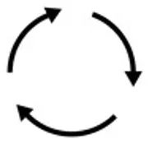
Future design plans
Software to upload images from your phone directly to the ESP32, no reformatting
Potting compound in pommel + battery section for further impact protection
Move 3.3 V connector pin away from ground to avoid bridging
Reinforce blade portion: steel wire or squid pen
2 JST connectors for faster assembly (+ and − vs low current split)
Injection mold tooling for faster build time

Slide 20
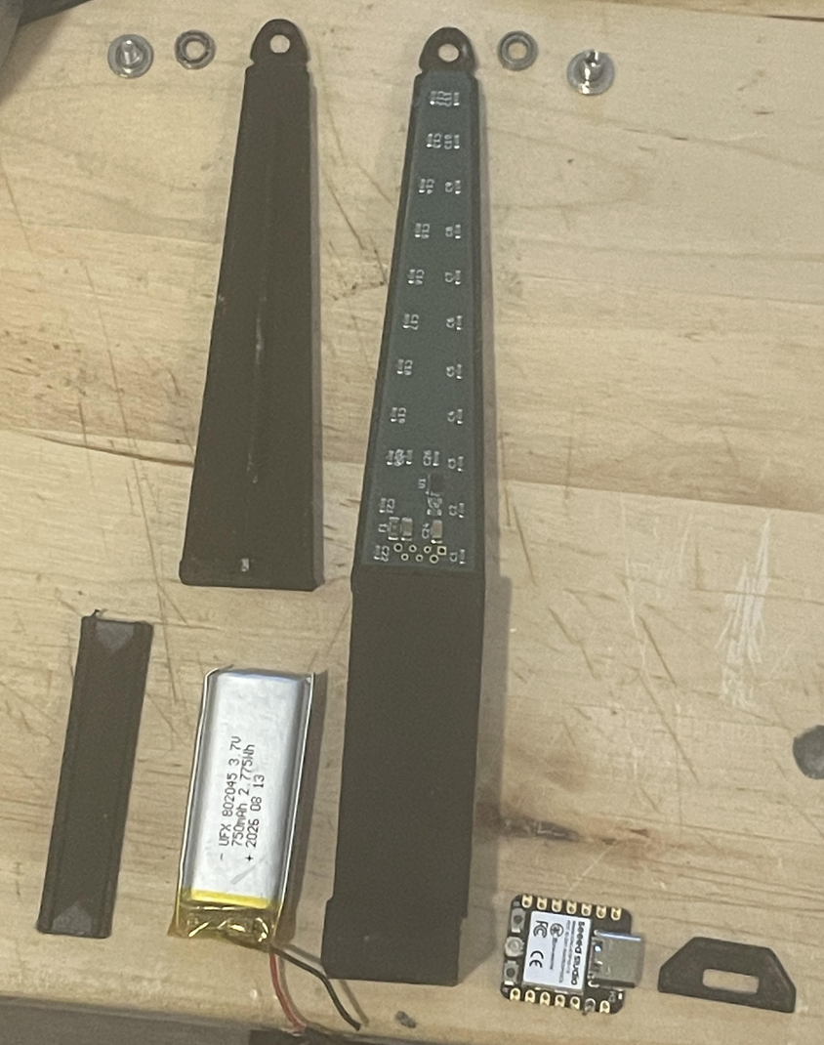
Final remarks / future plans
Idea stage to physical hardware prototype that functions as I imagined
Demonstrates learning new domains, iterative design, problem solving, self directed learning
Learned KiCad + soldering from scratch; relearned Autodesk Fusion, Blender, Arduino IDE; learned to work with manufacturers + test their parts
Proud of all my projects; most are on my GitHub: Elijah-w15
Happy to answer questions on this or any project in the interview portion

Slide 21
Thank you for your time.
Any Questions?

