Slide 1


Slide 2

About Huawei
Slide #2
180,000
36
14
Employees
Innovation Centers
Offices
Founded in 1987, Huawei is a leading global information and communications technology (ICT) solutions provider.

Slide 3
Financial Highlights
Slide #2
Revenue
Operating profit
CNY Million
CNY Million
CAGR
CAGR
26%
21%
+ 433,002
+ 39,082
14
15
16
17
18
14
15
16
17
18
CAGR - Compound Annual Growth Rate

Slide 4
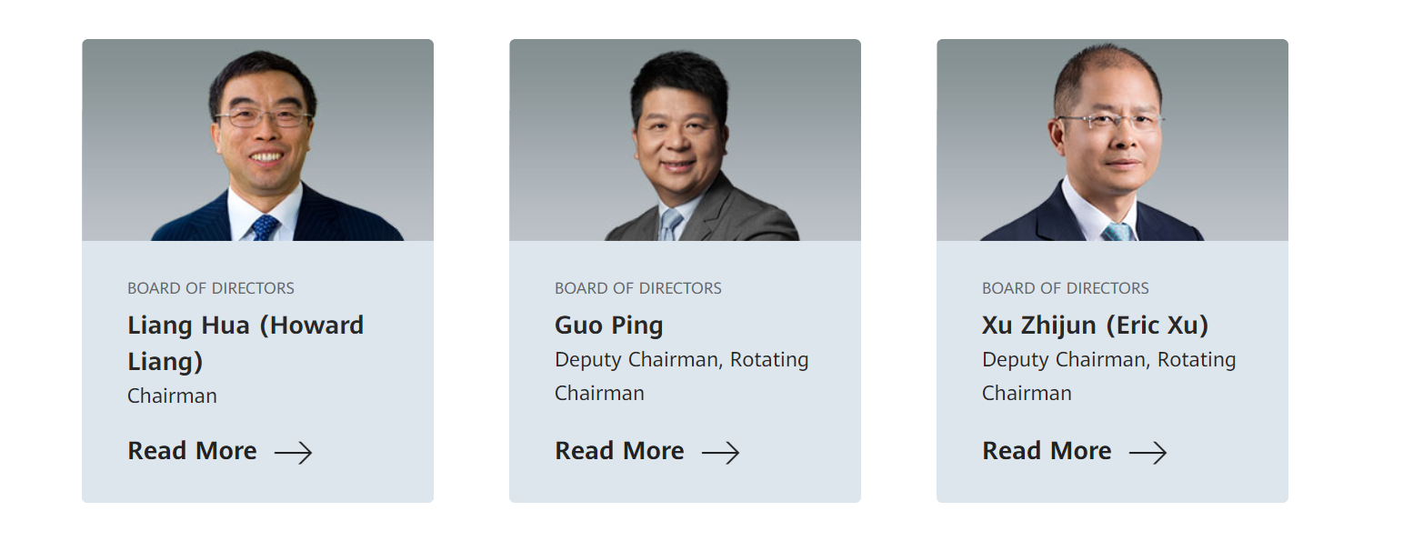
Board of Directors
Slide #2

