Slide 1
Getting started with azure machine learning
Elijah Kulesa

Slide 2
Overview
Introduction to Machine Learning
Automobile Price Experiment
Meeting the Models
Q&A

Slide 3
What is Machine learning?
A Quick Introduction

Slide 4
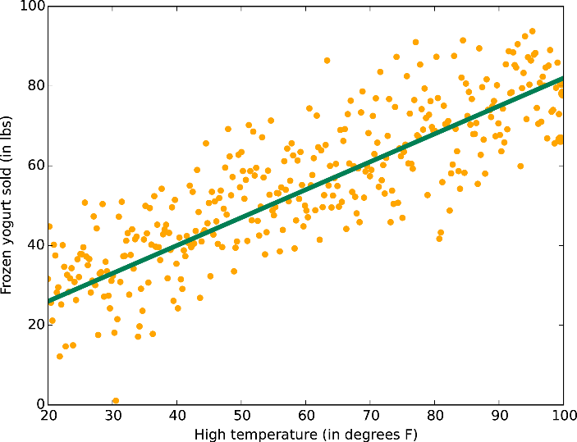
Predicting Data with Models
Pre-Built
Configurable
Trained

Slide 5
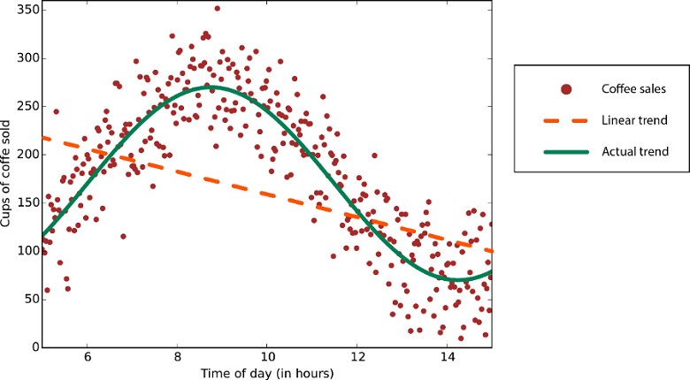
Data Manipulation
Clean Data
Consumable Data
Biased Data

Slide 6
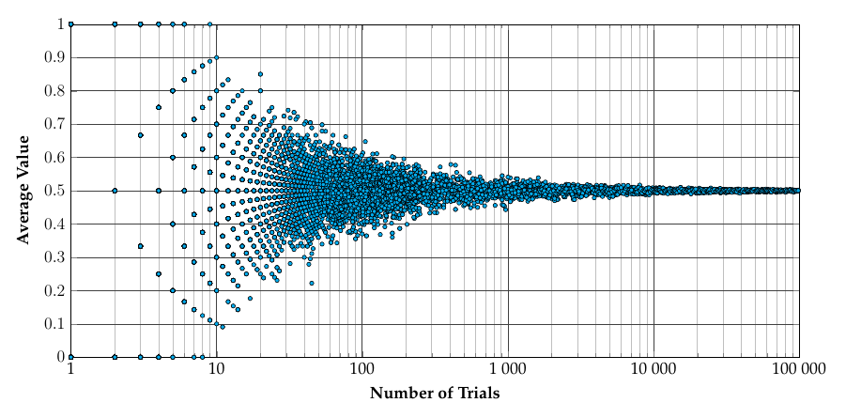
Statistics
Law of Large Numbers

Slide 7
Workflow in Azure ML Studio
Import Dataset
Split Dataset
Initialize / Train Model
Score Model
Evaluate Model
Data Manipulation

Slide 8
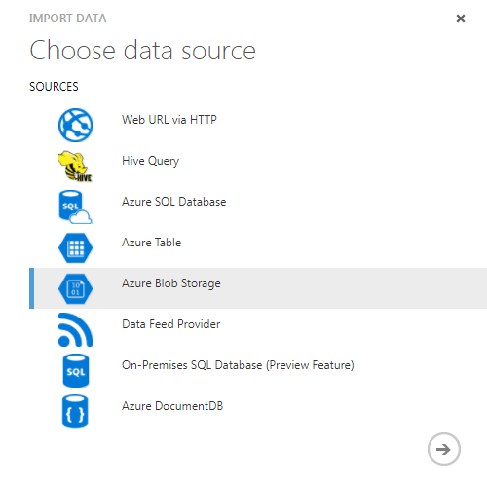
Import Data
From file
From Azure account
From URL
Sample Datasets

Slide 9
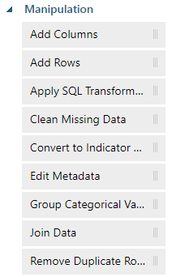
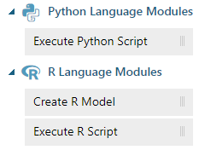
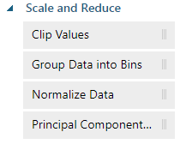
Data Manipulation
Make data consumable
Bias if needed
Scripts!

Slide 10
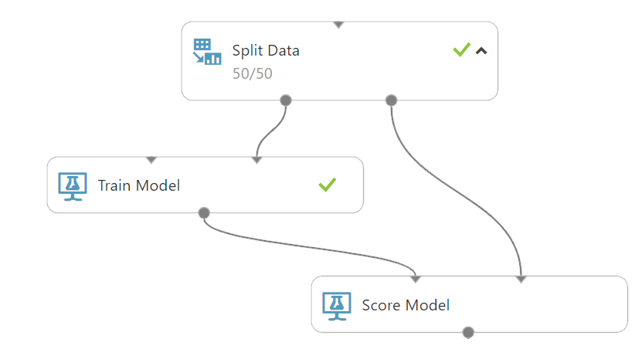
Split Dataset
Training vs Scoring
Ratio

Slide 11
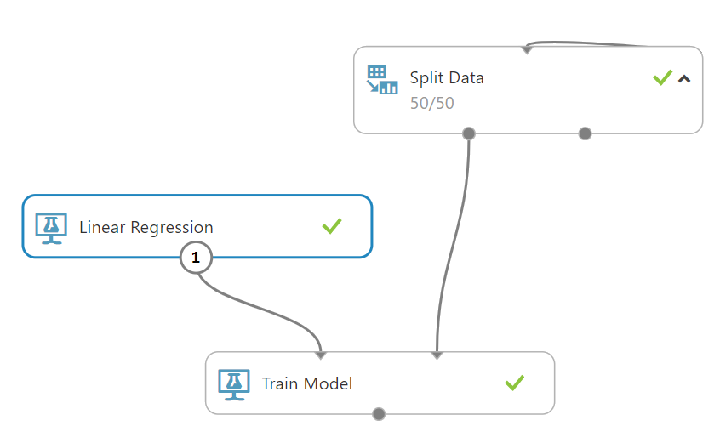
Initialize/Train Model
Linear Regression
Train with Dataset

Slide 12
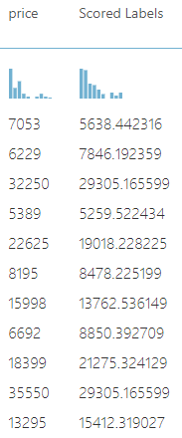
Score Model
Use Trained Model
Scoring Dataset

Slide 13
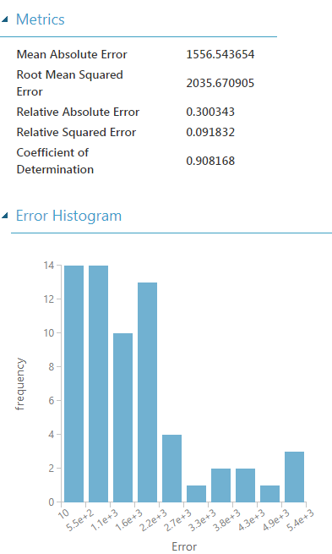
Evaluate Model
Summary of Scores
Predictability
Comparison

Slide 14

Demo

Slide 15
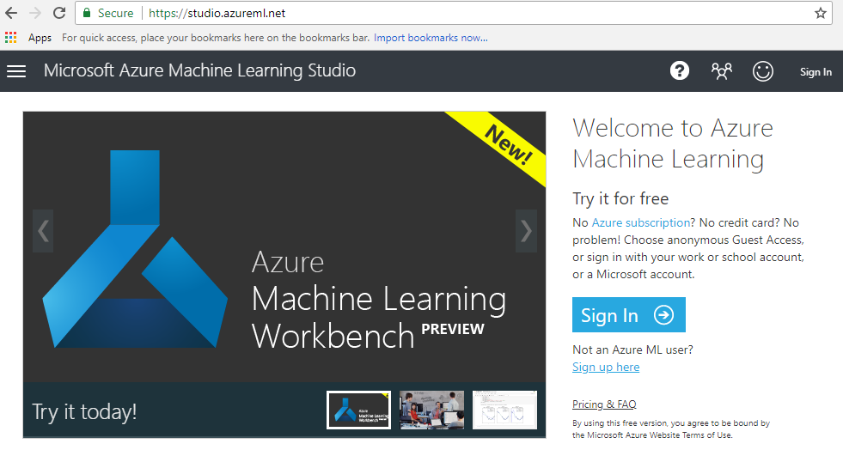

Slide 16
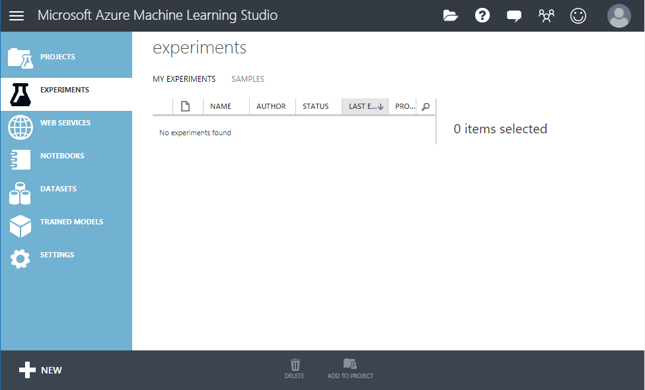
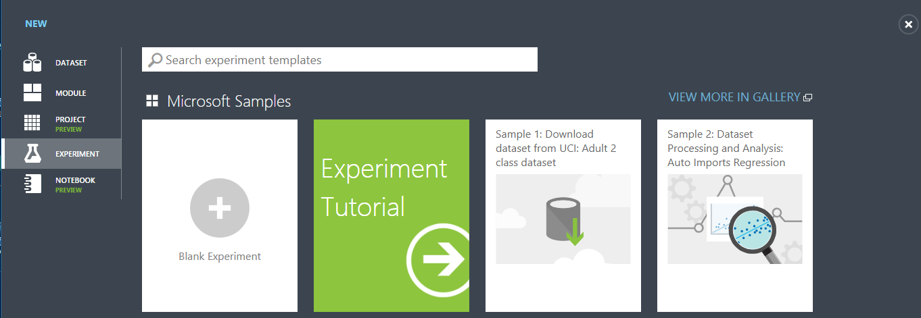

Slide 17
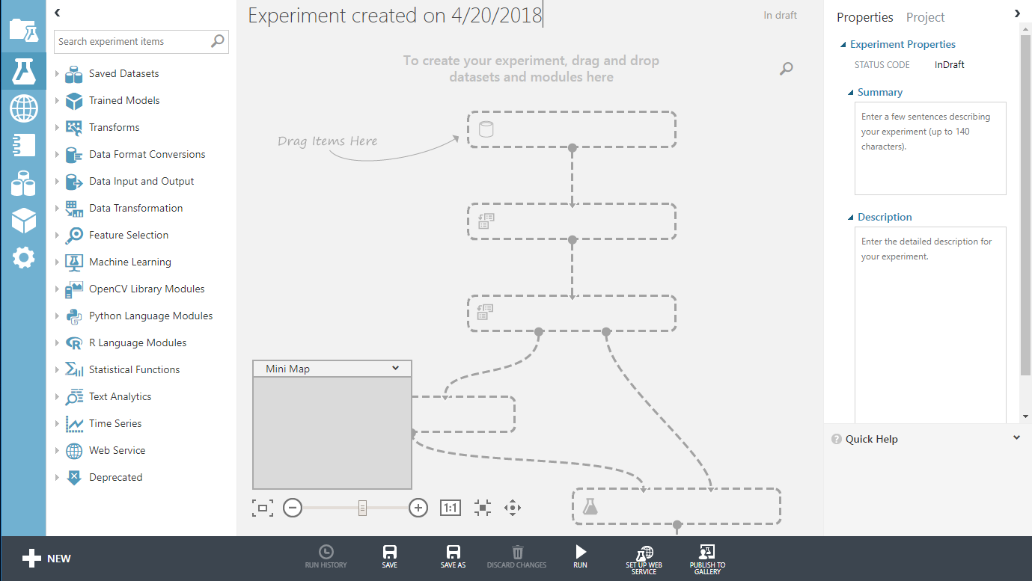
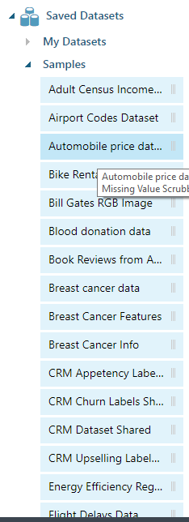

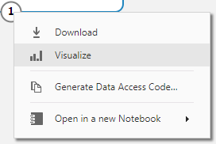

Slide 18
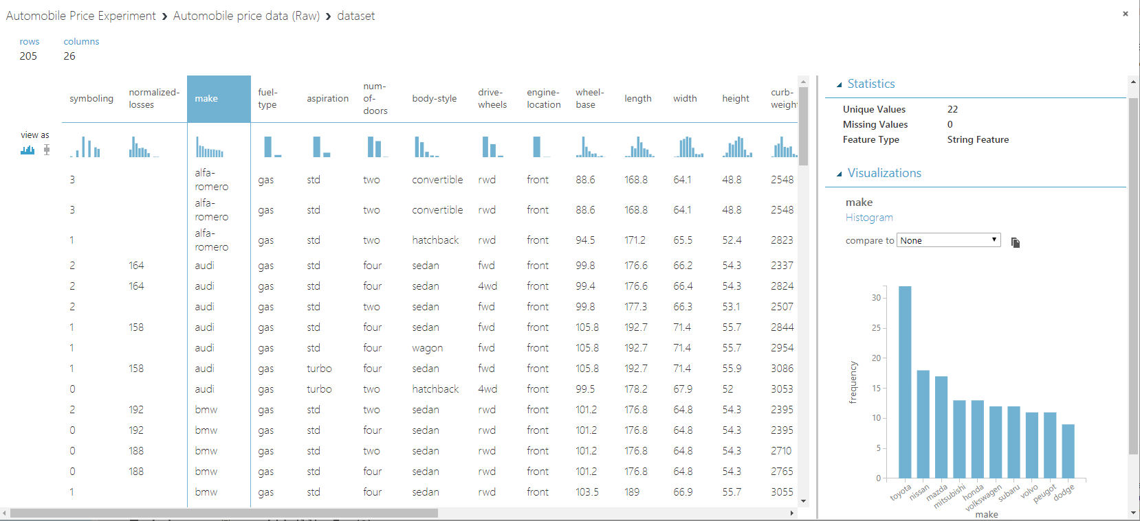
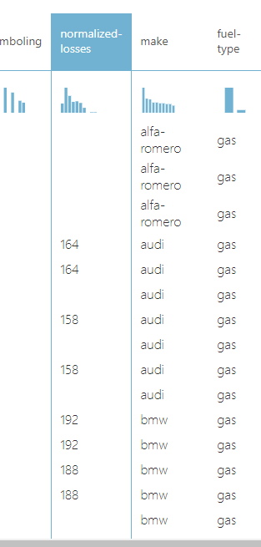
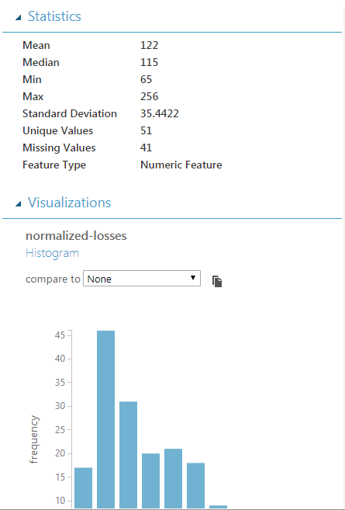

Slide 19
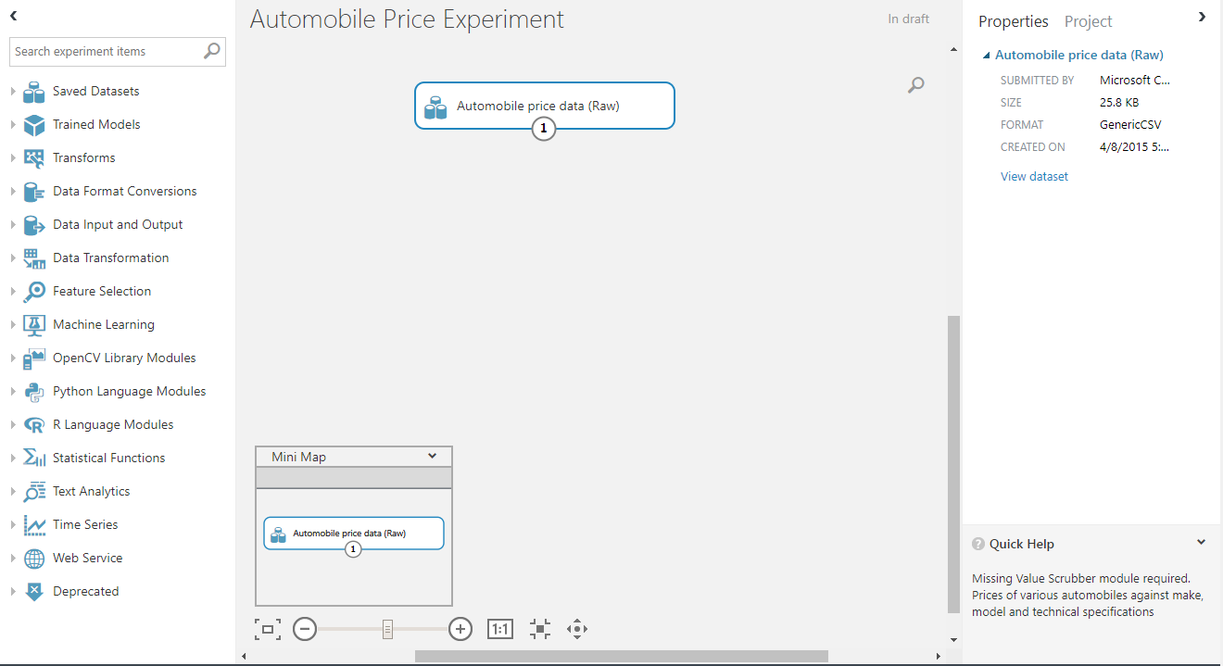
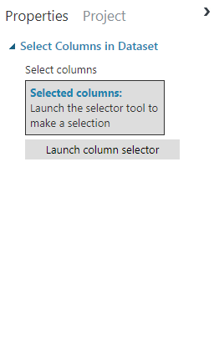
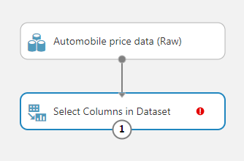
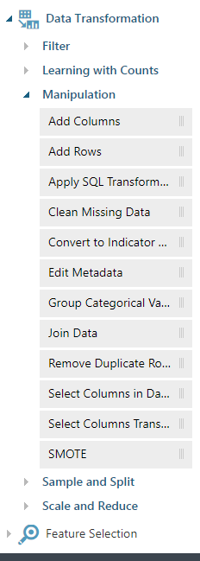

Slide 20
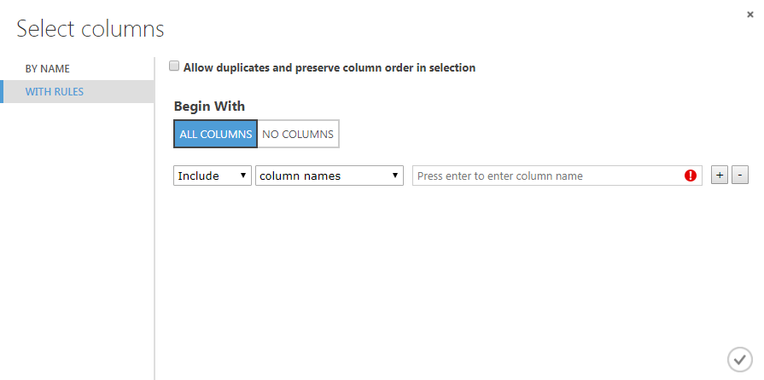
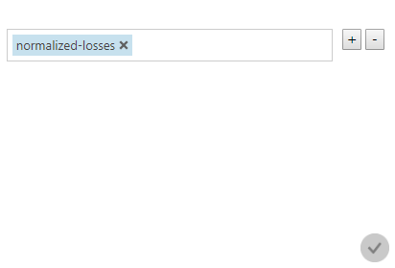


Slide 21
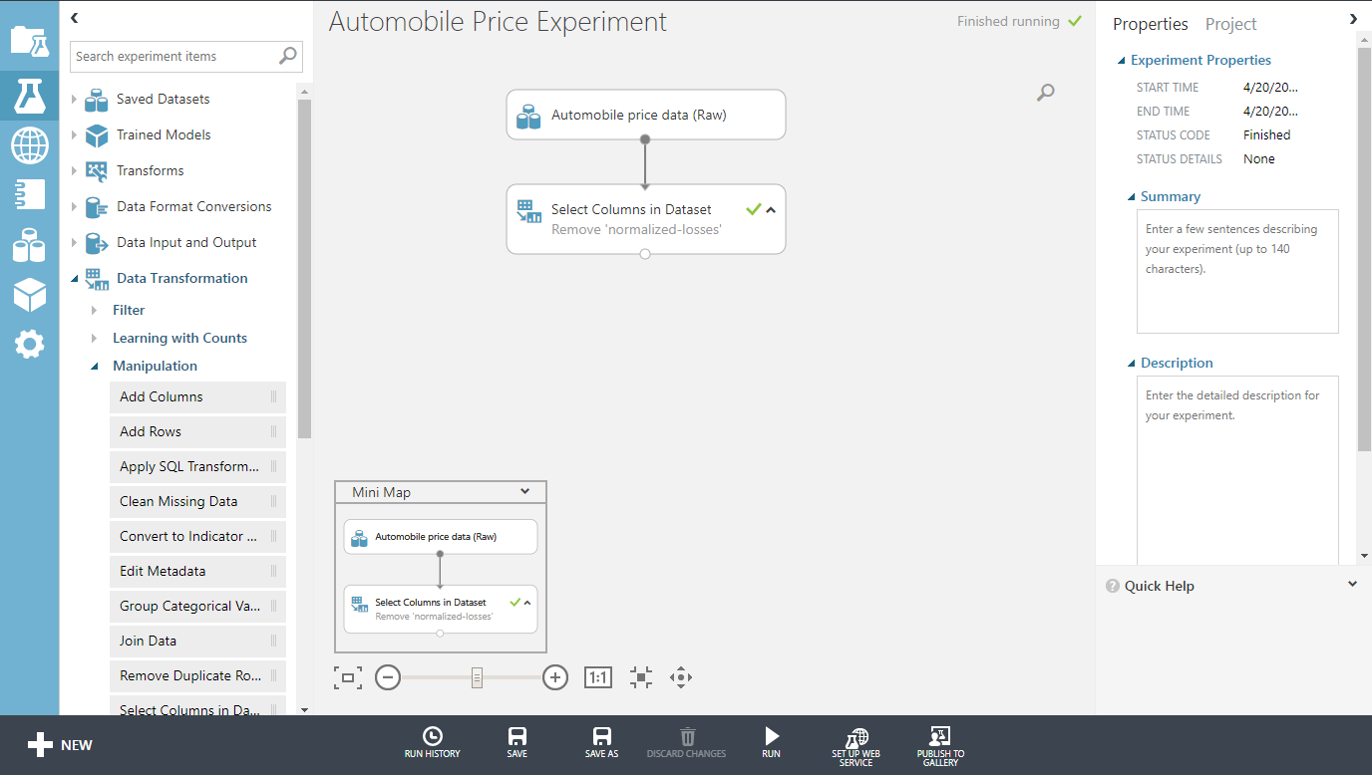
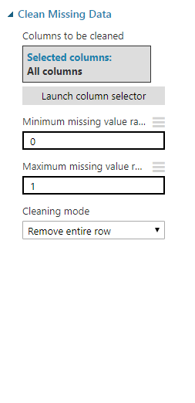
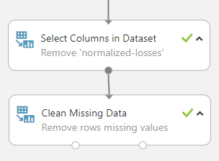

Slide 22
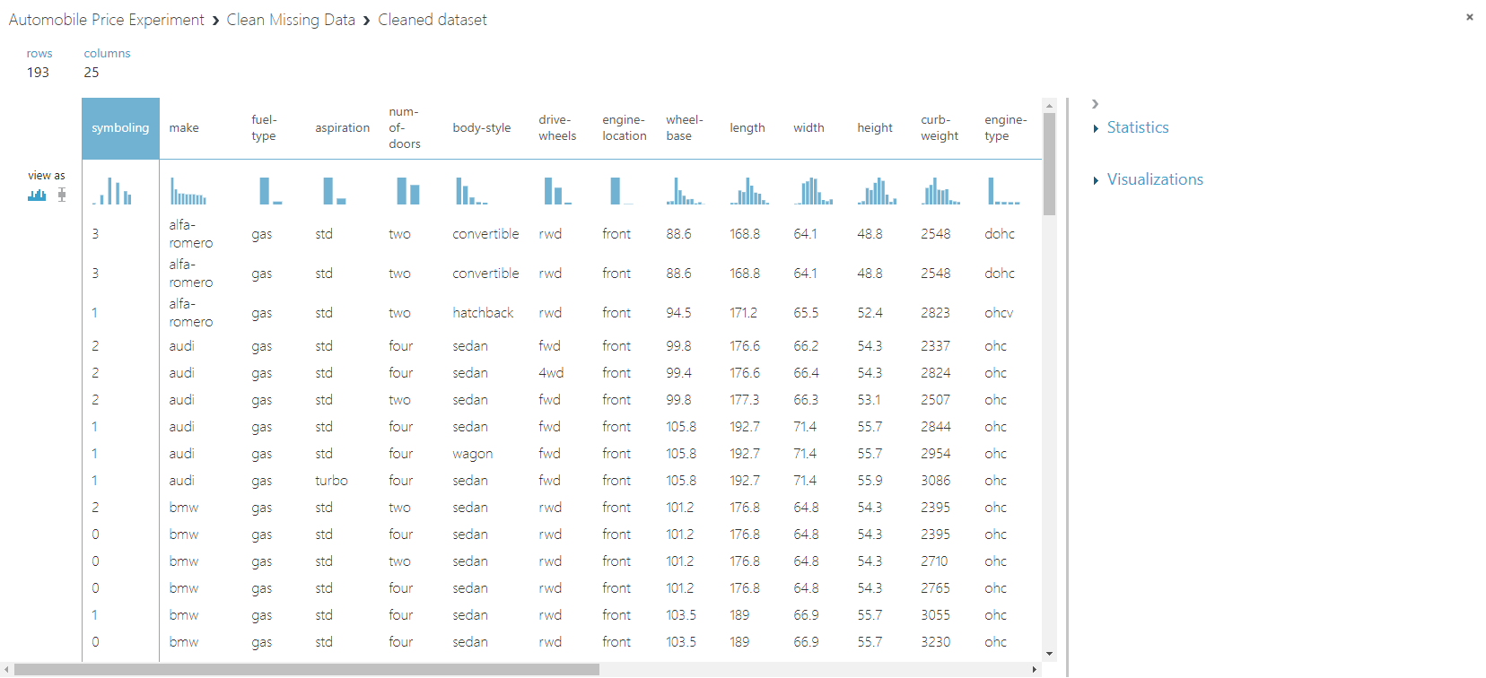

Slide 23
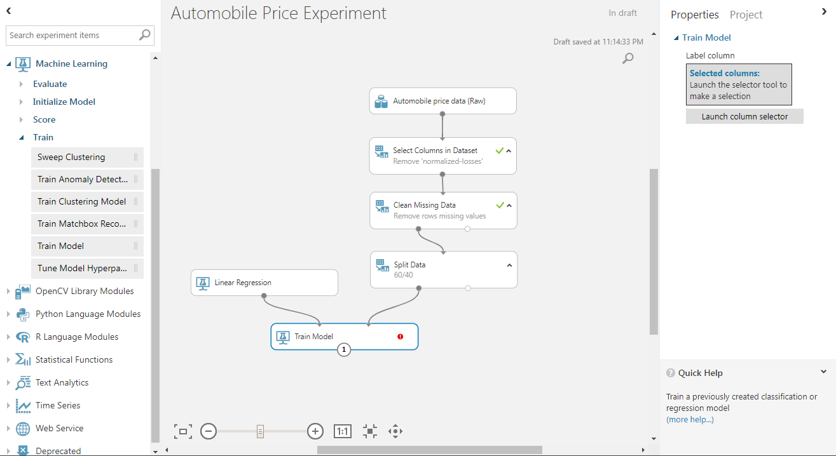
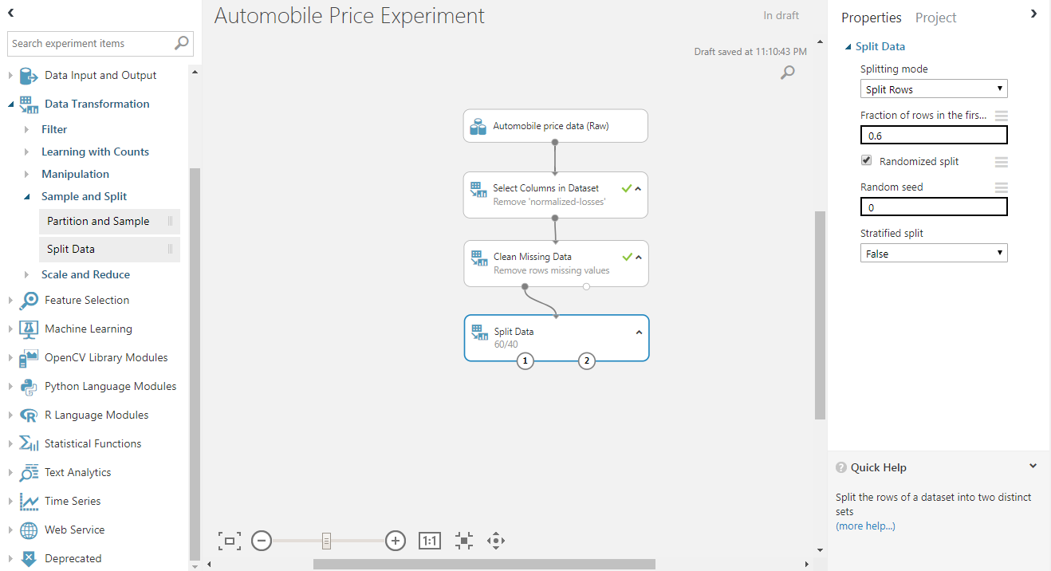
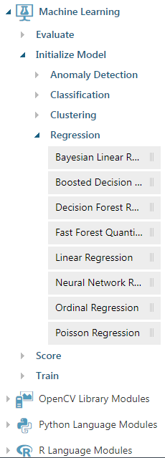
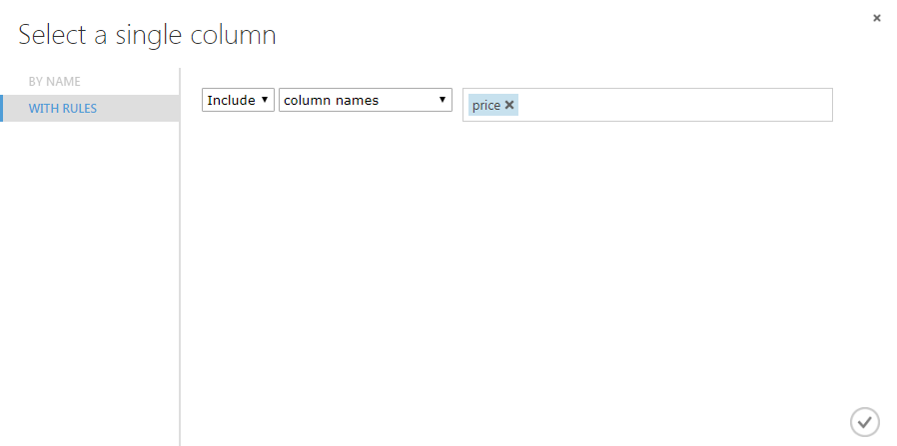

Slide 24
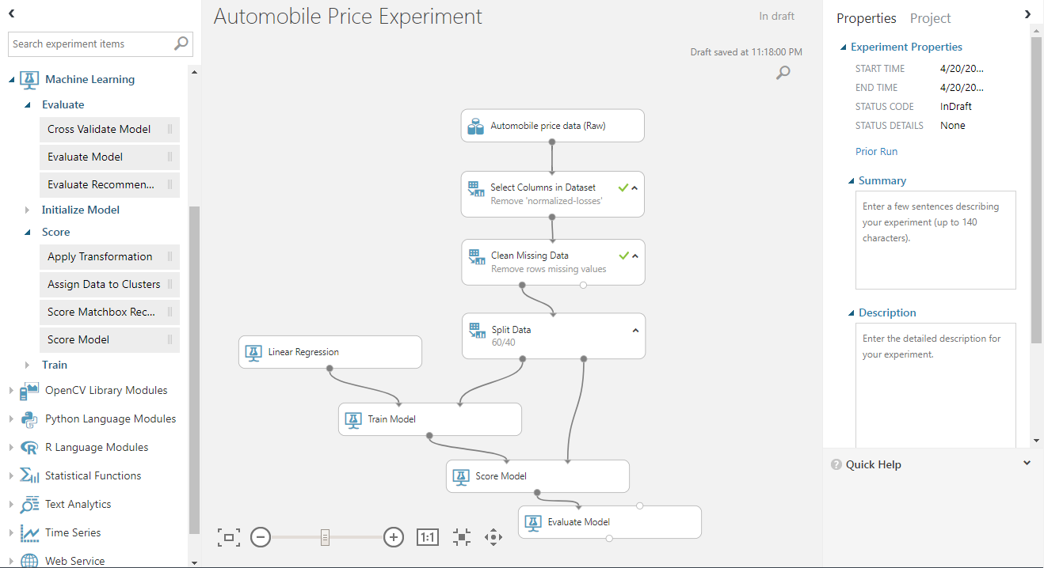

Slide 25
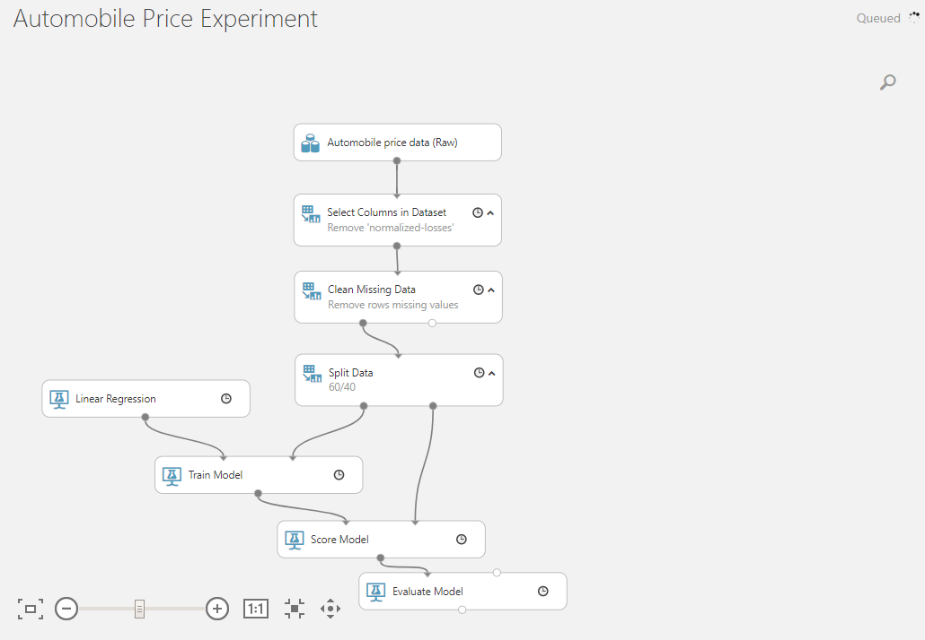

Slide 26
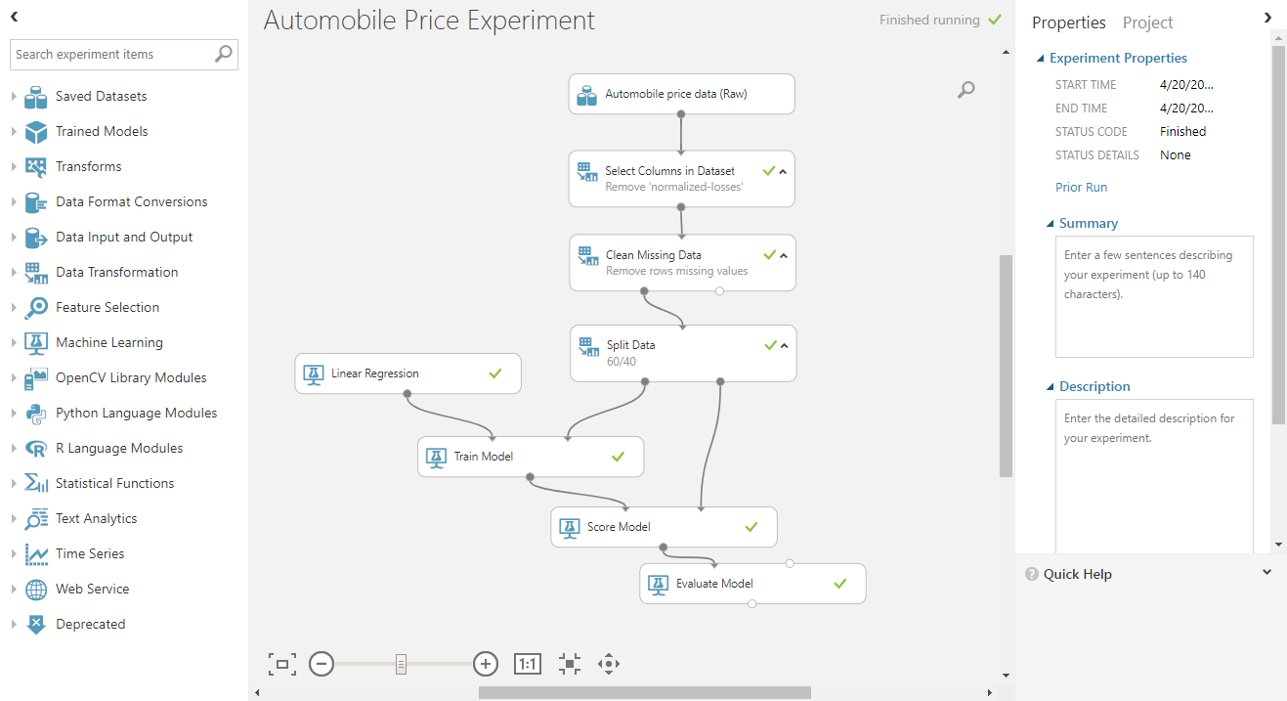
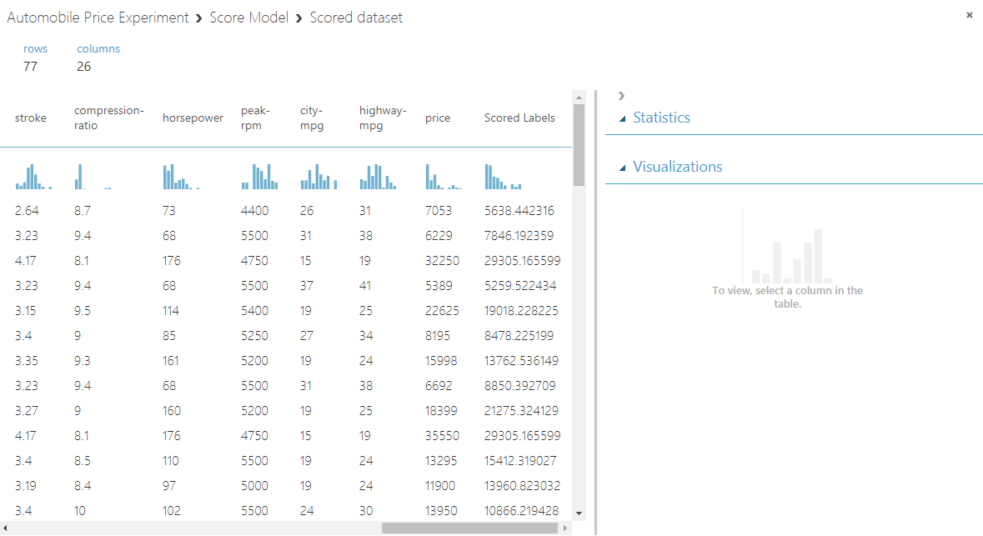

Slide 27
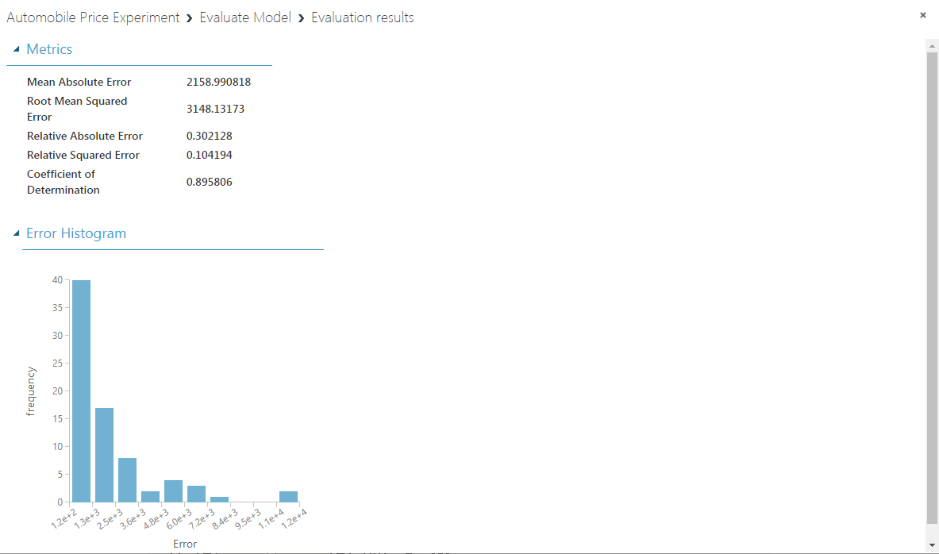

Slide 28
Meeting the models
An Adventure in Algorithms

Slide 29
Supervised
Predicting from Known Data
Classification
Regression
Anomaly Detection

Slide 30
Unsupervised
Organizational
No Labels (Predictions)
Only K-Means

Slide 31
Reinforcement
Action
Adapt & Overcome

Slide 32
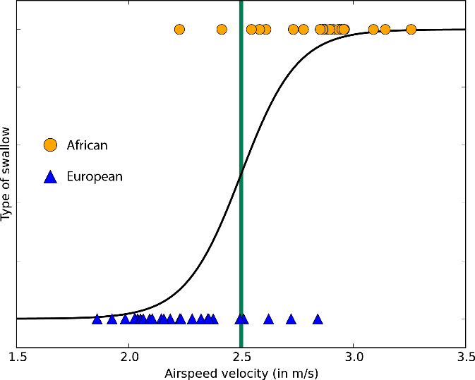
Regression
Linear
Logistic

Slide 33
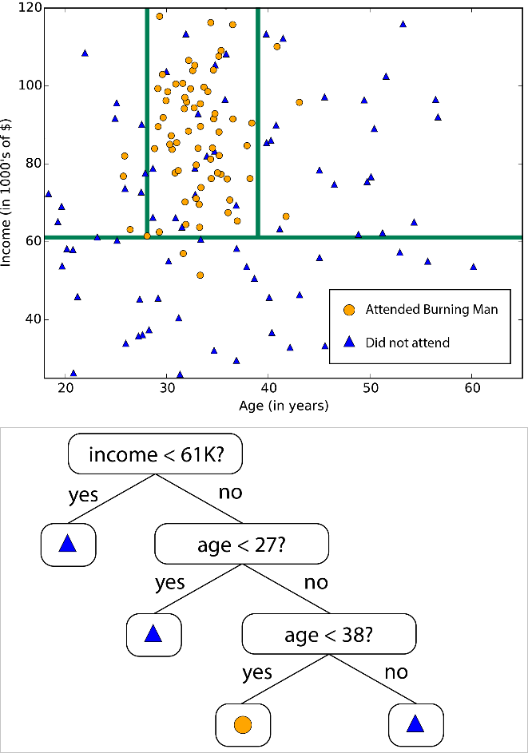
Decision Trees
Subdivide Data
Varies

Slide 34
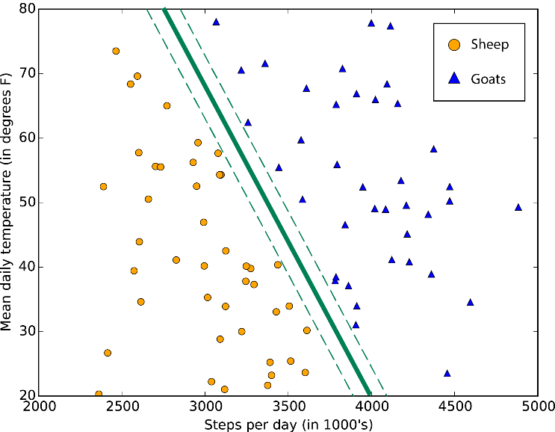
Support Vector Machines (SVMs)
Divide Data
2-Class Locally Deep
Anomaly Detection

Slide 35
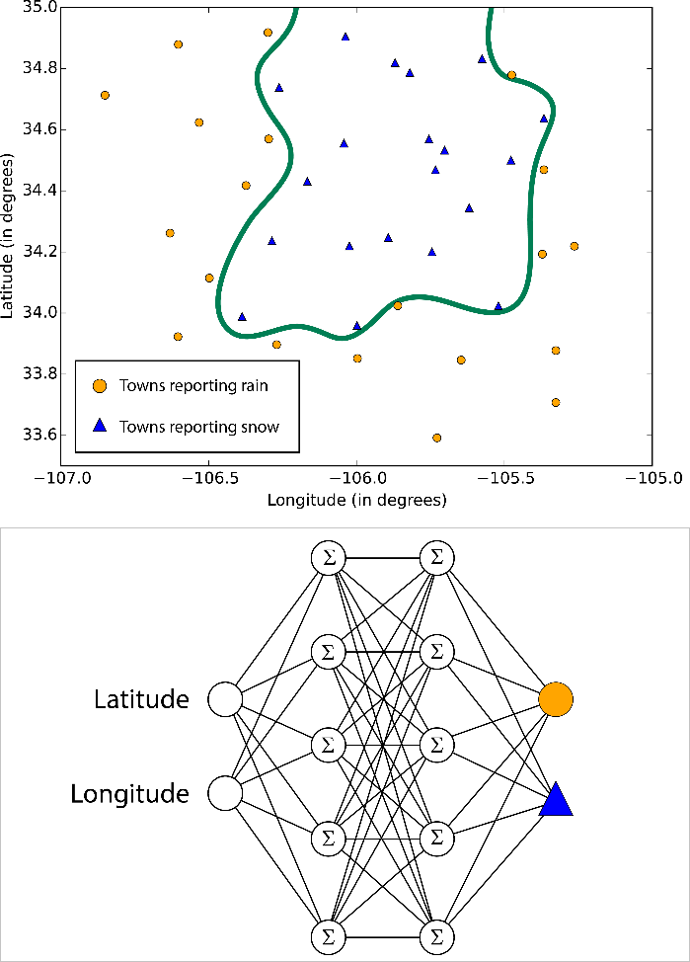
Neural Networks (and Perceptrons)
Brain-Based
Inputs Passed until Outputs

Slide 36
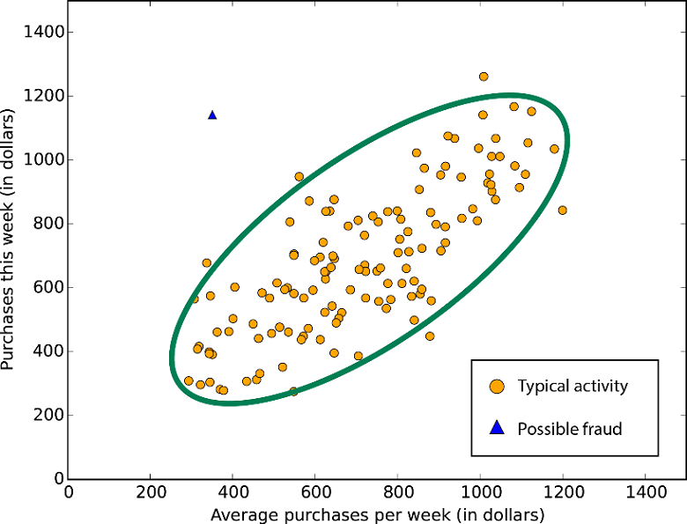
Principal-Component Analysis
Anomaly Detection
Differences

Slide 37
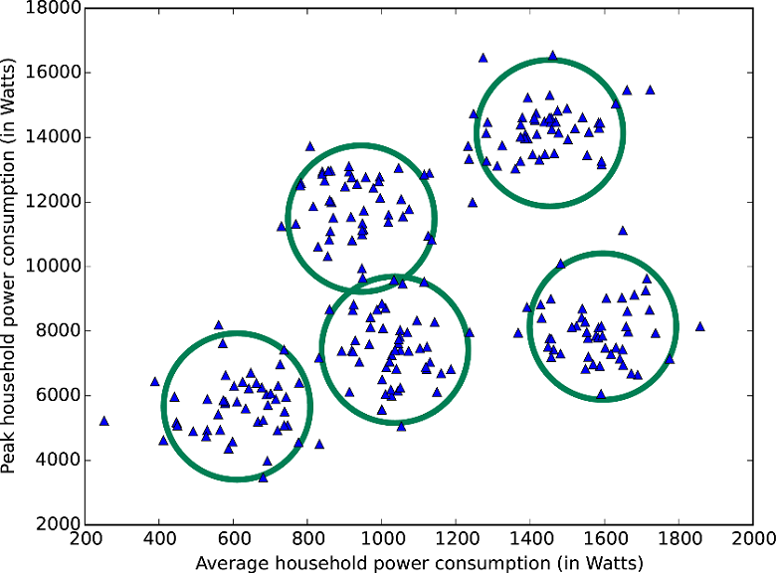
Clustering (K-Means)
Groupings
Unsupervised
Not Scored

Slide 38
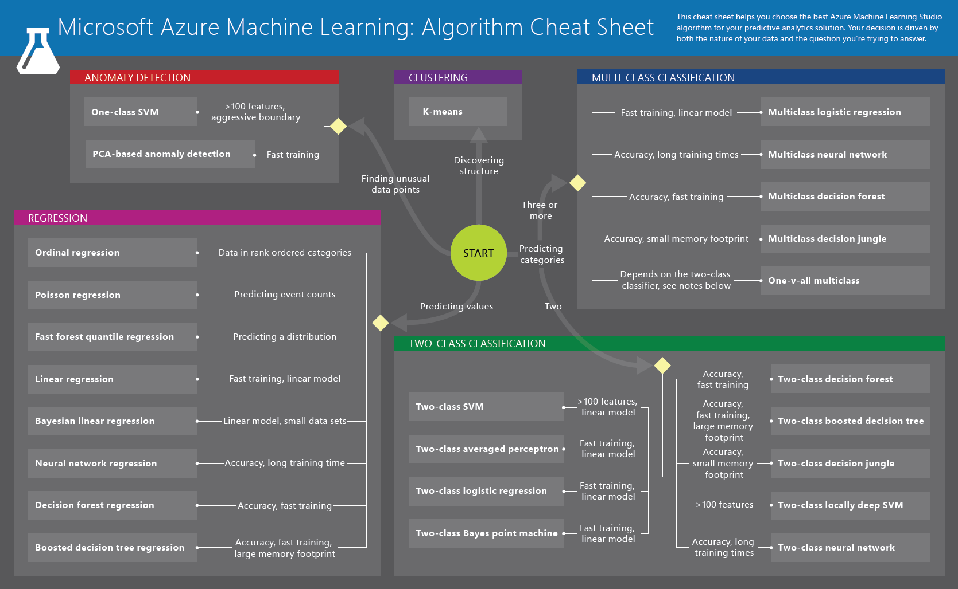

Slide 39
Q & A

Slide 40
Thank you!
Looking for summer work after graduation.
If interested, email me @
ElijahKulesa@gmail.com

