Slide 1
Optimal Transport Based Bayesian Inversion with Application to Signal Processing
By: Elijah Perez

Slide 2
Bayesian Inversion
Goal: Find conditional probability of parameter
Use Bayes’ theorem to find the conditional probability of parameter
Allows us to solve for conditional probability of input parameter given observation, hence inversion

Slide 3




Bayesian Inversion Cont.
Parameter vector:
Observed quantities:
Predicted quantities:
Predictive quantities are found from a forward model that depends on parameter:

Slide 4



Bayesian Inversion Cont.
Bayes’ Theorem:
Posterior:
Prior:
Likelihood:

Slide 5
Bayesian Inversion Cont. Likelihood Structure
Common likelihood is the Gaussian likelihood
Gaussian Likelihood:
Gaussian likelihood does not handle phase shift well

Slide 6
Bayesian Inversion Cont. Likelihood Structure
When selecting a likelihood, there are several things to consider:
Is the signal multidimensional?
What is the noise structure of the observed signal?
Is the likelihood function convex for the specific application?
With these considerations, the Gaussian likelihood is not always the best choice

Slide 7
Optimal Transport
Motivation: Concepts from optimal transport allow us to create likelihood functions that handle complicated noise structure, are more convex for problems with phase shift, and do not assume statistical independence for multidimensional signals.
The two concepts from optimal transport used are the Wasserstein distance and Debiased Sinkhorn Divergence.

Slide 8

Optimal Transport Cont.
Probability Vectors:
Defined on n points:
Define transport polytype:
Matrix P is a transport matrix that encodes a transport plan

Slide 9




Optimal Transport Cont.
Define cost function: so that
represents the cost of transporting one unit of mass from point x to
point y
Cost matrix:
Transport cost: ,

Slide 10

Optimal Transport Cont. Wasserstein Distance
Let matrix C be defined by a distance function:
Wasserstein Distance:
Note that the order p=2, one dimensional, squared Wasserstein distance is used for the applications in this talk.

Slide 11




Optimal Transport Cont. Sinkhorn Divergence
Now regularize problem by adding entropic term:
, ,
Suppose that this regularized problem has solution
Sinkhorn Divergence of order p:
This is the Wasserstein distance of the regularized problem

Slide 12
Optimal Transport Cont. DSD
DSD (Debiased Sinkhorn Divergence) allows us to create a distance function based on Sinkhorn Divergence.
DSD of order p is defined as:
In numerical examples, DSD of order p=2 is used

Slide 13

Optimal Transport Cont. Sinkhorn’s Algorithm
Lagrangian of regularized problem:
Setting we obtain:
Or in matrix factorization form:
Notes:
lambda

Slide 14

Optimal Transport Cont. Sinkhorn’s Algorithm
Now, we obtain equations:
Where is the Hadamard (entrywise) product.
Sinkhorn’s algorithm:
Where is the Hadamard (entrywise) division.

Slide 15
Optimal Transport Cont. Sinkhorn’s Algorithm
Tolerance:
Sinkhorn Divergence of order p:

Slide 16




Optimal Transport Cont. Computational Cost
Wasserstein distance with signal dimension has cost of
Sinkhorn divergence has cost of if cost matrix C is chosen naively.
With a better choice of cost matrix and with data on a regular grid, Sinkhorn divergence can have cost of
Notes:
A regular grid is a tessellation of n-dimensional Euclidean space by congruent parallelotopes

Slide 17
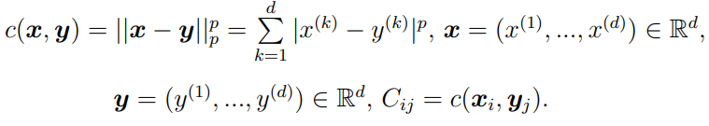
Optimal Transport Cont. Computational Cost
One choice of cost matrix to decrease computational cost of Sinkhorn divergence is:

Slide 18

Optimal Transport Likelihoods
Using an exponential likelihood as a base, we can create likelihood functions that utilize the Wasserstein distance and DSD.
Wasserstein likelihood:
Note that represents the squared one-dimensional Wasserstein distance of order p=2. For multidimensional applications, a trace-by-trace approach is used (described in [15]).

Slide 19

Optimal Transport Likelihoods Cont.
Using the Wasserstein likelihood as a template, we can create a likelihood based on DSD. Since DSD is still low cost for multidimensional applications, we do not limit it to one dimension like the Wasserstein likelihood.
DSD likelihood:
Note that is a shorthand for DSD of order p=2

Slide 20


Optimal Transport Likelihoods Cont. Convexity
In order to test the convexity of the DSD and Wasserstein likelihoods, we apply the likelihood functions to a set of examples involving phase shift.
Define to be the original signal, and
define to be a signal shifted by a value
s.
Varying s, we can see how well the likelihoods maintain convexity.

Slide 21


Optimal Transport Likelihoods Cont. Convexity
Normalization:
Note that this is done because the given signals are not probability distributions. Both DSD and Wasserstein require the input signals to be probability distributions.

Slide 22
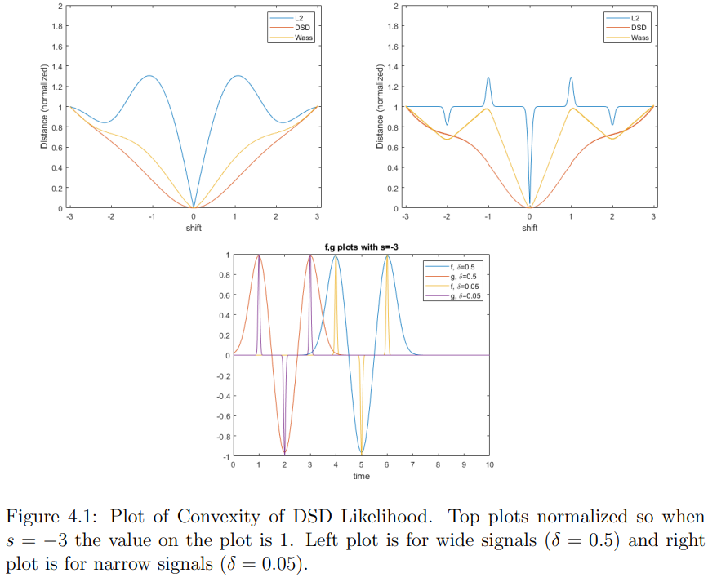

Slide 23

Numerical Algorithm
Two Markov Chain Monte Carlo (MCMC) algorithms combined
Gibbs sampler and Metropolis-Hastings sampler
Metropolis-Hastings-within-Gibbs (MH within G)
Note that:

Slide 24


Numerical Algorithm Cont.
The Gibbs sampler is used to find the posterior for the hyperparameter, s
Suppose s has prior: where both
We then have from Bayes’ Theorem for a fixed parameter vector :

Slide 25
Numerical Algorithm Cont.
We now have posterior for s:
This means the we have a conjugate prior for s
Other priors for s can be used and will result in different posteriors. Gamma prior is chosen here because it is a conjugate prior.

Slide 26




Numerical Algorithm Cont. Metropolis-Hastings sampler
Suppose now we have a fixed hyperparameter s.
Posterior for given again by Bayes’ Theorem:
Given a sample value of ( ) the goal is to generate a new sample.
First generate a candidate sample by drawing a sample from a proposal distribution

Slide 27


Numerical Algorithm Cont. Metropolis-Hastings Sampler
We then accept this candidate sample with probability:
The prior and proposal distributions are still undefined. The prior is typically chosen by an expert based on expert opinion of what is known about the parameter. For the proposal, a Gaussian random walk is used:

Slide 28

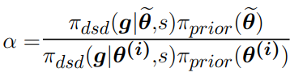
Numerical Algorithm Cont. Metropolis-Hastings sampler
Note that if the proposal distribution is symmetric ( ) the acceptance probability simplifies to:

Slide 29



Numerical Algorithm Cont. MH within G
Initialization: Select an initial starting point with
Normalize: Normalize the two signals and so that they are probability distributions.
Gibbs Sampler: Generate from posterior with:

Slide 30



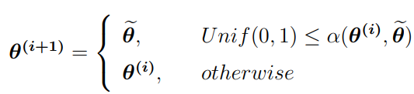
Numerical Algorithm Cont. MH within G
Metropolis-Hastings Sampler: Generate new sample :
Sample a candidate from the proposal distribution
Compute the ratio:
Set:

Slide 31
Numerical Algorithm Cont. MH within G
Iterate: Increment by 1 and repeat again at Gibbs Sampler.

Slide 32
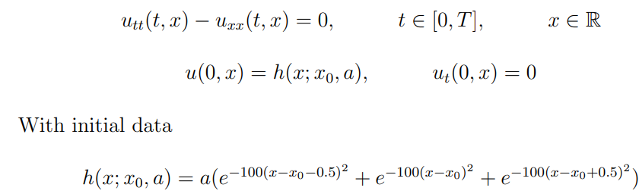
Numerical Examples
Cauchy problem for the one-dimensional wave equation:
With solution (d’Alembert’s formula):

Slide 33





Numerical Examples Cont. Known Posterior
To test the DSD Bayesian framework, it is useful to test a problem for which we know the true posterior
Suppose: with and
receivers with located at:

Slide 34





Numerical Examples Cont. Known Posterior
Receivers record noisy discrete time data over time interval
N discrete time levels with ,
Simulated signal:
Fixed parameter:

Slide 35


Numerical Examples Cont. Known Posterior
Synthetic data generated so that posterior of is known
True posterior:
Sample from and with to obtain:

Slide 36

Numerical Examples Cont. Known Posterior
This means that we know the true posterior distribution for and have used this posterior to create noise for the synthetic data.
Storing and :
Both vectors have entries

Slide 37
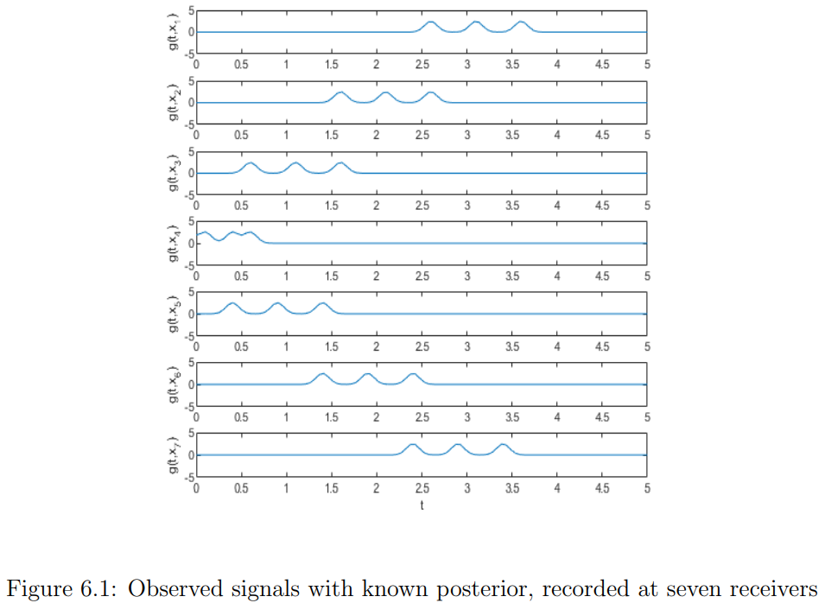

Slide 38
Numerical Examples Cont. Known Posterior

Slide 39



Numerical Examples Cont. Known Posterior
Ran with iterations
Burn (discard) the first
Thinning period of (i.e., every 4th entry is kept)

Slide 40
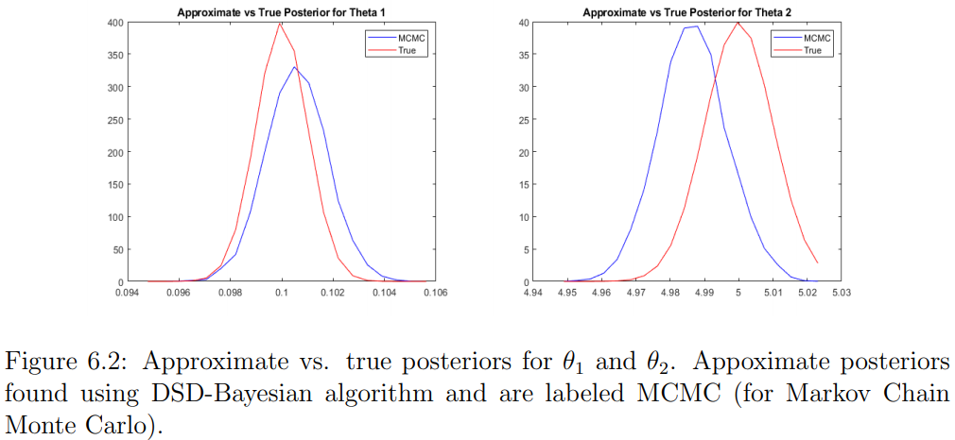

Slide 41



Numerical Examples Cont. Known Posterior
Wasserstein distance can be used to measure the dissimilarity between the posterior found through the DSD Bayesian framework and the true posterior.
With samples, we have Wasserstein distances:
: :
Can get an idea about convergence by measuring Wasserstein distance for varying number of iterations.

Slide 42
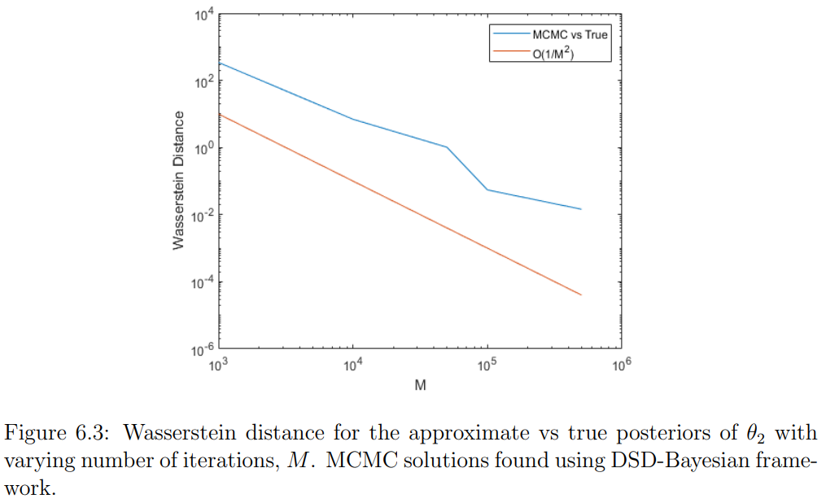

Slide 43
Numerical Examples Cont. Additive Gaussian Noise
Fixed Parameter:
Simulated signal:

Slide 44
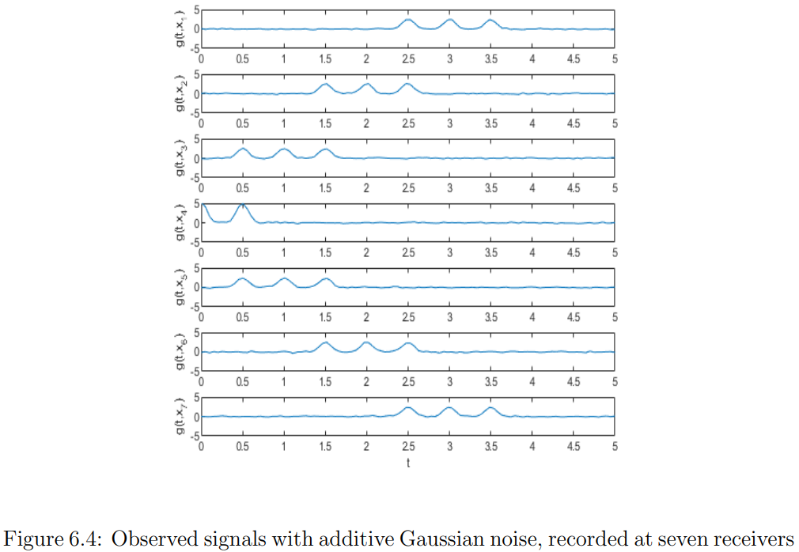

Slide 45

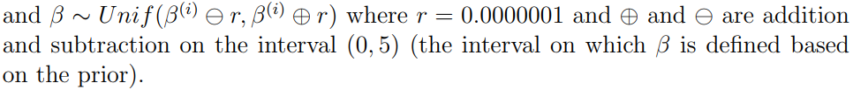
Numerical Examples Cont. Additive Gaussian Noise

Slide 46



Numerical Examples Cont. Additive Gaussian Noise
Ran with iterations
Burn (discard) the first
Thinning period of (i.e., every 2nd entry is kept)

Slide 47
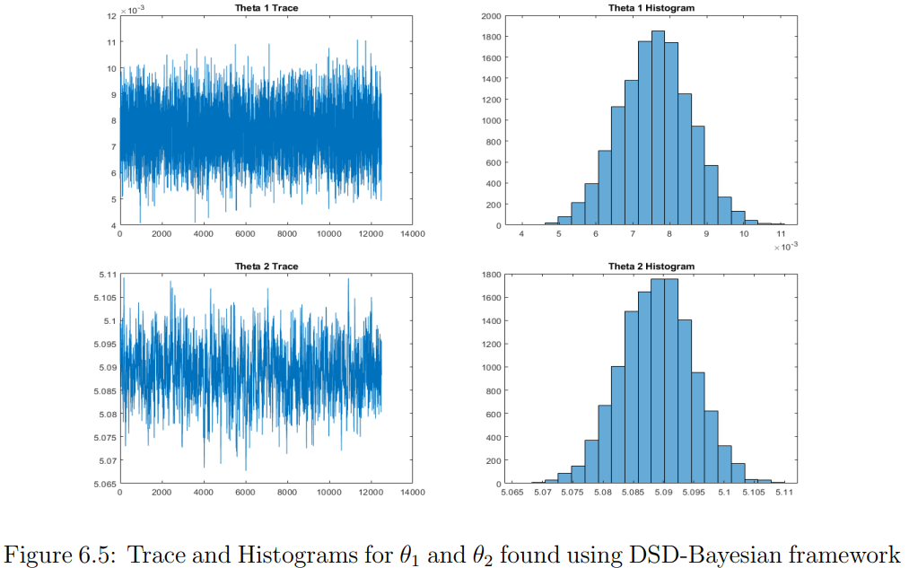

Slide 48
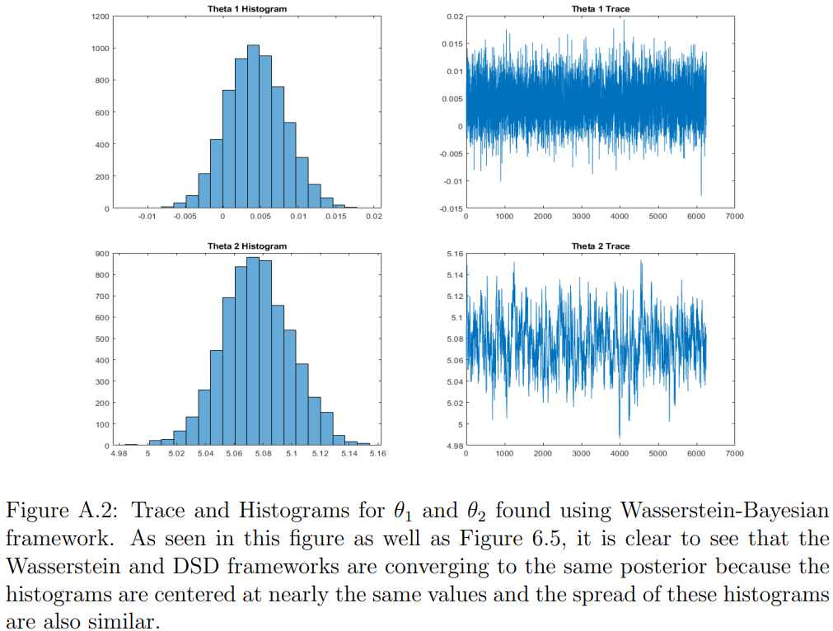

Slide 49
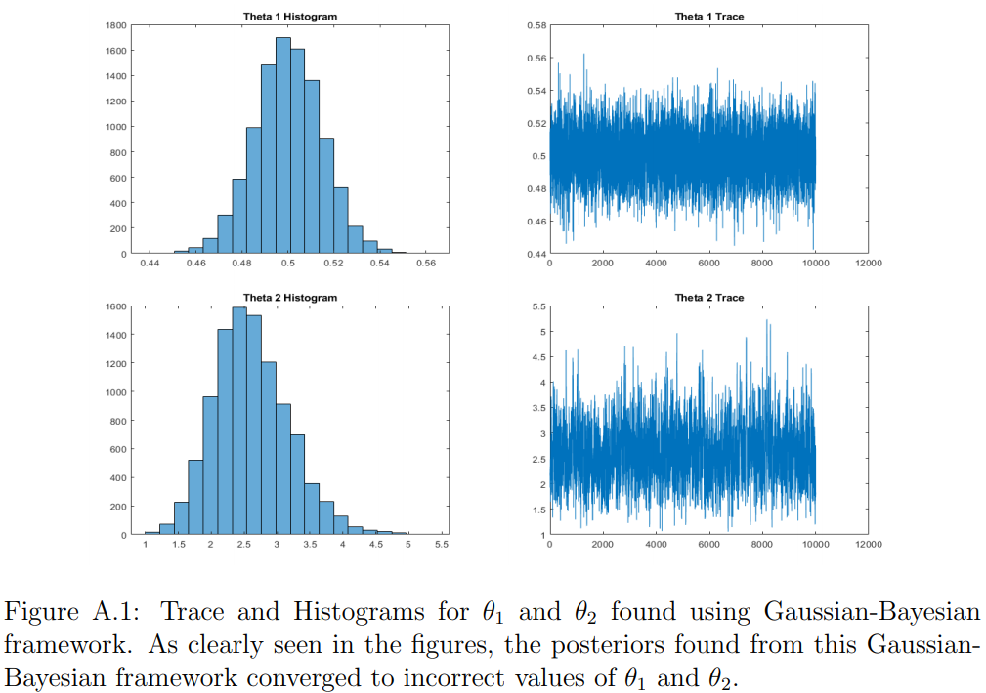

Slide 50
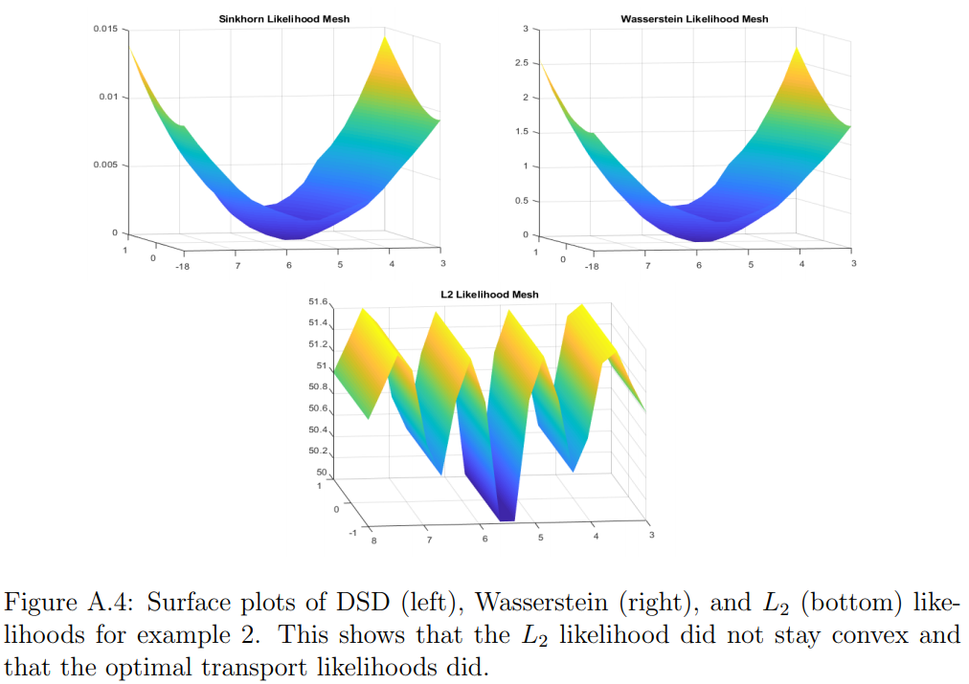

Slide 51
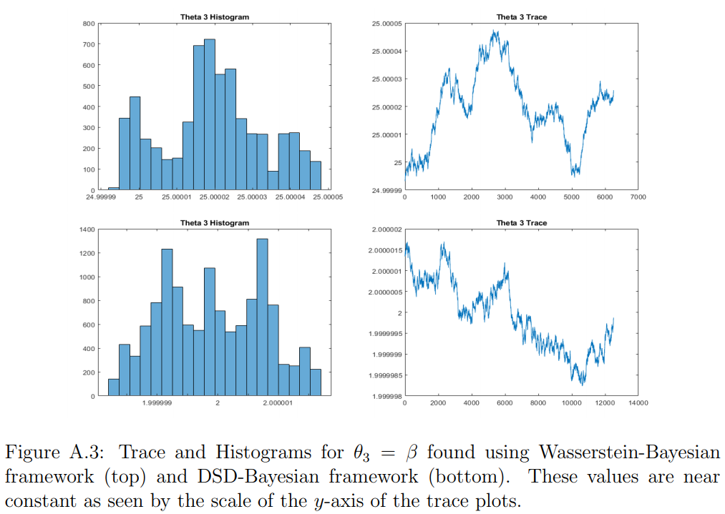

Slide 52
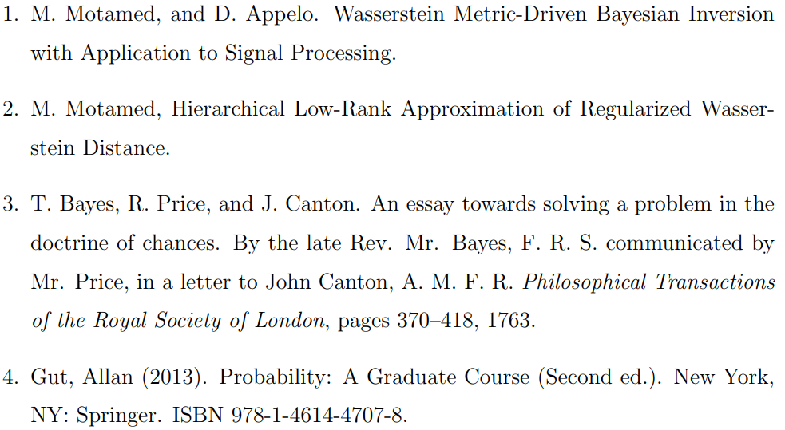
Refrences

Slide 53
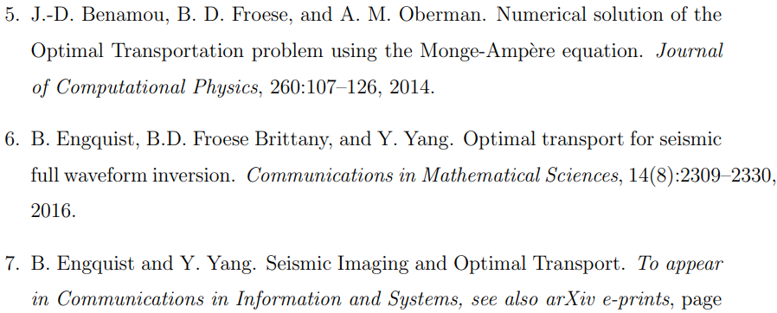
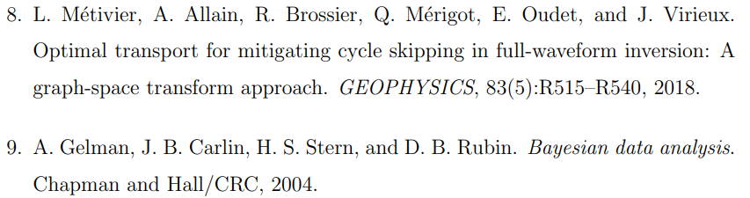

Slide 54
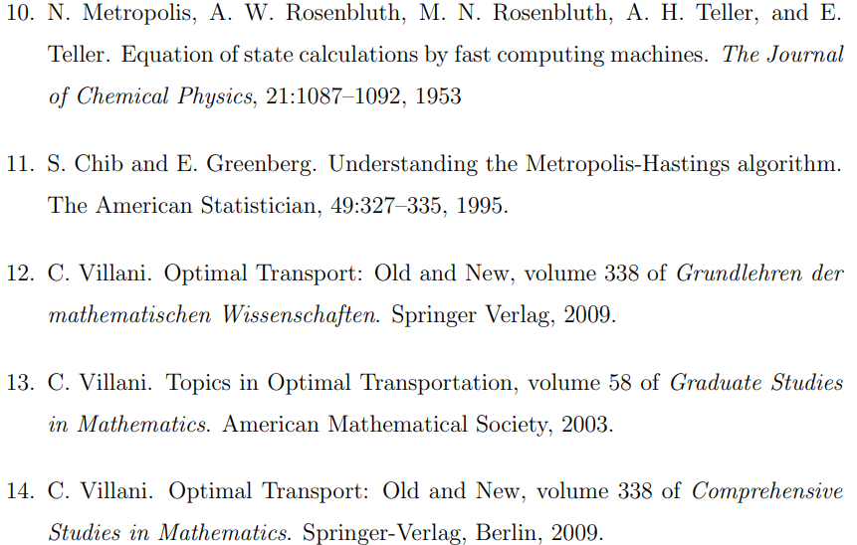
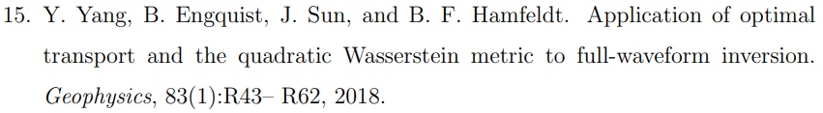

Slide 55
