Slide 1
CIS 598
Final Presentation
Elijah Seigel
Advised by: Professor mizuno

Slide 2
Concept
A mobile party game based on a silent disco.
Players put in headphones attempt to identify those dancing to the same song.
Those who have found their pair by the end of the round stay in, those who guess wrong or can’t find someone dancing to the same song are ‘out’.
Last pair standing have a dance off voted on by everyone else.

Slide 3
Features
Game rooms to play with your friends
Like jack box games
Simple matchmaking algorithm pairs up players and assigned random songs from a playlist
Embedded YouTube content for music to avoid licensing problems and costs
Players are assigned four digit codes used to make guesses
Final dance off voted on by those eliminated in earlier rounds
Restart functionality

Slide 4
Tools
Javascript, HTML, CSS
npm
QR code reader
QR code generator
websocket
Create react app
Express
Spotify Web API
Spotify Play Button
YouTube IFramePlayer API
Github
Github pages
White Star UML
Draw.io
Heroku

Slide 5
Development
Febuary
Define flow of control
Generate game assets
Final Design
March
Generate game assets
Major development
Develop client code
April
Develop client code
Finish development
Integrate superficial assets
Testing – April 28th
May
Finish development
Testing
Integrate superficial assets
Implement stretch goals

Slide 6
Implementation
A state machine with 13 states
Entrance
Join
Create
Wait
WaitStart
SongPlaying
Out
Vote
Loss
A
B
Winner
Instructions
Client-side and server-side triggered transition

Slide 7
Sample socket.IO code
Sending Data
socket.emit('start', id);
Receiving Data
socket.on('start', (result)=>{
this.code = result[0];
this.song = result[1];
})

Slide 8
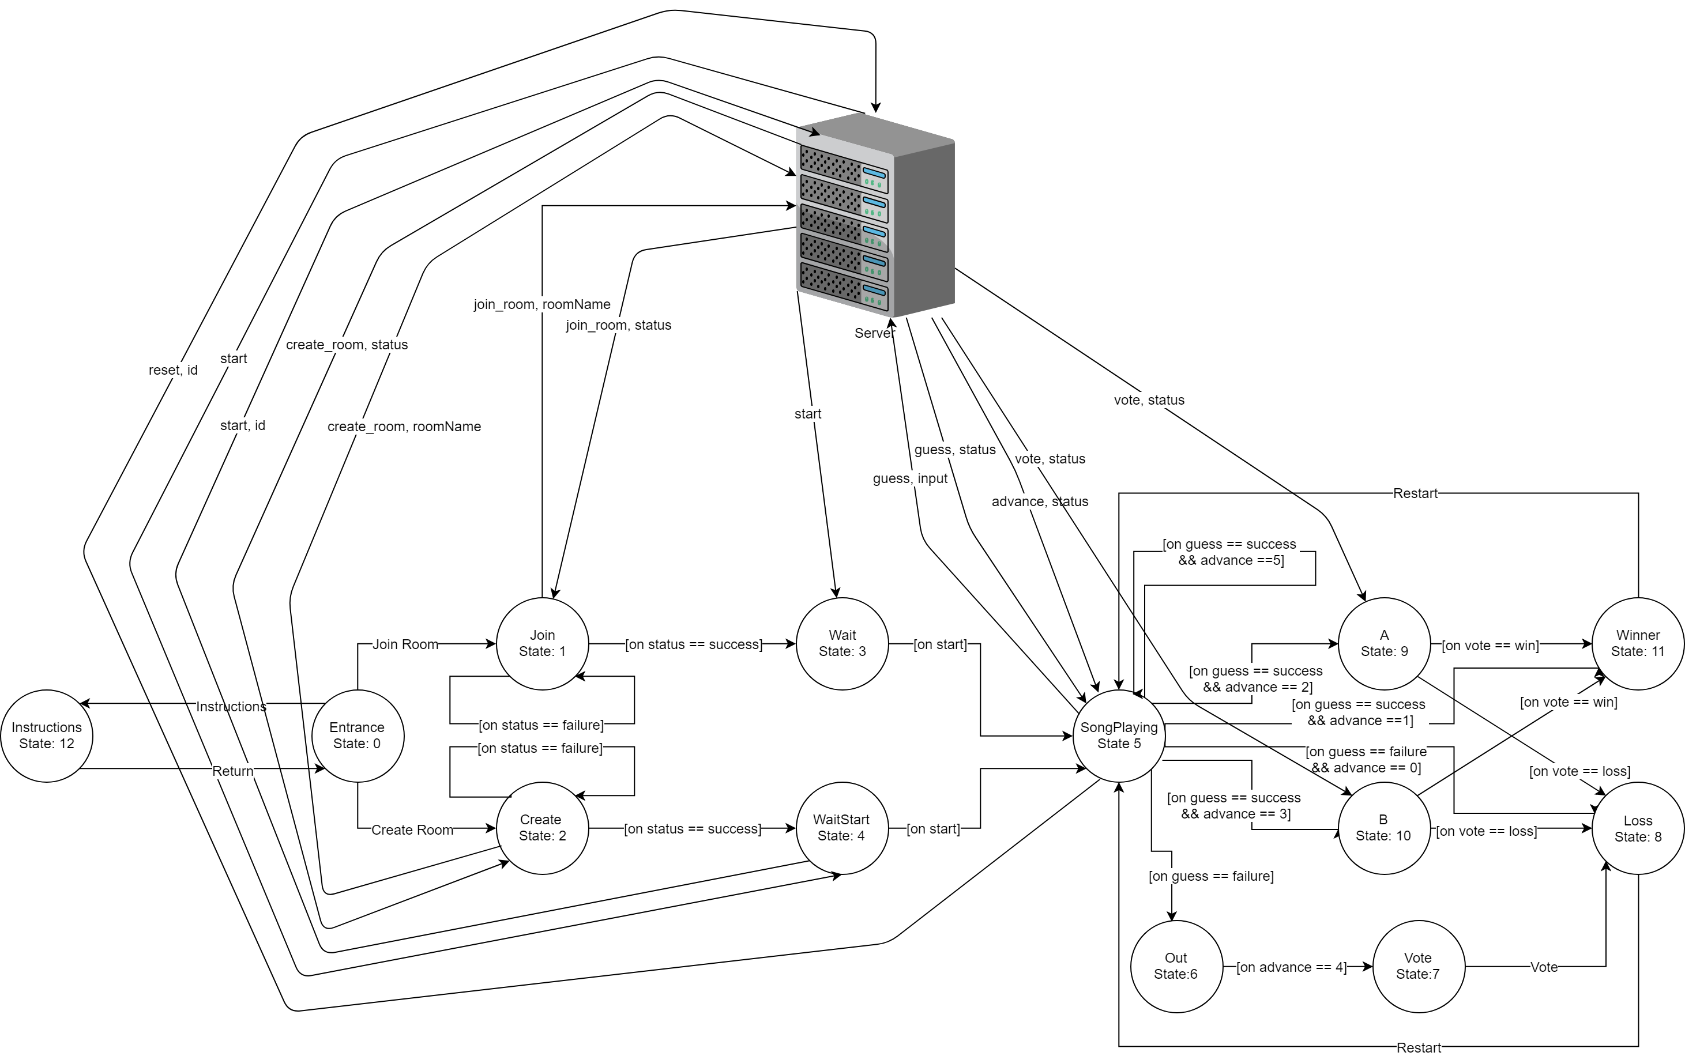
State transition diagram

Slide 11
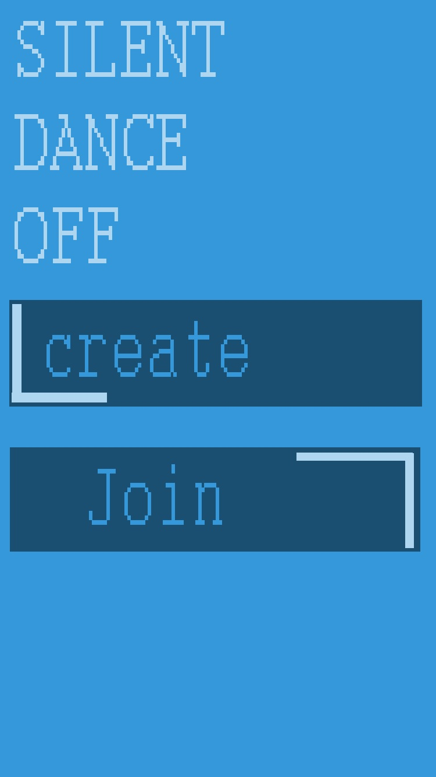

Art
Mock up V. implementation
Colors
Background: 52, 152, 219
Title TXT: 174, 214, 241
Title Font: Courier Bold
Button primary: 27, 79, 114
Button TXT: 52, 152, 219
Button Font: Courier body
Button accent: 174, 214, 241

Slide 12
Audio
YouTube video embedded in an IFrame with dimensions 0x0
defined by a 10 char video ID
All audio front loaded in the entrance state through the onYouTubeIframeAPIReady() function
Programmatically generate click events on the IFrame
cycle the playerState between PLAYING and ENDED with loops turned on

Slide 13
Challenges
Resolving dependency issues with node modules
Re-writing test scripts to work with new framework
Ensuring relative positioning looked presentable no matter the screen size or resolution
Hosting
Iphones

Slide 14
Demo!

Slide 15
Future Development
Improve aesthetic
All visuals are rendered on a canvas, and can be replaced with images by calling the canvas drawImage() function.
Implement additional game options
Select a music genre
Musical charades
Silent disco

Slide 16
Development Statistics
2 Days, 16 hours, and 49 minutes
Lines of code written: 24+31+356+24+261+7+778+59+1182+47+47+68+57+45+73+59+38+223+51+43+54+60
=3587 lines of production code written
Averaging 55 lines of production code an hour

Slide 17
Questions?

