Slide 1
CIS 598
Project Progress update
Elijah Seigel
Advised by: Professor mizuno

Slide 2
Concept
A mobile party game based on a silent dance party.
Players attempt to identify those dancing to the same song.
Those who have found their pair by the end of the round stay in, those who guess wrong or can’t find someone dancing to the same song are ‘out’.
Last pair standing have a dance off voted on by everyone else.

Slide 3
Features
Game rooms to play with your friends
Like jack box games
Simple matchmaking algorithm, with no bye rounds
QR codes and scanner to determine if the guess is correct
Stretch goal
Using music from players libraries when possible
A more aesthetic overall application

Slide 4
Tools
Javascript, HTML, CSS
npm
QR code reader
QR code generator
websocket
Create react app
Express
Spotify Web API
Spotify Play Button
Github
White Star UML

Slide 5
Development
Febuary
Define flow of control
Generate game assets
Final Design
March
Generate game assets
Major development
Develop client code
April
Develop client code
Finish development
Integrate superficial assets
Testing – April 28th
May
Integrate superficial assets
Implement stretch goals

Slide 6
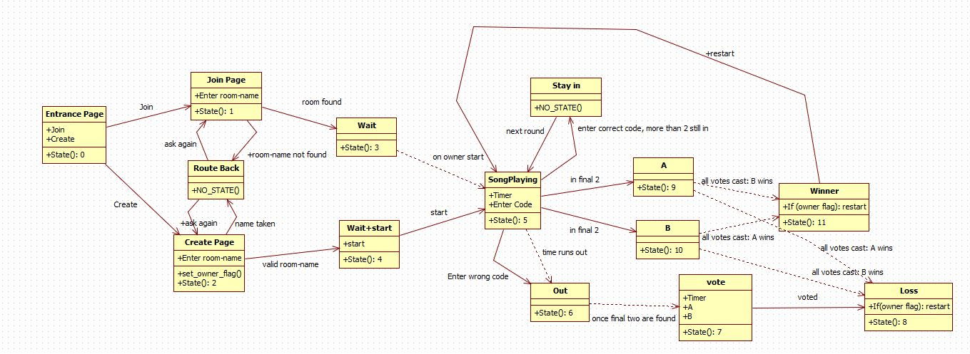
Design

Slide 7
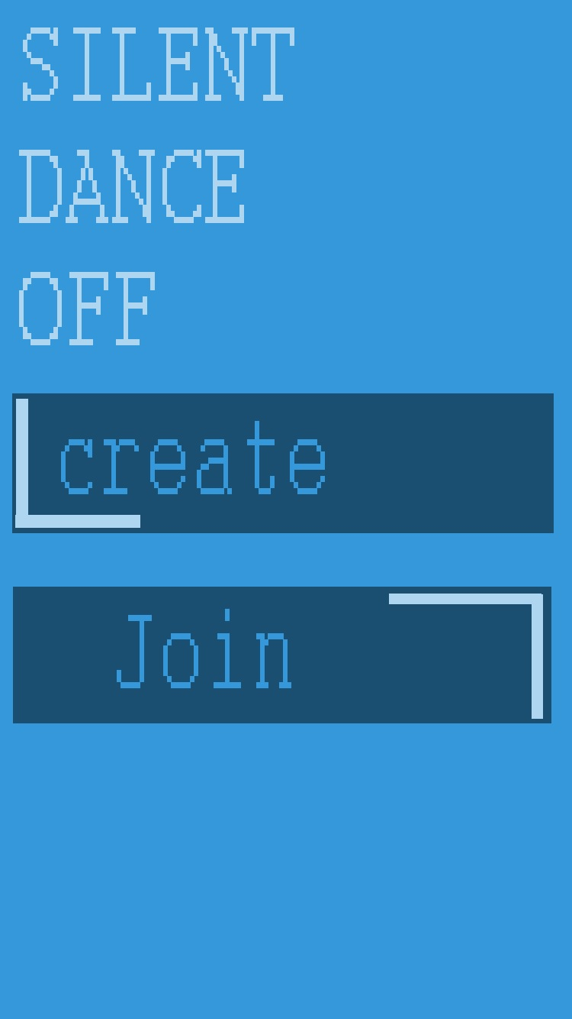

Art
Mock up V. implementation
Colors
Background: 52, 152, 219
Title TXT: 174, 214, 241
Title Font: Courier Bold
Button primary: 27, 79, 114
Button TXT: 52, 152, 219
Button Font: Courier body
Button accent: 174, 214, 241

Slide 8
Challenges
Resolving dependency issues with node modules
Re-writing test scripts to work with new framework
Ensuring relative positioning looked presentable no matter the screen size or resolution
Testing state transitions resulting from server side events.

Slide 9
Demo!

Slide 10
Questions?

