Slide 1
Gladiator
Simran Malhi, Conner McElroy, Elijah Seigel, Travis Atchison, Reed Anderson and Ben Miller

Slide 2
Design
First we discussed what type of game we wanted to create and what setting the game should take place in.
Platformer
Gained abilities
Once we decided on a game concept, we used WhiteStar UML to design a general architecture to define class interactions.

Slide 3
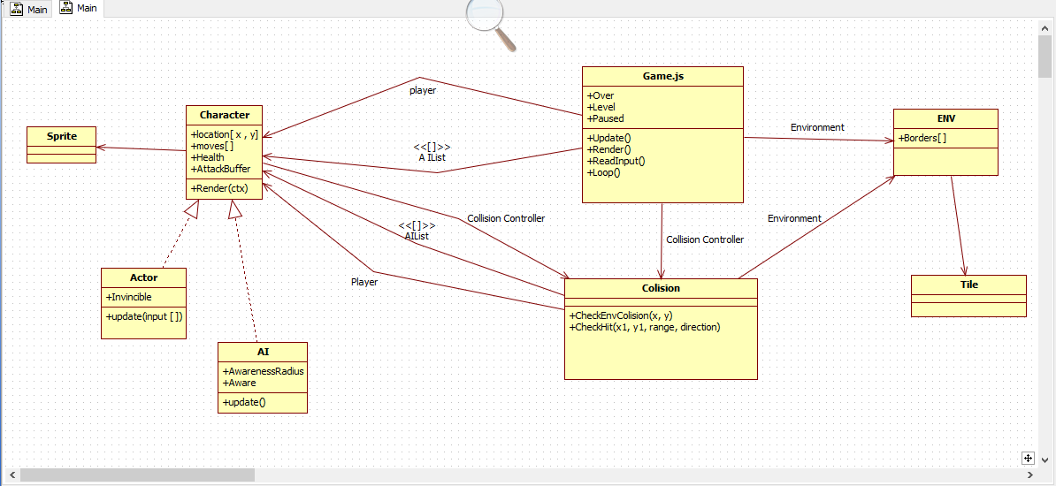
UML

Slide 4
Development
We used Trello to assign tasks, keep organized, and track progress.
Distributed design allowed for simultaneous development.
Redesigned the game throughout development.
Added an object collision controller
Re-designed player environment interaction
Adapted design to fit sprite animation

Slide 5
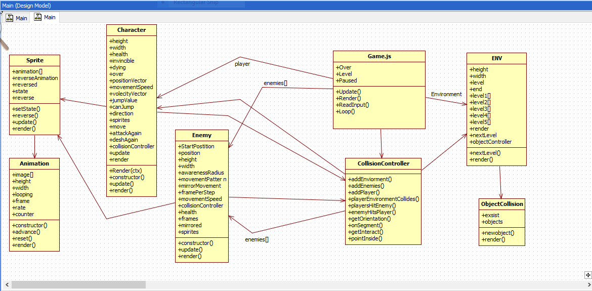
Final Design

Slide 6
Obstacles
Coordinating development with a six person team.
Troubleshooting bugs in shared code.
Implementing smooth movement with centralized collision control.

