Slide 1
Gladiator
Simran Malhi, Conner McElroy, Elijah Seigel, Travis Atchison, Reed Anderson and Ben Miller

Slide 2
Design
First we discuss what type of game we wanted to create and what setting the game should take place.
Once we figured it out the game we wanted to design, then we used WhiteStar UML to figured out our classes, method, and variable for our game
We used Trello to assign what each team member should do and due dates

Slide 3
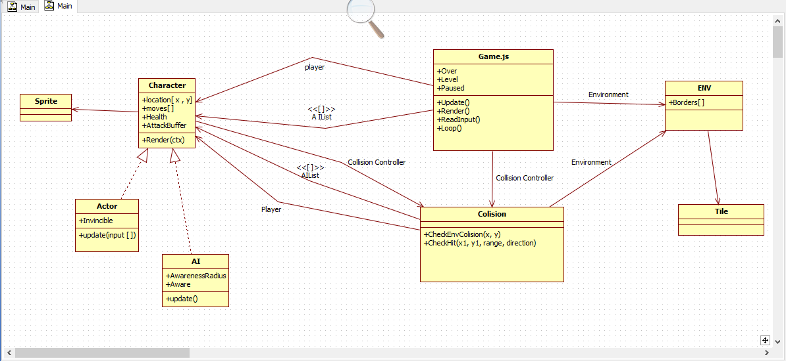
UML

Slide 4
Progression
We changed the game design
We added new classes
We got rid of tilemap

Slide 5
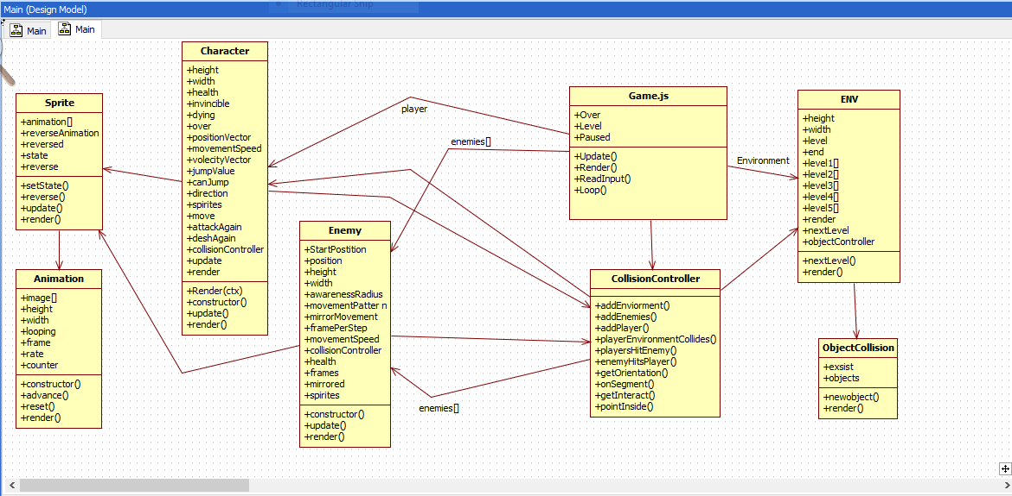
Final Design

Slide 6
Difficulty
Fixing all bus
Getting the collision working with the art
Matching the Level art with the background image
Having difficulty with the collision

