Slide 1
Workout - Mania
Personalized Fitness Planning with Machine Learning
Elijah Yuhas

Slide 2
Problem Statement
Generic workout plans fail 70% of users
One-size-fits-all approach ignores:
  Individual fitness levels
  Age and physical characteristics
  Personal goals and limitations
  Risk of injury from inappropriate exercises
Solution: AI-powered personalized workout generator
  Analyzes user profile (age, weight, height, fitness level)
  Generates customized plans using Google Gemini AI
  Learns from user feedback to improve recommendations

Slide 3
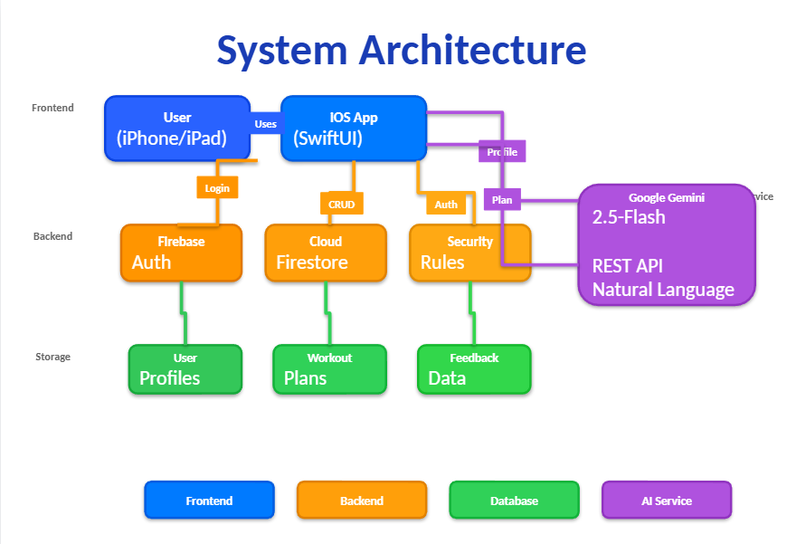
System Architecture
iOS App (SwiftUI)
  User authentication and profile management
  Workout plan generation interface
Firebase Backend
  Firestore: User profiles, workout plans, feedback data
  Authentication: Persistent user login
Google Gemini AI (2.5-flash)
  REST API integration for workout generation
  Natural language processing of user profiles

Slide 4
Dataset Description
Data Source: User workout feedback collected in-app
User Physical Attributes:
  Age (13-80 years), Weight (30-200 kg), Height (120-230 cm)
Workout Information:
  Fitness Level: Beginner, Intermediate, Advanced, Professional
  Duration: Day, Week, Month, Year
Outcome Metrics:
  Completion Rate (0-100%), Difficulty Rating (1-5)
  Effectiveness Rating (1-5), Injury Occurrence (Yes/No)
  Days Completed, User Feedback Text
Dataset Size: 50 samples for testing (expandable to 500+)

Slide 5
AI Model: Google Gemini 2.5-Flash
Why Gemini?
  Zero Infrastructure: No training servers or GPU required
  Natural Language Understanding: Processes user characteristics contextually
  Real-time Inference: Generates plans in seconds
  Cost-Effective: Free tier (60 requests/minute)
  Explainable: Can provide reasoning for recommendations
Alternatives Considered:
  Random Forest: Required manual feature engineering
  Neural Networks: Needed extensive training data (1000+ samples)
  XGBoost: Strong but less explainable than Gemini

Slide 6
Data Preprocessing Pipeline
1. Data Cleaning
  Remove invalid entries (negative values, missing fields)
  Validate data ranges (age 13-80, weight 30-200kg, etc.)
2. Normalization & Encoding
  Standardize fitness levels (Beginner → 1, ..., Professional → 4)
  Convert durations to days (Day → 1, Week → 7, etc.)
3. Outlier Removal
  Filter extreme values indicating data entry errors
4. Class Balancing
  Equal representation of successful/unsuccessful workouts
5. Train/Test Split: 80% training, 20% testing (randomized)

Slide 7
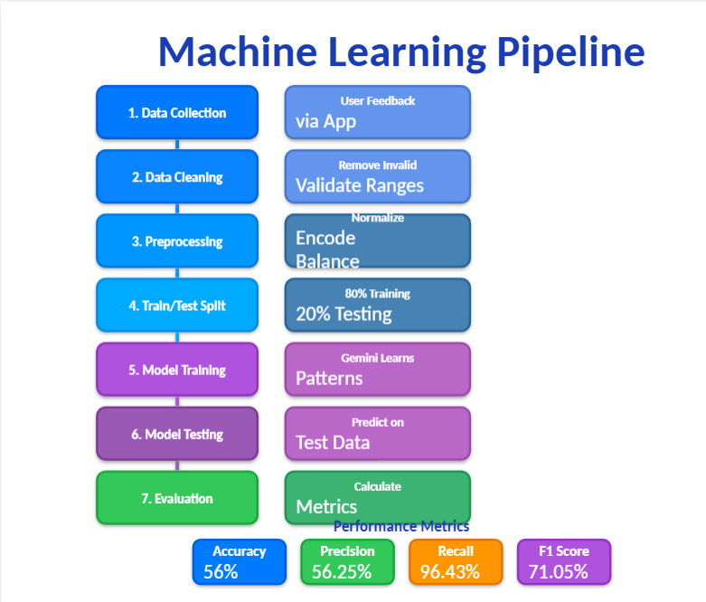
Model Training & Testing
Training Phase:
  1. Send training dataset to Gemini via prompt
  2. Gemini analyzes patterns in user profiles & outcomes
  3. Learns which user types succeed with which workouts
  4. Identifies injury risk factors and safety patterns
Testing Phase:
  1. For each test sample, provide user profile to Gemini
  2. Gemini predicts: success rate, difficulty, safety score
  3. Compare predictions with actual outcomes
  4. Calculate evaluation metrics

Slide 8
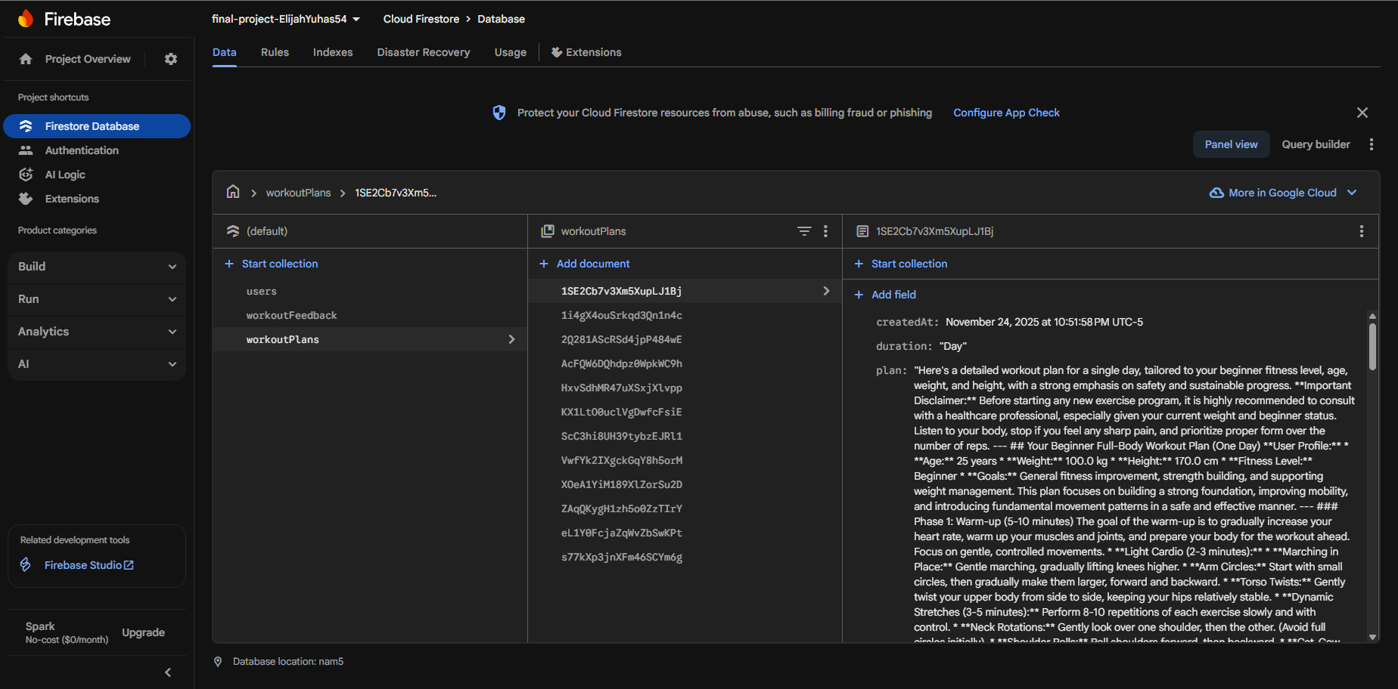
Firebase Plans

Slide 9
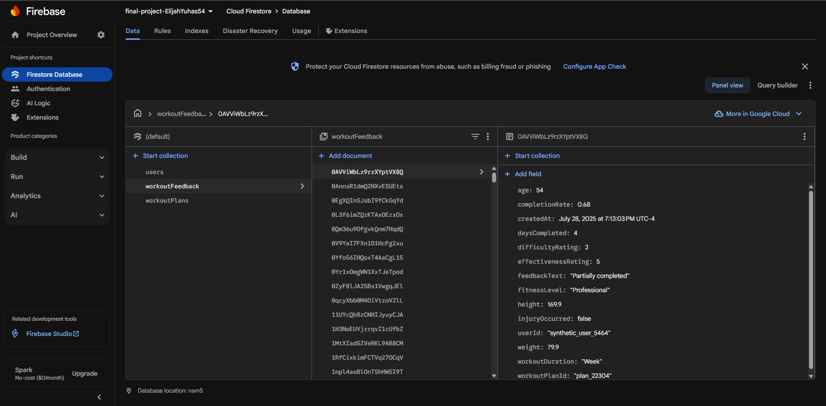
Firebase Feedback

Slide 10
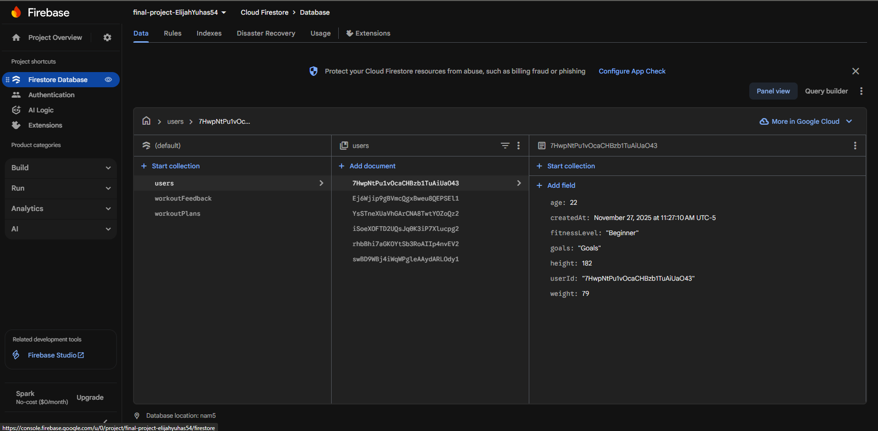
Firebase Users

Slide 11
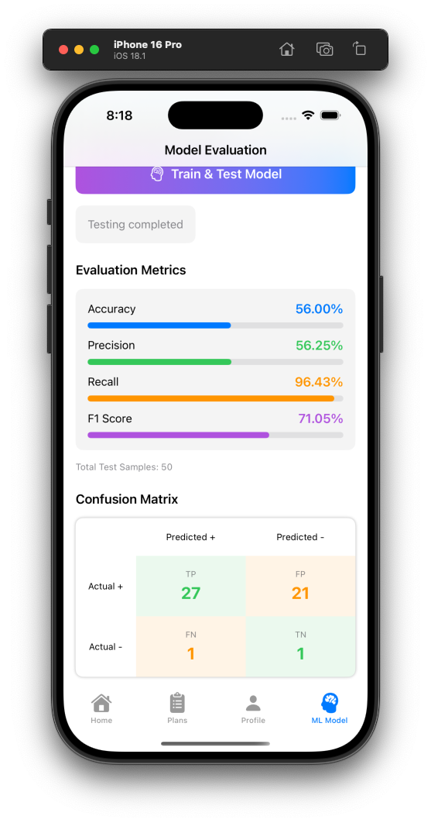
Evaluation Metrics Results
Test Set: 50 samples (20% of dataset)
Accuracy: 56.00% - Overall prediction correctness
Precision: 56.25% - Of positive predictions, 56% were correct
Recall: 96.43% - Caught 96% of successful workouts
F1 Score: 71.05% - Balanced performance metric

Slide 12
Confusion Matrix Analysis
True Positives (TP): 27 - Correctly predicted successful workouts
True Negatives (TN): 1 - Correctly predicted unsuccessful workouts
False Positives (FP): 21 - Predicted success but actually failed
False Negatives (FN): 1 - Predicted failure but actually succeeded
Model is cautious: Prefers false positives over false negatives

Slide 13
Key Observations
What Worked Well ✓
  High Recall (96.43%): Model rarely misses successful workout matches
  Seamless Gemini API integration with iOS
  Real-time workout generation in 2-3 seconds
  User-friendly feedback collection system
Challenges & Solutions ⚠️
  Small Dataset (50): Limited accuracy → Solution: Synthetic data generation
  High False Positives: Model too optimistic → Needs larger dataset
  Gemini Model Availability: gemini-pro not found → Switched to 2.5-flash
  Firebase Config: Complex setup → Created detailed setup guide

Slide 14
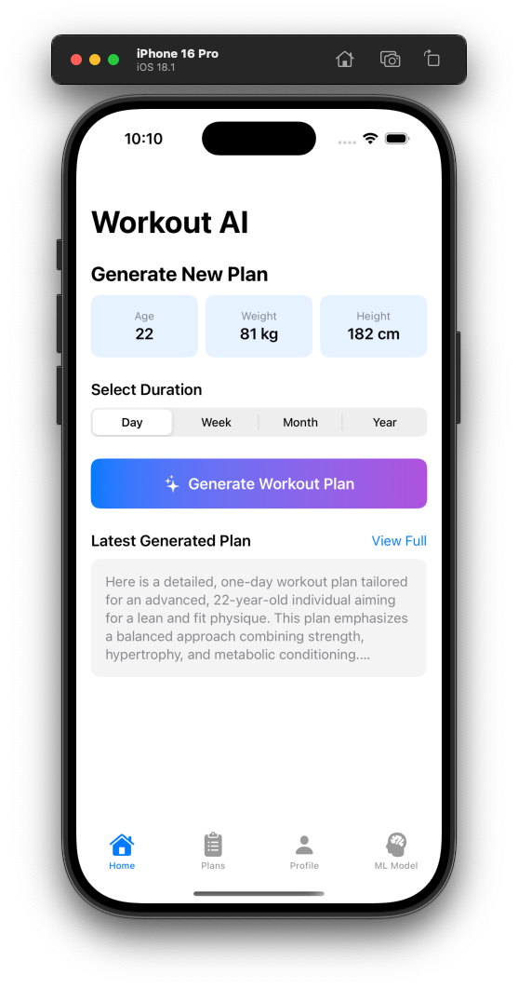
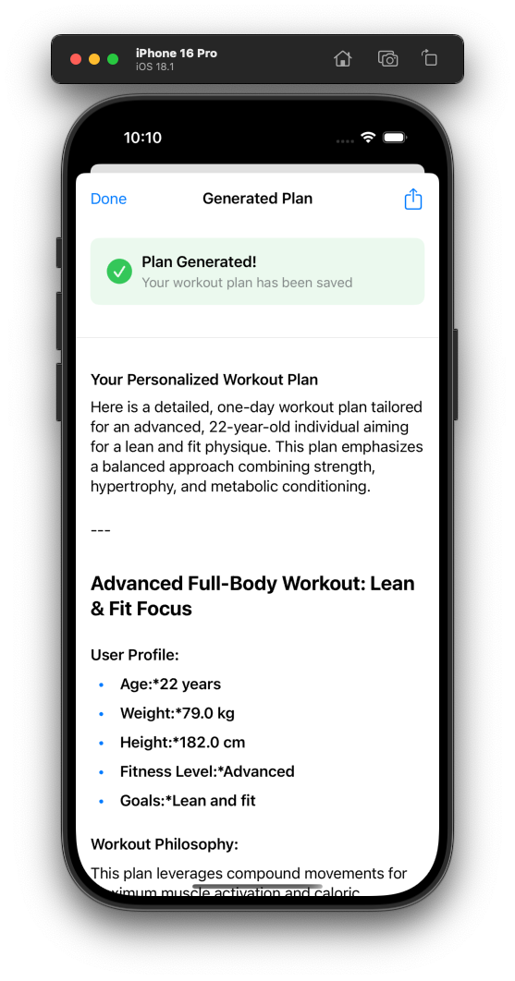
Application Demo
User Flow:
  1. Sign up / Login → Firebase Authentication
  2. Create Profile → Enter age, weight, height, fitness level, goals
  3. Generate Plan → Select duration, Gemini creates personalized workout
  4. View Plans → Browse all generated plans, formatted with markdown
  5. Submit Feedback → Rate difficulty, effectiveness, completion

Slide 15
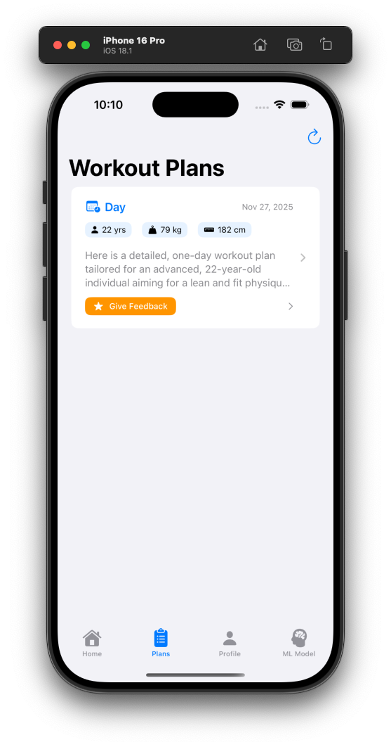
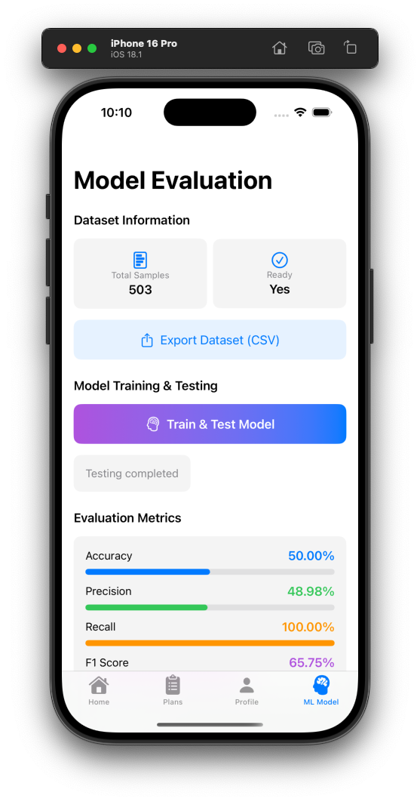
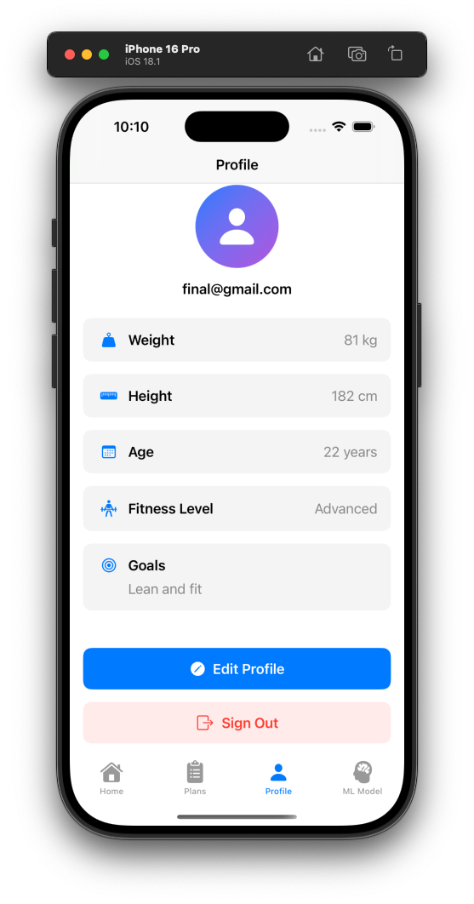

Slide 16
Conclusion & Future Work
Key Takeaways:
  Built complete ML pipeline in iOS app
  Achieved 71% F1 score with only 50 samples
  Gemini API enables AI without ML expertise
  High recall (96%) prioritizes user safety
Future Improvements:
  Collect 200+ samples → Target 80%+ accuracy
  Implement A/B testing for prompt optimization
  Add injury risk prediction with warnings
  Track user progress over time
  Fine-tune with more diverse user profiles

Slide 17
Sources & References
Google Gemini API Documentation
  https://ai.google.dev/docs
Firebase iOS SDK Documentation
  https://firebase.google.com/docs/ios/setup
Machine Learning Evaluation Metrics
  Precision, Recall, F1 Score - Scikit-learn Documentation
SwiftUI Documentation - Apple Developer
  https://developer.apple.com/documentation/swiftui
iOS App Development Best Practices
  Apple Human Interface Guidelines

