Slide 1

Cloud AI and Machine Learning
Group Members:
Caleb Watson-Danis
Catherine Daigle
Farhana Mahmud
Elias Ngugi Kariuki
Yue Gao

Slide 2
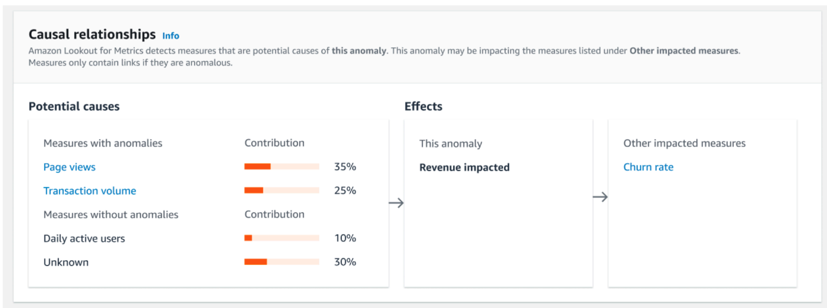
Introduction
What is AI and ML? Review
Use Case, Market Analysis, Challenges and Data cleaning
Tools for AI and ML
Amazon Lookout for metrics

Slide 3
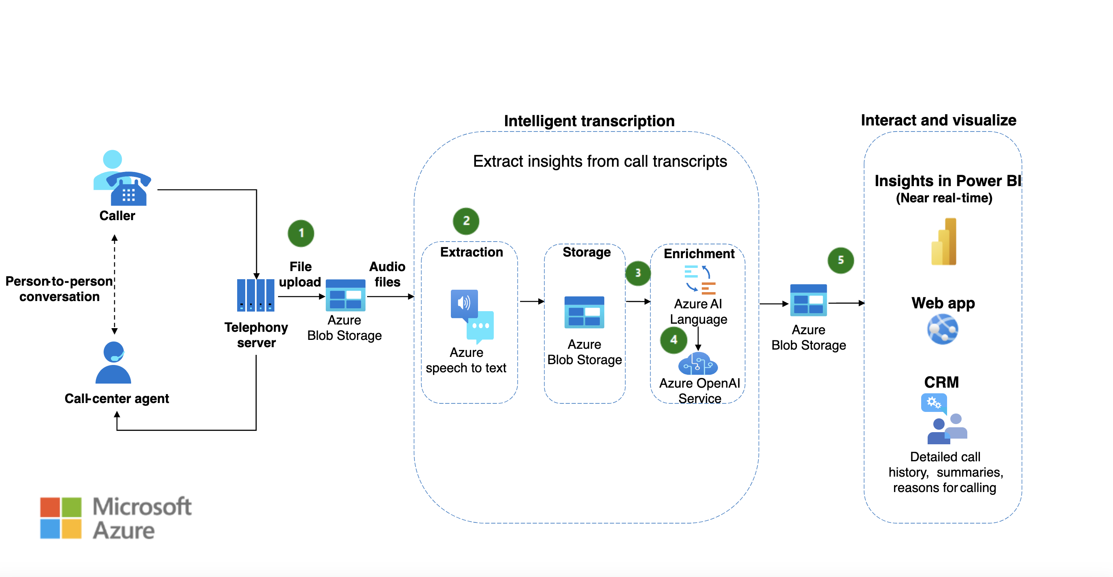
Chosen Cloud Architecture
How AI and ML work to analyze Call Center Data

Slide 4




Use Cases
Cognitive Services
Bot Service
Custom Neural Voice
OpenAI Service
Machine Learning
Microsoft Power Platform

Slide 5
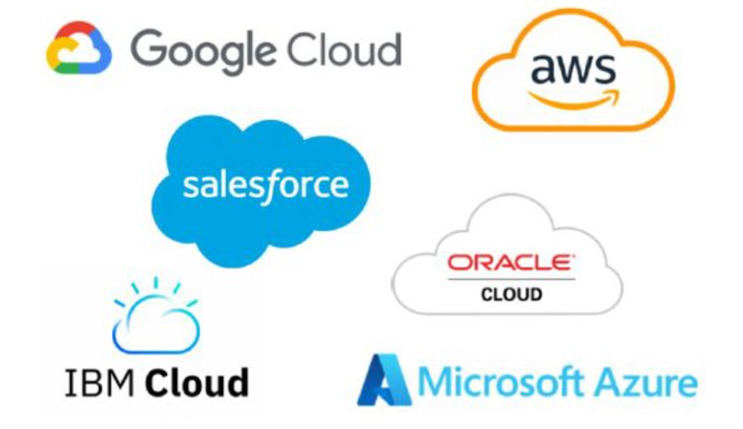
Market Analysis
Competitive landscape
AWS SageMaker
Azure Machine Learning
Vertex AI (Google Cloud)
IBM Watson
Oracle Cloud Infrastructure
Salesforce Einstein AI

Slide 6

Challenges
Challenges
Data integration
Scalability and Resource management
Complex model training and development
Security and Compliance
Data drift
Overcoming the challenges
Resilient data pipelines
Autoscaling and cost-efficient AWS spot instances
MLOps practices
Encryption, RBAC, Cloud native security
Real time monitoring

Slide 7
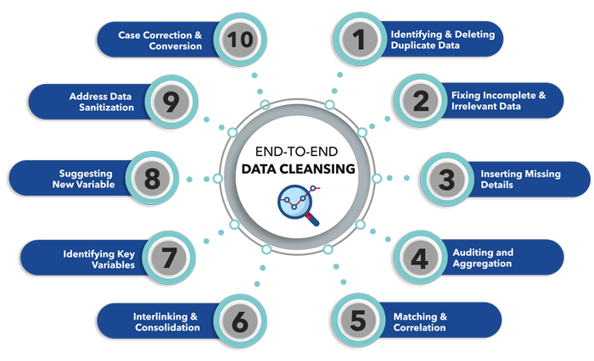
Process of Data Cleaning
(https://alliedinfoline.com/services/b2b-data-research/data-cleansing/)

Slide 8

What We Learned?
Gone through use cases of BBC, Shneider and Toyota
Observed AI and ML architecture
Observed the growth of Cloud AI market
Defined Challenges of Cloud and AI
Process of Data cleaning

Slide 9

Short Quiz!
What is data drift?
What does Amazon Lookout do?
Extracts and analyzes text documents
Detect anomalies and analyze the root causes
Retrieve relevant data via prompts or key-words
Which of the following applications address the scalability issues at Netflix
Metaflow
Kubernetes
MLOps
AWS Spot instances
What AWS services does AWS SageMaker have deep integration with?
EC2
S3
Lambda
All of the above
Which provider focuses on customer interactions, sales, marketing, and service operations:
AWS
Salesforce
Microsoft Azure
Google Cloud

Slide 10
Resources
Amazon Web Services. (2024). Amazon Lookout for Metrics - Developer Guide. What is Amazon Lookout for Metrics? https://docs.aws.amazon.com/lookoutmetrics/latest/dev/lookoutmetrics-welcome.html
Research and Markets. (2023, April). Global cloud AI market size, Share & industry trends analysis report by type, by industry, by technology (solution deep learning, machine learning, Natural Language Processing), by regional outlook and forecast, 2023-2029. Research and Markets - Market Research Reports https://www.researchandmarkets.com/reports/5806529/global-cloud-ai-market-size-share-and-industry
Fitzpatrick. (2024, April 10). Cloud and AI — Who are the top 6 Cloud AI service providers?. Firebrand. https://firebrand.training/uk/blog/cloud-and-ai-who-are-the-top-6-cloud-ai-service-providers
Microsoft. (2023, August 21). Extract and analyze call center data. Artificial intelligence (AI) architecture design. https://learn.microsoft.com/pdf?url=https%3A%2F%2Flearn.microsoft.com%2Fen-us%2Fazure%2Farchitecture%2Fai-ml%2Ftoc.json
BBC innovates how it delivers trusted news and entertainment with Azure AI. (n.d.). Microsoft Customers Stories. https://customers.microsoft.com/en-us/story/754836-bbc-media-entertainment-azure
GeeksforGeeks. (2024, July 31). Data cleansing: Introduction. GeeksforGeeks. https://www.geeksforgeeks.org/data-cleansing-introduction/
Vates. (2024, July 11). The future of machine learning: Emerging trends and applications. Vates. https://www.vates.com/the-future-of-machine-learning-emerging-trends-and-applications/
Allied Infoline. (n.d.). Data cleansing services. Allied Infoline. https://alliedinfoline.com/services/b2b-data-research/data-cleansing/

