Slide 1

Cloud AI and Machine Learning
Group Members:
Caleb Watson-Danis
Catherine Daigle
Elias Ngugi Kariuki
Yue Gao

Slide 2
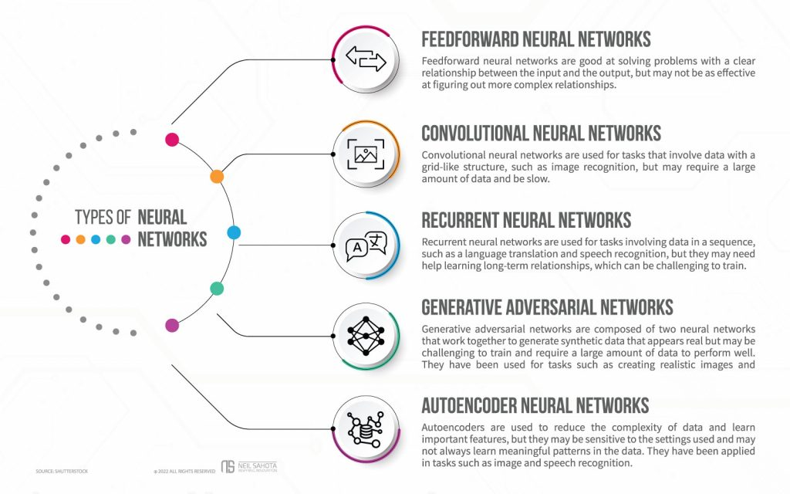
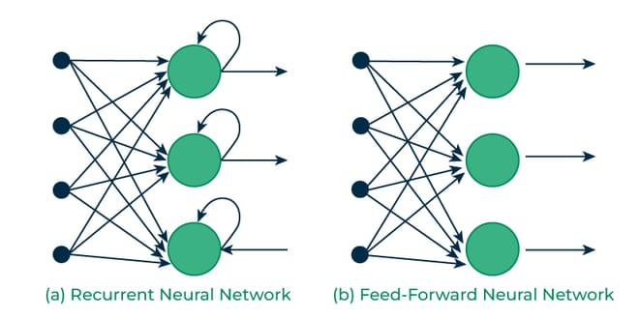
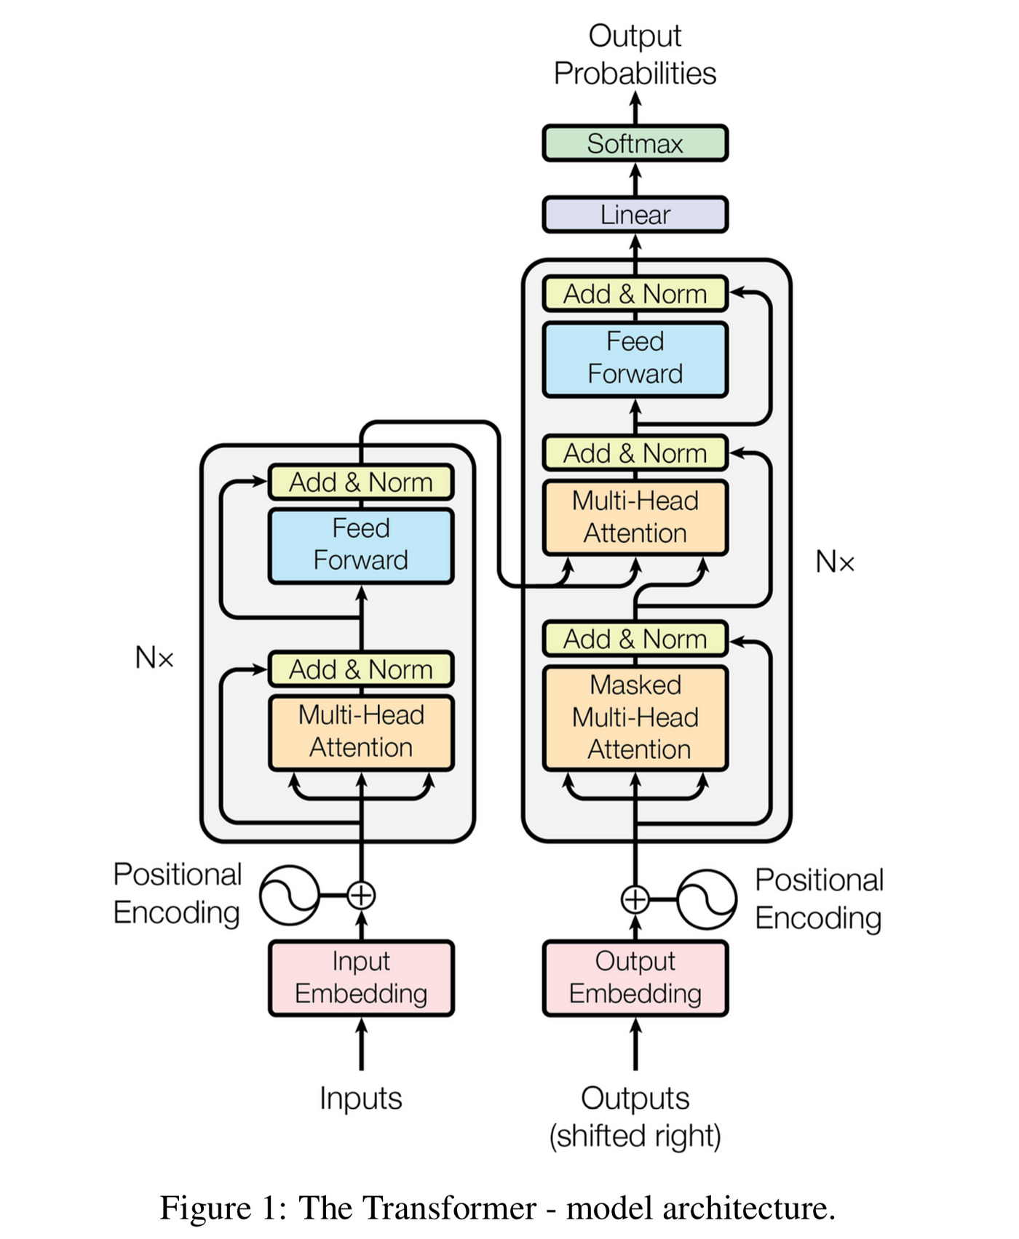
Introduction
Scope of multi-ML models
Vanishing Gradient Problem
Types of NN: Feed Forward, Recurrent, Transformative
Architecture Example
Market Analysis, Ethical Consideration and Processing Power

Slide 3
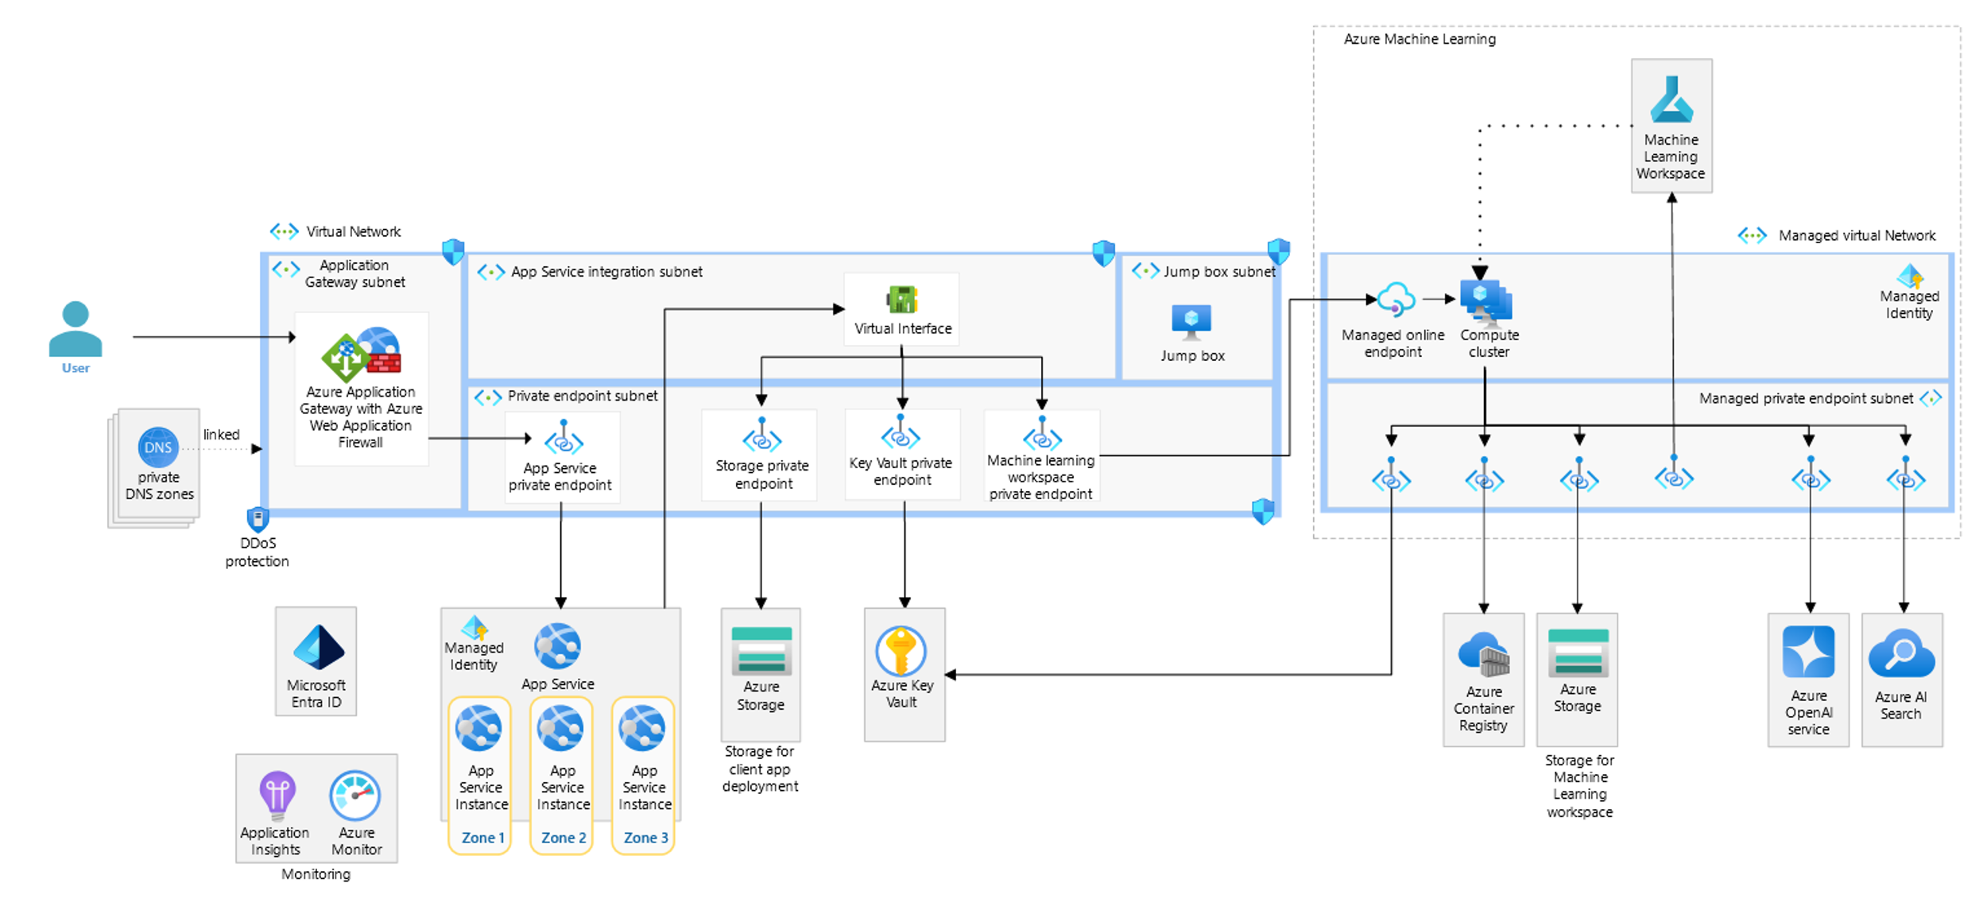
Chosen Cloud Architecture
An OpenAI enterprise-level chat model

Slide 4
Market Analysis
AI-as-a-Service (AIaaS)
5G and AI Integration
Emerging Opportunities
Healthcare AI
Finance

Slide 5
Ethical Considerations
Ethical Challenges
Data Privacy and security
Bias and Fairness
Accountability and explainability
Environmental impact
Design Strategies
Scalability and Flexibility
Model deployment and Maintenance
Latency and real time operation

Slide 6
Considerations for implementation in the Cloud
Data governance and compliance - Documentation of data sources and transformations
Cost management
Ethics review boards and audit - Ensure fairness inclusivity and safety
Human oversight and safety - Ensuring decisions are contextually accurate

Slide 7
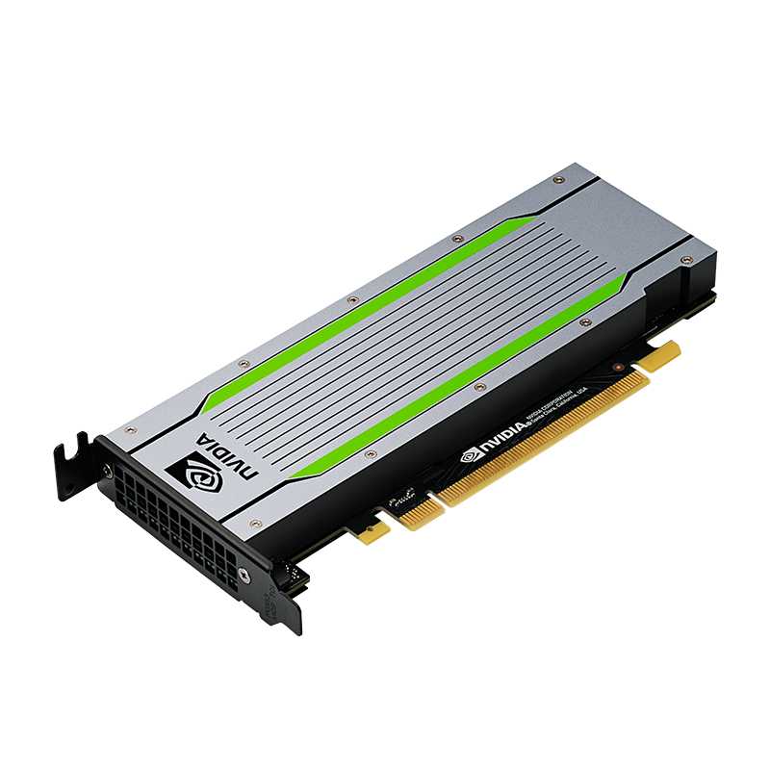
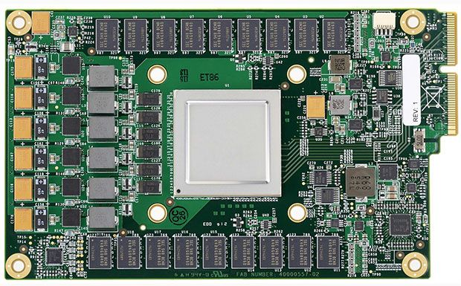

Processing Power
Differences:
GPU (Graphics Processing Unit) Parallel processing Nvidia Tesla series Tesla V100
GPU = more versatile, less focused
TPU = Specific to TensorFlow framework, focused on ML purposes
Google's TPU (Tensor Processing Unit) Matrix and vector operations TensorFlow framework Speed & efficiency

Slide 8

What We Learned?
Observed ML &NN architecture types
Observed the new opportunities of Cloud AI market
Processing Power
Ethical Considerations

Slide 9

Short Quiz!
Which machine learning model addresses the issue of Accountability and Explainability of Machine learning?
What is the Vanishing gradient problem
Where an error/change in the data grows so large it causes overflow
Where the change in data is so little the neural network cannot learn more
Where the model learns too much training data it does not perform well in testing
The model fails to learn the training data and does not perform in testing.
Which Neural Network is best for Chat bots?
Feed Forward NN
Convolutional NN
Longterm-Short-term NN
Transformative NN
Which of the following is a benefit for TPUs?
More power
Versatile
Speed & efficiency
How does Cloud AI and ML will improve in health sector?
telemedicine
medical imaging
drug discovery
All the above

Slide 10
Resources
Research and Markets. (2023, April). Global cloud AI market size, Share & industry trends analysis report by type, by industry, by technology (solution deep learning, machine learning, Natural Language Processing), by regional outlook and forecast, 2023-2029. Research and Markets - Market Research Reports https://www.researchandmarkets.com/reports/5806529/global-cloud-ai-market-size-share-and-industry
Fitzpatrick. (2024, April 10). Cloud and AI — Who are the top 6 Cloud AI service providers?. Firebrand. https://firebrand.training/uk/blog/cloud-and-ai-who-are-the-top-6-cloud-ai-service-providers
GeeksforGeeks. (2024, July 31). Data cleansing: Introduction. GeeksforGeeks. https://www.geeksforgeeks.org/data-cleansing-introduction/
Vates. (2024, July 11). The future of machine learning: Emerging trends and applications. Vates. https://www.vates.com/the-future-of-machine-learning-emerging-trends-and-applications/
Allied Infoline. (n.d.). Data cleansing services. Allied Infoline. https://alliedinfoline.com/services/b2b-data-research/data-cleansing/
Hochreiter, S. (1998). The vanishing gradient problem during learning recurrent neural nets and problem solutions. International Journal of Uncertainty, Fuzziness and Knowledge-Based Systems, 06(02), 1–5. https://doi.org/10.1142/s0218488598000094
Dong, E. (2024, July 1). Recurrent neural networks, simplified. AI, But Simple Issue #8. https://www.aibutsimple.com/p/recurrent-neural-networks-simplified
Maxime. (2020, March 5). What is a Transformer?. Medium. https://medium.com/inside-machine-learning/what-is-a-transformer-d07dd1fbec04
Microsoft. (2023, August 21). Extract and analyze call center data. Artificial intelligence (AI) architecture design. https://learn.microsoft.com/pdf?url=https%3A%2F%2Flearn.microsoft.com%2Fen-us%2Fazure%2Farchitecture%2Fai-ml%2Ftoc.json
Lo Piano, S. (2020, June 17). Ethical principles in machine learning and artificial intelligence: Cases from the field and possible ways forward. Nature News. https://www.nature.com/articles/s41599-020-0501-9
Sahota, N. (2022, December 25). Neural networks: A solution for complex problems in science and engineering. Neural Networks: A Solution for Complex Problems in Science and Engineering. https://www.neilsahota.com/neural-networks-a-solution-for-complex-problems-in-science-and-engineering/#:~:text=Neural%20networks%20rely%20heavily%20on,on%20new%20or%20unseen%20data.

