Slide 1

Cloud AI and Machine Learning
Group Members:
Caleb Watson-Danis
Catherine Daigle
Elias Ngugi Kariuki
Yue Gao

Slide 2
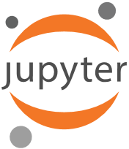
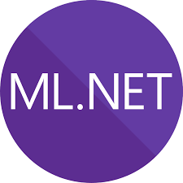
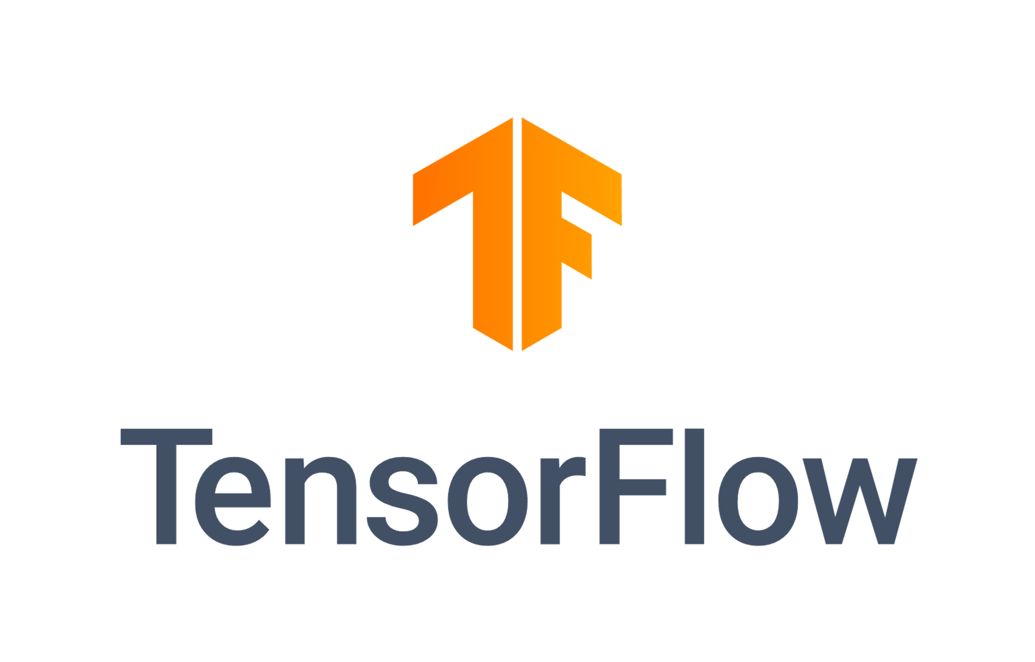
Introduction
Azure Machine Learning , Tensor Flow, Jupyter Notebook, ML.Net
MNIST Database
Architecture Example (Revisited)
Market Analysis, Impact of Machine learning at Netflix.

Slide 3
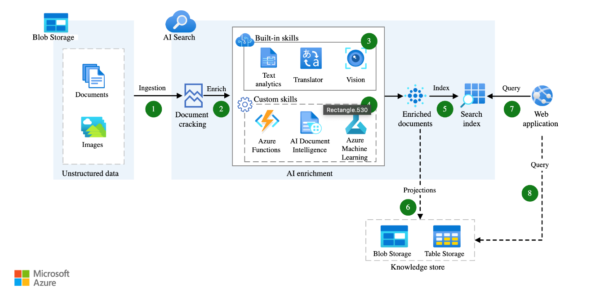
Chosen Cloud Architecture
Cloud-based Machine Learning Image architecture using AI and Machine Learning Technology

Slide 4
Market Analysis - Emerging Opportunities
Retail and E-Commerce
Visual Search Tools
Hyper-Personalized Shopping
Construction and Real Estate
AI-Enhanced Building Information Modeling (BIM)
AI-Driven Real Estate Valuation
Environmental Monitoring
Climate Change Modeling
Pollution Monitoring
Education
Personalized Learning Platforms
Automated Assessment

Slide 5
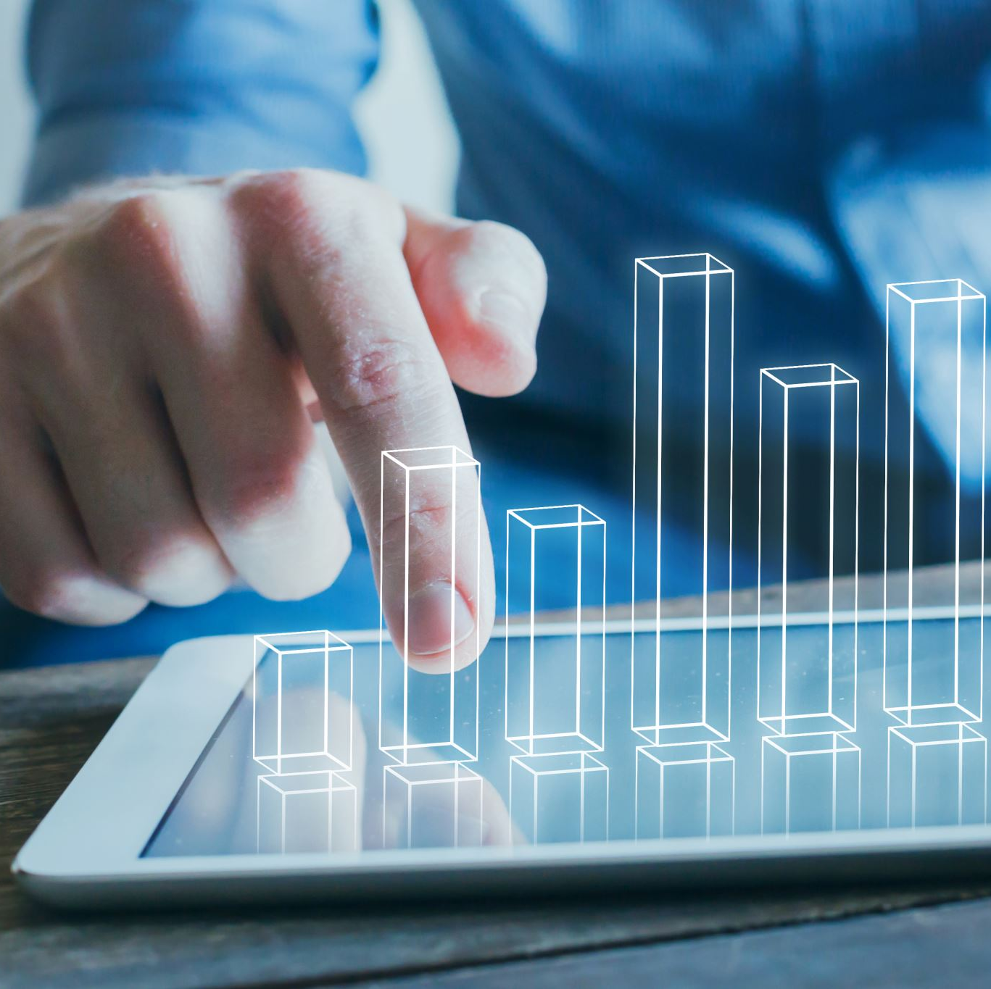
Impact of Machine Learning on Netflix’s Performance
1. Data-Driven Strategies for Streaming
Findings: Enhanced content delivery and user satisfaction through personalized recommendations.
Impact: Improved user engagement and retention.
2. Leveraging AI for Streaming Transformation
Findings: AI and machine learning improve user experience and streaming quality.
Impact: Higher customer engagement and reduced churn rates.

Slide 6
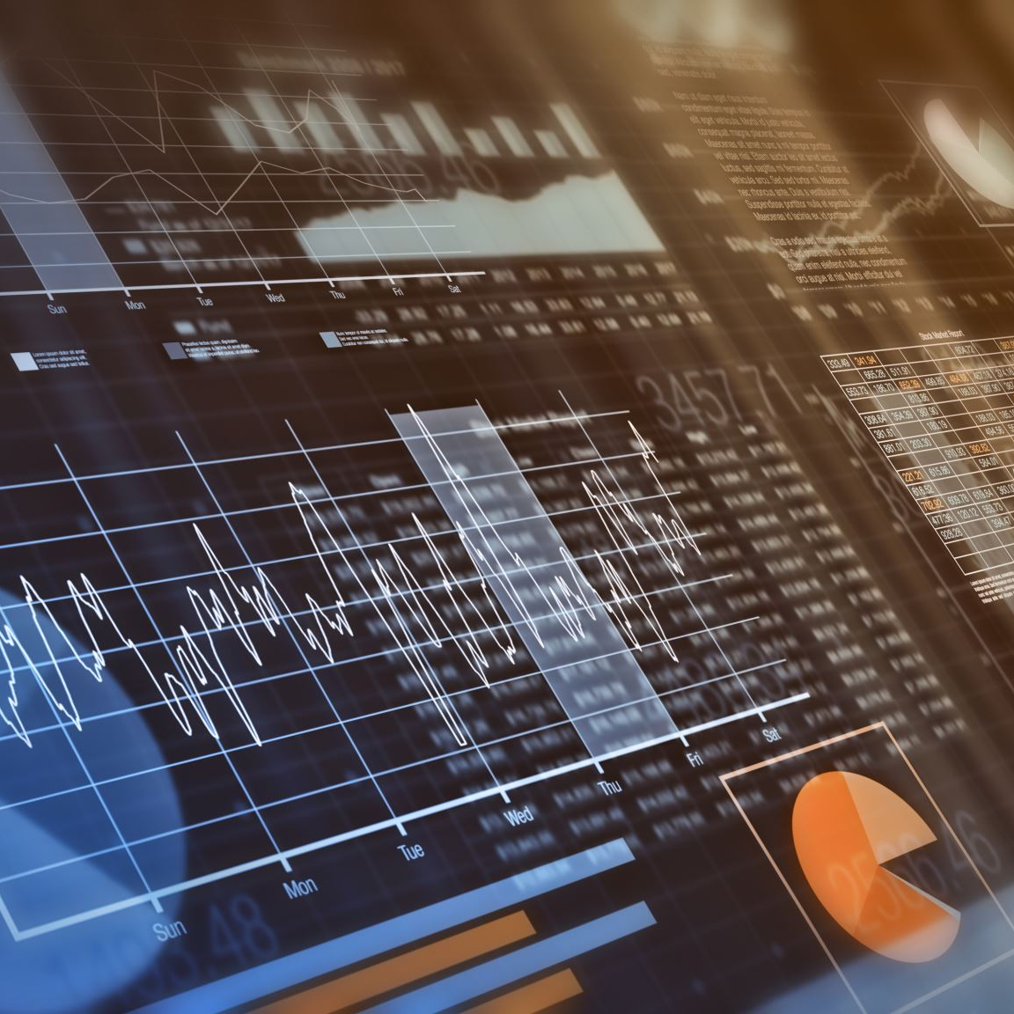
3. Deep Learning for Recommender Systems
Findings: Effective deep learning models for accurate content recommendations.
Impact: Increased recommendation accuracy and user satisfaction.
4. Machine Learning in Financial Forecasting
Findings: Accurate stock price predictions using machine learning models.
Impact: Demonstrates versatility of machine learning beyond content recommendations
Notes:
3. Content Creation and Curation
Strategy: Data-driven content production.
Impact: Successful launches of popular shows.
Outcome: High viewership and positive feedback for shows like "House of Cards.“

Slide 7
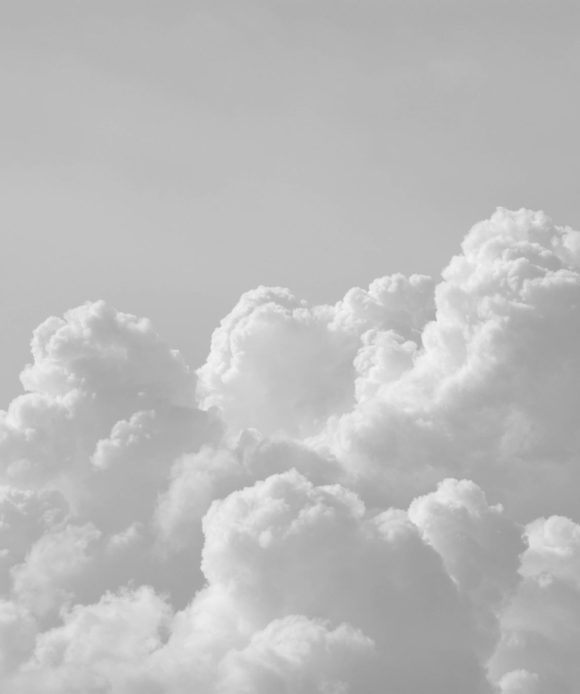
What We Learned?
Observed ML &NN architecture types
Observed the new opportunities of Cloud AI market
ML impact at Netflix

Slide 8
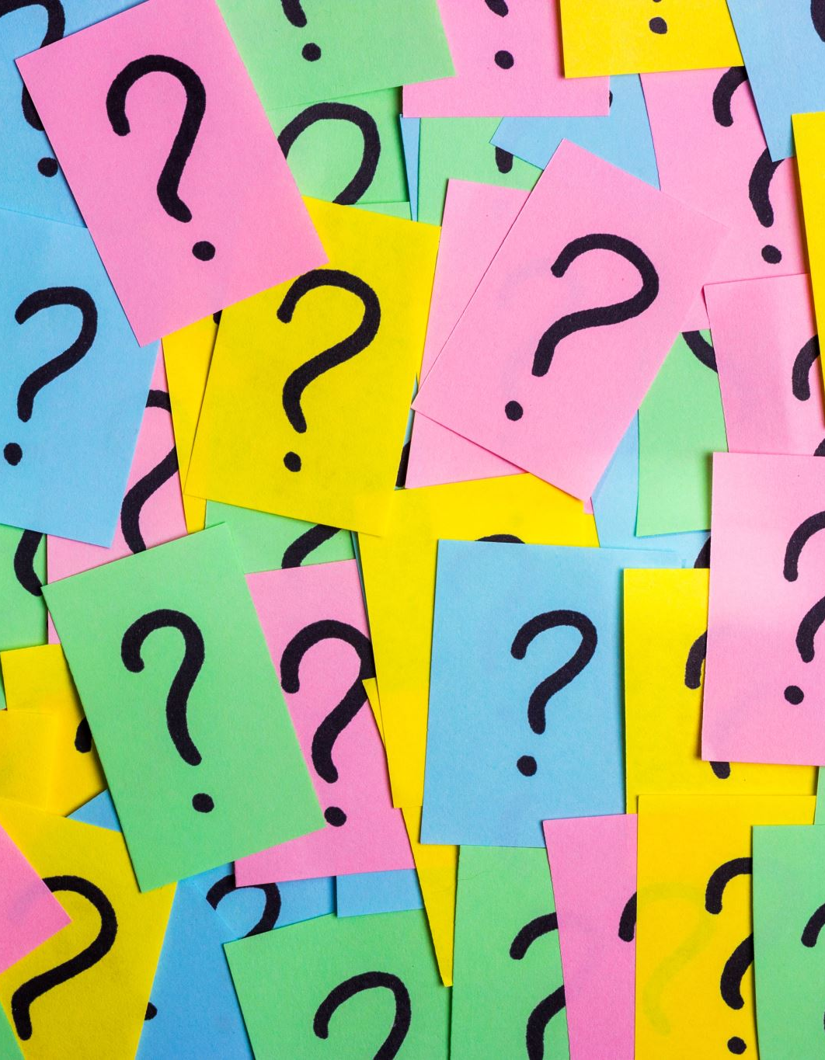
Short Quiz!
What is TensorFlow used for?
A Python Framework to simplify NN algorithms
A C# Framework to simplify NN algorithms
A NN Workstation to deploy NN models
A kernel notebook to automatically compile code
What is MNIST used for?
A Python Framework
Example Database to use for NN testing/training
Example models of NN
A set of NN algorithm examples
What is Adaptive Bitrate Streaming?
What does Cloud AI and ML help in Education industry?
AI-Driven Real Estate Valuation
Personalized Learning Platform
Pollution Monitoring
Hyper-Personalized Shopping
What does Cloud AI and ML help in Construction and Real Estate industry?
AI-Driven Real Estate Valuation
Personalized Learning Platform
Climate Change Modeling
Visual Search Tools

Slide 9
Resources
Vates. (2024, July 11). The future of machine learning: Emerging trends and applications. Vates. https://www.vates.com/the-future-of-machine-learning-emerging-trends-and-applications/
LeCun, Y., Cortes, C., & Burges, C. J. C. (1994). The mnist database. MNIST handwritten digit database, Yann LeCun, Corinna Cortes and Chris Burges. https://yann.lecun.com/exdb/mnist/
Santos, C. A. (2023, August 21). Use AI enrichment with image and text processing. Artificial intelligence (AI) architecture design. https://learn.microsoft.com/pdf?url=https%3A%2F%2Flearn.microsoft.com%2Fen-us%2Fazure%2Farchitecture%2Fai-ml%2Ftoc.json
Microsoft. (2024, April 17). What is ML.NET and how does it work? - ML.NET. ML.NET | Microsoft Learn. https://learn.microsoft.com/en-us/dotnet/machine-learning/how-does-mldotnet-work
Klingler, N. (2022, December 17). Jupyter notebook for Machine Learning - A Gentle Introduction. viso.ai. https://viso.ai/deep-learning/jupyter-notebook-for-machine-learning/#:~:text=The%20Jupyter%20Notebook%20is%20an,interactive%20environment%20in%20more%20detail.
NVIDIA. (2024). What is tensorflow?. NVIDIA Data Science Glossary. https://www.nvidia.com/en-us/glossary/tensorflow/
Zaytsev, A. (2023, November 15). Case study: How netflix is leveraging AI to transform streaming - aix: Ai expert network. AIX | AI Expert Network. https://aiexpert.network/case-study-how-netflix-is-leveraging-ai-to-transform-streaming/
Steck, H., Baltrunas, L., Elahi, E., Liang, D., Raimond, Y., & Basilico, J. (2021). Deep Learning for Recommender Systems: A Netflix Case Study. AI Magazine, 42(3), 7-18. https://doi.org/10.1609/aimag.v42i3.18140
Jupyter. (2024). Project jupyter. Project Jupyter. https://jupyter.org/
Wagner, B. (2018, October 31). File:Mldotnet.svg. Wikimedia Commons. https://commons.wikimedia.org/wiki/File:Mldotnet.svg
Google LLC. (2019, March 4). File:tensorflow logo.svg. Wikipedia. https://en.m.wikipedia.org/wiki/File:TensorFlow_logo.svg

