Slide 1

REST API on Python
How to use API’s through Python
By Herman and André

Slide 2
Preparation
Laptop with Python (3.8) installed
An IDE (PyCharm or VSCode)
Clone my repository
git clone https://hvdveer@bitbucket.org/linkit-group/python_api.git
Join the slack channel: python_api

Slide 3
Core concepts
HTTP
SOAP vs REST
Data serialization language
Endpoints
Postman

Slide 4
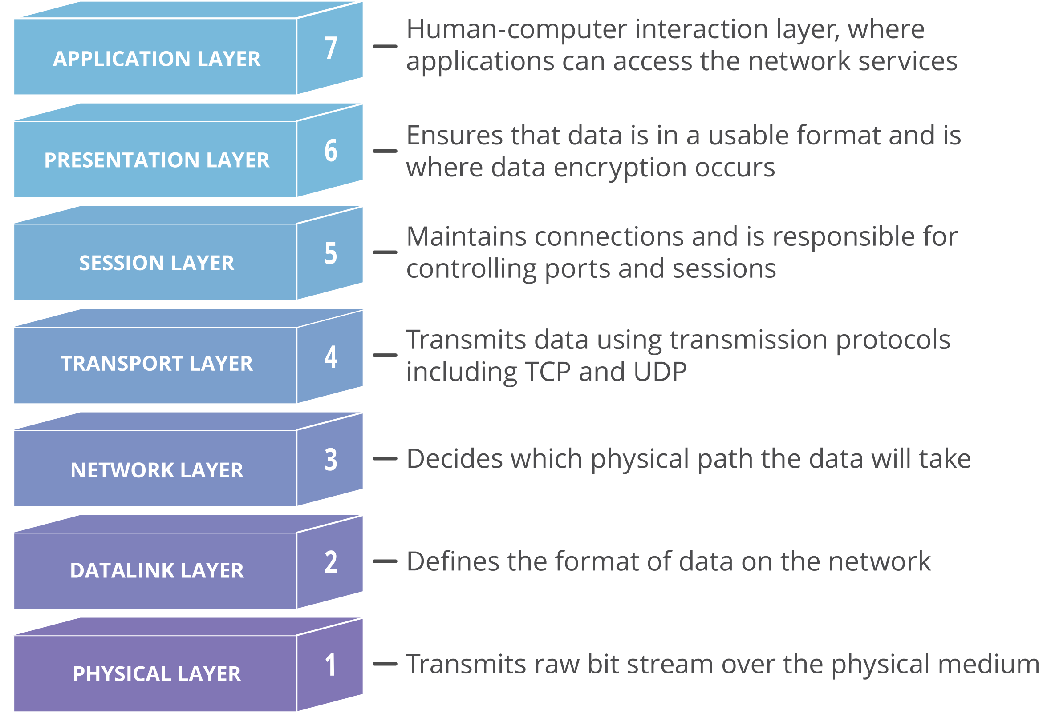
HTTP
OSI 7 layer model
Status calls

Slide 5
What is an API
Application Programming Interface
POST / PUT / GET / DELETE

Slide 6
REST Vs SOAP
RESTfull communication

Slide 7
Securing your api
RESTfull communication

Slide 8
Data serialization language
XML
JSON
YAML

