Slide 1

REST API on Python
How to use API’s through Python
By Herman and André

Slide 2
Preparation
Laptop with Python (3.8) installed
An IDE (PyCharm or VSCode)
Clone my repository
git clone https://hvdveer@bitbucket.org/linkit-group/python_api.git
Join the slack channel: python_api

Slide 3
Core concepts
HTTP
SOAP vs REST
Data serialization language
Endpoints
Postman

Slide 4
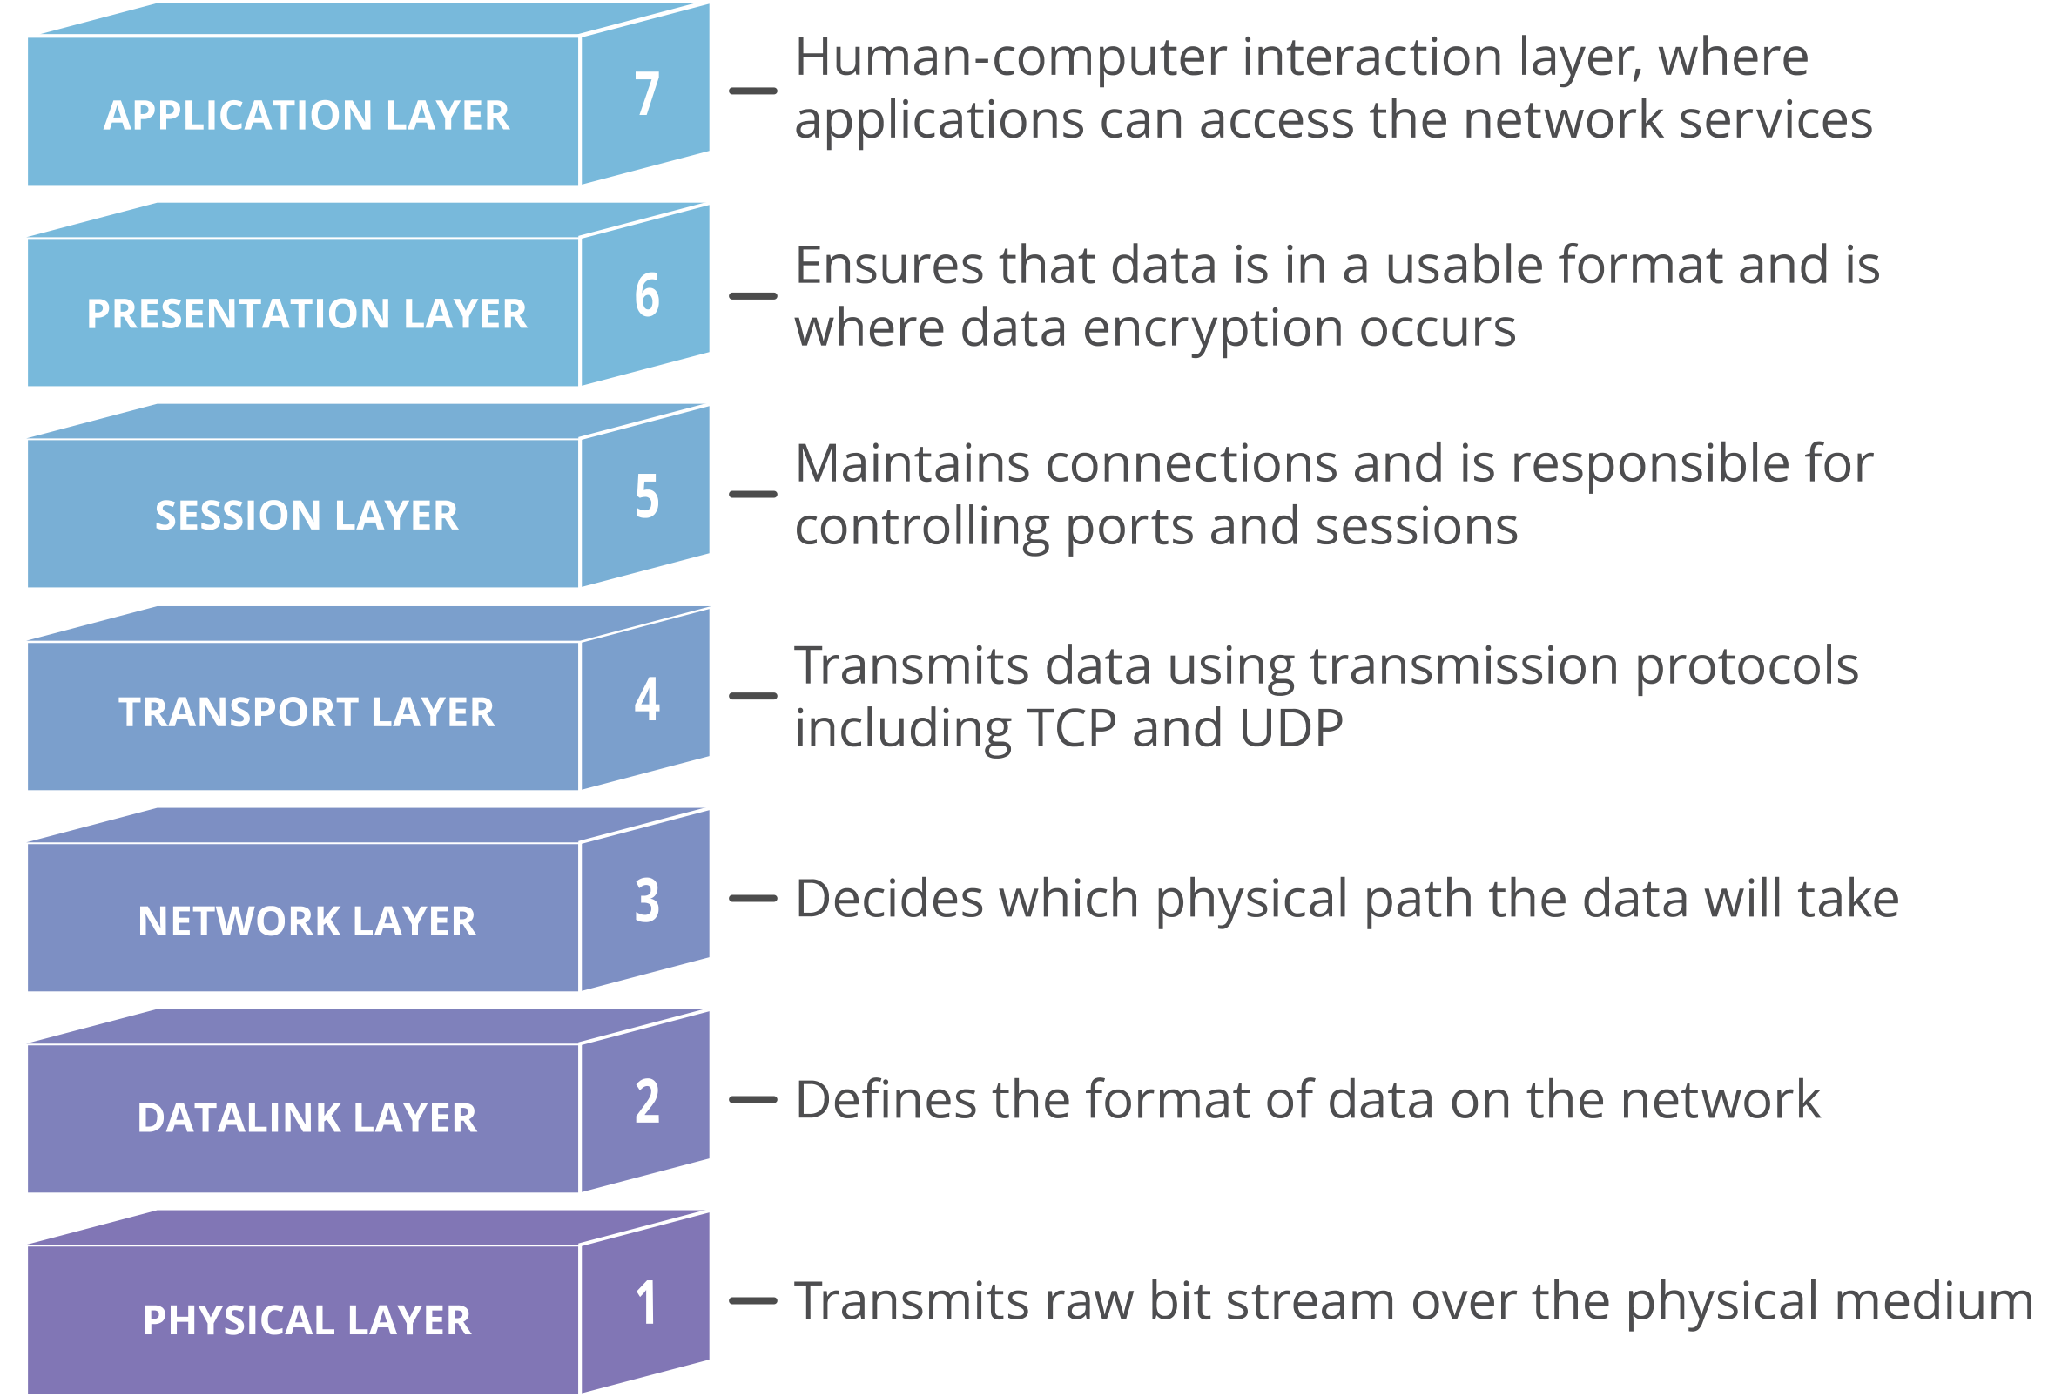
HTTP
OSI 7 layer model
Status calls

Slide 5
What is rest?
REST vs. SOAP
SOAP: Simple Object Access Protocol
Relies on XML
Data model defined in an XSD
Legacy
REST: Representational State Transfer
Open communication, no data model requirement
JSON, YAML or even CSV
Much simpler, smaller and faster

Slide 6
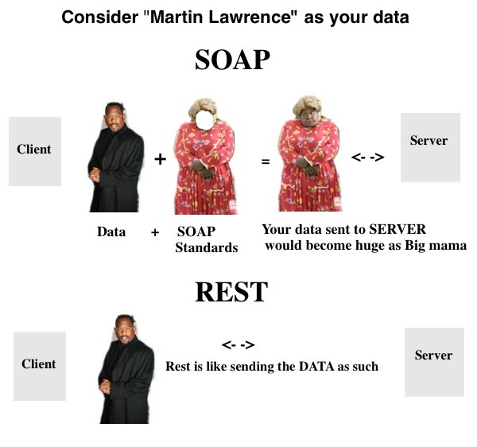

Slide 7
What is an API?
Application Programming Interface
Stateless (state stored client-side)
Client <-> Server independent
URL Composition standardized
GET /cities, GET cities/utrecht
POST / PUT / GET / DELETE

Slide 8
Securing your api
RESTfull communication

Slide 9
Data serialization language
XML
Contains data structure
JSON
Rigid, better for data interchange
YAML
Very (human) readable
Flexible
Better for configuration

Slide 10
XML
<CATALOG>
<PLANT>
<COMMON>Bloodroot</COMMON>
<BOTANICAL>Sanguinaria canadensis</BOTANICAL>
<LIGHT>Mostly Shady</LIGHT>
<PRICE>$2.44</PRICE>
<AVAILABILITY>031599</AVAILABILITY>
</PLANT>
<PLANT>
<COMMON>Columbine</COMMON>
<BOTANICAL>Aquilegia canadensis</BOTANICAL>
<LIGHT>Mostly Shady</LIGHT>
<PRICE>$9.37</PRICE>
<AVAILABILITY>030699</AVAILABILITY>
</PLANT>
</CATALOG>

Slide 11
JSON
{
"description": "List of plants by common name",
"plants": [
{
"name": "Alder",
"species": "Alnus”,
”poisonous”: true
},
{
"name": "Black alder",
"species": "Alnus glutinosa, Ilex verticillata"
},
{
"name": "Common alder",
"species": "Alnus glutinosa"
}
]
}

Slide 12
YAML
description: List of plants by common name
plants:
- name: Alder
species: Alnus
poisonous: true
- name: Black alder
species: Alnus glutinosa, Ilex verticillata
- name: Common alder
species: Alnus glutinosa

Slide 13
Clone our repository
git clone git@bitbucket.org:linkit-group/python_api.git git branch YOUR_NAME
git checkout YOUR_NAME

Slide 14
Assignment01 - Public api
Pick an API from: https://github.com/public-apis/public-apis
Read the information in Python

Slide 15
Assignment02 - private api
Open the

