Slide 1
Semester Projects
UCD Machine & Statistical Learning Club

Slide 2

Competition
The aim is to predict the results of the 2016 US Presidential Election
The person (or team) who predicts the most states correctly will win a prize.
With the exception of guessing from the gut, you may use any (ML or Stats) tools you would like.

Slide 3
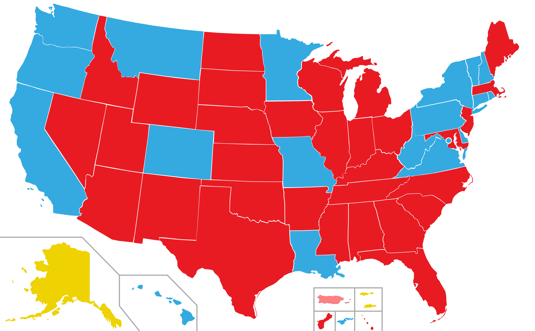
Teams are allowed
Whichever individual or team correctly predicts the most number of states will win.
As states may use different measures for determining a winner, we will declare the winner of the state as whichever candidate receives the majority of the votes.
In the case of a tie, we will use the voter turnout percentage of Colorado as a tie breaker

Slide 4
Rules Continued
Please use only publicly available data
You may only enter the competition one.
E.g. no entering as part of a team and as an individual
No “gut feelings”
We are really looking for infromed predictions.
If you plan to do Baysian Analysis, you may use your own gut instincts for your priors.
All entries must be received by 11:59 PM on Monday, November 8th

Slide 5
Additional Information
There will be an additional prize for Best Visualization
The officers will decide on the top 5 and then the club will vote on a winner.
The visualization is entirely optional
For your entry please include the following
Your predictions, both how the 50 states will go and voter turnout (Template)
Your code (how did you decide on your predictions?)
Your visualization (if applicable)
There will be a folder on the club Github repository where you can turn in your entry

Slide 6
A Declarative Learning Library
Max Lees

Slide 7
Goals
Learn ML techniques
Create a library
Resume
Use in other projects

Slide 8
Declarative Machine Learning
Focus on data and forms
Domain specific language
Easier to handle big projects
Customizable
Examples:
Tensor Flow
SystemML
OptiML

Slide 9
Where do we start?
Join slack channel
Find time to meet bi-weekly
Choose a language
Create a K Nearest Neighbor implementation

Slide 10
Kaggle competition
Project leaders: Aaron Nielsen and Evan Colvin

Slide 11
Kaggle competitions
http://www.kaggle.com
Competitions (most with prizes!) for data analysts, engineers, nerds
Most competitions are sponsored by a company
They provide the data set (training set)
You make predictions on new values

Slide 12
Bosch Production Line Performance
A good chocolate soufflé is decadent, delicious, and delicate. But, it's a challenge to prepare. When you pull a disappointingly deflated dessert out of the oven, you instinctively retrace your steps to identify at what point you went wrong. Bosch, one of the world's leading manufacturing companies, has an imperative to ensure that the recipes for the production of its advanced mechanical components are of the highest quality and safety standards. Part of doing so is closely monitoring its parts as they progress through the manufacturing processes.

Slide 13
Bosch Production Line Performance
Because Bosch records data at every step along its assembly lines, they have the ability to apply advanced analytics to improve these manufacturing processes. However, the intricacies of the data and complexities of the production line pose problems for current methods.
In this competition, Bosch is challenging Kagglers to predict internal failures using thousands of measurements and tests made for each component along the assembly line. This would enable Bosch to bring quality products at lower costs to the end user.

Slide 14
Bosch Production Line Performance
Started: 1:24 pm, Wednesday 17 August 2016 UTC
Ends: 11:59 pm, Friday 11 November 2016 UTC
Winner receives $30,000

Slide 15
Bosch Production Line Performance
The data for this competition represents measurements of parts as they move through Bosch's production lines. Each part has a unique Id. The goal is to predict which parts will fail quality control (represented by a 'Response' = 1).
Large data set (approx. 300MB)

