Slide 1
Compilateur Project
Created by :
Charbel El Haddad ID: 201610651
Elio Hanna ID: 201610091
Marc Al Raheb ID: 201610349

Slide 2
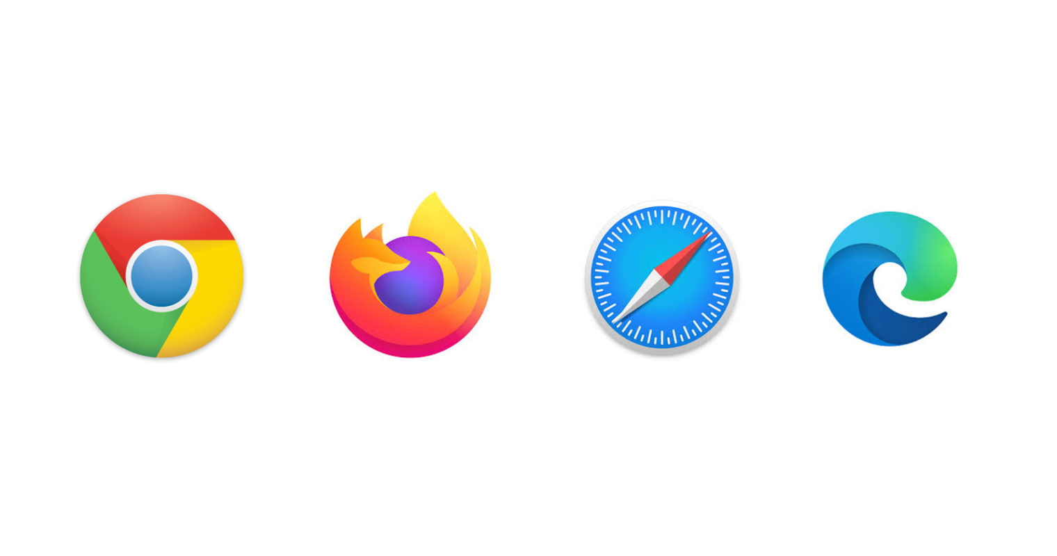
What is WebAssembly?
WebAssembly is a portable byte code format that has become available to the major browsers by Google, Microsoft, Mozilla and Apple.

Slide 3
History
June 2015 - WebAssembly was first announced.
March 2016 - Google, Microsoft, Mozilla preview WebAssembly in their
browsers.
October 2016 – WebAssembly becomes a binary release candidate.
March 2017 – Begins to be shipped on-by-default in browsers.
Link of interest:
http://webassembly.org/
https://github.com/WebAssembly
https://www.w3.org/community/webassembly/

Slide 4

Why would I need WebAssembly?
WebAssembly is a new type of code that can be run in modern browsers. It was created to get better performance on the web. It’s a low-level binary format that has a small size, so it’s fast to load and execute. You do not write WebAssembly, you compile other higher level languages to it.

Slide 5
The Advantage
It brings better performance to the web (especially for load times, games).
It offers a good compile target for the web, so that people can choose which language they code their websites in.
Files are a little smaller to download , since it is a binary format.

Slide 6
Webassembly Implementations
There are 2 types of Webassembly implementation:
Client Side works by downloading and running a small .NET runtime to the client and then executing your code in the browser’s UI thread. There is no dependency on the server and it can be hosted from any number of different environments. You can also support offline scenarios and Progress Web Apps
Server Side runs on the server with a small amount of code running on the client and a SignalR channel between the two. Any user input is transmitted back to the server and new render data is passed to the client and displayed

Slide 7
Client Side Pros and Cons
Pros | Cons
No need for a server | Big download size
No need for JavaScript | Less mature runtime
Offline support | Debugging is not great
 | All DLLs are downloaded

Slide 8
Server Side Pros and Cons
Pros | Cons
Small size, fast loading | You need a server
No need for JavaScript | No offline support
Debugging is much easier than client side | Higher latency
Runs on any browser | Hard to maintain and scale
Code stays on the server

Slide 9
Performance comparison between Client Side and Server Side
 | Client Side | Server Side
Speed of loading | 2 | 1
Speed of execution | 1 | 2
Speed of development | 1 | 2
Security | 2 | 1
Availability | 1 | 2
Debugging | 2 | 1
Scalability | 1 | 2

