Slide 1
Web Assembly Project
Created by :
Elio Hanna Marc Al Raheb

Slide 2
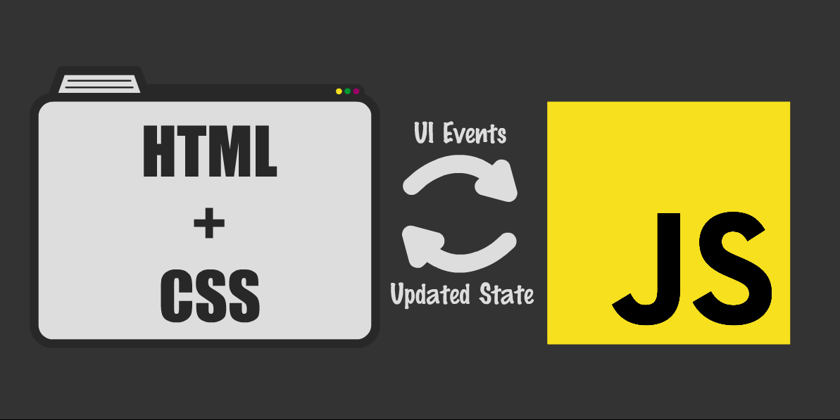
Language of the web:
Consider, the web. The web is the largest open technology platform in existence. And what is the language of the web? JavaScript.
Okay, but how important is JavaScript for Modern Web Developers?
The importance of JavaScript as a web technology can be determined from the fact that it is currently used by 94.5% of all websites. As a client-side programming language.
JavaScript helps web developers to make web pages dynamic and interactive by implementing custom client-side scripts.

Slide 3
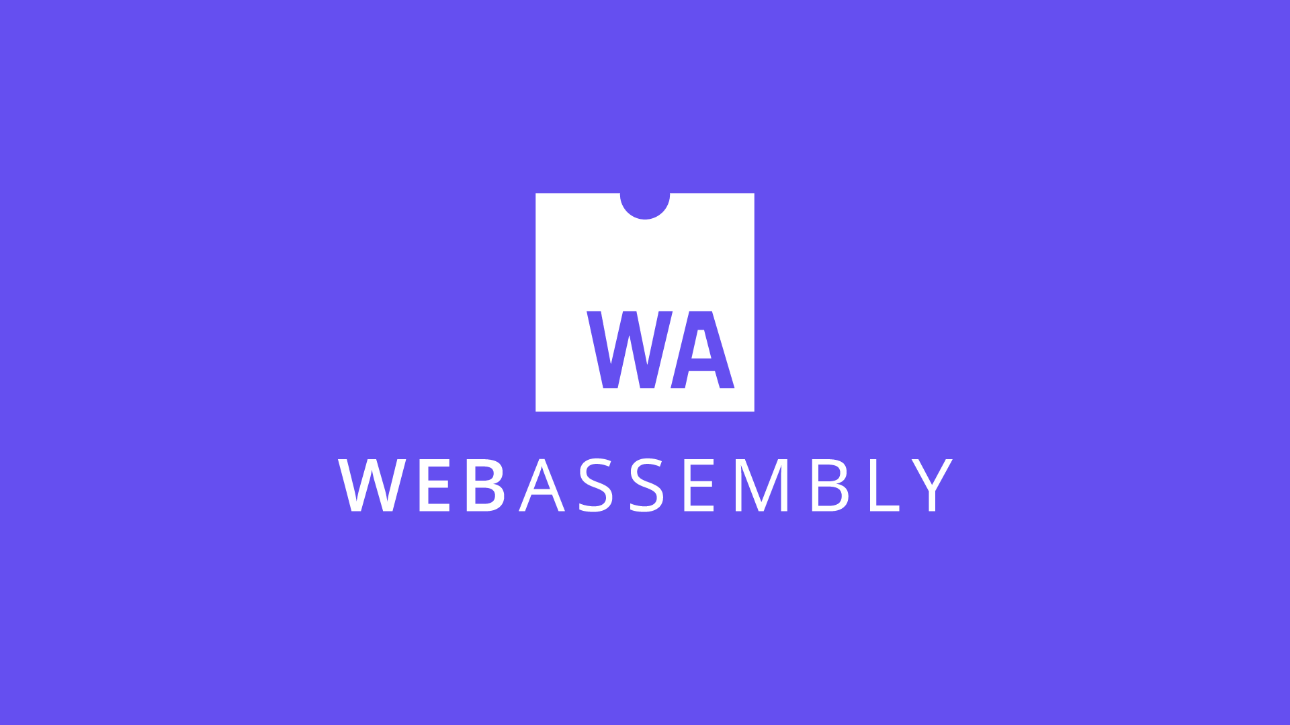
Language of the web:
Now picture another web. A web where you can write in your favorite languages, such as Elixir, Ruby, Python, and lower-level languages like C/C++, Rust, Go. You'd write code once in your language of choice, and share it across server and client. You even could write code in the same language that your browser is written in. The code would run on the client with near-native performance.
And it is already here, in the form of a language called WebAssembly.

Slide 4
History of WebAssembly:
June 2015 - WebAssembly was first announced.
March 2016 - Google, Microsoft, Mozilla preview WebAssembly in their
browsers.
October 2016 – WebAssembly becomes a binary release candidate.
March 2017 – Begins to be shipped on-by-default in browsers.
Link of interest:
http://webassembly.org/
https://github.com/WebAssembly
https://www.w3.org/community/webassembly/

Slide 5

What is WebAssembly?
WebAssembly is a portable byte code format that has become available to the major browsers by Google, Microsoft, Mozilla and Apple.

Slide 6
An improvement to JavaScript: Implement your performance critical stuff in wasm and import it like a standard JavaScript module.
A new language: WebAssembly code defines an AST (Abstract Syntax Tree) represented in a binary format. You can author and debug in a text format so it’s readable.
A browser improvement: Browsers will understand the binary format, which means we’ll be able to compile binary bundles that compress smaller than the text JavaScript we use today. Smaller payloads mean faster delivery. Depending on compile-time optimization opportunities, WebAssembly bundles may run faster than JavaScript, too!

Slide 7

Why would I need WebAssembly?
WebAssembly is a new type of code that can be run in modern browsers. It was created to get better performance on the web. It’s a low-level binary format that has a small size, so it’s fast to load and execute. You do not write WebAssembly, you compile other higher level languages to it.

Slide 8
The Advantage
It brings better performance to the web (especially for load times, games).
It offers a good compile target for the web, so that people can choose which language they code their websites in.
Files are a little smaller to download , since it is a binary format.

Slide 9
JavaScript and web assembly performance comparison
 | JavaScript | WASM
Speed of development | 2 | 1
Speed of execution | 2 | 1
Package size | 2 | 1
Maintenance | 2 | 1
Resource consumption | 1 | 2
Cross platform | 2 | 1
Security | 1 | 2
Stability | 2 | 1
Documentation | 2 | 1
Trend | 2 | 1
Future proof | 2 | 1
Position in quadrant | 2 | 1

Slide 10
Blazor WASM
Similar to JavaScript, Blazor Web Assembly apps run securely on the user's device from within the browser's security sandbox.
These apps can be deployed as completely standalone static sites without any . NET server component at all, or they can be paired with ASP.NET Core to enable full stack web development with .NET

Slide 11
PWA
Progressive Web Apps are web applications that have been designed so they are capable, reliable, and installable
example of WhatsApp on your phone. When there is no network, you can still open the app, check past messages and even reply to someone. When the phone gets the internet connection, the messages are being automatically sent in the background.
This is what PWA promises to provide in web apps
NO MORE DOWNASAUR

