Slide 1
Project Management tool
Presented by: Elio Hanna
In this power point we will discuss the different stage of the app (success and failure)
You can download the source code and the database from github

Slide 2
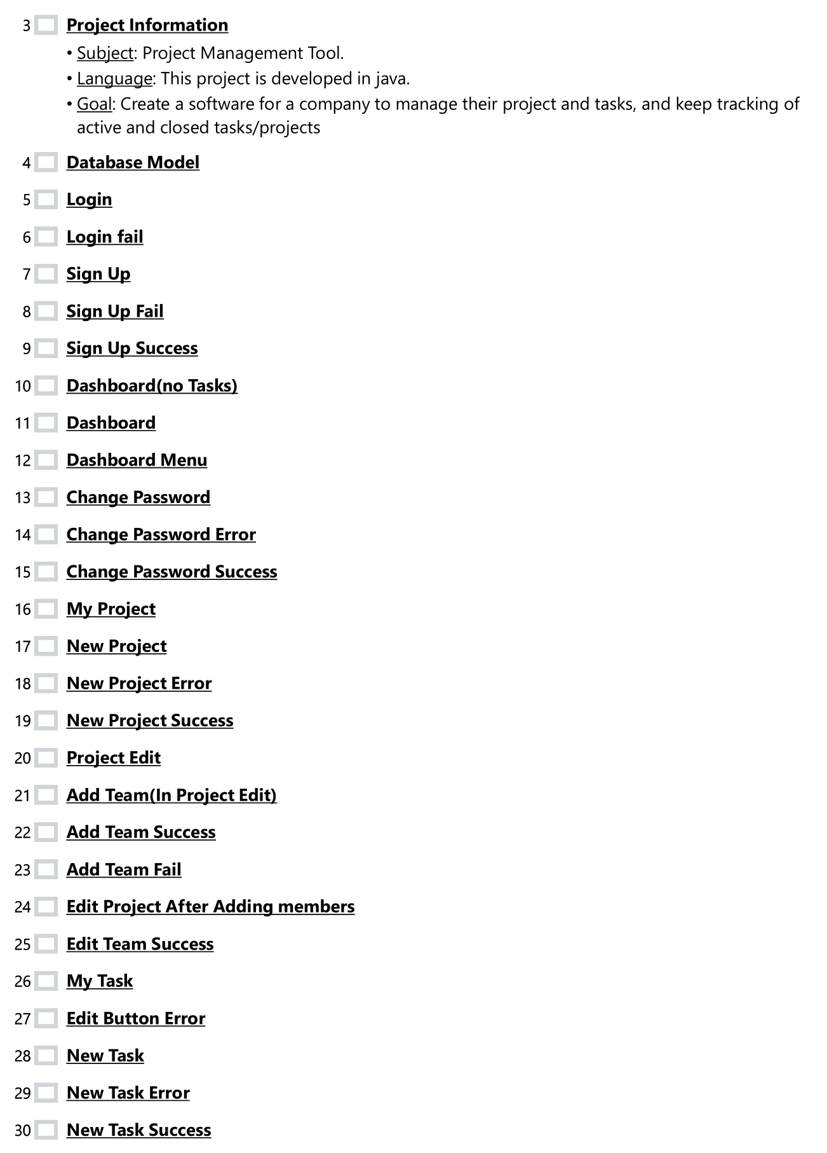


Slide 3
Project Information
Subject: Project Management Tool.
Language: This project is developed in java.
Goal: Create a software for a company to manage their project, tasks and keep tracking of active and closed tasks/projects

Slide 4
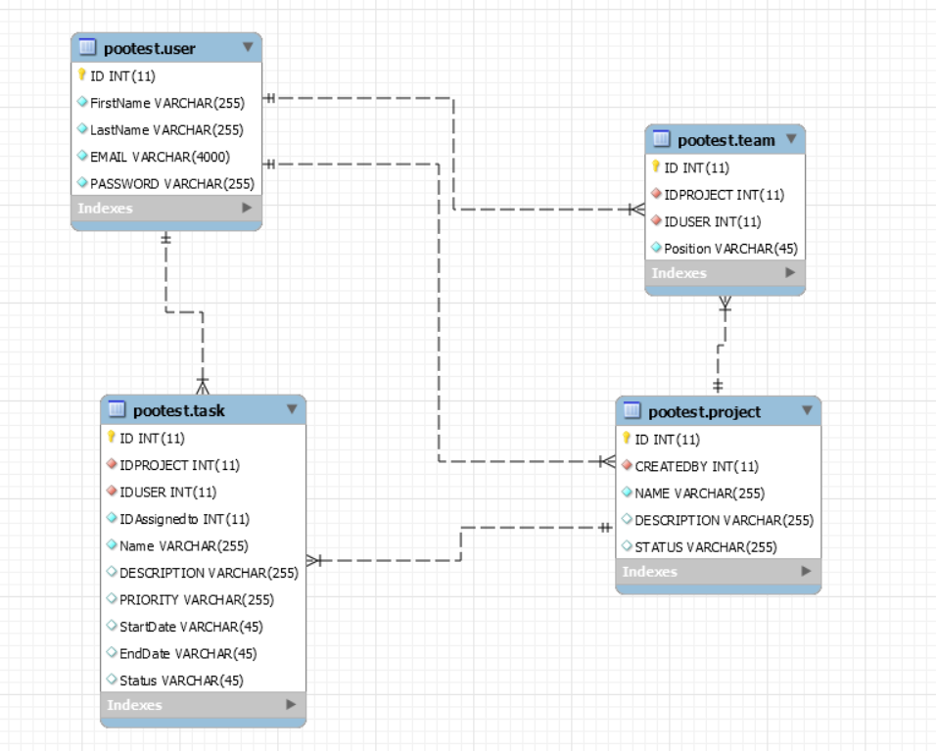
Database Model

Slide 5
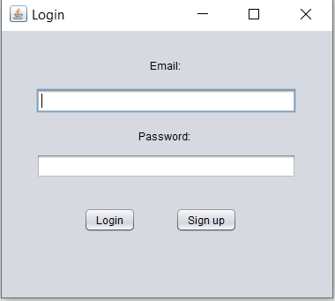
Login

Slide 6
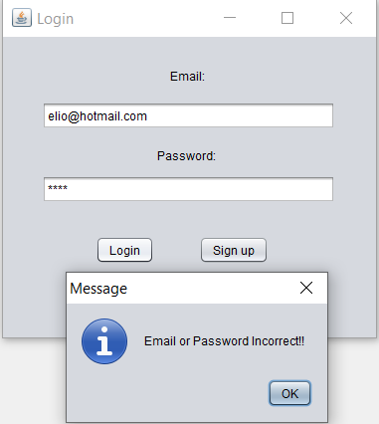
Login fail

Slide 7
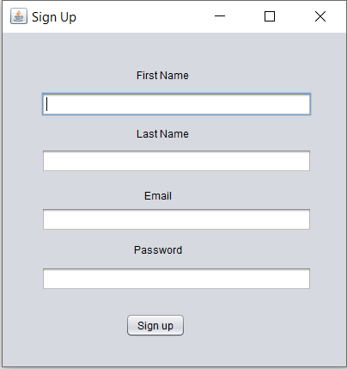
Sign Up

Slide 8
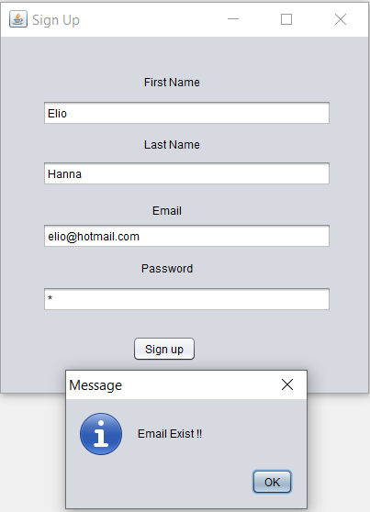
Sign Up Fail

Slide 9
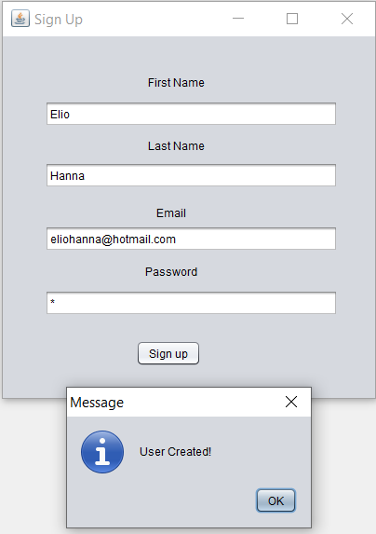
Sign Up Success

Slide 10
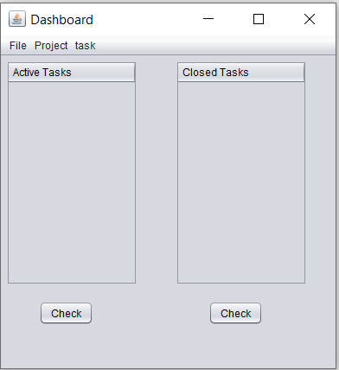
Dashboard(no Tasks)

Slide 11
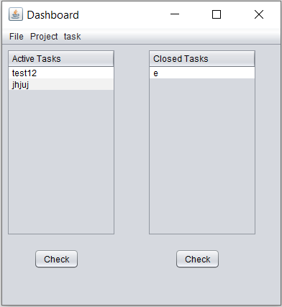
Dashboard

Slide 12
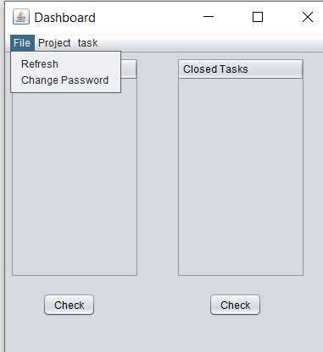
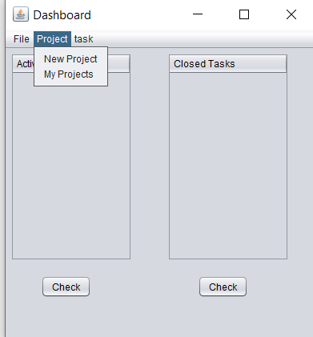
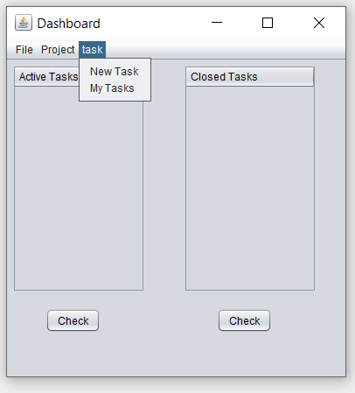
Dashboard Menu

Slide 13
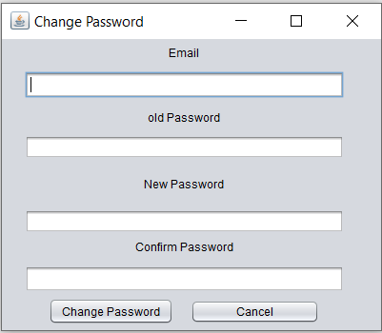
Change Password

Slide 14
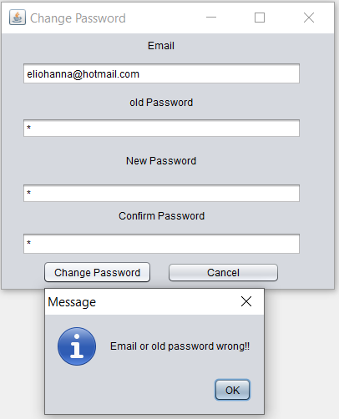
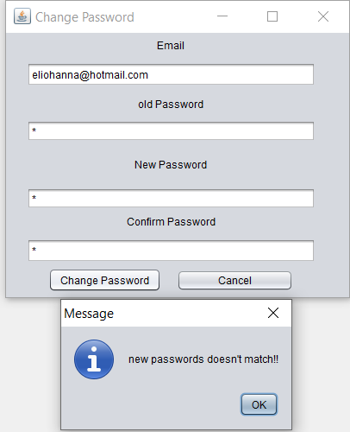
Change Password Error

Slide 15
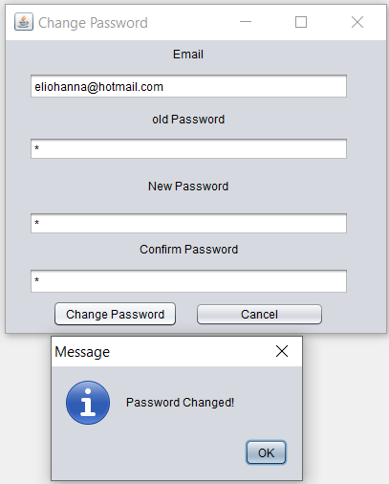
Change Password Success

Slide 16
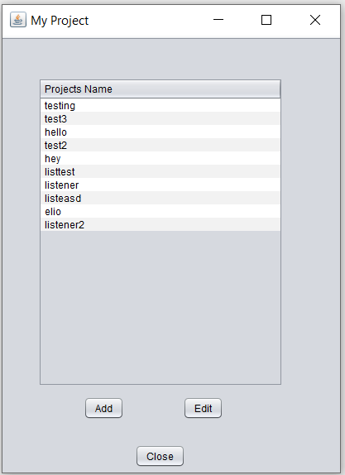
My Project

Slide 17
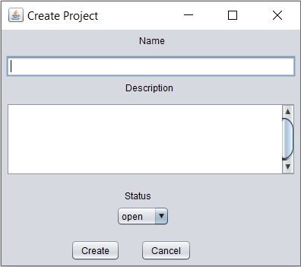
New Project

Slide 18
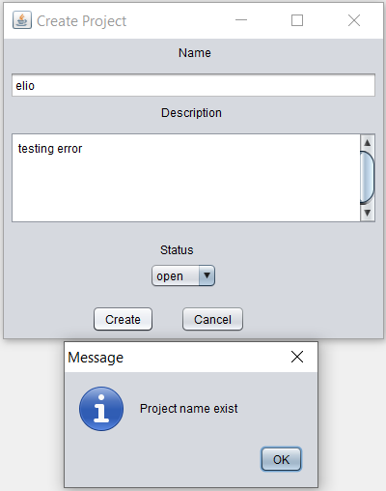
New Project Error

Slide 19
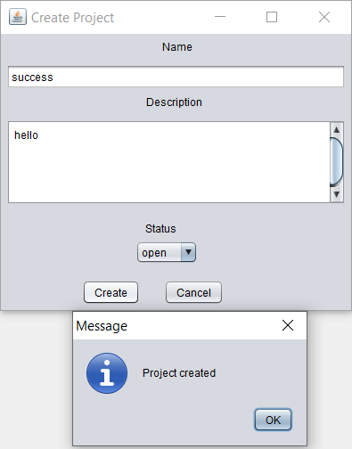
New Project Success

Slide 20
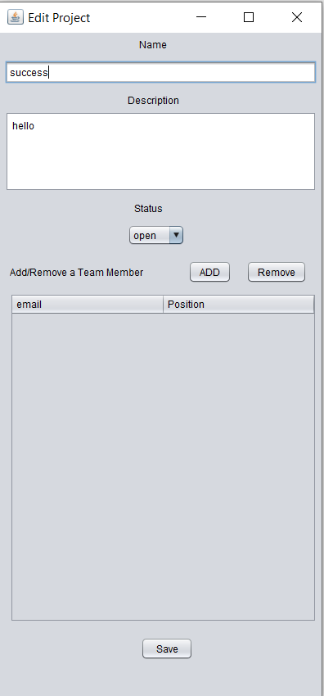
Project Edit

Slide 21
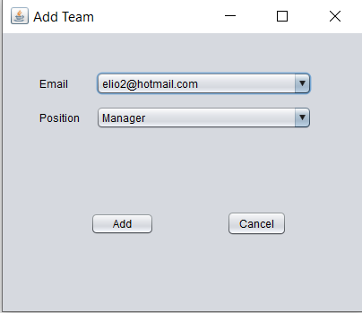
Add Team(In Project Edit)

Slide 22
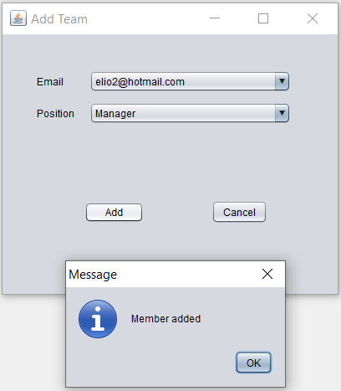
Add Team Success

Slide 23
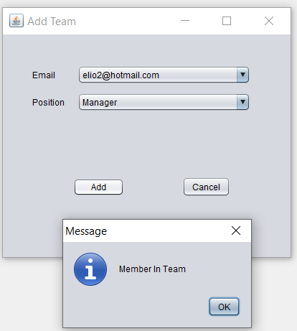
Add Team Fail

Slide 24
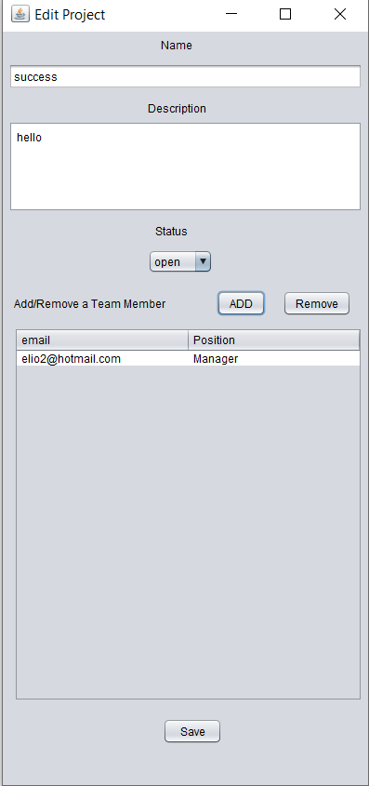
Edit Project After Adding members

Slide 25
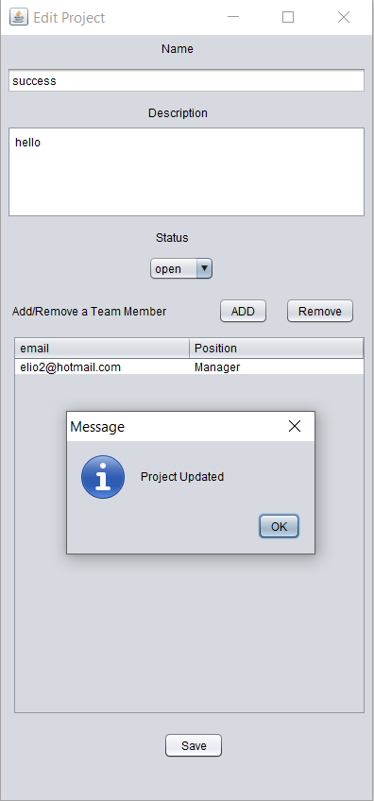
Edit Team Success

Slide 26
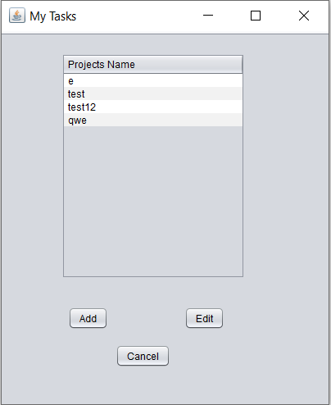
My Task

Slide 27
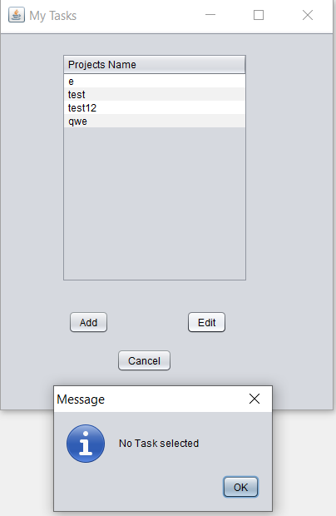
Edit Button Error

Slide 28
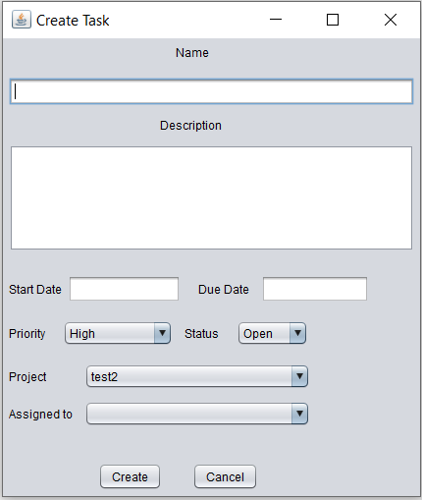
New Task

Slide 29
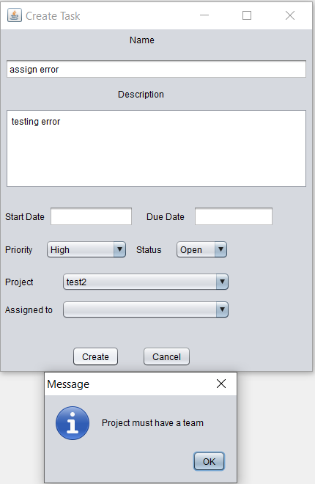
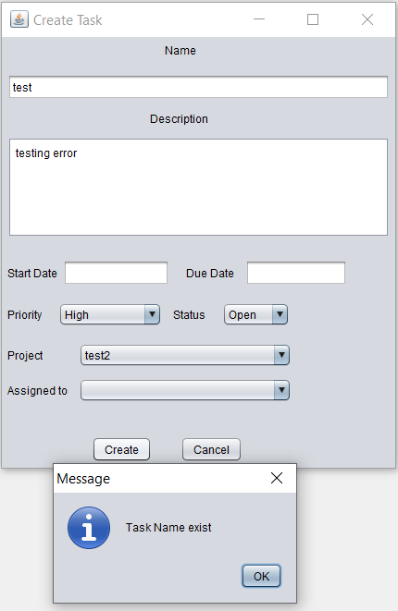
New Task Error

Slide 30
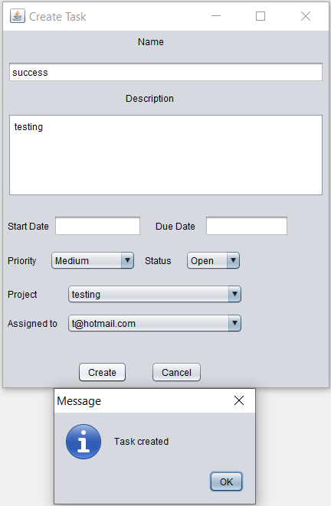
New Task Success

Slide 31
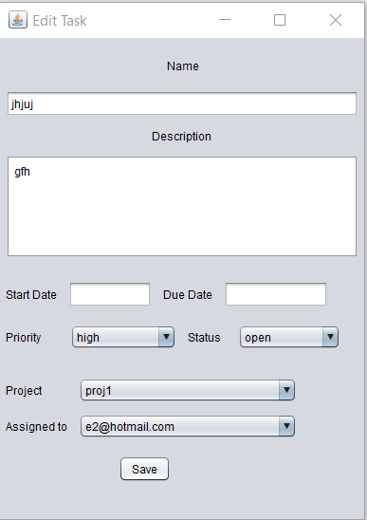
Edit Task

Slide 32
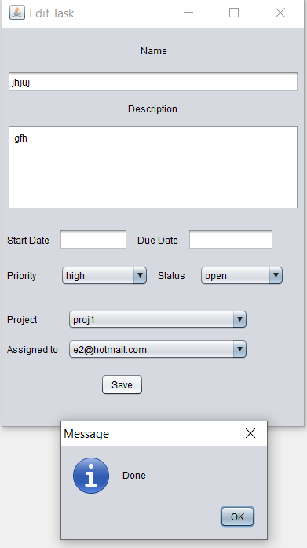
Edit Task Success

Slide 33
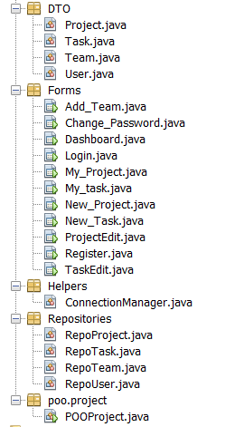
Project

Slide 34
