Slide 1



NetCrafter Tailoring Network Traffic for Non-Uniform Bandwidth Multi-GPU Systems
Amel Fatima¹
Yang Yang¹, Yifan Sun², Rachata Ausavarungnirun³, and Adwait Jog¹
1
2
3
Notes:
Hi Everyone, my name is Yang Yang and today, I will present our work “NetCrafter, Tailoring Network Traffic for Non-Uniform Bandwidth Multi-GPU Systems”
This work is a result of a collaborative effort between the University of Virginia, William & Mary, and King Mongkut’s University of Technology North Bangkok.

Slide 2



SUMMARY
Problem and Motivation
Multi-GPU systems accelerate workloads by interconnecting multiple GPUs
These interconnects often exhibit non-uniform bandwidth as systems scale
Slower links become performance bottlenecks, limiting scalability
Key Ideas
Target slower bandwidth links with two key strategies:
Reduce network traffic
Manage network traffic more efficiently
We propose NetCrafter, a network crafting engine that:
Stitches partially empty flits to improve flit utilization
Trims network packets with redundant data
Sequences network traffic to prioritize latency-critical packets
Performance
Up to 64% faster, and 16% average speedup over baseline non-uniform multi-GPU setups
Infinity Fabric GPU-GPU (50+50 GB/s)
GPU 5
GPU 4
GPU 2
GPU 3
GPU 7
GPU 6
GPU 0
GPU 1
Notes:
I’ll start by briefly summarizing our work.
Modern multi-GPU systems accelerate workloads by interconnecting multiple GPUs. However, as these systems scale to meet increasing demands of emerging workloads, they typically exhibit non-uniform interconnect bandwidth. In such setups, slower links often become performance bottlenecks, limiting overall scalability.
<click> To address this challenge, our goal is to optimize performance over these slower links by reducing and efficiently managing network traffic—ultimately improving bandwidth utilization where it is most constrained.
To this end, we propose NetCrafter, a network crafting engine that:
Stitches partially empty flits to improve utilization Trims redundant data from network packets, and
Sequences network traffic to prioritize latency-critical packets.
<click> With these optimizations, NetCrafter delivers up to 64% performance improvement, and 16% on average, over a baseline multi-GPU system with non-uniform interconnect bandwidth.

Slide 3
OUTLINE
BACKGROUND AND MOTIVATION
GOAL
OBSERVATIONS & KEY IDEAS
NETCRAFTER DESIGN
EVALUATION
CONCLUSION
Notes:
This is a brief outline of today’s talk

Slide 4
OUTLINE
BACKGROUND AND MOTIVATION
GOAL
OBSERVATIONS & KEY IDEAS
NETCRAFTER DESIGN
EVALUATION
CONCLUSION
Notes:
I’ll start by providing some background and then motivating our work

Slide 5



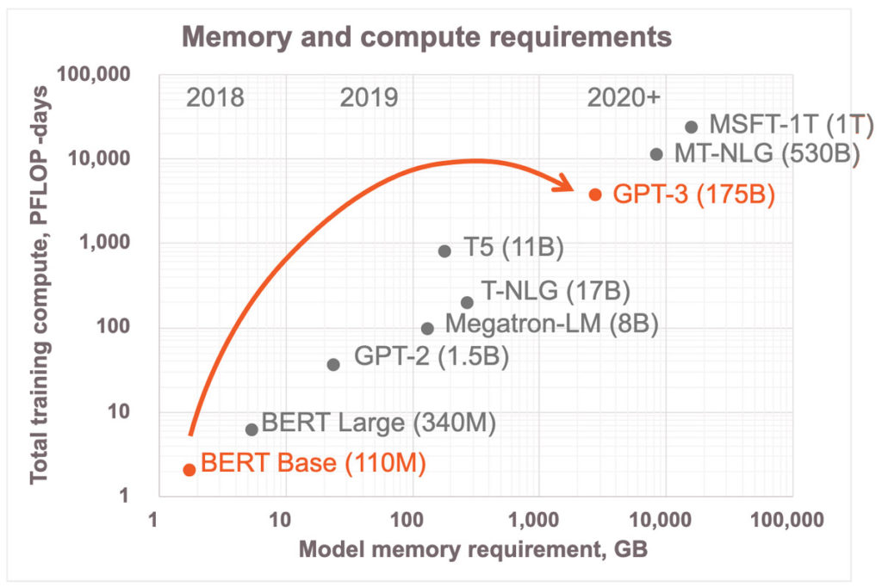


BACKGROUND
GPUs are used to accelerate a wide range of applications
Graph Processing
DNN
AR/VR
HPC Workloads
ChatGPT
Genomics
Rising application demands outgrow single-GPU capabilities
https://www.cerebras.net/blog/harnessing-the-power-of-sparsity-for-large-gpt-ai-models
Notes:
GPUs today drive everything from graph processing and deep learning to VR, HPC, genomics—and even large language models like ChatGPT.
<click>While GPUs accelerate these applications, the compute and memory demands of such workloads also continue to grow rapidly as depicted by this figure.
For example, —GPT-3 alone demands thousands of gigabytes of memory and petaflop-days of training.
<click> Clearly, a single GPU can no longer meet these skyrocketing demands - highlighting the limitations of standalone single-GPU capabilities.

Slide 6
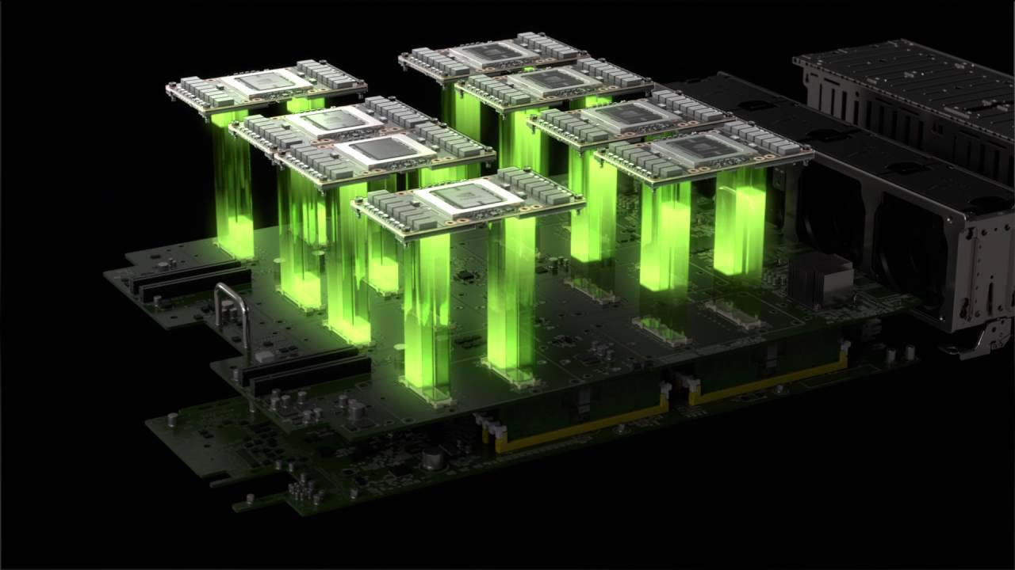
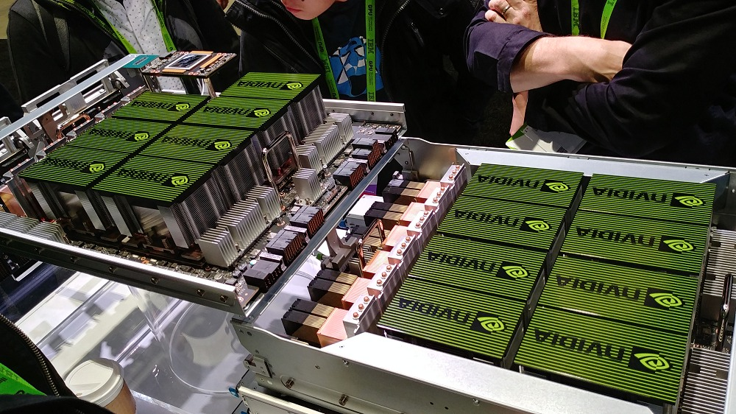
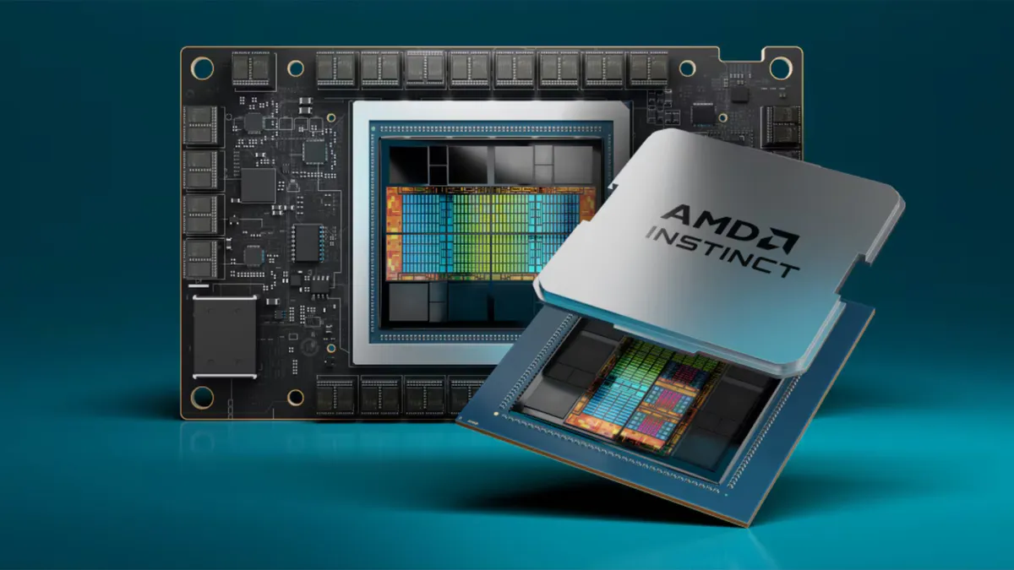
MULTI-GPU SYSTEMS TO THE RESCUE
Multiple GPUs are connected over high bandwidth interconnects to scale:
Compute by harnessing collective compute power of multiple GPUs
Memory by pooling memory across GPUs for a larger memory space
GPU 2
GPU 3
GPU 0
GPU 1
Notes:
That’s where multi-gpu systems come to the rescue;
<click> By connecting multiple GPUs over high-speed interconnects, these systems overcome the limitations of a single GPU by scaling
<click> compute using collective computation power of multiple GPUs and processing large scale data in parallel
<click> and memory by pooling memory across GPUs for a larger memory space
<click>This is exactly what commercial systems like NVIDIA DGX, AMD Mi300X, and Intel XE deliver with their multi-GPU setups.

Slide 7
SCALING MULTI-GPU SYSTEMS
Multi-GPU systems must scale with growing application demands
These systems typically scale in a hierarchical manner
Tightly coupled (e.g., MCM style): Linked via higher-bandwidth interconnects
Loosely coupled (e.g., Multi-GPU style): Connected over lower-bandwidth interconnects
GPU 5
GPU 4
GPU 2
GPU 3
GPU 7
GPU 6
GPU 0
GPU 1
Multi-GPU scaling typically introduces bandwidth non-uniformity
(e.g., Frontier, Summit, Aurora)
Notes:
However, Multi-GPU systems must continue to scale with the growing demands of modern applications.
<click> As we scale beyond a single GPU cluster, systems typically adopt a hierarchical interconnect design—
<click>with fast, high-bandwidth links connecting nearby GPUs
<click> and slower, lower-bandwidth links connecting distant ones
<click> This hierarchy introduces non-uniform bandwidth across all GPUs, creating new bottlenecks as the system scales. Now, lets take a look at the repercussions of this non-uniform bandwidth on our multi-GPU system.

Slide 8
NON-UNIFORM BANDWIDTH -> NUMA
Memory access bandwidth varies across the system
COMPUTE UNIT
SIMD
Wavefront
SIMD
SIMD
x
tid
address
SIMD
SIMD
0
0x0
GPU 5
GPU 4
GPU 2
GPU 3
Coalesce
1
0x4
2
0x8
L1 TLB
L1 $
3
0xC
GPU 7
GPU 6
GPU 0
GPU 1
GMMU
Coalesce
PWC
Shared
L2 TLB
Page Walker
Shared L2 Cache
64-BYTE CACHE LINE REQUEST
HBM
RDMA Engine
0x0
OFFSET
Notes:
Non-uniform bandwidth across GPU links creates a NUMA-style system
<click> where remote accesses cost far more than local ones.
To understand how this works, lets take a closer look <click> into our GPU architecture to observe a single GPU’s memory access path:
<click> SIMD Wavefronts issue fine-grained loads and stores.
<click> Coalescing logic merges accesses into 64-byte cache-line requests.
<click> These flows hit the L1 TLB and L1 data cache, then pass through the GMMU (page walker and PWC) into the shared L2 cache backed by HBM.
<click> Finally, any access that misses and targets remote memory is handed off to the RDMA engine for a peer-GPU fetch.
With that microarchitecture in mind, you can see how remote accesses over slower links will amplify latency and throttle bandwidth

Slide 9
NON-UNIFORM BANDWIDTH -> NUMA
Memory access bandwidth varies across the system
Nearby GPUs enjoy higher bandwidth and lower latency, and vice versa
COMPUTE UNIT
SIMD
Wavefront
SIMD
SIMD
x
tid
address
SIMD
SIMD
0
0x0
GPU 5
GPU 4
GPU 2
GPU 3
Coalesce
1
0x4
2
0x8
L1 TLB
L1 $
3
0xC
GPU 7
GPU 6
GPU 0
GPU 1
GMMU
Coalesce
PWC
Shared
L2 TLB
Page Walker
Shared L2 Cache
64-BYTE CACHE LINE REQUEST
HBM
RDMA Engine
0x0
OFFSET
Notes:
<click> Nearby GPUs enjoy higher bandwidth and lower latency,

Slide 10
NON-UNIFORM BANDWIDTH -> NUMA
Memory access bandwidth varies across the system
Nearby GPUs enjoy higher bandwidth and lower latency, and vice versa
COMPUTE UNIT
SIMD
Wavefront
SIMD
SIMD
x
tid
address
SIMD
SIMD
0
0x0
GPU 5
GPU 4
GPU 2
GPU 3
Coalesce
1
0x4
2
0x8
L1 TLB
L1 $
3
0xC
GPU 7
GPU 6
GPU 0
GPU 1
GMMU
Coalesce
PWC
Shared
L2 TLB
Page Walker
Shared L2 Cache
64-BYTE CACHE LINE REQUEST
HBM
RDMA Engine
0x0
OFFSET
Notes:
and far GPUs experience lower bandwidth and higher latency

Slide 11
NON-UNIFORM BANDWIDTH -> NUMA
Non-uniform bandwidth multi-GPU systems are constrained by:
Slower bandwidth interconnects connecting the GPUs
Higher is better
Non-uniform bandwidth causes up to 2.3× slowdown in GPU performance
Notes:
To quantify the impact of non-uniform bandwidth on application performance—
<click> This figure shows performance across different multi-GPU setups. Each red bar represents a run where some GPU pairs are connected via slower links, while the green bar shows the ideal case with all GPUs connected via high-speed links.
<click> As you can see, slower links introduce significant slowdowns— with IM2COL suffering up to a 2.3× drop in performance.
This clearly motivates smarter traffic crafting across slower links

Slide 12
Slower interconnects lead to performance bottlenecks. How can we minimize the impact of non-uniform bandwidth in emerging multi-GPU systems?
Notes:
That brings us to the key challenge of this work : slower interconnects create performance bottleneck-Therefore how can we minimize the impact of this non-uniform bandwidth in our next-generation multi-GPU systems?

Slide 13
OUTLINE
BACKGROUND AND MOTIVATION
GOAL
OBSERVATIONS & KEY IDEAS
NETCRAFTER DESIGN
EVALUATION
CONCLUSION
Notes:
To address that challenge, our goal is pretty straight forward

Slide 14
GOAL
Optimize slower bandwidth links:
Reducing network traffic across these links
Efficiently managing network traffic across these links
Notes:
which is to optimize slower links by
<click>Reducing the amount of traffic, and
<click>Efficiently Managing the network traffic that remains.

Slide 15
OUTLINE
BACKGROUND AND MOTIVATION
GOAL
OBSERVATIONS & KEY IDEAS
NETCRAFTER DESIGN
EVALUATION
CONCLUSION
Notes:
To achieve that goal, we make a few observations and propose our three main key ideas

Slide 16
Transmitting packets across the network
Network Transfer through Flits
Flit = fixed-size unit (x bytes), sent per cycle
Basic granularity of data transfer in interconnects
Flit
GPU packet breakdown
Packet = Header + Payload
Split into flits (fixed-size units)
Empty bytes padded to align the last flit with flit size
GPU request Packet
Transmitted to network
Header
Payload
Notes:
Before we dive into our observations, let’s see how GPUs send data over network.
<click> Network transfers happen in the granularity of a flit which is the smallest unit of data that can be sent across the network. <click> Each GPU request becomes a packet WHICH IS composed of a header that contains <click> the metadata to route the request over the network and the payload which is the actual data that needs to be sent over the network
<click>The packet is then split into fixed sized flits before being transmitted to the network.
<click>If the packet size is not a multiple of the flit size, the flit is padded with empty bytes to align to the flit size. <click>And then finally the flits are sent across the network

Slide 17
OBSERVATION #01
Inefficient Flit Utilization Due to Padding
Flits contain substantial empty bytes
These empty bytes are padded with redundant data
Redundant data increases unnecessary network load
Each packet type contributes differently to this network load
Read Req (Header + Address)
Write Req (Header + Data + Address)
Page Table Req (Header +Address)
Empty
Read Rsp (Header + Data)
Write Rsp (Header)
Page Table Rsp (Header + Address)
Packet Type
Read Req
Page Table Rsp
Write Rsp
Write Req
Read Rsp
Page Table Req
Shape
Notes:
Now LETS discuss our first observation which is <click>Inefficient flit utilization due to padding. As we discussed: <click> Flit contain empty bytes <click> which are padded with redundant data before being transmitted
<click> this redundant data increases uneccesary network load
<click>We further observed that there are different packet types in such network links, <click until finish>, those packets have different sizes and therefore different padding granularities
If you look at the breakdown by packet type, you’ll see that read requests and page-table responses send mostly header flits (small payloads) padded out to full size.
Write requests and read responses fare slightly better, but still pad their last flit.

Slide 18
OBSERVATION #01
Different packet types introduce varying padding overhead
Packet Type
Read Req
Page Table Rsp
Write Rsp
Write Req
Read Rsp
Page Table Req
Shape
%Padded
25%
25%
75%
25% + No padding
25% + No padding
25%
Percentage of Total Flits
Notes:
we see each packet type pads a different fraction of its last flits as shown below <click until finish>
<click> We further evaluated different workloads to see the percentage of flits which had redundant bytes padded to them, as shown in the figure

Slide 19
OBSERVATION #01
Different packet types introduce varying padding overhead
Packet Type
Read Req
Page Table Rsp
Write Rsp
Write Req
Read Rsp
Page Table Req
Shape
%Padded
25%
25%
75%
25% + No padding
25% + No padding
25%
~40% of flits in the network are padded with 25–75% useless data
Percentage of Total Flits
Notes:
Overall, we observed that around ~40% of all flits in the network are padded with either 25%~75% redundant bytes.

Slide 20
KEY IDEA I: STITCHING
Stitch flits across request categories to reduce network traffic overhead
Read Rsp
Read Rsp
PT Req
Write Rsp
PT Rsp
Write Req
Write Rsp
Read Req
Notes:
This brings us to our first key idea which is Stitching, We propose to Intelligently Stitch flits across request categories to reduce the total network traffic overhead. <click>This figure depicts a few network packets traversing the network. For better understanding, lets do a walk through of our stitching approach assuming these packets traversing the slower links

Slide 21
KEY IDEA I: STITCHING
Stitch flits across request categories to reduce network traffic overhead
Read Rsp
Read Rsp
PT Req
Write Rsp
PT Rsp
Write Req
Write Rsp
Read Req
Notes:
As discussed, we can stitch flits across different packet types when its appropriate,
Based on the empty bytes each network flit has, we intelligently stitch different flits together.
<click> E.g., read response packet can completely get rid of its last flit if the content is stitched with another read response flit. <click>

Slide 22
KEY IDEA I: STITCHING
Stitch flits across request categories to reduce network traffic overhead
Read Rsp
Read Rsp
PT Req
Write Rsp
PT Rsp
Write Req
Write Rsp
Read Req
Notes:
Similarly, here write response flit <click> can stitch its payload data with a preceding page table request flit to get rid of one more flit in the network.

Slide 23
KEY IDEA I: STITCHING
Stitch flits across request categories to reduce network traffic overhead
Read Rsp
Read Rsp
PT Req
Write Rsp
PT Rsp
Write Req
Write Rsp
Read Req
Notes:
Here page table response flit <click> can stitch its payload data with a write response flit

Slide 24
KEY IDEA I: STITCHING
Stitch flits across request categories to reduce network traffic overhead
Read Rsp
Read Rsp
PT Req
Write Rsp
PT Rsp
Write Req
Write Rsp
Read Req
Notes:
Again, write response flit <click> can stitch its flit data with a read response flit

Slide 25
KEY IDEA I: STITCHING
Stitch flits across request categories to reduce network traffic overhead
Read Rsp
Read Rsp
PT Req
Write Rsp
PT Rsp
Write Req
Write Rsp
Read Req
Notes:
And finally the read request flit <click> stitches its flit data with a write response flit together.

Slide 26
KEY IDEA I: STITCHING
Stitch flits across request categories to reduce network traffic overhead
Read Rsp
Read Rsp
PT Req
Write Rsp
PT Rsp
Write Req
Write Rsp
Read Req
Notes:
All in all, we are able to get rid of a total of five flits <click> from the network.

Slide 27
KEY IDEA I: STITCHING
Stitch flits across request categories to reduce network traffic overhead
Notes:
click

Slide 28
KEY IDEA I: STITCHING
Stitch flits across request categories to reduce network traffic overhead
Network Traffic Reduced
Notes:
<click> This helps reduce the total traffic over the slower network links and improve bandwidth utilization.
Details on the decision logic for flit stitching, the required packet structure modifications, and the un-stitching mechanism at the receiver are discussed in the paper. Please refer to it for more information.

Slide 29
OBSERVATION #02
Prefetched unused data wastes bandwidth
Notes:
<click> Now lets move to our second observation: which is prefetched unused data wastes bandwidth.

Slide 30
OBSERVATION #02
Prefetched unused data wastes bandwidth
COMPUTE UNIT
SIMD
Wavefront
SIMD
SIMD
x
tid
address
SIMD
SIMD
0
0x0
Coalesce
1
0x4
2
0x8
GPU 5
GPU 4
GPU 6
GPU 3
L1 TLB
L1 $
3
0xC
GMMU
Coalesce
PWC
GPU 7
GPU 6
GPU 0
GPU 1
Shared
L2 TLB
Page Walker
Shared L2 Cache
64-BYTE CACHE LINE READ REQUEST
HBM
RDMA Engine
Required by wavefront
Prefetched as part of cache line
Notes:
<click> As discussed previously, accesses generated for the same cacheline by a wavefront are coalesced by the coalescer and issued as a single cache line request.

Slide 31
OBSERVATION #02
Prefetched unused data wastes bandwidth
Read response includes more data than requested
Read Rsp
COMPUTE UNIT
SIMD
Wavefront
Header
Payload
SIMD
SIMD
x
tid
address
SIMD
SIMD
0
0x0
Coalesce
1
0x4
2
0x8
GPU 5
GPU 4
GPU 6
GPU 3
L1 TLB
L1 $
3
0xC
GMMU
Coalesce
PWC
GPU 7
GPU 6
GPU 0
GPU 1
Shared
L2 TLB
Page Walker
Shared L2 Cache
64-BYTE CACHE LINE READ REQUEST
HBM
RDMA Engine
Required by wavefront
Prefetched as part of cache line
Notes:
We observed that read responses may include more data than requested, which wastes network bandwidth

Slide 32
OBSERVATION #02
Prefetched unused data wastes bandwidth
Read response includes more data than requested
Percentage of Total
Read Requests
Most applications require ≤16B from each 64B GPU cache line
Notes:
<click> Digging into traffic, we find that most applications only need 16 bytes or less from 64-byte cache line.
Yet GPUs still fetch and ship the full 64 bytes over the network

Slide 33
KEY IDEA II: TRIMMING
Trim redundant flits to cut network overhead
Notes:
This gives us our second key idea: trim away unneeded bytes so only the requested data traverses the interconnect.
An example is shown below.
When the remote GPU hosting the cache line is ready to satisfy the packet request, we analyze it to determine the exact number of bytes requested by the wavefront.
If this number is 16 bytes or fewer, and the response packet has to traverse slower network, we trim the packet <click>
Otherwise, we don’t perform trimming to maintain spatial locality.
Q: How to decide how many bytes are needed?

Slide 34
KEY IDEA II: TRIMMING
Trim redundant flits to cut network overhead
Notes:
This gives us our second key idea: trim away unneeded bytes so only the requested data traverses the interconnect.
An example is shown below.
When the remote GPU hosting the cache line is ready to satisfy the packet request, we analyze it to determine the exact number of bytes requested by the wavefront.
If this number is 16 bytes or fewer, and the response packet has to traverse slower network, we trim the packet <click>
Otherwise, we don’t perform trimming to maintain spatial locality.
Q: How to decide how many bytes are needed?

Slide 35
KEY IDEA II: TRIMMING
Trim redundant flits to cut network overhead
Notes:
This gives us our second key idea: trim away unneeded bytes so only the requested data traverses the interconnect.
An example is shown below.
When the remote GPU hosting the cache line is ready to satisfy the packet request, we analyze it to determine the exact number of bytes requested by the wavefront.
If this number is 16 bytes or fewer, and the response packet has to traverse slower network, we trim the packet
Otherwise, we don’t perform trimming to maintain spatial locality.
Q: How to decide how many bytes are needed?

Slide 36
KEY IDEA II: TRIMMING
Trim redundant flits to cut network overhead
Notes:
This gives us our second key idea: trim away unneeded bytes so only the requested data traverses the interconnect.
An example is shown below.
When the remote GPU hosting the cache line is ready to satisfy the packet request, we analyze it to determine the exact number of bytes requested by the wavefront.
If this number is 16 bytes or fewer, and the response packet has to traverse slower network, we trim the packet
Otherwise, we don’t perform trimming to maintain spatial locality.
Q: How to decide how many bytes are needed?

Slide 37
KEY IDEA II: TRIMMING
Trim redundant flits to cut network overhead
Notes:
This gives us our second key idea: trim away unneeded bytes so only the requested data traverses the interconnect.
An example is shown below.
When the remote GPU hosting the cache line is ready to satisfy the packet request, we analyze it to determine the exact number of bytes requested by the wavefront.
If this number is 16 bytes or fewer, and the response packet has to traverse slower network, we trim the packet
Otherwise, we don’t perform trimming to maintain spatial locality.
Q: How to decide how many bytes are needed?

Slide 38
KEY IDEA II: TRIMMING
Trim redundant flits to cut network overhead
Network Traffic Reduced
Notes:
This gives us our second key idea: trim away unneeded bytes so only the requested data traverses the interconnect.
An example is shown below.
When the remote GPU hosting the cache line is ready to satisfy the packet request, we analyze it to determine the exact number of bytes requested by the wavefront.
If this number is 16 bytes or fewer, and the response packet has to traverse slower network, we trim the packet
Otherwise, we don’t perform trimming to maintain spatial locality.
Our trimming approach further help to reduce network traffic

Slide 39
OBSERVATION#03
PTW-related flits are more latency critical than other flits
Higher is better
Speedup Normalized to
Non-uniform BW Configuration
Notes:
<click> Our third observation shows that page-table walker (PTW) traffic is more sensitive to latency than data.
We ran two experiments under non-uniform links: <click>
one where we prioritize PTW-related flits (green bars) and one where we prioritize data flits (blue bars).
In almost every benchmark, giving PTW flits the lead yields higher speedups
This tells us: to reduce stalls and page-fault penalties, we should sequence PTW-related packets ahead of regular data on slow links.
(same number of data to be prioritized)

Slide 40
KEY IDEA III: SEQUENCING
Prioritize flits in flight so latency-critical packets lead the line on slow links
Notes:
Based on this observation, we propos our final key idea which is sequencing.
We propose to Prioritize flits in flight so latency-critical packets lead the line on slow links

Slide 41
KEY IDEA III: SEQUENCING
Prioritize flits in flight so latency-critical packets lead the line on slow links
Execution Time Reduced
Notes:
This will help to reduce execution time

Slide 42
PUTTING IT TOGETHER
Stitching
Network Traffic Reduced
Trimming
Network Traffic Reduced
Sequencing
Execution Time Reduced
Reducing network traffic across these links
Efficiently managing network traffic across these links
42
Notes:
Putting it together, NetCrafter’s stitching, trimming, and sequencing work to slash unnecessary flits, eliminate wasted data, and accelerate critical traffic on slow links.
Which satisfy our goals.

Slide 43
OUTLINE
BACKGROUND AND MOTIVATION
GOAL
OBSERVATIONS & KEY IDEAS
NETCRAFTER DESIGN
EVALUATION
CONCLUSION
Notes:
Now, we’ll dig deeper into NetCrafter design details

Slide 44
Mechanism: NetCrafter
Each cluster switch includes an integrated NetCrafter controller
NetCrafter Controller
Notes:
Our NetCrafter controller contains our Stitching, Trimming and Sequencing engine and is integrated within each cluster’s switch.

Slide 45
Mechanism: NetCrafter
Each cluster switch includes an integrated NetCrafter controller
NetCrafter Controller
Cache Line
(64B)
Trim Engine
Notes:
The packet come into the switch

Slide 46
Mechanism: NetCrafter
Each cluster switch includes an integrated NetCrafter controller
NetCrafter Controller
pkt.trim
Cache Line
(64B)
MUX ₀
Trim Engine
Notes:
We first check whether the trim signal is enabled

Slide 47
Mechanism: NetCrafter
Each cluster switch includes an integrated NetCrafter controller
NetCrafter Controller
pkt.trim
Cache Line
(64B)
MUX ₀
16B
Trim Engine
Decide the granularity
Notes:
If yes, we then trim the packets and send it to the next stage for stitching

Slide 48

Mechanism: NetCrafter
Each cluster switch includes an integrated NetCrafter controller
NetCrafter Controller
flit.empty_bytes
pkt.trim
pkt.dst + pkt.type
Cache Line
(64B)
CQ.type(s)
MUX ₂
MUX ₁
MUX ₀
16B
Per CQ.dst
Trim Engine
Decide the granularity
Choose the stitching candidates
Notes:
The stitch logic contain a cluster queue (CQ) structure, which is partitioned per destination and per type.
Packets will be enqueued and then wait for selection

Slide 49
Mechanism: NetCrafter
Each cluster switch includes an integrated NetCrafter controller
NetCrafter Controller
flit.empty_bytes
pkt.trim
pkt.dst + pkt.type
Cache Line
(64B)
Stitching Engine
CQ.type(s)
Flit to Stitch
MUX ₂
MUX ₁
MUX ₀
16B
Candidate
Per CQ.dst
Trim Engine
Decide the granularity
Choose the stitching candidates
Notes:
We will run stitch candidate searching to find two flits to be stitched, more details of this algorithm can be found in the paper

Slide 50
Mechanism: NetCrafter
Each cluster switch includes an integrated NetCrafter controller
NetCrafter Controller
flit.empty_bytes
pkt.trim
pkt.dst + pkt.type
Cache Line
(64B)
Stitching Engine
CQ.type(s)
Flit to Stitch
Stitched Flit
MUX ₂
type
MUX ₁
MUX ₀
ID
Size
16B
Candidate
Per CQ.dst
Trim Engine
Decide the granularity
Choose the stitching candidates
Packet support + Sequence
Notes:
And once the candidate is there, we will inject a small header if required into the flit to support correct unstitching at the target. The stitched flits are then ready to be shipped or sent back to the multiplexer for another chance of stitching.

Slide 51
Mechanism: NetCrafter
Each cluster switch includes an integrated NetCrafter controller
NetCrafter Controller
Trim Engine
flit.empty_bytes
pkt.trim
pkt.dst + pkt.type
Cache Line
(64B)
Stitching Engine
CQ.type(s)
Flit to Stitch
Stitched Flit
MUX ₂
type
MUX ₁
MUX ₀
ID
Size
16B
Candidate
Per CQ.dst
select
found?
CQ.timeout
CQ.timer.set
Scheduler
Activate
Sequencing
Flit Pooling (please check the paper!)
Notes:
To further optimize stitching, we designed a flit pooling process to allow more opportunities for stitching, please check the paper for more details.

Slide 52
OUTLINE
BACKGROUND AND MOTIVATION
GOAL
OBSERVATIONS & KEY IDEAS
NETCRAFTER DESIGN
EVALUATION
CONCLUSION
Notes:
Now, we will talk about our setup and evaluation

Slide 53
METHODOLOGY
MGPUSim Simulator:
Design points:
Baseline: non-uniform bandwidth configuration without NetCrafter
Sector Cache: baseline configuration with sector cache
NetCrafter: non uniform system with Stitching, Trimming & Sequencing
Compute Unit | 1GHz, 64 per GPU (4 GPUs in total)
L1 D/I, L2 cache | 64/32KB, 4MB per GPU (shared)
Heterogeneous Interconnect | Inter-GPU-cluster - 16GBps, bi-directional Intra-GPU-cluster - 128GBps, bi-directional
CTA/Page Scheduling | LASP (Locality-Aware Scheduling and Placement)
NetCrafter Parameters | Cluster Queue - 1024 Entries (16B each)
Notes:
We use MGPUSim to implement NetCrafter, and we simulate a 4-GPU setup. Detailed configurations are shown below
We evaluate on 3 design points: the baseline, a sector cache one, and then NetCrafter one

Slide 54
NetCrafter vs. Baseline
Higher is better
16% Speedup
1.64x
Speedup Normalized to
non-uniform BW Configuration
NetCrafter provides 16% speedup on average
Notes:
Here are our results
NetCrafter with all three mechanisms provides 16% speedup on average, with a maxium speedup of 1.64 times.

Slide 55
NetCrafter vs. Baseline
Reduces network traffic
Efficiently manages network traffic
Higher is better
16% Speedup
1.64x
Speedup Normalized to
non-uniform BW Configuration
NetCrafter provides 16% speedup on average
Notes:
And we evaluated different combinations of our mechanism, for example, stitching+trimming could reduce network traffic, while sequencing can efficiently manage network traffic

Slide 56
NetCrafter vs. Baseline + Sector Cache
Higher is better
Speedup Normalized to
non-uniform BW Configuration
NetCrafter provides 16% speedup on average
Notes:
Lastly, we compare our design towards a sector cache design, where the remote cache line request is sectored. This is to show the effectiveness or our trimming mechanism.
And it's clear that our trimming mechanism outperform this sector cache design. sector is for all link

Slide 57
More Details…
Flit Pooling and Selective Flit Pooling
Impact of trimming on cache MPKI
Modifications to the packet structure
Hardware overhead
Latency overhead
CTA/data placement
Coherence implications
Handling deadlocks
Packet unstitching details at the target
Sensitivity studies with varied :
Flit-Pooling windows
Bandwidth numbers and ratios
Flit sizes
Please check our paper!
Notes:
Before concluding, I’d like to highlight a few details covered in our paper but omitted here due to time constraints—such as Flit Pooling and Selective Flit Pooling, which enhance our stitching efficiency. Additional design elements, including packet structure modifications, associated overheads, and other implementation details, are also discussed in the paper. Please refer to it for a comprehensive understanding. For the switch latency:
Internally, the network components are wired to tick 12 times per cycles. With switch latency of 360, every cycle ticking 12 times, we get 30 cycles. In addition, the network components take an additional two cycles.
Hw: 0.098% of L2

Slide 58
OUTLINE
BACKGROUND AND MOTIVATION
GOAL
OBSERVATIONS & KEY IDEAS
NETCRAFTER DESIGN
EVALUATION
CONCLUSION
Notes:
Now I would like to conclude:

Slide 59
Conclusion
NetCrafter, a combination of novel approaches (Stitching, Trimming and Sequencing) to deal with the multi-GPU network traffic, which provides up to 64% speedup and 16% speedup on average.
Our proposed techniques are generic and can be applied to any network. They are especially useful in alleviating the bottlenecks presented by lower-bandwidth networks connecting multiple groups of GPUs.
Notes:
We focus on the problem of Multi-GPU system bandwidth non-uniformity.
read

Slide 60
NetCrafter Tailoring Network Traffic for Non-Uniform Bandwidth Multi-GPU Systems
Thanks!
Questions?
Amel Fatima¹, Yang Yang¹, Yifan Sun², Rachata Ausavarungnirun³, and Adwait Jog¹
1
2
3
Notes:
Thanks, questions are welcomed.

Slide 61
BACKUP SLIDES

Slide 62
Packet structure to support NetCrafter
3b
3b
Type Field
Unused Address Bits
Trim
Trim
Header
Meta-data
Address
Meta-data
Address
Meta-data
Address
Occupied
Occupied
Occupied
Payload
Empty
Header
Payload
ID
Size
Payload (Partial)
a) A typical PCIe Packet
b) Stitching a complete packet
c) Stitching a partial packet

Slide 63
Ratio of Data vs Page Table Accesses per GPU

Slide 64
Distribution of Memory Access Requests/GPU

Slide 65
Cache MPKI Comparison with Sector Cache
L1 Cache MPKI Normalized to
Trimming Approach

Slide 66
