Slide 1
FFT and iFFT under GPU
Implementations and Optimizations on FFT
2021.12.27
Yang Yang
FFT
FFT-loop
FFT
FFT
FFT-loop
FFT-loop
Copy to Host
……
……
FFT
FFT
FFT-loop
__brev
FFT-loop
FFT-inner

Slide 2
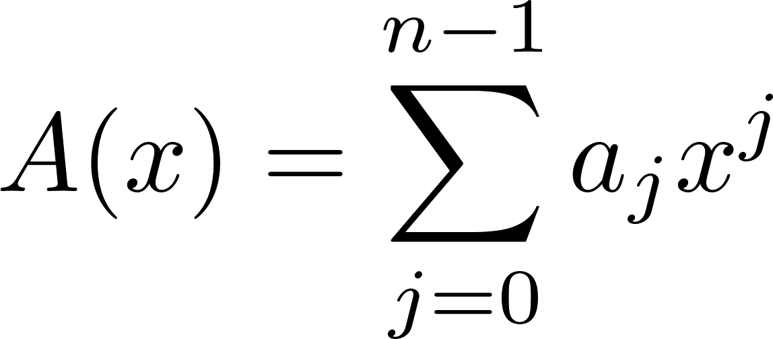
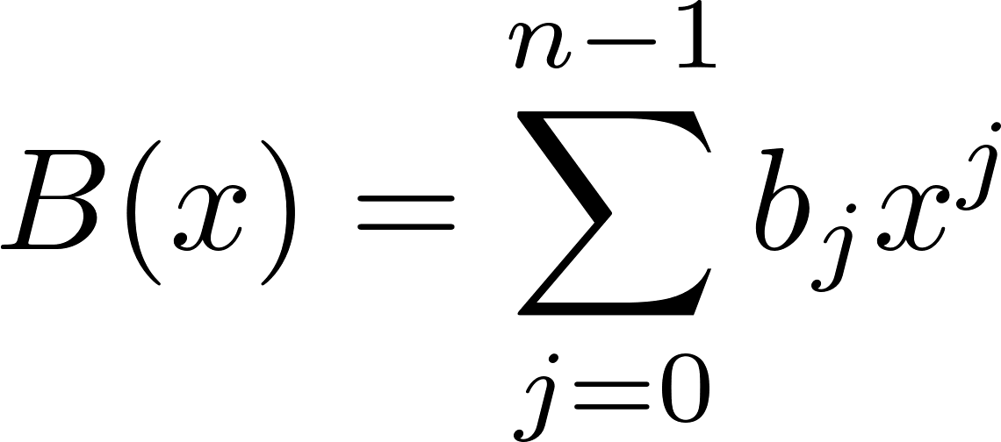
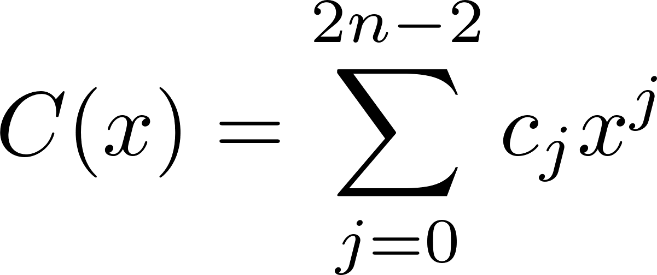
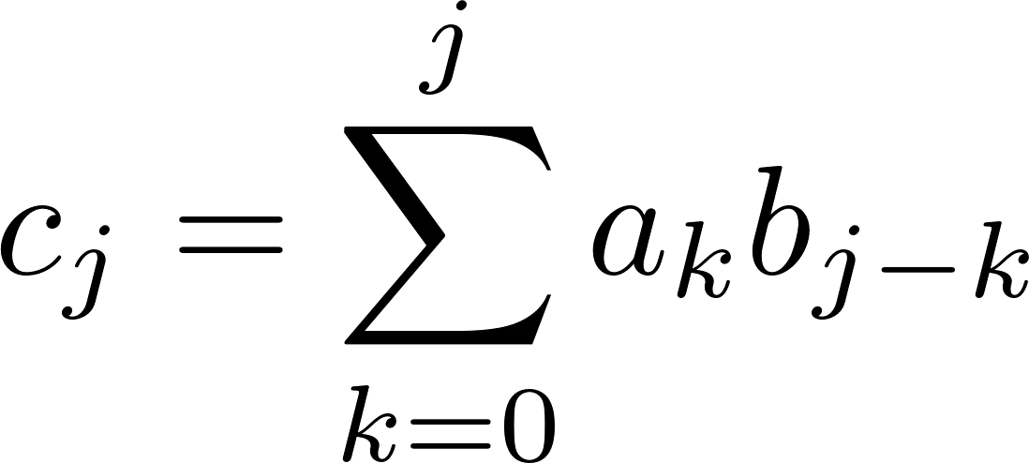
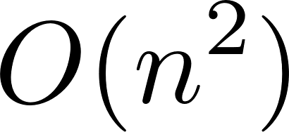
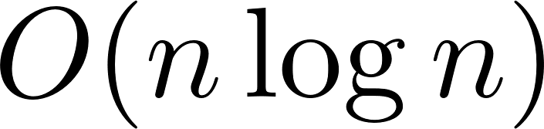
Overview of Polynomial Multiplication
Given two polynomials :
The multiplication will be like :
Ordinary coefficients multiplication will be in :
FFT along with iFFT(FFT-inverse) will reduce this process by value-based representation to:
Notes:
问题的出发点是求两个多项式的乘积

Slide 3
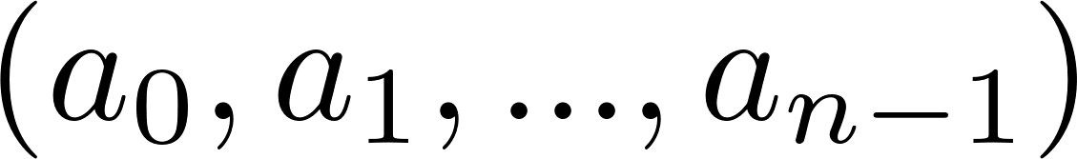
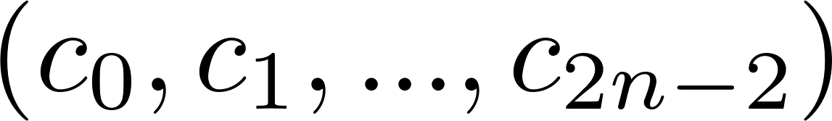
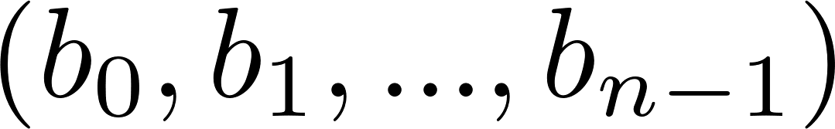
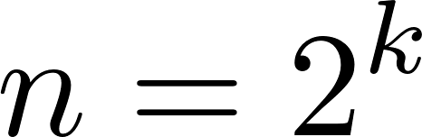
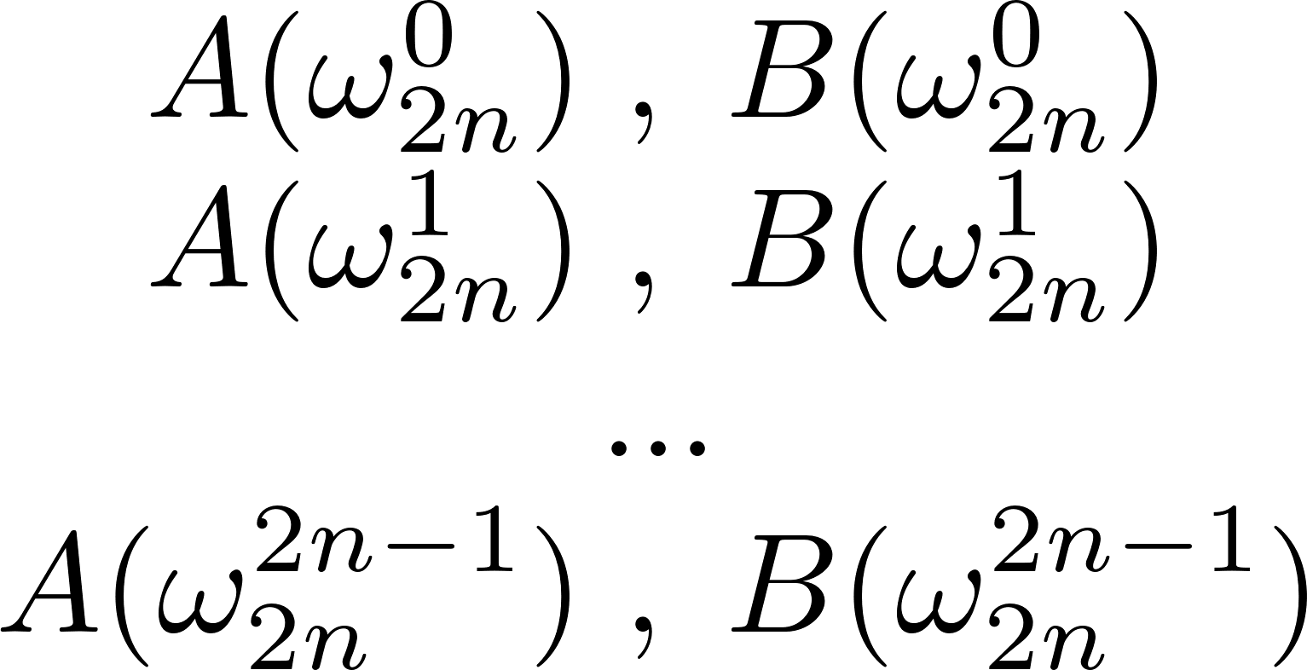
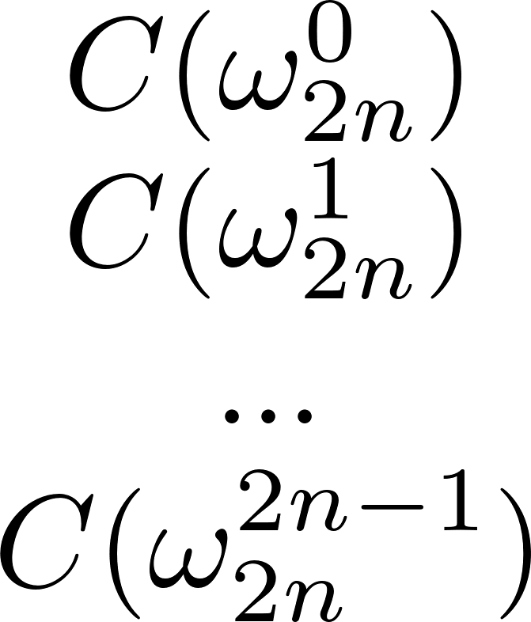
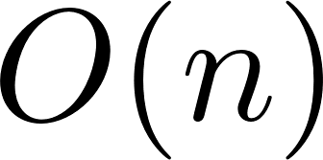
Overview of Polynomial Multiplication
Ordinary multi.
Evaluation: FFT
Interpolation: iFFT
Dot-pair multi.
Notes:
总体上看，整个的过程如下

Slide 4
Benchmark Environment
Local :
CPU : Intel i7-8550U 8 Core
GPU: NVIDIA MX-250
Language: C++
Compiler: NVIDIA 11.3 g++ 8.3.0
OS :Debian GNU/Linux 10 (buster)
Benchmark: Google Benchmark
Server :
CPU : Intel(R) Xeon(R) Gold 6148 CPU @ 2.40GHz 12cores 24threads
GPU: Tesla V100-SXM2
Language: C++
Compiler: NVIDIA 10.1 (with O3 optimization)
OS : Ubuntu1 16.04.9
Benchmark: C++ chrono

Slide 5
Ordinary Multiplication Method Benchmark
Ordinary method:
9501 iterations on average for each multiplication
friend Polynomial &operator*(const Polynomial &a, const Polynomial &b) { …… for (int j = 0; j <= c_order; j++) { for (int k = 0; k <= j; k++) { cj += (a.coeff[k] * b.coeff[j - k]); } c_coeff.push_back(cj); } …… }
order | avg_time(μs)
10 | 4.96532
20 | 26.6619
30 | 59.0193
40 | 139.44
50 | 283.4867
60 | 560.6607
70 | 960.5893
80 | 1448.13
90 | 2354.206
100 | 3257.07
Notes:
简单的双循环

Slide 6
Notes:
基本是n^2

Slide 7
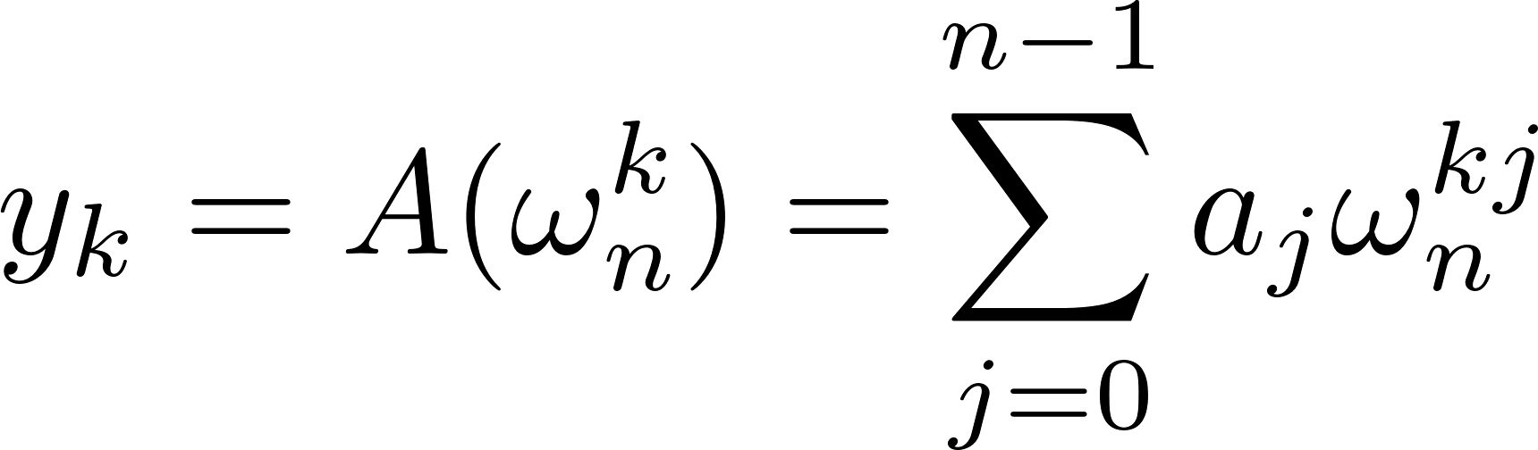
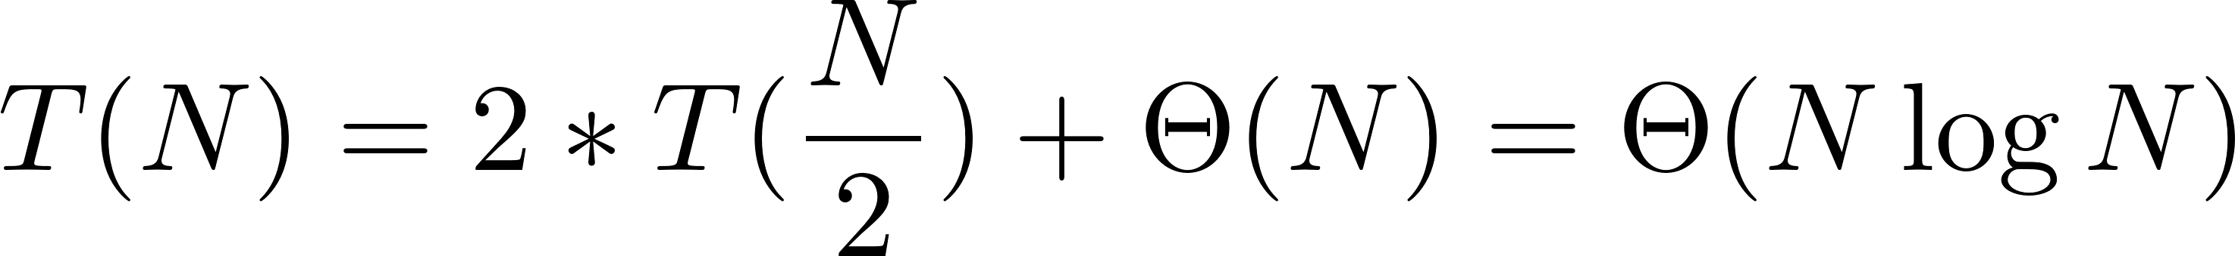
FFT Based Method Benchmark
order | time(μs)
10 | 20.142
20 | 45.104
30 | 92.304
40 | 130.133
50 | 157.751
60 | 200.697
80 | 231.768
rFFT method:
12254 iterations on average for each multiplication
void rFFT(complex<double> a[], unsigned N, int flg){ if (N == 1){ return; } int half = N >> 1; …… rFFT(a0,half,flg); rFFT(a1,half,flg); complex<double> wn = complex<double>(cos(2 * pi / N), flg*sin(2*pi/N)); complex<double> w = complex<double>(1,0); for(int k=0;k<=half-1;k++){ complex<double> u = w*a1[k]; a[k]=a0[k]+u; a[k+half]=a0[k]-u; w *= wn; } }
Notes:
递归 类似归并算法

Slide 8
method | order | time(μs)
OM | 80 | 3584
rFFT | 80 | 231
Be faster ?

Slide 9
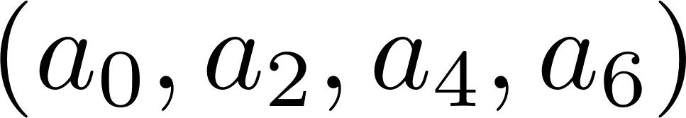
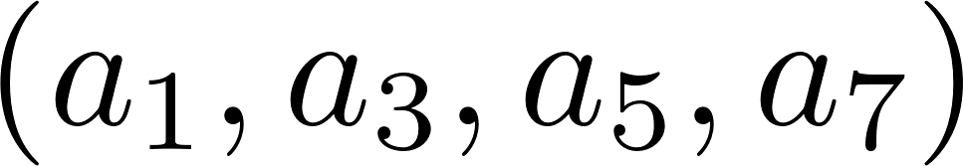
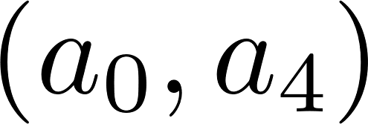
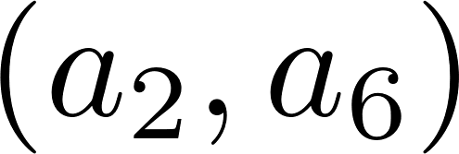
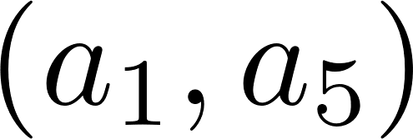
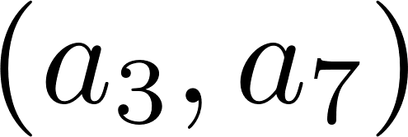
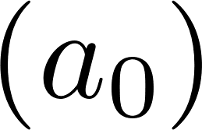
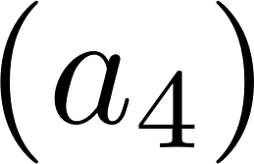
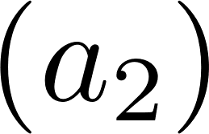
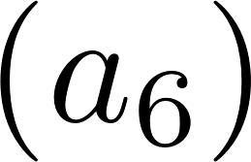
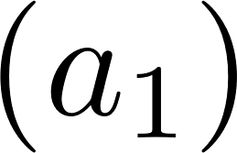
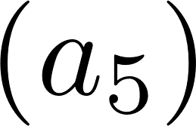
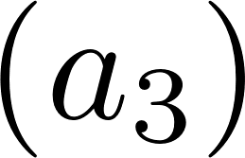
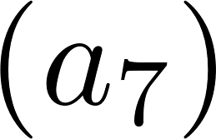
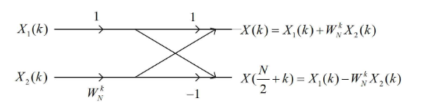
Butterfly Operation and Parallelization
The process of rFFT when N=8
Change recursion to iteration by sort the array.
Put all these iterations on GPU
for(half =1;half<N;half<<1){ w_m; for(j=0;j<N;j+=2*half){ for(k=0;k<half;k++){ t a[j+k] a[j+k+half] } } }
Notes:
预排序 位倒置变换

Slide 10
__device__ void FFT_core_loop(Complex* __restrict__ reordered, int j, int k, int m, int N,int flag) {
…… Complex t,u; t.x = __cosf((2.0*PI*k) / (1.0*m)); t.y = - __sinf(flag*(2.0*PI*k) / (1.0*m)); …… reordered [k + j] = u*t; reordered [k + j + m / 2] = u-t; } } __global__ void FFT_core_loop_parallel(Complex* __restrict__ reordered, int m, int N, int threadN,int flag) { int j = (blockIdx.x *threadN + threadIdx.x)*m; for (int k = 0; k < m / 2; k++) { iteration_FFT_core_loop(reordered, j, k, m, N,flag); } }
void FFT(Complex *__restrict__ data, size_t N, size_t threads,int flag) { ...... int s = log2(N); bits_rev << < ceil(N / threads), threads >> > (reoredred, device,s,threads); for (int i = 1; i <= s; i++) { int m = 1 << i; iteration_FFT_core_loop_paralel <<< ceil((float)N / m / threads), threads >> > (reoredred, m, N, threads,flag); } …… }
Notes:
__device__内联
__global__ 全局内存
j 寄存器
Threads 一般是 512

Slide 11
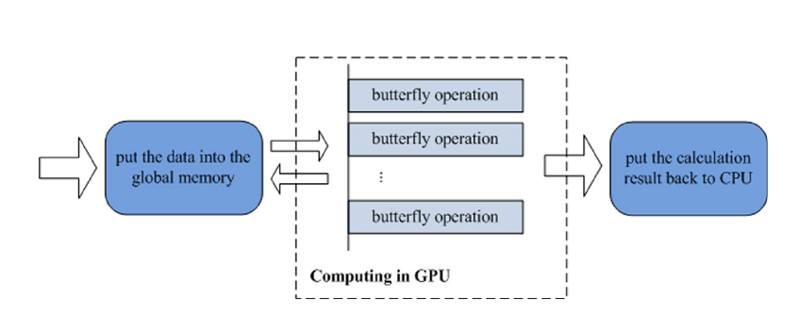
FFT
FFT
FFT
……
FFT
FFT
bits_rev <<< ceil(N / threads), threads >>> ;
__brev
cudaDeviceSynchronize()
FFT-loop
FFT_core_loop_parallel <<< ceil(N / m / threads), threads >>>
FFT-loop
FFT-loop
……
FFT-loop
FFT-loop
FFT-inner
Copy to Host
[7]

Slide 12
FFT-GPU Based Method Benchmark
order | times(μs)
1000 | 154181
2000 | 156935
3000 | 157233
4000 | 153390
5000 | 156434
6000 | 160146
7000 | 160861
8000 | 157947
9000 | 160130
10000 | 157857
Notes:
基本维持150ms

Slide 13
Comparison

Slide 14
More?
Memory
Threads
Algorithm

Slide 15
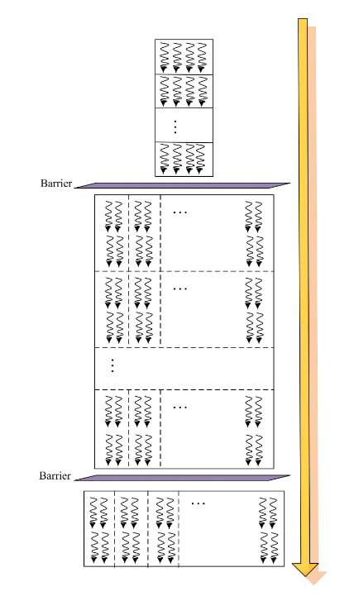
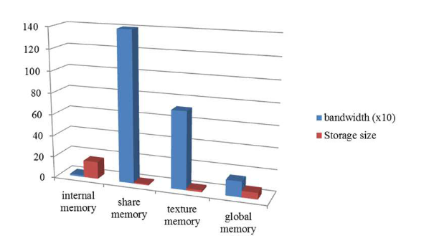
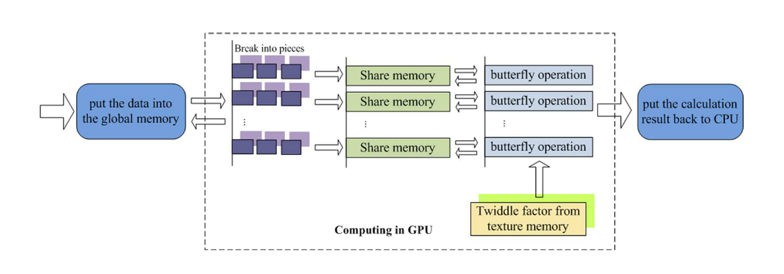
More?
[7] Fan Zhang, Chen Hu, Qiang Yin and Wei Hu.
“A GPU Based Memory Optimized Parallel Method For FFT Implementation”
arXiv: Distributed, Parallel, and Cluster Computing (2017): n. pag.

Slide 16
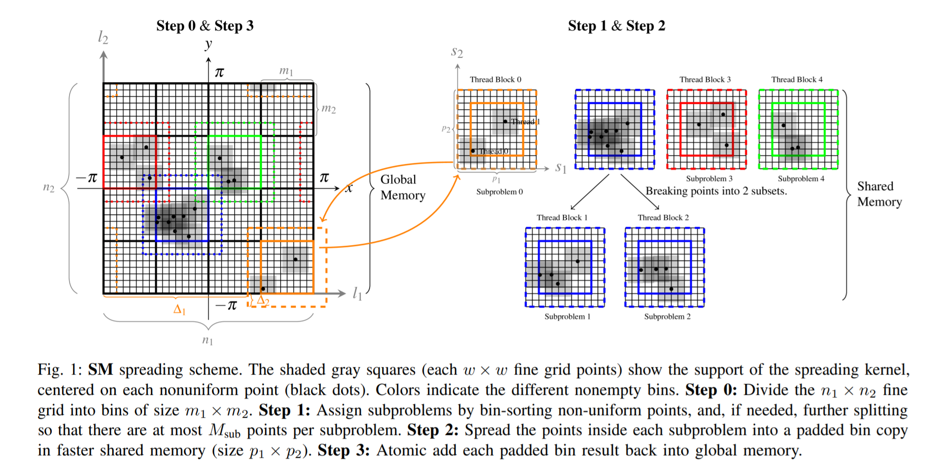
[6] Yu-hsuan Shih, Garrett Wright, Joakim Andén, Johannes Blaschke and Alex H. Barnett.
“cuFINUFFT: a load-balanced GPU library for general-purpose nonuniform FFTs”
International Parallel and Distributed Processing Symposium (2021).
Notes:
负载平衡,用于缓存感知访问的bin排序以及快速共享内存的使用

Slide 17
Reference
[0] https://docs.nvidia.com/cuda/cufft/index.html
[2] https://developer.nvidia.com/cuda-example
[3] https://docs.nvidia.com/cuda/archive/11.3.0/pdf/CUDA_Math_API.pdf
[4] https://zhuanlan.zhihu.com/p/110897470
[5] Kenneth Moreland and Edward Angel. “The FFT on a GPU”
SIGGRAPH/EUROGRAPHICS Conference On Graphics Hardware (2003).
[6] Yu-hsuan Shih, Garrett Wright, Joakim Andén, Johannes Blaschke and Alex H. Barnett.
“cuFINUFFT: a load-balanced GPU library for general-purpose nonuniform FFTs”
International Parallel and Distributed Processing Symposium (2021).
[7] Fan Zhang, Chen Hu, Qiang Yin and Wei Hu.
“A GPU Based Memory Optimized Parallel Method For FFT Implementation”
arXiv: Distributed, Parallel, and Cluster Computing (2017): n. pag.
[8] Amir Gholami, Judith Hill, Dhairya Malhotra and George Biros.
“AccFFT: A library for distributed-memory FFT on CPU and GPU architectures”
arXiv: Distributed, Parallel, and Cluster Computing (2015): n. pag.
[9] C.L.R.S. “Introduction to Algorithms”

