Slide 1
FIRST TECH CHALLENGE
-What is the FIRST organization?
-Who are we?
-Advantages
-How can a sponsorship can help us?
-Ability Edge from Ashdod, Israel.

Slide 2



FIRST
FIRST is an international youth organization that was established in 1989 by Dean Kamen and Woodie Flowers. Its expressed goal is to develop ways to inspire students in engineering and technology fields. FIRST has landed in Israel since 2005, and is managed by the academic university Technion which is the top 100 universities in the world. The organization is devided into 3 mini-organization:
Each program, has a season, every start of the season each program gets a mission for the season. The missions are with the same idea and same mindset, but with a different level of difficultness.
The teams design robots from lego, and custom parts from other providers that can get very pricey some times. At the end of each season, the teams from the state of the program gather up and play in a tournament kind of gameplay. The winner of the state championship gets an entry to the world finals in Houston/Detroit, and shows the world what it’s state is capable of!

Slide 3
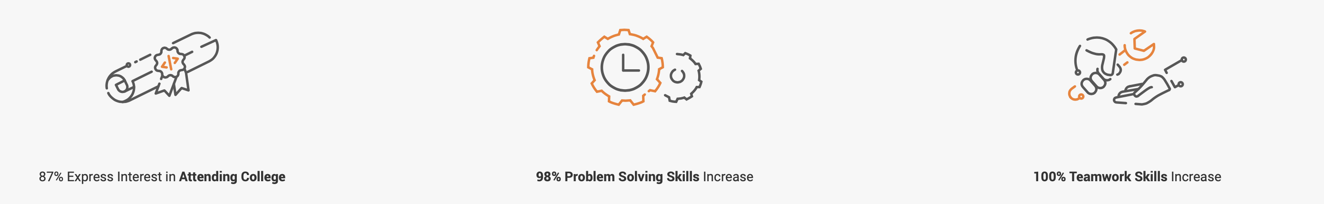
FIRST is proven to provide many skills at a young age, these are just some examples.
For the full set of skills FIRST provides, click here.

Slide 4

ABILITY EDGE
FTC TEAM
• Our group was founded privately before
2 years by our coach Aviel Abu. The team
Consists of 11 students from the tenth grade. our team works with a variety of companies such as Elta, Albatech,
Delek Israel, and more…
At the 10 of June 2021 we won the Israeli championship!
And we have fulfilled the goals we set for ourselves.
From the day we were founded, the road has been amazing and hard, but
It's a huge experience and was worth everything!

Slide 5
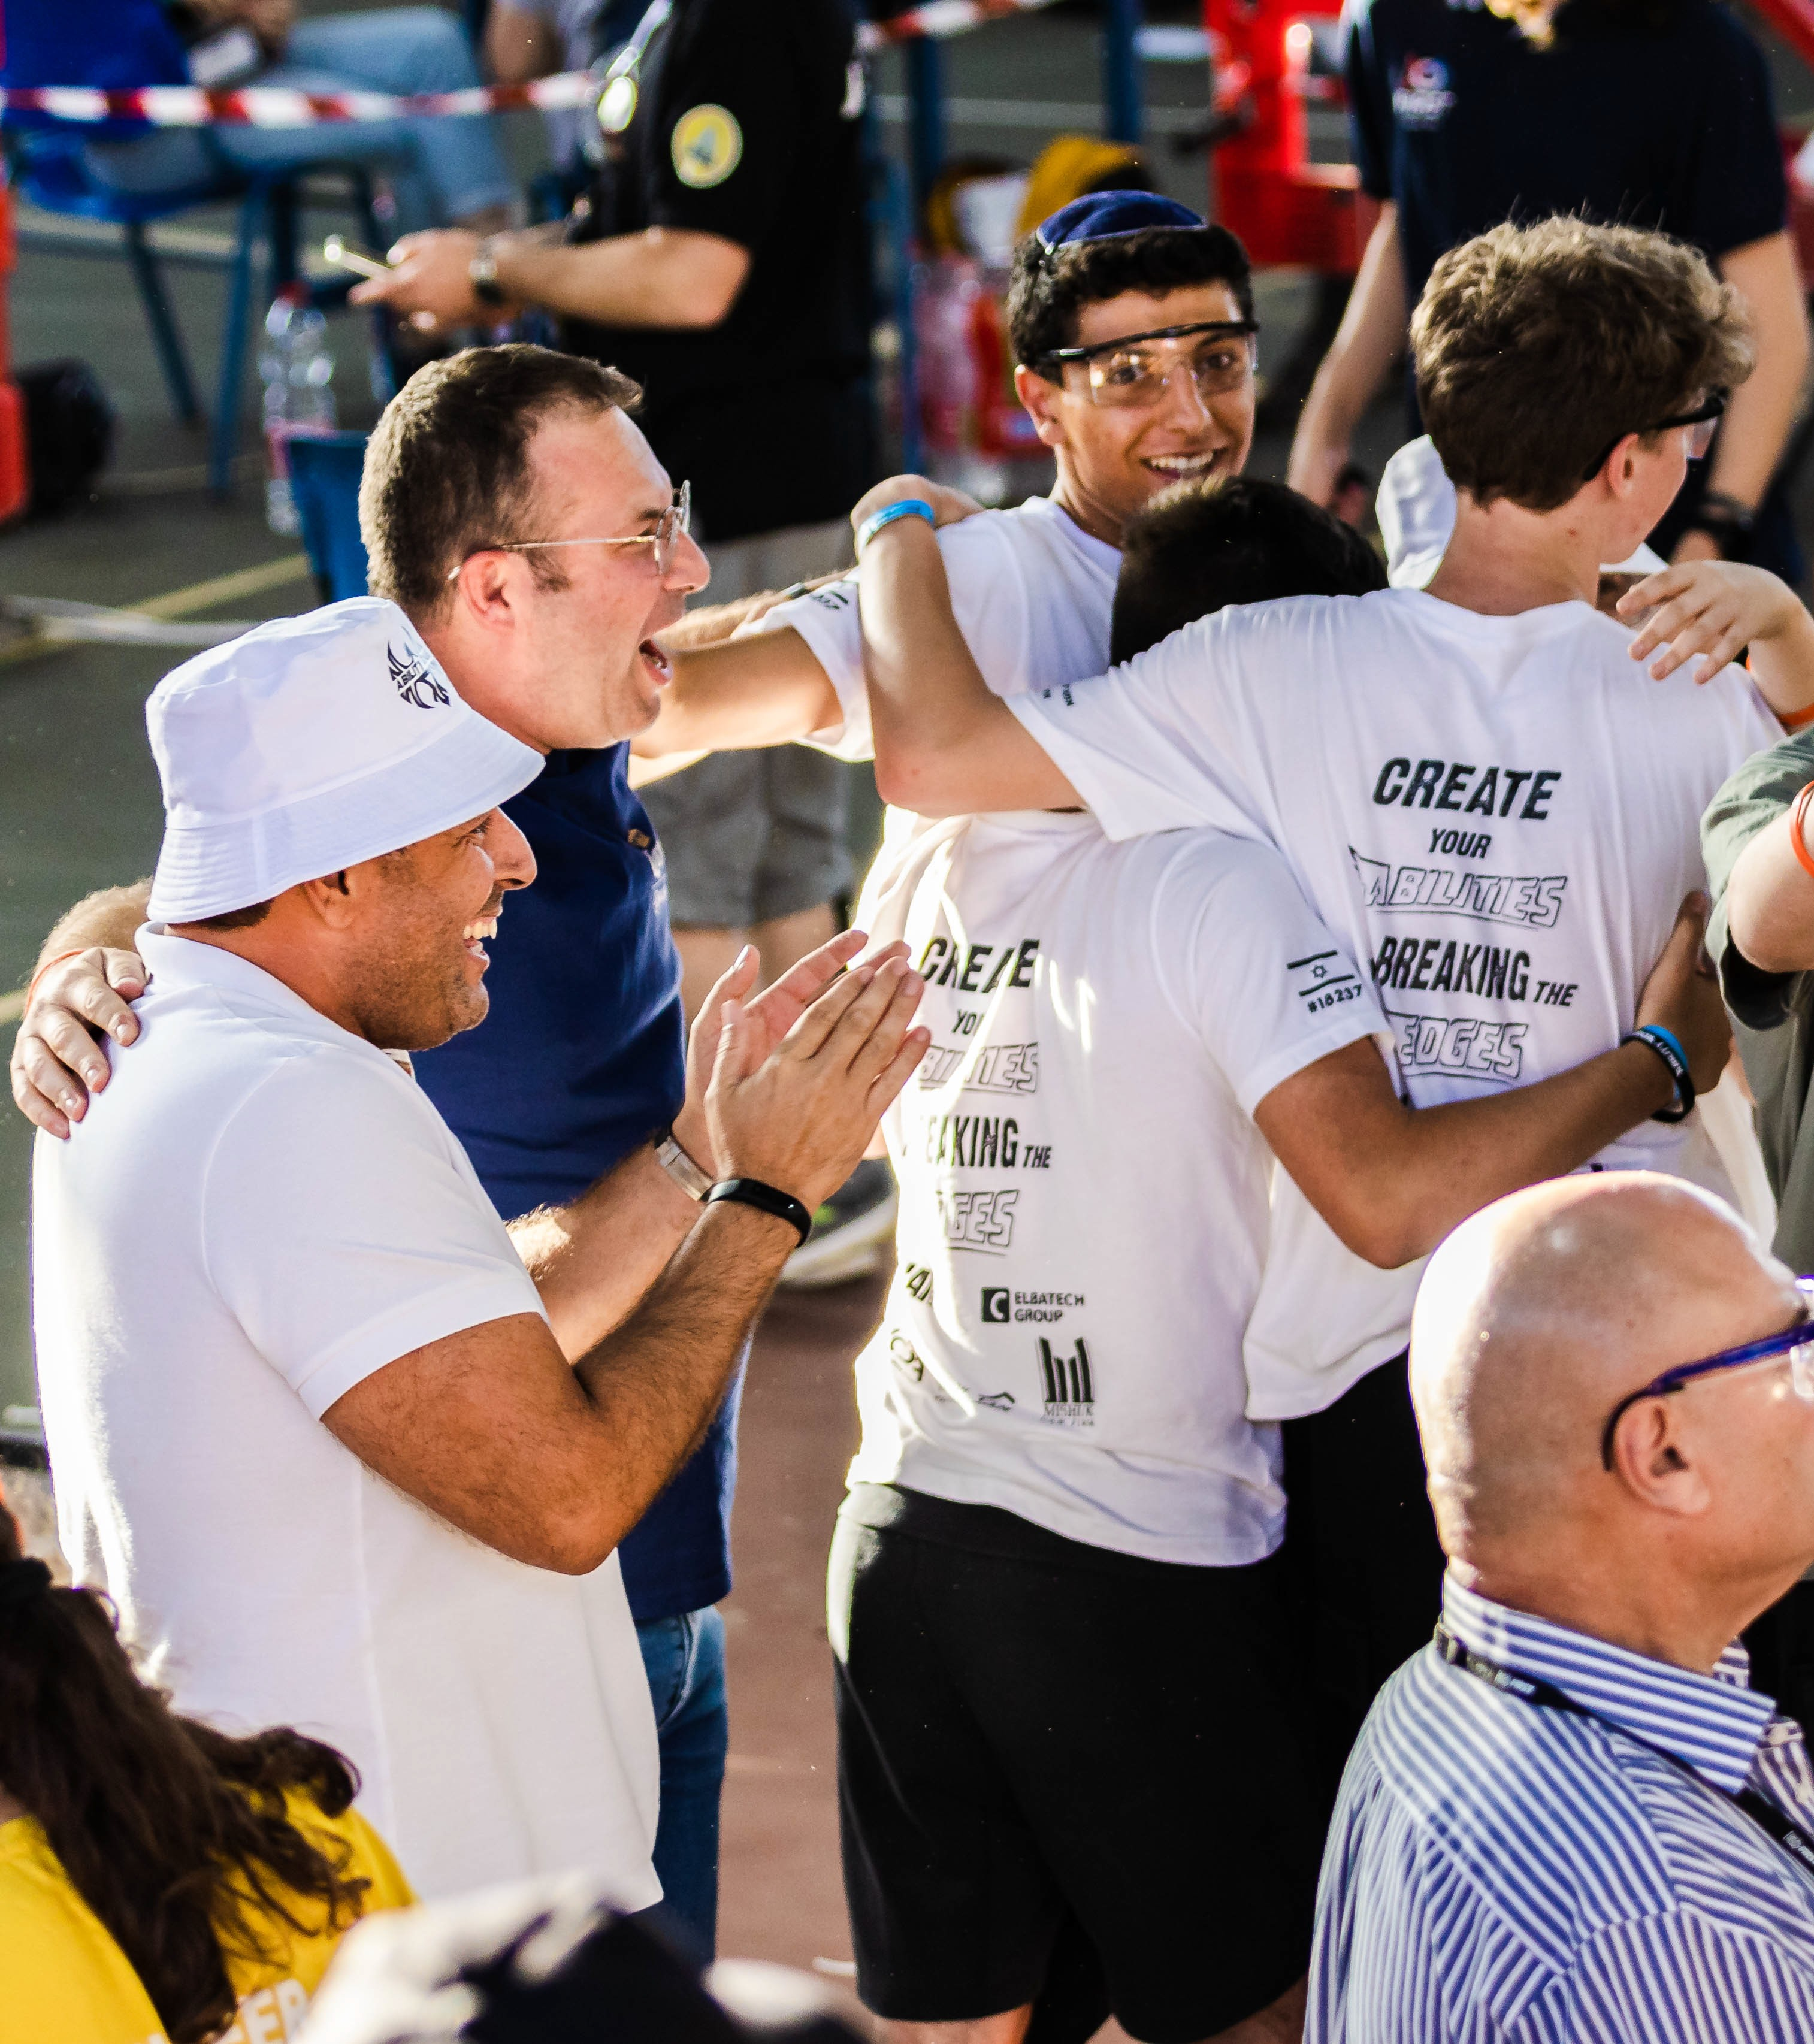
Advantages
• Promoting children in the areas of STEM, communication, leadership and mental strength
• Creates a good name for sponsors and supporters.
Support
Sponsorship support does not have to be financial but also of products that can help our robotics team.
In addition, the sponsor receives support from us on our social networks and appears in the hands of the group and many other networks.

Slide 6






Our Sponsors:

Slide 7
Help us by what you can provide, and Join our family!

