Slide 2
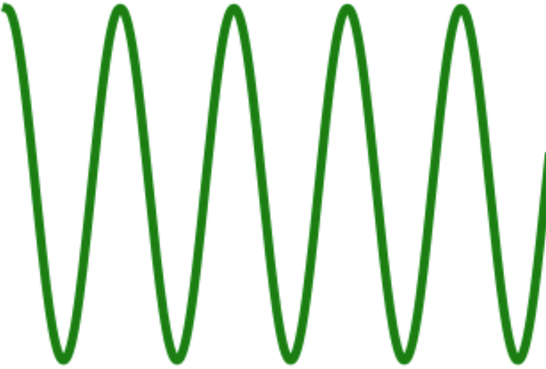
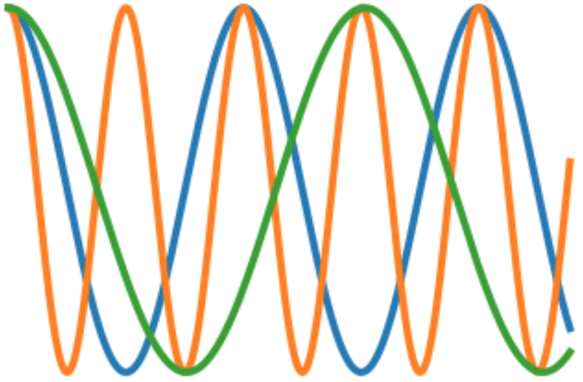
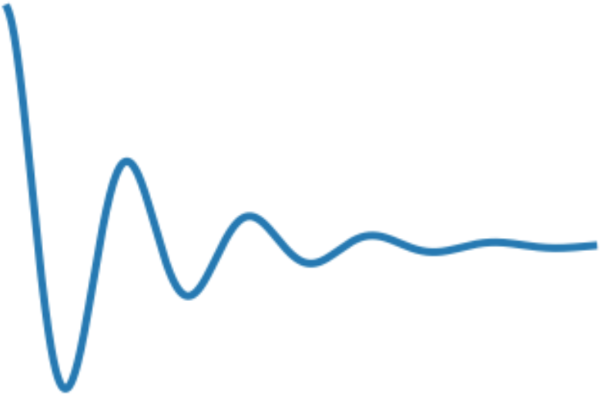
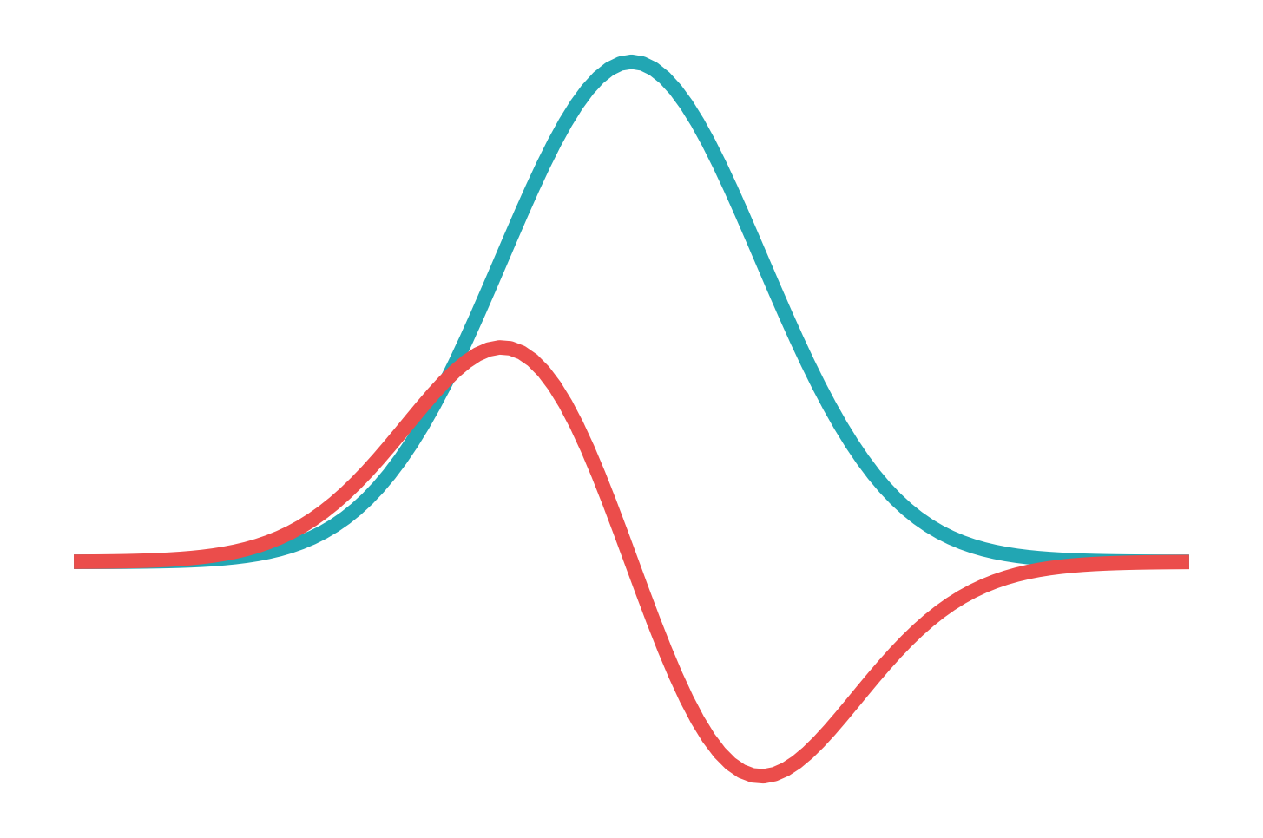
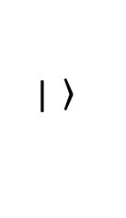


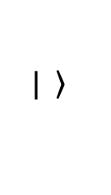

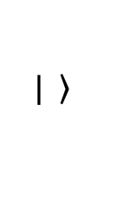







Molecules and bath
$$P$$
$$\left.| \right\rangle$$
$$\left.| \right\rangle$$
+
$$\left.| \right\rangle$$
$$t$$
$$P$$
$$R(t)$$
$$t$$
$$t$$
$$R(ω)$$
$$A(ω)$$
$$D(ω)$$
$$ω$$

Slide 3
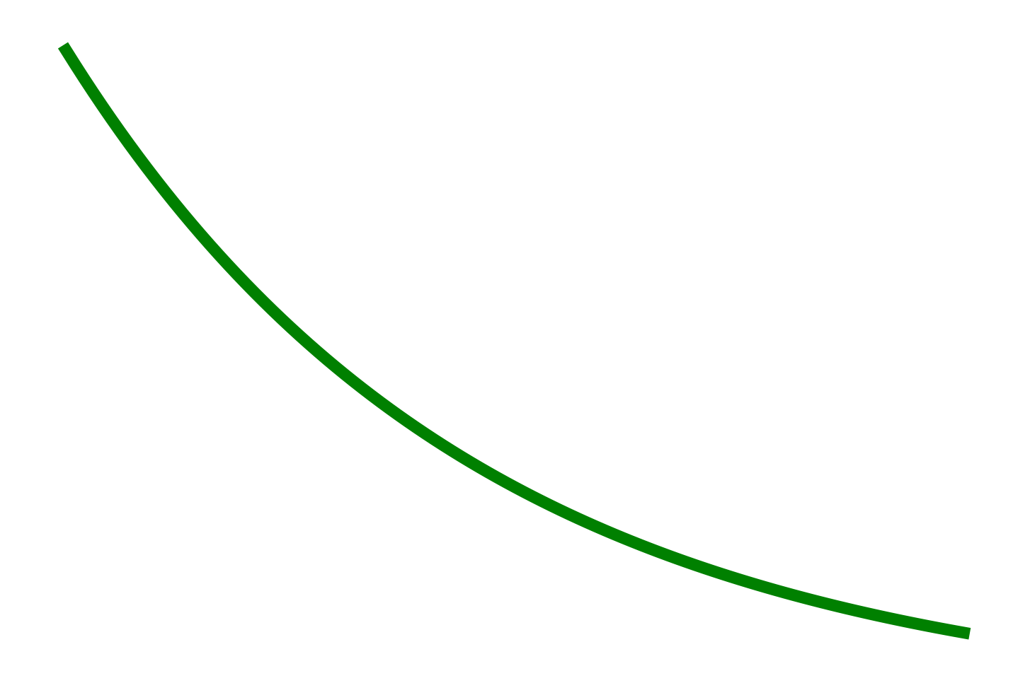
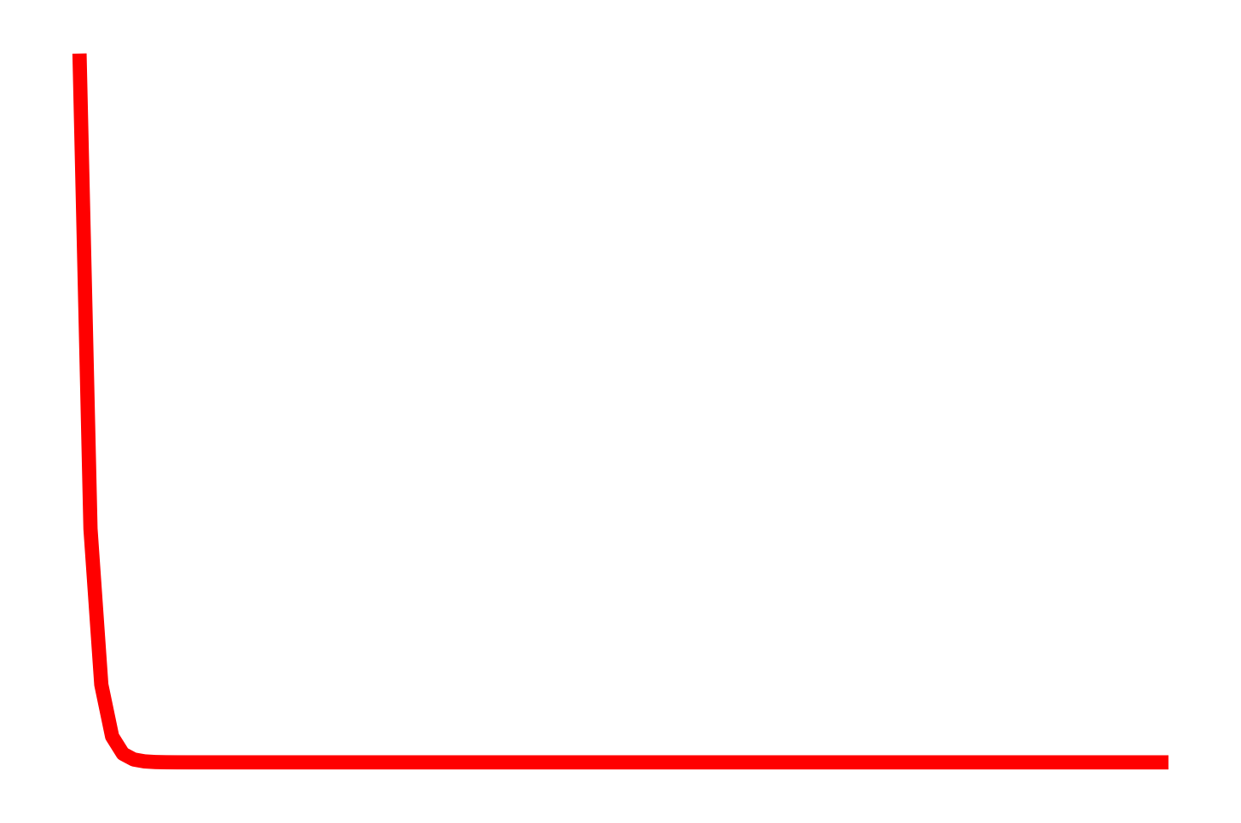
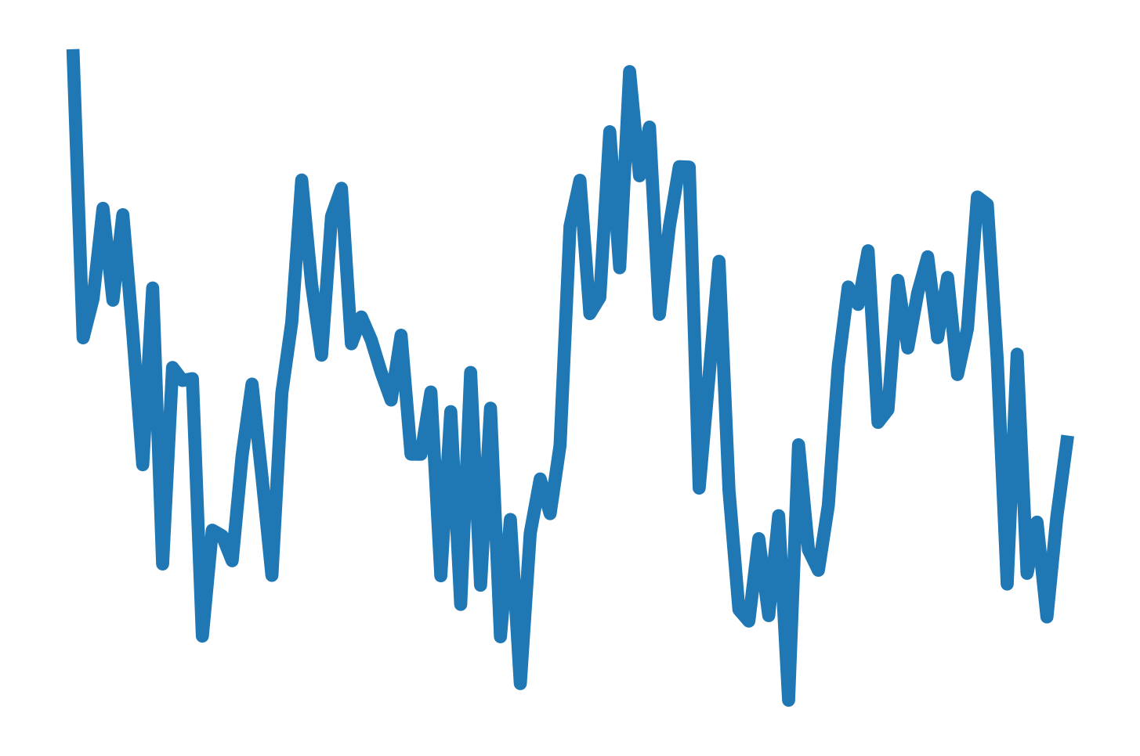

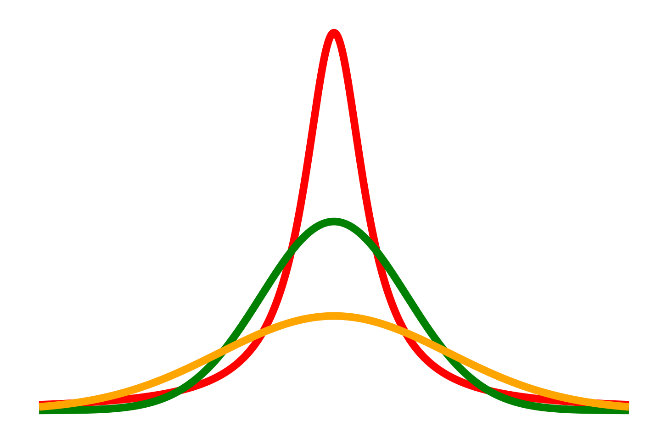



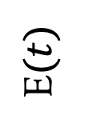



Bath timescales
$$λτ≫1$$
Gaussian
E$(t)$
⟨𝛅(t)𝛅(0)⟩
𝛌
Lorentzian
$$λτ≪1$$
$$t$$
$$t$$
$$R(ω)$$
$$ω$$
Notes:
Fast and slow modulations along with timescale picture

Slide 4
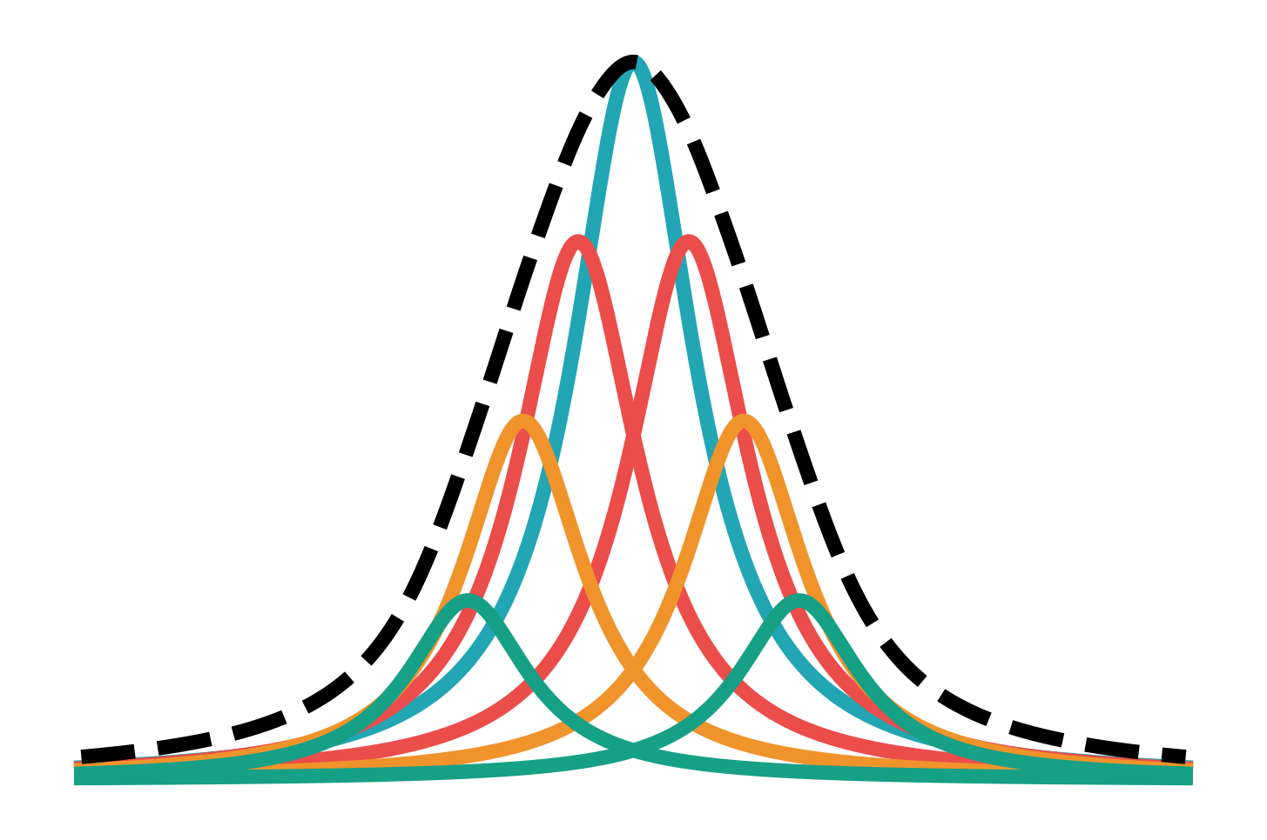
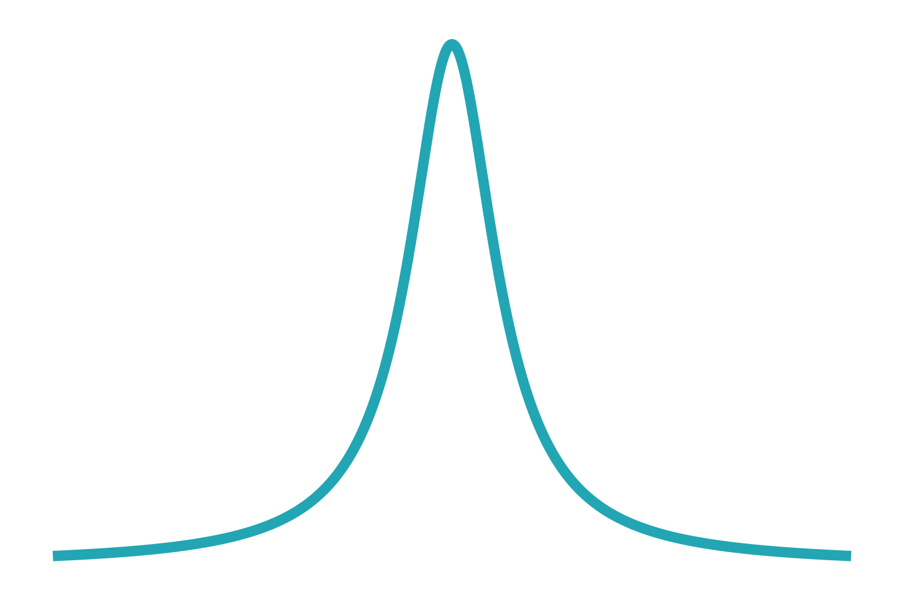

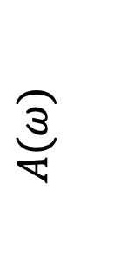
Linewidth broadening
Lorentzian
$$A(ω)$$
Gaussian
$$ω$$
Notes:
Homogenous and Inhomogenous broadening

Slide 5
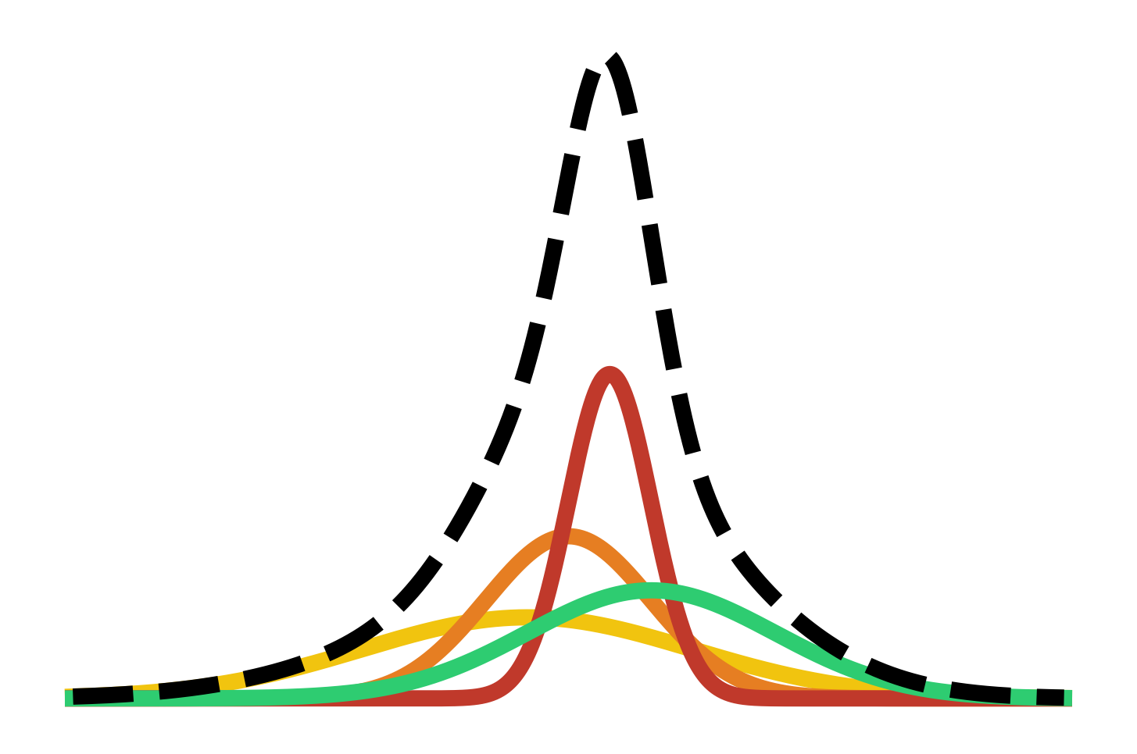
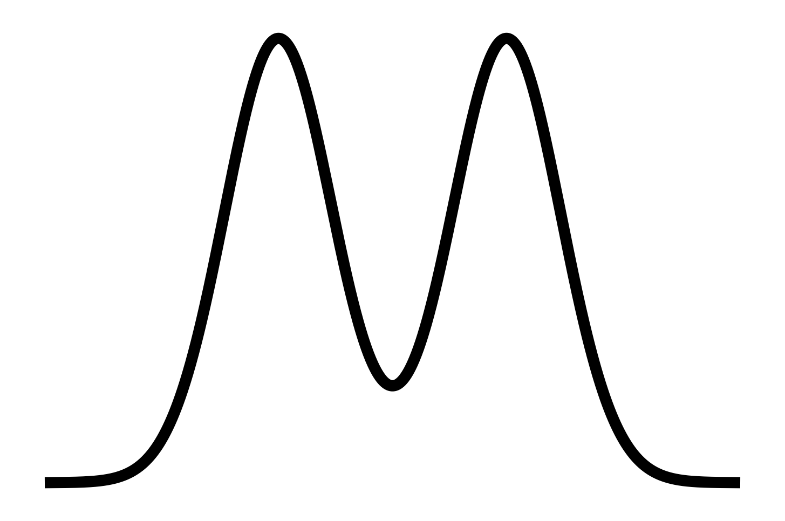
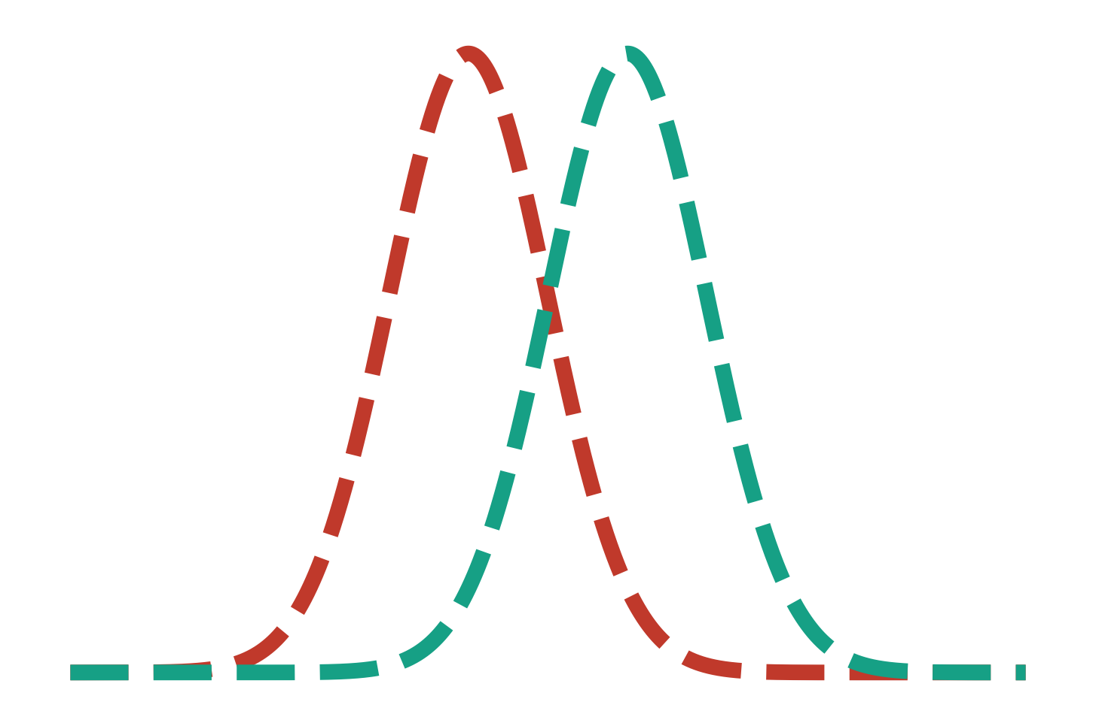
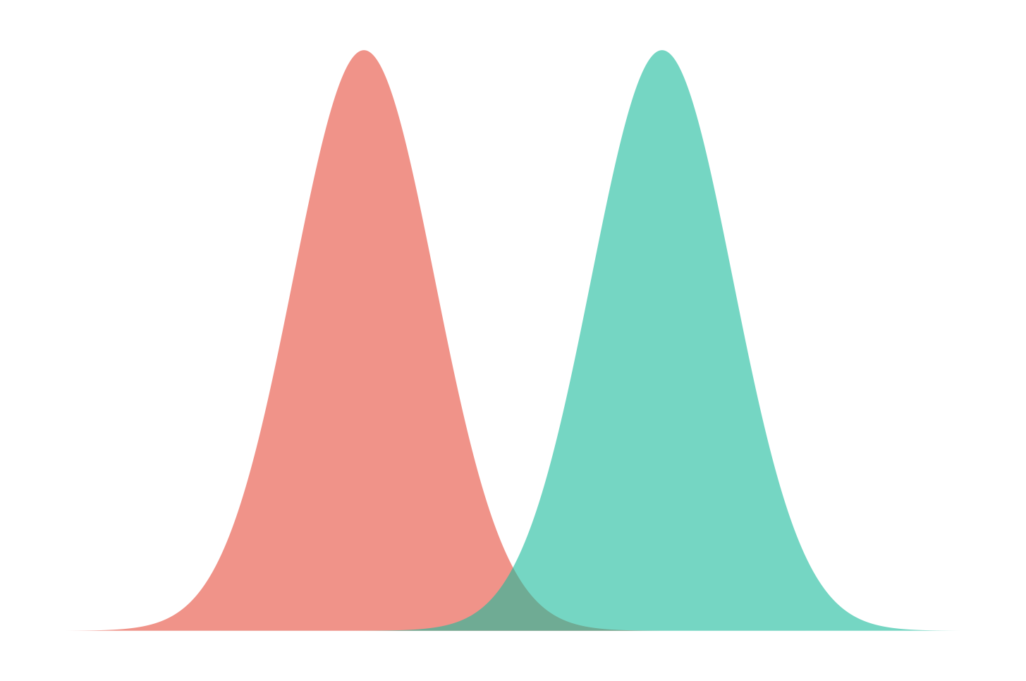
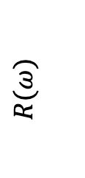
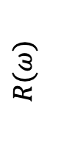


Limitations
Inhomogeneous
Homogeneous
$$R(ω)$$
$$ω$$
Uncoupled
$$R(ω)$$
Coupled
$$ω$$

Slide 6




Homogenous & Inhomogenous broadening
$$ω_{3}$$
$$ω_{1}$$
$$A(ω)$$
$$ω$$

Slide 7
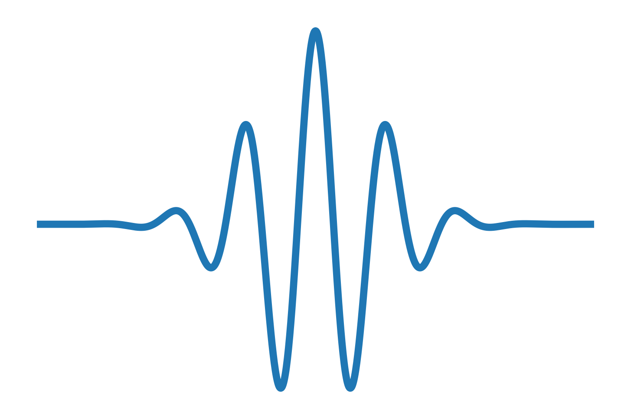

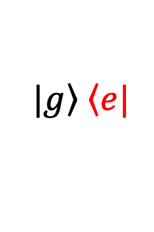
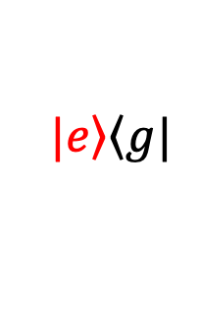
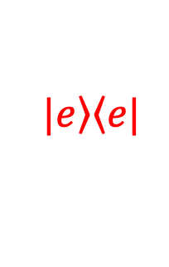



Rephasing
$$\left.|e\right\rangle \left\langle e|\right.$$
$$\left.|e\right\rangle \left\langle g|\right.$$
$$e^{−iω_{eg}t}$$
$$\left.|g\right\rangle \left\langle e|\right.$$
$$e^{iω_{eg}t}$$
$$t1$$
$$t3$$

Slide 8
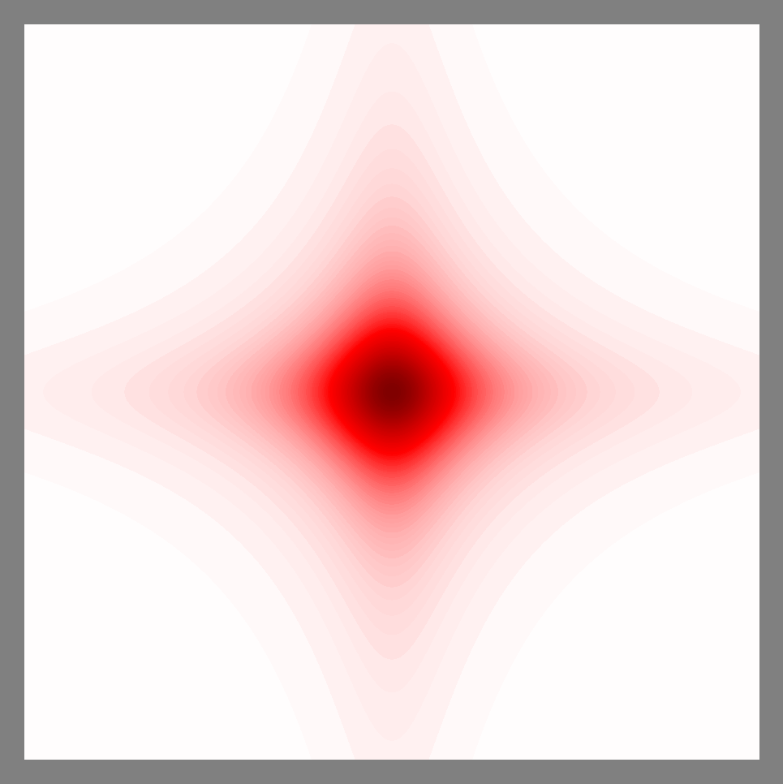
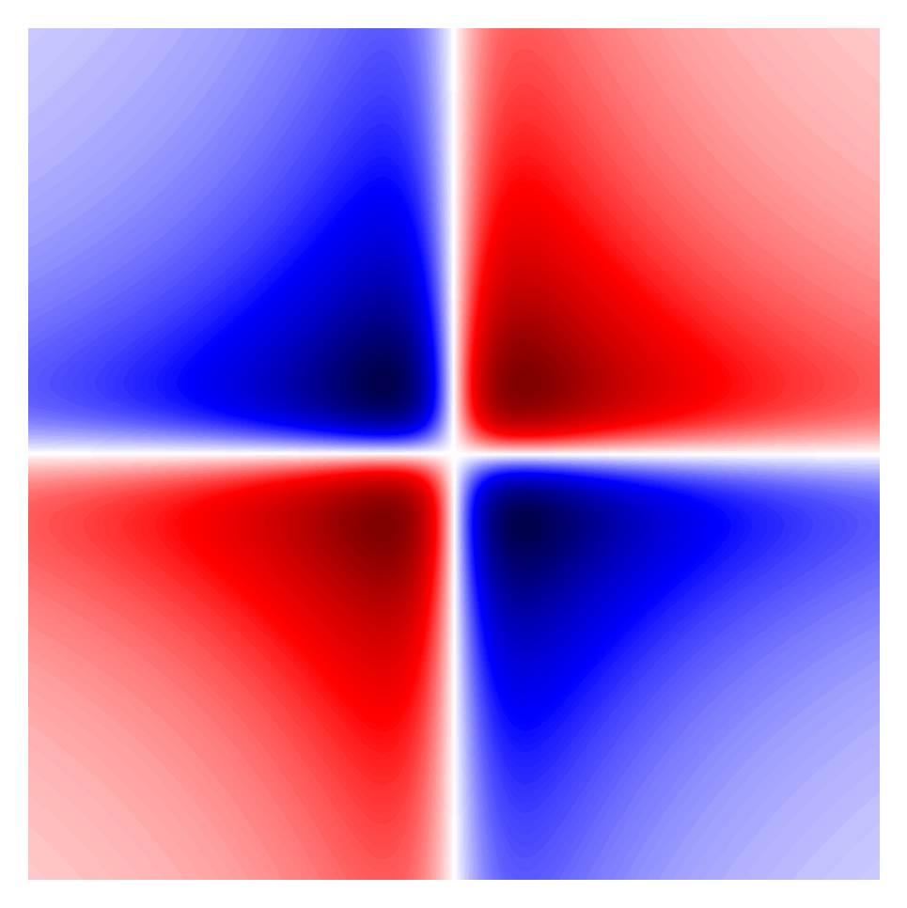
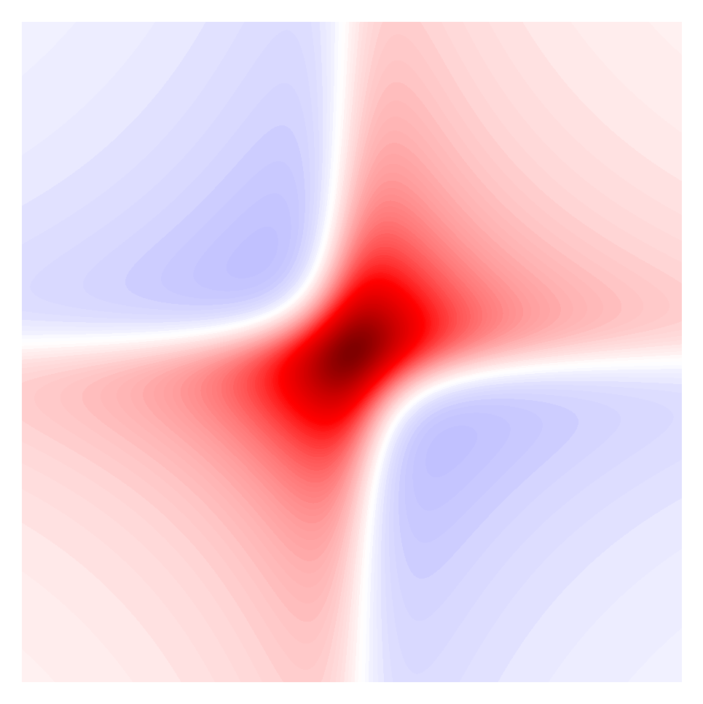
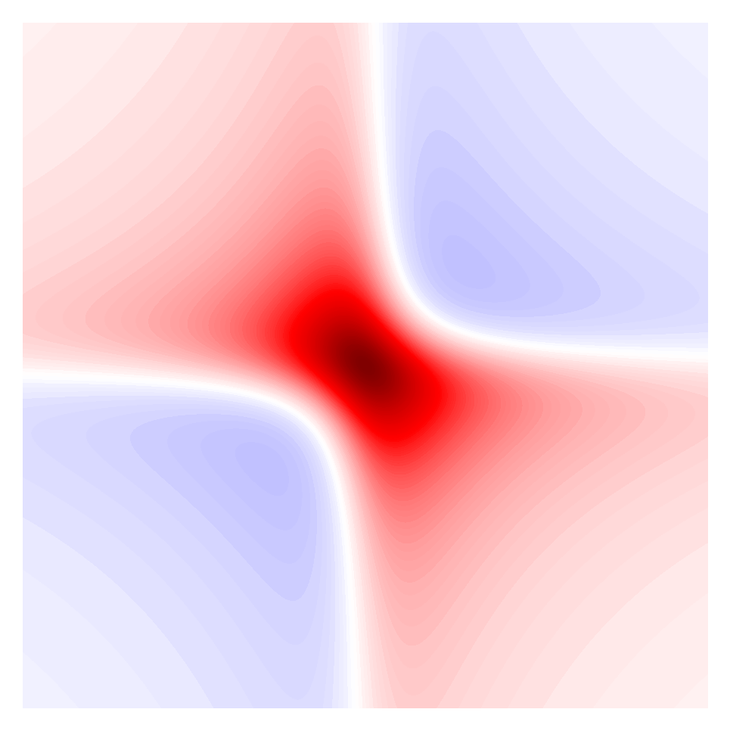




Intution for 2D lineshapes
$R^{\left(3\right)}\left(ω_{1}, ω_{3}\right)=R^{\left(1\right)}{(ω}_{1}){ R}^{\left(1\right)}(ω_{3}$) = $(A{(ω}_{1})+$ $iD{(ω}_{1}))(A{(ω}_{3})+$ $iD{(ω}_{3}))$
$$=A{(ω}_{1})A{(ω}_{3})−D{(ω}_{1})D{(ω}_{3})+i\{A{(ω}_{1})D{(ω}_{3})+A{(ω}_{3})D{(ω}_{1})\}$$
Rephasing
$$−$$
$$=$$
Total
$$+$$
$$+$$
$$=$$
Non-Rephasing

Slide 9
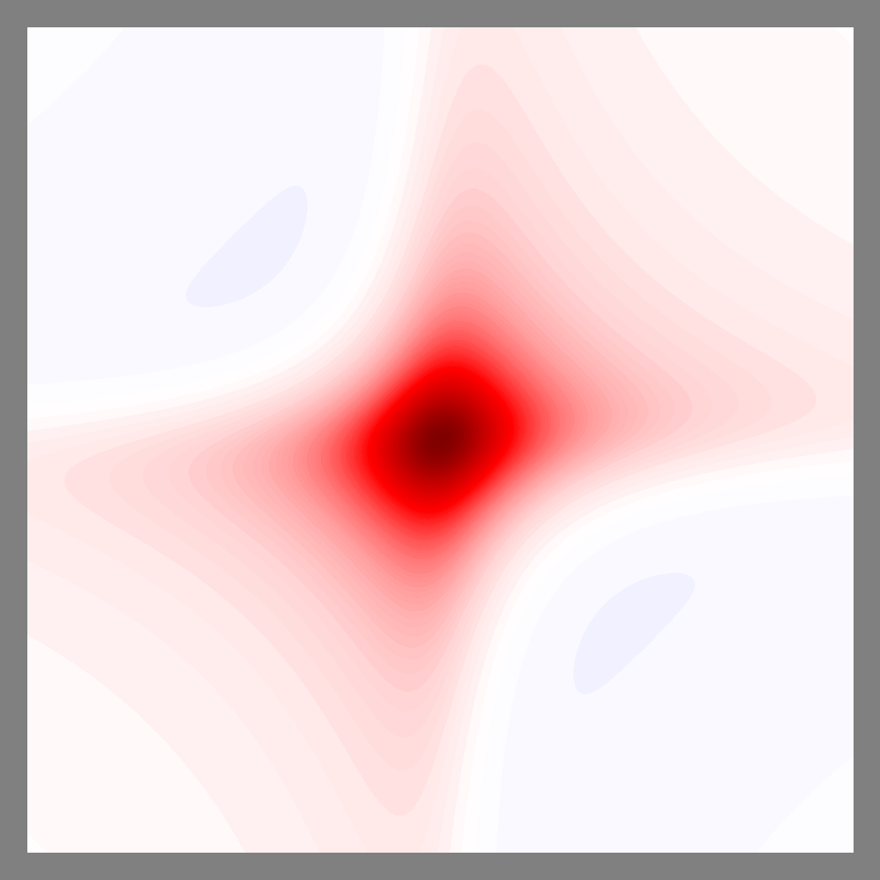
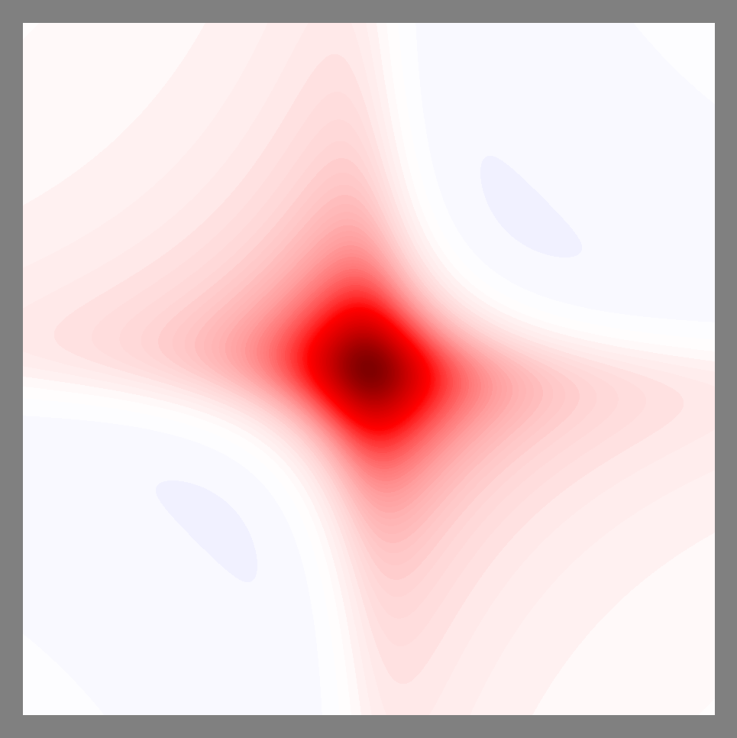




Inhomogenous and homogenous 2D lineshapes
Inhomogenous
$$+$$
$$=$$
$$2 x$$
$$0. 5x$$
$$+$$
$$=$$
Homogenous

