Slide 1


Quantum Dynamics Simulations of Polariton Spectroscopy
Mohammad Elious Ali Mondal
Department of Chemistry, University of Rochester

Slide 2
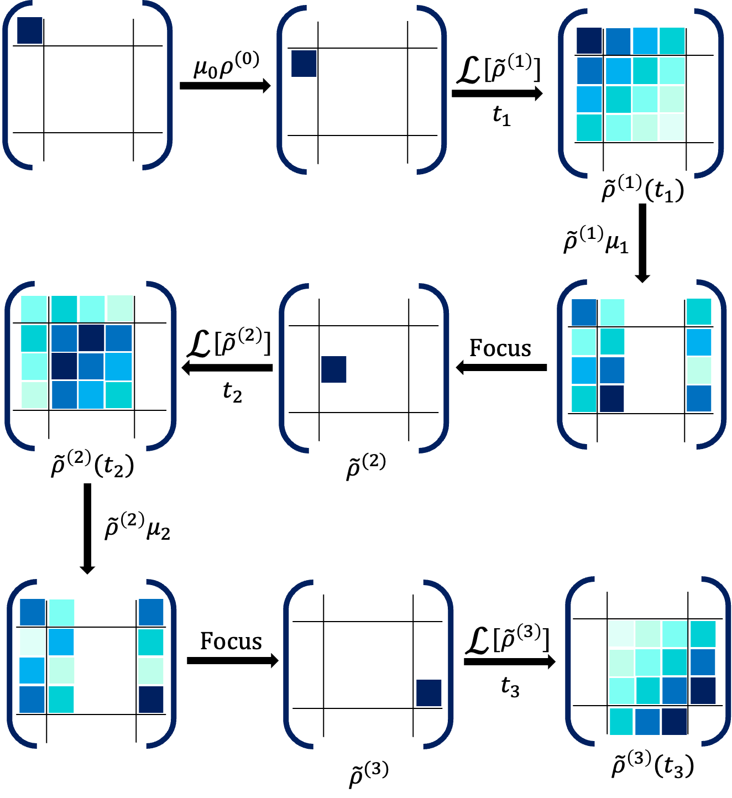
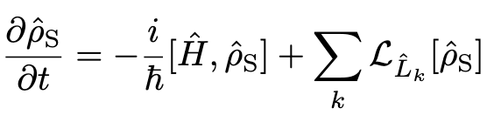



𝓛-PLDM Spectroscopy
$$Γ$$
𝛌
$$λ$$
$$Γ$$
Non-Markovian
Markovian
Lindblad
PLDM
Lindblad
J. Chem. Phys. 159, 094102 (2023)

Slide 3
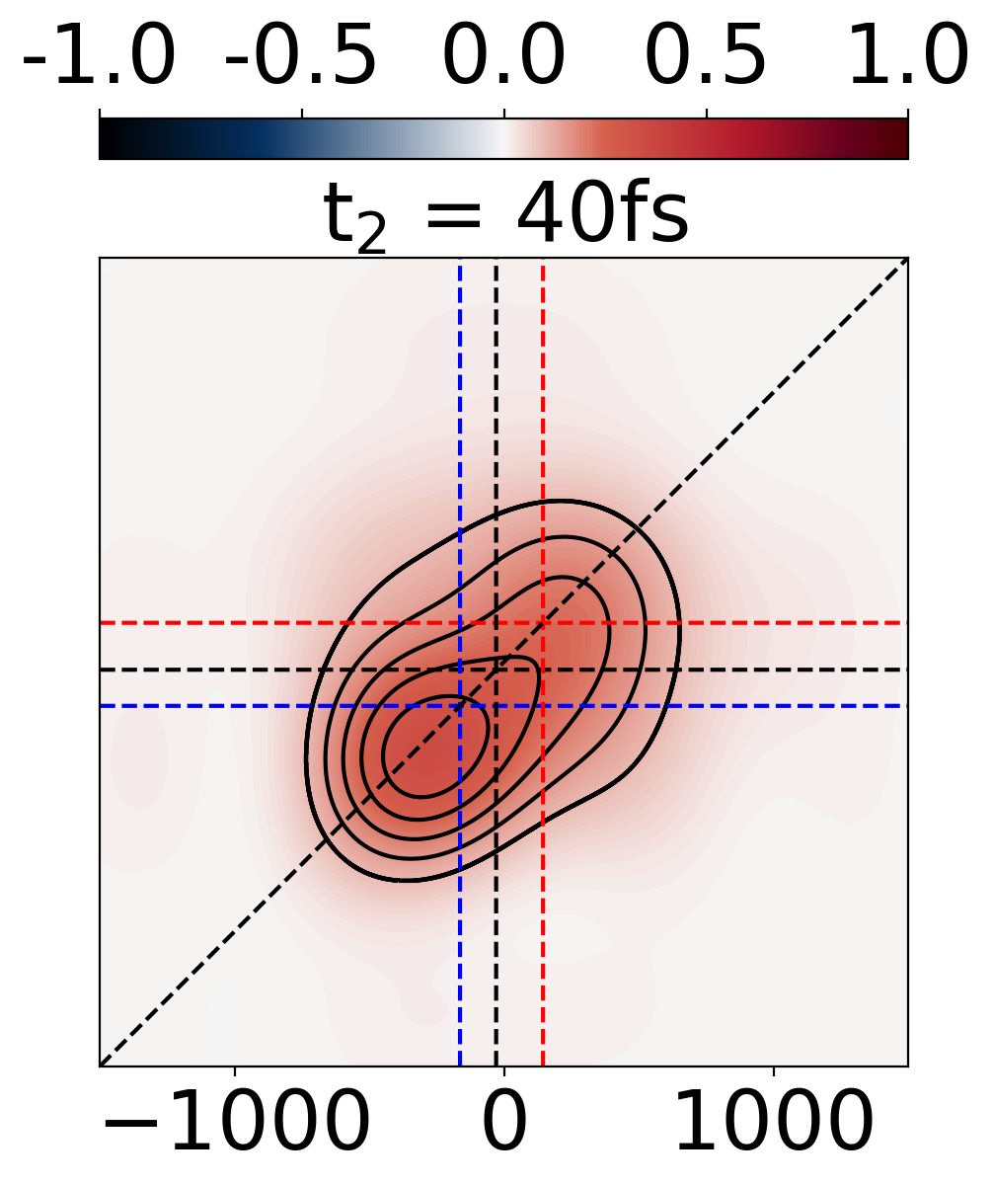
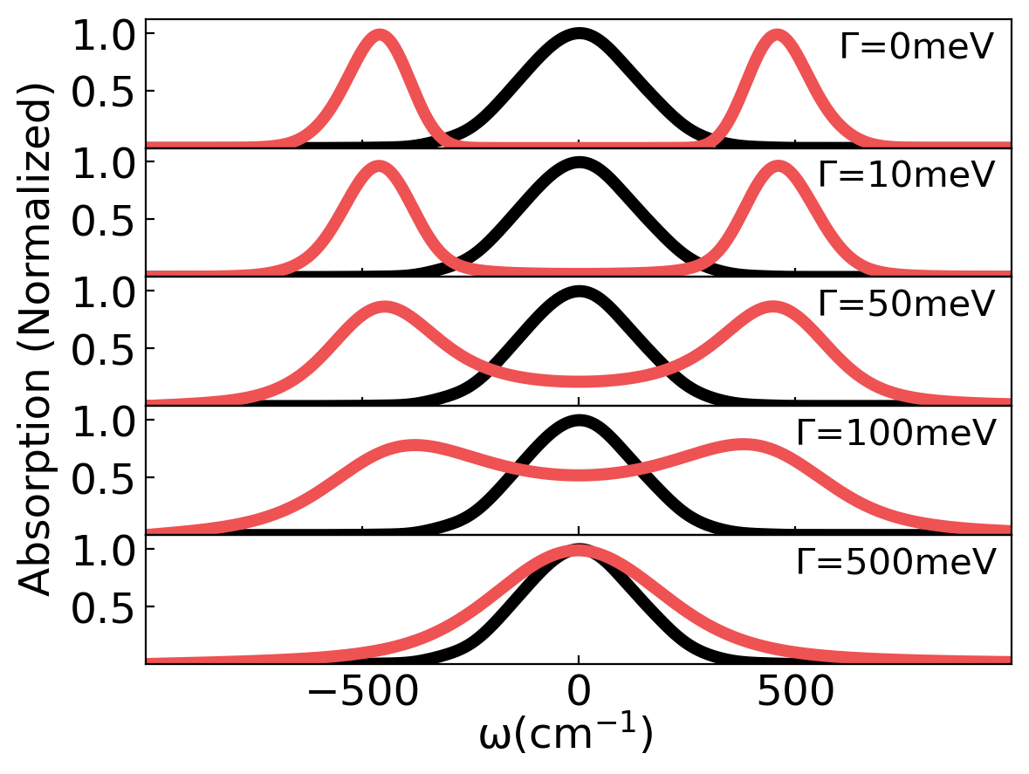
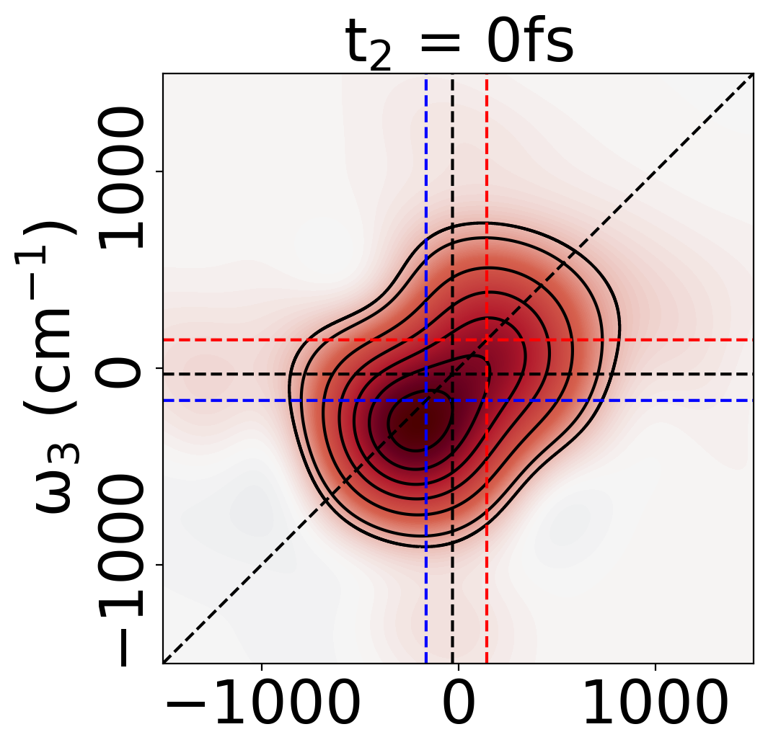
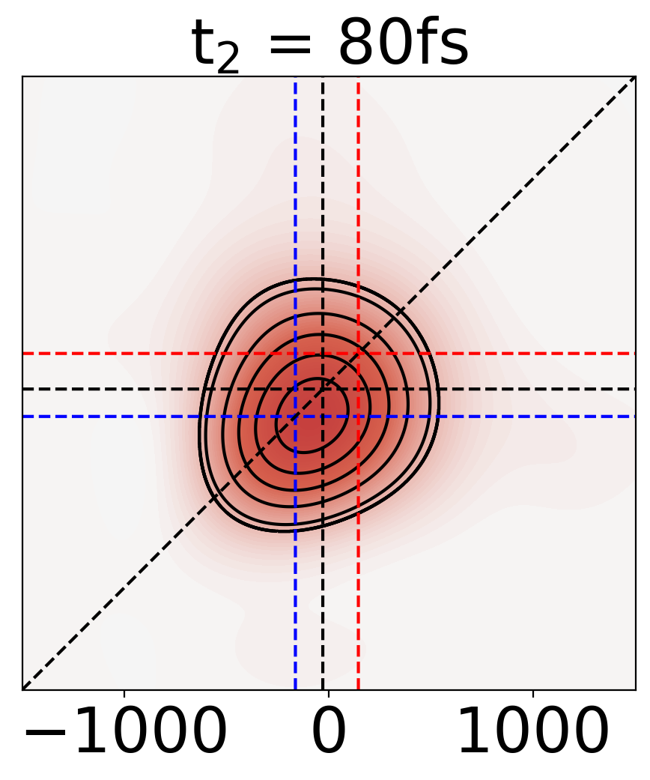
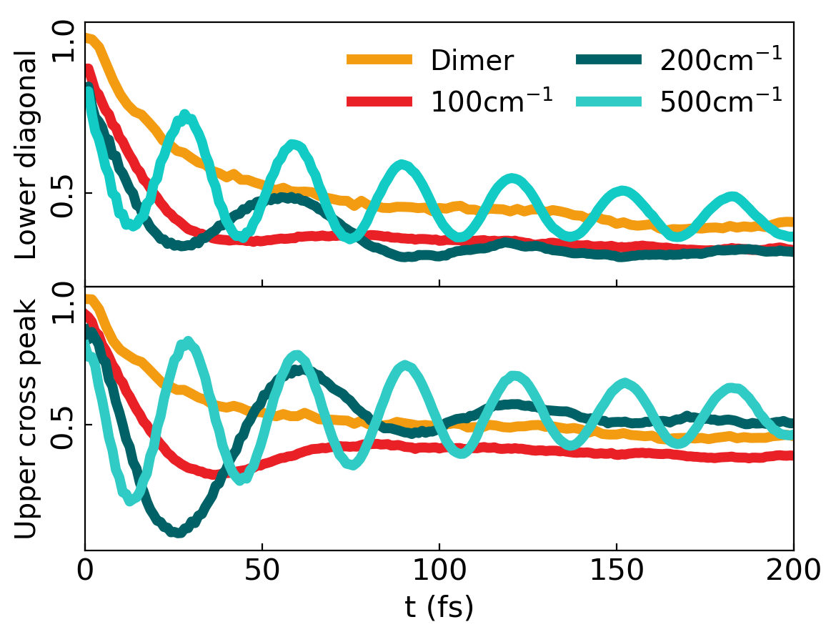
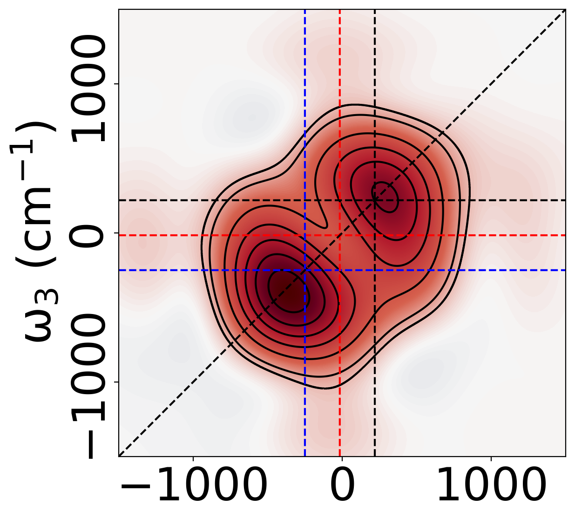
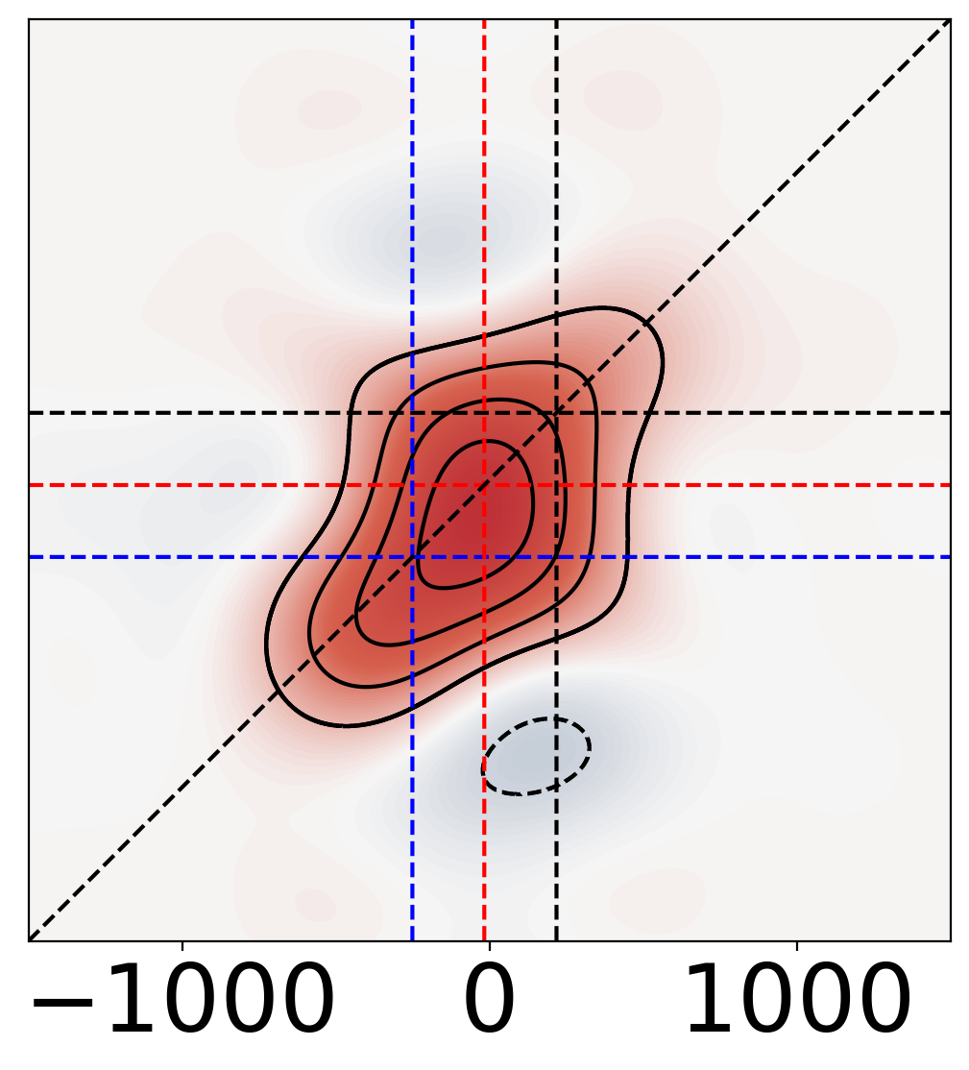
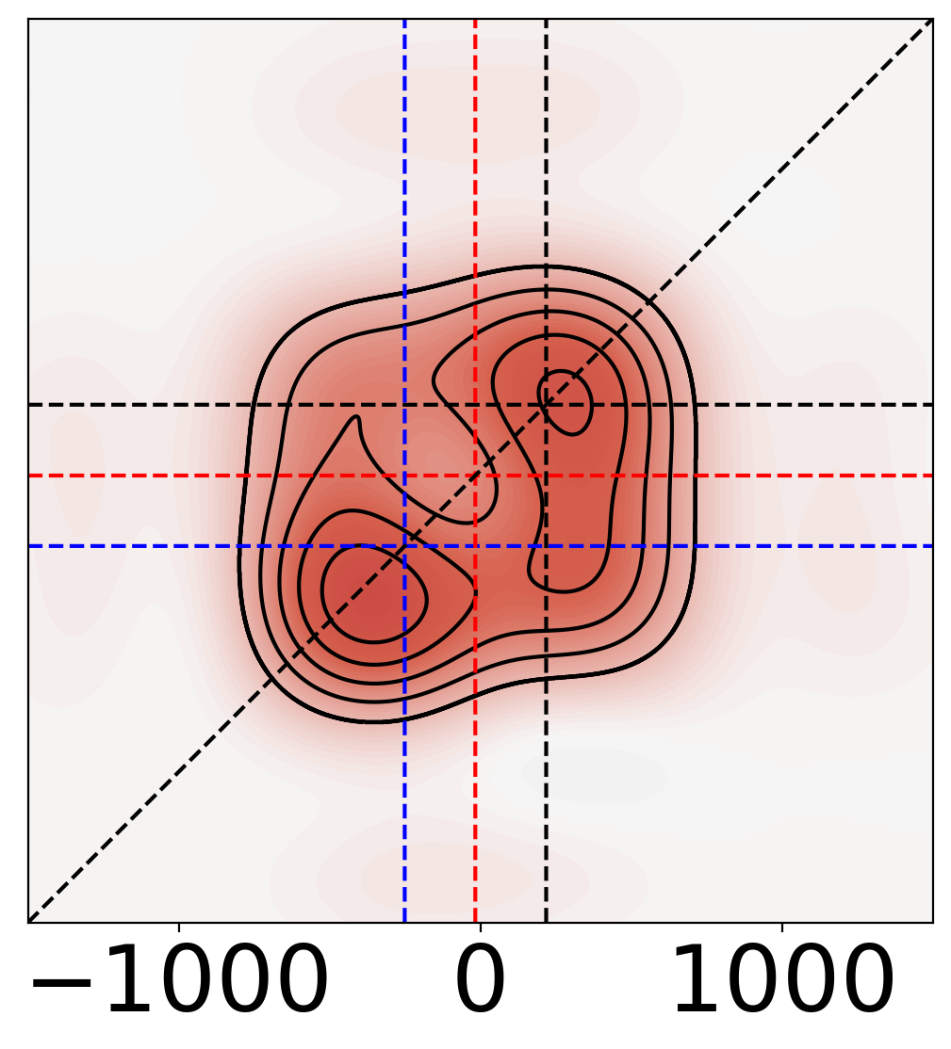
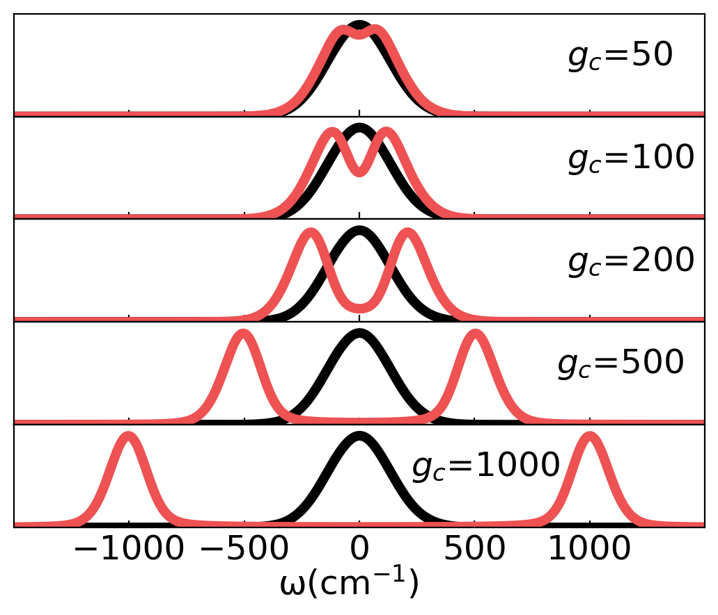
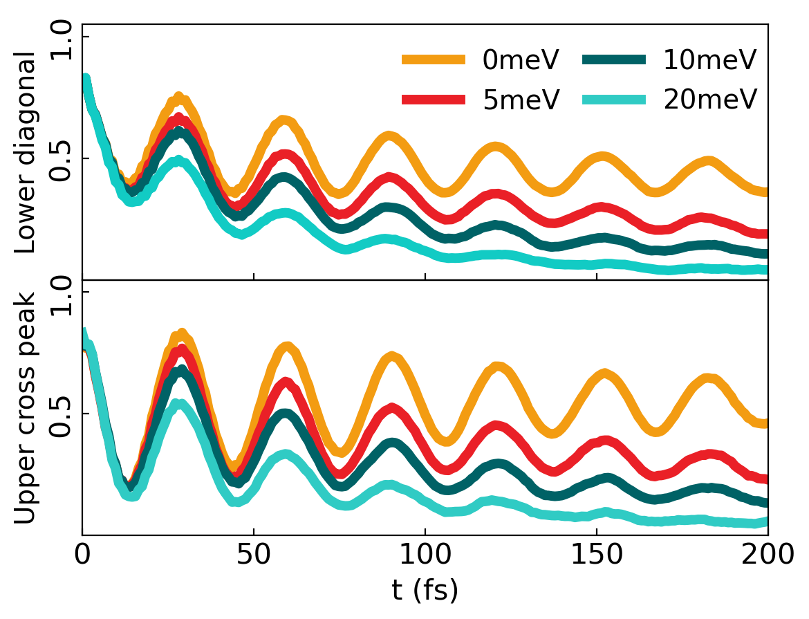
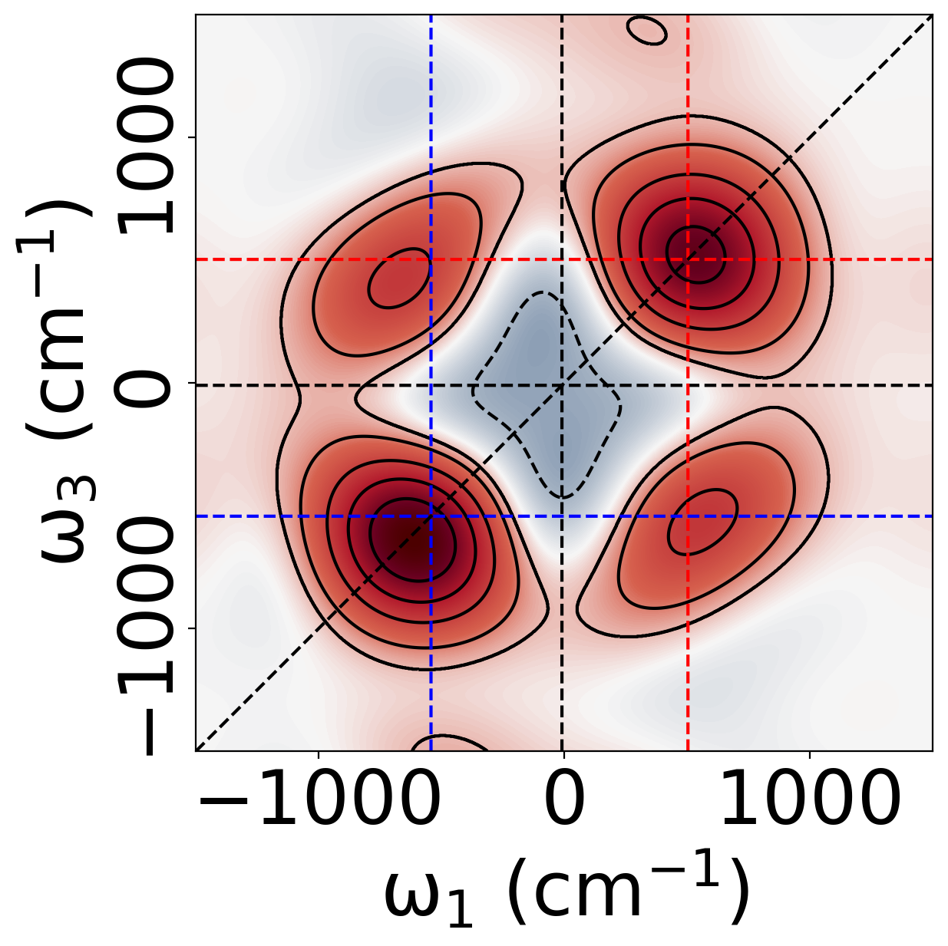
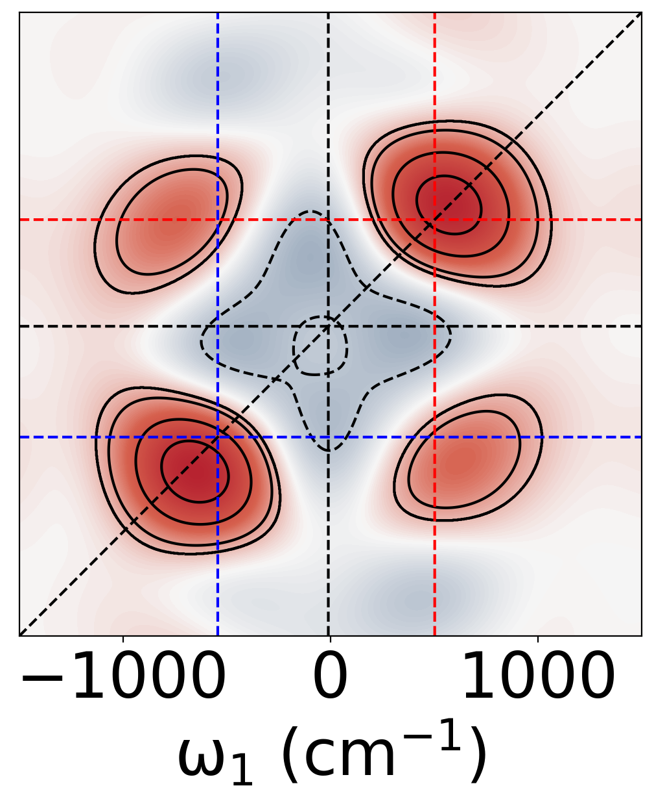
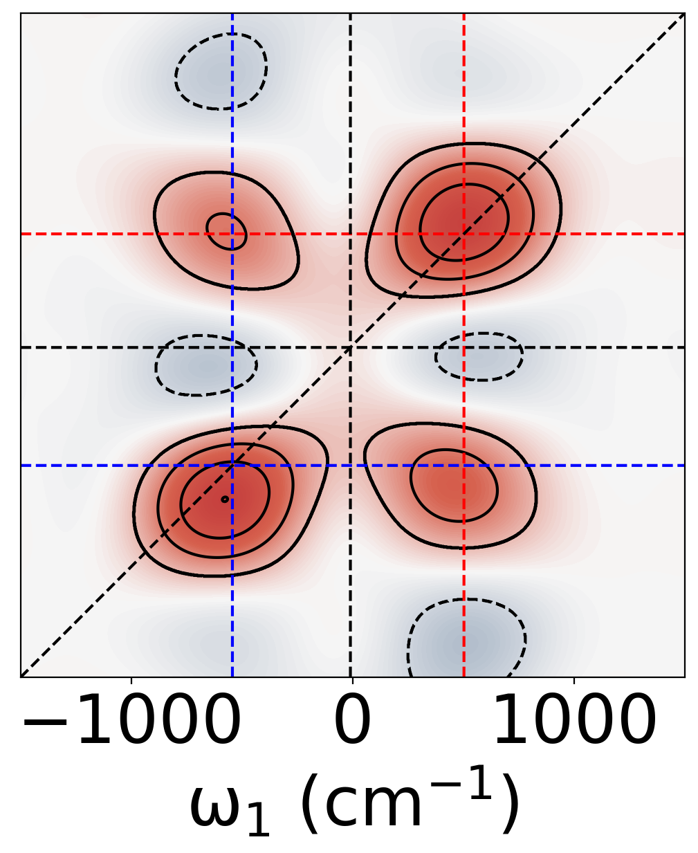



Spectra of molecules in Cavity
(a)
$$g_{c}=100{cm}^{−1}$$
(b)
(c)
(a)
Absorption
(b)
$$g_{c}=200{cm}^{−1}$$
(d)
(e)
(f)
(c)
Absorption
(g)
$$g_{c}=500{cm}^{−1}$$
(h)
(i)
(d)
J. Chem. Phys. 159, 094102 (2023)

