Slide 1
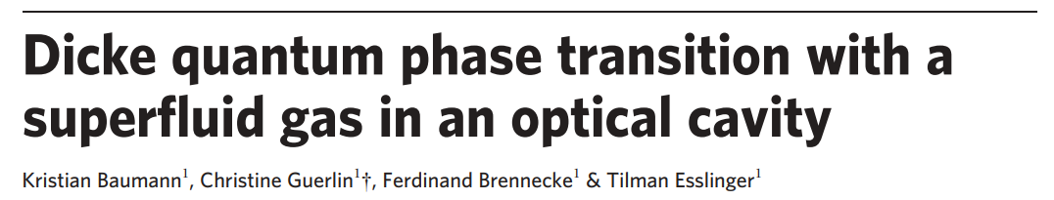

Slide 2




Dicke Model
Describes light-matter interaction; coupling between a single-mode cavity and N two-level systems
Symmetry preserved: normal
Spontaneously broken: superradiant
Notes:
Dicke considered N two-level atoms that are initially prepared in their excited state. At a given time, one of the atoms decays by emitting a photon. This induces a chain reaction that leads to the decay of all the N atoms and the emission of N photons in free space. Dicke explained that if all the atoms are trapped within a fraction of a wavelength, the photons emitted will be indistinguishable. In this case, the emission processes will interfere constructively, giving rise to an electromagnetic field with amplitude proportional to N.
This notation simplifies the numerical study of the model because it involves a single spin-S with S< N/2, whose Hilbert space has size 2S+1, rather than N spin-1/2, whose Hilbert space has size 2^N.
Dicke model has a global symmetry. Parity belongs to Z2 group as applying parity twice returns to same hamiltonian. This symmetry arises due to conservation of the parity of the total number of excitations.
Above a critical value of lambda, Dicke model goes into supperadiant phase transition.

Slide 3
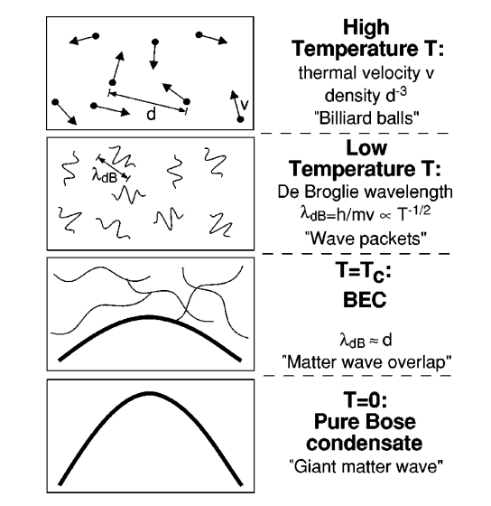
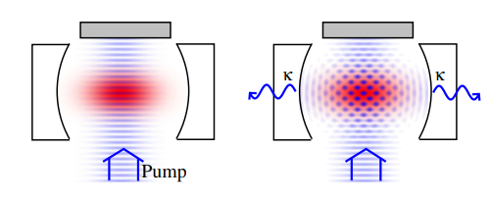
What is BEC?
State of matter in which all the atoms occupy
lowest quantum state (ground state)
Rev. Mod. Phys. 74, 1131
Notes:
In a BEC, the atoms are delocalized, and the phase of the scattered light is random. In this situation, the scattered photons are incoherent and their number does not grow with N. In contrast, in the self-organized state, all atoms emit photons coherently, giving rise to a superradiant phase, where the number of photons is proportional to N.

Slide 4
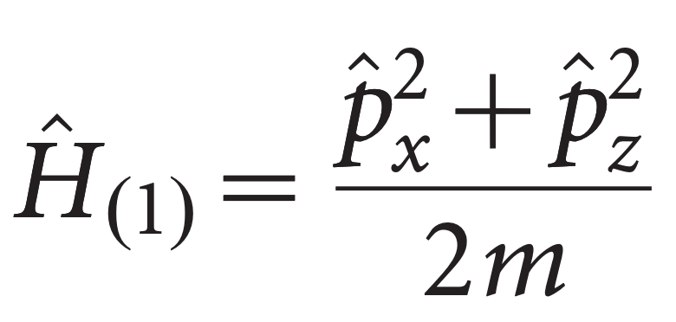
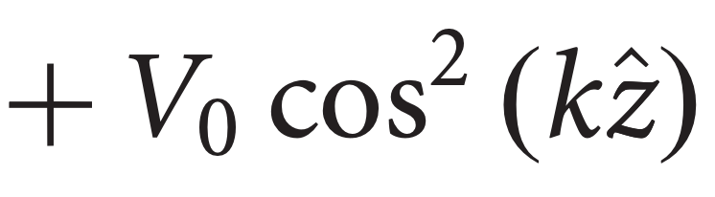
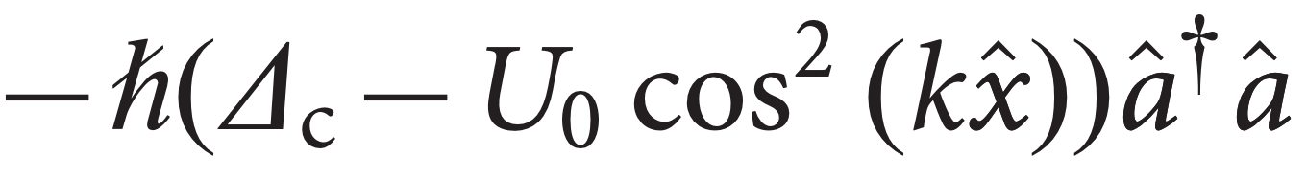
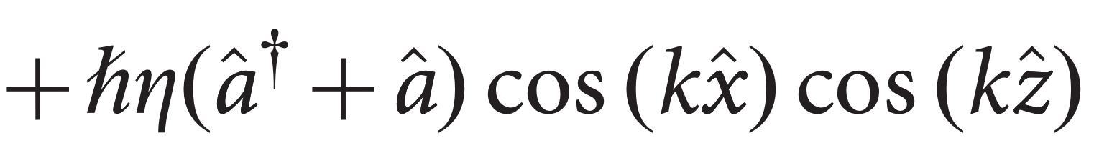
Atom + Pump + Cavity

Slide 5
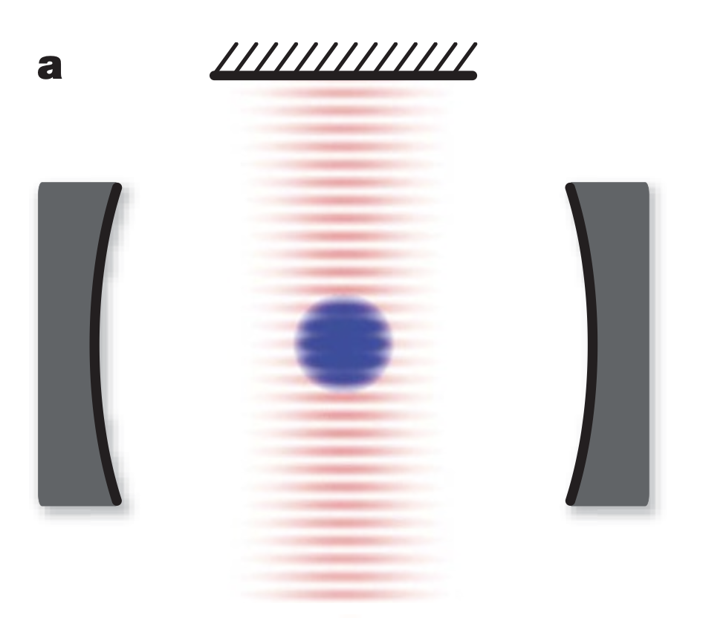
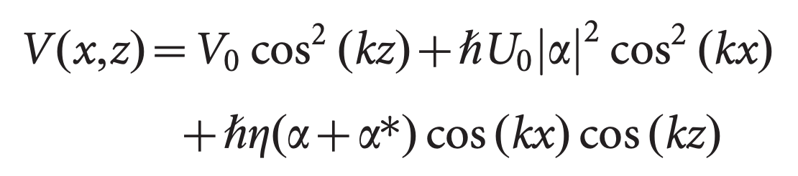
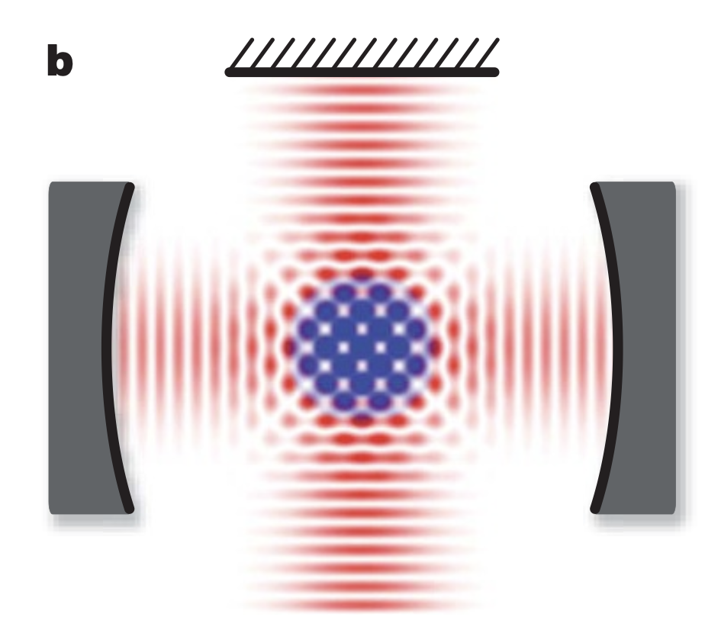
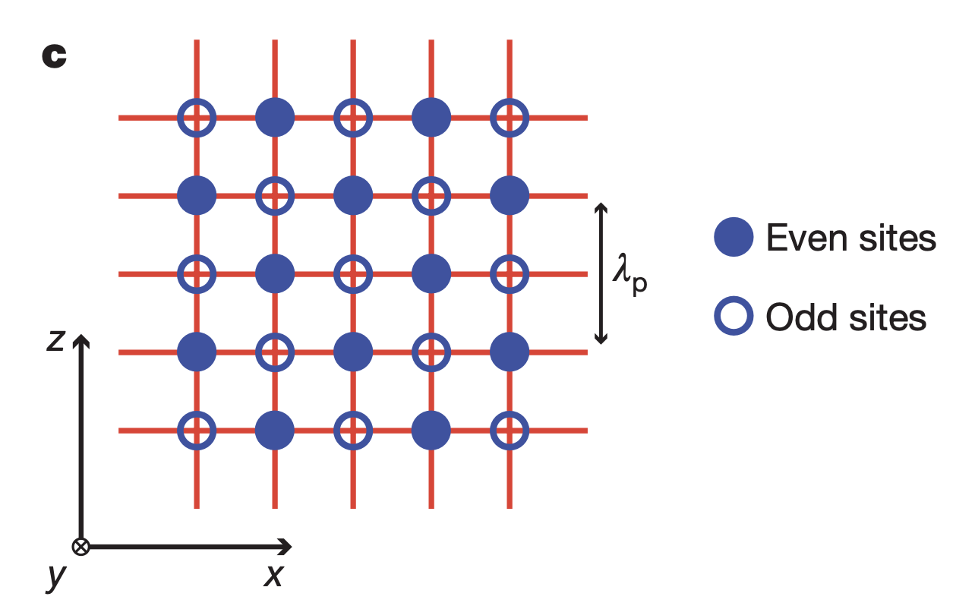
New States
Weak pump
Strong pump

Slide 6

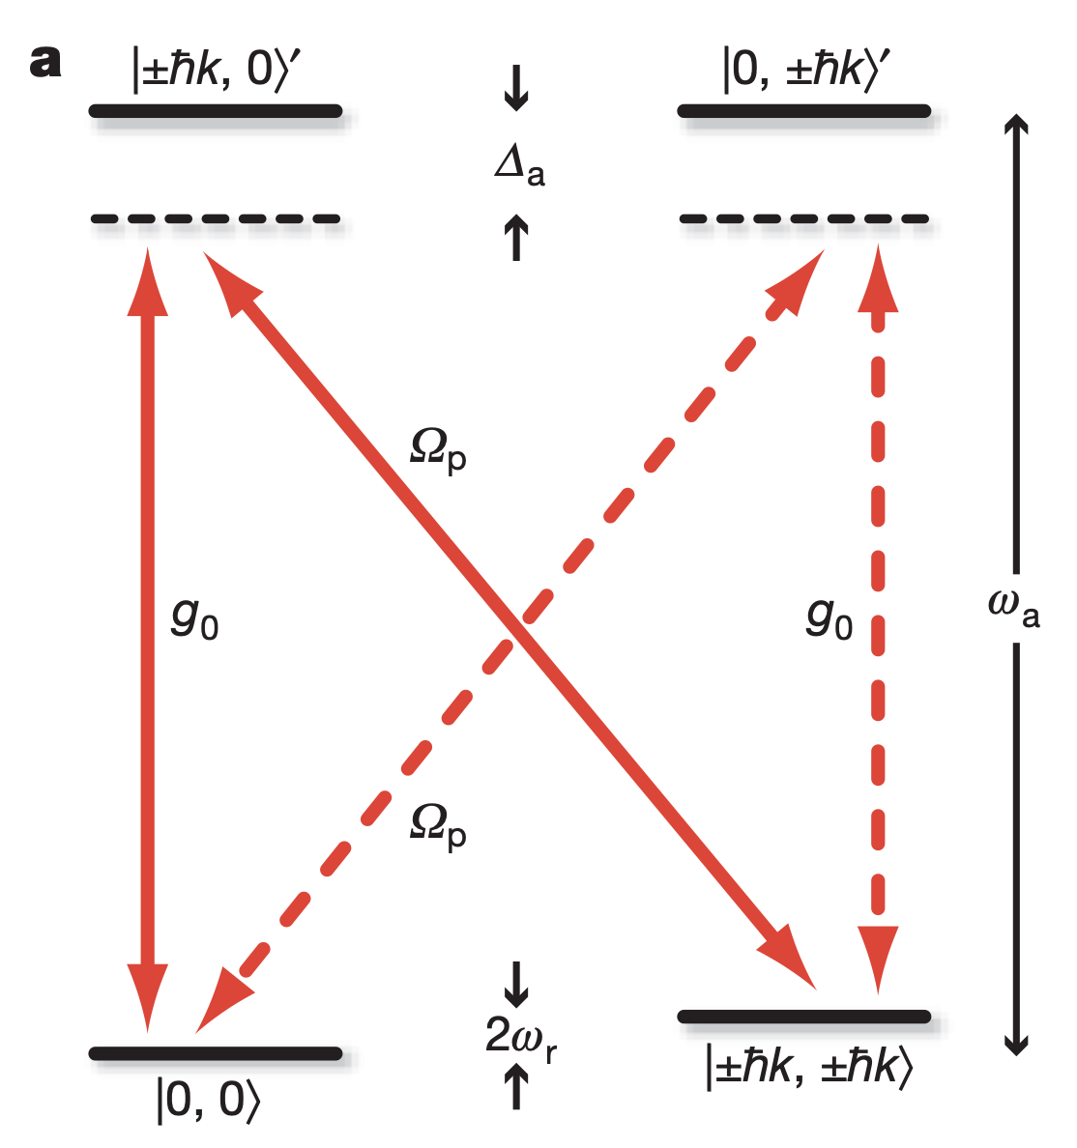
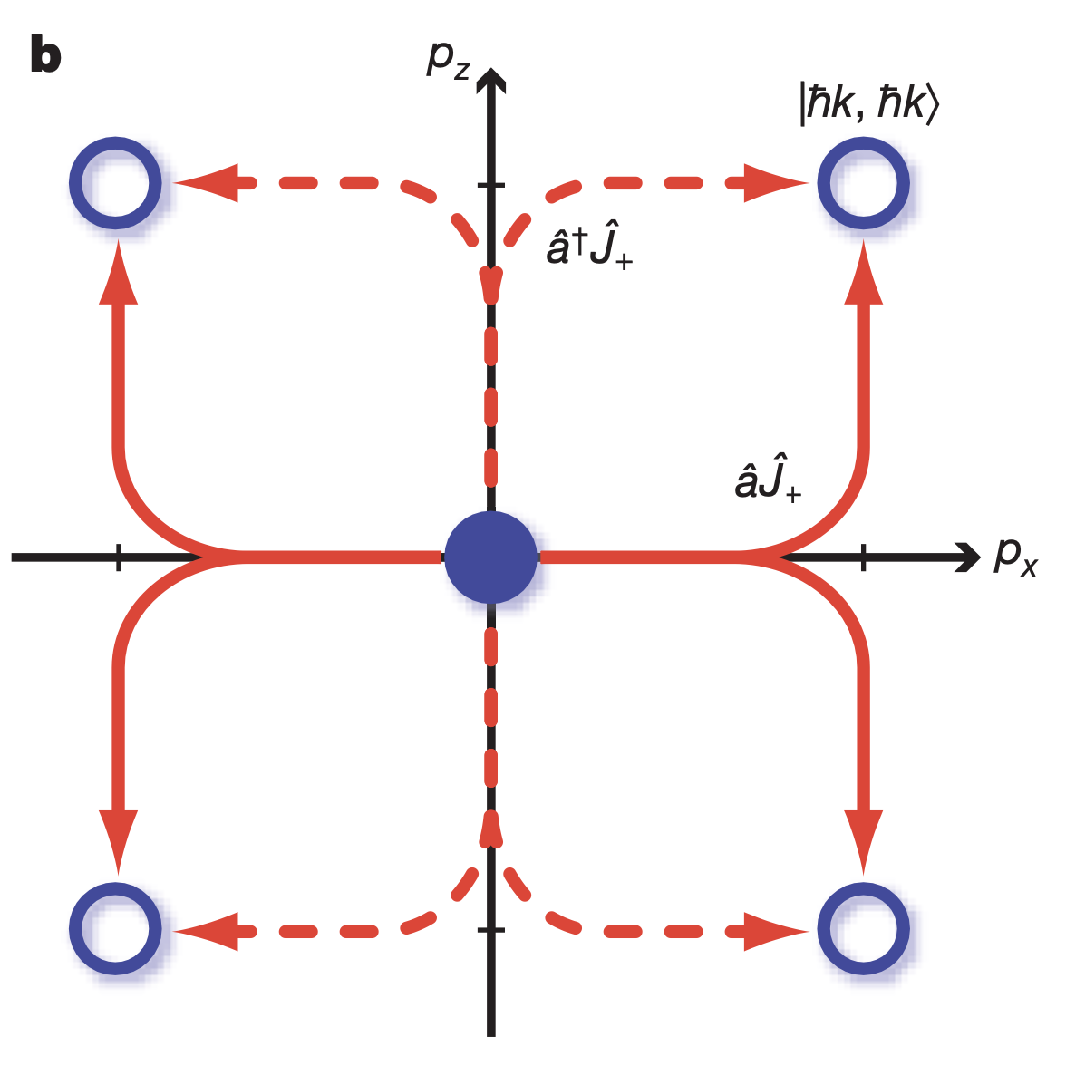
Intuition of the process

Slide 7
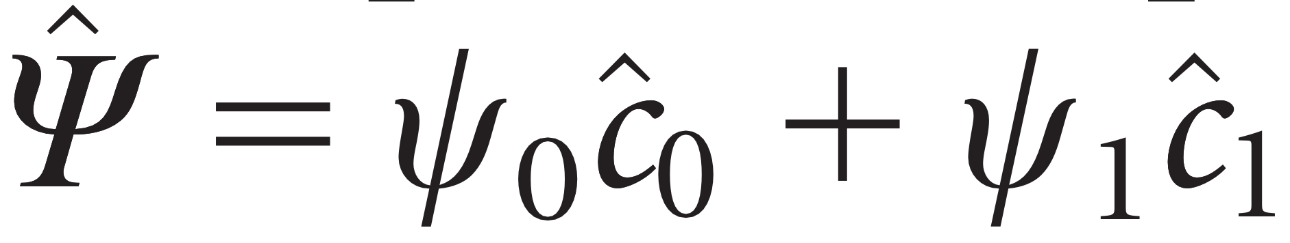
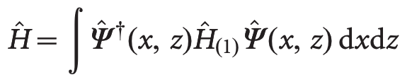
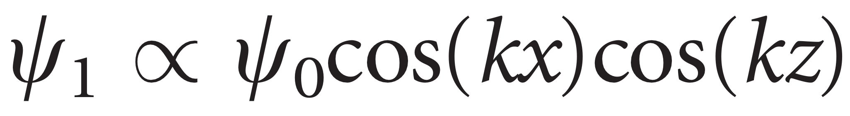
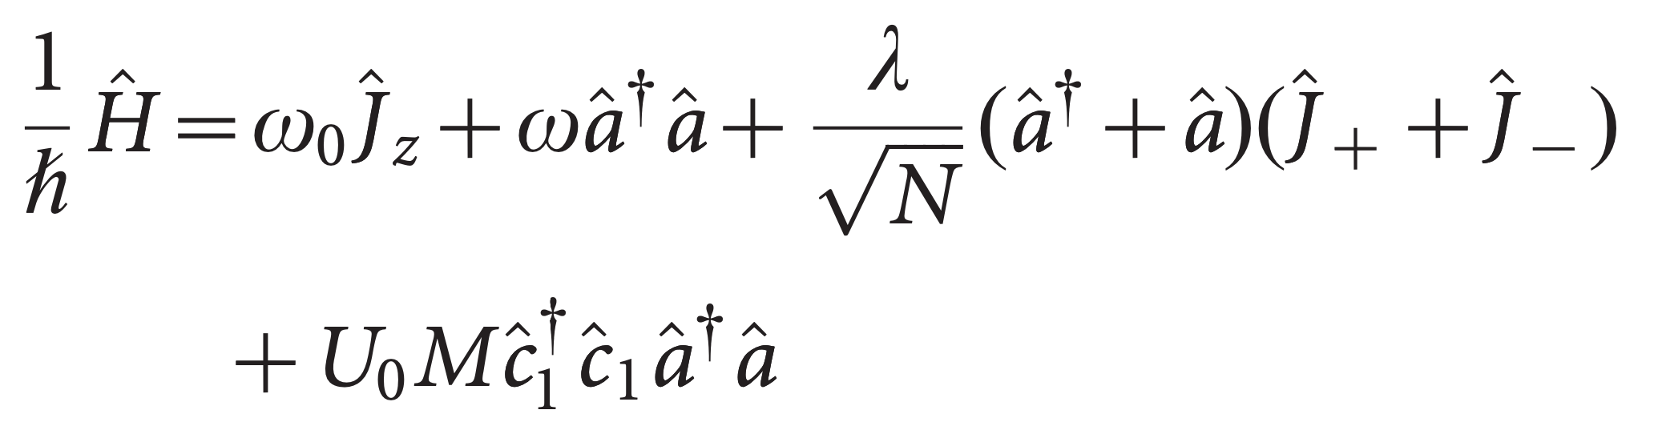
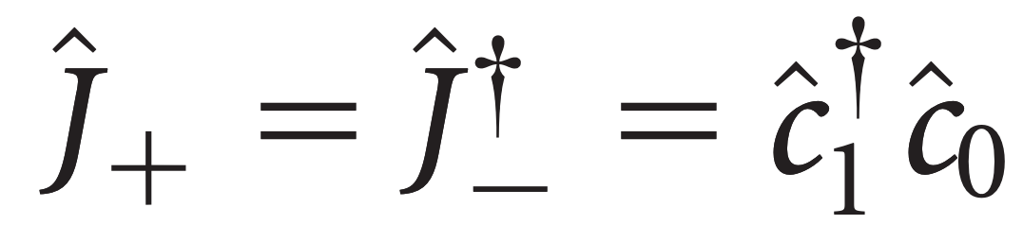
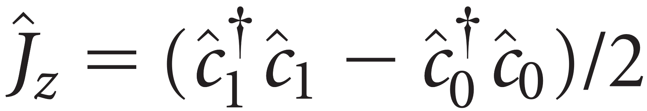
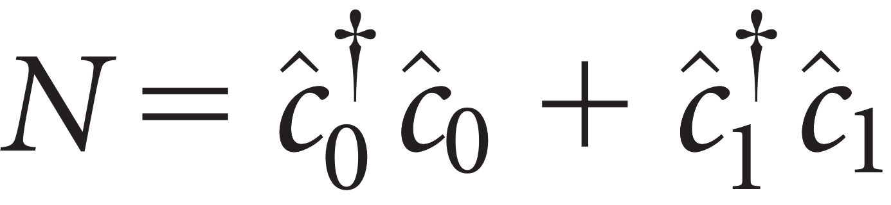
Connection to Dicke model

Slide 8

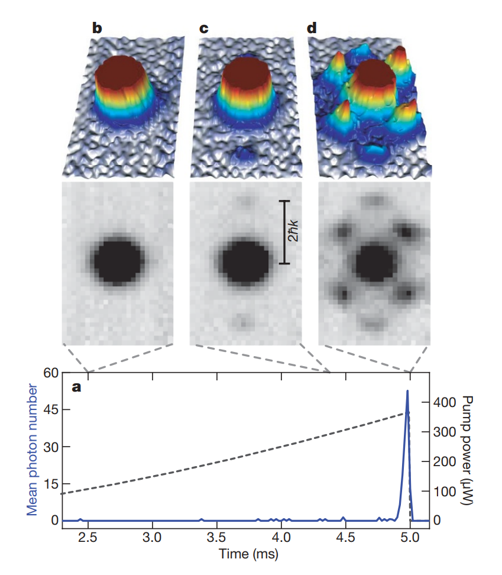

Observing Phase Transition
Additional Momentum Component
Conceptually, the self-organized quantum gas can be regarded as a supersolid, but requires:
non-trivial diagonal long-range order corresponding to a periodic density modulation (1)
off-diagonal long-range order associated with phase coherence (2)
For any two concentric spheres S1 and S2 with radii R1 and R1+R, the relative probabilities of the various possible configurations of particles inside S1 are not independent of the situation outside S2
Chequerboard structure is determined by the long-range cavity-mediated atom–atom interactions
The spatial atomic structure in traditional optical lattice experiments is given solely by the externally applied light fields
The off-diagonal long-range order of the BEC is not destroyed by the phase transition
The atomic coherence length extends over almost the full atomic ensemble
pump–cavity detuning was Δc = -2π × 14.9(2) MHz
O. Penrose and L. Onsager, Phys. Rev. 104, 576 (1956)

Slide 9
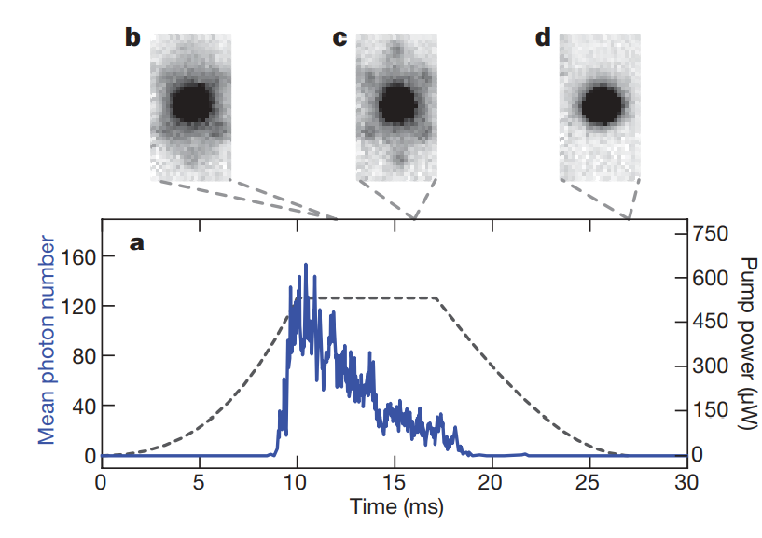
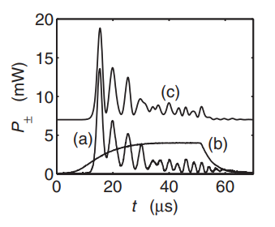
Observing PT (Conti. Steady State)
The pump–cavity detuning was Δc = -2π × 6.3(2) MHz and the atom number was N = 0.7(1) × 10^5
Organized phase is stabilized by scattering-induced light forces
Previous: net transfer of momentum to the atomic cloud inhibited a steady state
Decrease in the mean cavity photon number
residual spontaneous scattering at a rate
back-action-induced heating of the atoms
Deduce an overall atom loss of 30% for the pump power sequence
Reduction can be restored :
steadily increasing the pump intensity
chirping the pump–cavity detuning
Suppressed tunnelling rate
Lower interference
Intensity = 0
Pure BEC reoccur
N decrease
Lattice depth lowers
Coherence restored
Slama, S., Bux, S., Krenz, G., Zimmermann, C. & Courteille, P. W. Superradiant Rayleigh scattering and collective atomic recoil lasing in a ring cavity. Phys. Rev. Lett. 98, 053603 (2007)

Slide 10
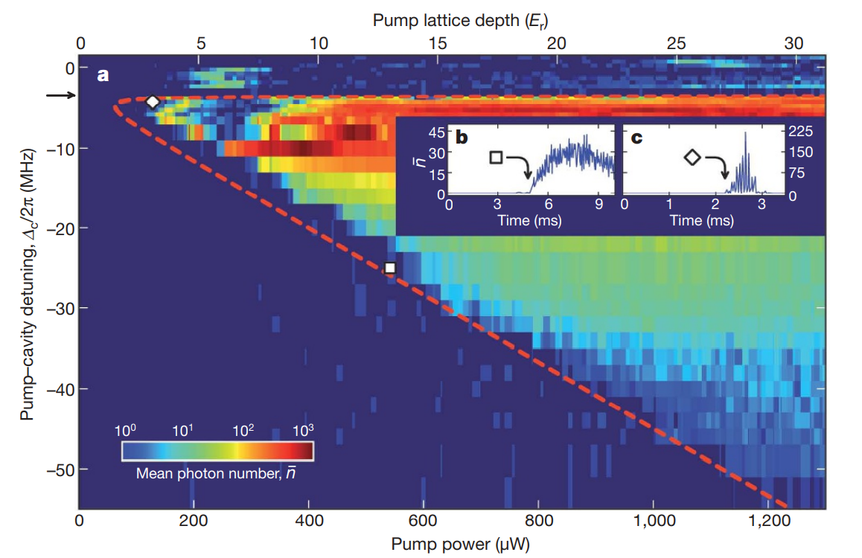

Mapping out PT as a Phase Diagram :dependence of the critical pump power on the pump–cavity detuning
the critical pump power scales linearly with the effective cavity frequency
Bo denotes the spatial overlap between the cavity mode profile and the atomic density in the non-organized phase
Changes in chequerboard pattern
Affects the scattering rate
Changes the spatial overlap
dynamically shifts the cavity resonance
For ω < 0, the critical coupling strength has no real solution.
no light scattering is observed if the pump–cavity detuning is larger than the dispersive shifted cavity resonance at U_0B_0 = -2π × 3.5 MHz

Slide 11
Future Remarkes
Realizing a second-order dynamical quantum phase transition in a driven BEC coupled to the field of an ultrahigh-finesse optical cavity
The steady state realized by the system spontaneously breaks an Ising-type symmetry and the superfluid atoms enter a self-organized phase
process of self-organization is shown to be equivalent to the Dicke quantum phase transition in an open system
possible to study the coherent dynamics of the Dicke model at the critical point
Experimental access to the phase diagram of the Dicke model

