Slide 1

VLSI Routing Optimization
Using
Dynamic Programming
for Exact RSMT
Eliram Amrusi
Eliraz Kadosh
Supervisor: Amnon Stanislavsky
Technion – Faculty of Electrical and Computer Engineering, VLSI Lab

Slide 2
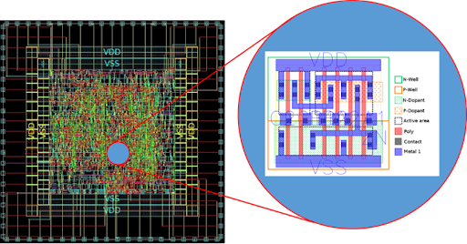
Background
VLSI involves designing and integrating millions of logical
components on a single chip.
The task of routing all components on a chip — known as routing,
it is one of the most complex and challenging stages in VLSI design.
It is increasingly challenging due to the growing chip density,
the large number of components, and the use of many metal layers.
Routing takes place after placement and before fabrication,
making it a critical step in the physical design flow.

Slide 3
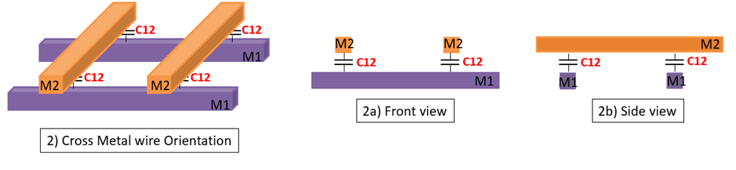
Importance of Routing Optimization
Due to lithographic limitations, routing in silicon chips is restricted to straight lines (horizontal and vertical
only, at 90-degree angles).
This structure reduces congestion, simplifies analysis (e.g., delay, noise, capacitance), enables efficient
via usage, and improves the chances of successful physical routing.

Slide 4
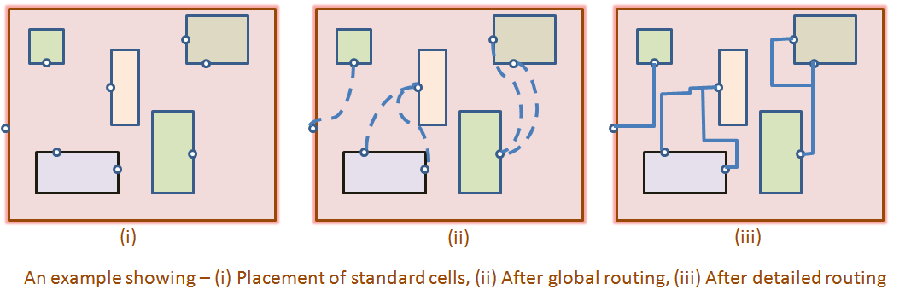
Project Goals
Develop a software tool for optimizing routing paths in VLSI design.
Implement an “exact” RSMT algorithm.
Provide a graphical user interface (GUI) and output files to the user.

Slide 5
Steiner Tree
Software & Architecture
Validation & Results
FDP Algorithm
Conclusions

Slide 6
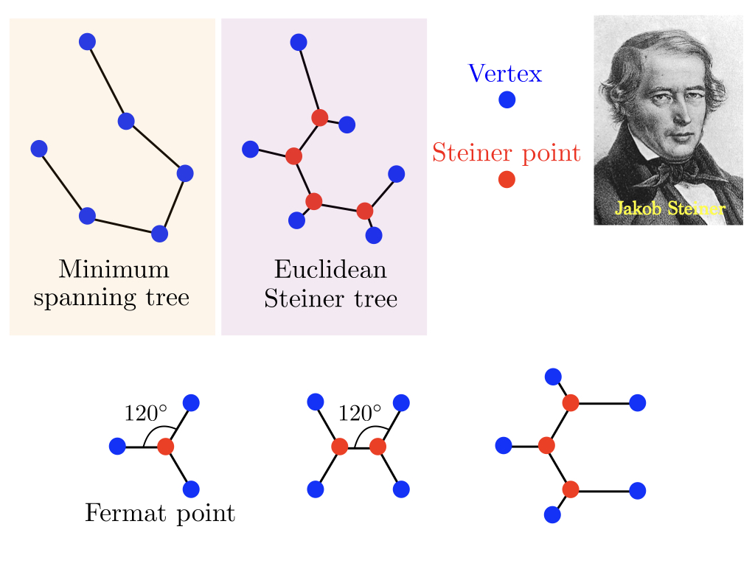
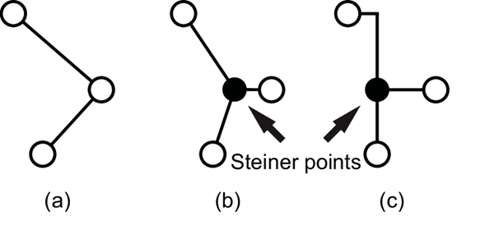
Steiner Trees – Problem Definition
MST: Minimum Spanning Tree = tree of terminals only
(illustration a).
STP: Steiner Tree Problem = allows the use of
additional points - called Steiner points - to reduce
the total connection length (illustration b).
RSMT = Rectilinear Steiner Minimum Tree – similar to
STP but allows only rectilinear connection (illustration c).
As we focus on VLSI, we address the RSMT problem
and its optimization.

Slide 7
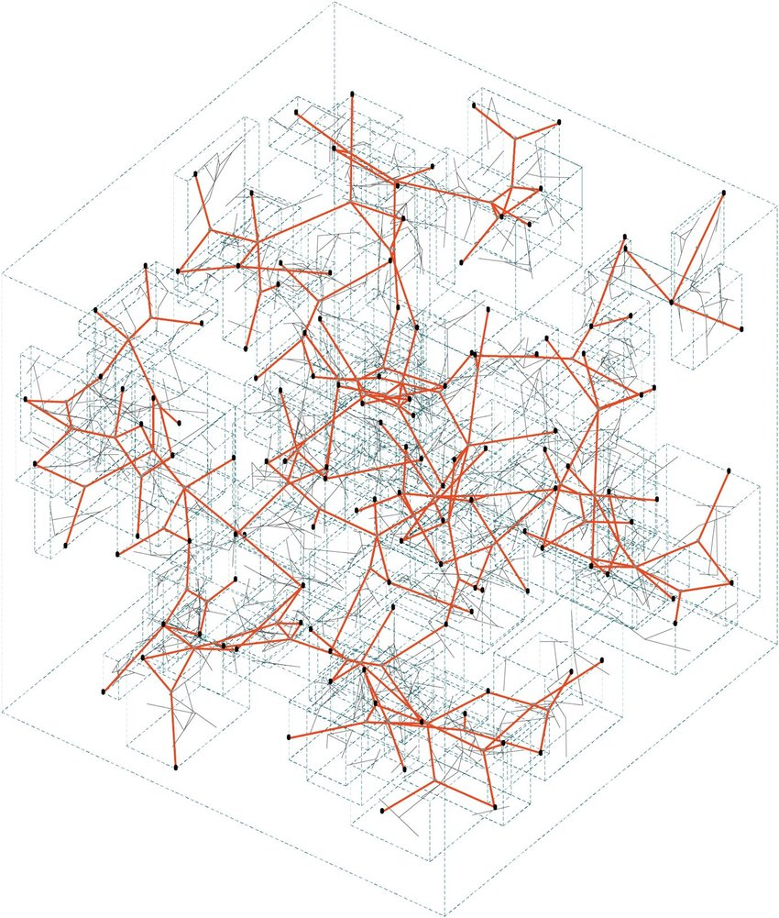
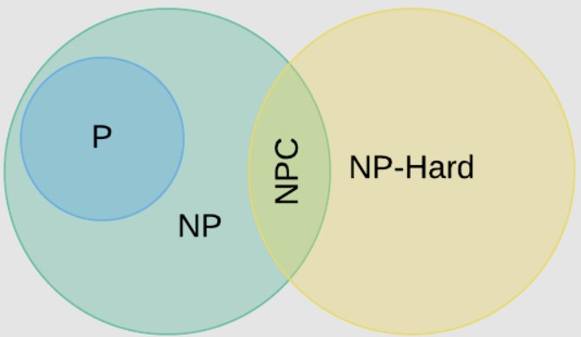
Algorithms for Steiner Tree Problem
RSMT problem is NP-Hard - finding an optimal solution is computationally difficult, especially as the
number of terminals increases.
Main solution approaches:
Exact algorithms: Guarantee optimal solution, but often have exponential runtime.
Approximation algorithms: Provide near-optimal solutions with better performance.
Heuristics: Fast and scalable, but no guarantee on solution quality.
In our project, the implemented algorithm is exact, but it uses dynamic programming,
which helps reduce its runtime.
Venn Diagram of Computational Complexity Classes
3D structures generated using a Euclidean
Steiner tree-based algorithm.

Slide 8
FDP Algorithm
Software & Architecture
Validation & Results
Steiner Tree
Conclusions

Slide 9
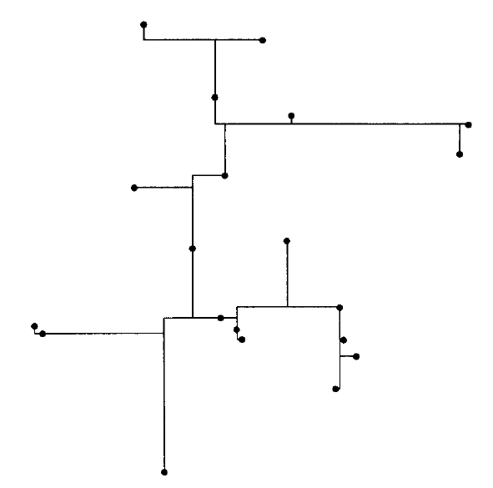
Paper Overview
Title: A Faster Dynamic Programming Algorithm for Exact Rectilinear Steiner Minimal Trees
Authors: Joseph L. Ganley and James P. Cohoon, University of Virginia
Goal of the Paper: Develop an exact algorithm for the RSMT problem that is faster and more memory efficient than previous methods.
Key Contributions:
Proposes the FDP (Full-set Dynamic Programming) algorithm.
Improves on the classic Dreyfus-Wagner method.
Demonstrates better runtime and scalability up to 20 terminals.
Based on dynamic programming.
Optimal RSMT for 20 terminals

Slide 10
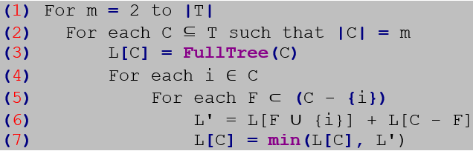
Algorithm Analysis
Key idea: Use dynamic programming to combine smaller subtrees
Avoids exploring all possible Steiner trees by breaking the problem into smaller subproblems based on subsets of terminals
Either use a Full Tree or combine two subtrees via a common terminal
Pseudocode is shown below
FDP Pseudocode

Slide 11
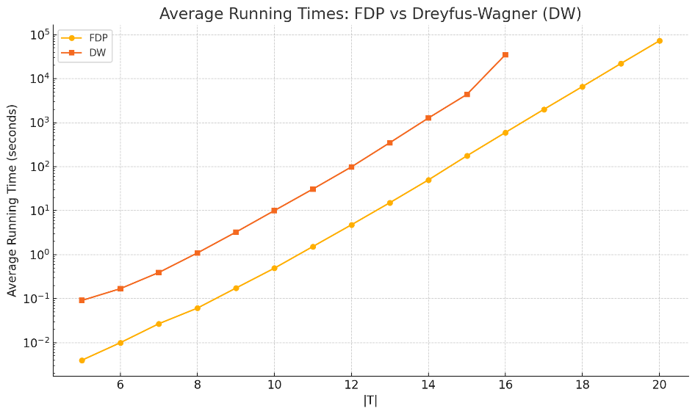
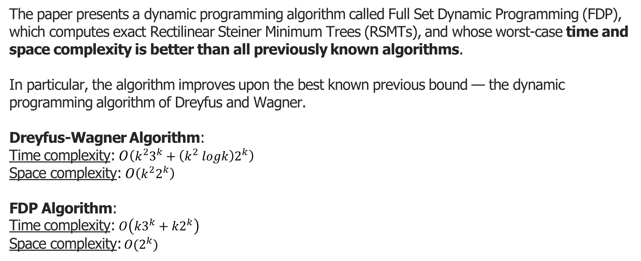
Algorithm Analysis (cont.)
The paper presents a dynamic programming algorithm called Full Set Dynamic Programming (FDP), which computes exact Rectilinear Steiner Minimum Trees (RSMTs), and whose worst-case time and space complexity is better than all previously known algorithms.
In particular, the algorithm improves upon the best known previous bound — the dynamic programming algorithm of Dreyfus and Wagner.
Dreyfus-Wagner Algorithm:
Time complexity: $O\left(k^{2}3^{k}+\left(k^{2} logk\right)2^{k}\right)$
Space complexity:$O\left(k^{2}2^{k}\right)$
FDP Algorithm:
Time complexity: $O\left(k3^{k}+k2^{k}\right)$
Space complexity: $O(2^{k})$

Slide 12
Software & Architecture
Steiner Tree
Validation & Results
FDP Algorithm
Conclusions

Slide 13
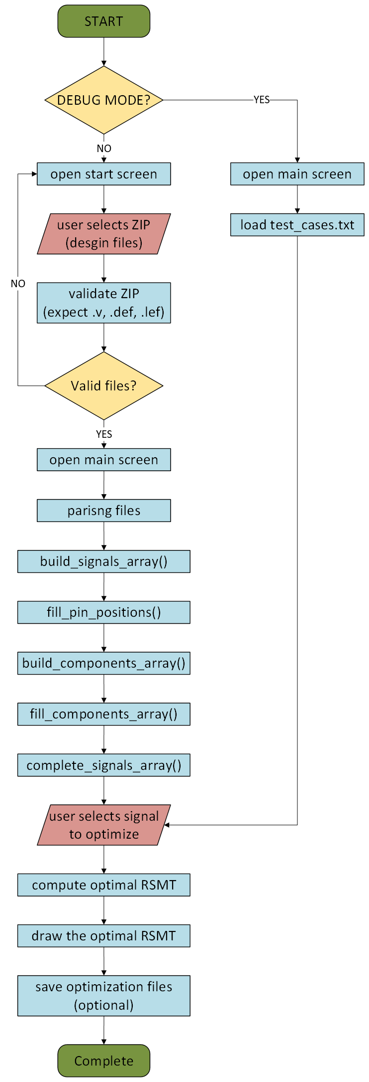
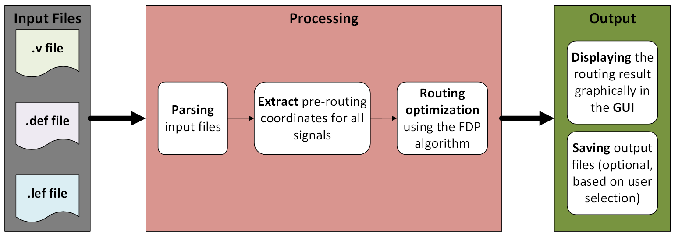
Implementation Highlights
Our software implementation was in Python, developed in an Ubuntu environment.
Two main modules:
main.py: GUI + flow control.
FDP.py: Core FDP logic using GeoSteiner.
Can parse DEF/LEF/Verilog to extract terminal coordinates
Uses the FDP algorithm to return the optimal RSMT and output files for the next production stage in the VLSI process
Flowchart of the data processing stages – from input files to output presentation

Slide 14
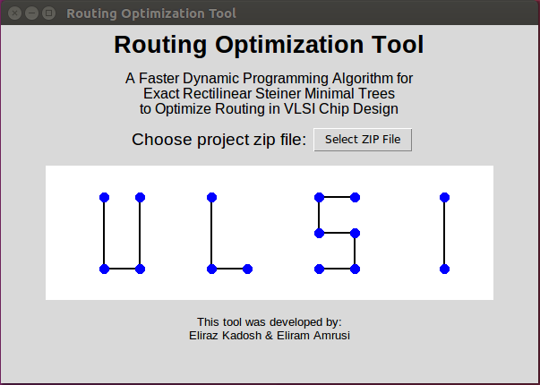
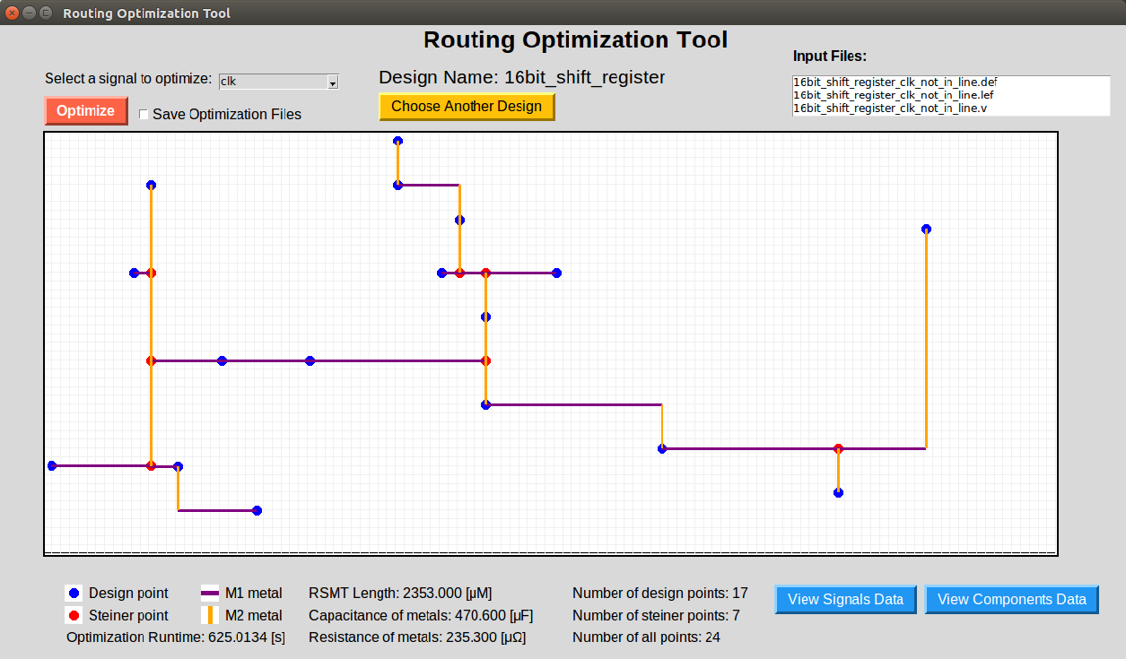
User Interface (GUI)
Purpose of the GUI:
User-friendly interface
Visualize signal nets, terminals, and Steiner trees
The start screen of the GUI
Main Features:
Load Design files
Optimizing signal length.
Two representation options:
Graphical representation for quick visualization
Text file representation for easy transferring to
the next design stage
The main screen of the GUI

Slide 15
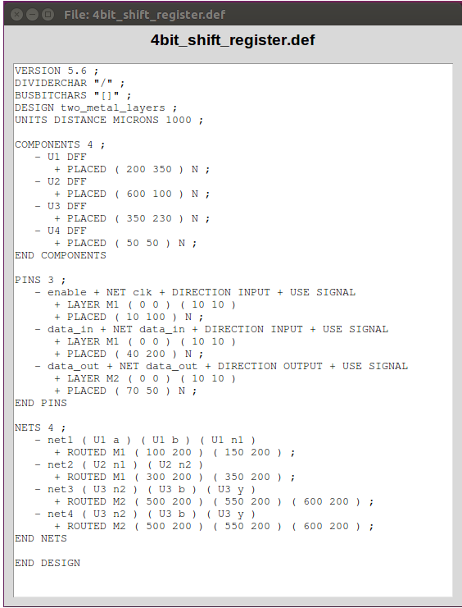
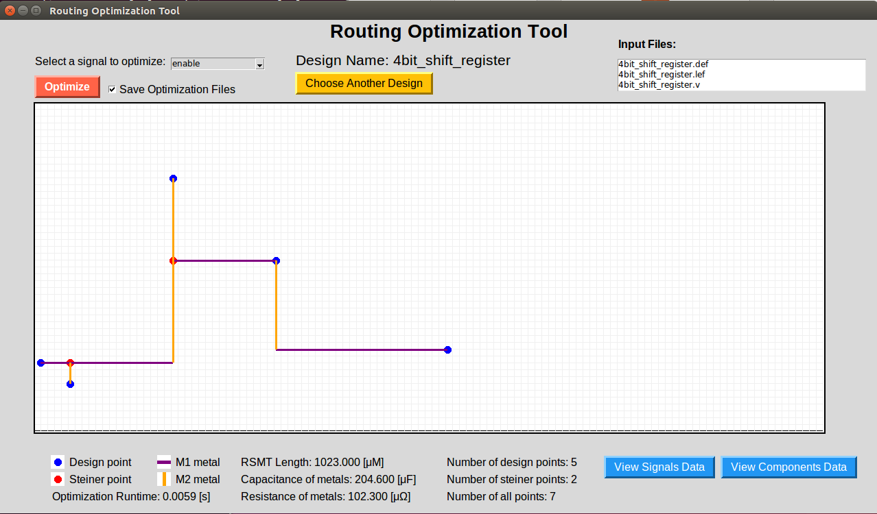
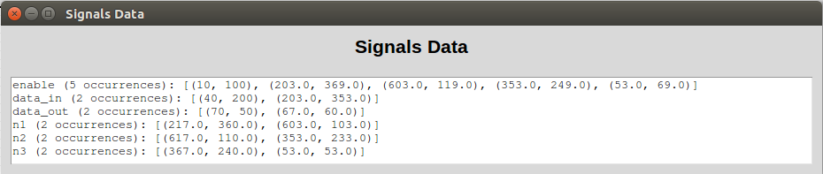
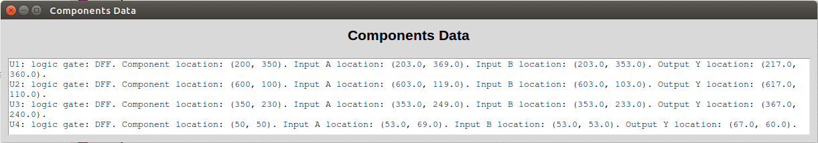
User Interface (GUI)

Slide 16
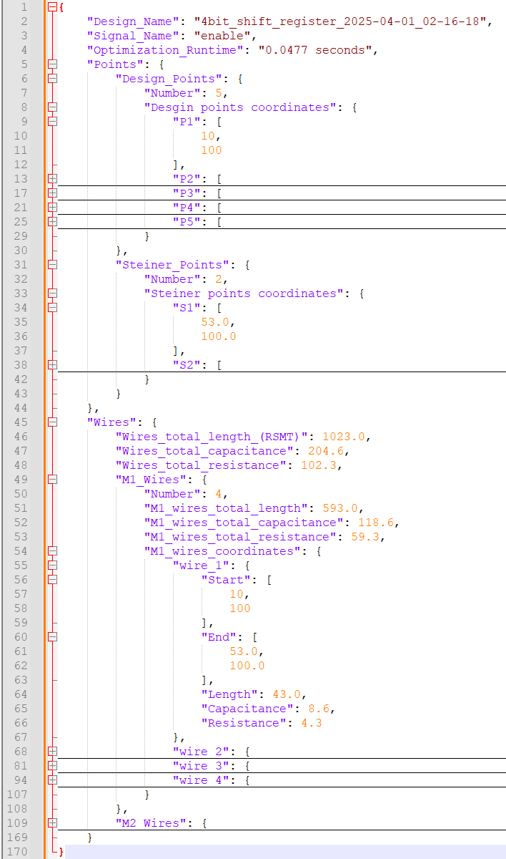
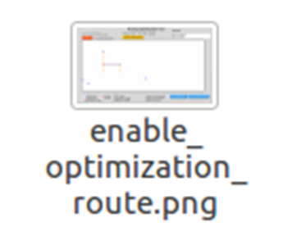
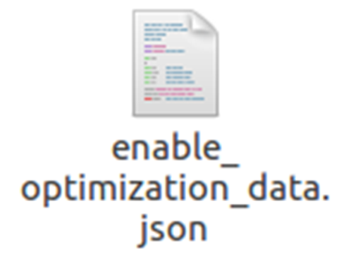
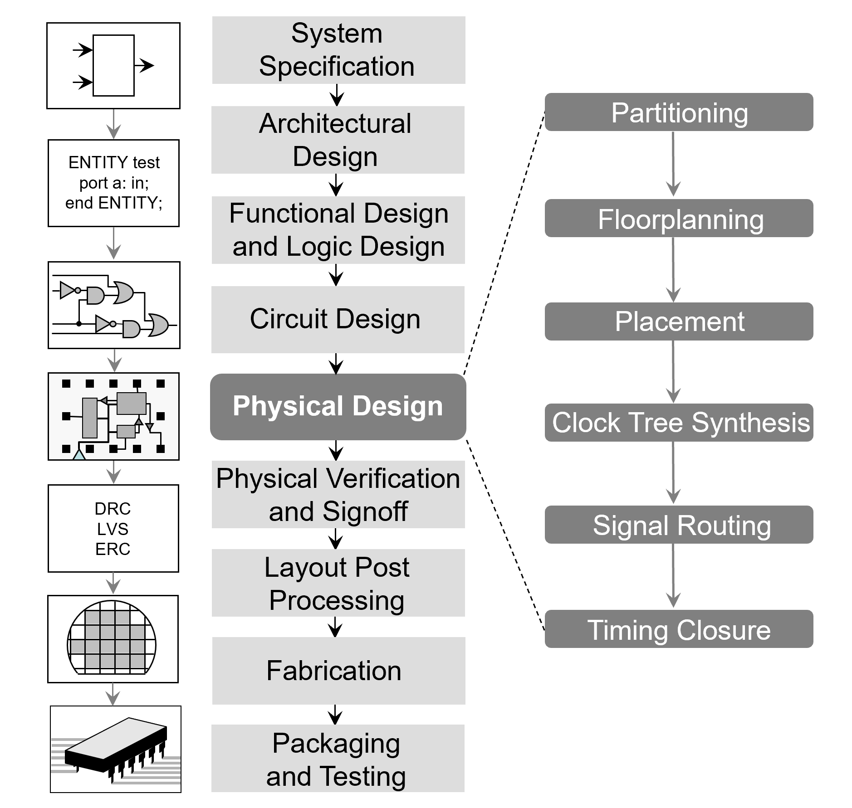
Output Files
For each signal optimized by the tool, we generate two output files:
A graphical file for quick visual validation, allowing users to easily verify that all terminals are properly connected.
A JSON file in a structured, parser-friendly format that can be easily integrated into other tools with minimal effort.
As can be seen, each segment in the tree is defined by its start and end coordinates, and is classified according to either the M1 or M2 layer.

Slide 17
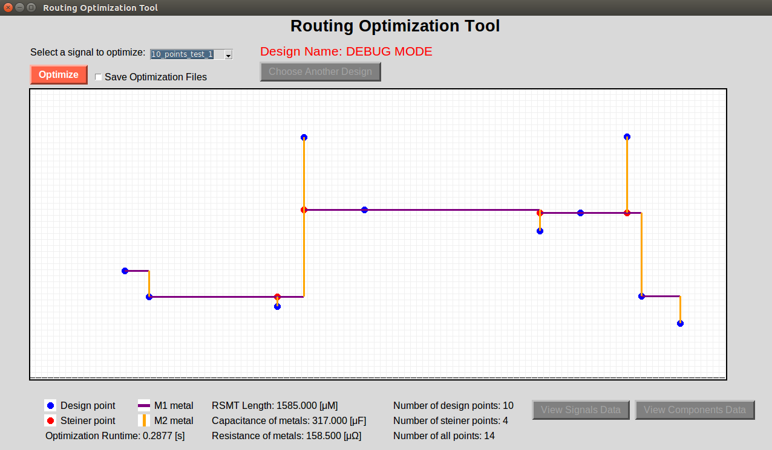
Debug Mode
The interface includes a debug mode, which can be enabled for internal testing, issue analysis, and understanding the algorithm’s behavior.
To launch debug mode, simply add the -D flag: python3.10 main.py -D
Upon startup, the main screen is displayed immediately, with irrelevant buttons disabled.
Signals are automatically loaded from a file named test_cases.txt.

Slide 18
Validation & Results
Steiner Tree
Software & Architecture
FDP Algorithm
Conclusions

Slide 19
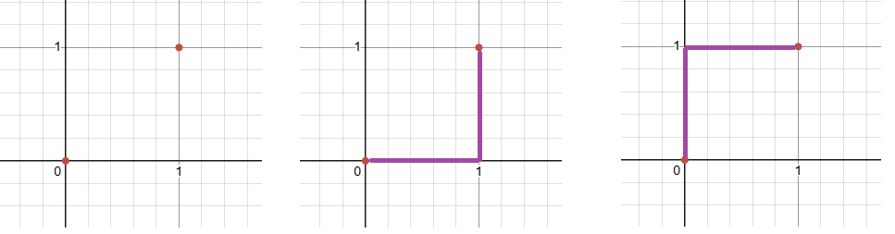
Validation
Validation Criteria:
Correctness: We verify that the algorithm produces a valid Steiner tree (connected, tree structure, with allowed Steiner points).
Consistency: We ensure the algorithm produces consistent outputs on repeated runs and on similar inputs.
Accuracy: We compare the solution length returned by our algorithm against the optimal length computed by GeoSteiner. For small test cases (e.g., 2–5 terminals), we also compare against manually computed solutions.
Note: Steiner trees are not canonical — different structures can have the same total length.
For example, the points (0,0) and (1,1) have two optimal solutions with equal length but different shapes.

Slide 20
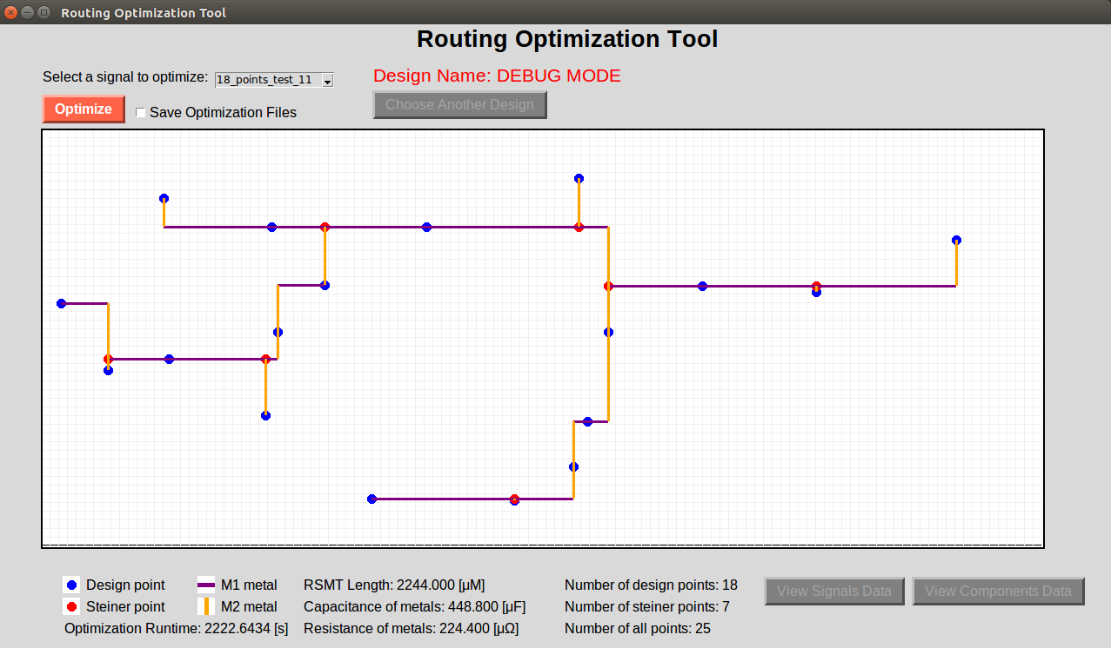
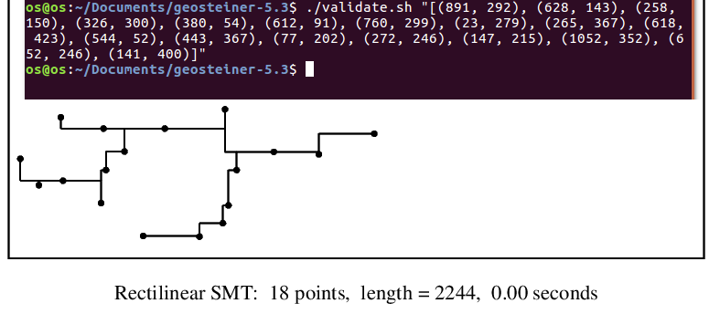
Validation
We wrote a script called “validate.sh” to validate RSMT results.
The script receives a list of terminals as input.
It runs GeoSteiner in standard mode and generates a visual output.
The total tree length matches our implementation, as expected.
Slight differences in connections may occur, since the tree is not canonical
GeoSteiner result
Our result

Slide 21
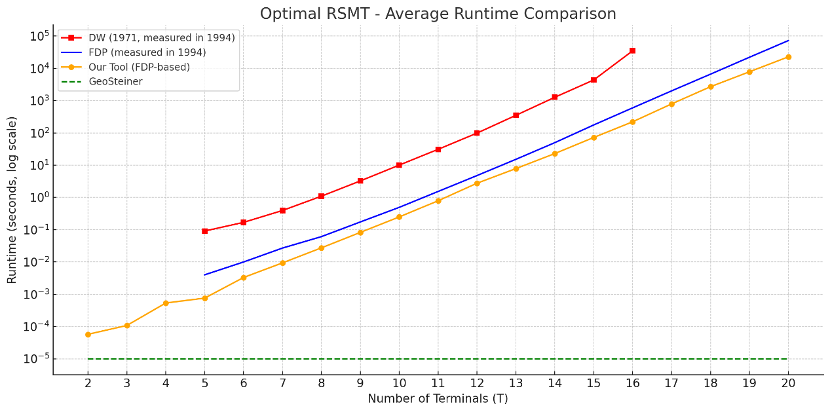
Results
To evaluate performance, we compared the average runtime of our FDP-based algorithm against three other sources.
DW (1971, measured in 1994): Runtime grows exponentially. Becomes impractical from T = 17 onward.
FDP (measured in 1994): Significantly better than DW, but still relatively slow due to hardware limitations of that era.
GeoSteiner: Computes solutions instantly, appearing as a flat line at the bottom of the graph.
Our Tool (FDP-based): Clearly outperforms the 1994 results, thanks to modern computing power. However, it is still slower than GeoSteiner, likely due to additional processing layers.
average runtime as a function of the number of terminals (T), where T ranges from 2 to 20.

Slide 22
Conclusions
Steiner Tree
Software & Architecture
FDP Algorithm
Validation & Results

Slide 23
Summary & Conclusions
During the project, we gained several valuable insights that helped us deepen both our
technical knowledge and professional skills:
Learned about the VLSI design flow and key roles in the development process.
Combined theory with practical implementation across the full design flow.
Understood the importance of early planning and modular design.
Gained skills in academic reading, debugging, teamwork, and tool integration.

Slide 24
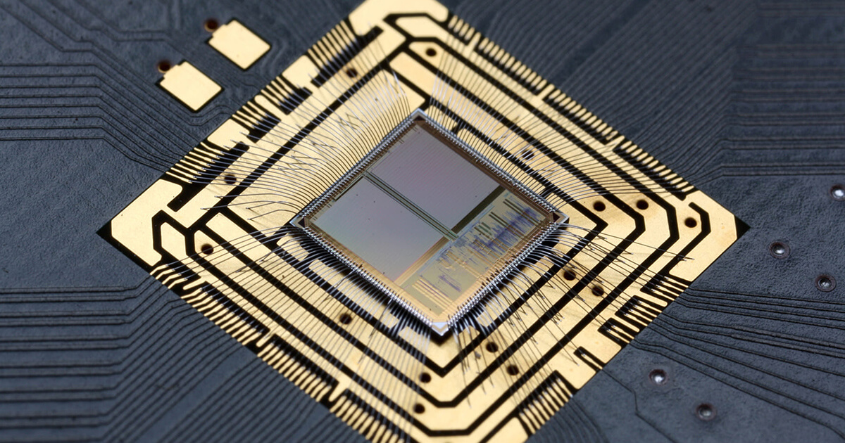
We appreciate your attention and guidance along the way.
Any questions?

