Slide 1
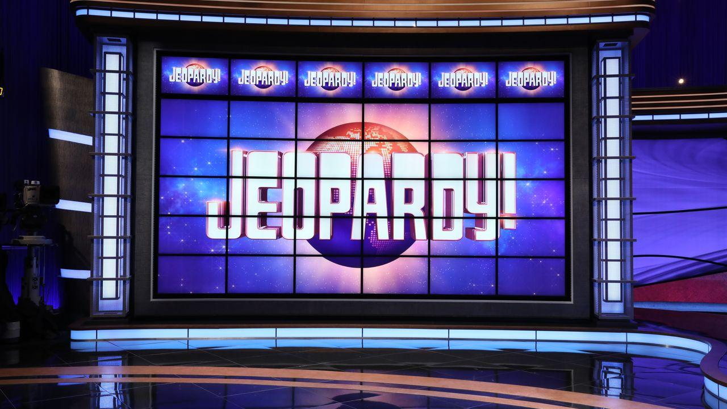
About Jeopardy

Slide 2
Project 4 - Jeopardy
Group:
Elisangela Jardim
Geetha Rajendram
Justin DeMaagd
Kurt Goesch

Slide 3
Geetha

Slide 4
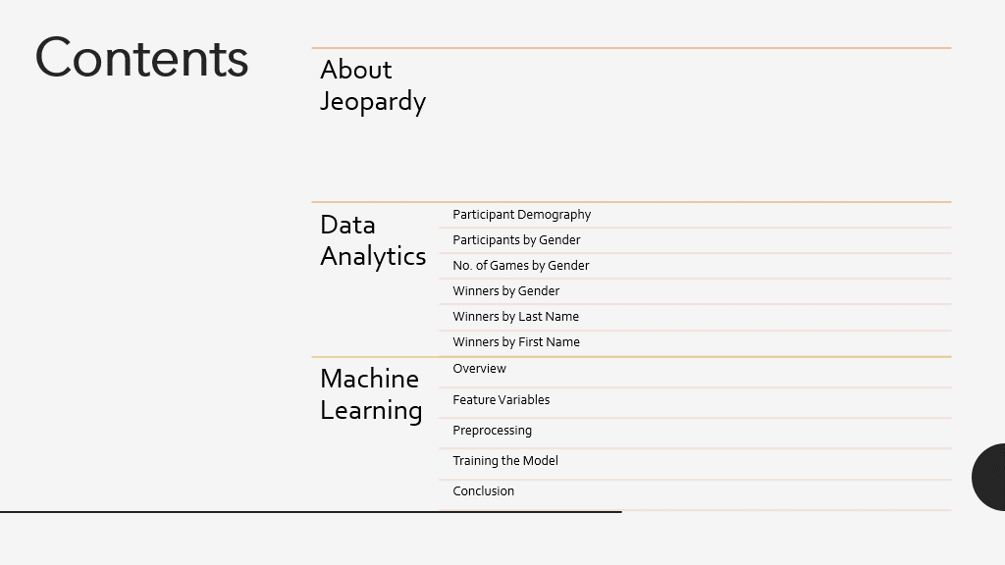

Slide 5
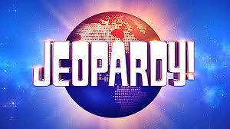
About Jeopardy
American television game show created by Merv Griffin
Original version debuted in March 1964 and ran until Jan 1975
Current version premiered in Sept 1984
Has won a record 39 Daytime Emmy awards

Slide 6

Data Analytics
Data Courtesy
kdnuggets.com

Slide 7
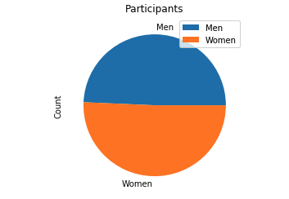
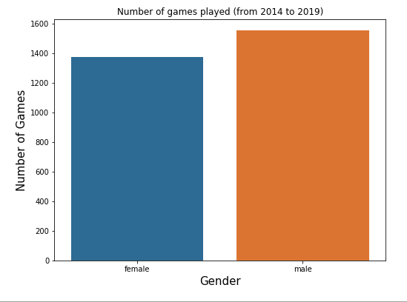
Participant Demography
Date Range for Data: Feb 11, 2014 – July 26, 2019
Pyspark was used for the analysis
Used gender-guesser (python package) to classify gender
Total number of games played = 2927
Total Number of games played by women = 1374
Total number of games played by men = 1553
INSIGHT: Even though the number of men contestants is lower, men have played more games than women
Data Source: kdnuggets.com

Slide 8
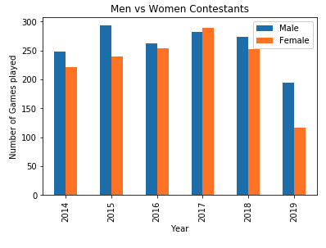
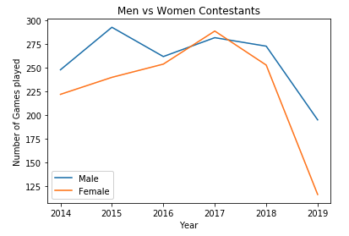
Participants by Gender
Total Number of Individual Contestants = 1827
Unique Individual Men Contestants = 901
Unique Individual Women Contestants = 926
INSIGHT: Men have consistently won more games than women.

Slide 9
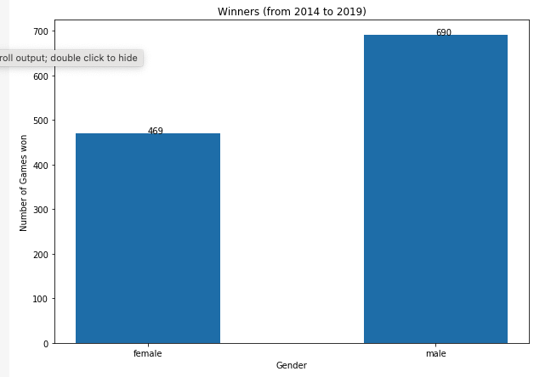
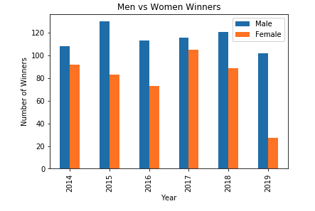
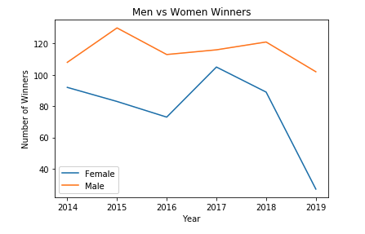
Winners by Gender
Games won by men = 690
Games won by women = 469
Women participation = 46%
Women wins = 40%
INSIGHT: Men have won more games, but men have also played more games

Slide 10
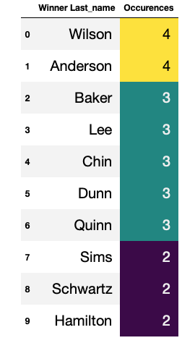
Most Common Last name among the Winners

Slide 11
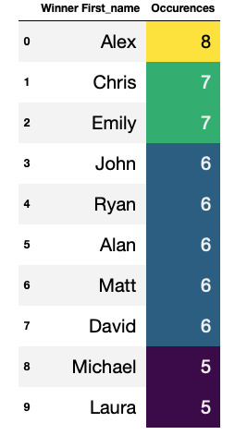
Most common First name among the Winners

Slide 12
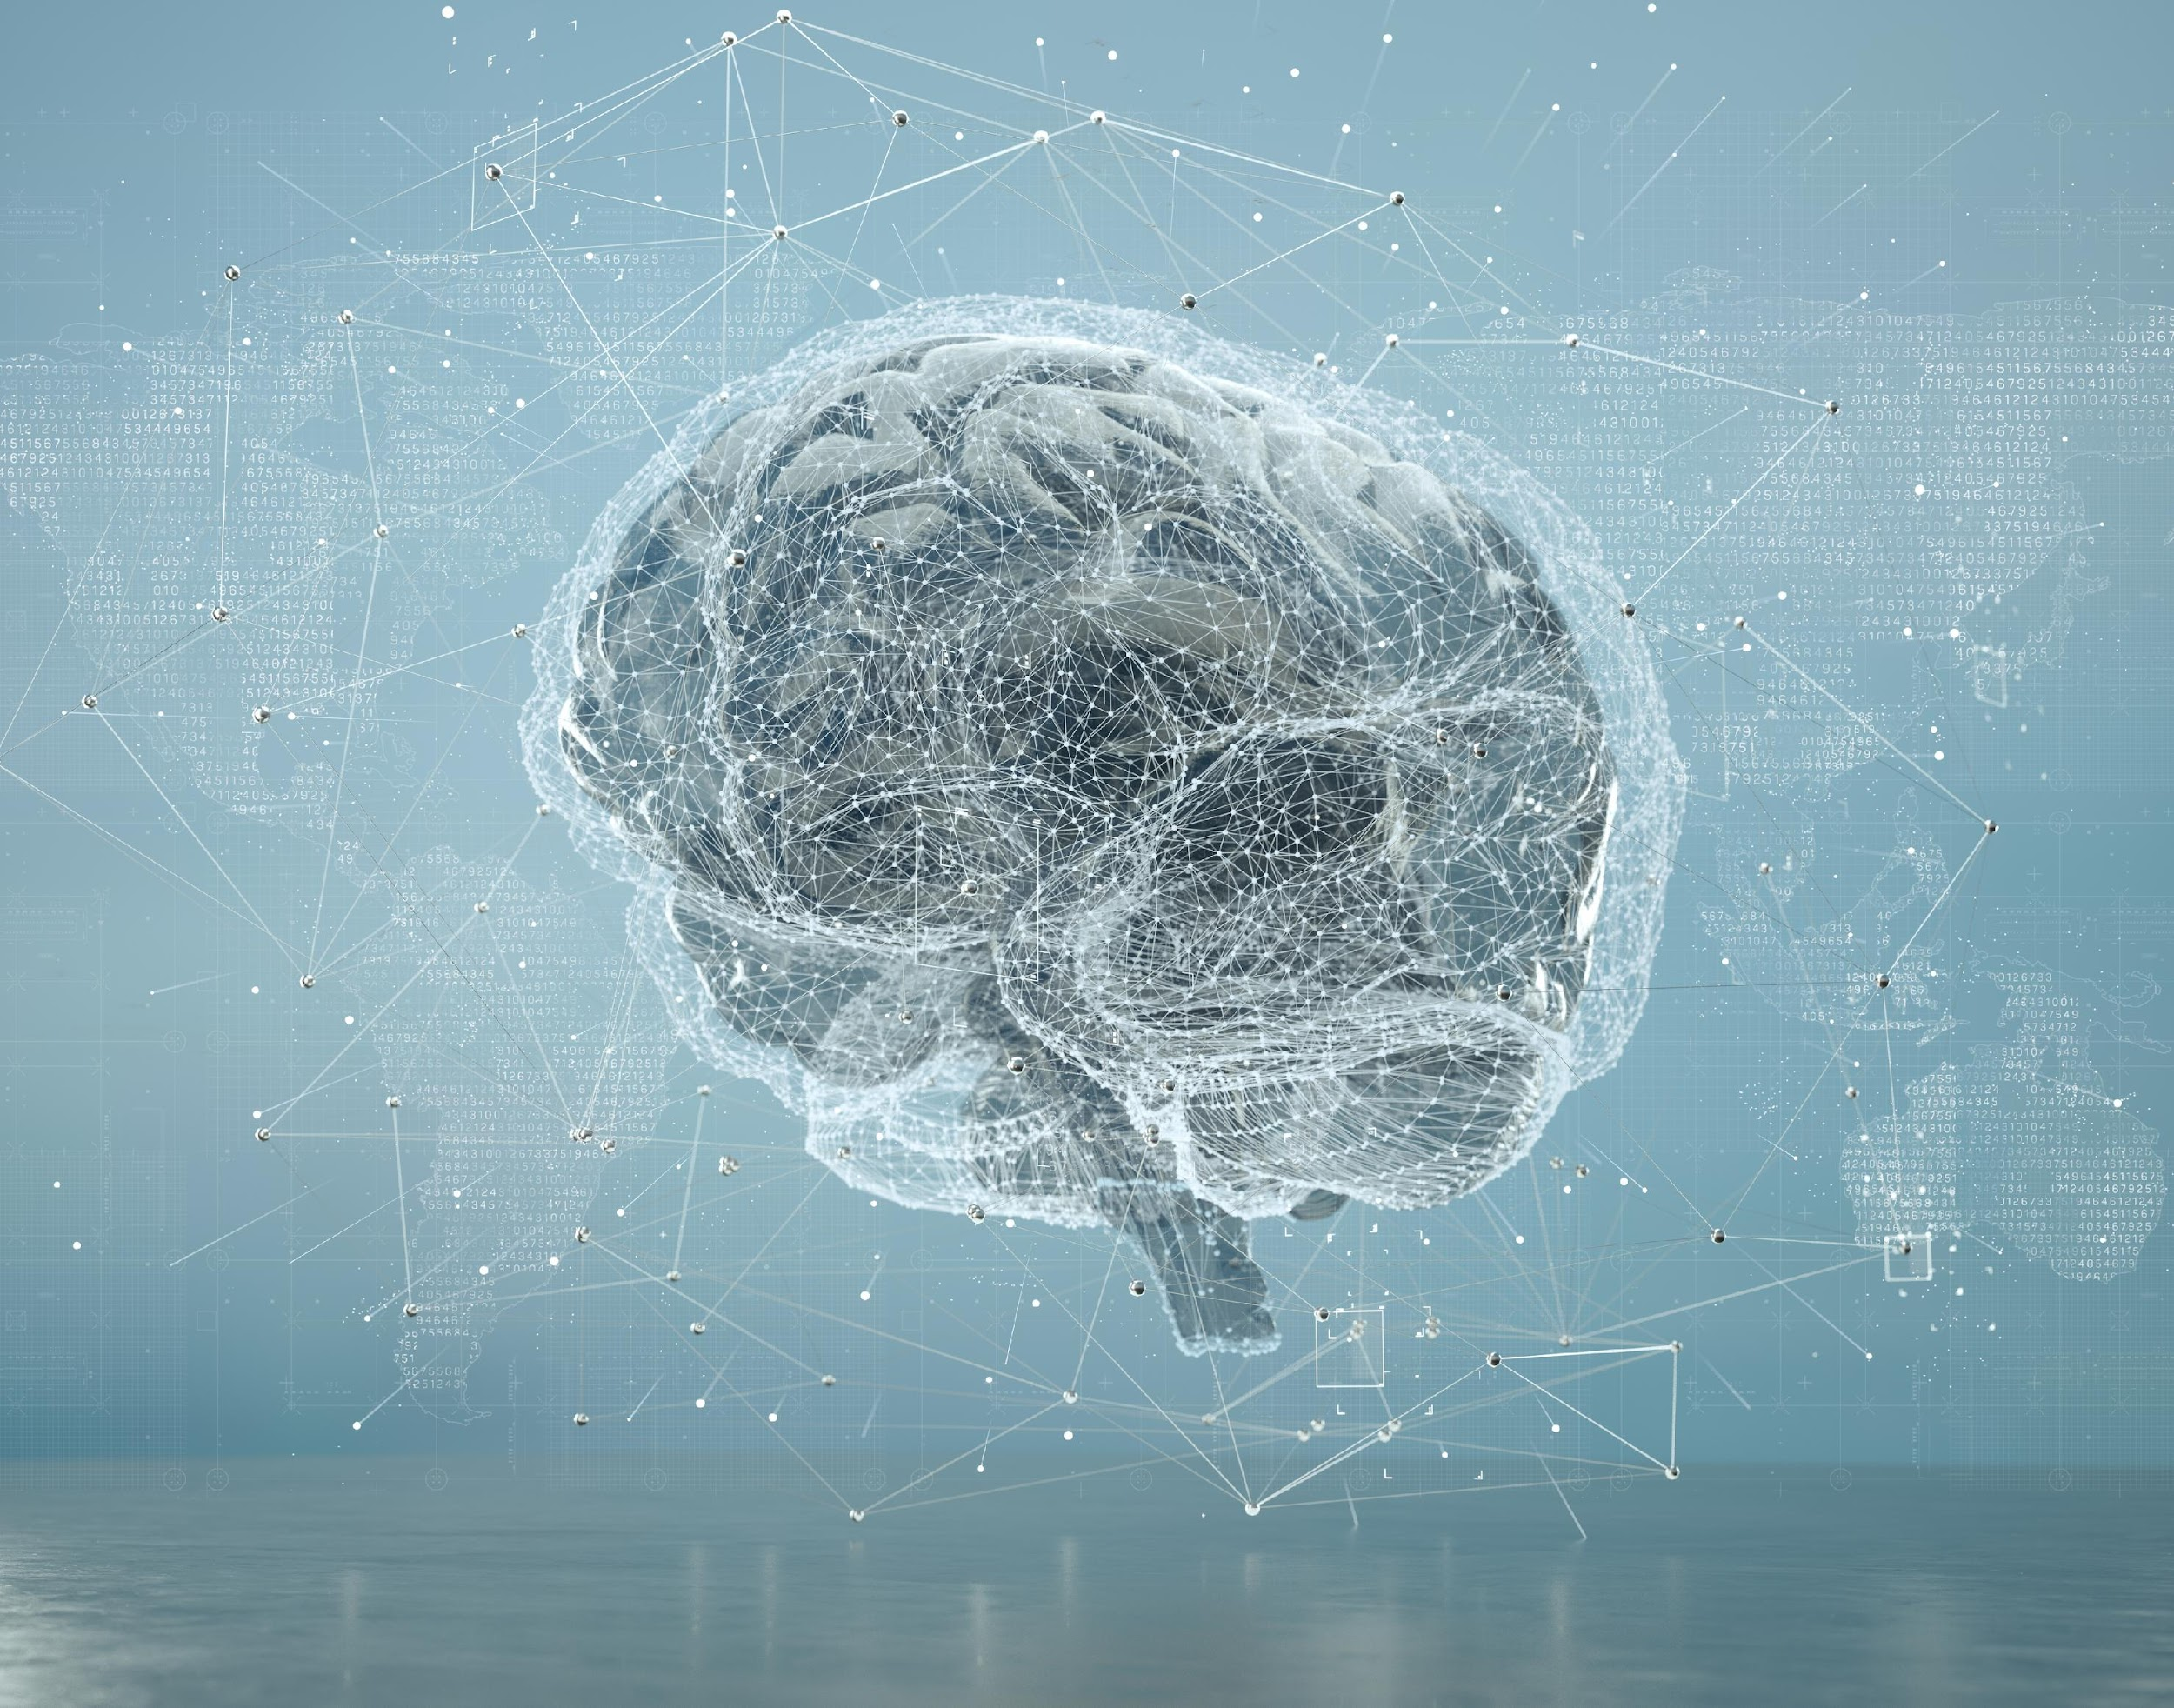
Machine Learning

Slide 13

Objective
The purpose of this analysis is to create a binary classification model using deep learning techniques to determine what factors contributed to winning the Jeopardy Game.
Data Source: kdnuggets.com
Data date range: 2014 - 2019

Slide 14
Feature Variables
Full name
First Name
Last Name
Occupation
City
State
Show number
Date of show
Winner_flg (‘1’ if they won)
Final_score for that game
Gender

Slide 15
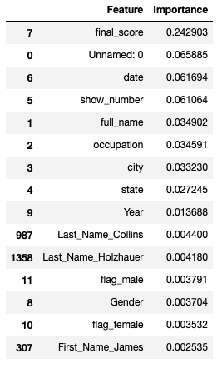
Preprocessing
The data was read and converted to numerical data using get_dummies.
This numerical data was then run through a RandomForestClassifier to find which features were of most importance.
It was found that while final_score was the biggest determinant of whether a contestant was going to win, their gender or where they were from did not play a significant role.

Slide 16
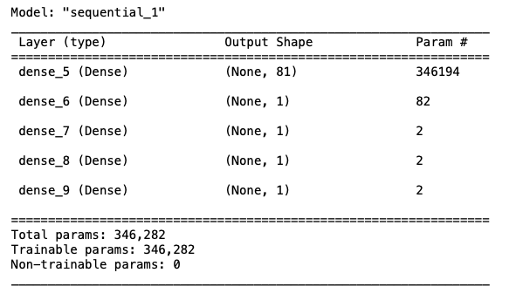
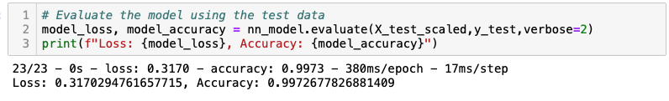
Training the model
The first task was to drop the insignificant features (including Gender) from the data. Next, the data was run through a keras tuner to find the best optimization for training.
Epochs chosen was 100, to produce an accuracy of 99.72% and a loss of 31.7%

Slide 17
Conclusion
According to this small dataset, Jeopardy! is a fair game where the outcome is entirely dependent on the accuracy of the contestant’s answer and has nothing to do with their gender , where they were from or when they participated in the game.

Slide 18
Thank You

Slide 19
Justin

Slide 20
Jeopardy Common Words Introduction
Datasets in Jeopardy take into consideration several classes including: Contestants, Show number, Date of air, score, Questions, Categories, Answers, and much more.
The Questions, Categories, and Answer sets are highly robust, containing a vast amount of information that can be analyzed and interpreted through Natural Language Processing.
Word Frequency
Sentiment Analysis
Term Frequency–Inverse Document Frequency (TF-IDF)

Slide 21
Objective
The task was to build a database for querying relevant data to explore.
Query the dataset to provide relational datasets that can be further analyzed in NLP processes
Utilize new technologies including “Natural Language Toolkit” (NLTK) and TF-IDF.
Program to train a classification model on the language sentiment found in datasets
Program to train a classification model on how important the common words that were found when other features are applied to the machine learning
In the case of this project the independent feature was on highly frequent categories

Slide 22
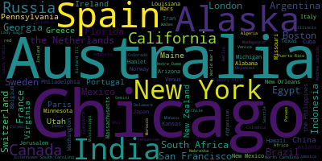
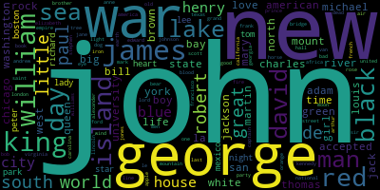
Word Clouds – Most Common Words
Why do we have two different outputs from different modules?
The Word Cloud generated cloud did not go through the same preprocessing such a lemmatization.
The NLTK module, words were tokenized into unigrams, adding more granularity to the word count frequency
Word Cloud from WordCloud Module for Answers
Word Cloud from NLTK Module for Answers

Slide 23
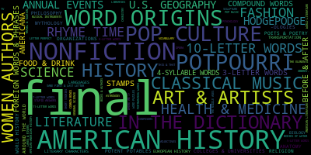
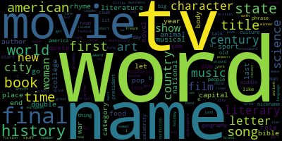
Word Clouds Most Common Words (Cont.)
The Word cloud from the WordCloud Module justifiably better classifies the categories frequency because most of the categories are not single words.
Word Cloud from WordCloud Module for Categories
Word Cloud from NLTK Module for Categories

Slide 24
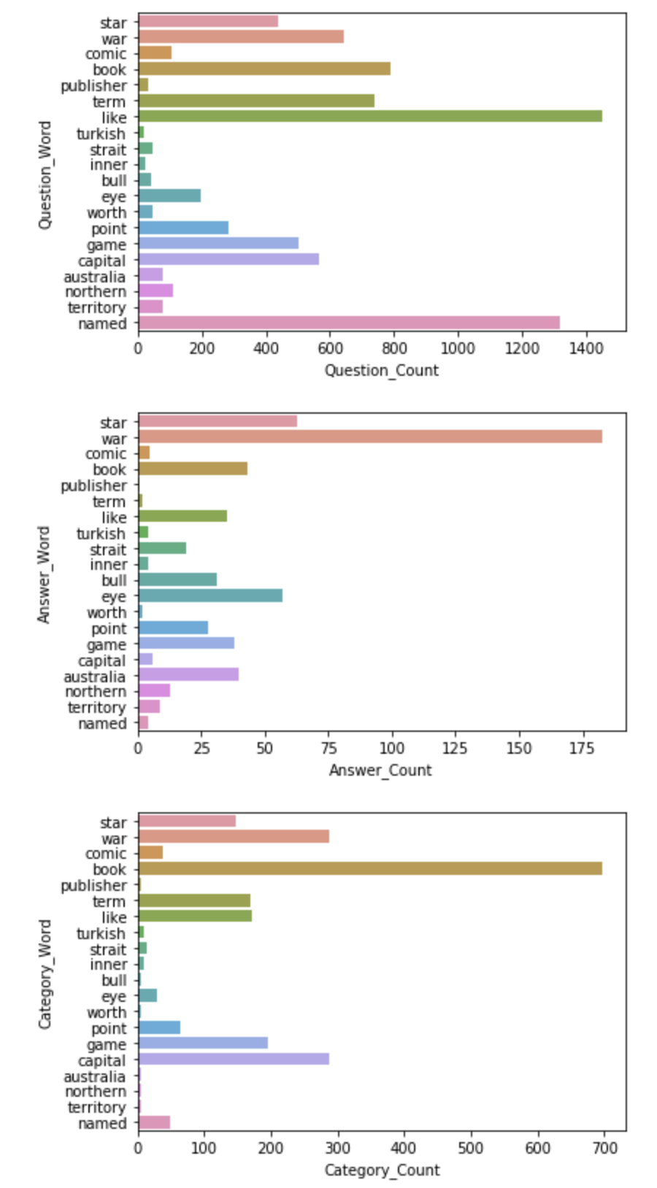
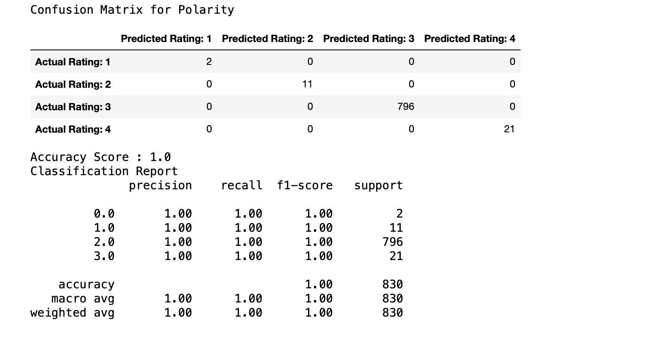
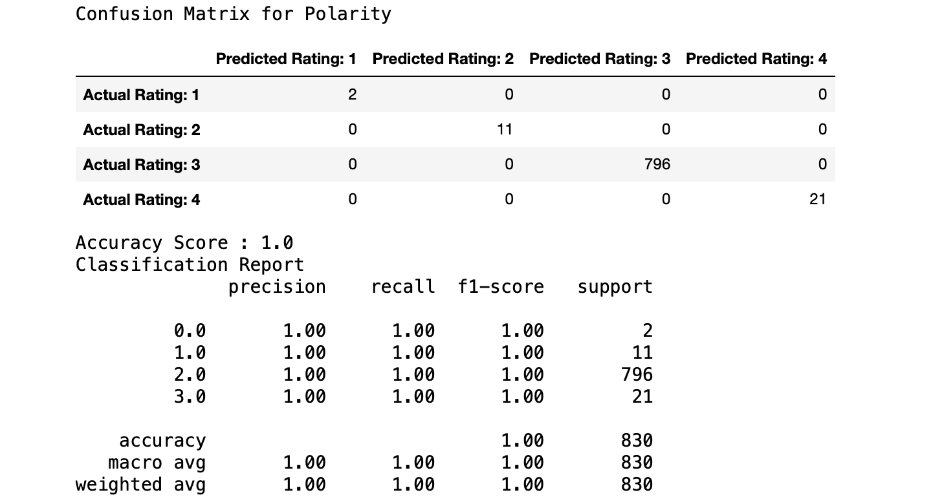
Sentiment Analysis Using a Random Forest Classifier

Slide 25
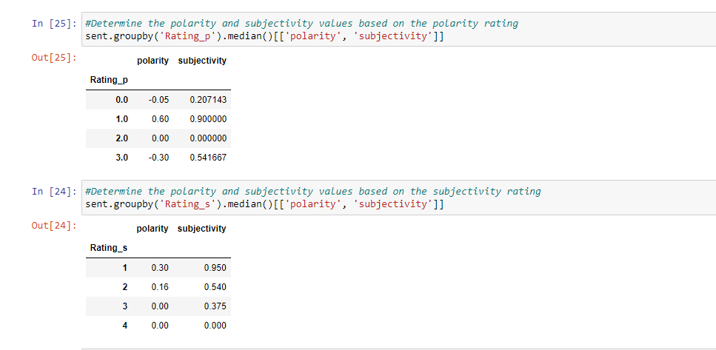
Median Sentiment of polarity and subjectivity
Rating:
1 = High Level
2 = Average Level
3 = Low Level
4 = Very Low Level
*0.0 in Rating_p = 1. This is an inaccuracy due to an issue in the code. Ergo 1,2, & 3 are respective to 2,3, & 4.
Polarity refers to the degree of positivity and negativity measured between a range of -1(negative) and 1(positive).
Subjectivity refers to the degree that a piece of text expresses an opinion or judgement. It is measured between a range of 0 (objective) to 1 (subjective).
Our data indicates that polarity fluctuates in those classified with an average level of sentiment
Our subjectivity regresses and decreases as we move across the classifications

Slide 26
TF-IDF
TF = Term Frequency
TF = # of times the term appears in document / total # of terms in appear in the document
IDF = Inverse Document Frequency
IDF = log( # of documents in the corpus / # of documents in the corpus that contain the term)
This will assign a numeric value to declare the importance of the word (ie. How often amongst all documents the word has been used)
Results from TF-IDF Classification
Unfortunately, the resulting IDF array returned all ‘0’s making it meaningless to run any machine learning models
This is prevalent in the rest of the code, as the classification report produced poor results.

Slide 27
Discussion
The objective was to determine the best features of our dataset to classify the most common words found in our Jeopardy dataset
This was in effort to enlighten our audience to think about ways a contestant would be able to focus their preparation on the show
Word frequencies and the word clouds offer a basis for someone studying to have a fundamental starting point for their study efforts
The TF-IDF values proved to be challenging because the imbalance of our independent data prevented for an accurate score in the classification report
Issues possibly include overfitting the data, and analyzing classification ratings with relatively low counts against classifications with much higher counts
The sentiment analysis was processed and trained with much more accuracy.
This may have been impacted by utilizing a smaller view of the data
The sentiment analysis does not bring much relevant insight to our audience as it is meant to describe the emotional context of the words. Since Jeopardy is a game of facts, a basis of emotion has little bearing for a potential contestant.

Slide 28
Thank You

Slide 29
Elisangela

Slide 30
Jeopardy by occupation
We can see a wide range of occupation represented in our sample of Jeopardy contestants.
Within our range of contestants, there are approximately 1,317 distincts careers held by individual contestants.
But is it possible to predict who will win based on just a contestant's occupation?
This is the challenge question that I would like to answer.

Slide 31
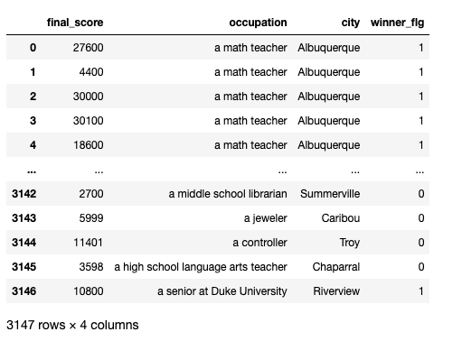
Occupation

Slide 32
Features
Occupation
City
State
Date of show
Winner_flg (‘1’ if they won)
Final_score for that game

Slide 33
Preprocessing
The data was read and converted to numerical data using get_dummies. I have choose to keep all initial features. I also have choose drop the "winner_flg"in X.

Slide 34
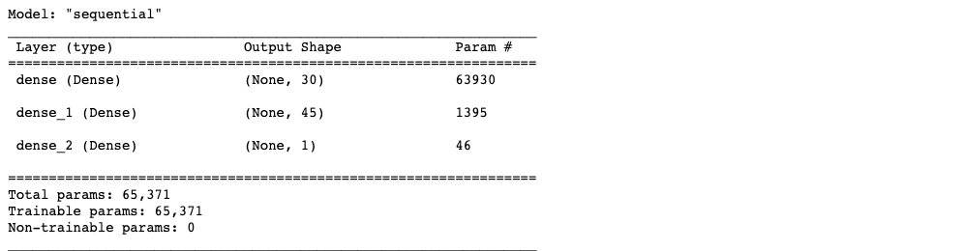
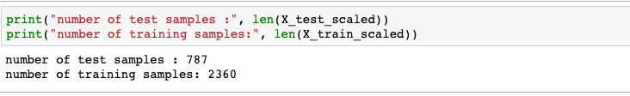
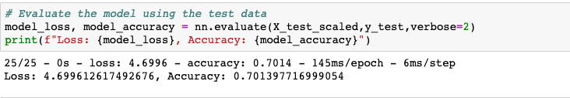
Training the model

Slide 35
Thank You

Slide 36
Kurt

Slide 37
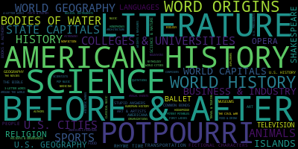
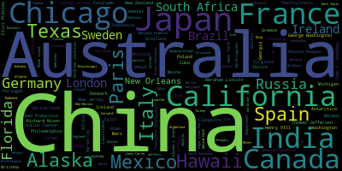
Category Cloud
Answers Cloud

Slide 38
Going to Tableau…

