Slide 1
Flagged vs. Unflagged Trump Tweets
Elisa Bayoumi | PLSC 31101 | Professor Rochelle Terman | December 11th, 2020

Slide 2
Goals
Create dataset of @RealDonaldTrump tweets with whether or not Twitter has flagged them
Three levels of analysis:
Time series
Popularity
Word frequency

Slide 3
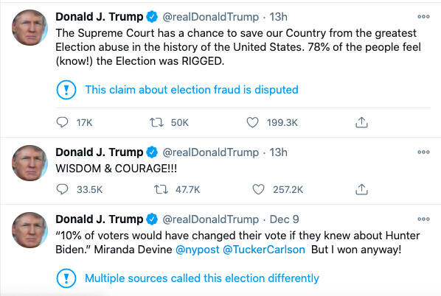
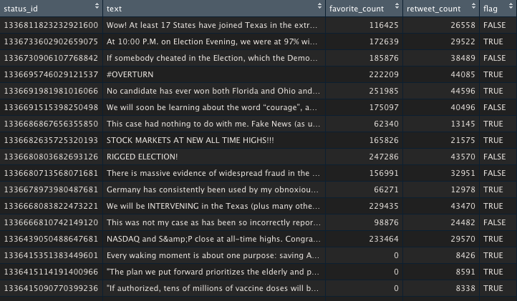
You can also split your content
Dataset Creation
WHITE
Is the color of milk and fresh snow, the color produced by the combination of all the colors of the visible spectrum.

Slide 4
About this template
ggplot Time Series Analysis
round_date()
EDIT IN GOOGLE SLIDES
Click on the button under the presentation preview that says "Use as Google Slides Theme".
You will get a copy of this document on your Google Drive and will be able to edit, add or delete slides.
You have to be signed in to your Google account.

Slide 5
Favorites
Favorites
Retweets
Retweets
Retweets and Favorites of Flagged vs. Unflagged Tweets Over Time

Slide 6
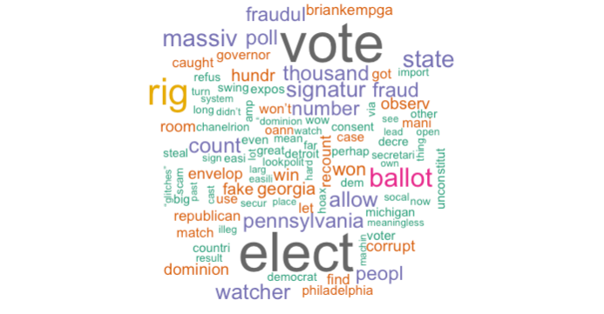
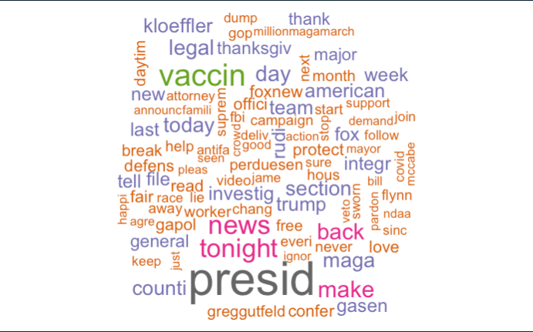
Most Frequent Words in Flagged Tweets from @RealDonaldTrump
Most Frequent Words in Unflagged Tweets from @RealDonaldTrump

Slide 7
About this template
Going Beyond
Continued Questions
How to add labels to geom_smooth in ggplot (geom_text, direct_labels, and ggrepel didn’t work)
How to autosave work in Rstudio and save yourself some trouble!
How to read .RHistory
Future Work
Adding flag scraping tool to RTweet
Fix RTweet’s bug with @RealDonaldTrump
Adapting sentiment dictionary to @RealDonaldTrump
Isolating tagged accounts for frequency analysis
Thank you to everyone who helped and reached out yesterday! And thank you to…
@RealDonaldTrump, RTweet, SlidesCarnival, Piazza, GitHub, and a very patient and understanding class

