Slide 1
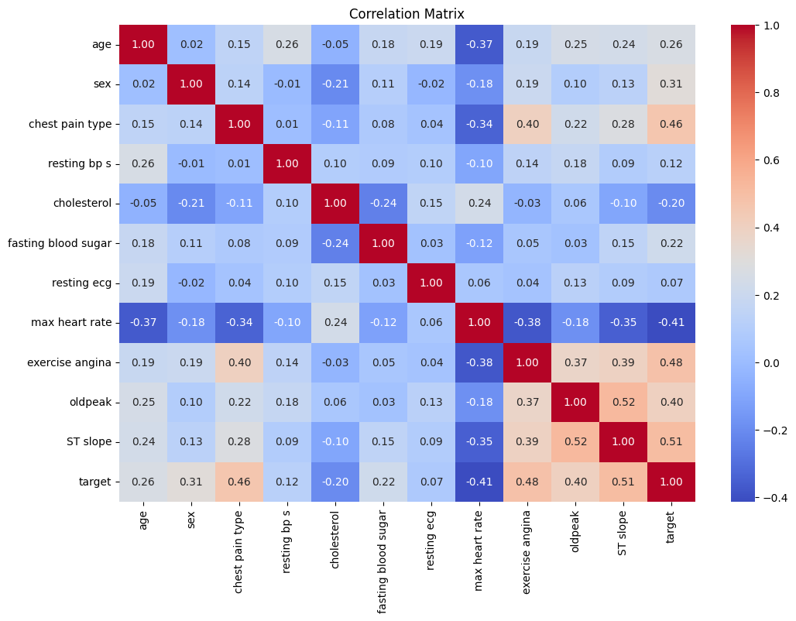
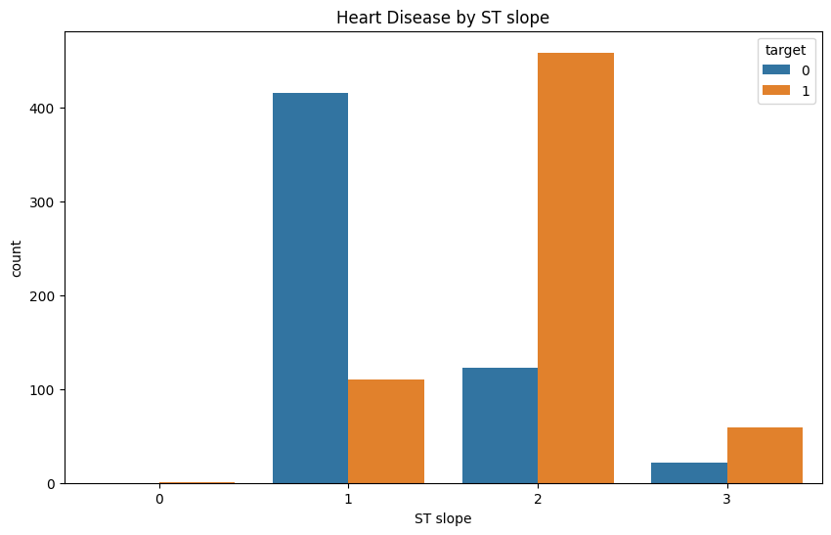
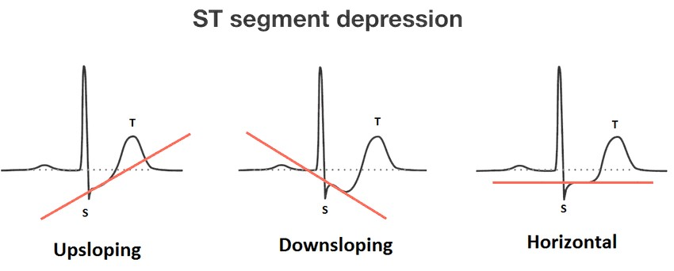
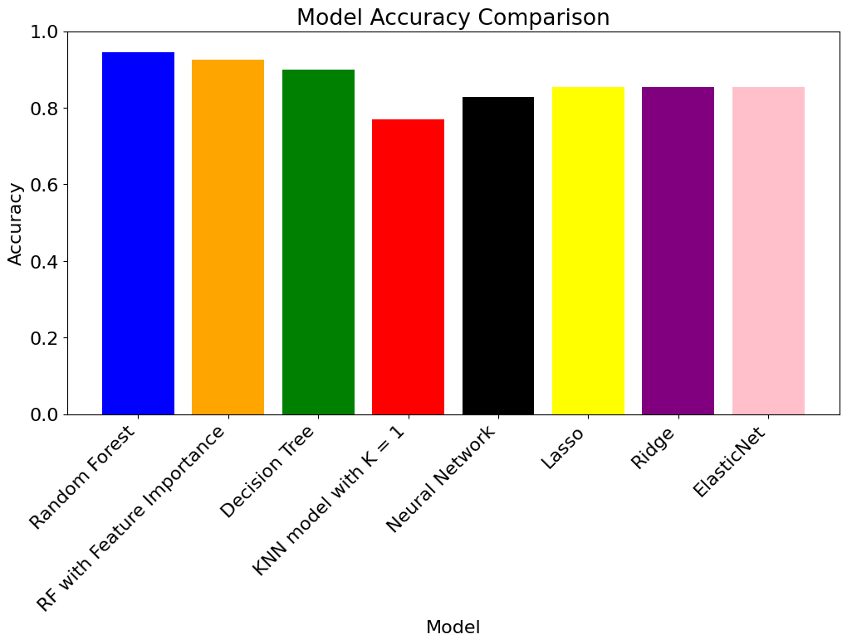
Johanna Kasenurm
Elisabet Hein
HEART DISEASE PREDICTION
BACKGROUND
DATA
GOALS
CORRELATIONS
MOST IMPORTANT FEATURES
RESULTS

