Slide 1
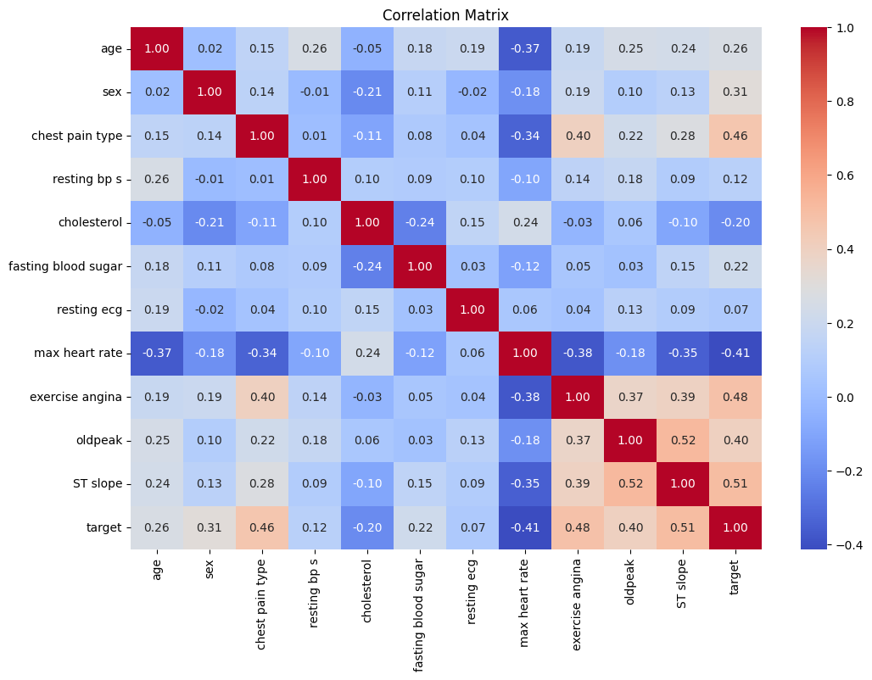
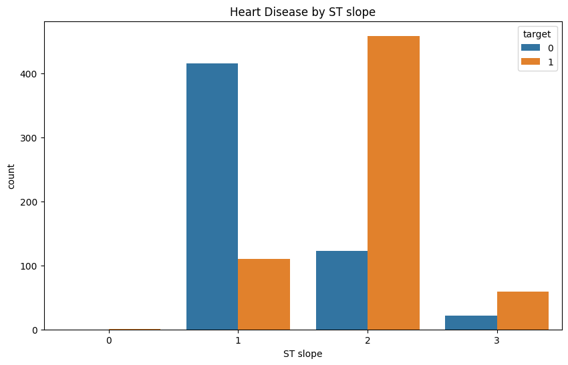
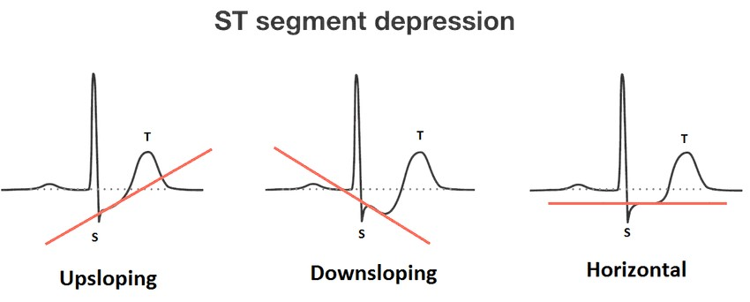
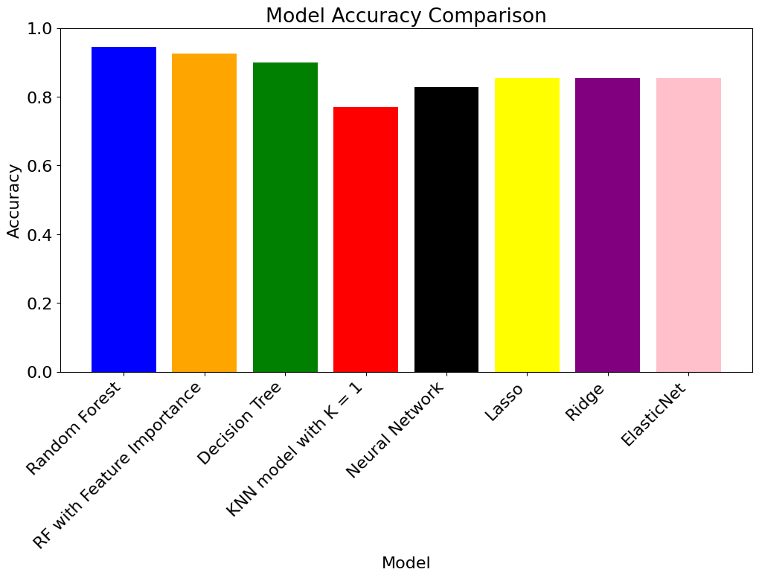
Johanna Kasenurm
Elisabet Hein
HEART DISEASE PREDICTION
BACKGROUND
DATA
Heart diseases, also known as cardiovascular diseases (CVDs) are causing the most deaths around the world. It is argued that CVDs are among the deadliest diseases in both developed and developing countries. CVDs take an estimated 17.9 million lives each year which is about 32% of all deaths globally. However, the chance of survival is higher if the diagnosis is made early enough. Therefore machine learning has become one of the most important tools in solving this problem by helping to predict which people are at risk of heart diseases.
Explore diverse machine learning techniques
Random forest
Decision tree
K Nearest Neighbors
Neural Network
Optimizing all those models
GOALS
Look deeper into features and see which factors influence or boost the development of the diseases the most.
Write a programm to predict the presence of heart disease based on user input
CORRELATIONS
MOST IMPORTANT FEATURES
RESULTS

