Slide 1


Adventure Works report
View in Power BI
Last data refresh:
6/22/2023 3:02:40 PM UTC
Downloaded at:
6/22/2023 3:08:44 PM UTC

Slide 2
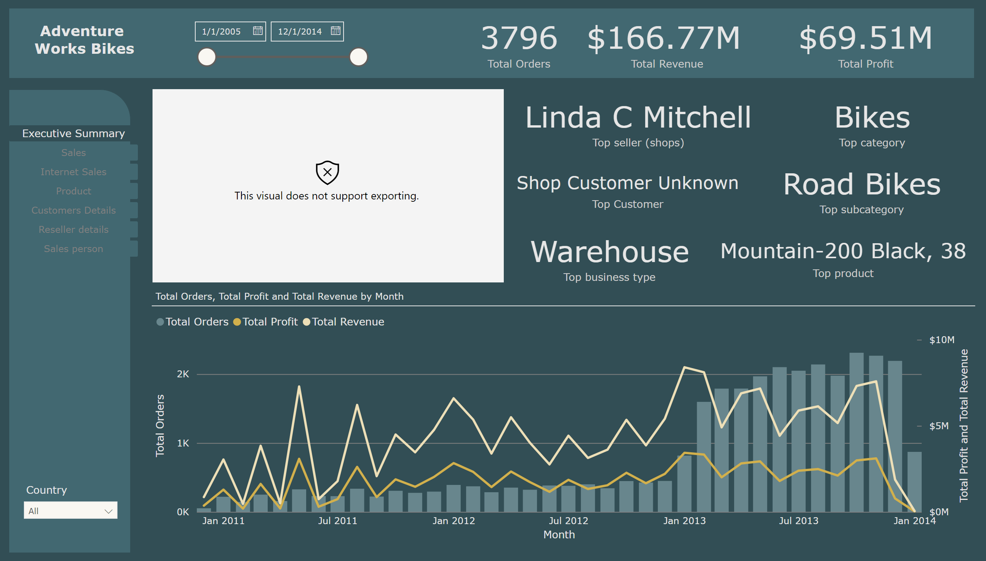
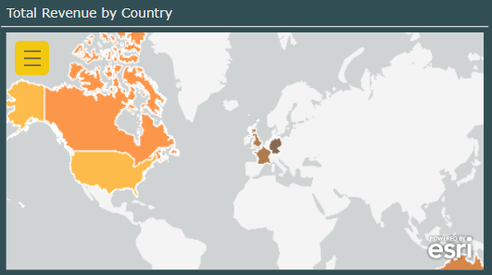
Executive Summary
Notes:
slicer
No alt text provided
pageNavigator
No alt text provided
textbox
No alt text provided
slicer
No alt text provided
shape
No alt text provided
shape
No alt text provided
lineStackedColumnComboChart
No alt text provided
Total revenue (Top costumer)
No alt text provided
Total revenue (Top costumer)
No alt text provided
Total orders
No alt text provided
card
No alt text provided
card
No alt text provided
card
No alt text provided
card
No alt text provided
card
No alt text provided
Top customer (Total revenue)
No alt text provided
esriVisual
No alt text provided

Slide 3
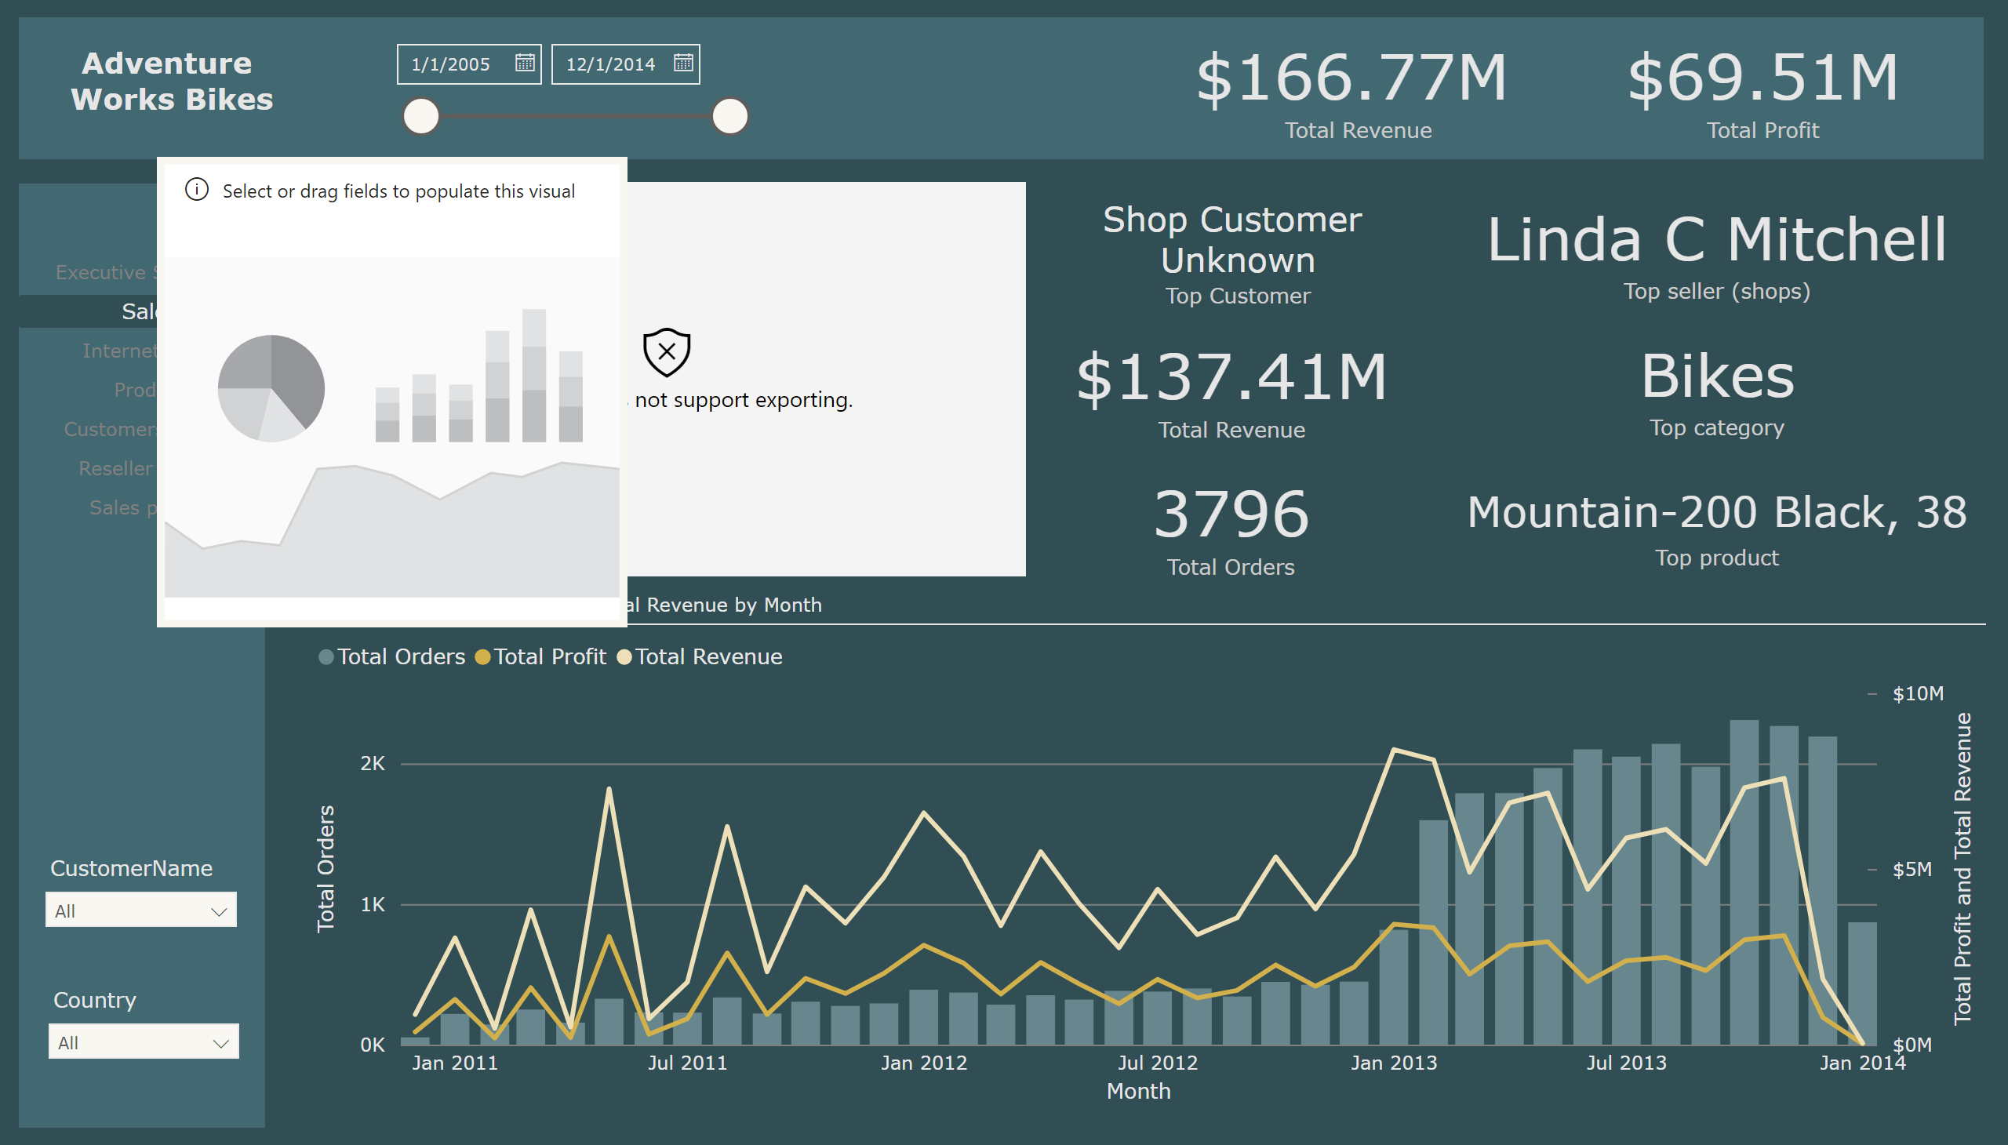
Sales
Notes:
textbox
No alt text provided
pageNavigator
No alt text provided
textbox
No alt text provided
slicer
No alt text provided
slicer
No alt text provided
shape
No alt text provided
shape
No alt text provided
lineStackedColumnComboChart
No alt text provided
Total revenue (Top costumer)
No alt text provided
Total revenue (Top costumer)
No alt text provided
card
No alt text provided
card
No alt text provided
card
No alt text provided
Top customer (Total revenue)
No alt text provided
Total revenue (Top costumer)
No alt text provided
Total orders
No alt text provided
esriVisual
No alt text provided
slicer
No alt text provided
esriVisual
No alt text provided

Slide 4
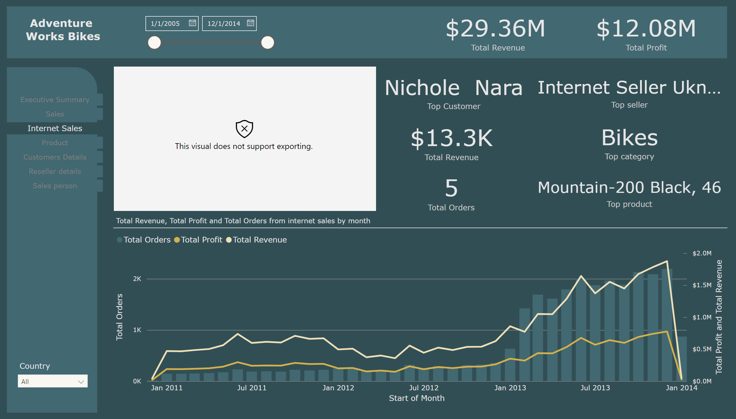
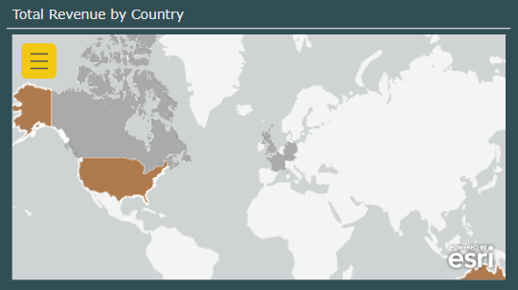
Internet Sales
Notes:
Top customer (Total revenue)
No alt text provided
Total revenue (Top costumer)
No alt text provided
Total Revenue, Total Profit and Total Orders from internet sales by month
No alt text provided
Total orders
No alt text provided
pageNavigator
No alt text provided
shape
No alt text provided
textbox
No alt text provided
slicer
No alt text provided
shape
No alt text provided
slicer
No alt text provided
Total revenue (Top costumer)
No alt text provided
Total revenue (Top costumer)
No alt text provided
card
No alt text provided
card
No alt text provided
card
No alt text provided
esriVisual
No alt text provided

Slide 5
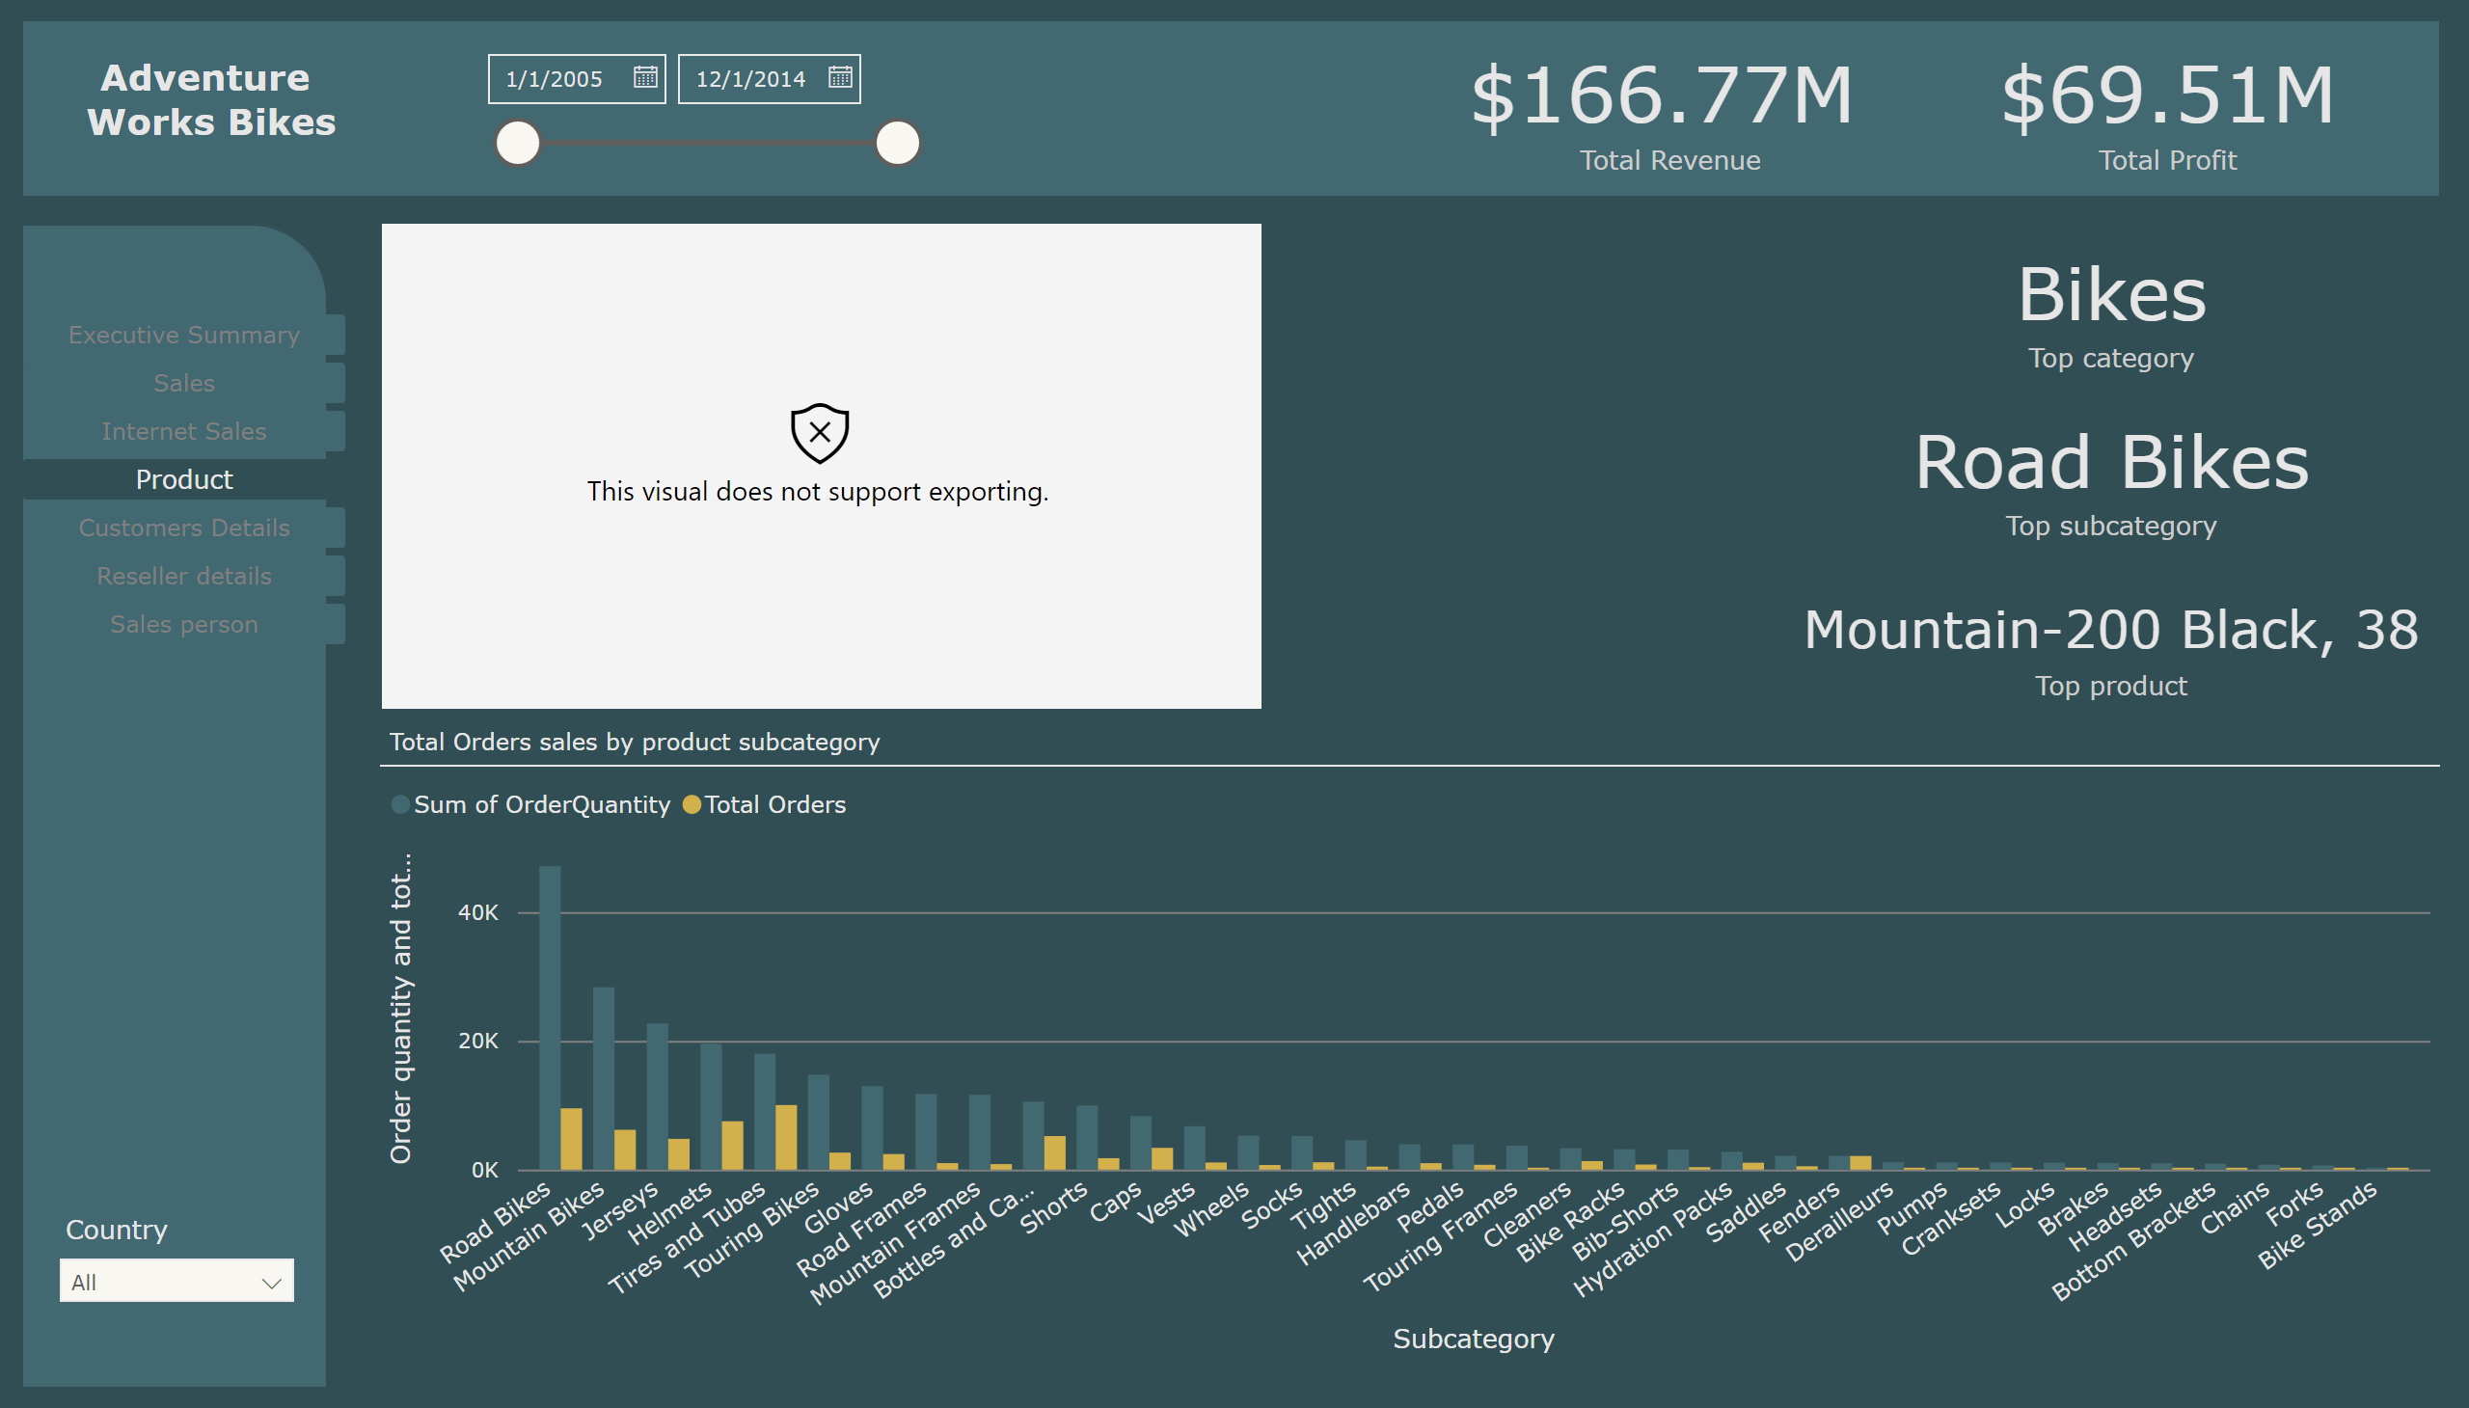
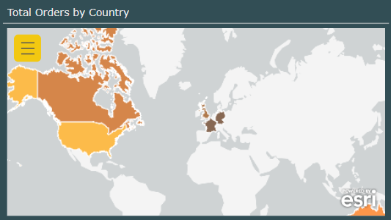
Product
Notes:
pageNavigator
No alt text provided
textbox
No alt text provided
slicer
No alt text provided
slicer
No alt text provided
shape
No alt text provided
shape
No alt text provided
Total Orders sales by product subcategory
No alt text provided
Total revenue (Top costumer)
No alt text provided
Total revenue (Top costumer)
No alt text provided
card
No alt text provided
card
No alt text provided
card
No alt text provided
esriVisual
No alt text provided

Slide 6
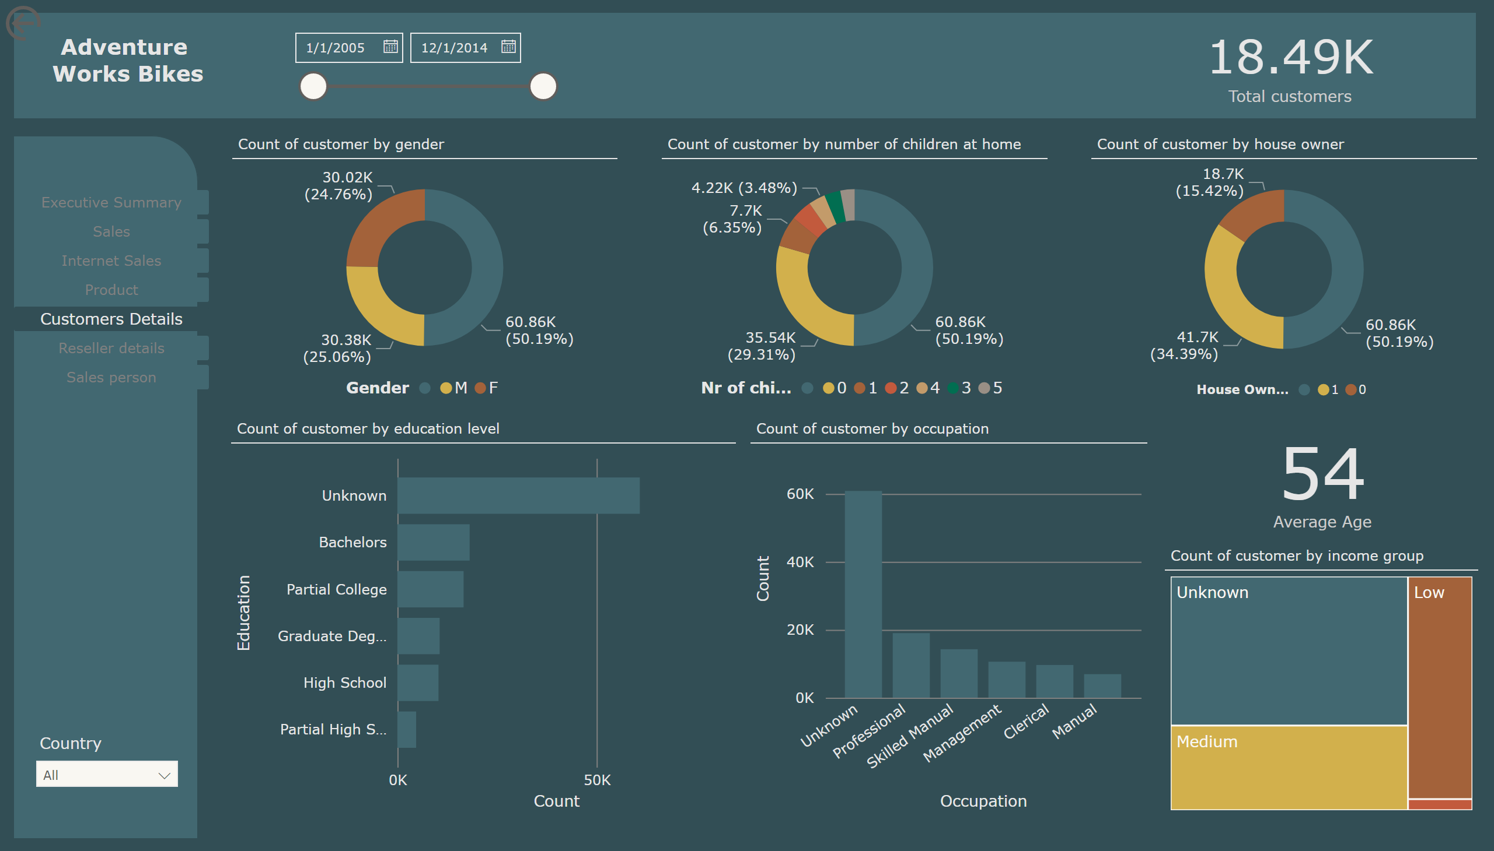
Customers Details
Notes:
Count of customer by gender
No alt text provided
Count of customer by education level
No alt text provided
Count of customer by occupation
No alt text provided
Count of customer by customer age
No alt text provided
Count of customer by income group
No alt text provided
Count of customer by number of children at home
No alt text provided
Count of customer by house owner
No alt text provided
actionButton
No alt text provided
pageNavigator
No alt text provided
slicer
No alt text provided
slicer
No alt text provided
textbox
No alt text provided
shape
No alt text provided
shape
No alt text provided
card
No alt text provided

Slide 7
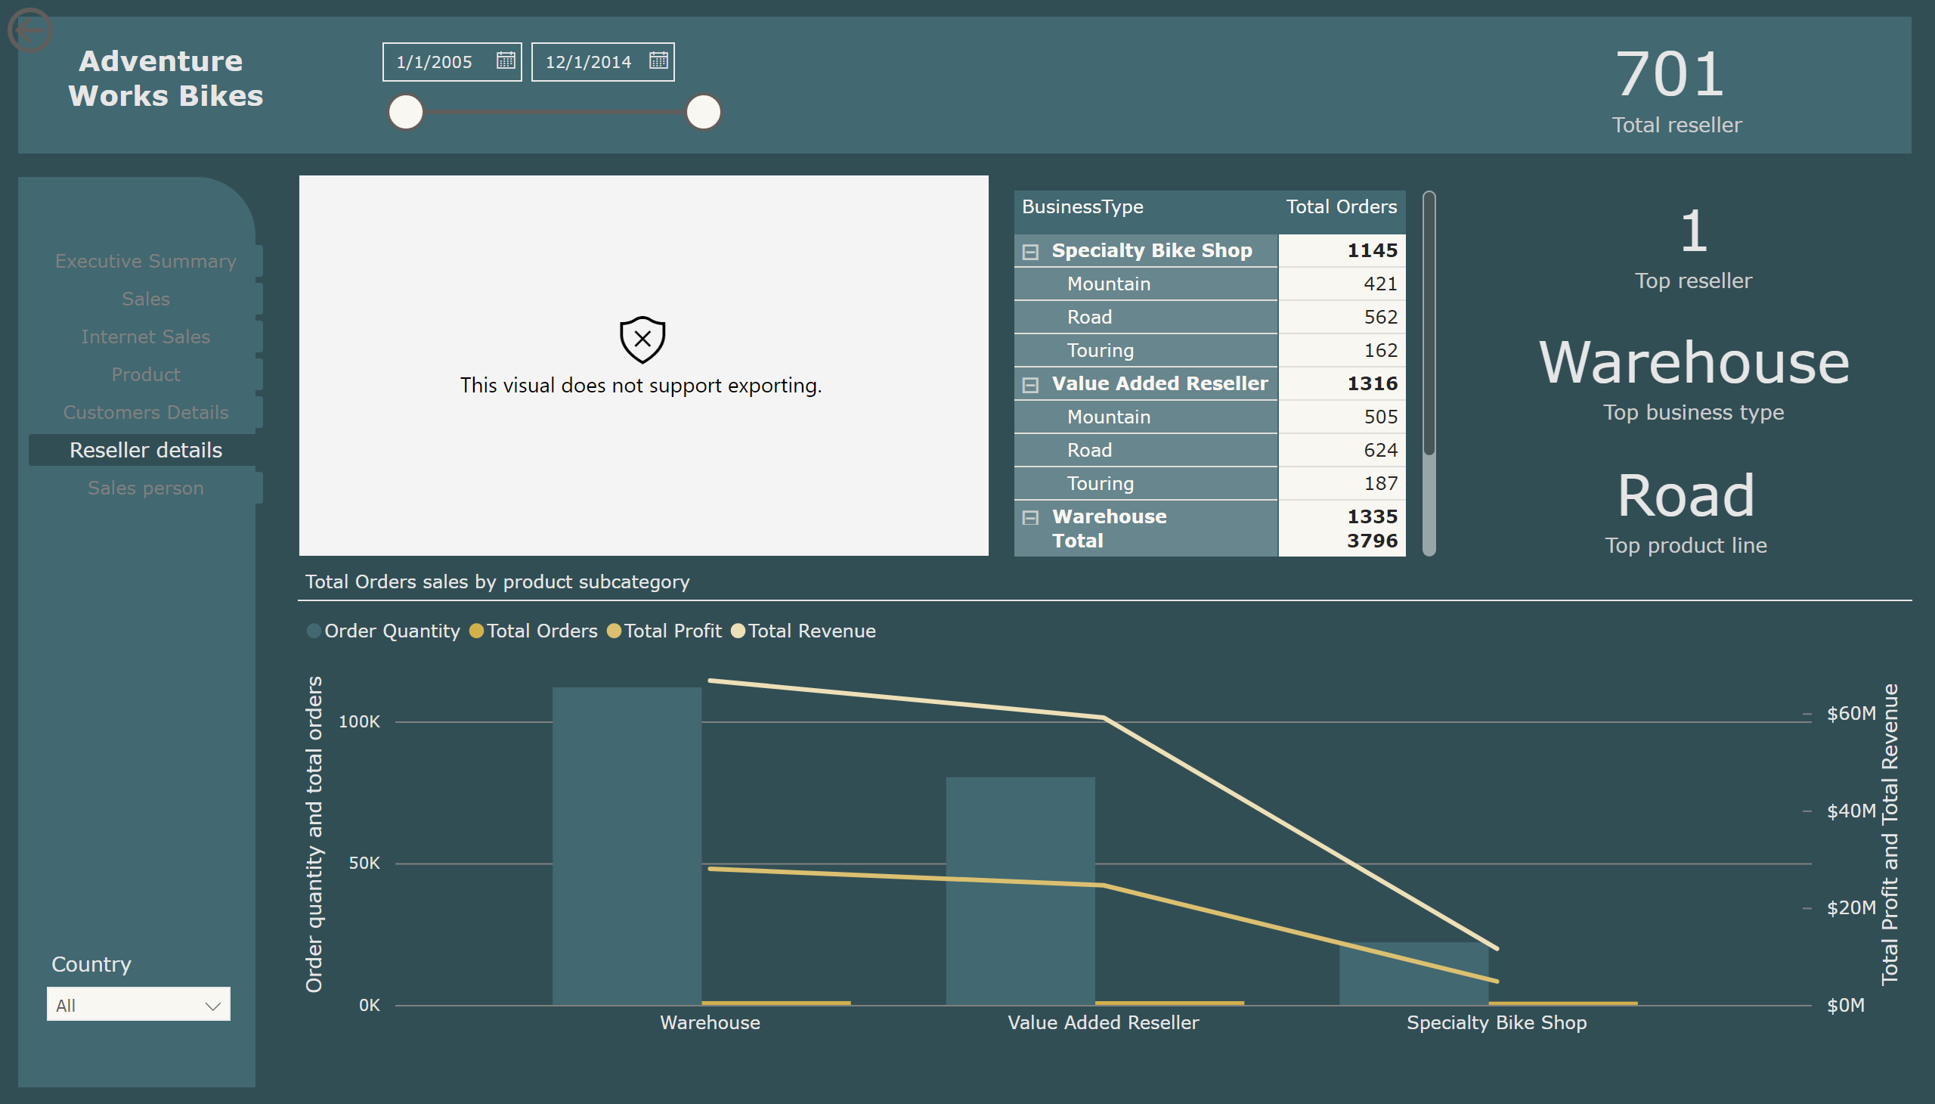
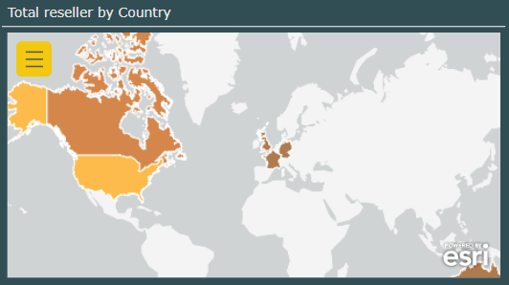
Reseller details
Notes:
pageNavigator
No alt text provided
slicer
No alt text provided
textbox
No alt text provided
slicer
No alt text provided
shape
No alt text provided
shape
No alt text provided
Total Orders sales by product subcategory
No alt text provided
esriVisual
No alt text provided
card
No alt text provided
card
No alt text provided
actionButton
No alt text provided
card
No alt text provided
card
No alt text provided
pivotTable
No alt text provided

Slide 8
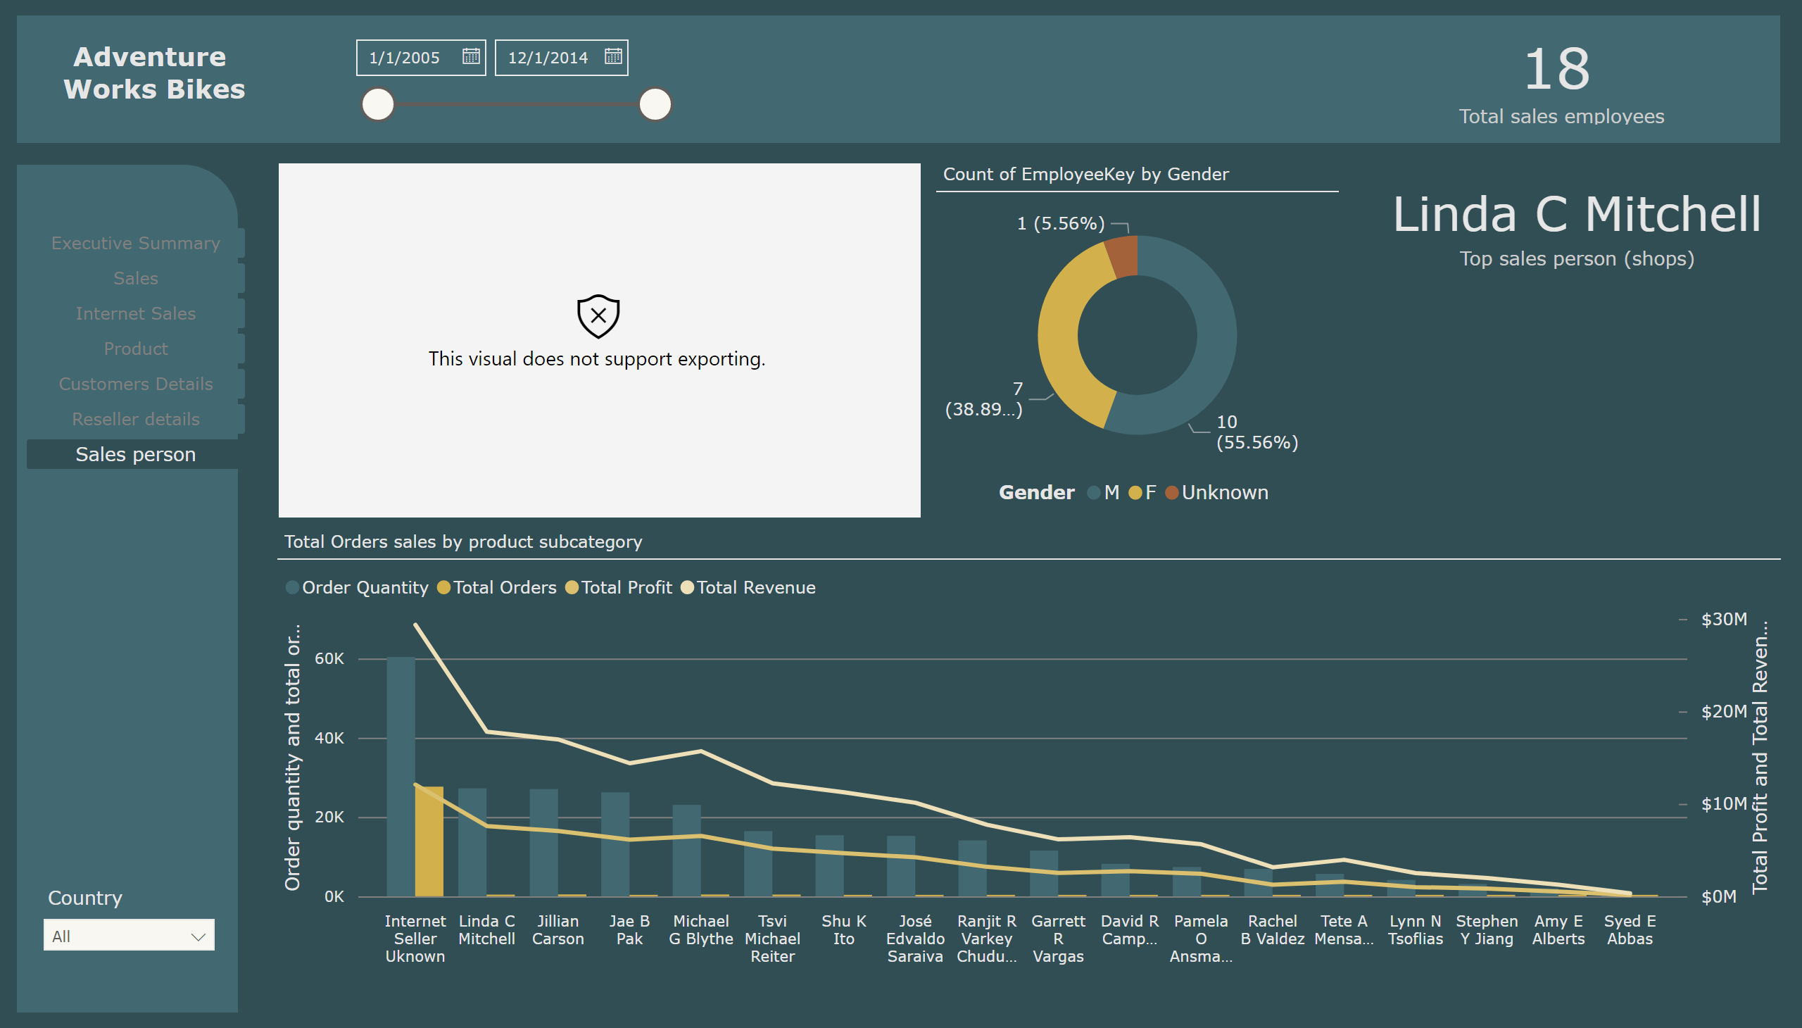
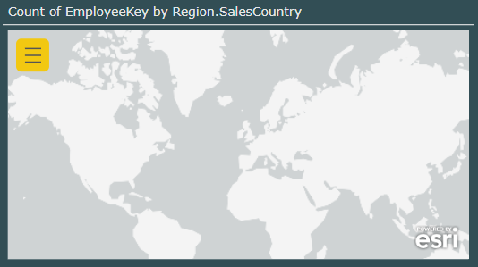
Sales person
Notes:
pageNavigator
No alt text provided
textbox
No alt text provided
slicer
No alt text provided
slicer
No alt text provided
shape
No alt text provided
shape
No alt text provided
Total Orders sales by product subcategory
No alt text provided
card
No alt text provided
esriVisual
No alt text provided
donutChart
No alt text provided
card
No alt text provided

