Slide 1
Optimization for the Home Healthcare Routing and Scheduling Problem
«A matheuristic for the home healthcare routing and scheduling problem with ferry-dependent travel times»

Slide 2
Problem
Routing and scheduling a team of caregivers
Minimize the sum of the route durations across all caregivers

Slide 3
Primary aspects
Geographical area
Caregivers
Patients
Several regions, each one
Set of patients
At least one ferry terminal
Regions are connected by public ferries having fixed timetables

Slide 4
Primary aspects
Geographical area
Caregivers
Patients
Several regions, each one
Set of patients
At least one ferry terminal
Regions are connected by public ferries having fixed timetables
Sequence of visits and ferry trips
Qualification
Time priority

Slide 5
Primary aspects
Geographical area
Caregivers
Patients
Several regions, each one
Set of patients
At least one ferry terminal
Regions are connected by public ferries having fixed timetables
Sequence of visits and ferry trips
Qualification
Time priority

Slide 6
Primary aspects
Geographical area
Caregivers
Patients
Sequence of visits and ferry trips
Qualification
Time priority
Number of visits, each one
Number of caregivers
Service duration
Occurring in a time window
Qualification requirements

Slide 7
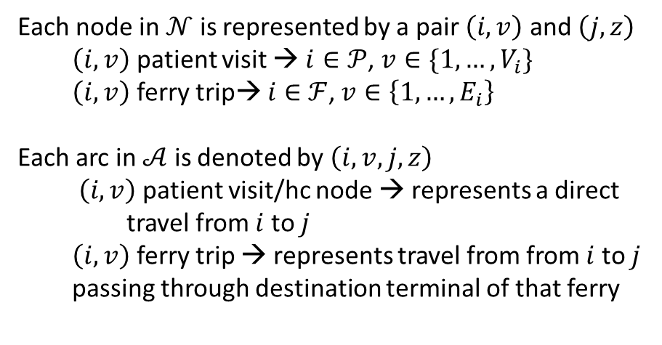
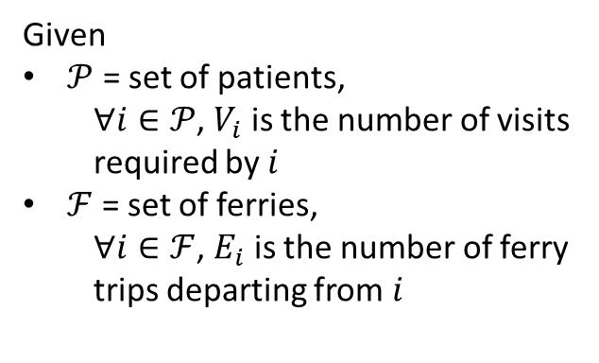
Mathematical formulation
Geographical area
Caregivers
Patients
Problem structured as a $𝒢=\left(𝒩, 𝒜\right)$, directed, connected and incomplete
Given
$𝒫$ = set of patients,
$∀i∈𝒫$, $V_{i}$ is the number of visits required by $i$
$ℱ$ = set of ferries,
$∀i∈ℱ$, $E_{i}$ is the number of ferry trips departing from $i$
Each node in $𝒩$ is represented by a pair $\left(i,v\right)$ and $\left(j,z\right)$
$\left(i,v\right)$ patient visit → $i∈𝒫$, $v∈\{1, …,V_{i}\}$
$\left(i,v\right)$ ferry trip→ $i∈$ $ℱ$, $v∈\left\{1, …,E_{i}\right\}$
Each arc in $𝒜$ is denoted by $\left(i,v, j, z\right)$
$\left(i,v\right)$ patient visit/hc node → represents a direct travel from $i$ to $j$
$\left(i,v\right)$ ferry trip → represents travel from from $i$ to $j$ passing through destination terminal of that ferry
Number of visits, each one
Number of caregivers
Service duration
Occurring in a time window
Qualification requirements

Slide 8
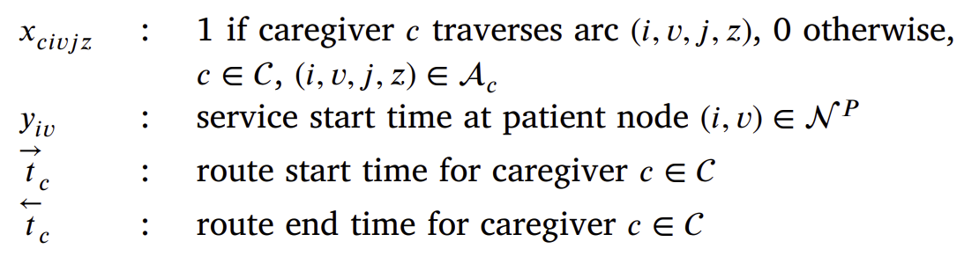
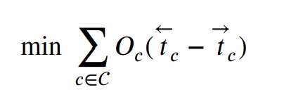
Mathematical formulation
Decision variables
Objective function

Slide 9
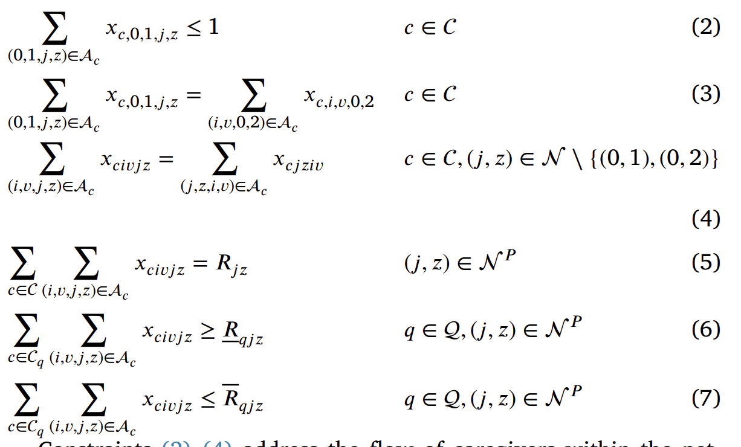
Mathematical formulation
Routing constraints

Slide 10
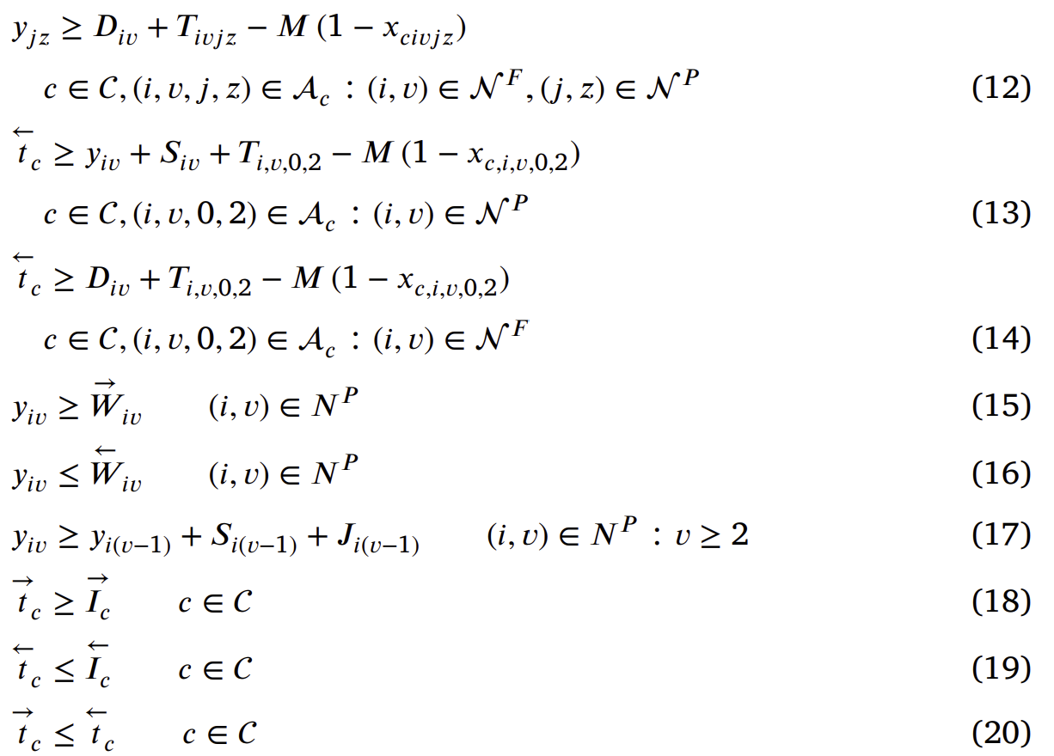
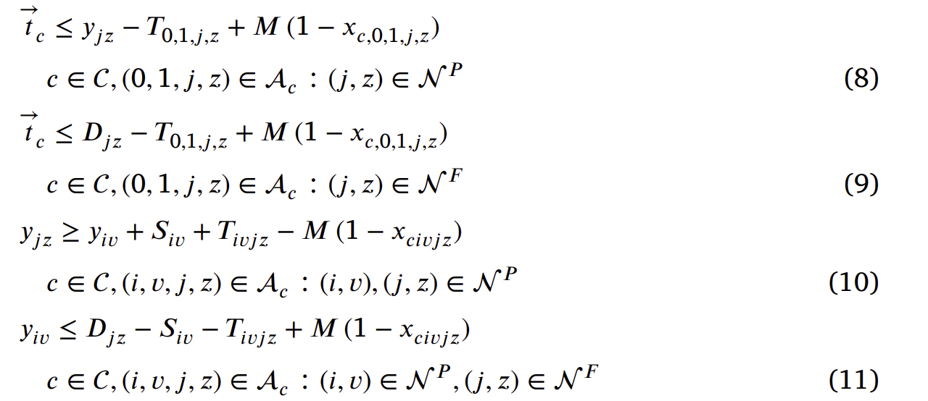
Mathematical formulation
Scheduling constraints

Slide 11
Two-phase solution method
Based on Weighted Proximity Search
Proximity Search (PS): matheuristic designed to improve a known feasible solution to a mixed-integer programming problem; iteratively:
Cut-off constraint addedd → exlude solutions not outperforming
Objective function replaced with a Hamming distance function → # differing 0-1 variables between candidate and incumbent
Minimize that function → search toward solutions in the vicinity of the incumbent

Slide 12
Two-phase solution method
Based on Weighted Proximity Search
Weighted Proximity Search (WPS): replaces the standard Hamming distance function with a weighted version; differentiated penalization:
Lower weights → variables more promising to change
Higher weights → variables expected to remain fixed

Slide 13
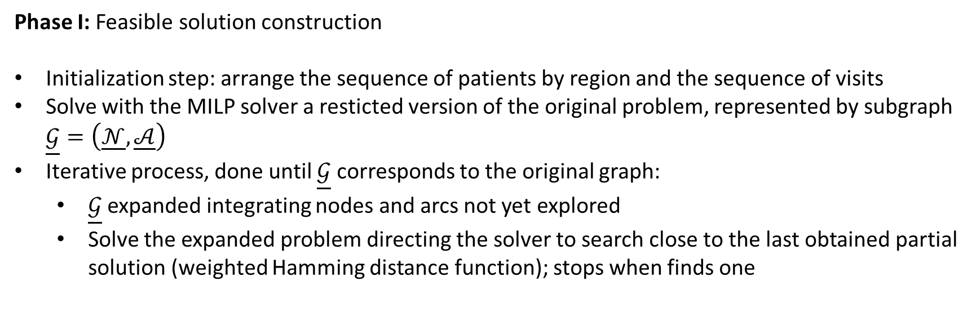
Two-phase solution method
Phase I: Feasible solution construction
Initialization step: arrange the sequence of patients by region and the sequence of visits
Solve with the MILP solver a resticted version of the original problem, represented by subgraph $\underline{𝒢}=\left(\underline{𝒩}, \underline{𝒜}\right)$
Iterative process, done until $\underline{𝒢}$ corresponds to the original graph:
  $\underline{𝒢}$ expanded integrating nodes and arcs not yet explored
  Solve the expanded problem directing the solver to search close to the last obtained partial solution (weighted Hamming distance function); stops when finds one

Slide 14
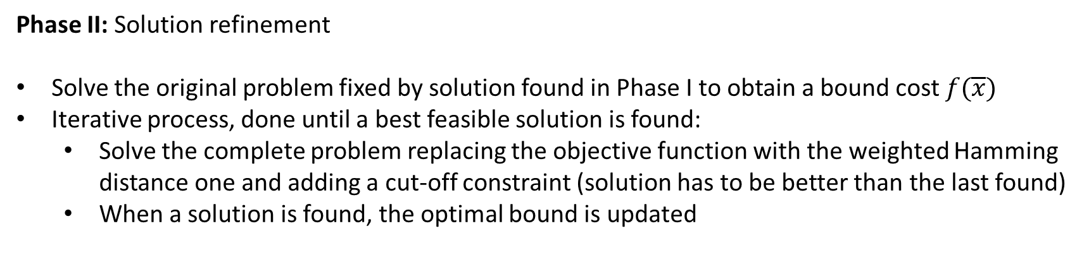
Two-phase solution method
Phase II: Solution refinement
Solve the original problem fixed by solution found in Phase I to obtain a bound cost $f(\overline{x})$
Iterative process, done until a best feasible solution is found:
  Solve the complete problem replacing the objective function with the weighted Hamming distance one and adding a cut-off constraint (solution has to be better than the last found)
  When a solution is found, the optimal bound is updated

Slide 15
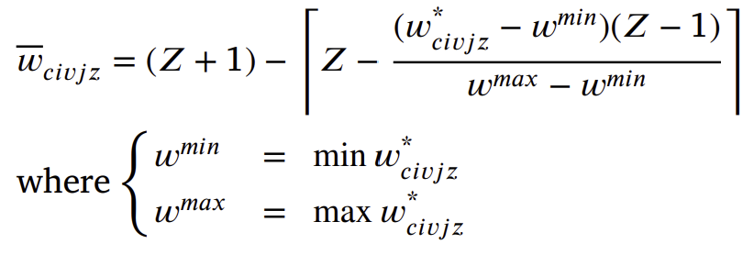
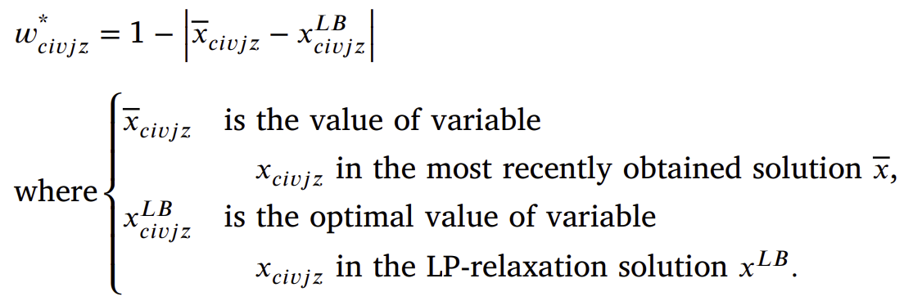
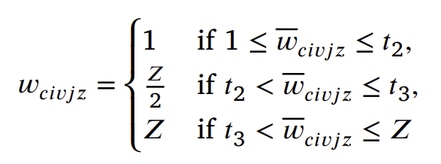
Two-phase solution method
Weight calculations
Combination of linear relaxation proximity and a three-value discretization system
and finally:

