Slide 1
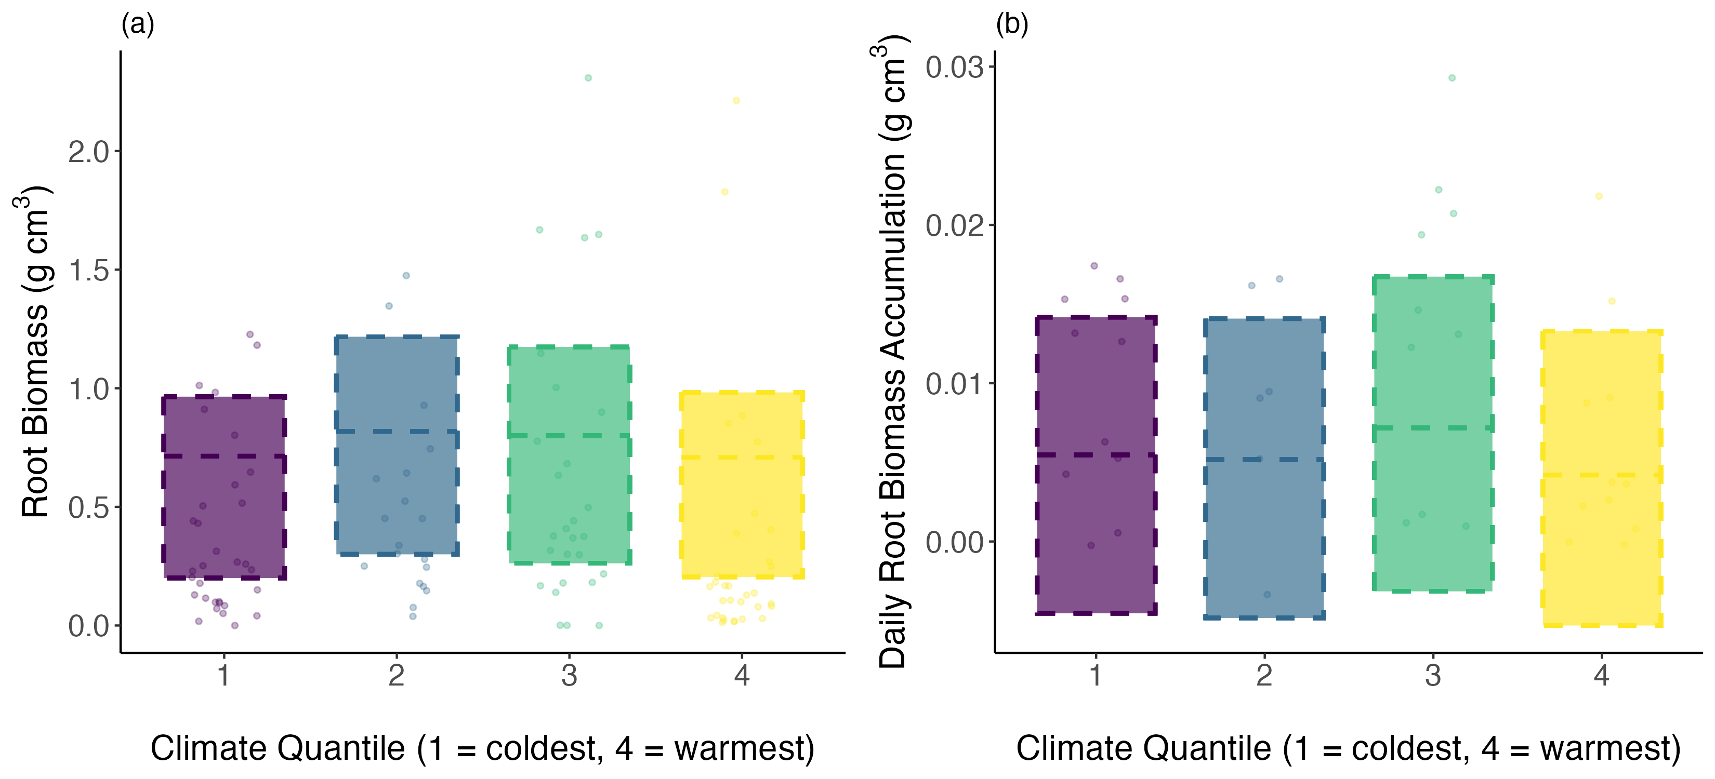
Diff: -0.00
(-0.12 – 0.12)
Diff: -0.00
(-0.01 – 0.00)
Diff: 0.09
(-0.04 – 0.21)
Diff: 0.00
(-0.00 – 0.01)
Diff: 0.11
(-0.01 – 0.22)
Diff: -0.00
(-0.01 – 0.00)

