Slide 1
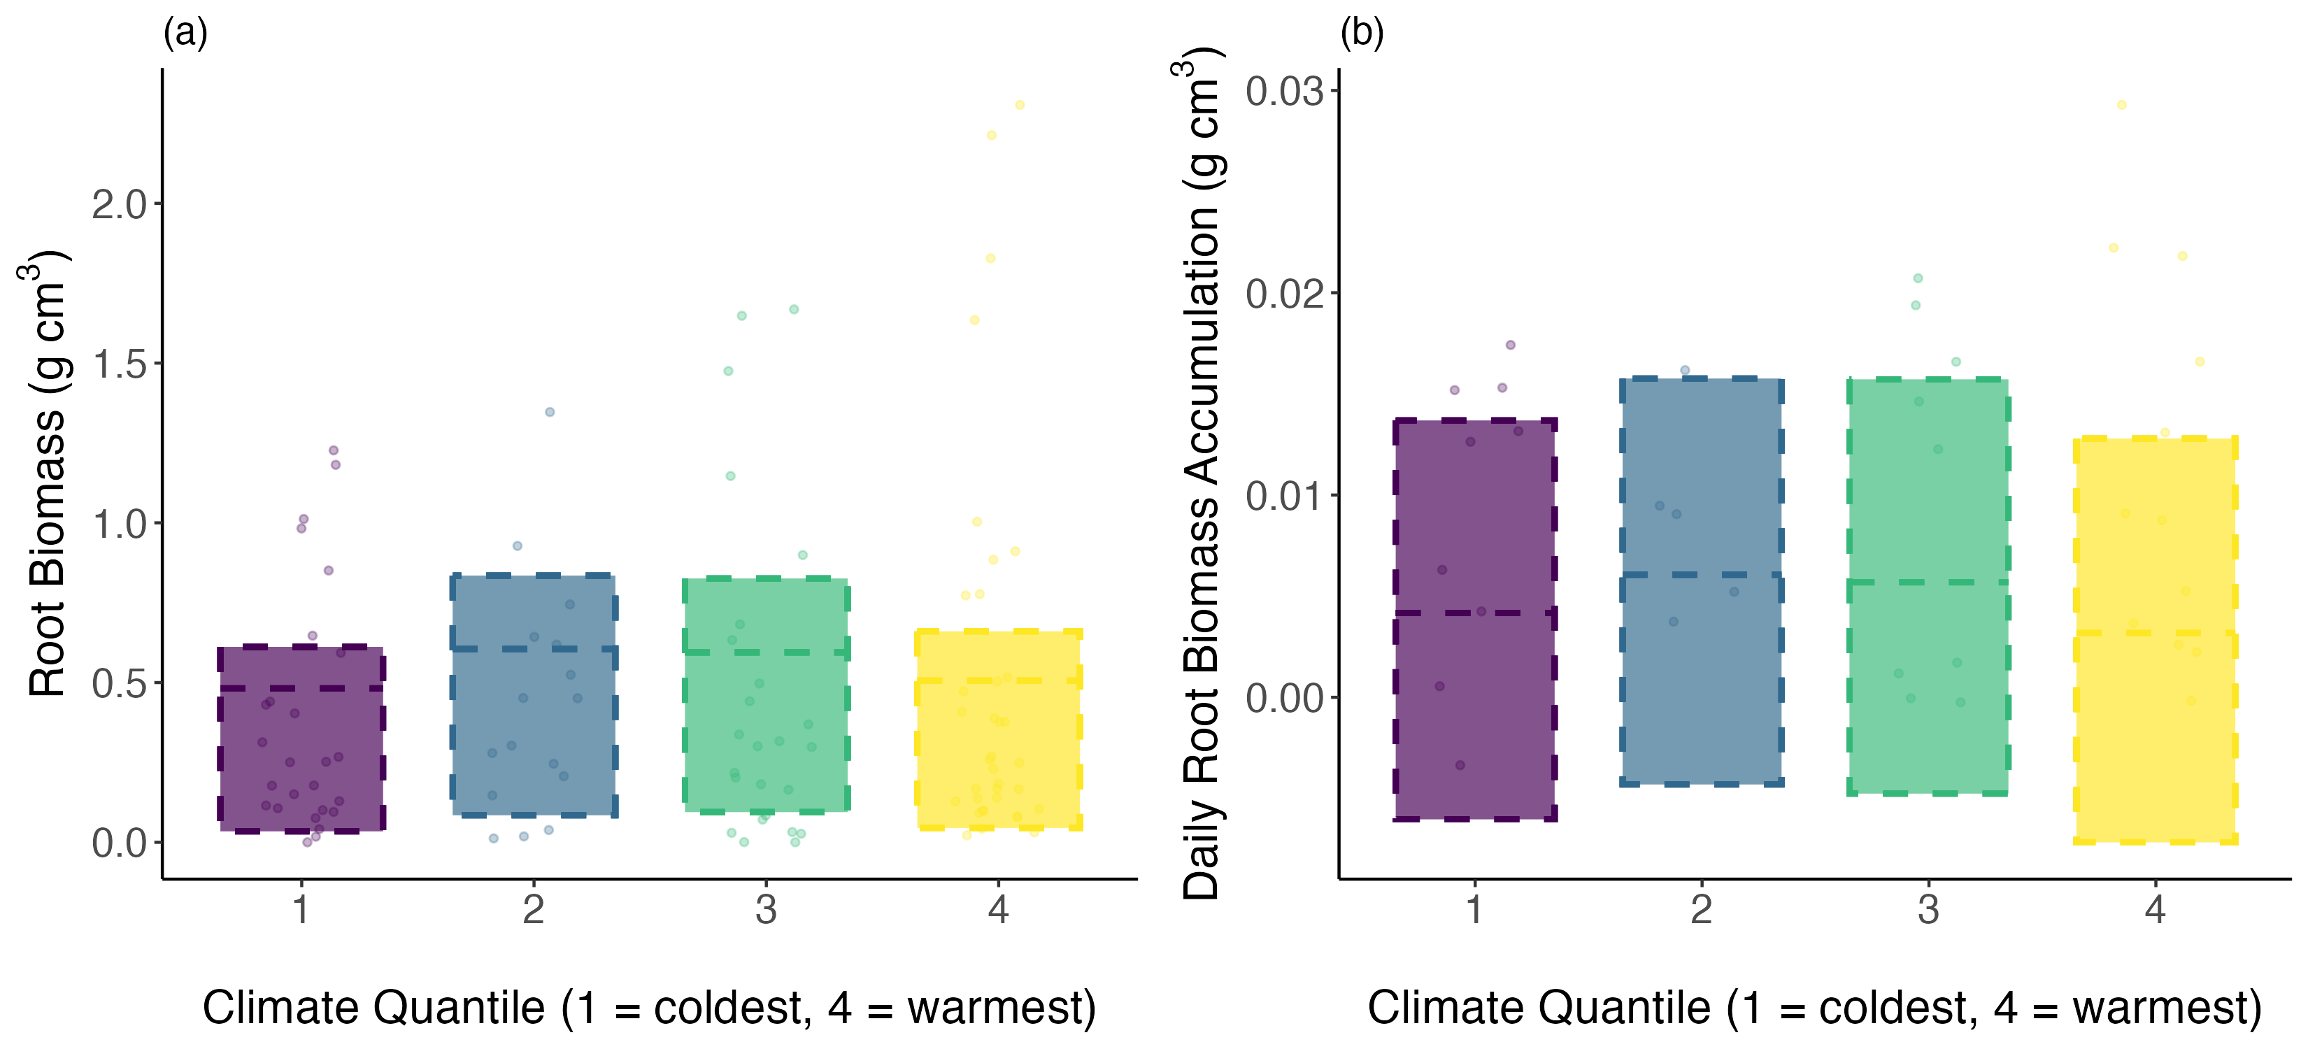
a)
b)
Diff: -0.02
(-0.08 to 0.13)
Diff: -0.00
(-0.01 to 0.00)
Diff: 0.11
(-0.02 to 0.25)
Diff: 0.00
(-0.00 to 0.01)
Diff: 0.13
(-0.03 to 0.27)
Diff: -0.00
(-0.00 to 0.01)

