Slide 1
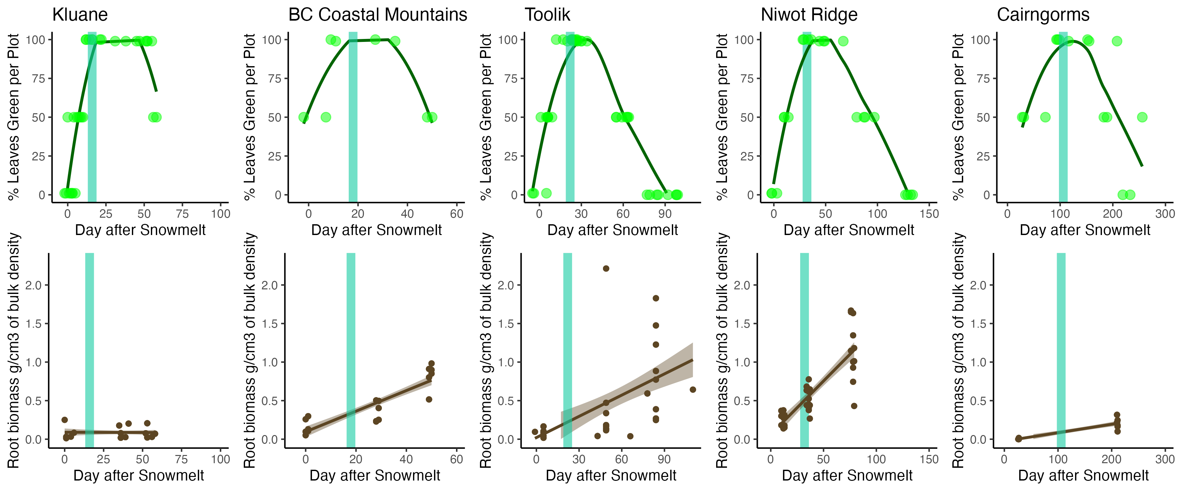

Slide 2
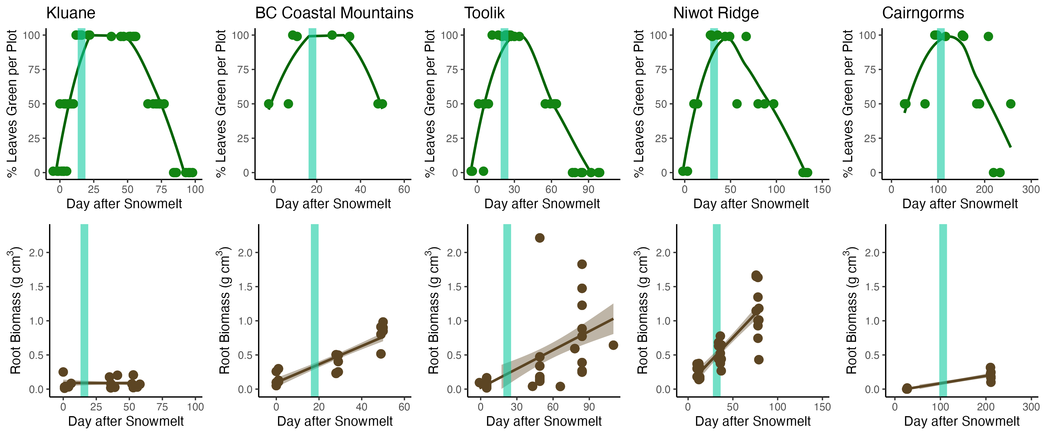
32
62
47
101
x = Number of days of observed root growth after the date of peak aboveground growth

Slide 3
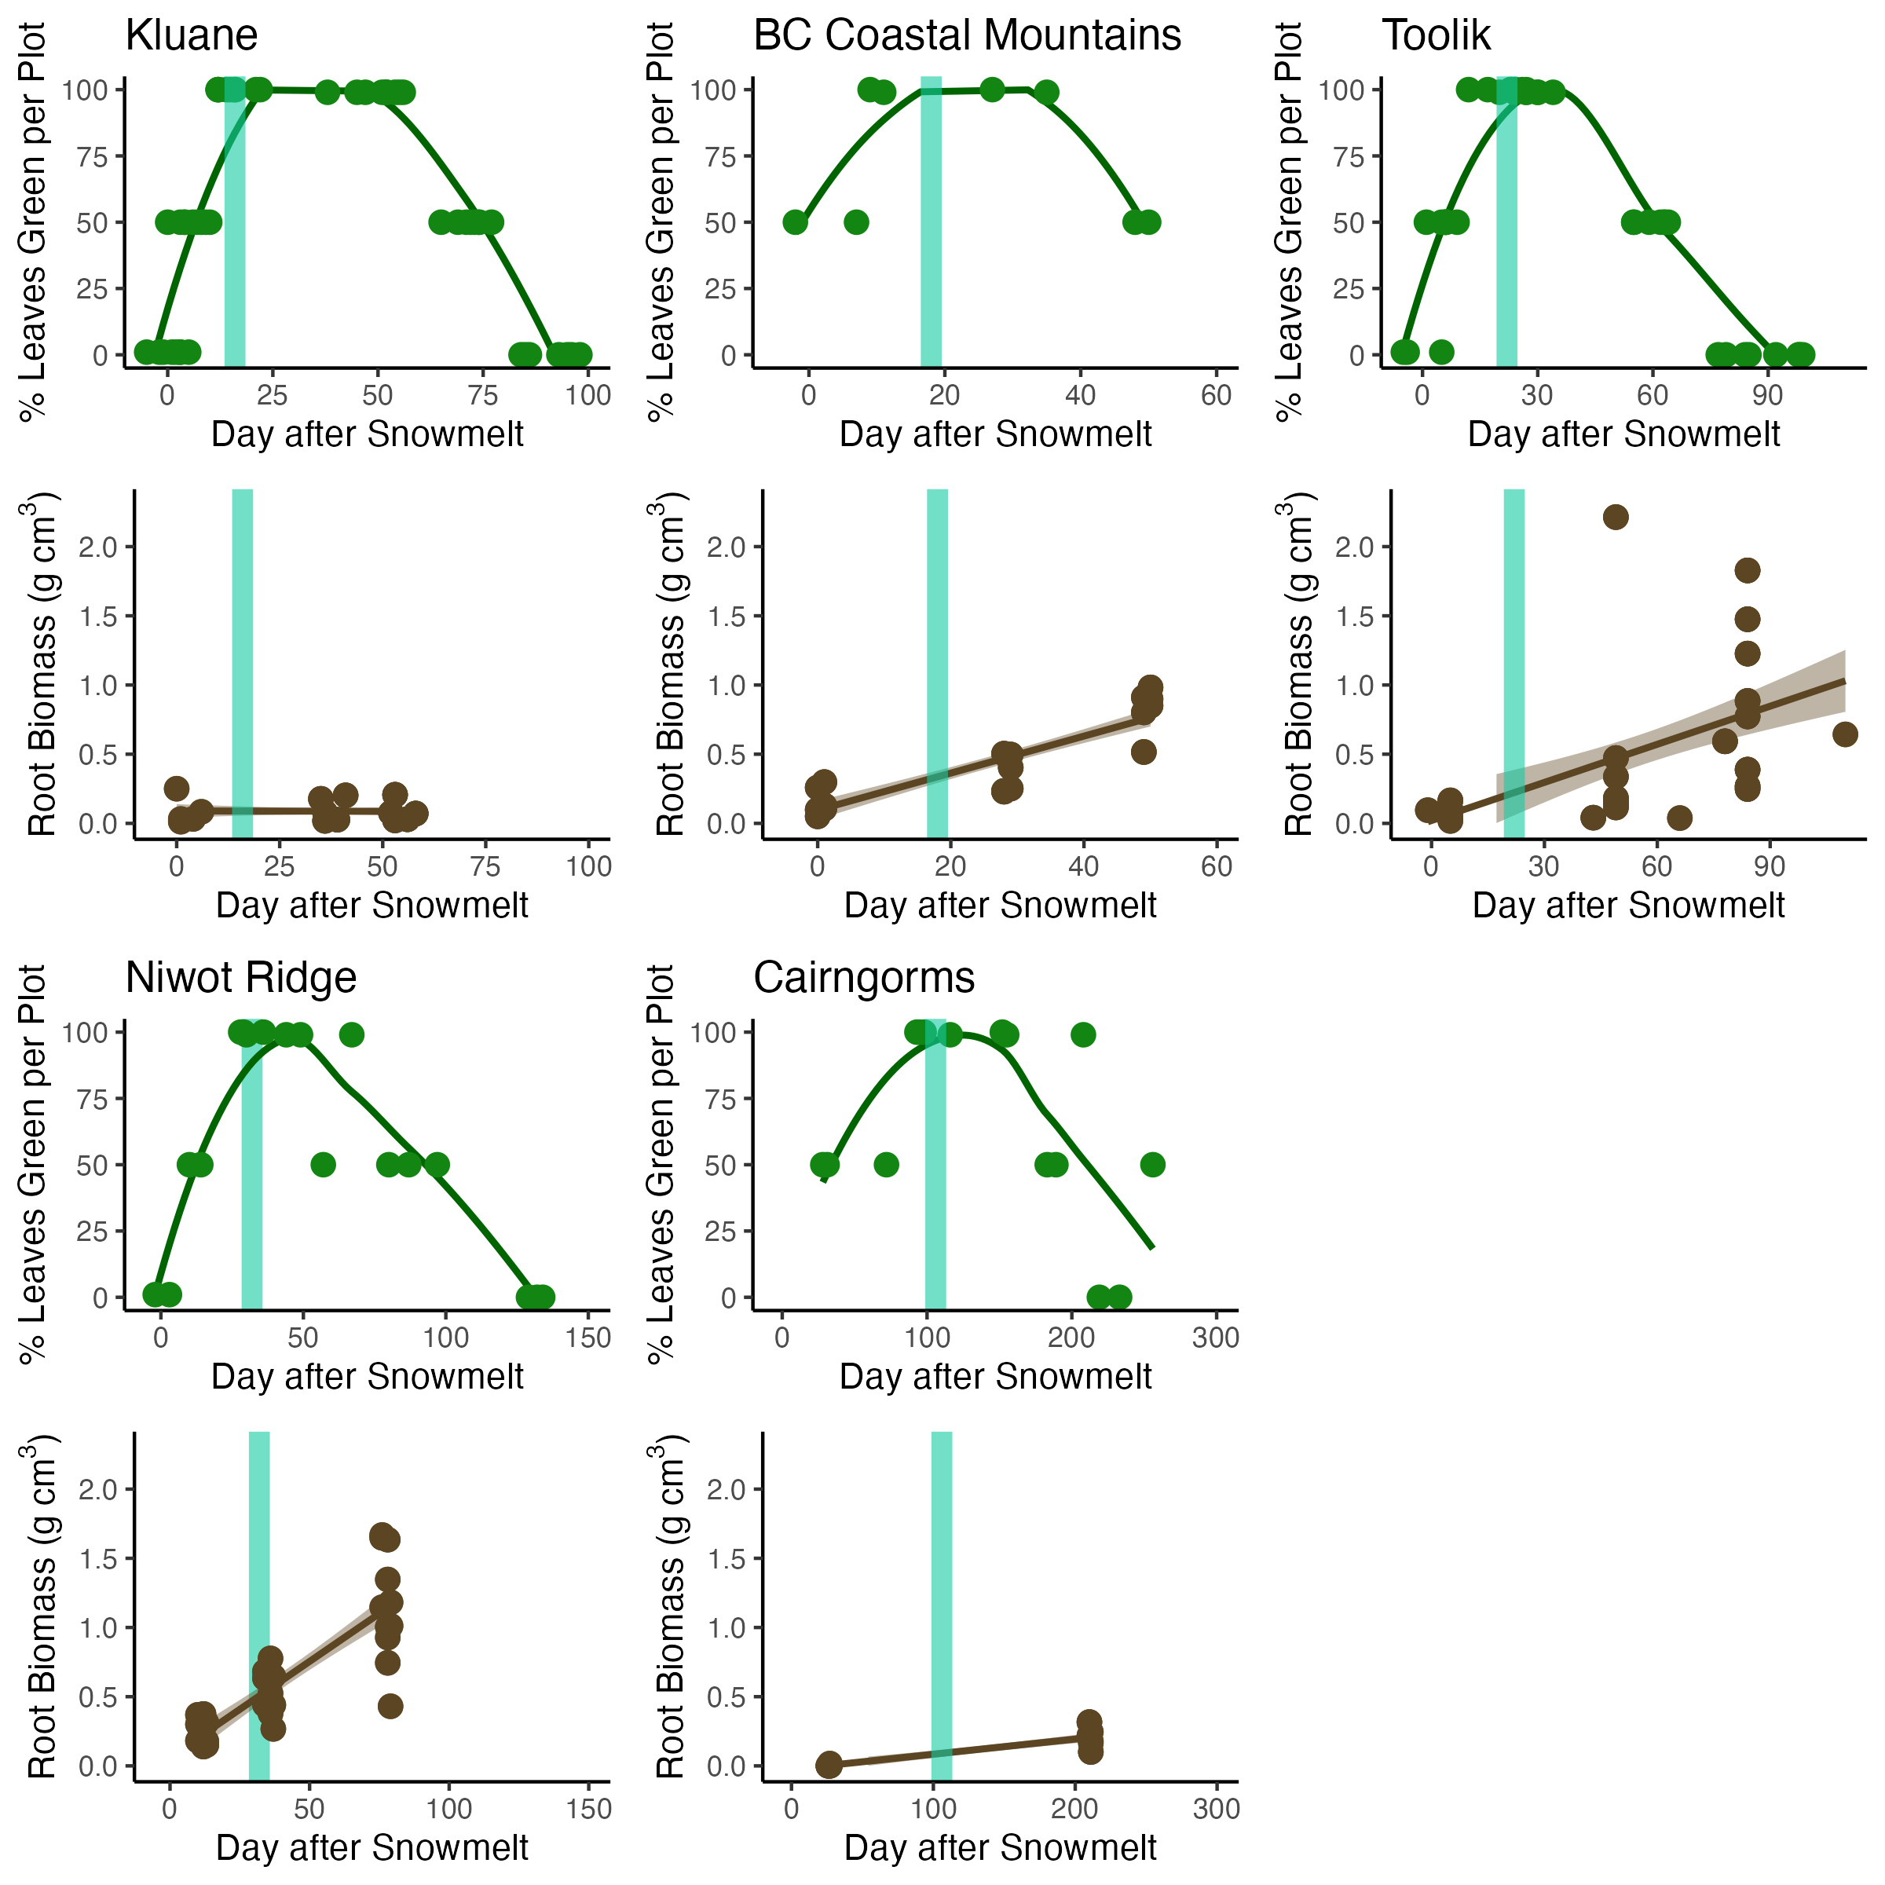
No observed increases in root biomass
32
62
x = Number of days of observed root growth after the date of peak aboveground growth
47
101

